Slide 1
Digital Leaders Update

Slide 2
Chromebooks
We have had a few people being banned from chromebooks for behaviour reasons.
EVERYONE signed the Acceptable Use Agreement which you must abide by or you will be banned from chromebooks.

Slide 3
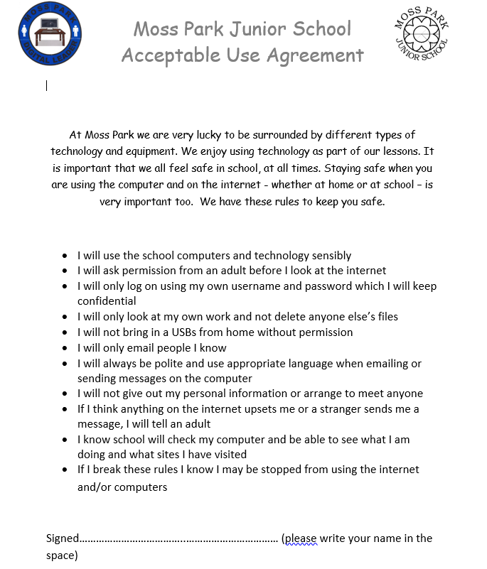
Acceptable Use Agreement
Miss McEvoy has all copies which have been signed.
You will be signed a big one and it will be going up in your classroom.

Slide 4
E-safety issues
There has been a few reports of nasty comments on videos at home.
Behaviour online is the same at home as in school.
These reports can and will be taken very serious.

Slide 5
Year 6 Leaflets
All Year 6 children need to send their e-safety leaflet to Mr Ward- he will come to each class and explain.
We will then judge these and the best one will be sent out to every child in the school and put on our school website.

Slide 6
E-safety visit
On the 31st January we will be having a visit from a woman who will decide if we get an award for being a safe school online.
Miss McEvoy will be choosing some children to speak to her about internet safety in our school.
We need parents to come and speak to her as well so if your parent would like to come in on 31st Jan they can do!

Slide 7
Safer Internet Day
Internet safety Day happens every year and is celebrated around the UK. This day is 11th February- we are on half term so will be doing ours when we come back. This years theme is all about Online Identity.
The Digital Leaders will be coming to your classroom to deliver a lesson about online identity.

Slide 8
Online safety Karaoke
Each class will be creating a song about online safety. You will choose a online safety topic and then you rewrite the lyrics to a song about your chosen topic.
The Digital leaders will then judge each song (with Miss McEvoy and Mr Ward) to decide the winning year group. The winners will get a special prize!

Slide 9
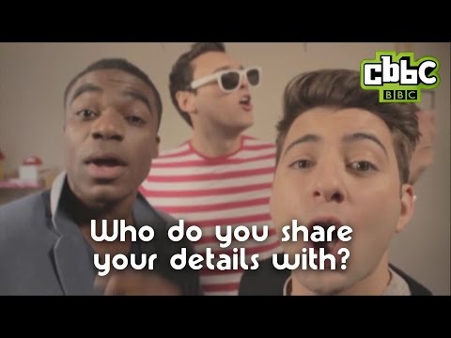

Slide 10
Any questions?

