Slide 1

Welcome To Our Digital Assembly!
Made by your trusty Digital Leaders
Fahad ,James ,Hamza Aaron , Joshy ,Gia,Katyln ,Ebohny, Dylan, Faatimah

Slide 2
Our Weekly Meetings
Every Wednesday At 12:30 in 4M we have meetings and training so that we can make sure we can help protect our school of cyberbullying.
So if you have any issues please come and speak to us

Slide 3
DIGITAL LEADERS
We will be all around school and you can always come and speak to us.
Bring a friend if your scared do not hesitate to speak to us. If you don’t get something speak to us.

Slide 4
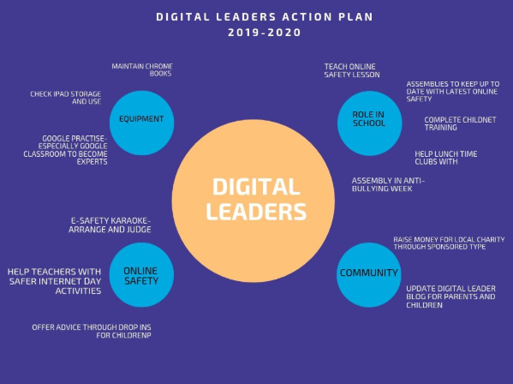
Our goals for the year
Our main goals:
Look after our equipment
Build online safety in school to make sure we are all safe
Complete our training to ensure we can advise you.
Update our website so you know what we are up to!

Slide 5
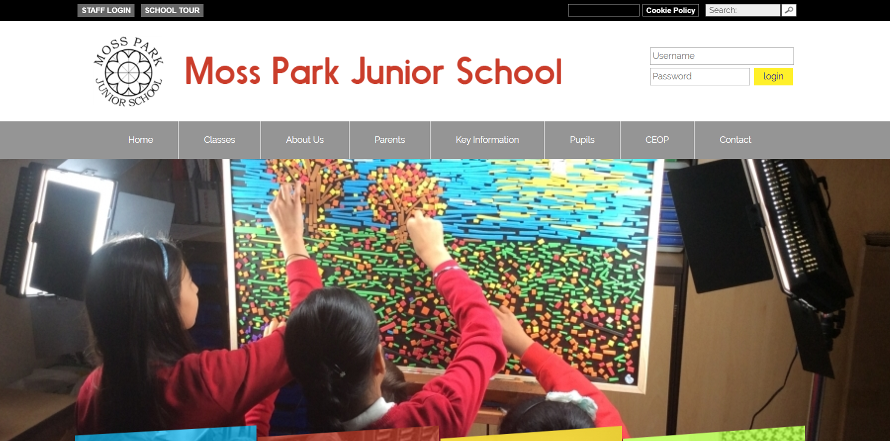
Websites
You can go to our school website to see our page and keep up to day with upcoming events and see our blog.
http://mpjs-trafford.co.uk/

Slide 6
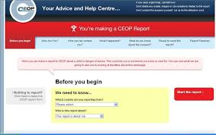
What is CEOP?
CEOP is a website to report abuse on online platforms. CEOP will help you solve or help you in those situations when you feel sorrowful about what somebody’s done to you or somebody you know.
Has anyone ever used CEOP?

Slide 7
Not always C.E.O.P
Who else?
If you are having trouble with something online, you don’t always have to contact CEOP your school Digital Leaders are always here to help! We can help you sort out problems and tell you if you need to tell your parents or contact CEOP.
Remember, CEOP is is a Law enforcement agency tasked with the Safety and prevention of online abuse.

Slide 8
Scenarios:
We have a couple of scenarios to show you- what would you do?
I saw that message that you sent me yesterday, I didn’t like that and it wasn’t very nice.

Slide 9
Scenarios:
We have a couple of scenarios to show you- what would you do?
You posted a picture that you had drawn but it was so ugly and bad that a nursery child could of done better.

Slide 10
Scenarios:
We have a couple of scenarios to show you- what would you do?
Your friend posted a picture of you without your permission.

Slide 11
Scenarios:
We have a couple of scenarios to show you- what would you do?
I was playing a minecraft and a person online asked for my name and address. They then asked to meet up.

Slide 12
Any questions?

