Slide 1

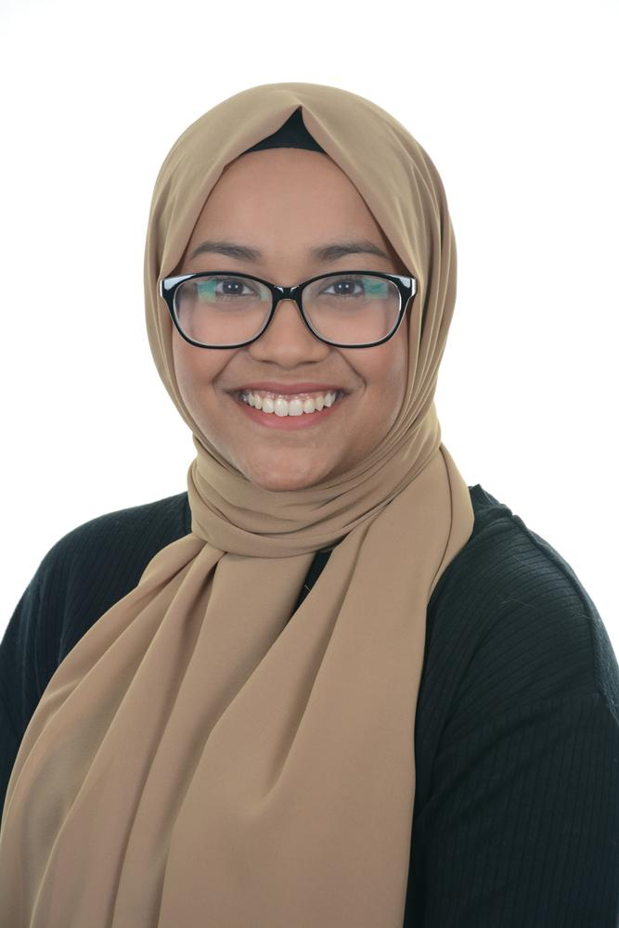
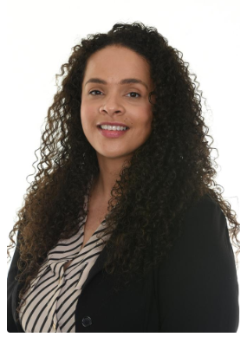
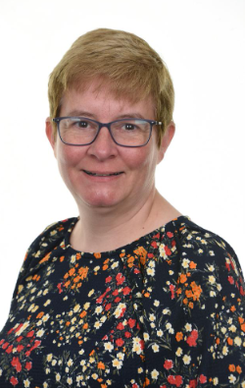
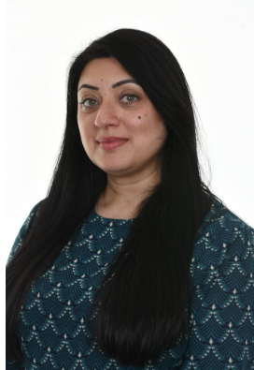
Meet the staff
Welcome to
Moss Park Primary
Miss Naushin
Miss Caines
Teaching Assistants
Welcome to Year 4
Achieving Excellence Together
Mrs Khan
Mrs Kendal
P.E - Mr D Jordan & Specialist Lacrosse
Music - Mr S Sandiford
Spanish - Ms J Butler/MLA

Slide 2


Positive Behaviour at Moss Park
Our core school focus is recognising and praising different positive behaviours throughout school life.
Team Points
Attendance
Lunchtime

Slide 3


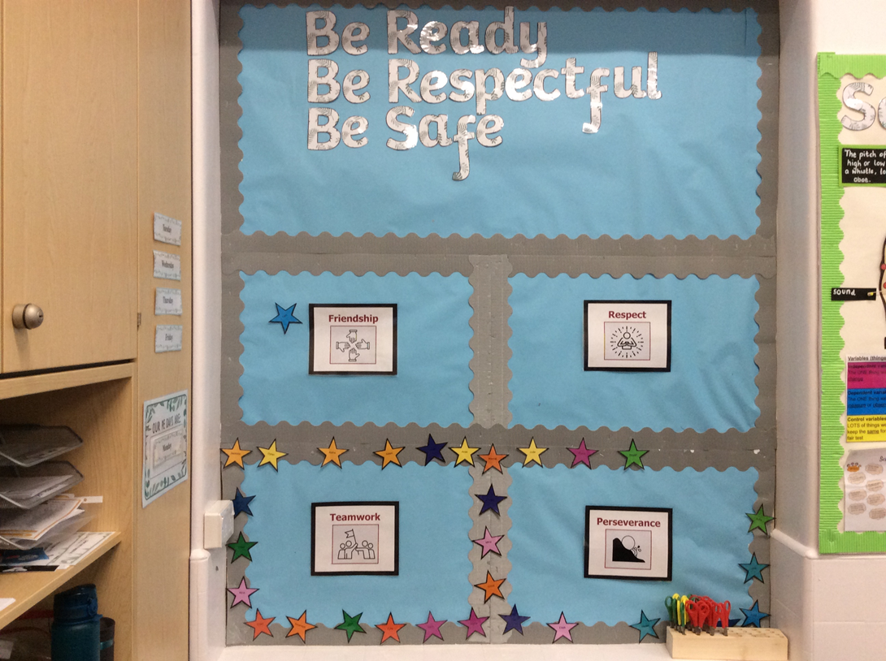


Celebrating our values
Recognition Board

Slide 4
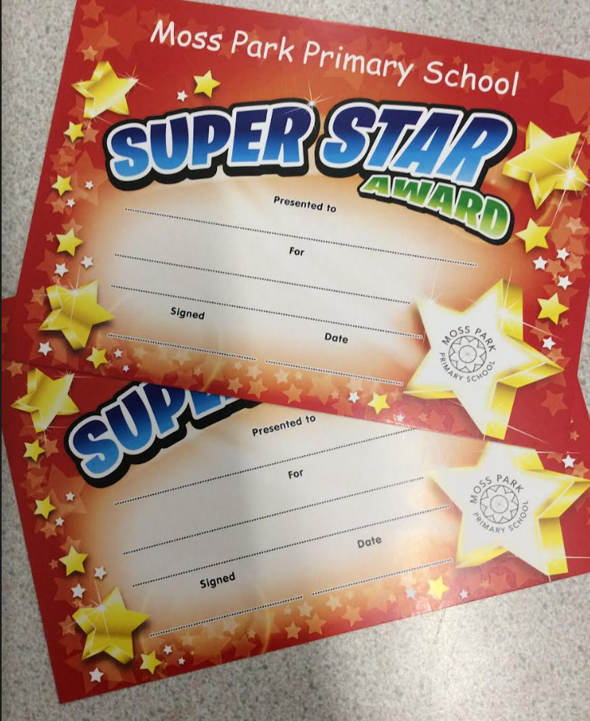
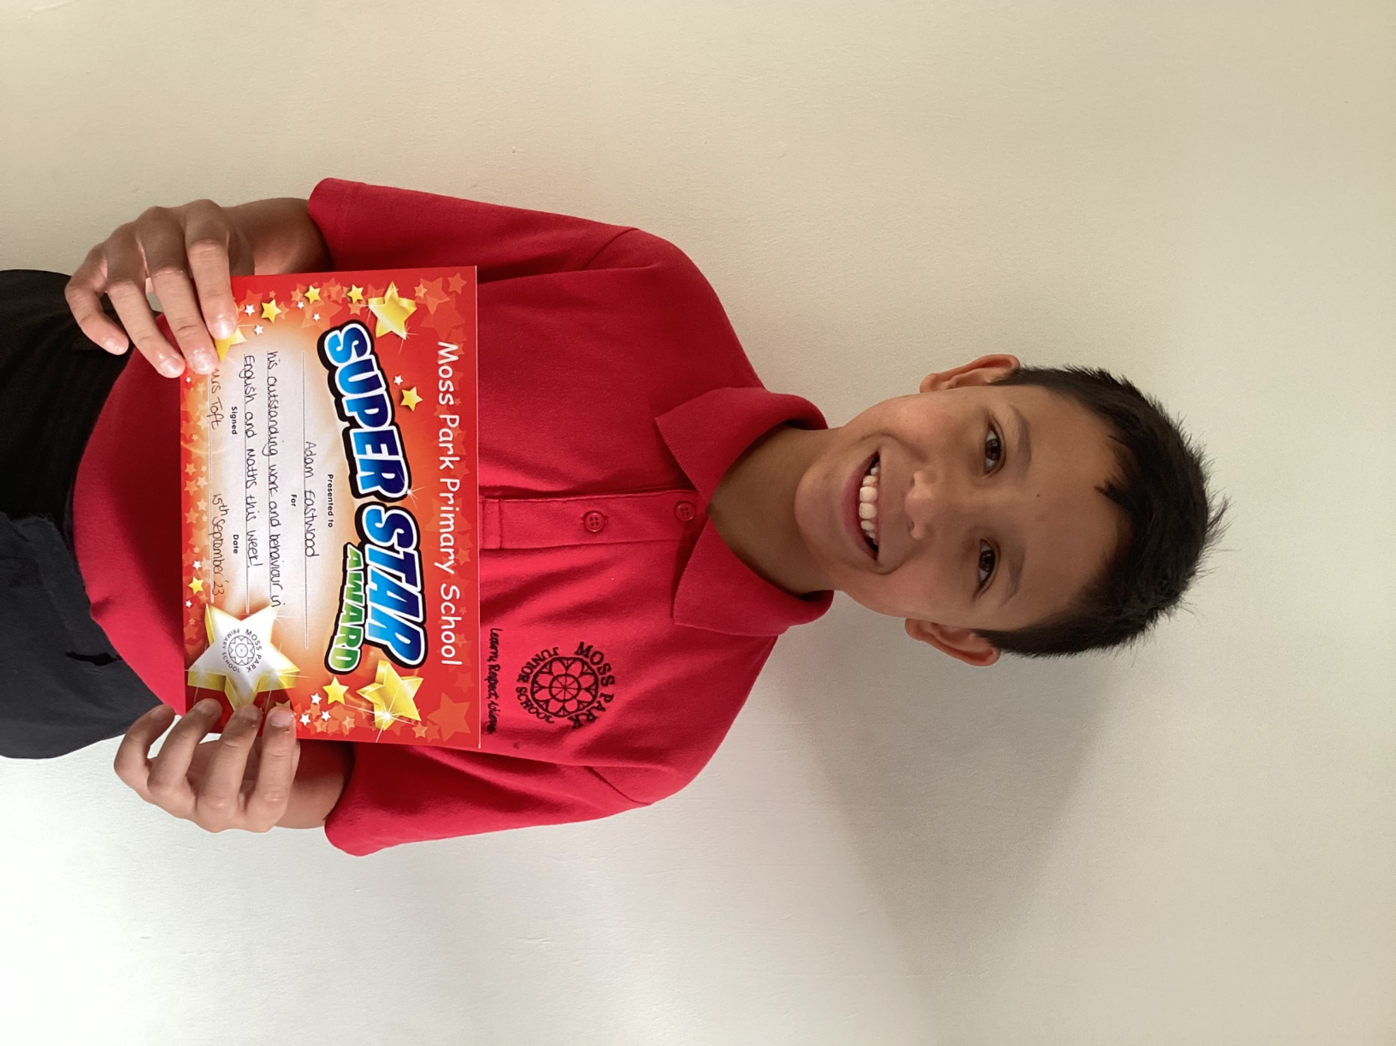
Celebrating our Learning
Celebrating children’s learning is what we love to do at Moss Park Primary. Each and everyone of you makes a difference to our school and that is why celebrations are all about you.
Year 4 will continue to attend assemblies just like they did in Year 5 throughout the week, including a special celebration Assembly on Fridays.
Our weekly super learners receive certificates in our Facebook live (closed private group) assembly. You will be invited in person and families can watch from home and you can send your child greetings (when you have joined the group)*
We also celebrate pupils’ home achievements In class we will also celebrate super learners, home learning and reading incentives.
We also have a in class reading incentive where the children will receive a reward for engaging in their home reading 3 or more times a week.
*We respect parents right for their child not to be on screen – we are very careful about this and follow your instructions on the consent forms. See Mrs Nunwick for further info or questions.

Slide 5
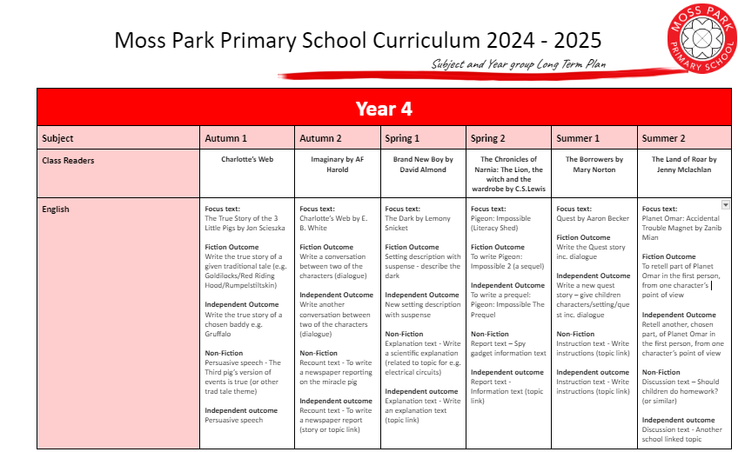
Year 4 Long Term Overview

Slide 6
Boarding pass and passport
At Moss Park Primary School we have been working hard developing our curriculum since our amalgamation. We want to share our curriculum enrichment offer and also keep you informed about the age related expectations in English and Maths. We have enclosed a copy of your child’s ‘boarding pass’ and ‘passport’.
Boarding Pass - this details all the trips, experiences and class books your child will study this year
Passport - this has the key national curriculum statements for reading, writing and maths for your child’s year group
This is how we describe the curriculum journey at MoPPS
Moss Park Primary School is like an International Airport – a melting pot of different travellers all ready to go on a learning journey that lasts 190 days!
Every September we have 450 travellers in the Year Group Departure Lounges ready to fly off to exciting destinations
We all have a Curriculum Map to help us get there - you can find these on our class page
Our subject leaders have worked out the Flight Paths in their subject for everyone - you can find these on the curriculum pages
Our teachers use Route Plans in every subject to make sure we go the right way
We hand out a Boarding Pass that show the exciting places we will visit and the experiences we will have on our journey
Our Passports help keep us on track with our reading, writing and maths
Teachers do regular On Board Checks (assessments!) to make sure everyone is getting the most out of their journey - these are shared with you each term
At the end of the year we touch down again in Arrivals and we write a Trip Review before going off on our new exciting world tour

Slide 7
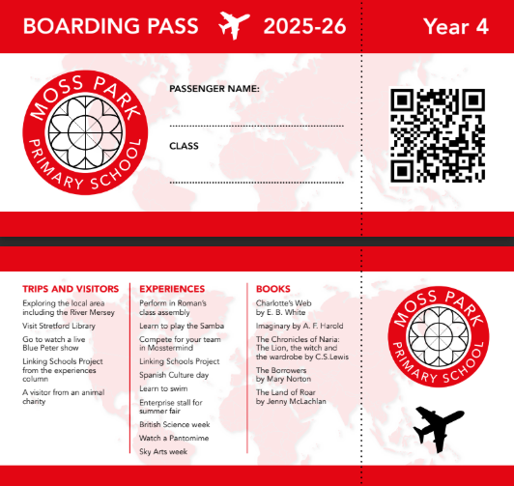

Slide 8

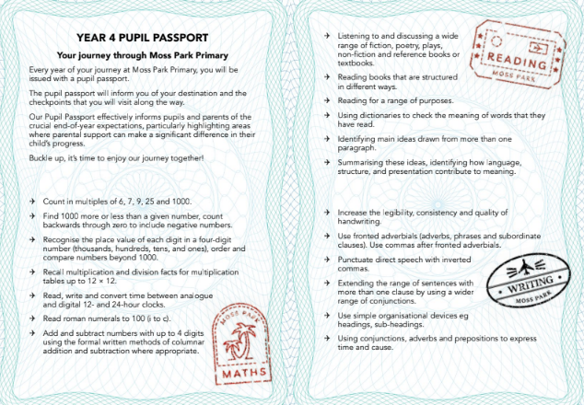

Slide 9
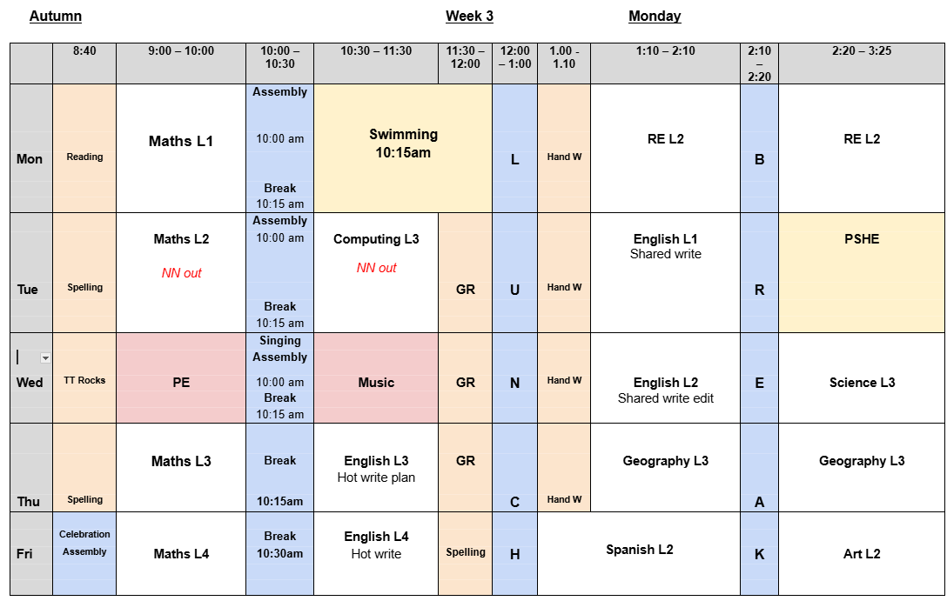
A Day in Year 4
Every day we will welcome all of the children in the corridor from 8.40am.
Start of the Day Activity (SODA task)
Once the children have arrived safely, they can then get straight onto a start of the day activity.
In Year 4, we use this time carefully and the children will complete a range of activities: times tables, spellings, handwriting, 1:1 reading and fix it time.

Slide 10
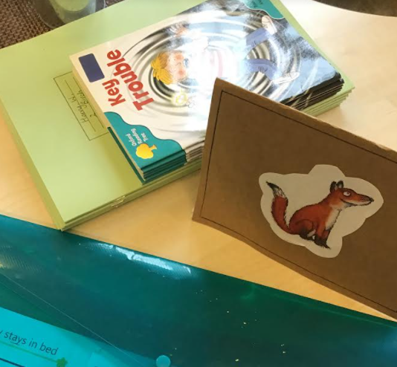
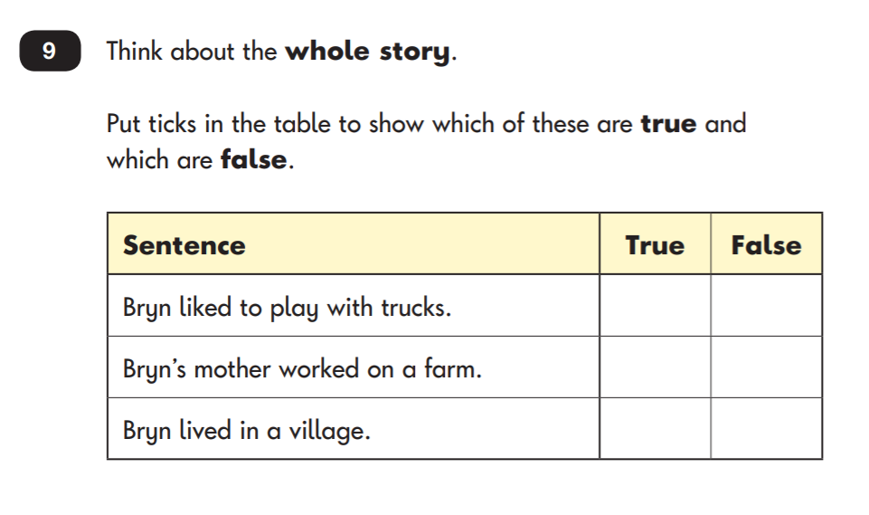
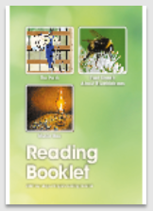
Guided Reading
In Year 4, we have guided reading sessions 4 times a week for half an hour as a whole class where we explore the reading content domains set out by the National Curriculum.
Children are expected to read at 120 words a minute.
We explore a range of texts: fiction and nonfiction.

Slide 11
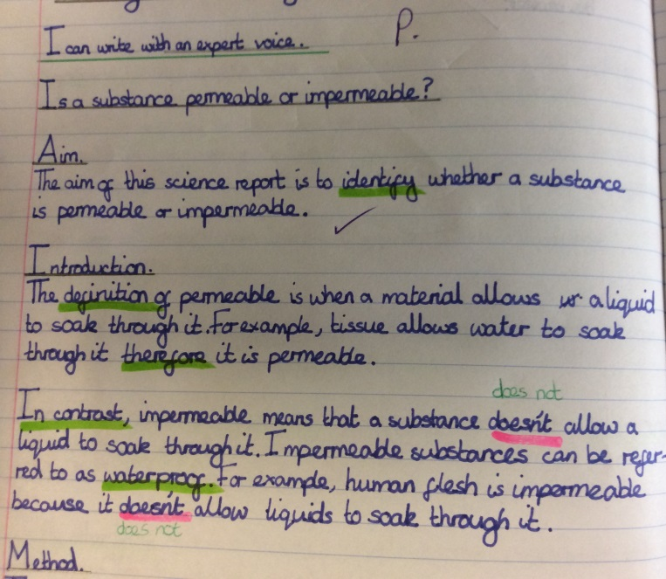
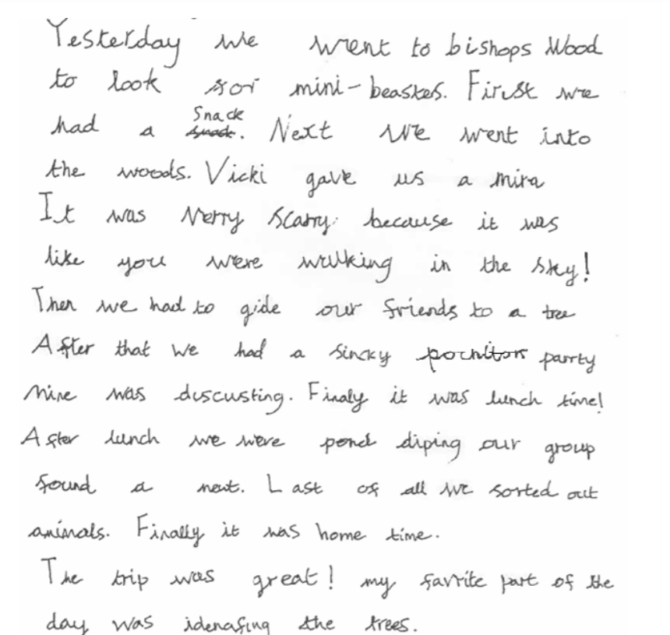
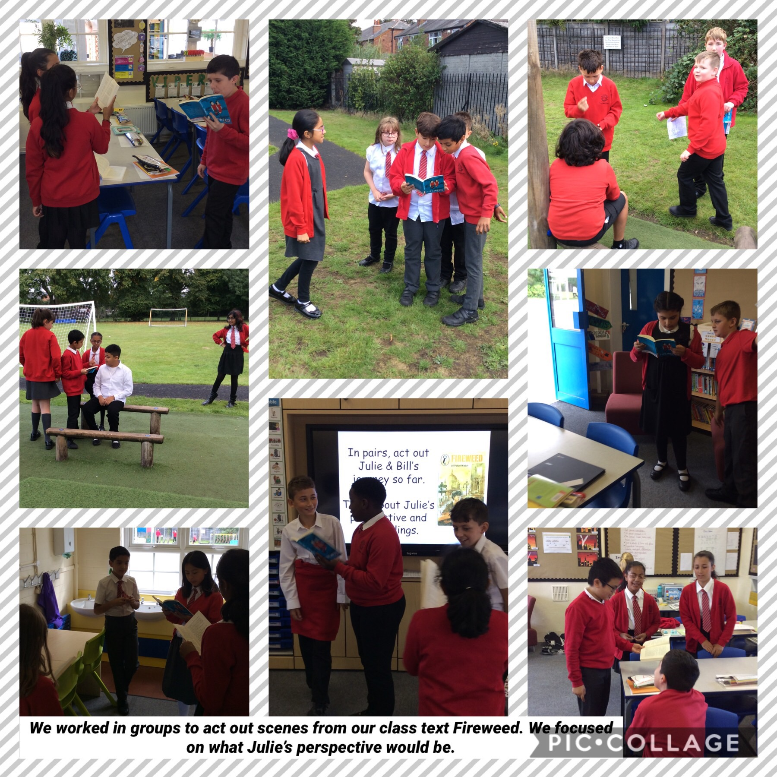
English
Children are expected to read at 120 words a minute.
Year 4 children are expected to write for longer and edit their own work.
By Year 4 children should be able to join and use cursive handwriting.
We explore audience and purpose for each text as well as how authors use grammar to cause an effect.
By Year 6, children should be able to join and use cursive handwriting.

Slide 12
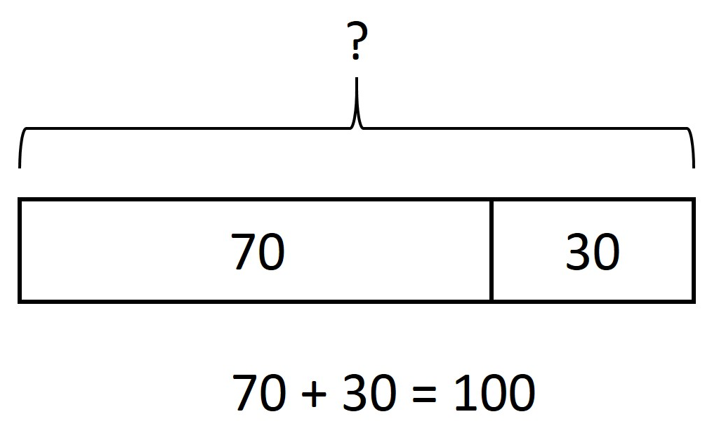
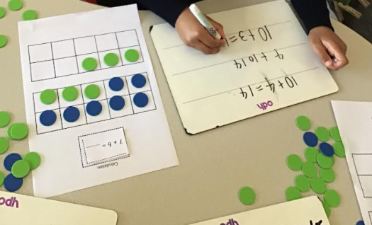
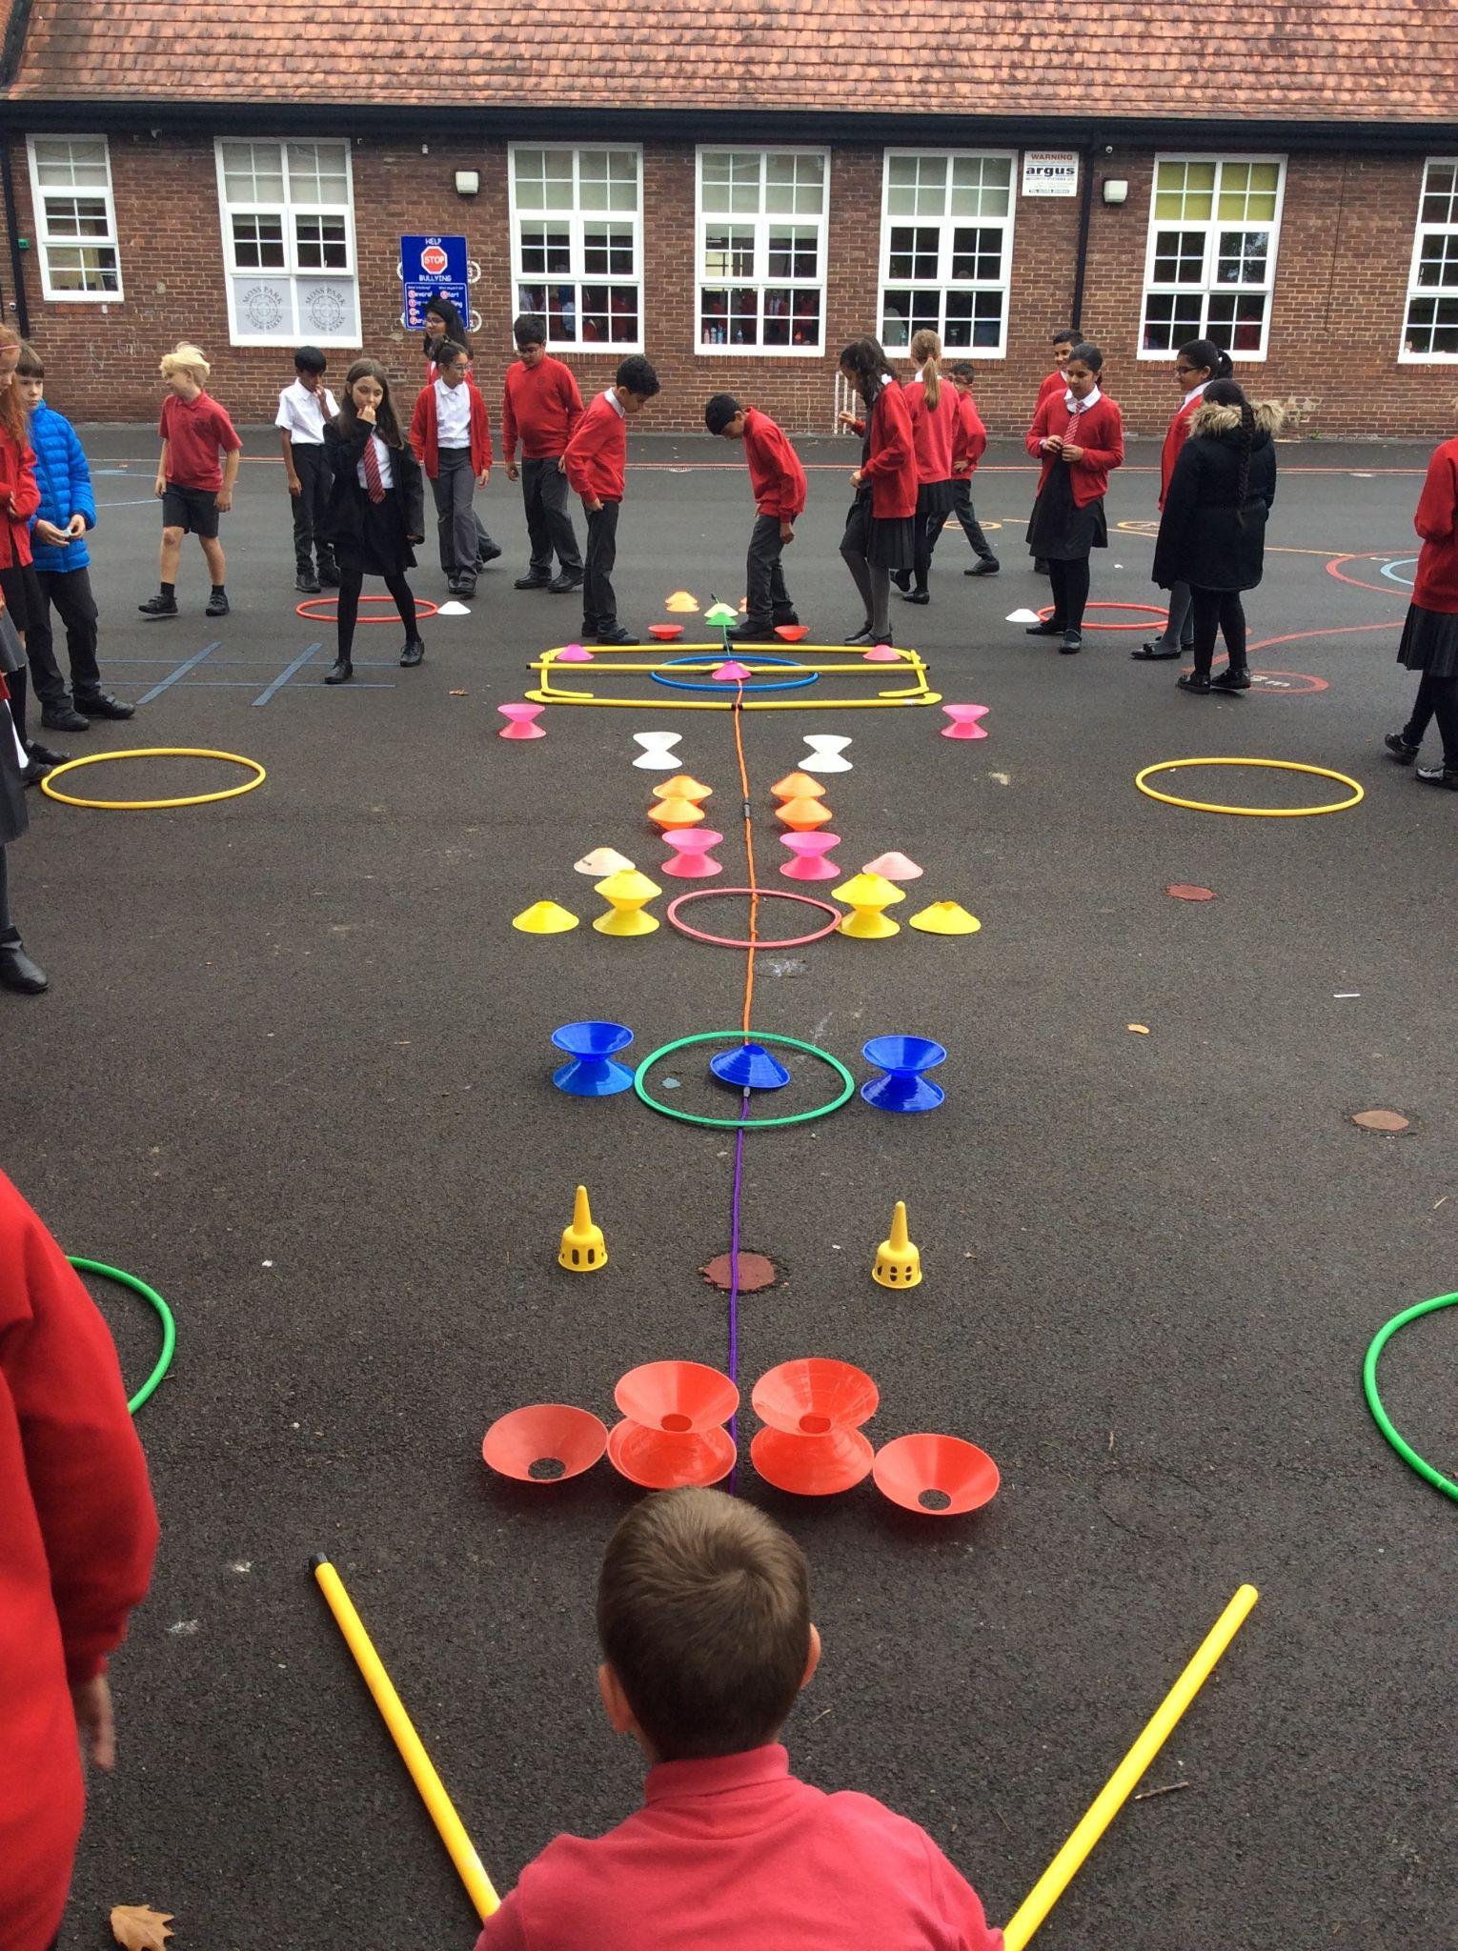
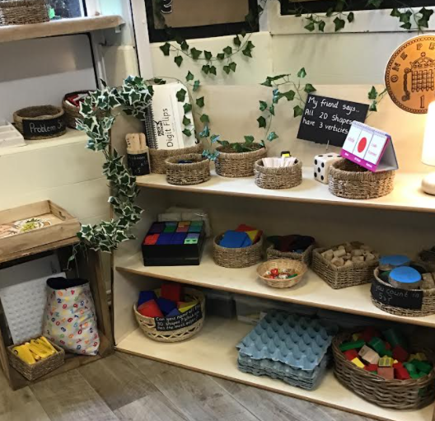
Maths
Children are expected to read at 120 words a minute.
Children need to know the mechanics of maths in written and through mental calculation
Reasoning identifies children’s mathematical understanding.
By Year 6, children should be able to join and use cursive handwriting.
Children include alternative methods that show their mathematical thinking
Greater depth demonstrates independent reasoning over a longer time with and without resources

Slide 13



Foundation Subjects
Children are expected to read at 120 words a minute.
We cover a range of foundation subjects at Moss Park to enhance knowledge of the world.
Children will engage in a range of practical and written activities to support their understanding.
By Year 6, children should be able to join and use cursive handwriting.
Children will use iPads and Chromebooks throughout the curriculum to incorporate use of technology.
These include Art, Computing, DT, Geography, History, Music, PE, PSHE, RE and Spanish (KS2).

Slide 14

Spelling
Children are expected to read at 120 words a minute.
We cover a range of foundation subjects at Moss Park to enhance knowledge of the world.
In Years 3, 4, 5 and 6 the children learn a new spelling pattern every week as well as revising those already taught. They will also have the opportunity to revise the statutory spellings for their year group - these are called ‘Challenge Weeks’.
Children in Years 3 to 6 also have a weekly spelling test. Spelling tests help children to learn the spelling rule or pattern being taught but it is important that children are able to apply the rule to spell other words. Therefore, spelling is assessed through ‘Dictation’ tests. This means that teachers read out words and sentences for the pupils to copy. Your child will be sent home with a group of words that contain a spelling pattern or rule to learn.
In the weekly dictation test, your child may be tested on those words or different words in the same family in order to see if they can apply the spelling rule. They may put the words into a sentence.
This year, your child will have access to Spelling Shed which is a scheme designed for pupils to practise their weekly spellings online via the use of the web link: https://play.spellingshed.com which is free of charge and/or can be accessed via the Spelling Shed App. Each week, your child will receive their spellings to learn via the Spelling Shed programme (alongside their printed copy) which they will also use for homework.
By Year 6, children should be able to join and use cursive handwriting.
Spellings are taught in class each week with prior spellings revised at the start of each lesson.
Each year group follows a week by week learning plan where children will have the opportunity to consolidate their learning in an independent task.
The children’s scores are monitored each week and words they struggle with are highlighted/written into their red spelling books.

Slide 15

Times Table Check
This year, the multiplication times table checks will be undertaken by all eligible year 4 pupils within the 2-week period from Monday 1 June 2026.
The check will include the times tables up to 12. The children will be practising in class during maths lessons and S.O.D.A but it is also important that they practise at home by engaging in any homework set on TT Rockstars.

Slide 16
After School Curriculum Clubs
Children are expected to read at 120 words a minute.
We cover a range of foundation subjects at Moss Park to enhance knowledge of the world.
In Year 4, we have these clubs on offer:
Multisports
Singing Club (Young Voices)
Football
Football Club (boys & girls)
Please encourage your child to join a club. They can learn something new and have fun! Just £1 per hour session!
The Club Calendar is ready for Autumn term. The clubs are led by school staff and school sport coaches on every night of the school week. Make sure you sign up quickly as places are limited. We have sent out the calendar for you to look at with your child and slots were released on Monday 18th September on ParentPay. Clubs cost just £10 for a block of 10 lessons (Monday 25th September to Friday 8th December). If you are eligible for Free School Meals then our clubs are free and the discount will be taken off automatically - no need to do anything. Please encourage them to try something new this term!
By Year 6, children should be able to join and use cursive handwriting.

Slide 17

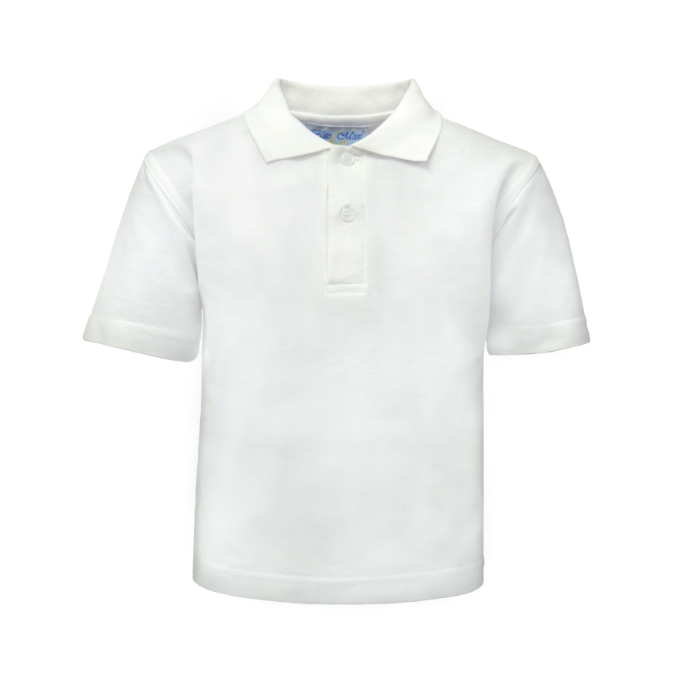


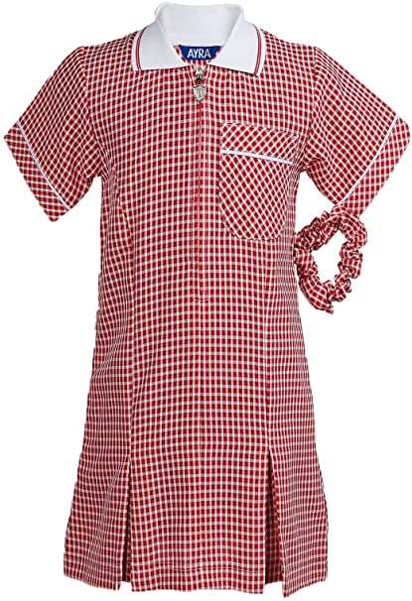
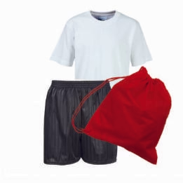
Our School Uniform?
Top: Red jumper or cardigan
Bottoms: Grey or black trousers or skirt. No trainers unless its a PE day
Dress: Red dress
PE Kit: Appropriate sportswear, with the option for long jogging bottoms in winter. Trainers
Please ensure all clothing, lunch and water bottles are clearly labeled with your child's name, as items can often go missing.

Slide 18
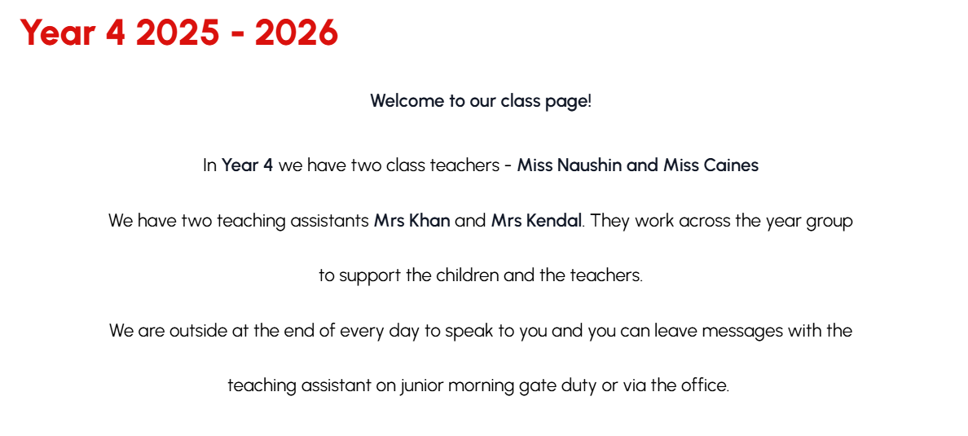
Our Class Website Page
https://www.mossparkprimary.co.uk/class/year-4

Slide 19
Learning at Home
Children are expected to read at 120 words a minute.
Reading – Everyday (the single most important thing for all children to do at home)
Homework – linked to what's happening in class. No new learning.
Spelling homework is set on Spelling Shed and also provided within your child’s red spelling book. Maths homework is set on MyMaths. Any additional homework will be assigned and posted on Google Classroom. Homework goes out on Friday to be completed by Wednesday.
Most homework will reinforce the learning that happens each week. We go through it on Friday with the pupils. It might be linked to our topics, and it will be creative and manageable. We sometimes set whole school holiday homework challenges and projects – these are optional.
Try not to put pressure on your child, have fun working together, encourage them to talk about the how and why. Allow them to talk to you about what they have been doing in class.
By Year 6, children should be able to join and use cursive handwriting.

Slide 20
Home Reading
Children are expected to read at 120 words a minute.
Each child will be given a Reading Record and a Reading Book. We suggest that children read everyday at home either with a grown up or independently (Preferably with a grown-up/sibling where possible.)
Reading is so important for a child’s development in all subjects!
By Year 4 children are still reading at a book banded level. It is important to know that the reading level does not change as quickly as in KS1.
Reading books will be appropriate to your child’s reading level regardless of their ability to read
Reading books can be changed as required - we encourage children to finish the book before changing it
Children are expected to record comments and questions about what they have read in their reading records
If a child has read 3x in a week and their parent has signed 3x then they will be given a raffle ticket and entered into our termly prize draw
Parents always ask how they can help their child at home - listen to them read, question them on what they have read and enjoy reading together!
By Year 6, children should be able to join and use cursive handwriting.

Slide 21
How is my child doing in school?
Children are expected to read at 120 words a minute.
As well as our regular marking and assessing of classroom work, your child will take tests in Reading, Spelling & Grammar and Maths each term. Most pupils will take the same test but we adjust this for pupils with additional learning needs. We use these tests to track progress across the year for your child and the class, and to plan future learning.
We let you know how your child is doing each term with a termly individual report from SONAR (our tracking system), 2x parents meetings and a full annual written report in July.
By Year 6, children should be able to join and use cursive handwriting.
Parents Evening 1 | Autumn term 2025
Parents Evening 2 | Spring term 2026
End of Year reports/drop ins | July 2026

Slide 22
Communication
Children are expected to read at 120 words a minute.
Teachers are outside at the end of each day (3.25 - 3.35 pm) for quick chats and messages - just let us get most of the pupils away safely
You can email school at admin@mossparkprimary.co.uk and your teacher will get this email and will contact you when you are free
You can phone school 0161 864 1710 or call into the office to request a callback or face to face meeting with your teacher
Weekly news bulletin and diary dates via email and on the outside notice boards and on website www.mossparkprimary.co.uk
The Headteacher holds half termly coffee mornings/afternoons and drop-ins for parents for any queries you might have
A member of the SLT is always on the gate in the morning/end of day
We don’t talk about anything that has gone wrong in front of other parents - we text you to ask you to phone us or pop into school
By Year 6, children should be able to join and use cursive handwriting.

Slide 23

Questions

