Slide 1

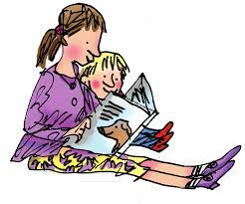
Welcome to
Moss Park Primary
Achieving Excellence Together
Welcome to Reception
18th September 2025

Slide 2
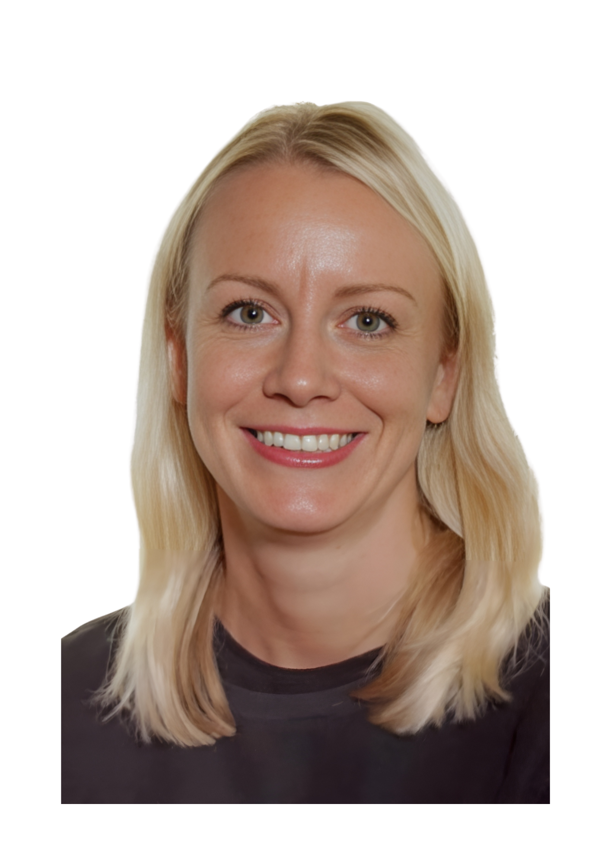
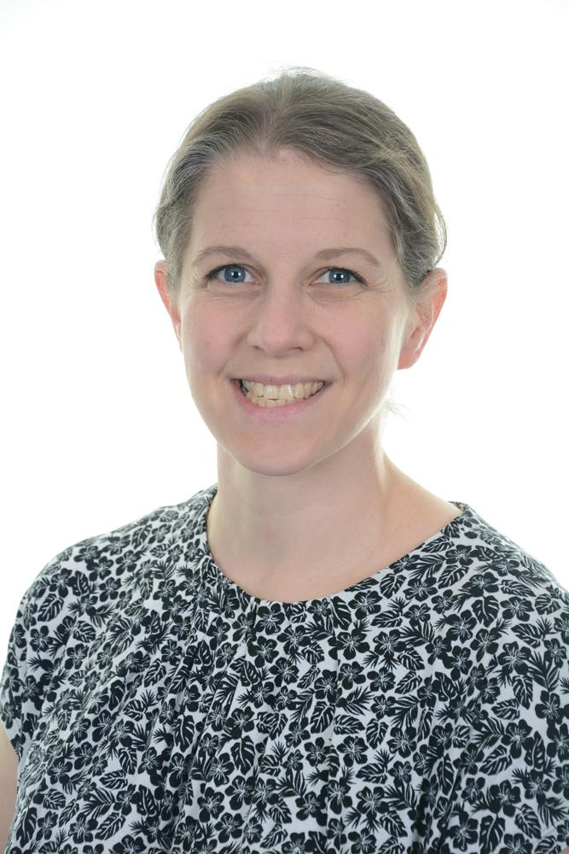


Meet the staff
Miss Emily Bull
Early Years Leader & Class Teacher
Class RB (Mon-Thurs)
Mr Connor Gallagher
School SENDCO & Class Teacher
Class RB (Friday)
Miss S Brown
Teaching Assistant
Mr Lowe- PE

Slide 3
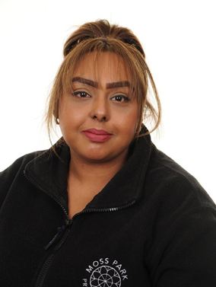
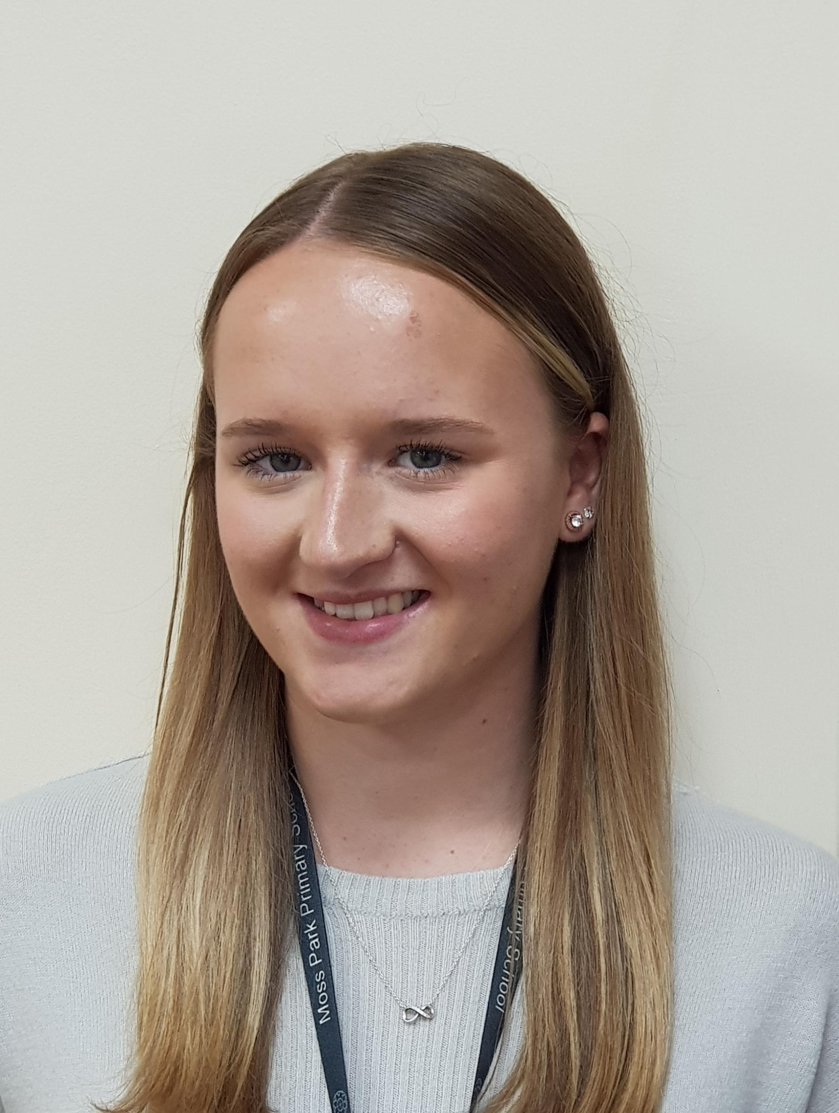
Lunchtime
Mrs Derbyshire
Lunchtime Supervisor
and Additional Reception Teaching Assistant
Mrs Singh
Lunchtime Supervisor
and Additional Reception Teaching Assistant

Slide 4




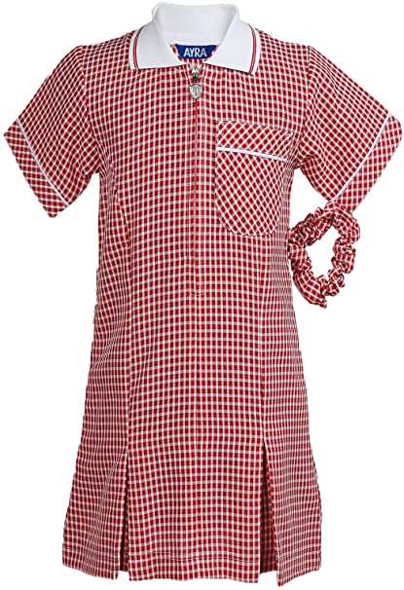
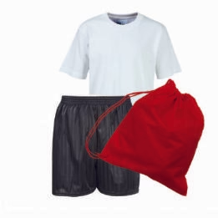
Our School Uniform
Top: Red jumper or cardigan
Bottoms: Grey or black trousers or skirt
Dress: Red dress
PE Kit: Appropriate sportswear, with the option for long jogging bottoms in winter. Earrings taken out or covered at home. Bracelets need to come off or be covered by sweat bands. Round collar on t-shirt.
Please ensure all clothing, lunch and water bottles are clearly labeled with your child's name, as items can often go missing.

Slide 5
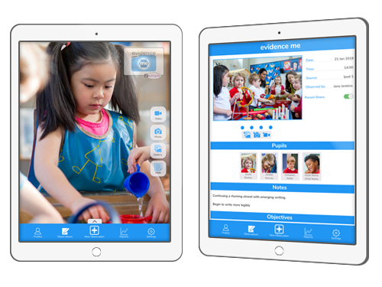

Early Learning Goals (ELG’s) and observations of learning
You should have received a log in this week for Evidence me.
We will use Evidence me for you to share WOW moments of your child home learning.

Slide 6




Celebrating our values

Slide 7
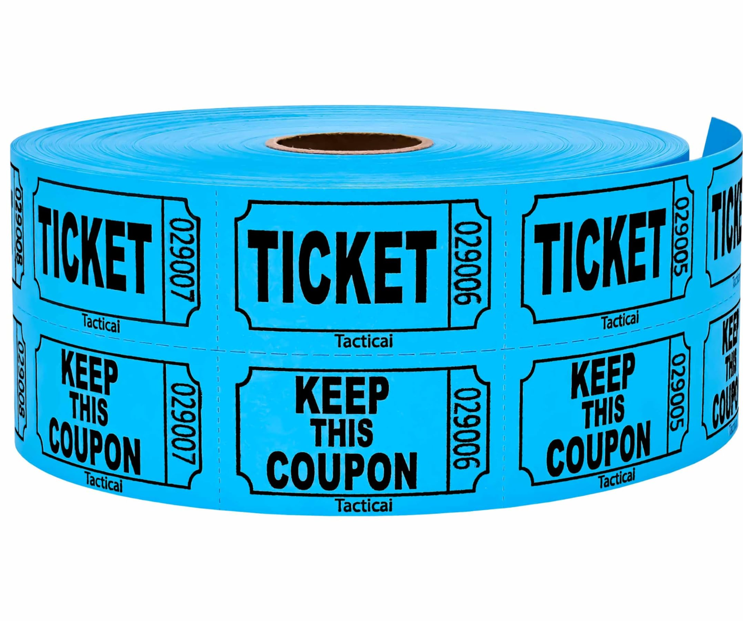
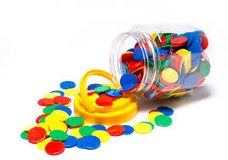



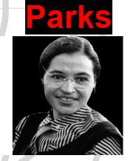
Recognition and Rewards
Ready Respectful and Safe
Stickers
Team points (all pupils are now in a team)
Weekly super learners celebrated in assembly (TBC)
Raffle tickets for home reading x3 (6 reads a week = 2 raffle tickets)
Lunch time raffle tickets

Slide 8
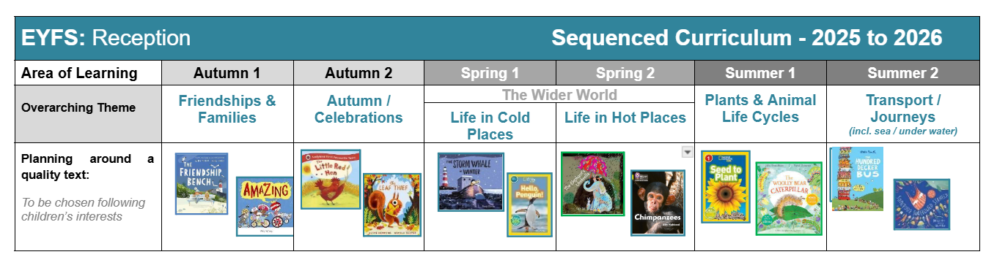
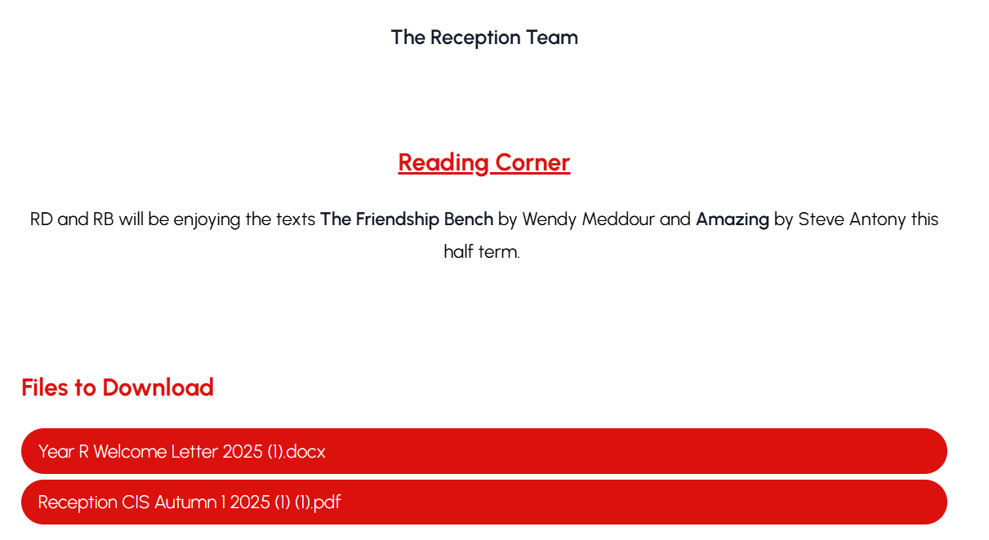
Our curriculum overview and website
https://www.mossparkprimary.co.uk/class/reception

Slide 9
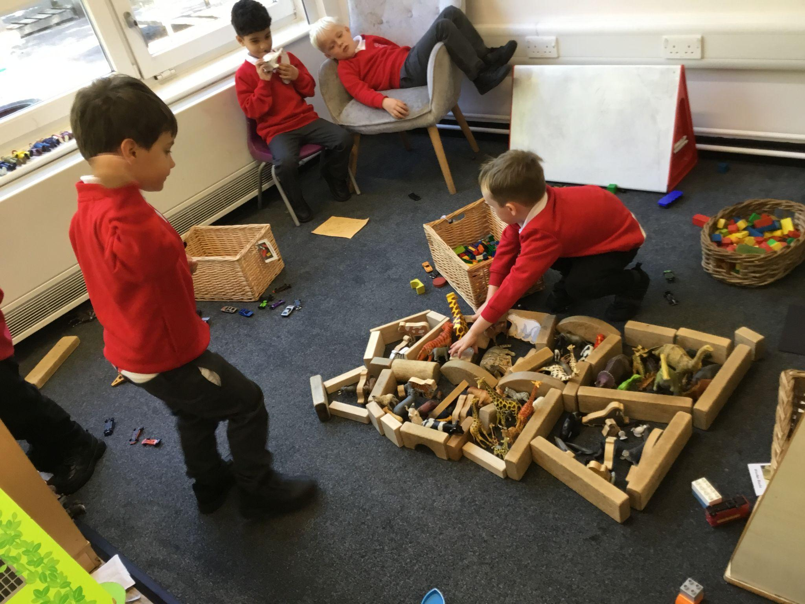
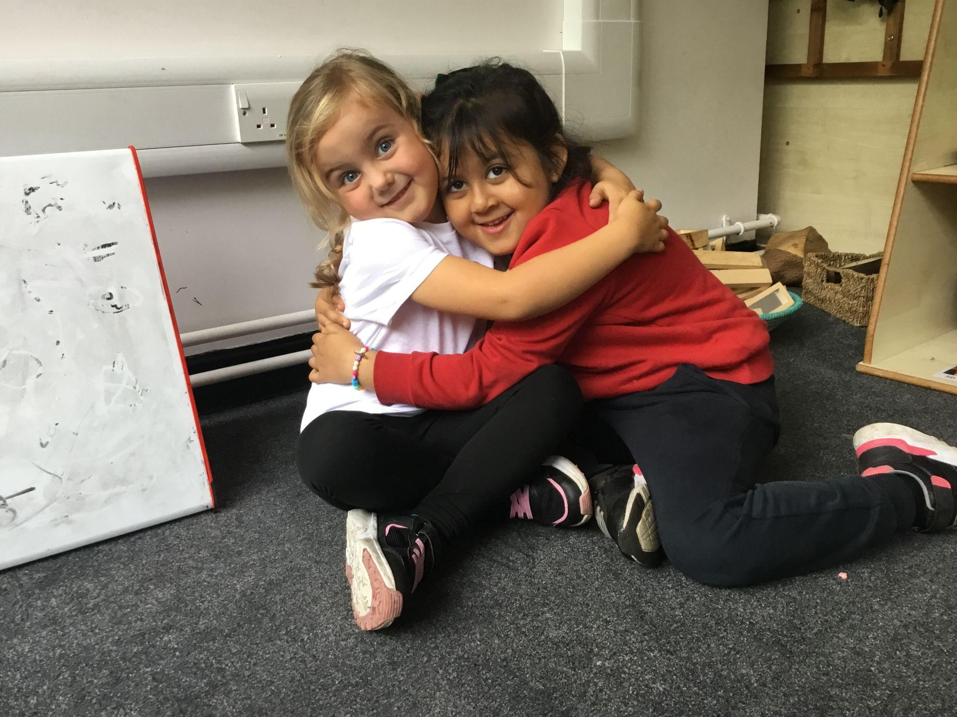
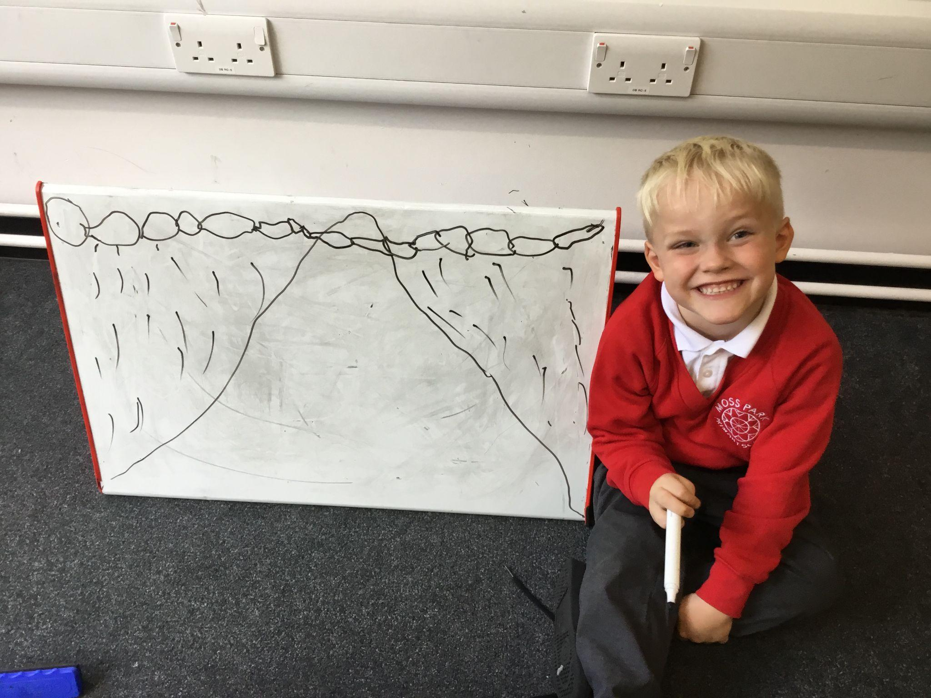
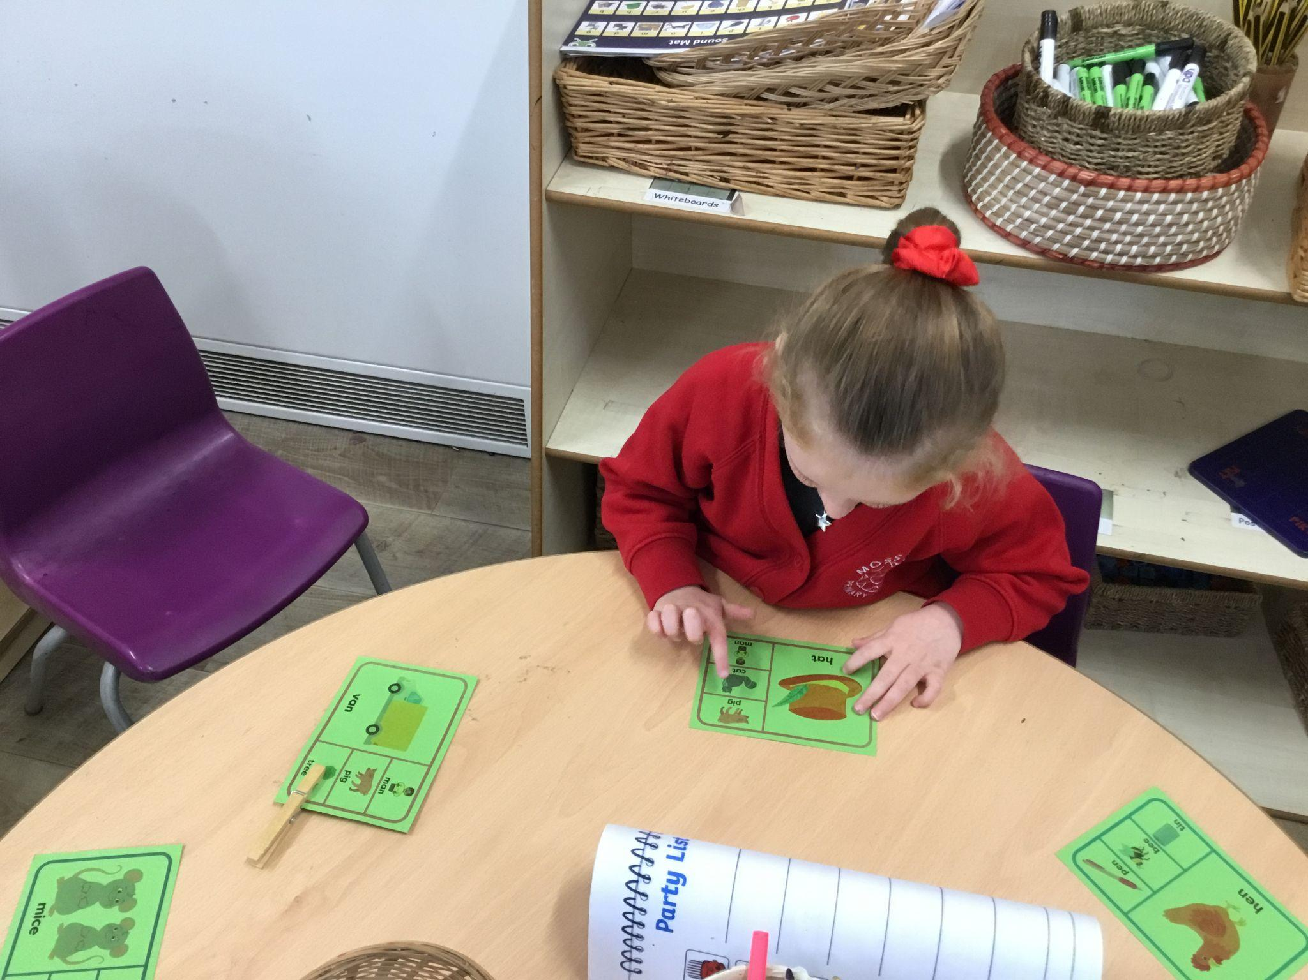
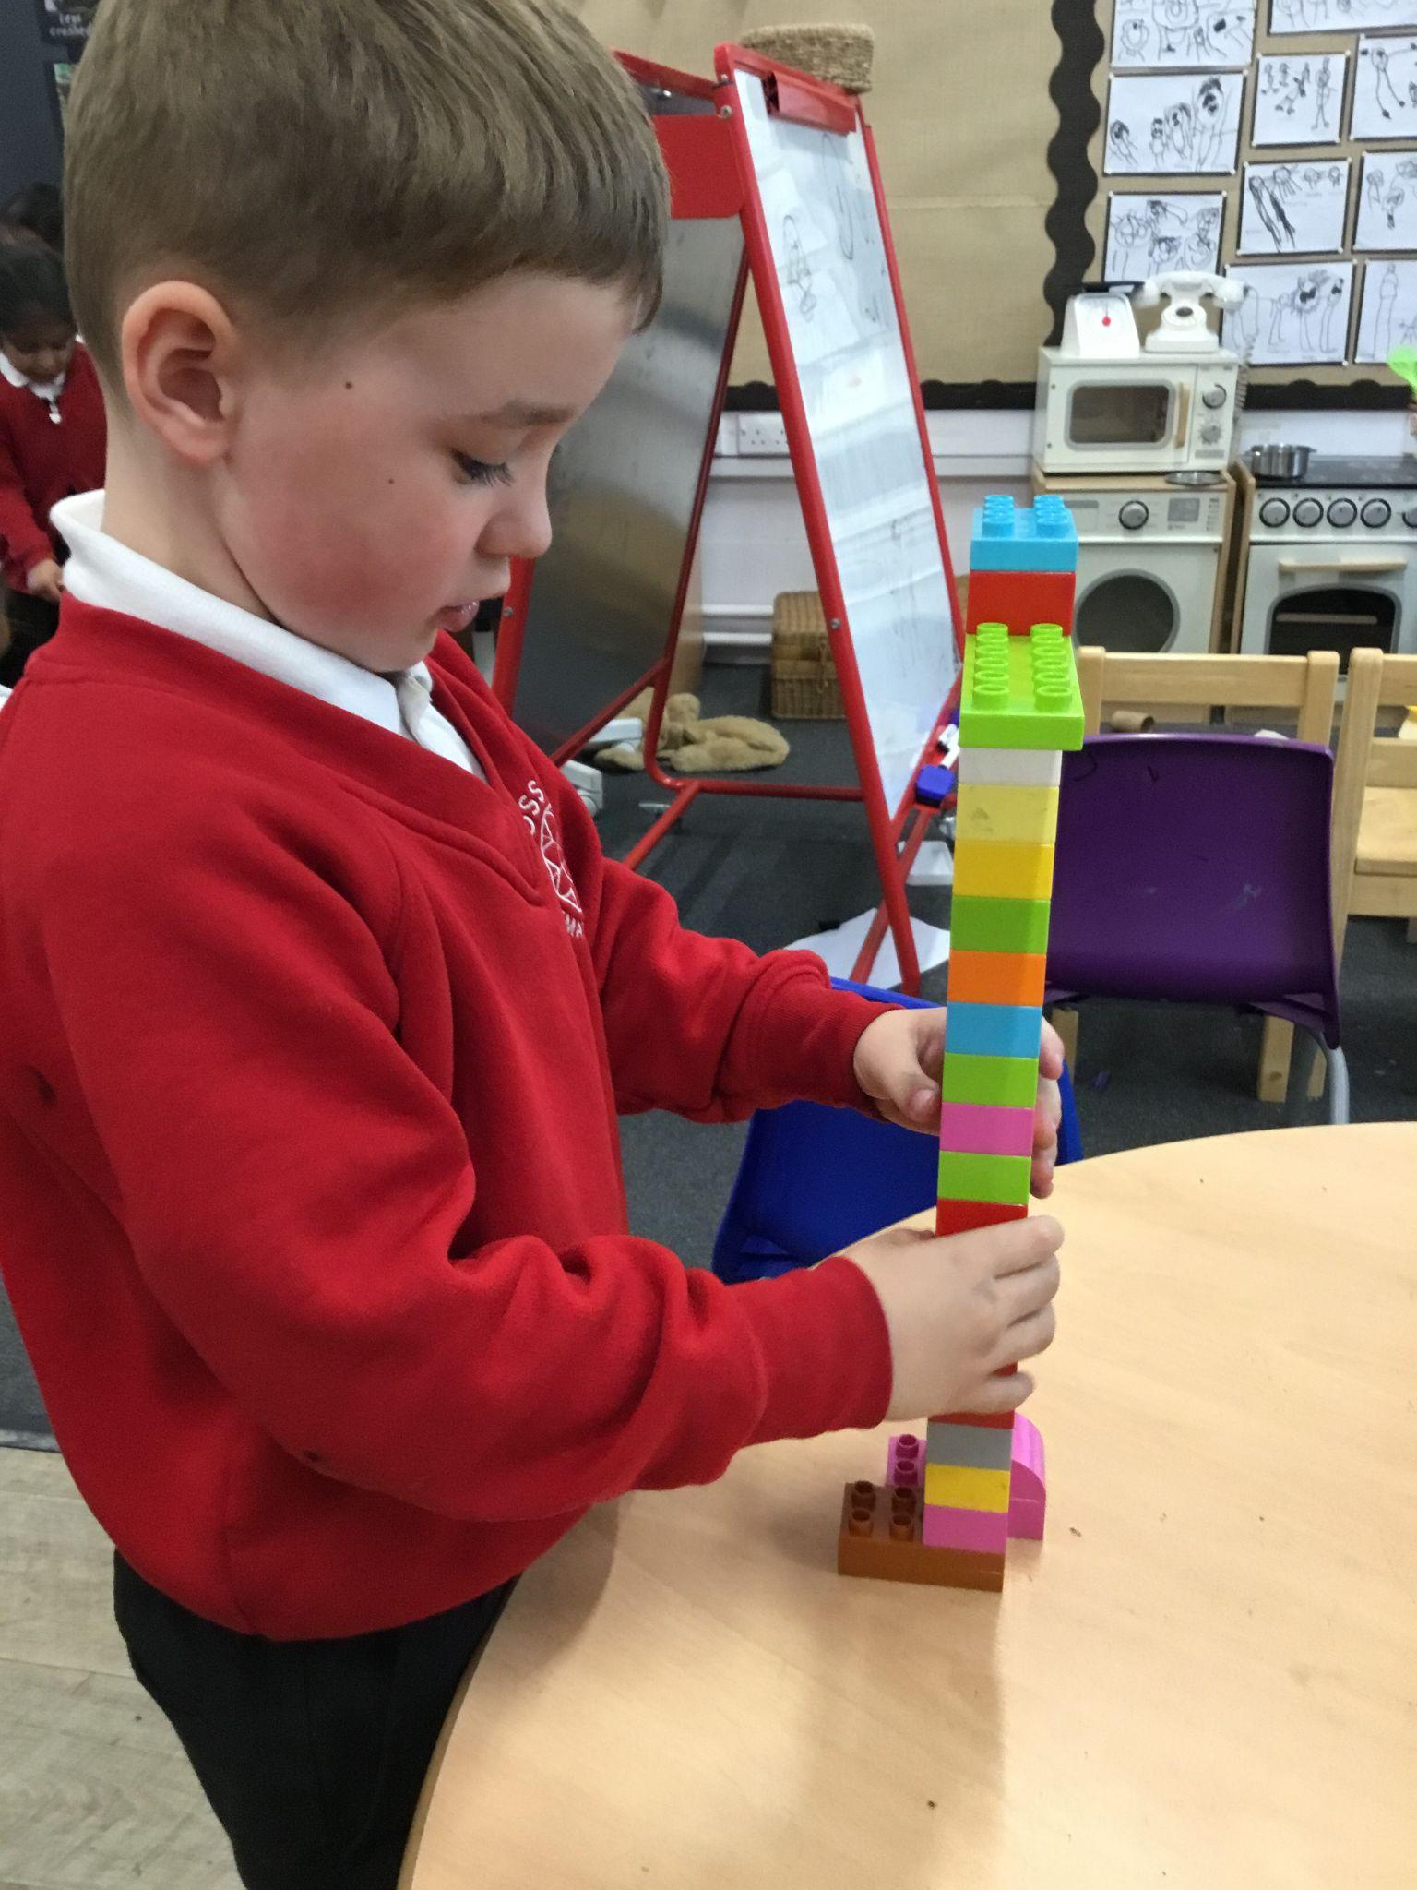
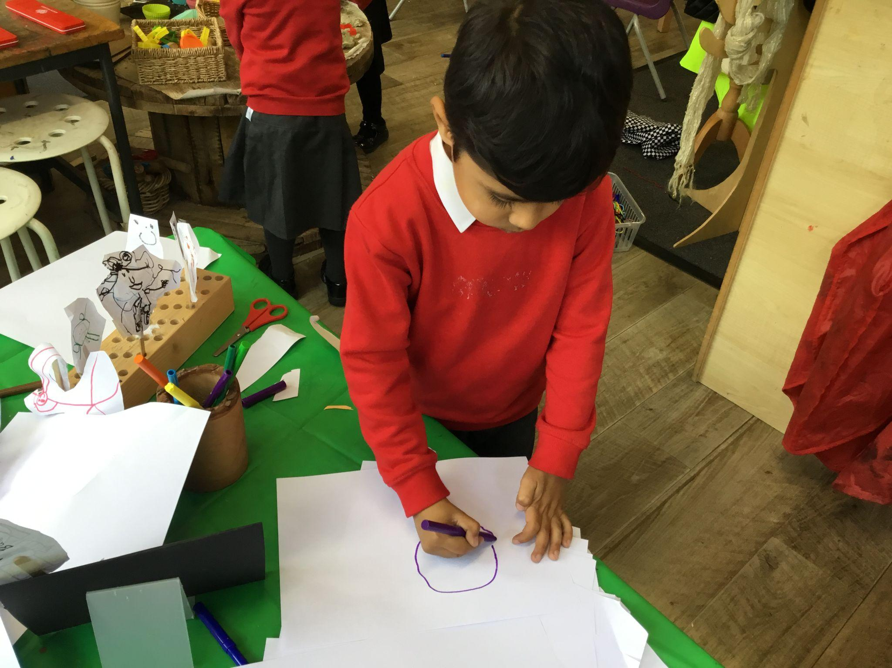
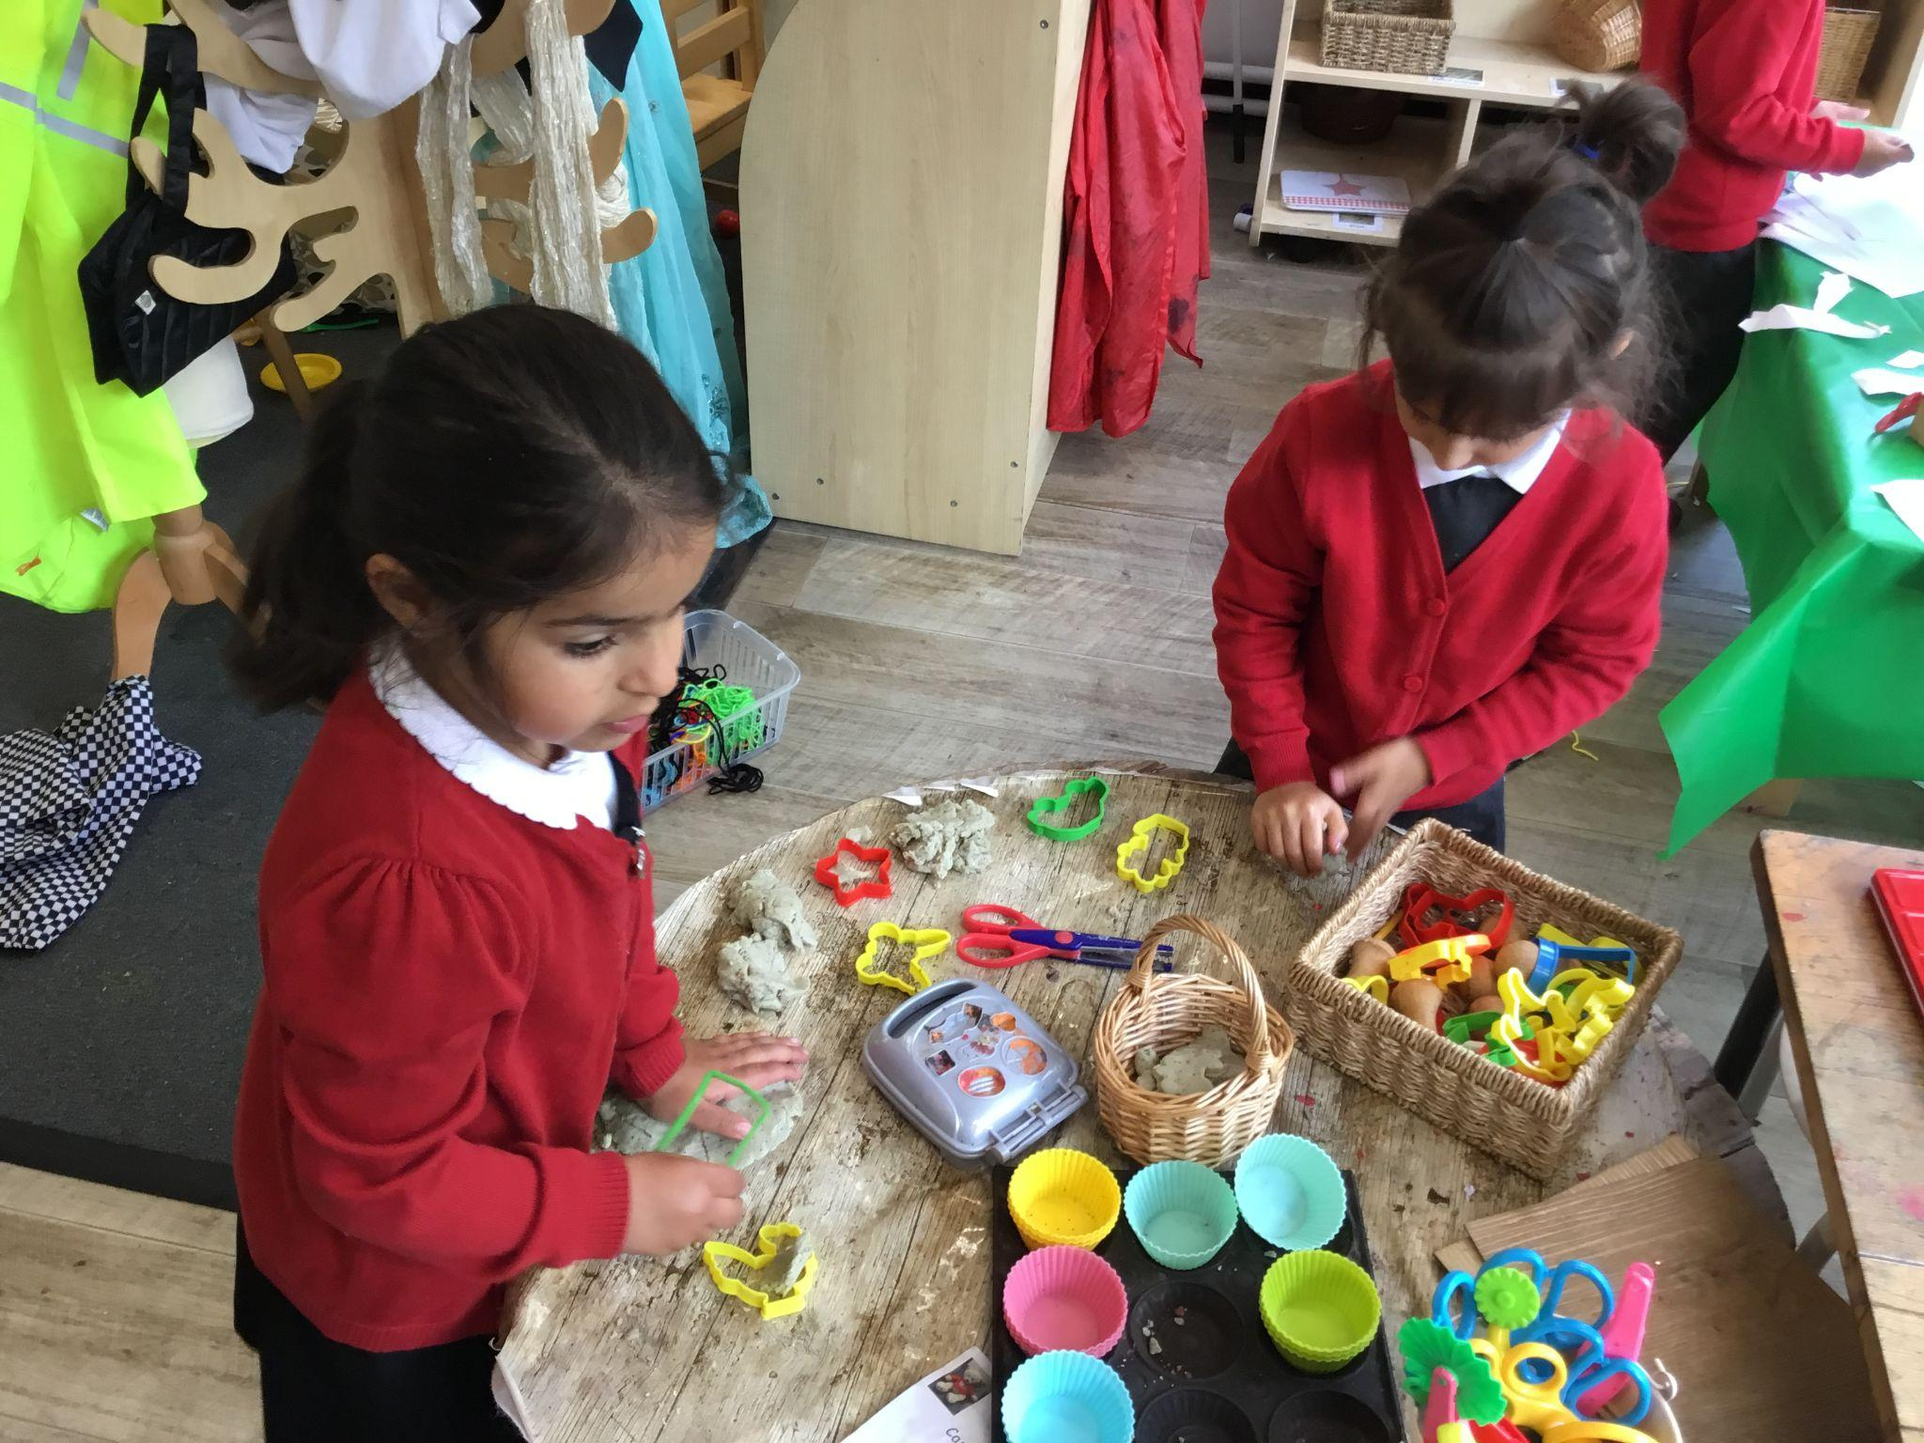
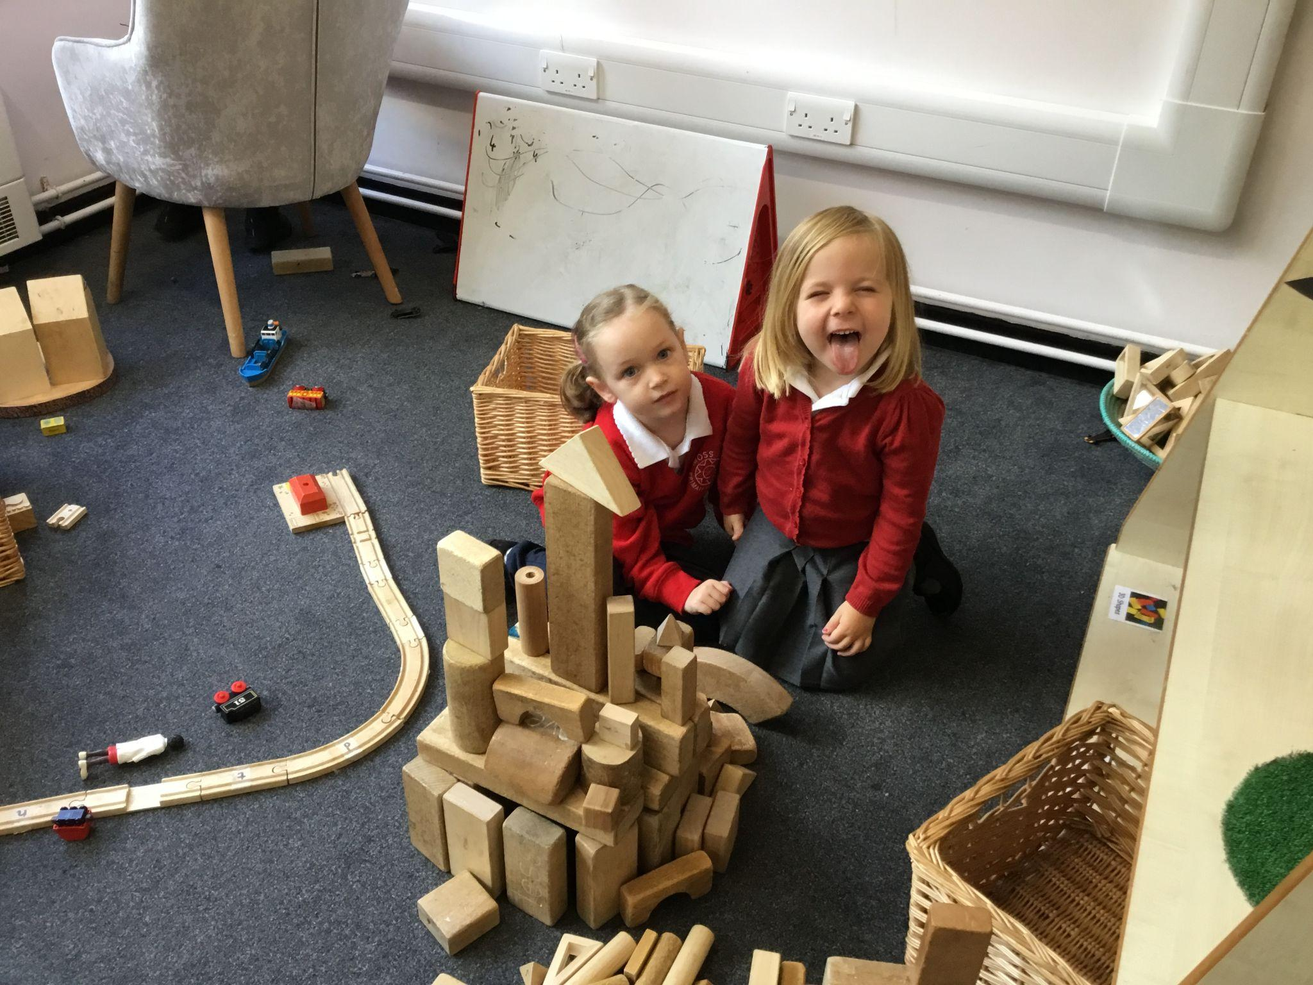
Our first week in Reception

Slide 10


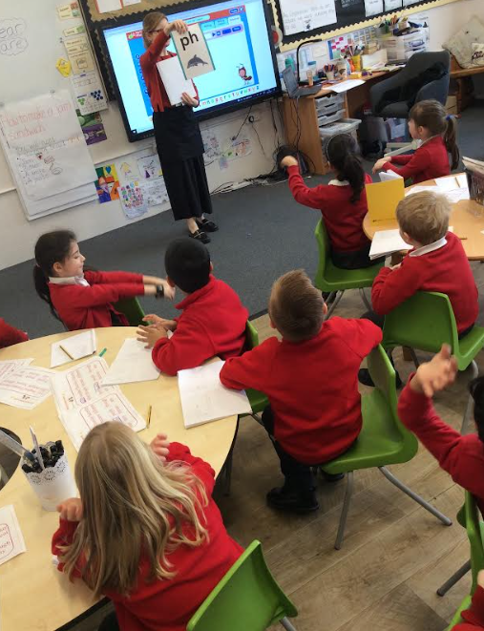
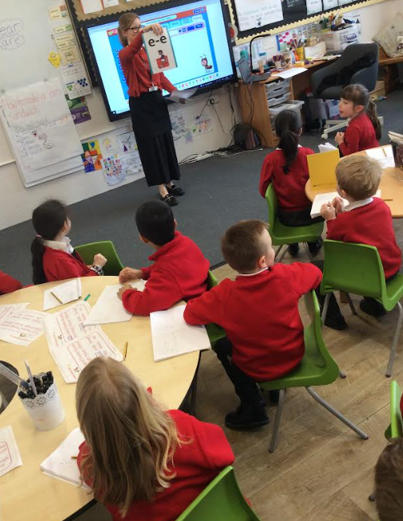
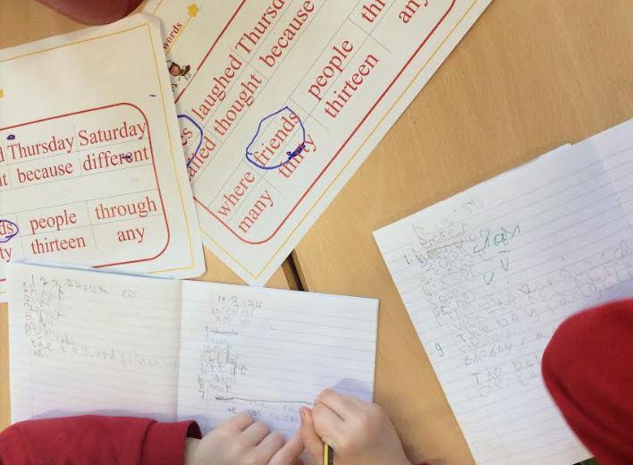
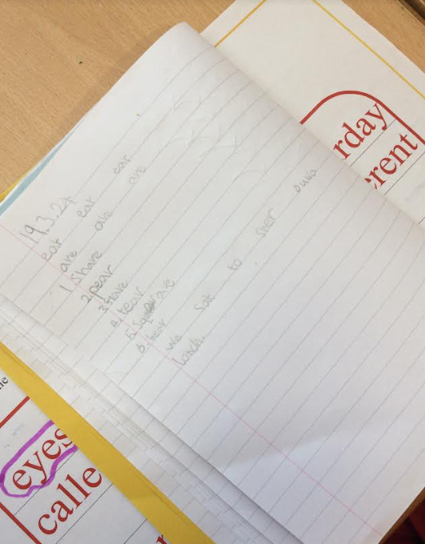
and Early Reading
Children are taught Phonics at Moss Park Primary using Bug Club Phonics.
They will start phonics in the first term but will not receive a book until they have learnt the first set of sounds - model reading pack.
Reading books will match the sounds they have learnt in school.
They will have one reading book to take home each week and one reading for pleasure book. These are clearly labelled as non-decodable books.
Books in school every day with reading record.
Collected stickers and raffle tickets for regular home reading.

Slide 11
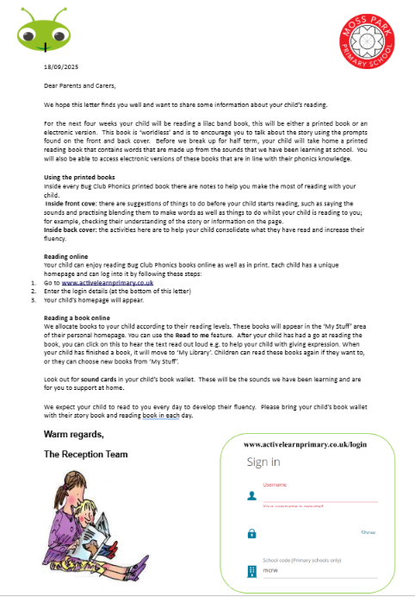

and Early Reading
Book bag
Oral blending and segmenting
Sound mat phase 2
Tricky words phase 2
Children will learn actions for each sound

Slide 12
Donations from home
If you have any of the following at home that you are happy to donate please bring them in.
•Junk
•Old games or construction materials
•Old clean sheets for den making
•Spare clothes
Thank you in advance.

Slide 13

Questions

