Slide 1
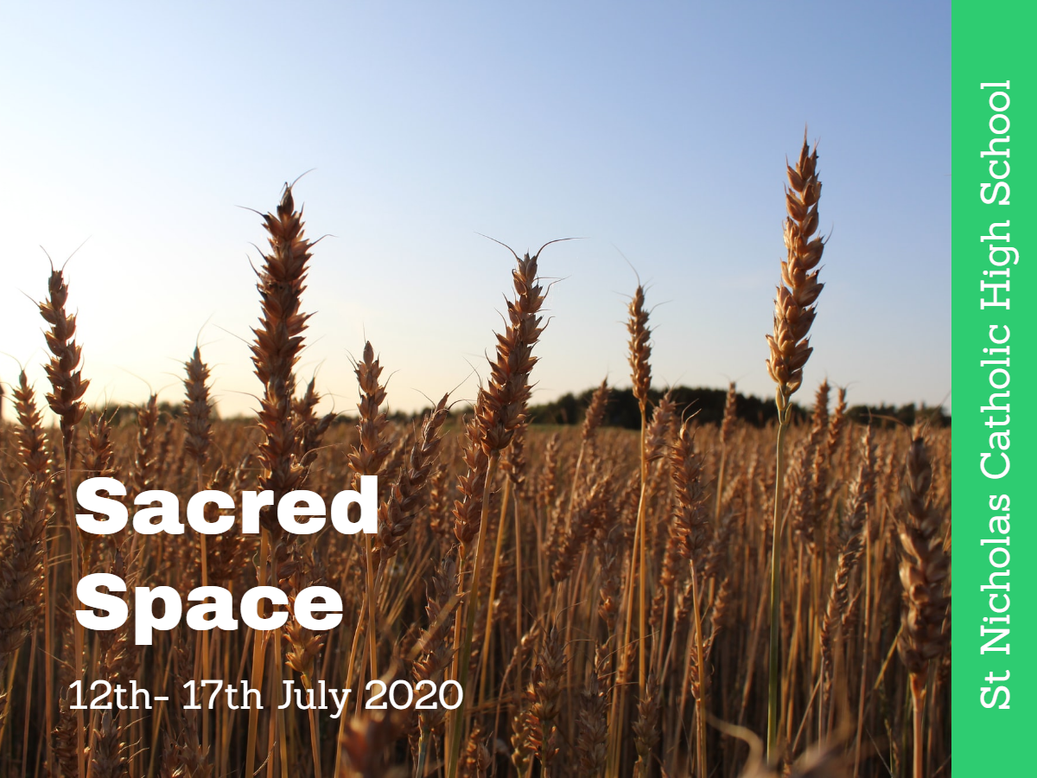


Slide 2
Sunday Reading –
Matthew 13:1-23
Jesus said to his friends ‘Happy are your eyes because they see, your ears because they hear! I tell you solemnly, many prophets and holy men longed to see what you see, and never saw it; to hear what you hear, and never heard it.
‘You, therefore, are to hear the parable of the sower. When anyone hears the word of the kingdom without understanding, the evil one comes and carries off what was sown in his heart: this is the man who received the seed on the edge of the path. The one who received it on patches of rock is the man who hears the word and welcomes it at once with joy. But he has no root in him, he does not last; let some trial come, or some persecution on account of the word, and he falls away at once. The one who received the seed in thorns is the man who hears the word, but the worries of this world and the lure of riches choke the word and so he produces nothing. And the one who received the seed in rich soil is the man who hears the word and understands it; he is the one who yields a harvest and produces now a hundredfold, now sixty, now thirty.

Slide 3
Sunday Space
The theme for this week is ‘Grow in Good Soil’ – I suppose that would have meant me sending you off with the wish to spend the summer doing whatever is best for you to grow, until we meet again.
Matthew’s Jesus almost seems disappointed with the people who are following him. He seems to expect that, apart from a special few, they will not do what is needed to be faithful and committed to the Christian message. I read this parable in a different way. I think I can make rocky, thorny, and good choices all on the same day. Every experience or interaction gives us a chance to ‘get it right’ or ‘get it wrong’. But if we keep to good ‘soil’ – positive attitudes, taking care of ourselves and others, showing kindness and compassion – they we are more likely to continue along the right path.
Coming out of lockdown just before the summer holidays is great news but even with all the reopenings and opportunities there is a note of caution. So please do enjoy yourselves and take care of yourselves and your families. I will be continuing to pray for you every day and hope that you and your family stay well. I look forward to seeing you all in September.
God Bless, Mairie
If you are printing the pages from the booklets remember to choose ‘current page’ only.

Slide 4
Mindful Monday
At the start of the week, we begin with a sense of knowing that where we are is maybe not where we are meant to be.
God, forgive us when
We treat your generosity as our right
And keep it to ourselves.
Give us enough trust to live secure in your love
And to share it freely with others
In the confidence that
Your grace will never run out.
Amen
Jan Berry
‘If anyone gives so much as a cup of cold water to one of these little ones because he is a disciple, then I tell you solemnly, he will most certainly not lose his reward.’
Matthew 10
In the next weeks we will be faced with many opportunities to make little gestures of kindness. Look out for and take these chances and maybe keep a diary of what you did and how it made you feel, just for you to look back at.
Watch -
Come to the Water

Slide 5
Thankful Tuesday
We often think about what we want. We rarely think about what we already have.
We are surrounded by good
fortune. Take a moment to count your blessings.
Lord,
I wish you could give me eyes so large
that I could see the world as you do.
Because I like looking at the world
but sometimes I forget to notice,
to admire, to acknowledge
all that is good.
Amen
God said, “But if you do not stand by me,
you will not stand at all.”
Isaiah 7
There is a quote from a number of people that says–
‘If you don't stand for something, you'll fall for anything.’
Like the wheat in the Sunday gospel, a plant will often need support as it grows before it can stand by itself. We need support as we grow and knowing we have God on our side is as good as it gets!
Stand by Me

Slide 6
Wonder Wednesday
It’s good to take a moment and pay attention to the small but important something that may be in front of our eyes.
“I think us here to wonder, myself. To wonder. To ask.
And that in wondering ‘bout the big things and asking ‘bout the big things, you learn about the little ones, almost by accident. But you never know nothing more about the big things than you start out with.
The more I wonder, the more I love.”
― Alice Walker
“I pray, kneeling before the Father, from whom every family, whether spiritual or natural, takes its name:
Out of his infinite glory, may he give you the power through his Spirit for your hidden self to grow strong, so that Christ may live in your hearts through faith, and then, planted in love and built on love, you will with all the saints have strength to grasp the breadth and the length, the height and the depth; until, knowing the love of Christ, which is beyond all knowledge, you are filled with the utter fullness of God.”
St Paul’s blessing to the Ephesians
This is such a lovely blessing – imagine that it is be prayed for you and your family.
Bless the Lord

Slide 7
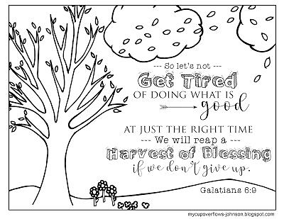

Slide 8
Thoughtful Thursday
Where does the time go?
Maybe time to focus on where the week is going?
Anything that needs to change?
Lord, do not simply say that you are with us.
Millions do not know you, and to those of us who do,
what is the difference?
What is the point of your presence
if our lives do not change?
Lord, I give you permission to change my life.
Amen
“Jesus said, ‘Come to me, all you who labour and are overburdened, and I will give you rest. Shoulder my yoke and learn from me, for I am gentle and humble in heart, and you will find rest for your souls. Yes, my yoke is easy and my burden light.’ Matthew 11
Remember this gospel from last week. When we feel challenged in life we can ask Jesus to guide us and even to carry us. When we don’t know which way to go – ask God for guidance – that is what prayer is for.
We are here to love

Slide 9
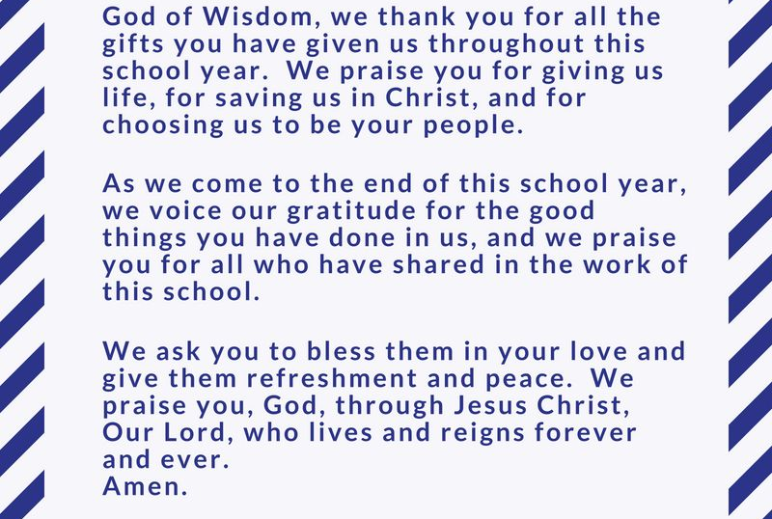
Fabulous Friday
End of the School Year

Slide 10
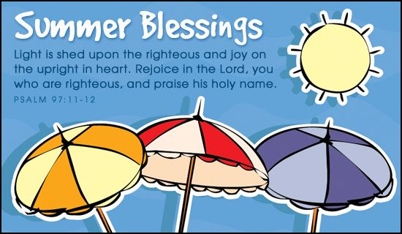

Slide 11
Prayers of the Church
Our Father who art in heaven, hallowed be thy name.
Thy kingdom come.
Thy will be done, on earth as it is in heaven.
Give us this day our daily bread; and forgive us our trespasses, as we forgive those who trespass against us; and lead us not into temptation, but deliver us from evil. Amen
Hail Mary, full of grace, the Lord is with thee.
Blessed art thou amongst women and blessed is the fruit of thy womb, Jesus.
Holy Mary, Mother of God, pray for us sinners, now and at the hour of our death. Amen
Glory be to the Father, the Son and the Holy Spirit. As it was in the beginning, is now and forever will be, world without end. Amen

Slide 12
Simply Saturday
Prayer for the World
God of love and hope,
you made the world and care for all creation,
but the world feels strange right now.
The news is full of stories about Coronavirus.
Some people are worried that
they might get ill.
Others are anxious for their family
and friends.
Be with them and help them to find peace.
We pray for the doctors and nurses
and scientists,
and all who are working to discover
the right medicines
to help those who are ill.
Thank you that even in these anxious times,
you are with us.
Help us to put our trust in you and
keep us safe. Amen
We pray today for all those affected by the Pandemic.
And add our own intentions to the prayers of the world.
Amen

