Slide 1



Slide 2
Sunday Reading –
Matthew 11:25-30
Jesus exclaimed, ‘I bless you, Father, Lord of heaven and of earth, for hiding these things from the learned and the clever and revealing them to mere children. Yes, Father, for that is what it pleased you to do. Everything has been entrusted to me by my Father; and no one knows the Son except the Father, just as no one knows the Father except the Son and those to whom the Son chooses to reveal him.
‘Come to me, all you who labour and are overburdened, and I will give you rest. Shoulder my yoke and learn from me, for I am gentle and humble in heart, and you will find rest for your souls. Yes, my yoke is easy and my burden light.

Slide 3
Sunday Space
The theme for this week is very appropriately ‘Supporting each other’ – something I am sure that we have all needed over the past weeks and continue to do as we move on towards the end of the school year.
Matthew’s Jesus now shows us the depth of his love for us. It is one of the traditions of faith that the word ‘Love’ is both a noun and a verb. We should always think of God as Love and express our faith as love in action. We have seen so many examples of this over the past months with people putting others first – whether NHS staff, shop assistants, neighbours, voluntary workers or ourselves helping out more at home or with relatives - help has been offered to make other lives easier. It’s been a long commitment and it’s not always easy to do, so Jesus reassures us with the promise that he is there helping us in our efforts and doing the work alongside us.
Please do have a good week and take care of yourselves as the lockdown starts to ease it is time to be making good decisions about our own actions. I am praying for you every day and hope that you and your family are well. If you have any prayers you would like me to say for you, or if you would like a chat - please email me.
M.gelling@st-nicholas.cheshire.sch.uk
God Bless, Mairie
If you are printing the pages from the booklets remember to choose ‘current page’ only.

Slide 4
Mindful Monday
At the start of the week, we begin with a sense of knowing that where we are is maybe not where we are meant to be.
God, forgive us when
We treat your generosity as our right
And keep it to ourselves.
Give us enough trust to live secure in your love
And to share it freely with others
In the confidence that
Your grace will never run out.
Amen
Jan Berry
Jesus was approached by a woman, who had suffered from a haemorrhage for twelve years, and she touched the fringe of his cloak, for she said to herself, ‘If I can only touch his cloak I shall be well again.’ Jesus turned round and saw her; and he said to her, ‘Courage, my daughter, your faith has restored you to health.’ And from that moment the woman was well again. Matthew 9:18-26
One of the loveliest scenes in the Gospel . Watch a reflection from an artist based in India
The Healing of the Woman
Listen One Touch

Slide 5


Slide 6
Thankful Tuesday
We often think about what we want. We rarely think about what we already have.
We are surrounded by good
fortune. Take a moment to count your blessings.
Lord,
I wish you could give me eyes so large
that I could see the world as you do.
Because I like looking at the world
but sometimes I forget to notice,
to admire, to acknowledge
all that is good.
Amen
Jesus made a tour through all the towns and villages, teaching in their synagogues, proclaiming the Good News of the kingdom and curing all kinds of diseases and sickness.
And when he saw the crowds he felt sorry for them because they were harassed and dejected, like sheep without a shepherd. Then he said to his disciples, ‘The harvest is rich but the labourers are few, so ask the Lord of the harvest to send labourers to his harvest.’
Matthew 9:32-37
It can be difficult to stay positive when things are hard. It can help to find something to be thank for - Giving Thanks

Slide 7
Wonder Wednesday
It’s good to take a moment and pay attention to the small but important something that may be in front of our eyes.
“I think us here to wonder, myself. To wonder. To ask.
And that in wondering ‘bout the big things and asking ‘bout the big things, you learn about the little ones, almost by accident. But you never know nothing more about the big things than you start out with.
The more I wonder, the more I love.”
― Alice Walker
“These are the names of the twelve apostles: first, Simon who is called Peter, and his brother Andrew; James the son of Zebedee, and his brother John; Philip and Bartholomew; Thomas, and Matthew the tax collector; James the son of Alphaeus, and Thaddaeus; Simon the Zealot and Judas Iscariot, the one who was to betray him.“ Matthew 10:1-7
These names are so familiar that we hardly think about them now except as ‘apostles’. But each one is a person with a life ‘before Jesus’. Everyone is called to be part of the story. Take the chance to say - Here I am

Slide 8
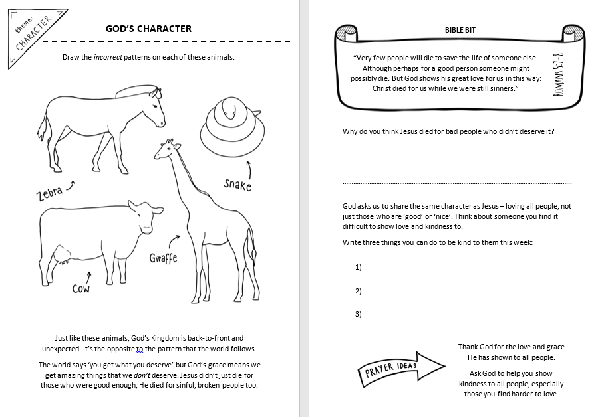

Slide 9
Thoughtful Thursday
Where does the time go?
Maybe time to focus on where the week is going?
Anything that needs to change?
Lord, do not simply say that you are with us.
Millions do not know you, and to those of us who do,
what is the difference?
What is the point of your presence
if our lives do not change?
Lord, I give you permission to change my life.
Amen
“Jesus instructed the Twelve as follows: ‘As you go, proclaim that the kingdom of heaven is close at hand. Cure the sick, raise the dead, cleanse the lepers, cast out devils. You received without charge, give without charge. Provide yourselves with no gold or silver, not even with a few coppers for your purses, with no haversack for the journey or spare tunic or footwear or a staff, for the workman deserves his keep.” Matthew 10:7-15
Jesus tells us ‘we are enough’. We can change lives by just being who we are mean to be. What is keeping you from your best self?
We are here to love

Slide 10
Fabulous Friday
Take a minute.
Reflect back on your successes and your challenges. Are you beginning Friday in the best place? If not, now’s the time to make it right. If so – then – Fantastic!
Loving Father,
In all of us there is a longing
for a life that has not yet come,
for a world that that is free and just,
for a dream of hope for all people.
May your Kingdom come.
Amen
Dorothy McMahon (adapted)
“Jesus said to his Apostles: “Behold, I am sending you like sheep in the midst of wolves; so be shrewd as serpents and simple as doves.” Matthew 10
We end the week with another tricky Matthew verse. Jesus understands that being sent out to ‘love’ people is hard and we are not meant to let ourselves be exploited. So ask for wisdom and make good decisions with a kind heart. It’s not a bad way to live.
A few years ago we had the Worship band ‘Amongst Wolves’ in school – here is one their songs - Let me love you

Slide 11
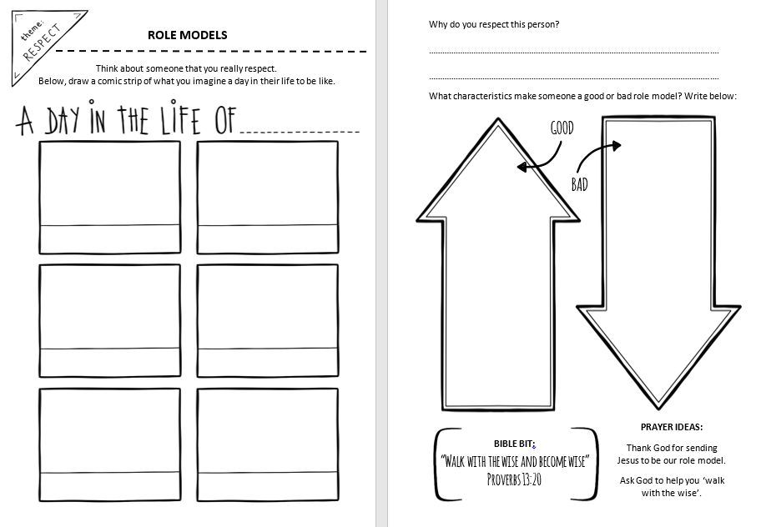

Slide 12
Prayers of the Church
Our Father who art in heaven, hallowed be thy name.
Thy kingdom come.
Thy will be done, on earth as it is in heaven.
Give us this day our daily bread; and forgive us our trespasses, as we forgive those who trespass against us; and lead us not into temptation, but deliver us from evil. Amen
Hail Mary, full of grace, the Lord is with thee.
Blessed art thou amongst women and blessed is the fruit of thy womb, Jesus.
Holy Mary, Mother of God, pray for us sinners, now and at the hour of our death. Amen
Glory be to the Father, the Son and the Holy Spirit. As it was in the beginning, is now and forever will be, world without end. Amen

Slide 13
Simply Saturday
Prayer for the World
God of love and hope,
you made the world and care for all creation,
but the world feels strange right now.
The news is full of stories about Coronavirus.
Some people are worried that
they might get ill.
Others are anxious for their family
and friends.
Be with them and help them to find peace.
We pray for the doctors and nurses
and scientists,
and all who are working to discover
the right medicines
to help those who are ill.
Thank you that even in these anxious times,
you are with us.
Help us to put our trust in you and
keep us safe. Amen
We pray today for all those affected by the Pandemic.
And add our own intentions to the prayers of the world.
Amen

