Slide 1



Slide 2
Sunday Reading –
Acts:2:1-11
When Pentecost day came round, they had all met in one room, when suddenly they heard what sounded like a powerful wind from heaven, the noise of which filled the entire house in which they were sitting; and something appeared to them that seemed like tongues of fire; these separated and came to rest on the head of each of them. They were all filled with the Holy Spirit, and began to speak foreign languages as the Spirit gave them the gift of speech.
Now there were devout men living in Jerusalem from every nation under heaven, and at this sound they all assembled, each one bewildered to hear these men speaking his own language. They were amazed and astonished. ‘Surely’ they said ‘all these men speaking are Galileans? How does it happen that each of us hears them in his own native language? Parthians, Medes and Elamites; people from Mesopotamia, Judaea and Cappadocia, Pontus and Asia, Phrygia and Pamphylia, Egypt and the parts of Libya round Cyrene; as well as visitors from Rome – Jews and proselytes alike – Cretans and Arabs; we hear them preaching in our own language about the marvels of God.’

Slide 3
Sunday Space
Happy Feast Day! Happy Birthday to the Church. This is only one of several readings for today that follow the journey of faith for believers to speak the Good News which is what the word ‘gospel’ means. Pentecost was already an ancient feast day when the Holy Spirit arrived – a feast of thankfulness for all God had given the people. That’s why there were so many people in Jerusalem from different countries. People with the same faith but different languages. The Holy Spirit broke down the barriers and allowed people to come together as a community. That is what Pentecost is for us now. People of faith are finding lots of different ways of praying and worshipping during the lockdown but whether it’s the rosary, a prayer book, Zoom services or live-streamed Masses, its important to remind ourselves that we are all part of one ‘holy conversation’ that is made up of people not buildings.
There is a worksheet on the Gospel attached – some of it may be a little young for you but maybe to share with siblings or the family. Also links to some wildlife
As we enter June, officially summer-time now, please do have a good week and try to do something to make it a bit different, maybe one of the PE department challenges?
I am praying for you every day and hope that you and your family are well. If you have any prayers you would like me to say for you, or if you would like a chat - please email me. M.gelling@st-Nicholas.Cheshire.sch.uk
God Bless, Mairie
If you are printing the pages from the booklets remember to choose ‘current page’ only.

Slide 4
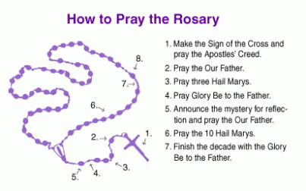
Pray the Rosary
In May we traditionally think about Mary, Jesus’ mother, and how she guides us to talk to and listen to her son. We often make a point of saying the Rosary during May as this gives us time to sit with Mary and Jesus in prayer. The Rosary is a wonderful prayer if you are anxious or unable to sleep. Many people think of it as a way of making time for God. The diagram below is a very simple way of praying the Rosary – you can add readings from scripture and other prayers but this heartfelt repetition is just as good and you can place the name of a person or situation before you begin to pray. Saying the Rosary with someone else is also very meaningful- perhaps you could say it over social media with one of your relatives? If you don’t have a rosary you can use your fingers or beads, marbles or pebbles. Here is a video of how to pray the rosary – and to pray along – from St Nicholas’ Church in Hereford.
Praying the Rosary

Slide 5
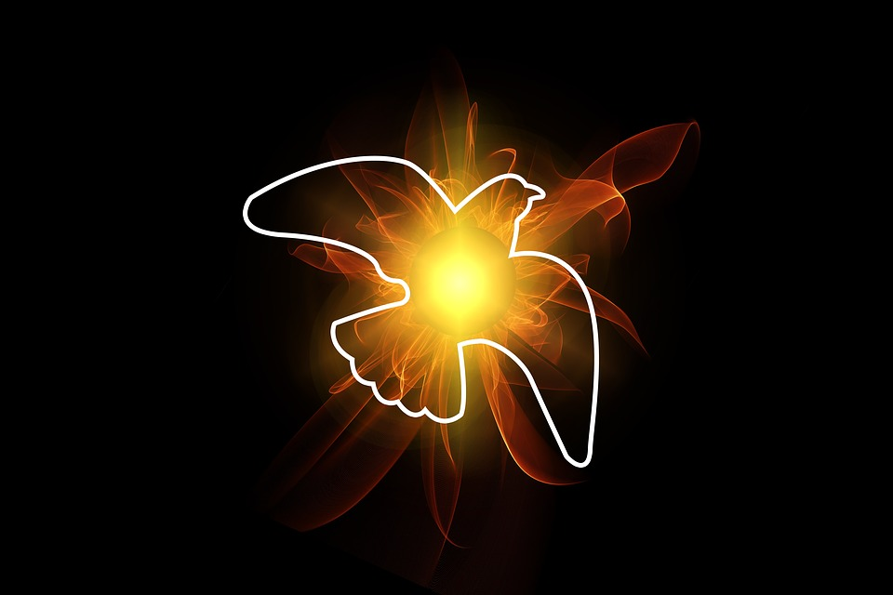
Mindful Monday
At the start of the week, we begin with a sense of knowing that where we are is maybe not where we are meant to be.
Come Lord,
Change our lives, shatter our complacency.
Take away the quietness of a clear conscience.
Press us uncomfortably,
For only thus that other peace is made,
your peace.
Amen
Helder Camara
“When Pentecost day came round, they had all met in one room, when suddenly they heard what sounded like a powerful wind from heaven, the noise of which filled the entire house in which they were sitting;.’” Acts 2
Watch - What is the Feast of Pentecost

Slide 6
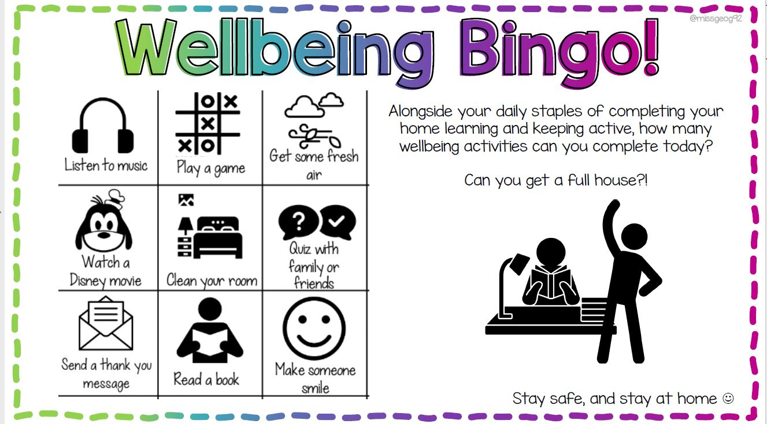

Slide 7

Thankful Tuesday
We often think about what we want. We rarely think about what we already have.
We are surrounded by good fortune. Take a moment to count your blessings.
Loving God
Help me to walk in the boots of the worker
The shoes of the trader
The slippers of the housebound
And the sandals of Jesus the Master
Amen
Native American
“something appeared to them that seemed like tongues of fire; these separated and came to rest on the head of each of them. They were all filled with the Holy Spirit, and began to speak foreign languages as the Spirit gave them the gift of speech.” Acts 2
Watch -Breath of God

Slide 8
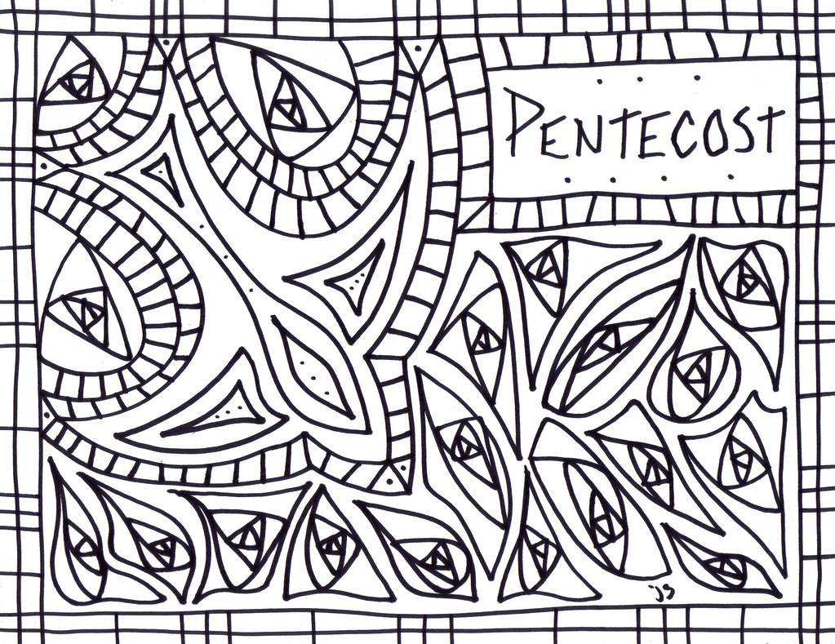

Slide 9
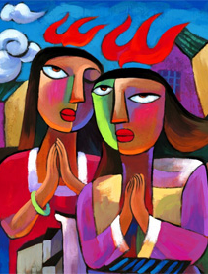
Wonder Wednesday
It’s good to take a moment and pay attention to the small but important something that may be in front of our eyes.
Breath of God,
moving through the heart of creation,
let me see the glory which surrounds me;
Word of God, vibrant in every movement,
open my mind to the mystery of your presence;
Spirit of God, source of transformation and life,
make me one of the people of Light.
Amen
Isaiah 12
“Now there were devout people living in Jerusalem from every nation under heaven, and at this sound they all assembled, each one bewildered to hear these men speaking his own language. They were amazed and astonished”-
Acts 2
More than conquerors

Slide 10
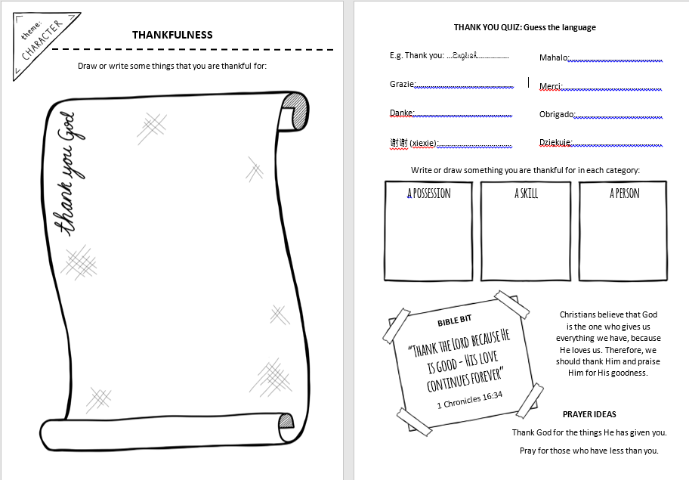

Slide 11
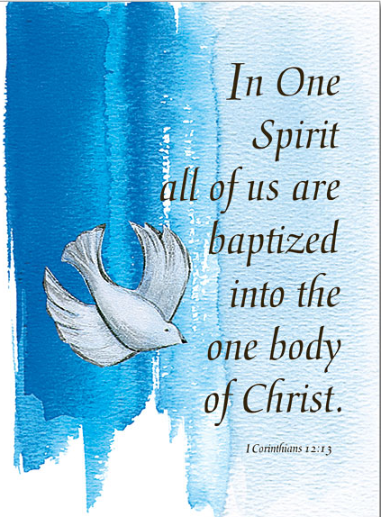
Thoughtful Thursday
Oh, Thursday already. Where does the time go? Maybe time to focus on where the week is going? Anything that needs to change?
Eat and drink together:
Talk and laugh together:
Enjoy life together:
But never call it friendship
Until you have wept together.
African saying
“ Just as a human body, though it is made up of many parts, is a single unit because all these parts, though many, make one body, so it is with Christ. In the one Spirit we were all baptised, Jews as well as Greeks, slaves as well as citizens, and one Spirit was given to us all to drink..” Corinthians
Watch -This is Living

Slide 12
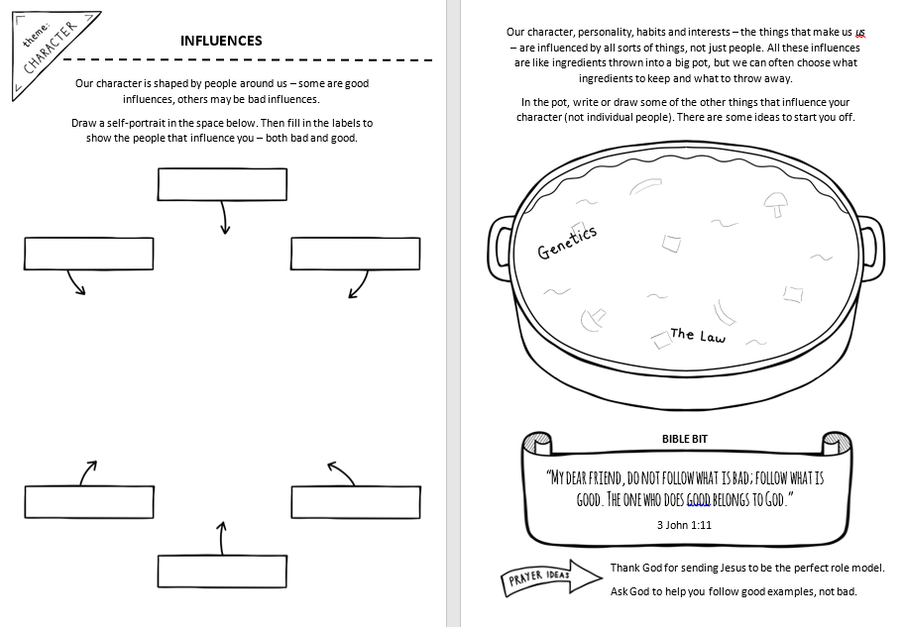

Slide 13
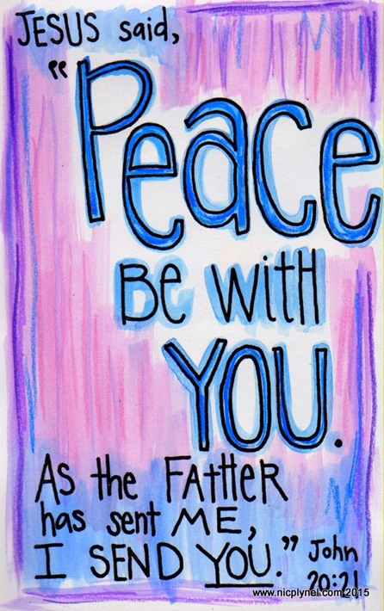
Fabulous Friday
Before racing into the weekend, take a minute.
Reflect back on your successes and your challenges. Are you beginning Friday in the best place? If not, now’s the time to make it right. If so – then – Fantastic!
Loving God
I have often seen power corrupt others –
leaders of armies, governments, organisations
and even in my own family and friends –
so when you see it happening to me
can you give me a well aimed nudge?
Amen
Alex Gilmore
“In the evening of the first day of the week, the doors were closed in the room where the disciples were, for fear of the Jews. Jesus came and stood among them. He said to them, ‘Peace be with you’, and showed them his hands and his side. The disciples were filled with joy when they saw the Lord, and he said to them again, ‘Peace be with you.”
John 20
Watch -My Lighthouse

Slide 14
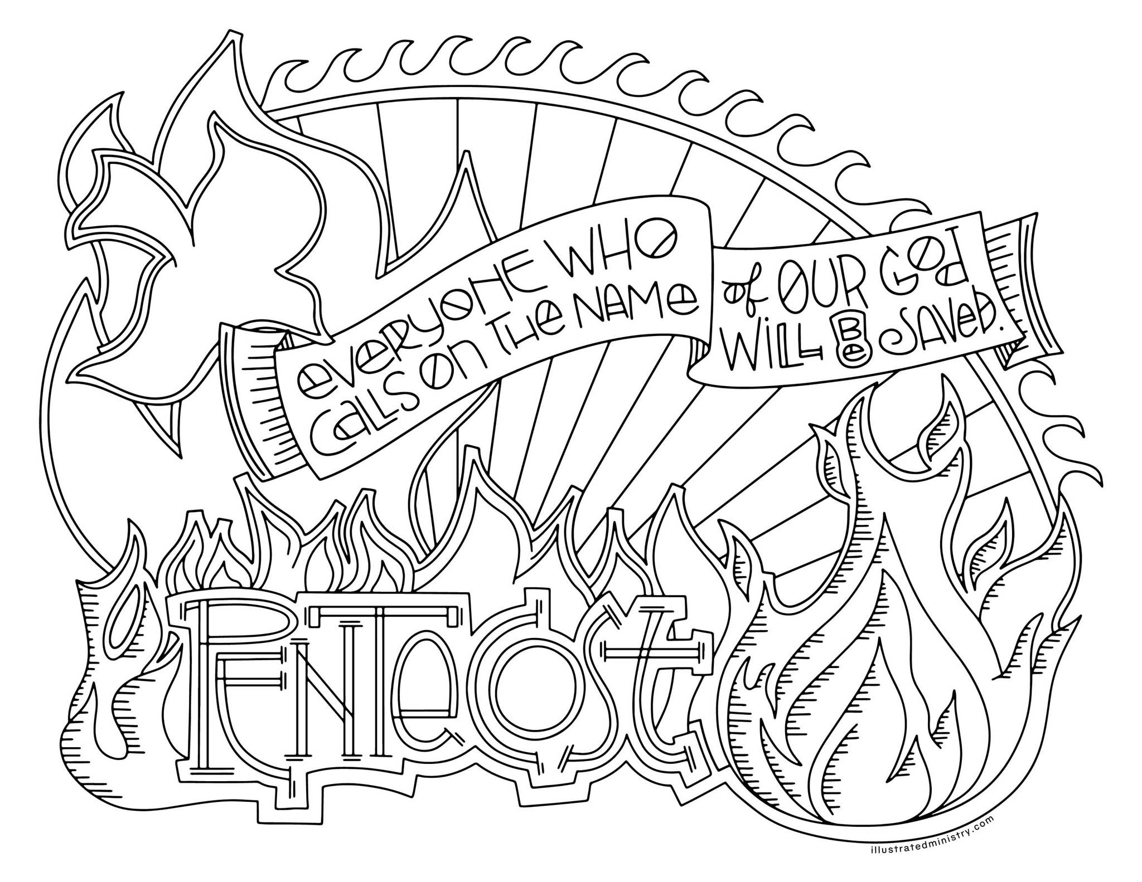

Slide 15
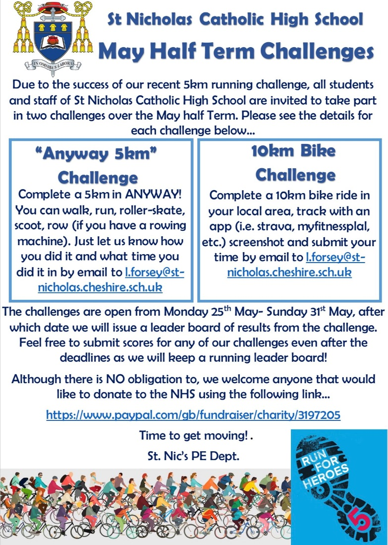
Things to do
In the Garden -Garden ideas
Tree Explorer - Tree Activity
You could try the half-term challenge just for fun

Slide 16
Prayers of the Church
Our Father who art in heaven, hallowed be thy name.
Thy kingdom come.
Thy will be done, on earth as it is in heaven.
Give us this day our daily bread; and forgive us our trespasses, as we forgive those who trespass against us; and lead us not into temptation, but deliver us from evil. Amen
Hail Mary, full of grace, the Lord is with thee.
Blessed art thou amongst women and blessed is the fruit of thy womb, Jesus.
Holy Mary, Mother of God, pray for us sinners, now and at the hour of our death. Amen
Glory be to the Father, the Son and the Holy Spirit. As it was in the beginning, is now and forever will be, world without end. Amen

Slide 17
Simply Saturday
Prayer for the World
God of love and hope,
you made the world and care for all creation,
but the world feels strange right now.
The news is full of stories about Coronavirus.
Some people are worried that
they might get ill.
Others are anxious for their family
and friends.
Be with them and help them to find peace.
We pray for the doctors and nurses
and scientists,
and all who are working to discover
the right medicines
to help those who are ill.
Thank you that even in these anxious times,
you are with us.
Help us to put our trust in you and
keep us safe. Amen
We pray today for all those affected by the Pandemic.
And add our own intentions to the prayers of the world.
Amen

