Slide 1


Slide 2
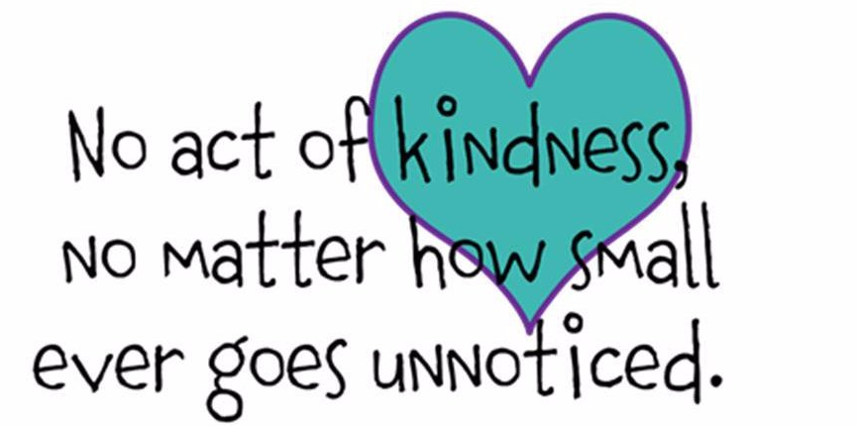
Power of Kindness
Attached to your resources this week is a Power of Kindness calendar and log.
It can be difficult to remember kindness at difficult times. We tend to think of what we need rather than what other people may need. We are especially likely to take others for granted so it is always a good idea to remind ourselves to be kind.
You may want to do this yourself or with your family.
If you are printing the pages from the ppt remember to choose ‘current page’ only.

Slide 3

Sunday Space
Easter is not just one day. We will celebrate Easter for the next 50 days – all the way to Pentecost on 31st May. We see Jesus’ followers getting used to the idea that they have to preach the Gospel now. It won’t be easy.
It is very likely that we will continue to live in unusual times just as we did during Lent. You may have seen on social media or the TV, how some people are doing lots of new things, learning new skills and being very creative. You may be doing this yourself. You may also feel that you are not up to doing new things, that you find you only have enough energy to manage the normal day. This is fine. Social media, as you know, can sometimes show an ideal that no one is really living. Do what you can each day and remember to let other people know how you are feeling
I am praying for you every day and hope that you and your family are well. If you have any prayers you would like me to say for you, please email me. God Bless, Mairie

Slide 4
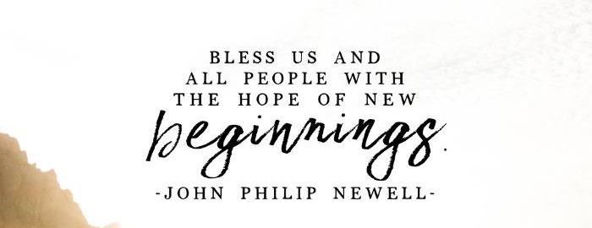
Mindful Monday
At the start of the week, we begin with a sense of knowing that where we are is maybe not where we are meant to be.
God, forgive us when we treat your generosity as our right and keep it to ourselves. Give us enough trust to live secure in your love and to share it freely with others in the confidence that your grace will never run out. Amen
Jan Berry
‘Filled with awe and great joy the women came quickly away from the tomb and ran to tell the disciples.
And there, coming to meet them, was Jesus. ‘Greetings’ he said. And the women came up to him and, falling down before him, clasped his feet. Then Jesus said to them, ‘Do not be afraid; go and tell my brothers that they must leave for Galilee; they will see me there.’ Matthew 28
How great is our God

Slide 5
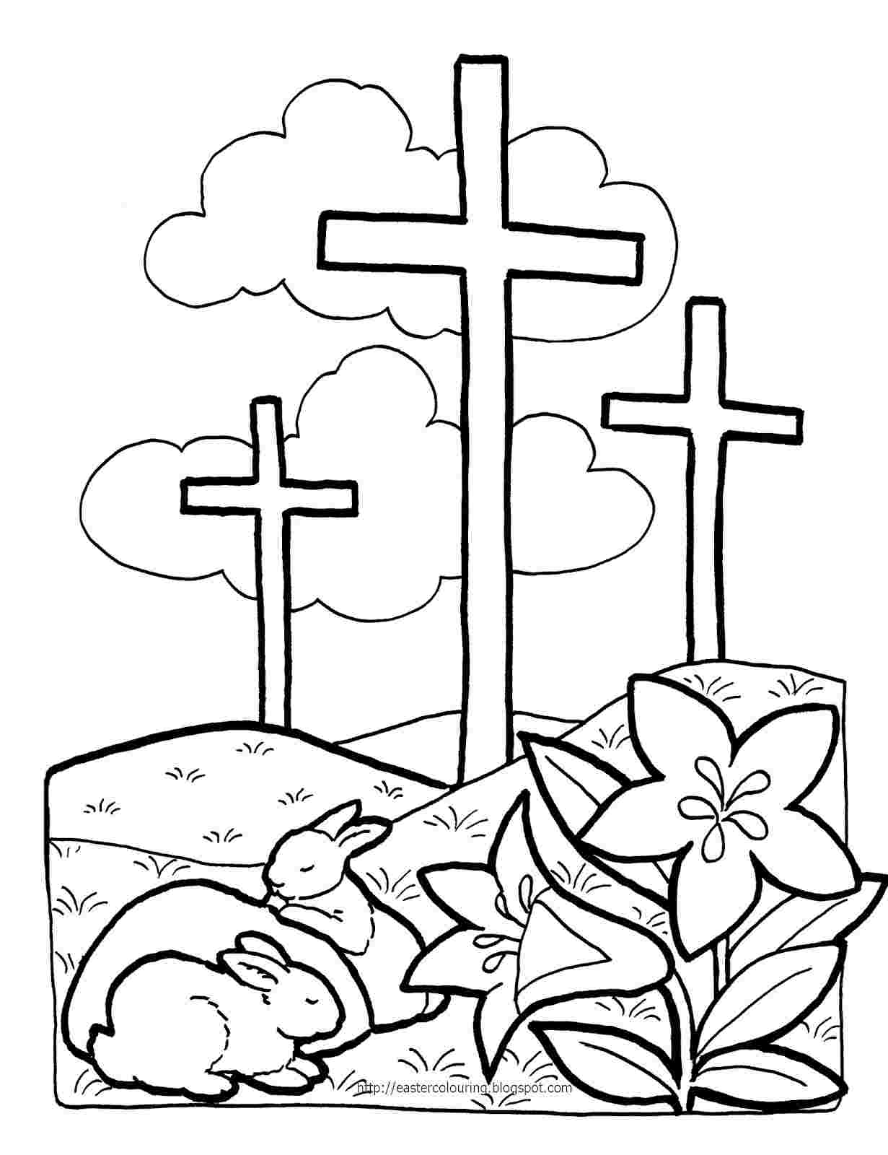

Slide 6
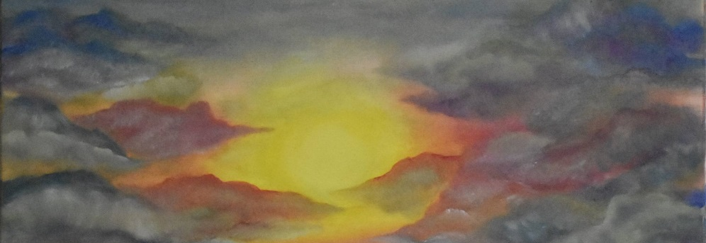
Thankful Tuesday
We often think about what we want. Let’s think about what we already have.
We are surrounded by good fortune. Take a moment to count your blessings.
Lord, I wish you could give me eyes so large that I could see the world as you do.
Because I like looking at the world
but sometimes I forget to notice, to admire, to acknowledge all that is good.
Amen
Jesus said, ‘Woman, why are you weeping? Who are you looking for?’ Supposing him to be the gardener, she said, ‘Sir, if you have taken him away, tell me where you have put him, and I will go and remove him.’ Jesus said, ‘Mary!’ She knew him then and said to him in Hebrew, ‘Rabbuni!’ – which means Master. - John 20
Mary and Jesus in the Garden
What a beautiful name

Slide 7
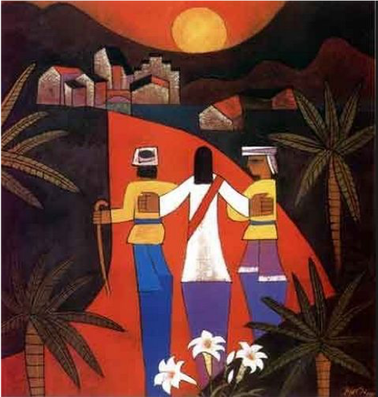
Wonder Wednesday
It’s good to take a moment and pay attention to the small but important something that may be in front of our eyes.
“I think us here to wonder, myself. To wonder. To ask.
And that in wondering ‘bout the big things and asking ‘bout the big things, you learn about the little ones, almost by accident. But you never know nothing more about the big things than you start out with.
The more I wonder, the more I love.”
― Alice Walker
‘Did not our hearts burn within us as he talked to us on the road and explained the scriptures to us?’
Luke 24
The Road to Emmaus

Slide 8
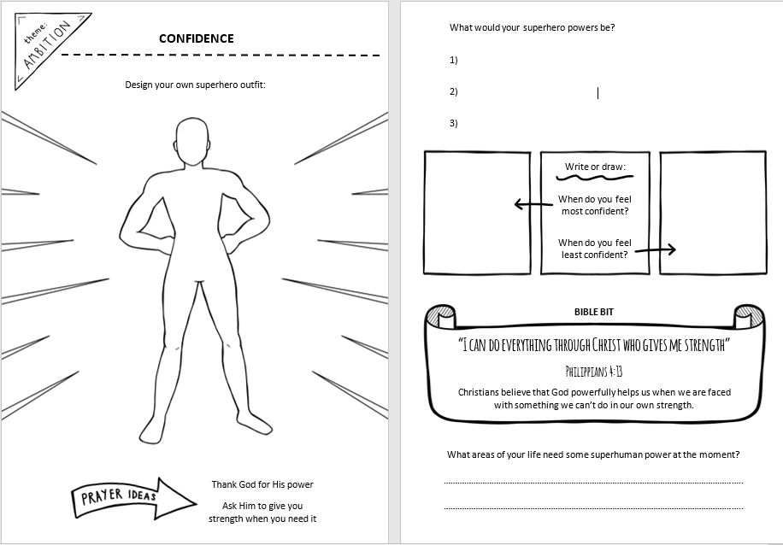

Slide 9
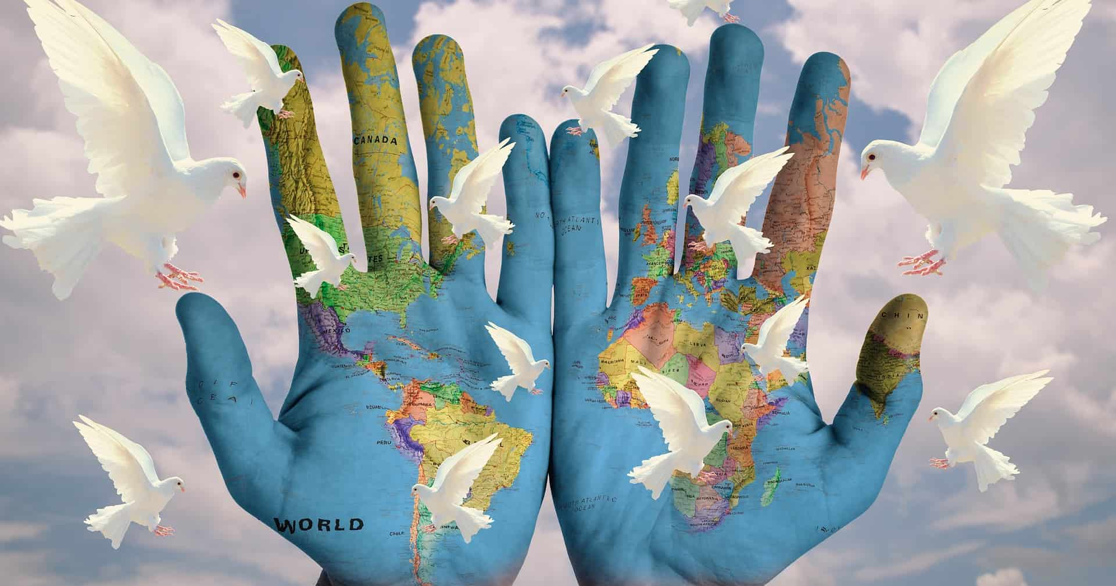
Thoughtful Thursday
Oh, Thursday already. Where does the time go? Maybe time to focus on where the week is going? Anything that needs to change?
Lord, do not simply say that you are with us.
Millions do not know you, and to those of us who do,
what is the difference?
What is the point of your presence
if our lives do not change?
Lord, I give you permission to change my life.
Amen
‘While they were still speaking about this, he stood in their midst and said to them, “Peace be with you.”’
Luke 24
Easter continues
Somewhere over the Rainbow

Slide 10
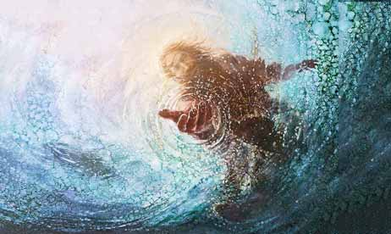
Fabulous Friday
Another week. How was it for you?. Reflect back on your successes and your challenges. Are you beginning Friday in the best place? If not, now’s the time to make it right. If so – then – Fantastic!
Loving Father,
In all of us there is a longing
for a life that has not yet come,
for a world that that is free and just,
for a dream of hope for all people.
May your Kingdom come.
Amen
Dorothy McMahon (adapted)
‘Jesus revealed himself again to his disciples at the Sea of Tiberias. He revealed himself in this way.’ John 21
Feed my sheep
My Lighthouse

Slide 11
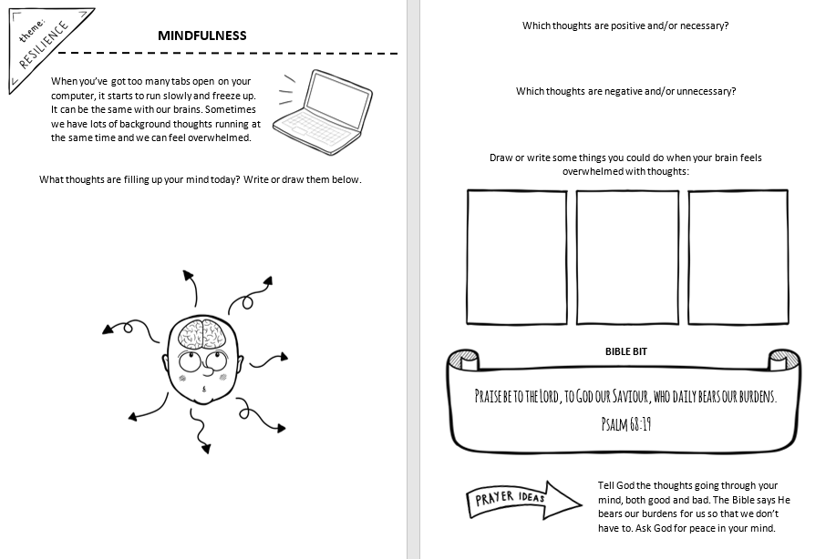

Slide 12
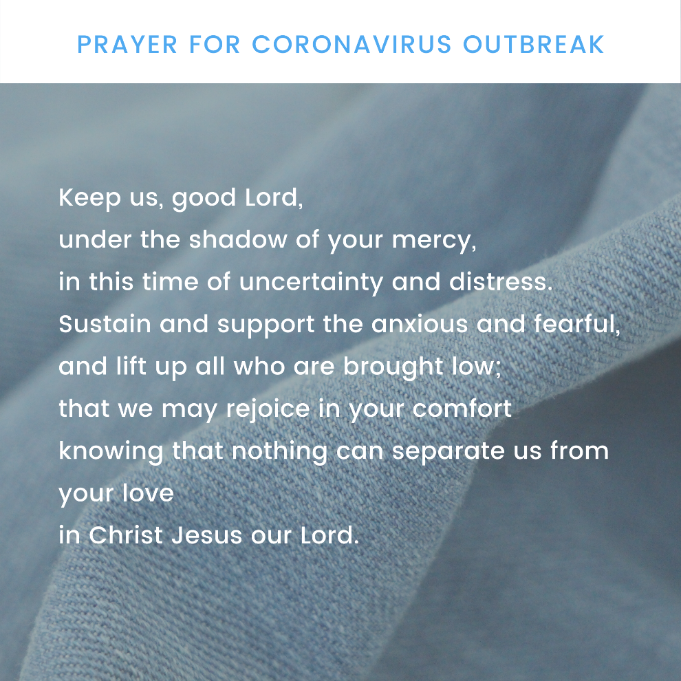
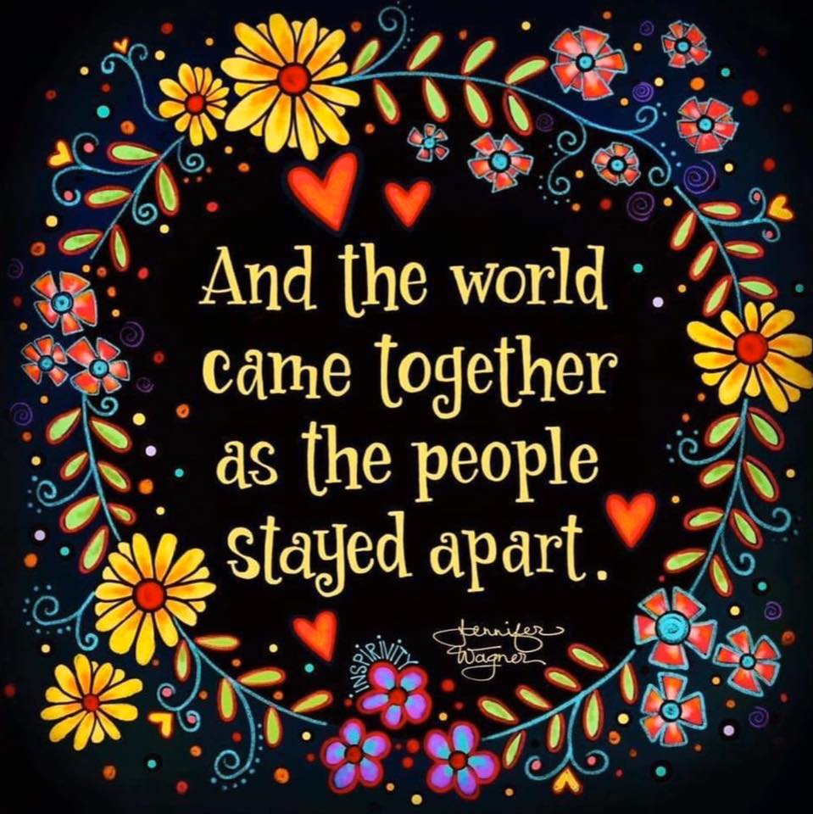
Simply Saturday
We pray today for all those affected by the Pandemic.
And add our own intentions to the prayers of the world.

