Slide 1

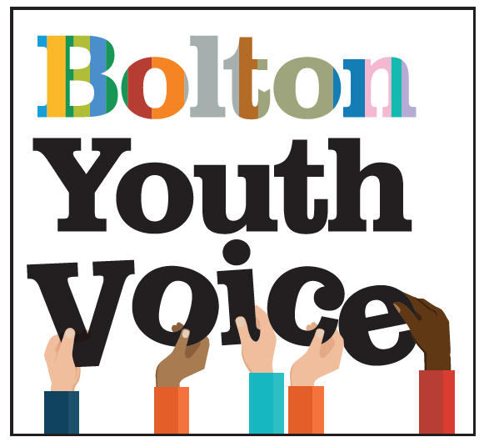



Welcome from Bolton Youth Voice
The Safeguarding Partnership Meeting
March 2022!
Bolton Youth council
Next Steps
Voice 4 U
Healthy Minds
TIME TO SHINE

Slide 2
WELCOME BACK!
Agenda
Ice Breaker
Introducing the theme of the Safety in Bolton.
Feedback on the Safety Consultation’s.
Bolton Youth Voice – Our focus for for the partnership
Respect ME!
Next Steps- Feedback from the partnership on how they can support
Next Steps -What does the partnership need from Us.
Closing words – AOB.

Slide 3



House Keeping

Slide 4

ICE BREAKER

Slide 5
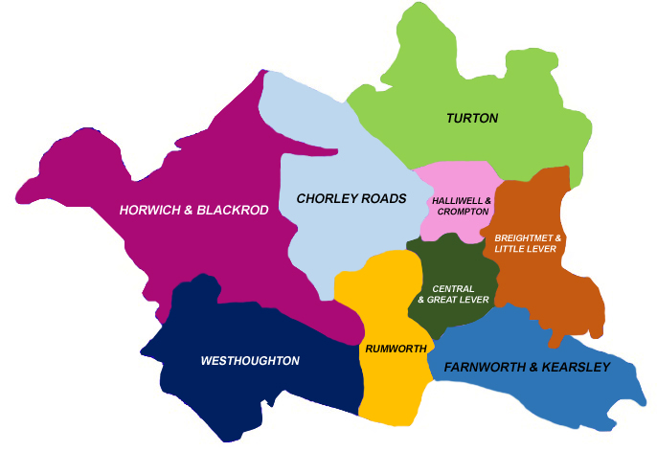
Safety Consultation
Horwich
Little Lever
Tonge Moor
Farnworth
Blackrod

Slide 6
What does safety mean to you?
Not feeling unsafe when I am by myself when walking alone.
Feeling safe in school and online
Being around people you trust
Going to places you feel safe and not being worried about anything happening
Nothing because no one really helps you
Being confident nothing will happen to you.
The ability to do things and not be at risk of injury or death.
Not having to look over your shoulder on a walk
Being mentally and physically safe
Being comfortable where you are
Not needing to lookover my shoulder or remove my headphones
Feeling comfortable in your area.
no chance of attack or being verbally or physically abused
to protect something or someone

Slide 7
Do you feel safe in Bolton?

Slide 8
Do you feel safe in Bolton?
In summary we had 56% of young people did not feel safe in Bolton with 13% feeling that the felt safe only sometimes.
With only 23% of young people in Bolton feeling safe which is alarming.
Sometimes because there has been allot of kidnaping and raping.
No because I’m scared, of the boys on Snapchat
No Because of Homophobic people.
Too many Roadmen.
No because there is always news of stabbings and rapes on social media.
No because of men who stick their hands up girls’ skirts.
-No because there is allot of kidnapping and raping on social media
No because there is always news of stabbings.

Slide 9
What Makes you feel unsafe in Bolton?

Slide 10

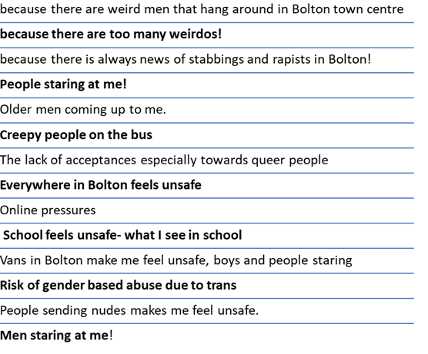

What Makes you feel unsafe in Bolton?
people online
Cat calling, unwanted attention
Bad experience in lay by with a male trying to assault me
Little lever- group trying to et me in the van!
No because people looking at me
Because men keep looking and whispering.
Older men coning to you doing weird things
Dark places make me feel unsafe
Bus station in town
Online pressures
School feels unsafe- what I see in school
Sometimes on the bus because these creepy people laugh at me and my friends
I know people who carry knives

Slide 11
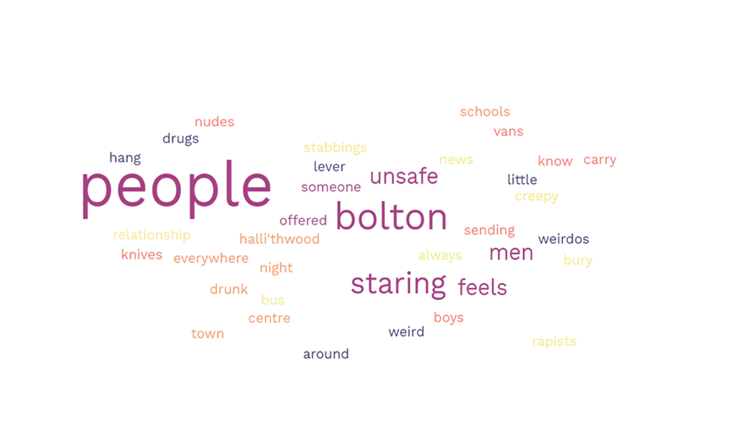

Slide 12
What is needed to make Bolton feel more safe?

Slide 13

2 Key Themes:
Gender Based Abuse/ Violence
Knife Crime and Violence

Slide 14

What makes a healthy relationship?
Notes:
Hi, I am Jess and I am originally from Bolton. I am 18 years old and a member of Bolton Youth Council. Today I will be delivering a project about Healthy relationships, developing healthy sexual boundaries and the concept of consent. So, a little bit about why this project is important, to me.
Throughout school, I witnessed the impact of first-hand peer pressures and some unhealthy attitudes to relationships. I also felt that there was a lack of support to address these areas within PSHE. So this project will aim to address some of these topics which might be sensitive at times but really need to be spoken about.
Throughout the session there will be a number of staff available, should you need support during or after the session. We are aware this information may be triggering or difficult for some people, so we will talk through all the services available should you need support and provide a hand-out with this information on at the end of the session.
Pastoral leads/Heads of Year are aware of the sessions taking place and the support that may be needed afterwards so should you want to access support at another time privately, you can.

Slide 15
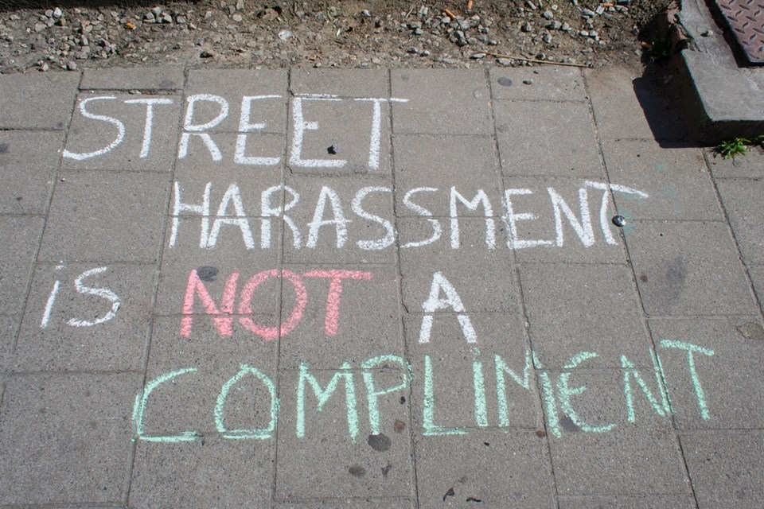
Street Harassment
Street harassment is unwanted comments, gestures, and actions forced on a stranger in a public place without consent.
This includes unwanted whistling, sexual names, comments and demands, following, flashing, groping, sexual assault and rape.
No form of harassment is ok. It is never a compliment.
2 out of 3 girls in the UK have been sexually harassed in public
35% of UK girls wearing school uniform have been sexually harassed in public
33% of UK girls who have been sexually harassed felt too embarrassed to tell anyone.
Notes:
Public street harassment happens too often, and we don’t speak about it enough. It’s important to recognise that complaining or being upset about receiving harassment in the street is not ‘being sensitive’ and the worry is that lots of people aren’t recognising some of these behaviours as sexual harassment or harmful.
‘Ofsted consulted with 32 Unnamed schools and results highlighted when speaking to young people that nine out of ten girls and half the boys that took place in this review said that they had been sent unsolicited explicit pictures also known as ‘ *ick picks’ or videos happens allot or sometimes to them or their friends.’
So what is Public Sexual Harassment? This is unwanted comments, Gestures and actions forced on a stranger in a public place without consent.
Image: (Jess to create image for slogan) We are not cats, its public sexual harassment, not cat calling.
It is more than someone saying something inappropriate.
Click Video- From Buzz Feed to be shown on the impacts of Cat Calling and Young people’s experiences.

Slide 16
‘Ofsted consulted with 32 Unnamed schools and it was significantly alarming that:
Nine out of ten girls and half the boys that took place in this review said that they had been sent unsolicited explicit pictures
Which is often referred to as *ick pics by young people.
They said this happens allot or sometimes to them or their friends.’
No form of harassment is ok. It is never a compliment.
Notes:
Jacob and Eliza are at home. Eliza tries to become sexual with Jacob. Jacob doesn’t want to so he tries to pull away. However, after some persistence from Eliza, he feels pressure to go along with this against his wishes.
In this scenario of Jacob and Eliza, it is important that we recognise that bot parties must always consent to any sexual or intimate act and that neither party feels pressured or fearful of their partners response.

Slide 17
“We are not cats, its public sexual harassment, NOT cat calling!! ”
Notes:
Jacob and Eliza are at home. Eliza tries to become sexual with Jacob. Jacob doesn’t want to so he tries to pull away. However, after some persistence from Eliza, he feels pressure to go along with this against his wishes.
In this scenario of Jacob and Eliza, it is important that we recognise that bot parties must always consent to any sexual or intimate act and that neither party feels pressured or fearful of their partners response.

Slide 18
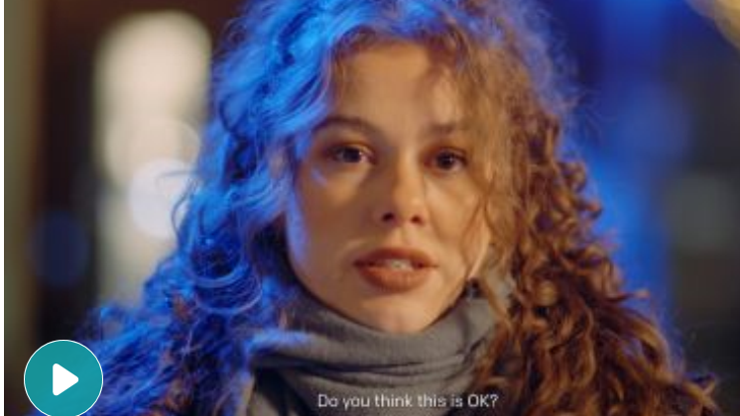

Slide 19
What can I do if street harassment happens to me?
Go Somewhere Safe
If you feel like you’re being followed or that you’re physically unsafe, going to a local business, store or coffee shop where the harasser may feel discouraged from approaching you.
Report
If street harassment happens outside a business or on public transportation, you can report that behaviour. If you can guess the employer of the person, you can report the harassment to the company. Some forms of street harassment, such as groping, flashing and following are legally recognisable.
Notes:
What can you do if you experience street harassment?
Go Somewhere Safe
If you feel like you’re being followed or that you’re physically unsafe, going to a local business, store or coffee shop where the harasser may feel discouraged from approaching you.
Report
If street harassment happens outside a business or on public transportation, you can report that behaviour. If you can guess the employer of the person, you can report the harassment to the company. Some forms of street harassment, such as groping, flashing and following are legally recognisable.

Slide 20
How to help if you see someone else getting street harassed:
Notify an adult
If you can, call out the harasser on what they did and say why it was not ok.
Check in with the person being harassed
Check in with the person being harassed to make sure that they are ok and if they need any help.
Never blame the victim
The best thing you can do is listen to the victim without judgement and tell them they did not deserve what happened.
Notes:
How can you help If you see someone being street harassed?
Notify an adult - If you can, call out the harasser on what they did and say why it was not ok.
Check in with the person being harassed - Check in with the person being harassed to make sure that they are ok and if they need any help.
Never blame the victim - The best thing you can do is listen to the victim without judgement and tell them they did not deserve what happened.

Slide 21
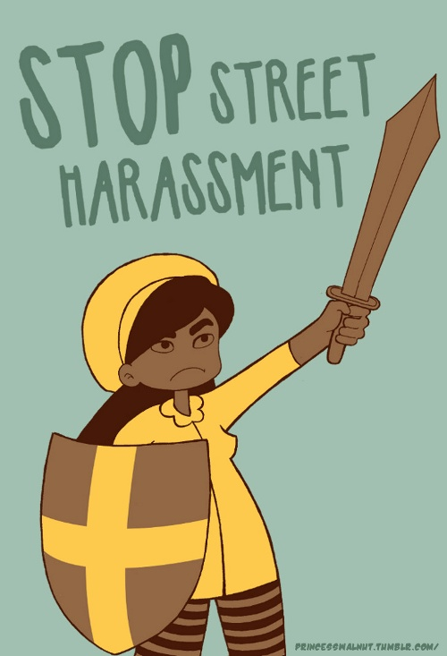
Whilst the statistics show that there is a higher prevalence of females suffering public sexual harassment, It imperative to note that Public sexual harassment can happen to anyone regardless of:
Gender
Sexual orientation
Religion
Ethnicity.
Social Economic Status
Notes:
Whilst the statistics show that there is a higher prevalence of females suffering public sexual harassment, It imperative to note that Public sexual harassment can happen to anyone regardless of
-Gender
-Sexual orientation
-Religion
-Ethnicity.
-social Economic status.
We want young people to feel safe on our streets and in our schools. Some students we acknowledge may not feel safe in school so in order to combat this, teachers have shown their support and understanding around these topics discussed today in the hope to encourage young people to seek support about these issues.
We have set up a Pledge wall in the ……….Location………., we encourage you to read your teachers pledges to listen to and respond to these issues to keep you safe.

Slide 22

Revenge Porn
What is revenge porn?
revealing or sexually explicit images or videos of a person posted on the internet, typically by a former sexual partner, without the consent of the subject and in order to cause them distress or embarrassment
the Criminal Justice and Courts Act, 2015 made “the distribution of a private sexual image of someone without their consent and with the intention of causing them distress” a specific criminal offence.
15% of Britons between the age 18 to 15 surveyed said intimate sexual pictures of them had been shared without consent.
Notes:
Revenge Porn is the sharing of private, sexual material either photos or videos of another person without their consent and with the purpose of causing embarrassment or distress. The images are sometimes accompanied with personal information such as name, address, or social media link. This includes the sharing off and online, uploading images to the internet and sharing via text, email or showing someone an electronic version of the image.

Slide 23
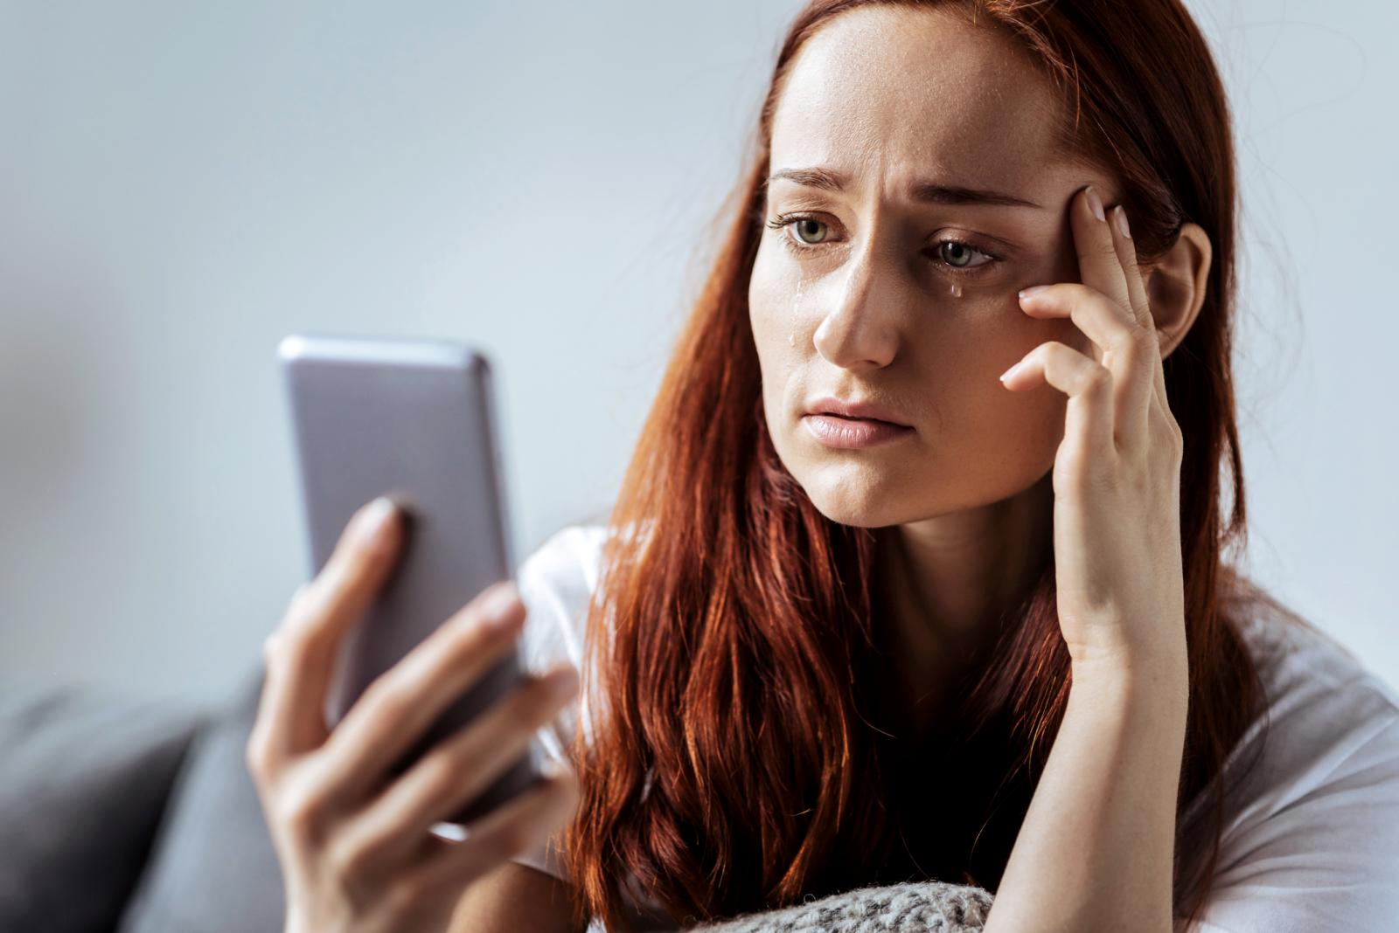
Effects of being a victim of revenge porn:
Emotional distress
Humiliation
Embarrassment
School absence and withdrawal
Body shame
Loss of relationships
Isolation
Mental health difficulties like low mood and anxiety
Notes:
When looking at revenge porn it will look at this from a number of perspectives. The first we will look at is the victim.
So we need to ask what is the impact to the victim;
-Emotional distress
-Humiliation
Embarrassment
School absence and withdrawal
Body shame
Loss of relationships
Isolation
Mental health difficulties like low mood and anxiety

Slide 24
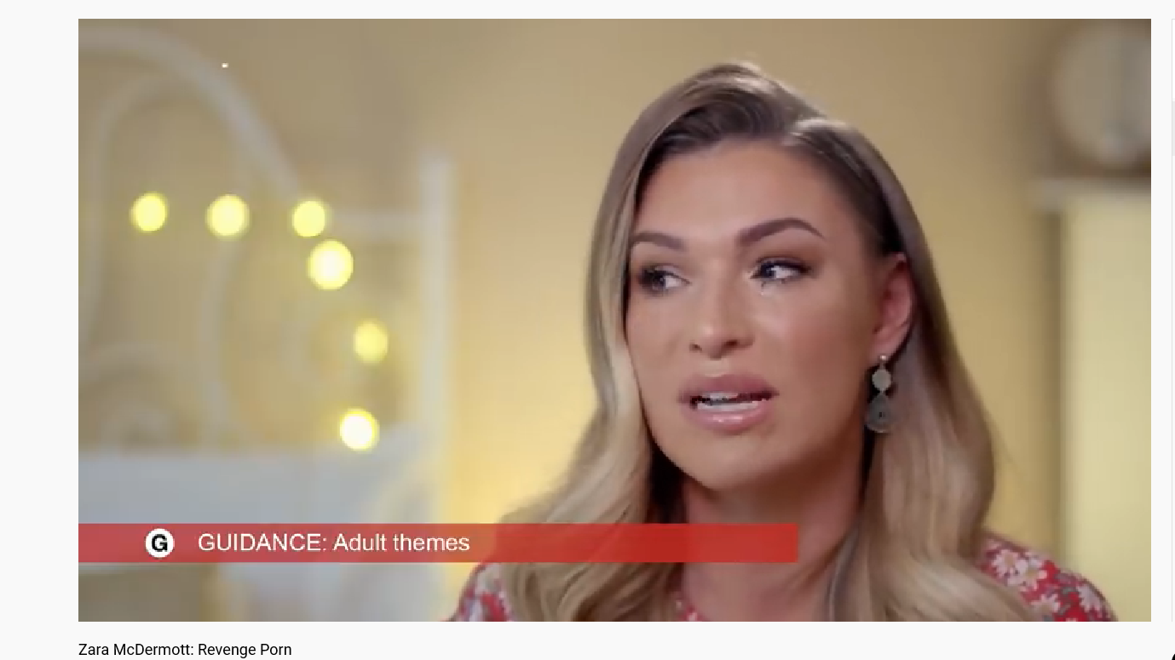
https://www.youtube.com/watch?v=v0FIAj_fFeI&list=PLalL1C-0oQlNfYTC117YNV9bljebzLZe_&index=1

Slide 25
Consequences of distributing revenge porn:
There are criminal consequences of sharing revenge porn. Those found guilty could face up to two years imprisonment.
Sharing of images could lead the person sharing this to struggle with trust in future relationships leading to unhealthy relationships being developed.
It is imperative to recognise the pressures from peers to share images, and the impacts if you are to share an image of someone else, YOU will be accountable, you are responsible.
Notes:
Next, we will look at the image of revenge porn on the person who shares or distributes the video/image.
It is important to be aware that revenge porn is a crime and there are criminal consequences for this act. Those found guilty of this crime could face up to 2 years imprisonment.
Sharing of images could lead the person sharing this to struggle with trust in future relationships leading to unhealthy relationships being developed.
It is imperative to recognise the pressures from peers to share images, and the impacts if you are to share an image of someone else, YOU will be accountable, you are responsible.

Slide 26


Things we should say to respond and support.
It is not okay, that this has happened
This should not have happened.
There is support to help with this
It is not your fault.
Do you want to report this to the Police.
There are people here to support you through this.
Things we should NOT say
It is because of what you wear
You’re an attention seeker
You deserve it
You where stupid, what did you do it for
It’s just a joke
It’s no big deal
We MUST avoid victim blaming and making the victim feel shame

Slide 27

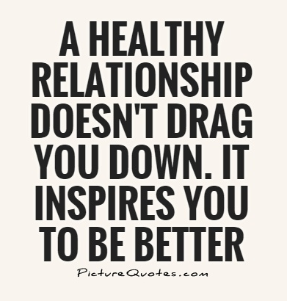
WHAT TRAITS MAKE A RELATIONSHIP HEALTHY?
Healthy relationships should make you feel good about yourself and your partner.
A healthy relationship should have trust, consent, compassion, equality, and respect.
TASK: On your table, there should be some cards which have examples of behaviours in unhealthy relationships. We have given you some hand out scenarios on. Can you match scenarios with the unhealthy behaviours (some scenarios fit more than one behaviour).
Notes:
Traits of unhealthy relationships.
Generally, people have an idea of what a healthy relationship looks like but sometimes are unable to self-reflect and put this into action within their own relationship. When you have emotional attachment to someone it is important that what we consider as a healthy relationship doesn’t become blurred and to ensure that we can identify when unhealthy behaviours and attitudes arise.
In front of you are some behaviours of an unhealthy relationship. We have also given you a handout with some scenarios on. What we are asking is if you can match up the scenario with the behaviour.

Slide 28
Scenario 1:
Sarah wants to see David this weekend, however David has a test on Monday which he has to revise for. Sarah gets frustrated with David until he gives in and agrees to see her.
What traits of an unhealthy relationship are shown in this scenario?
Notes:
Sarah wants to see David this weekend, however David has a test on Monday which he has to revise for Sarah gets frustrated with David until he gives in and agrees so see her.
In a healthy relationship, though it’s understandable that you would want to see your partner allot, you should respect their independence also. So the concern in this scenario is that David is being pressured to do something that he doesn’t want to do.

Slide 29

In a healthy relationship, though it’s understandable that you would want to see your partner a lot, you should also respect their independence. So the concern in this scenario is that David is being pressured to do something that he doesn’t want to do.
In a healthy relationship, though it’s understandable that you would want to see your partner a lot, you should also respect their independence. So the concern in this scenario is that David is being pressured to do something that he doesn’t want to do.

Slide 30
Scenario 2:
Ben and Javinda are in a relationship, Javinda has plans to see some friends who Ben does not like. Ben tells Javinda that I she doesn’t stay home with him this evening that he would hurt himself.
What traits of an unhealthy relationship are shown in this scenario?
Notes:
Ben and Javinda are in a relationship, Javinda has plans to see some friends who Ben does not like. Ben tells Javinda that I she doesn’t stay home with him this evening that he would hurt himself.
It is really important that some people require support with their mental health, however it is important that this does not become at the expense of your own emotional well-being. The issue here is that Ben is using his emotional health difficulties to manipulate Javinda into staying home,

Slide 31
It is really important that some people get support with their mental health, however it is important that this does not become at the expense of your own emotional well-being. The issue here is that Ben is using his emotional health difficulties to manipulate Javinda into staying home.

Slide 32
Scenario 3:
Liz has heard a rumour in school that her girlfriend Amelia has kissed someone at a party. When Liz asks Amelia about this rumour, Amelia tells Liz that she is insecure and always overreacts about things.
What traits of an unhealthy relationship are shown in this scenario?
Notes:
Liz has heard a rumour in school that her girlfriend Amelia has kissed someone at a party. When Liz asks Amelia about this rumour, Amelia tells Liz that she is insecure and always overreacts about things.
It is really important that some people require support with their mental health, however it is important that this does not become at the expense of your own emotional well-being. The issue here is that Ben is using his emotional health difficulties to manipulate Javinda into staying home.

Slide 33
The issue here is that Amelia is minimising legitimate concern and making Liz feel like she is the problem, lying and being deceitful.

Slide 34
Scenario 4:
Jacob and Eliza are at home. Eliza tries to become sexual with Jacob. Jacob doesn’t want to so he tries to pull away. However, after some persistence from Eliza, he feels pressure to go along with this against his wishes.
What traits of an unhealthy relationship are shown in this scenario?
Notes:
Jacob and Eliza are at home. Eliza tries to become sexual with Jacob. Jacob doesn’t want to so he tries to pull away. However, after some persistence from Eliza, he feels pressure to go along with this against his wishes.
In this scenario of Jacob and Eliza, it is important that we recognise that bot parties must always consent to any sexual or intimate act and that neither party feels pressured or fearful of their partners response.

Slide 35
In this scenario of Jacob and Eliza, it is important that we recognise that bot parties must always consent to any sexual or intimate act and that neither party feels pressured or fearful of their partners response.

Slide 36
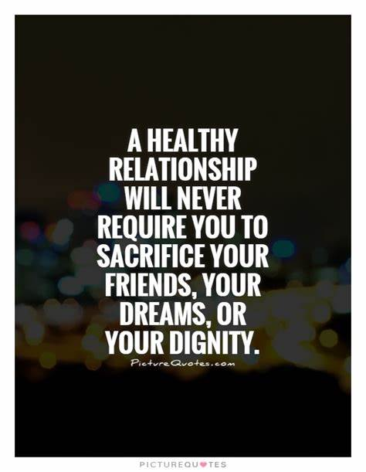
THE EFFECTS OF UNHEALTHY RELATIONSHIPS:
Erosion of self worth
Insecurity
Stress
Low mood
Anxiety
Unstable lifestyle
Isolation
Low self esteem
Notes:
Some effects of Unhealthy Relationships are
- Erosion of self-worth
- Unstable Lifestyle
- Insecurity
- Isolation
- Stress
- Low Mood
- Low Self esteem
- Anxiety

Slide 37

Notes:
When speaking about the concept of consent the most important message is
‘its okay to say no.’
In this activity we want you to identify if consent is required?

Slide 38
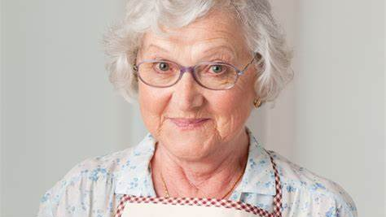
YOUR GRANDMA OFFERS YOU A BISCUIT AND YOU DON’T WANT ONE
Notes:
Your grandma offers you a biscuit and you don’t want one.

Slide 39
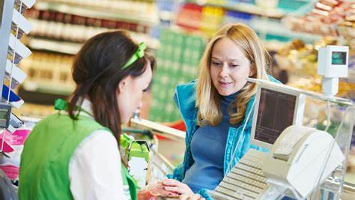
WHEN SOMEONE AT THE STORE ASKS IF YOU’D LIKE A BAG WITH YOUR SHOPPING
Notes:
When someone at the store asks if you’d like a shopping bag with your shopping

Slide 40

WHEN YOUR FRIEND ASKS TO BORROW A PENCIL BUT YOU DON’T HAVE A SPARE
Notes:
When your friend asks to borrow a pencil but you don’t have a spare

Slide 41
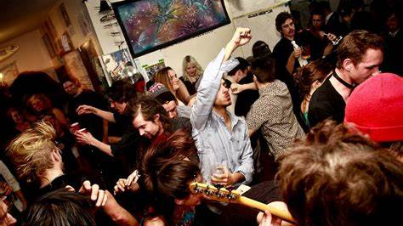
WHEN SOMEONE YOU DON’T FANCY TRIES TO KISS YOU AT A PARTY
Notes:
When someone you don’t fancy tries to kiss you at a party

Slide 42
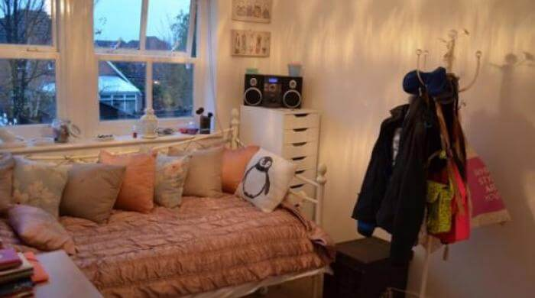
WHEN YOUR PARTNER WANTS TO BE SEXUAL BUT YOU DON’T WANT TO
Notes:
When your partner wants to be sexual but you don’t want to.

Slide 43

Saying no is not a bad thing!
Someone saying NO to you is not a bad thing, it is good that they are asking for consent.
Notes:
Saying No is not a bad thing
Someone saying NO to you is not a bad thing, it is good that you are thinking about and asking for consent

Slide 44
The legal definition of consent is when someone agrees to sexual activity by choice and has the freedom and capacity to make that decision by choice.
Consent looks like:
The person you are asking consent enthusiastically saying yes.
Talking to your partner about what you do and do not want and listening to them in return.
Checking if your partner is okay.
Consent does not look like:
Having sex when someone is unconscious or asleep
Feeling like you have to say yes due to fear of someone’s reaction.
Assuming someone wants to have sexual intercourse.
Taking a condom off in sex when you agree to use on.
Notes:
The legal definition of consent is when someone agrees to sexual activity by choice and has the freedom and capacity to make that decision by choice.
So we ask , What does consent look like?
The person you are asking consent from enthusiastically saying yes
Talking to your partner about what you do and do not want to do and listening to them in return and their wishes.
Checking if your partner is okay.
Consent Does not look like:
Having sex when someone is unconscious or asleep
Feeling like you have to say yes due to fear of someone’s reaction
Carrying on with sexual activity when the person is showing cues such as appearing uncomfortable or pulling away. Someone assuming that you want sexual intercourse.
Taking a condom off in sex when you agree to use one.

Slide 45
Stereotypes
“Teachers and adults don’t understand these issues!”
“only men can be abusive in relationships.”
FALSE
FALSE
FALSE
“all men are sexist.”
“only attractive women receive public street harassment.”
FALSE
“victims always act in a certain way. If you don’t cry, you can’t be a victim!”
FALSE
“You have to be sexual in a relationship.”
FALSE
Notes:
In this next section we want to look at some harmful norms and stereotypes that we wish to destabilise.
“Only men are abusive in relationships”
“Victims always act in one way- Crying etc”
“Teachers and adults don’t understand”
“Women Lie about Rape”
“You have to be sexual to be in a relationship”
“All men are sexist”
“Only attractive women receive public street harassment”
Have a think in private about any other stereotypes you may have heard

Slide 46
Services and Support
If you, or someone you know, is affected by gender-based violence please call Greater Manchester Victims’ Services on 0161 200 1950 for help and advice or visit gmvictims.org.uk. Please remember, you on their 24/7 Supportline – 0808 1689 111 - or via their live chat facility. If you, or someone you know, has come to harm or is at risk of coming to harm, you can report this to Greater Manchester Police via GMP’s Livechat facility at gmp.police.uk or call 101. If you, or someone else is in immediate danger always dial 999. If you are calling 999 from a mobile phone and you are unable to speak, you can use the Silent Solution by pressing 55 when prompted. Once you press 55, the operator will then transfer the call to the relevant police force as an emergency.

Slide 47
Services and Support
Domestic abuse and violence: Greater Manchester's Domestic Abuse Helpline 0800 254 0909 Website: www.domesticabusehelpline.co.uk Men’s Advice Line 0808 801 0327 Website: www.mensadviceline.org.uk 24-hour National Domestic Violence Freephone Helpline 0808 2000 247 Website: www.nationaldahelpline.org.uk Galop Galop provide help, advice and support for LGBT victims of domestic abuse. 0207 704 2040 Website: www.galop.org.uk

Slide 48
Services and Support
Rape or sexual assault: St Mary’s Sexual Assault Referral Centre (SARC) 24 hour helpline 0161 276 6515 Website: www.stmaryscentre.org Survivors Manchester UK Helping male victims of sexual assault and abuse to break the silence. 0808 800 5005 Website: www.survivorsmanchester.org.uk
Forced marriage and so-called honour-based violence: Karma Nirvana Karma Nirvana is a UK registered charity that supports victims and survivors of Forced Marriage and Honour Based Abuse. 0800 5999247 Website: www.karmanirvana.org.uk/get-help/helpline

Slide 49
Services and Support
Female Genital Mutilation: The Guardian Project A free service covering the whole of Greater Manchester. It provides care and support for women and girls who may be at risk from, or who have been victims of, female genital mutilation. 07449 651 677 Email guardian.project@outlook.com
Bekindtomymind https://www.bekindtomymind.co.uk/ Fort Alice 01204 365 677 (Fort Alice provide advice and support around domestic abuse in Bolton) https://fortalice.org.uk/

Slide 50
Next Steps –
Focal Points for The Safeguarding Partnership
Priority Next Steps: The Next steps are going to be generic and will be asking the board? As a partnership how can you lead to embed this work across our community, including schools, youth clubs and online etc? Honest Feedback on the Resource developed- Respect me? To identify an agency to develop a fold away leaflet that could be given to young people, Parents, and professionals -which will coincide with the Respect Me programme. How can we ensure that we add to the work of Andy Burnham’s Is this okay to ensure that this message is heard Bolton and how can each agency support to embed the Greater Manchester Gender based abuse strategy? Further Next Steps for the partnership to discuss: Knife crime- How can we stop this from being normalised in Bolton? From a community safety perspective –Dark spaces where identified as factors impacting a feeling of safety, how can we address Street Lighting? Young people have shared feeling unsafe due to lack of education and understanding around LGBTQ+ Can we take this on a theme for the next partnership?

Slide 51
Next Steps –
What does the safeguarding partnership need from Bolton Youth Voice?

Slide 52
AOB:
Closing Words

