Slide 1



Slide 2
I won't forget a single one of them. Not ever.'

Slide 3
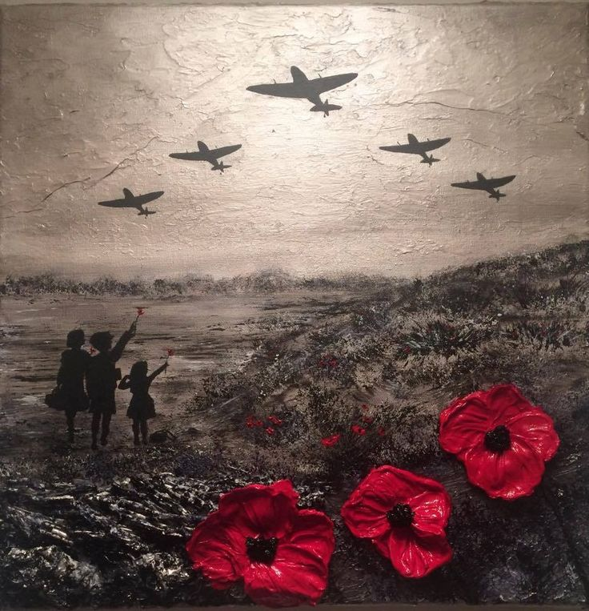
Turn our thoughts on this occasion to those who fought and died in the war.
Years have passed and time has forgotten, but we will remember the soldiers once more.

Slide 4
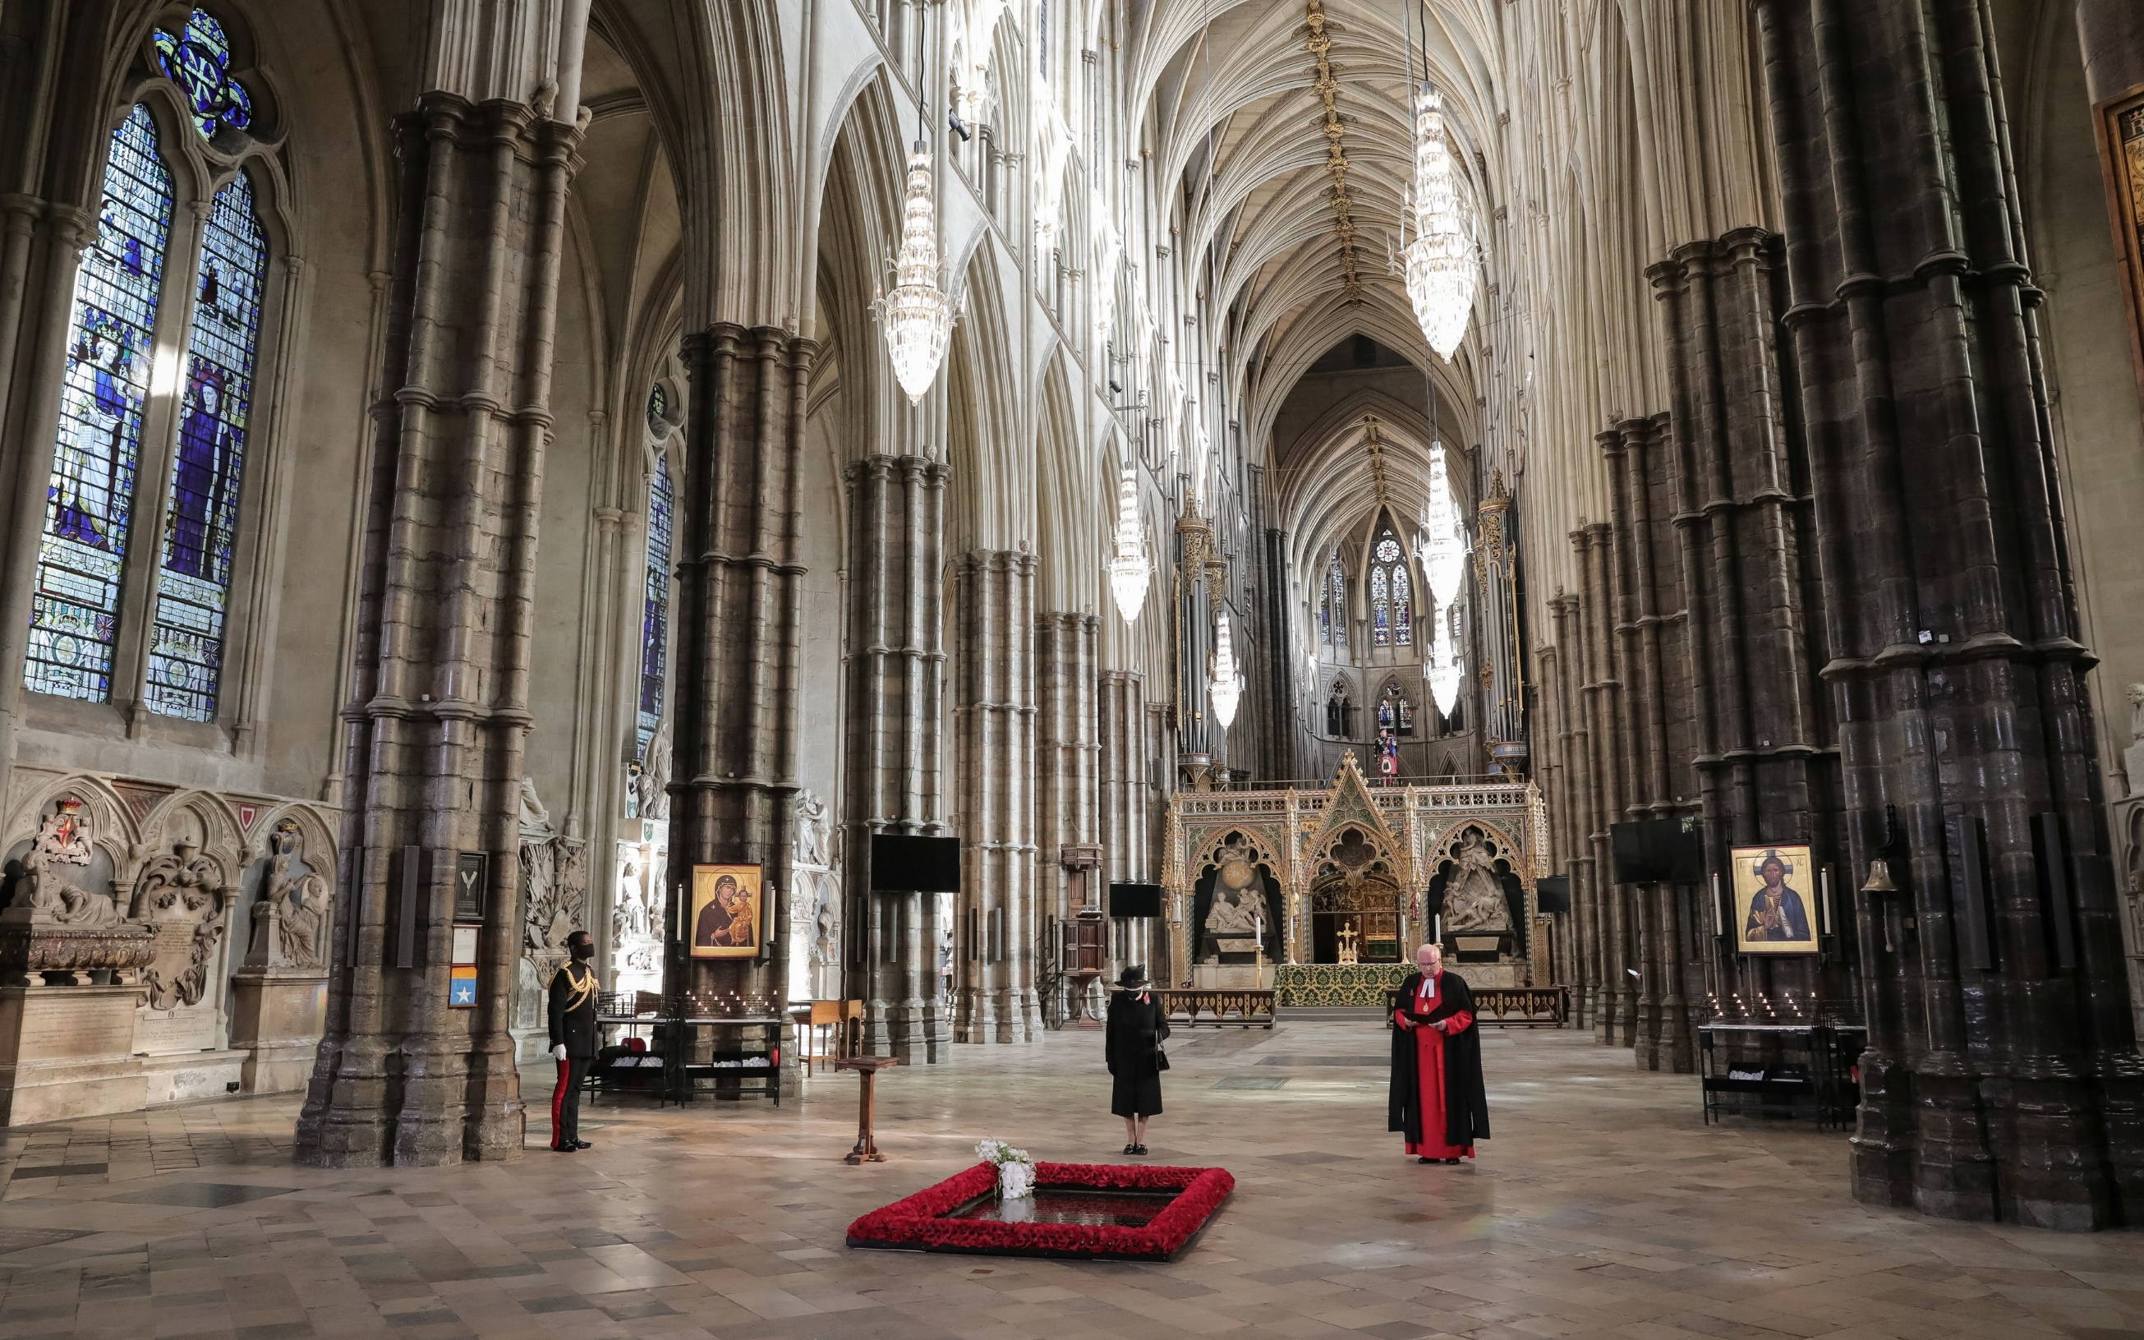
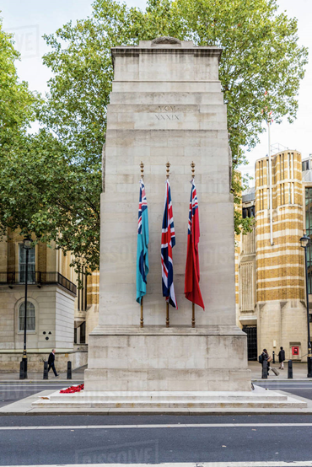

Slide 5
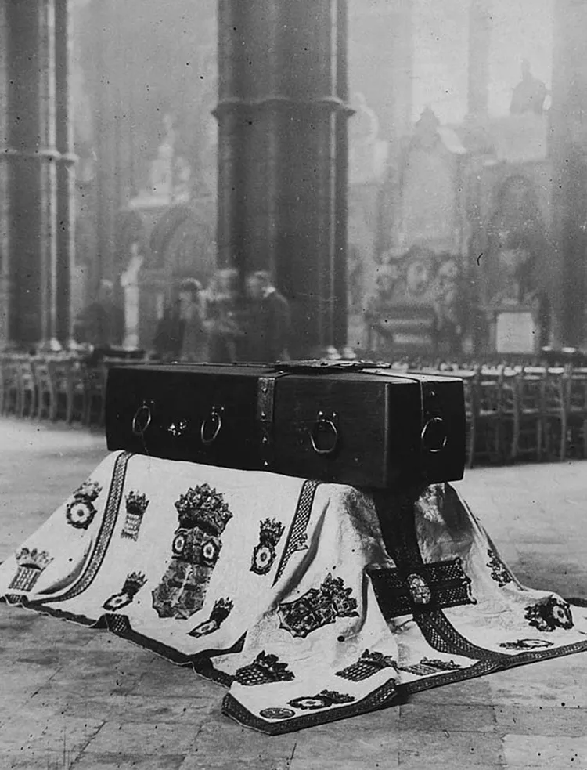
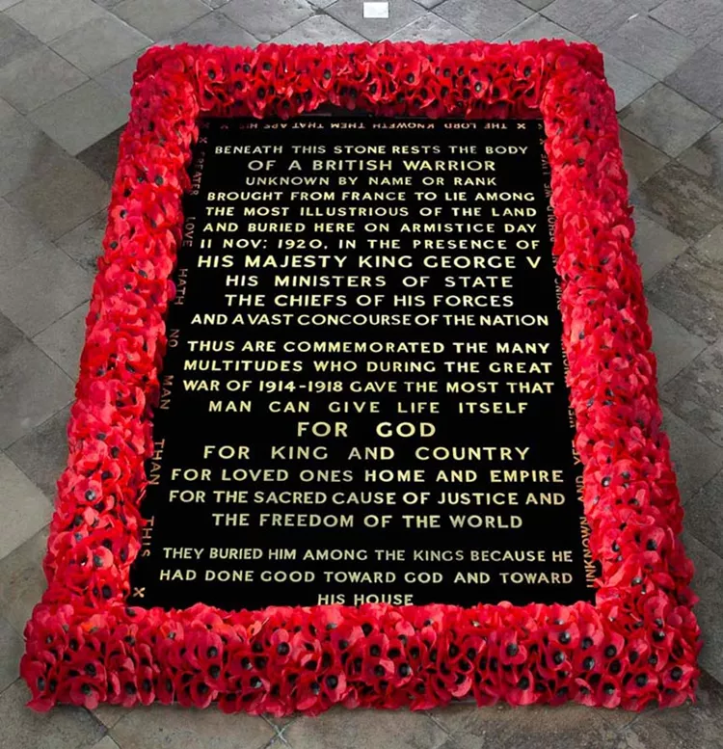

Slide 6
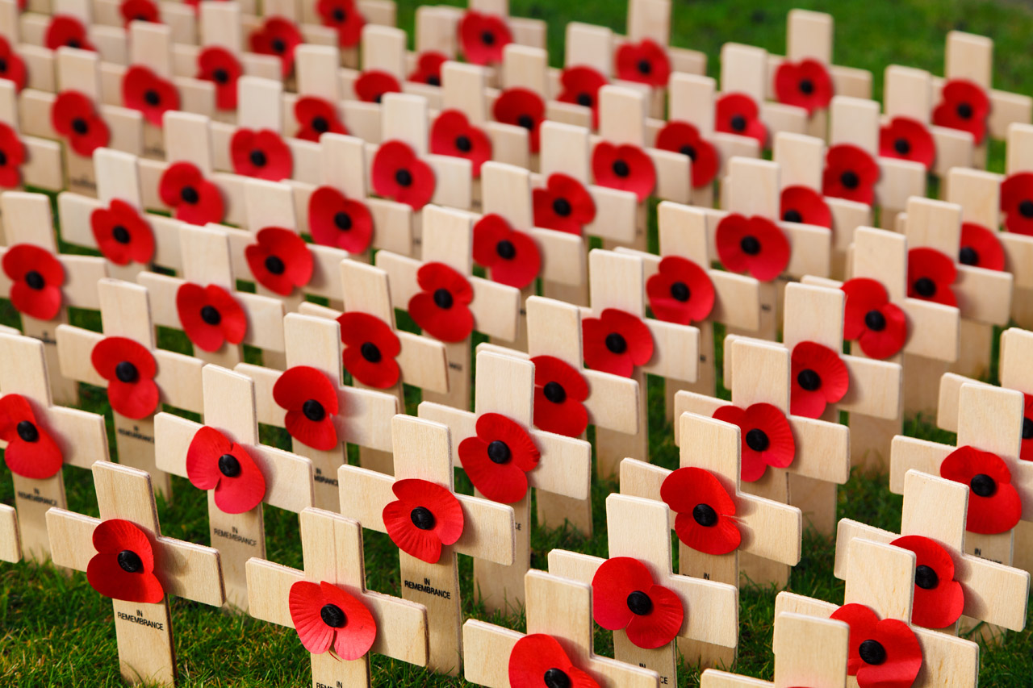
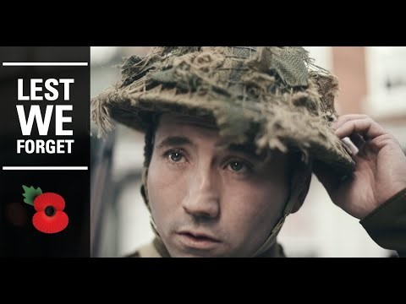

Slide 7

Our response is………
God Give Peace

Slide 8


