Slide 1

Celebrating our …….
Year 6

Slide 2
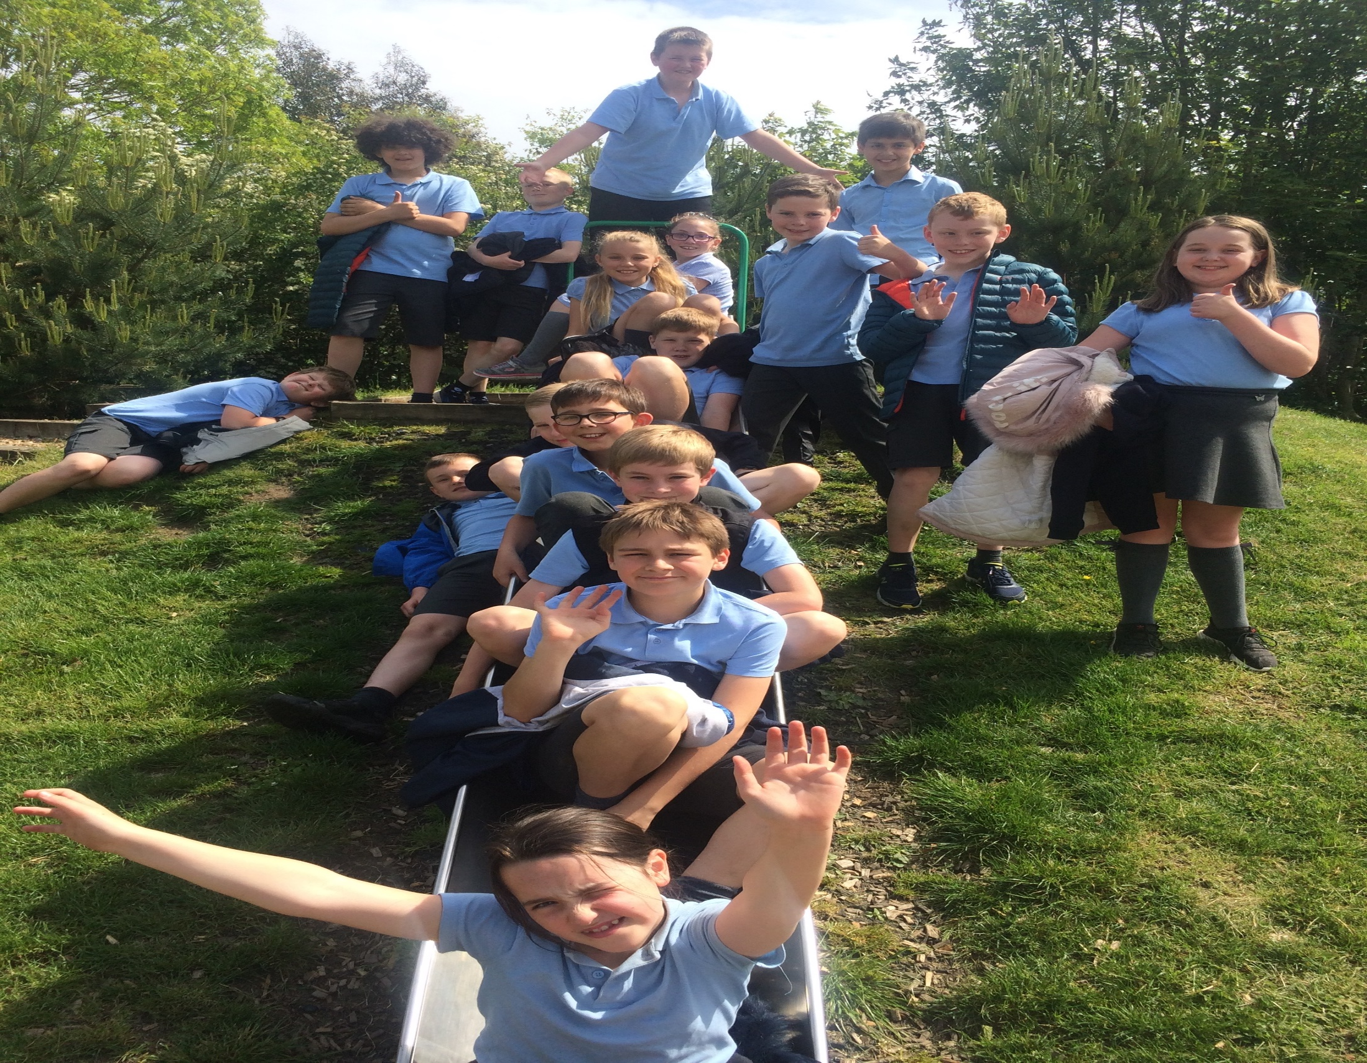

Slide 3

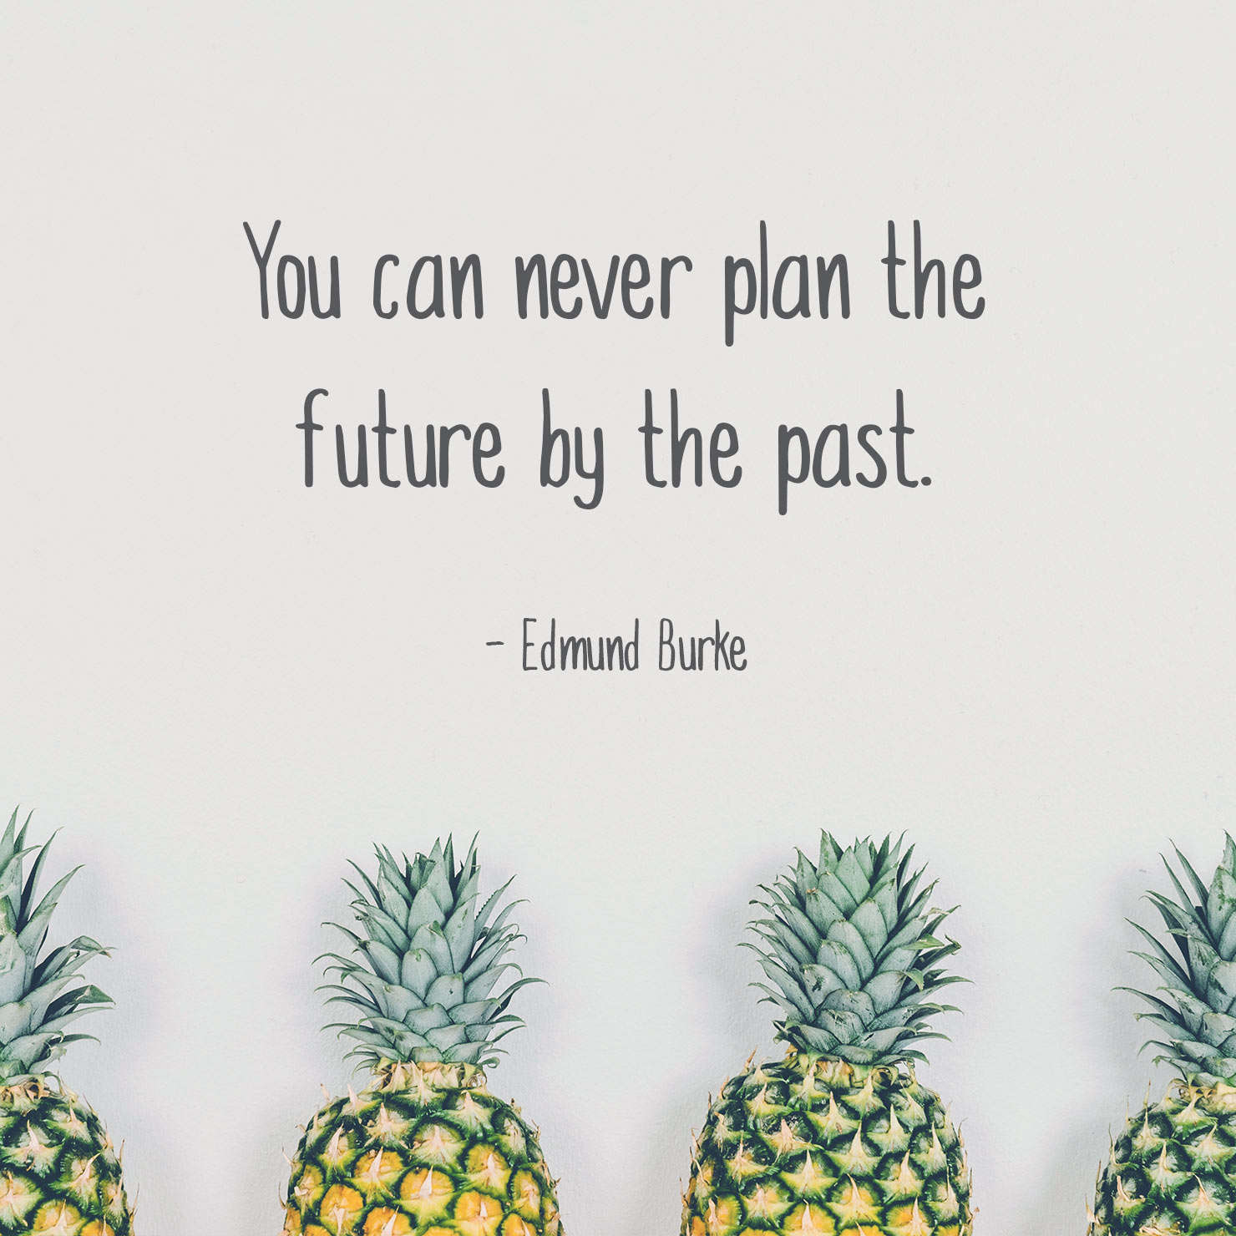

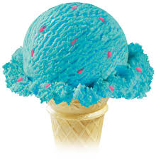

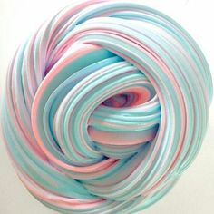
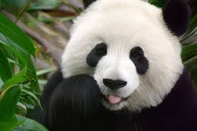
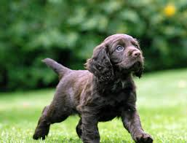
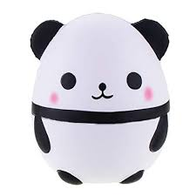
Arianna Pope
Bishop Rawstorne
Favourite things
.pandas

Slide 4
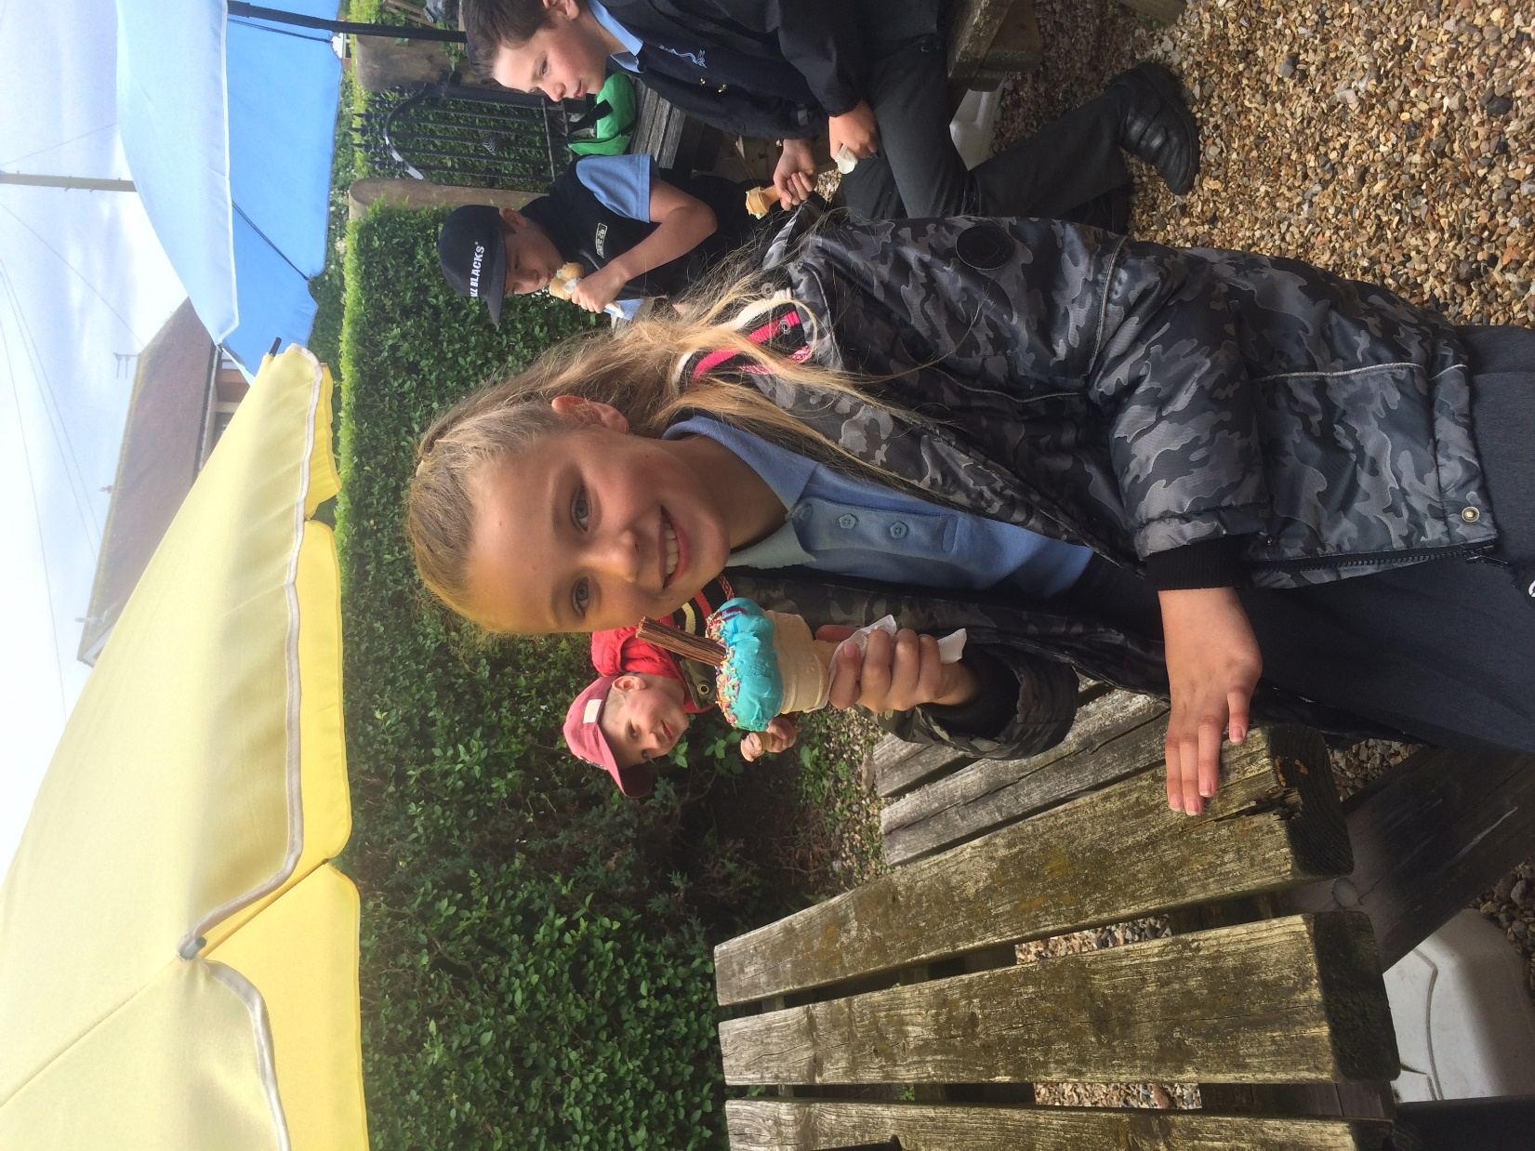

Slide 5
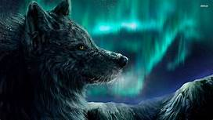

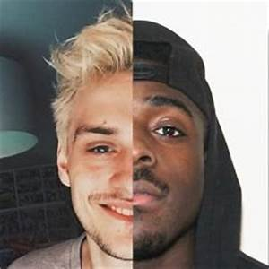
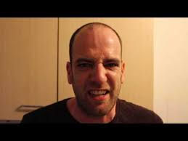
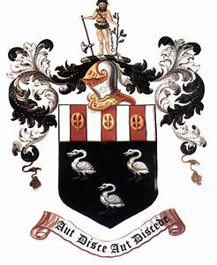
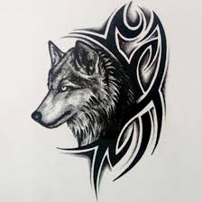
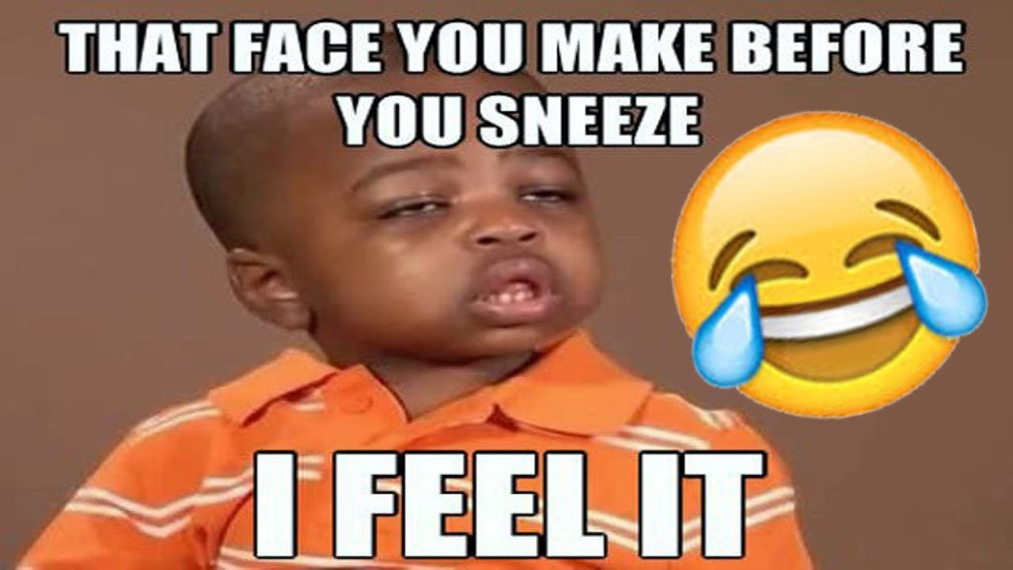
Going to Hutton Grammar School
Adam Bagwell
Interests: memes symbolism wolves and rampworx skatepark
‘Those who don’t know the value of loyalty can never truly appreciate the cost of betrayal.’

Slide 6
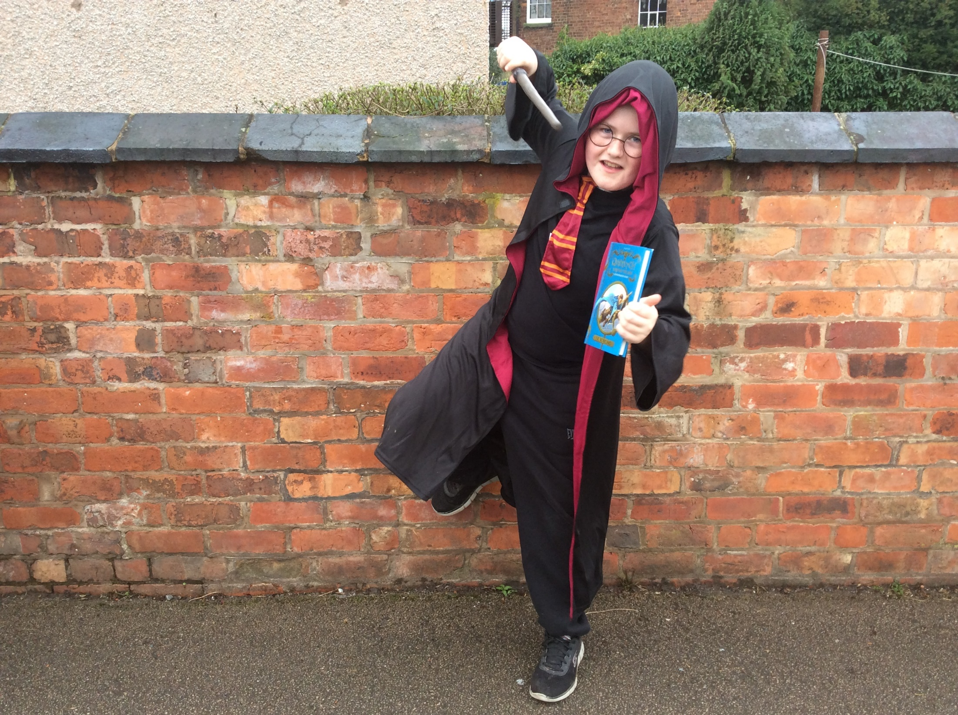

Slide 7
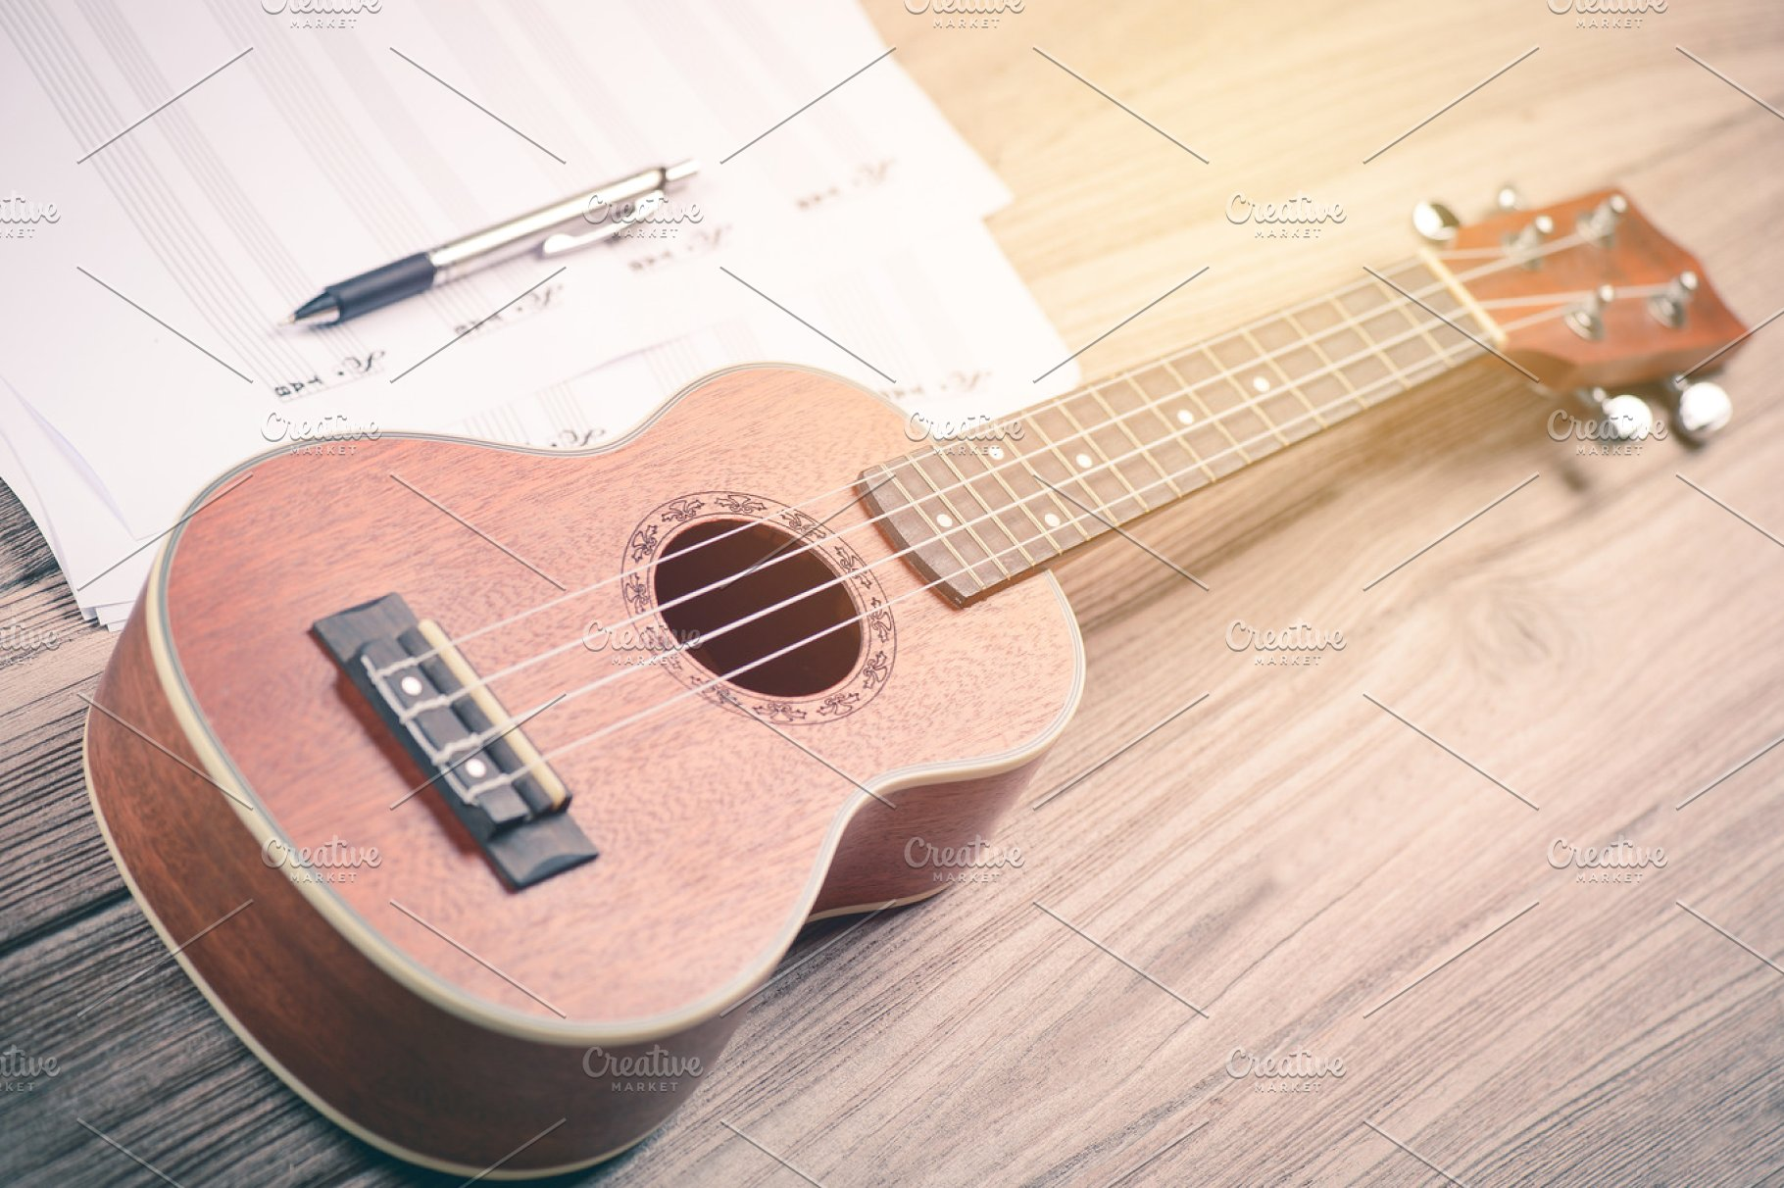

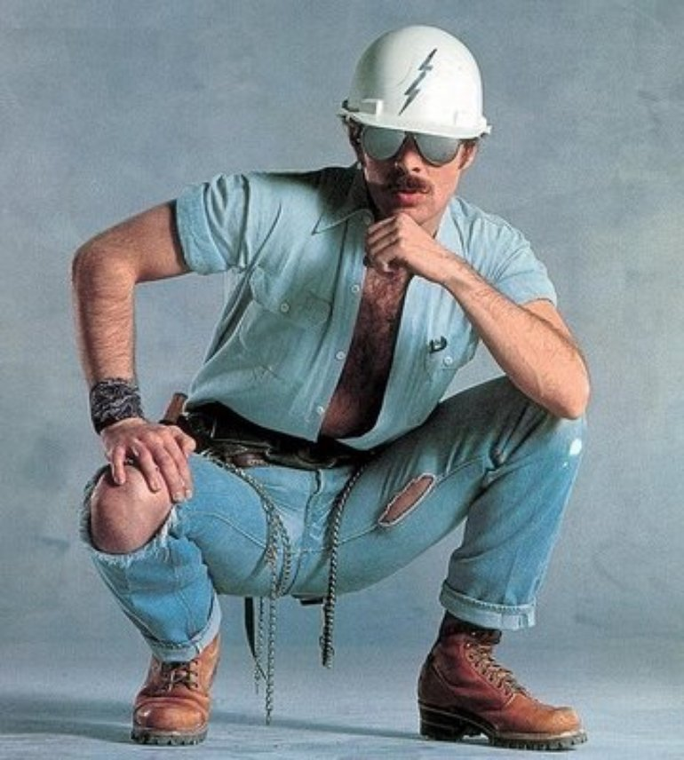

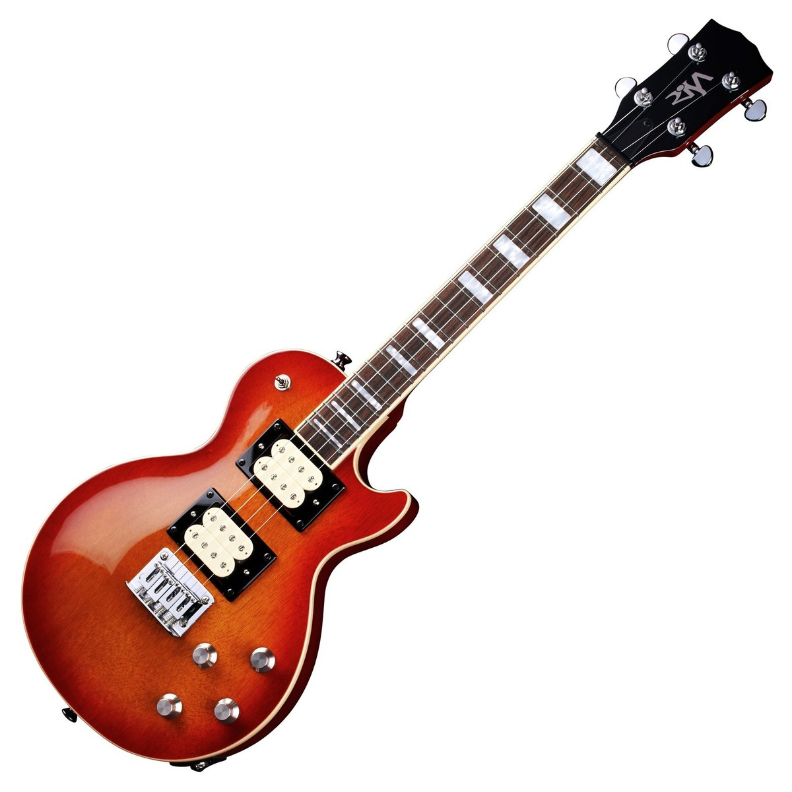
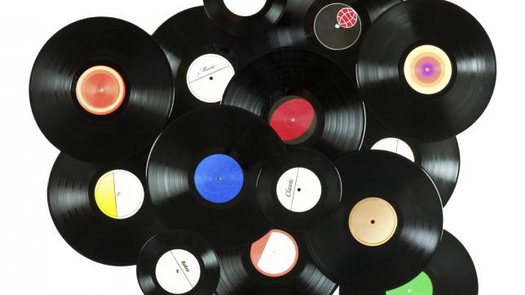
I would like to be a musician and I'm always spinning records.
I’m going to Bishop Rawstorne
Archie Scott

Slide 8
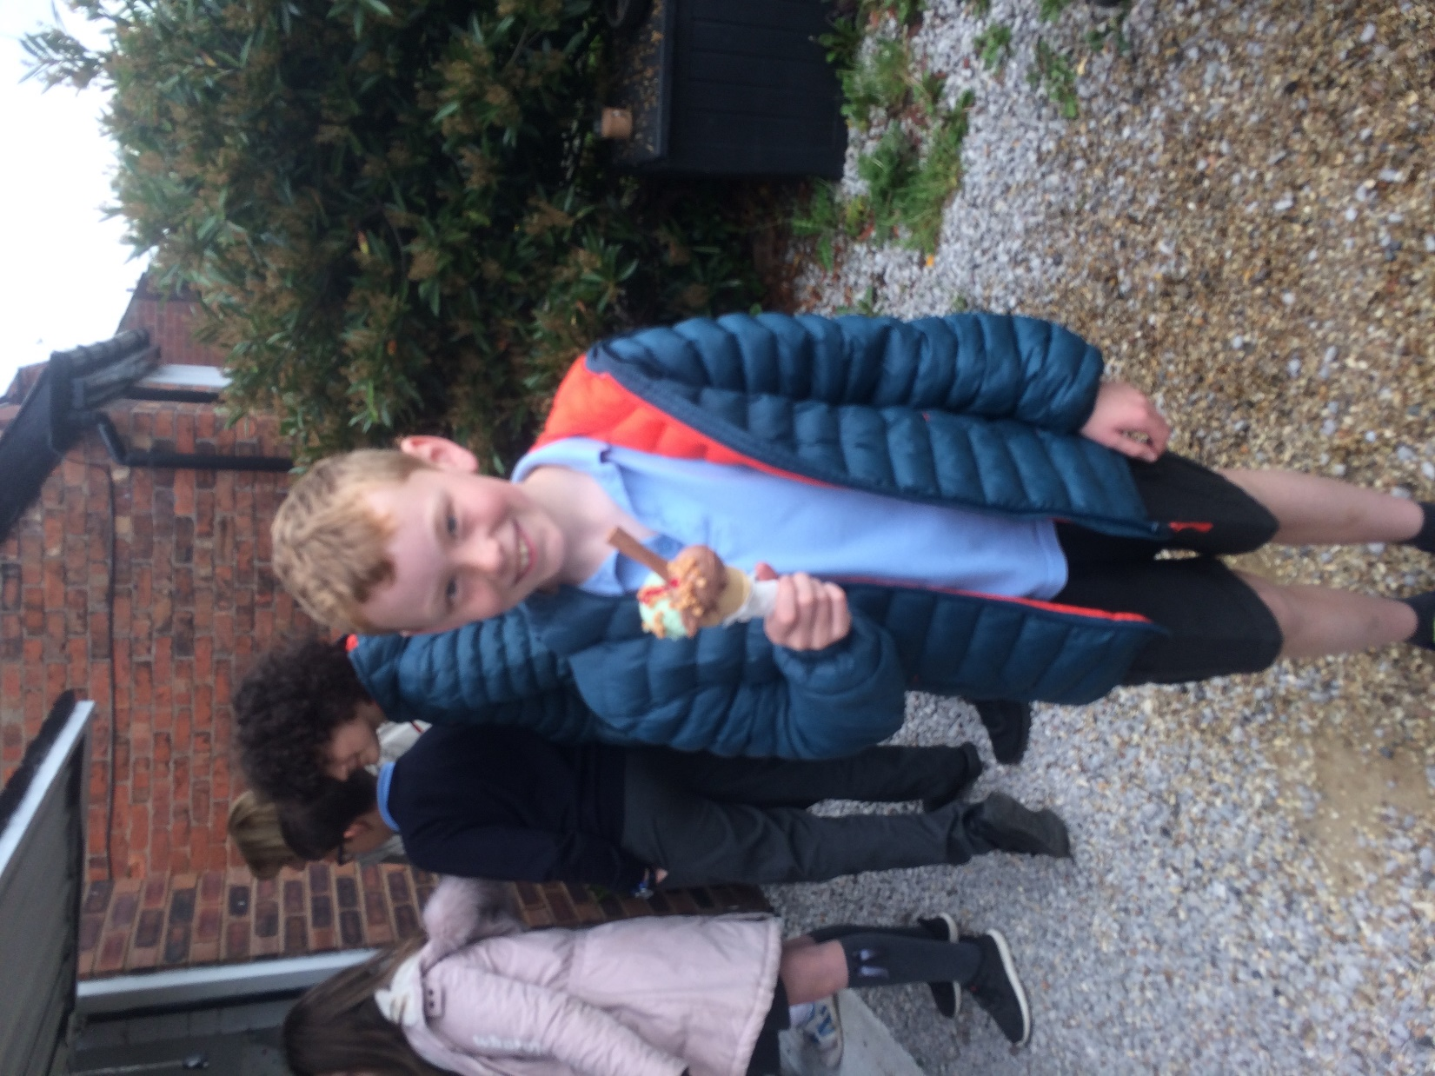

Slide 9
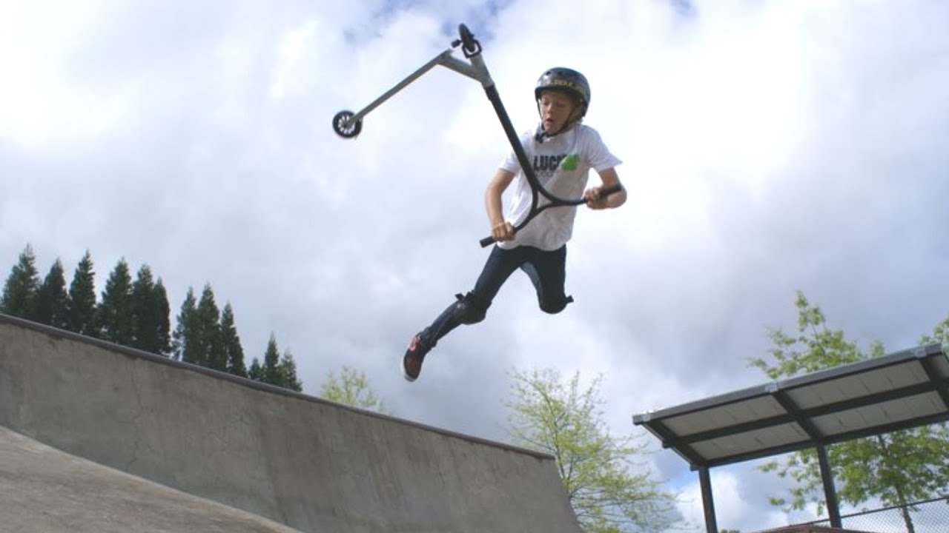




Charlie Hunter
Interests: scooters and LFC.

Slide 11

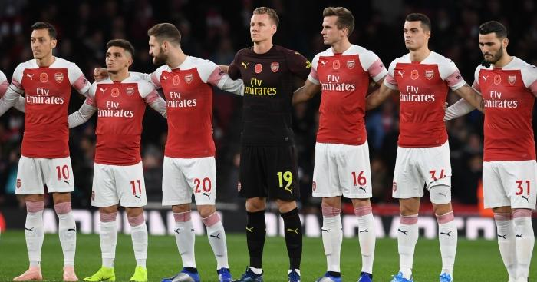



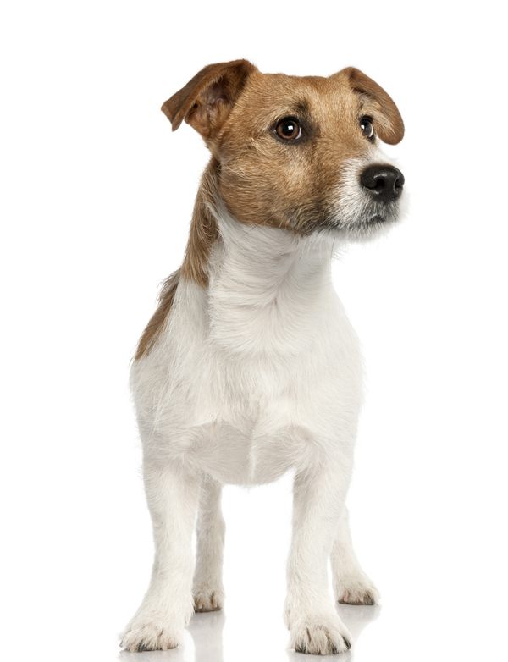
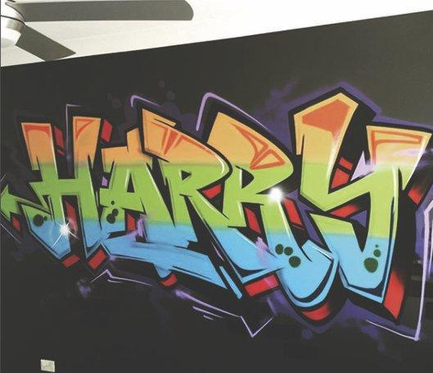
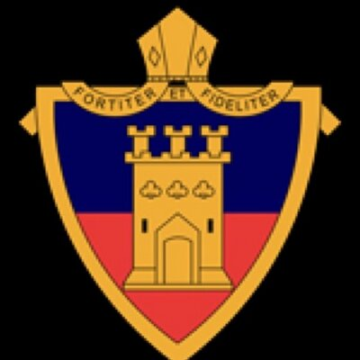
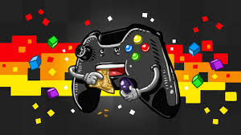
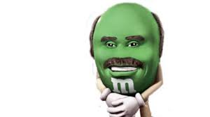
Bishop
Rawstorne
0

Slide 12
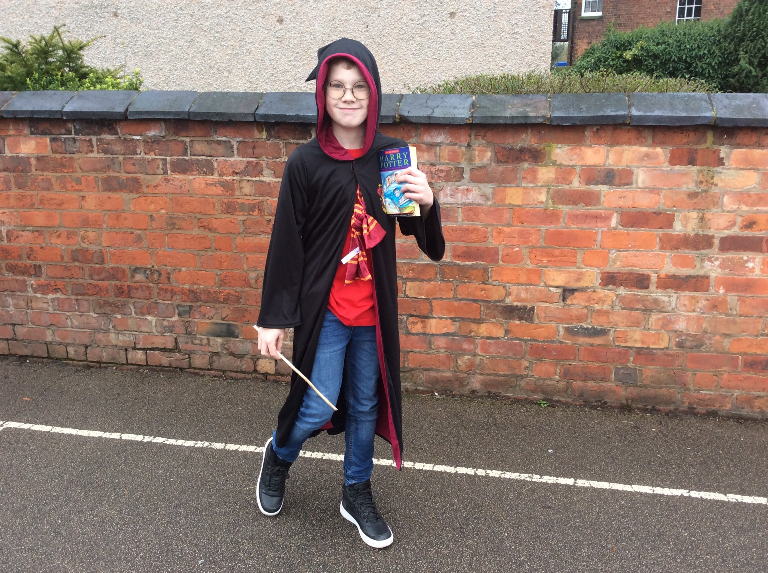

Slide 13
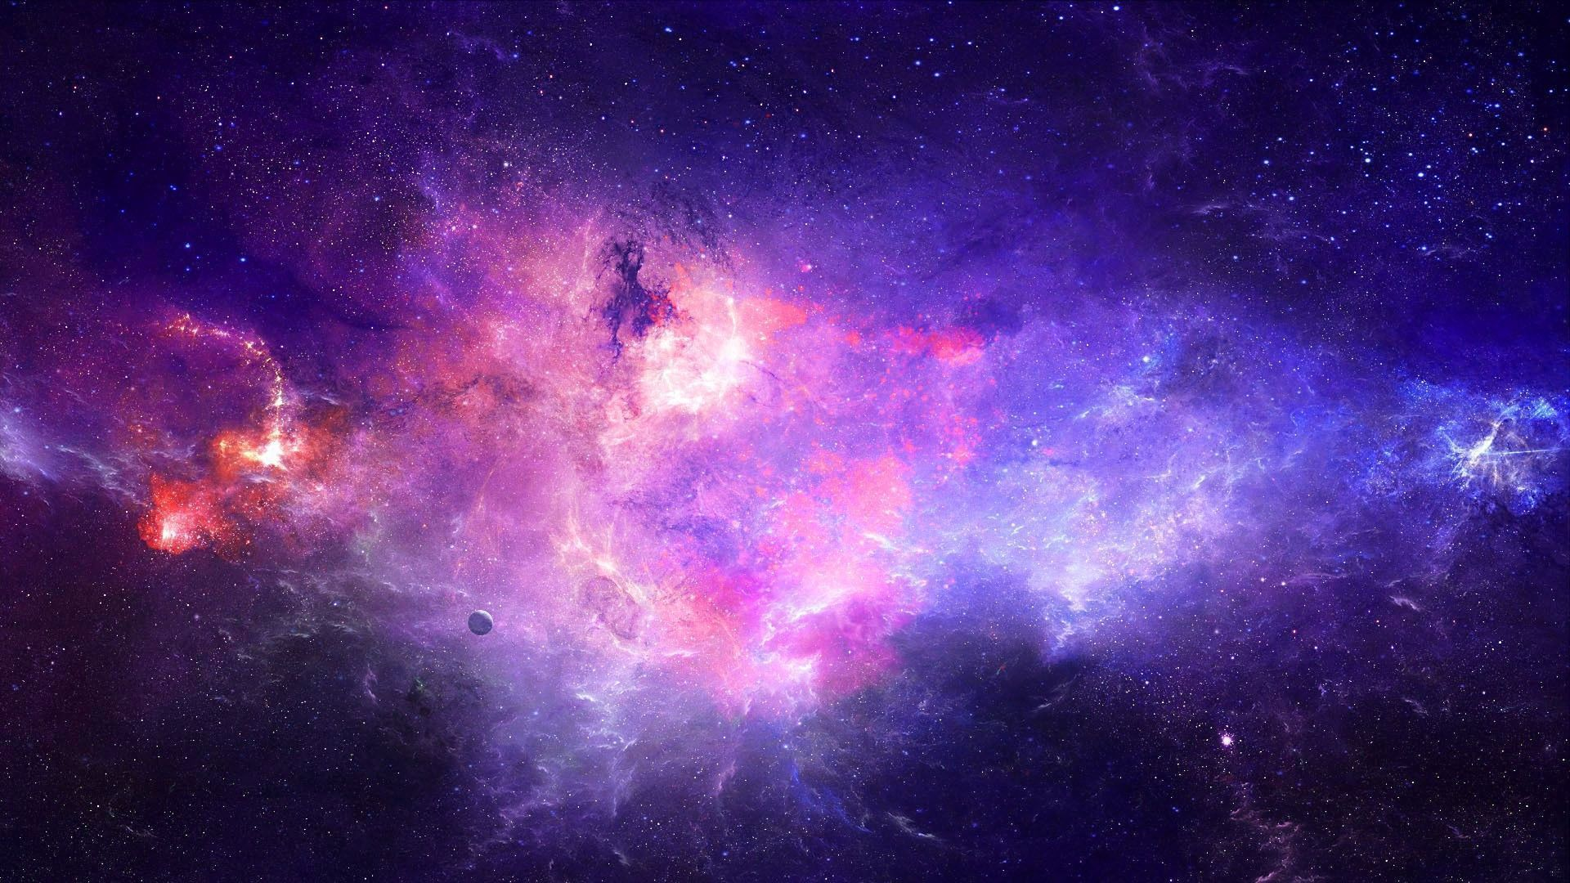
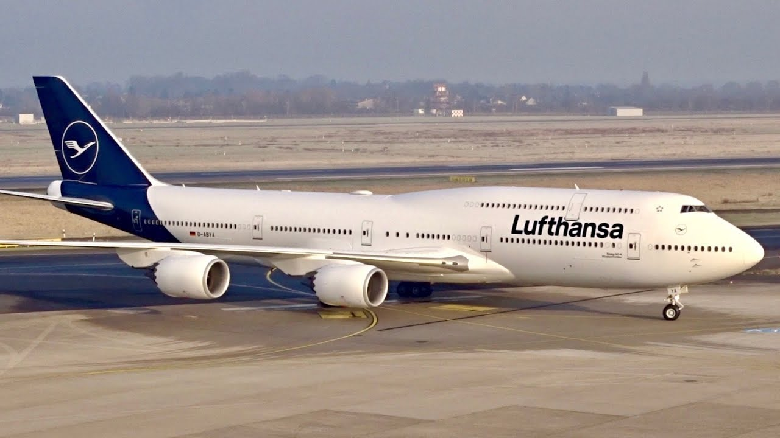
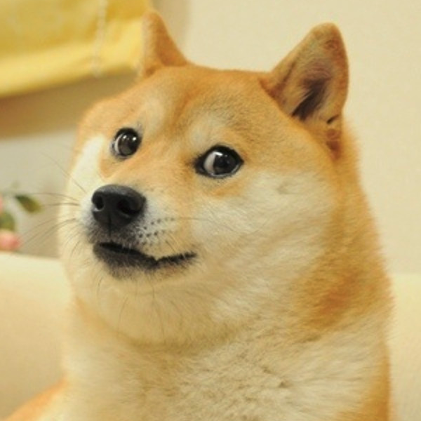






Jack Flömer
I is a floating
Boblets
I am going to Kirkham Grammar School

Slide 14
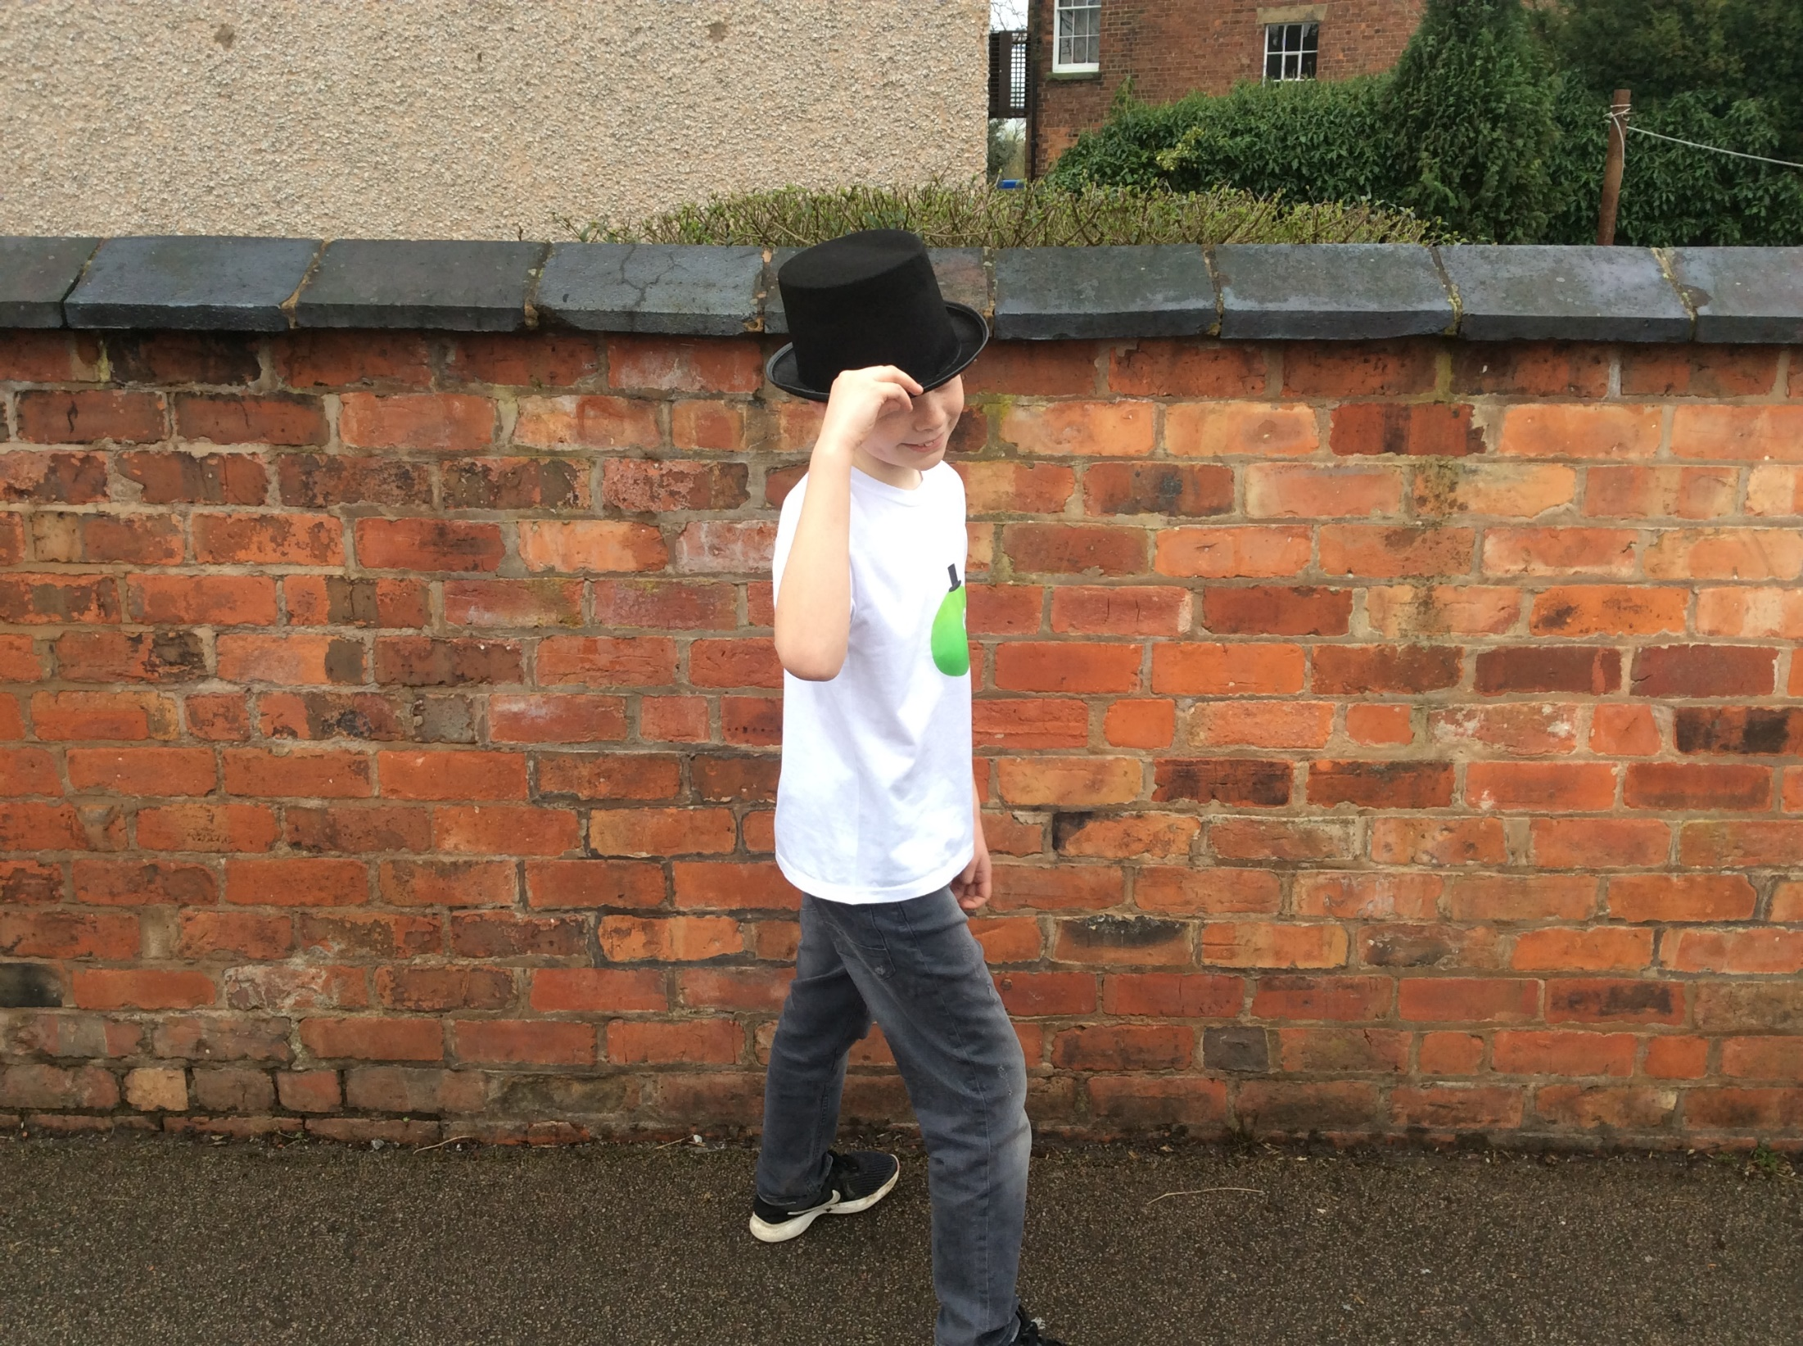

Slide 15
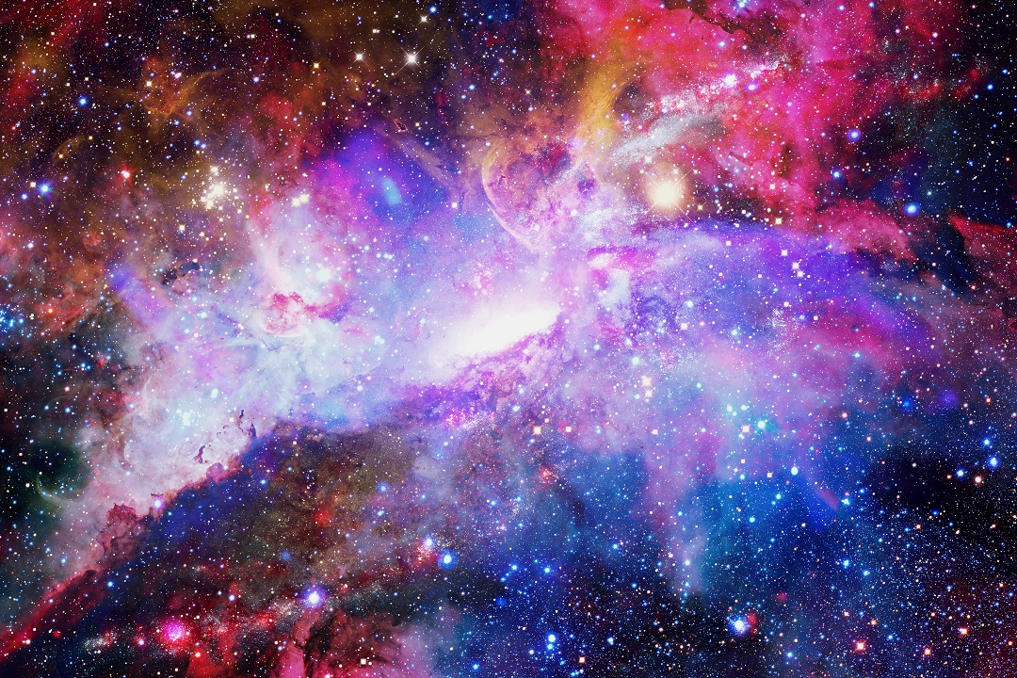


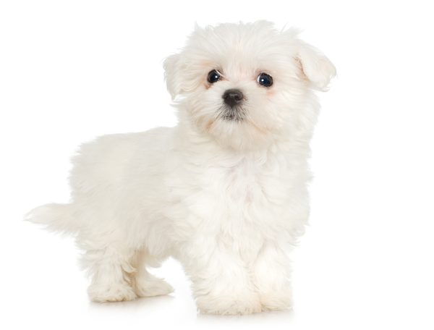
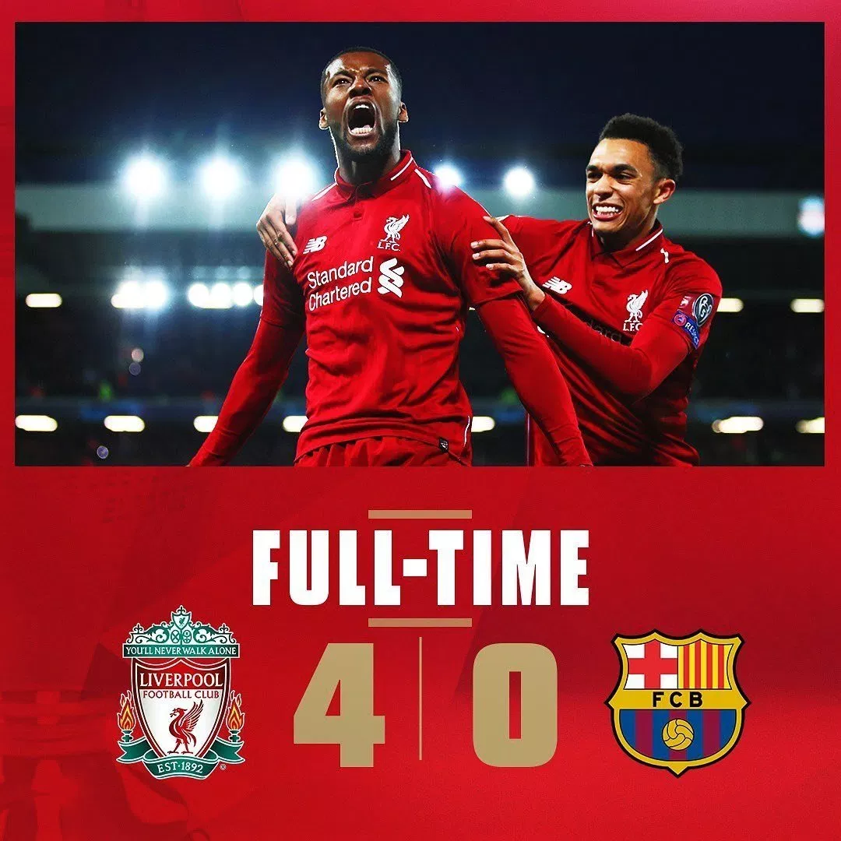
Jacob Conron

Slide 16
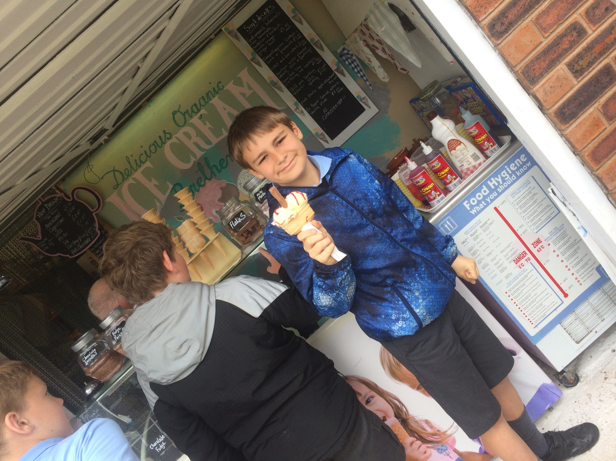

Slide 17
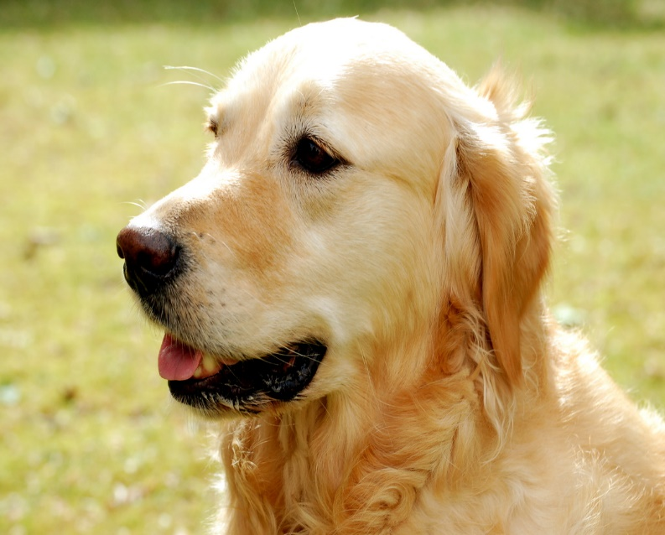
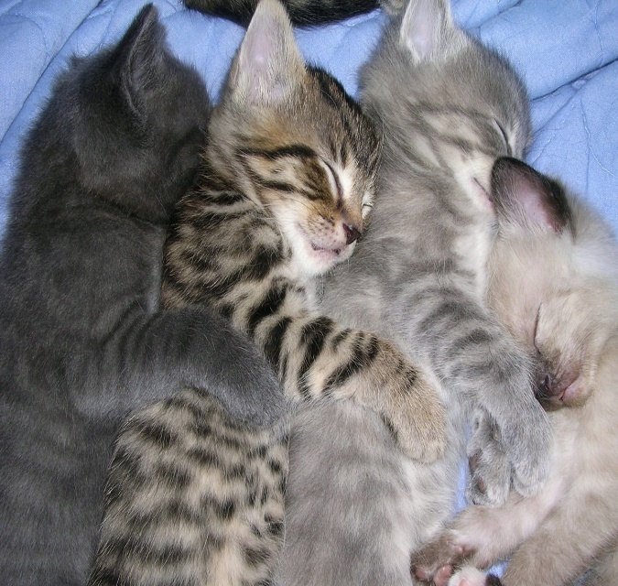

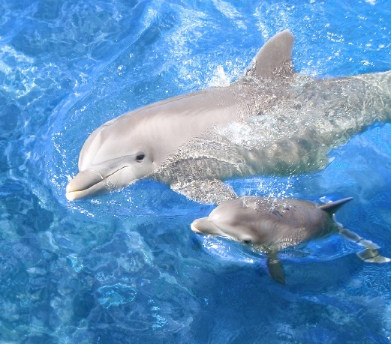
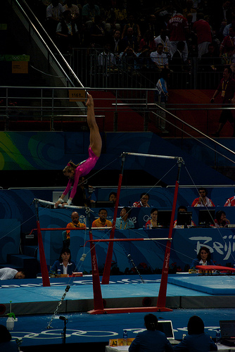
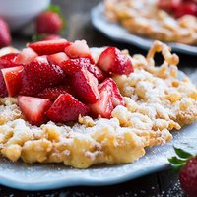
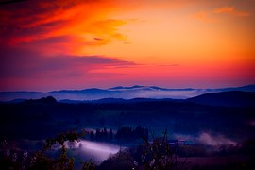
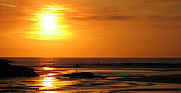

THE BEGINNING
Name : Jessica Lockett.
High School : Tarleton
I am kind , caring , loving and friendly.
I enjoy playing on my Xbox and on my phone and I like outdoor games and I enjoy watching DVD’s.
I love dogs , cats and every single animal . I am a very sporty and strong.
This Photo by Unknown Author is licensed under CC BY-SA

Slide 18
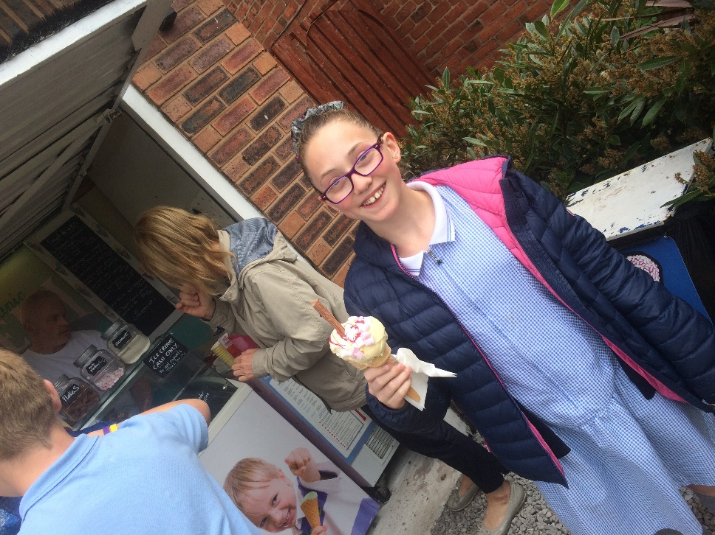

Slide 19
Kyle Houghton
I’m going to Bishop Rawstone and I like running, climbing trees, and creating things. I also like trains and trainspotting.

Slide 20
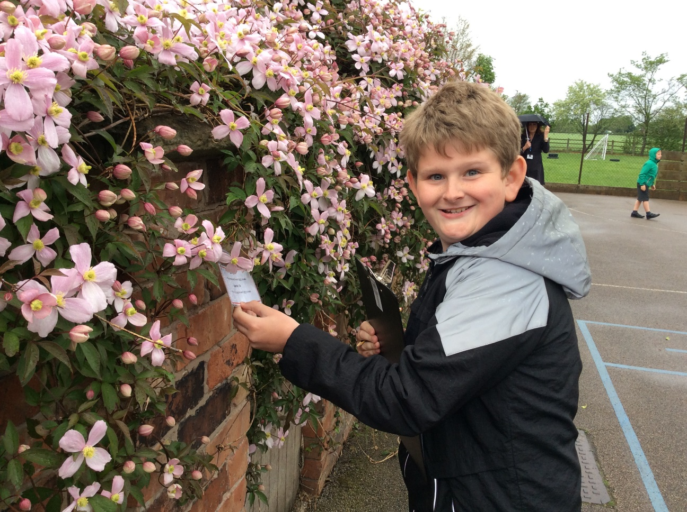

Slide 21




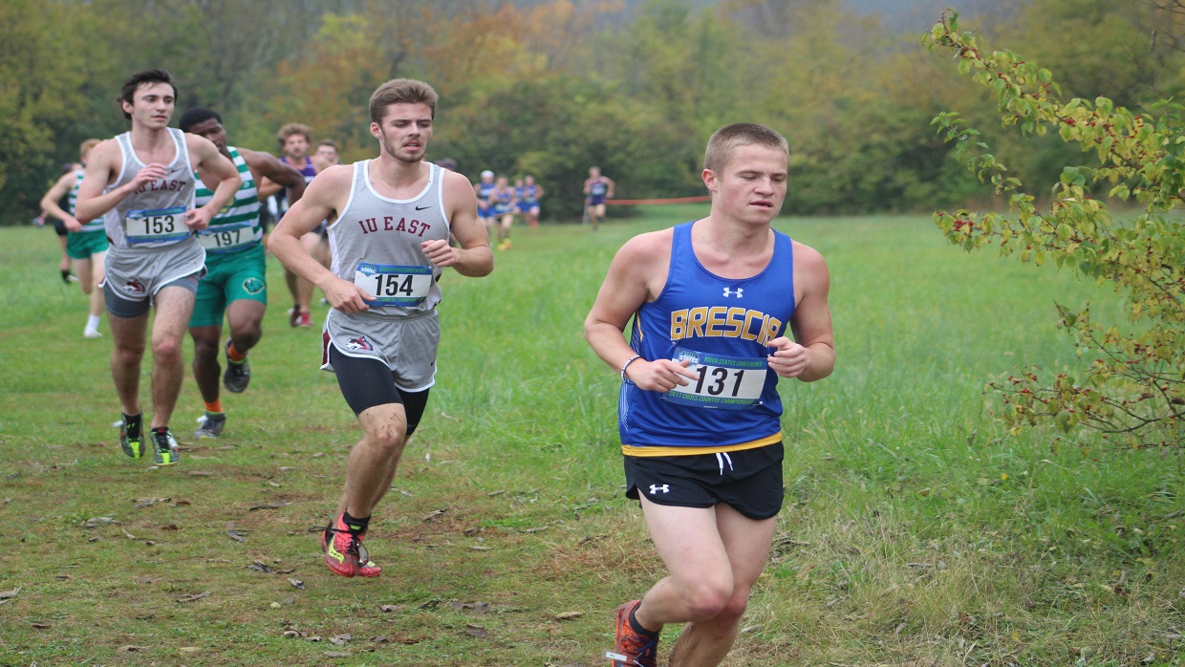
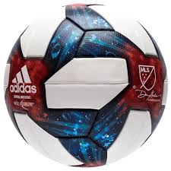

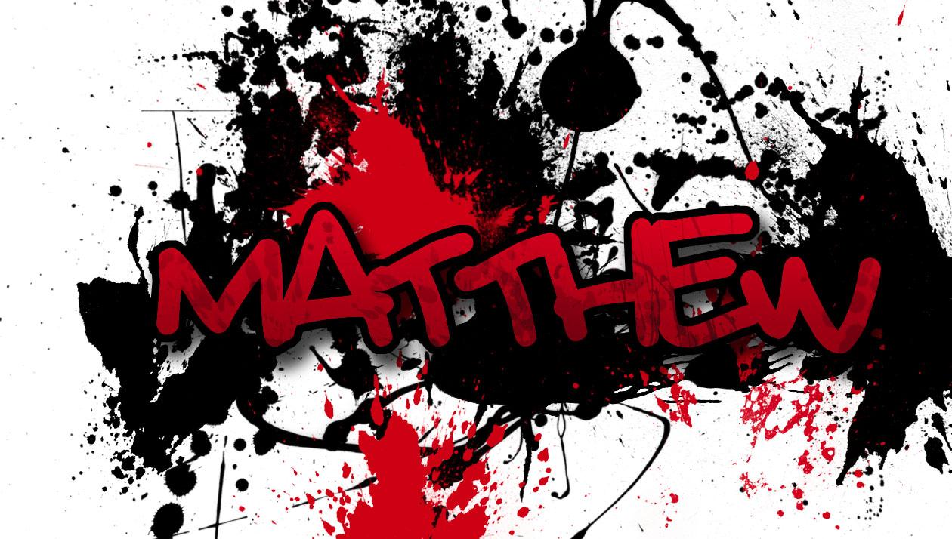
St Marys high school

Slide 22
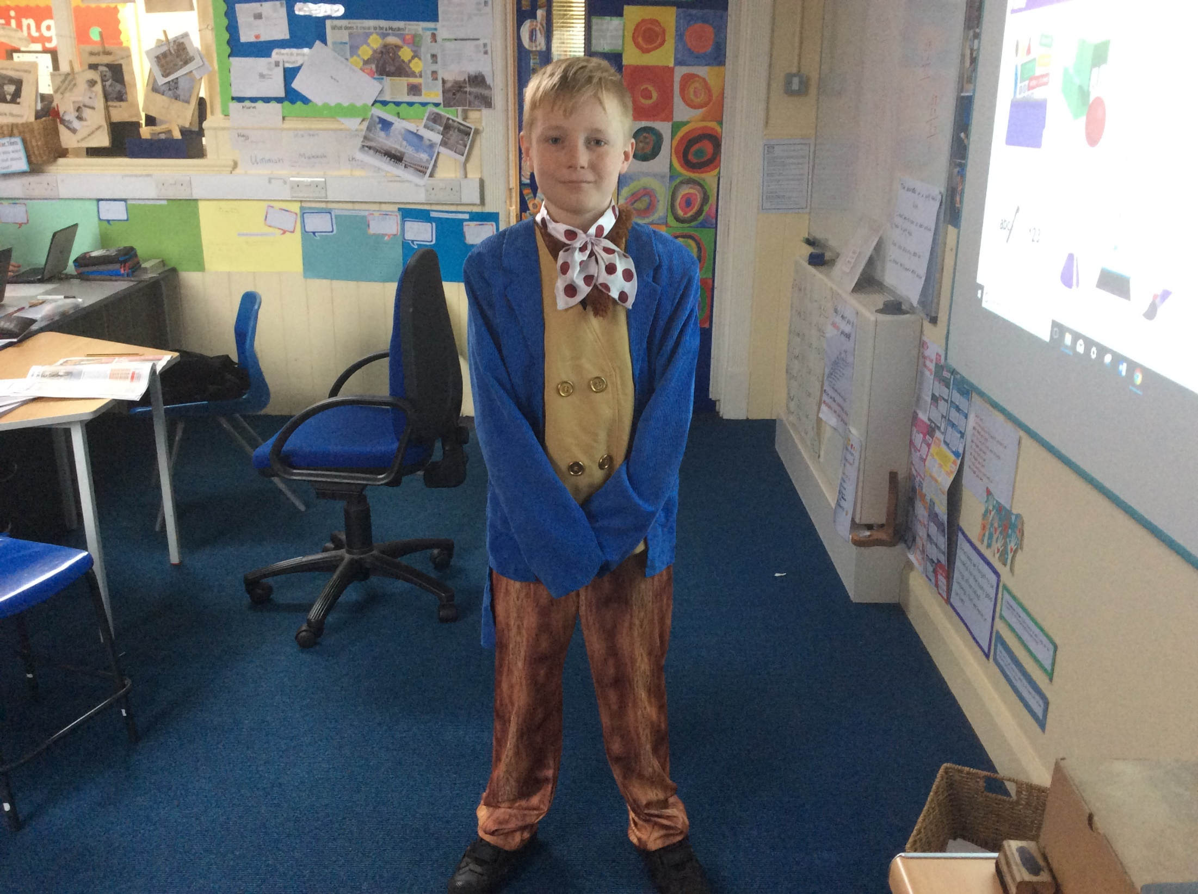

Slide 23
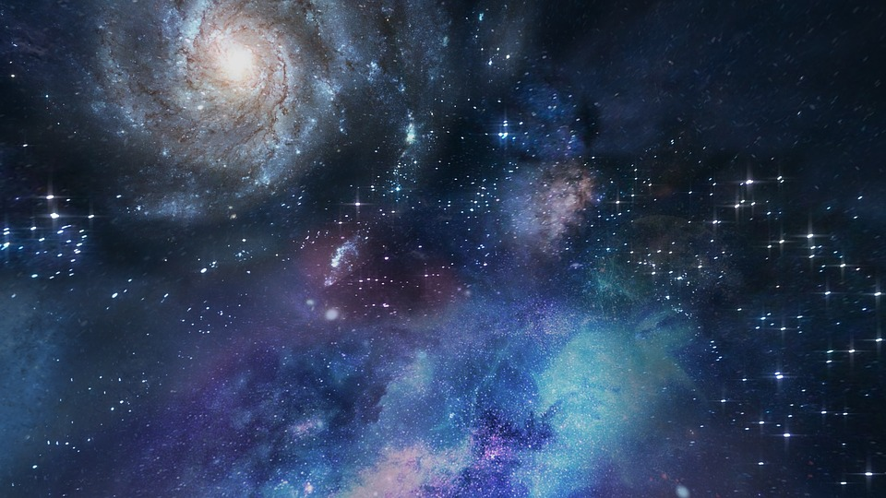




High School.
I am going to All Hallows-
Mia Grice.
Facts
I want to become an Astrophysicist.
I love to Dance

Slide 24


Slide 25



SOPHIE BURGESS MAUGHAN
I’m going to Bishop Rawstorne
I love animals
I like singing
When I’m older I want to be a …..
Zoo keeper

Slide 26


Slide 27







Tobias

Slide 28


Slide 29










Toby
Crawford

Slide 30


Slide 31












I'm going to

Slide 32


Slide 33






William Greenhalgh
I enjoy netball, Harry Potter and playing video games.
I am going to Hutton Grammar School
I have three cats. Here are two of them.

Slide 34


Slide 35










Interests: Mountain biking,
running and javelin throwing.
I am going to
Benjamin Zachary
Glew

Slide 36


