Slide 1
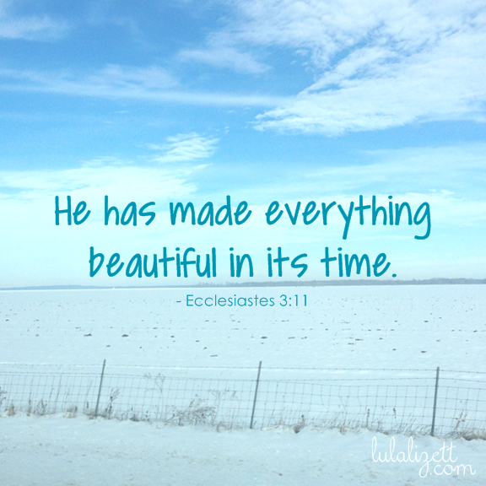

Slide 2
https://www.youtube.com/watch?v=qlJ7XoTLpc8

Slide 3

Bretherton Endowed 21/5/18
Notes:
Welcome
Overview of arts week
Art skills
Other skills
Creativity
Relaxation
Expression
Individuality
Thanks to teachers and children and all our volunteers.

Slide 4

Notes:
Morris dancing
- Driven towards walking day but would develop further – impact of dance on wellbeing, memory, strengths, fitness and expression

Slide 5
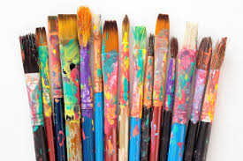
Notes:
Exhibition
This week children have been creative – modern art, look at different artists
Visitors thank you
Names:
Class 1 or 2 display- Shelly Roche walker
Year 6 – David Hodgkinson – New Longton Artists
Various children – new longton artist – lady
Rosie Stansfield – associate governor

Slide 6

Class 1 Art Week Memories
Notes:
2-3 children talk about what they have done and learned

Slide 7
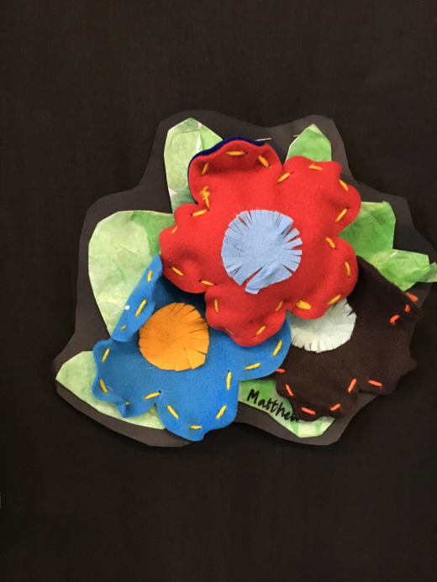
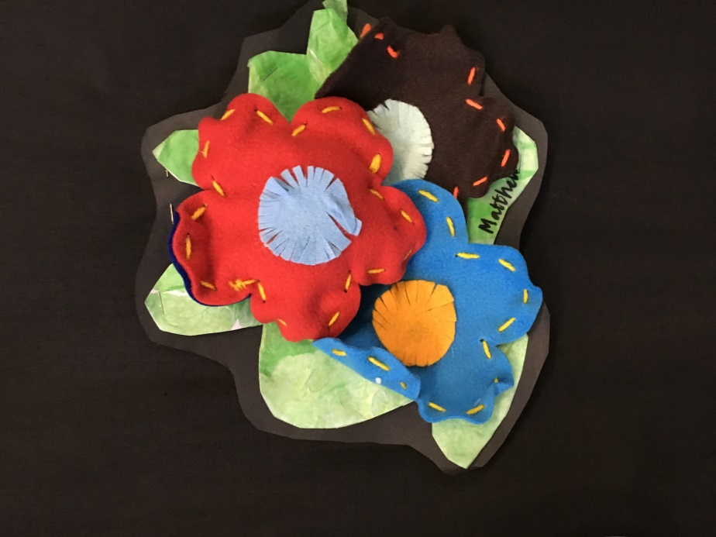
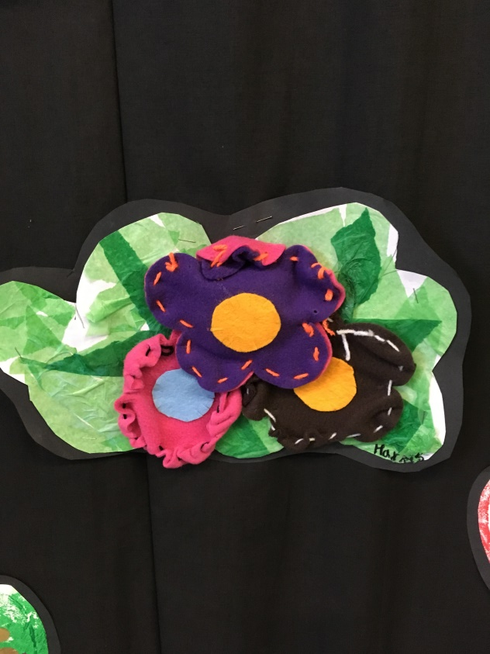
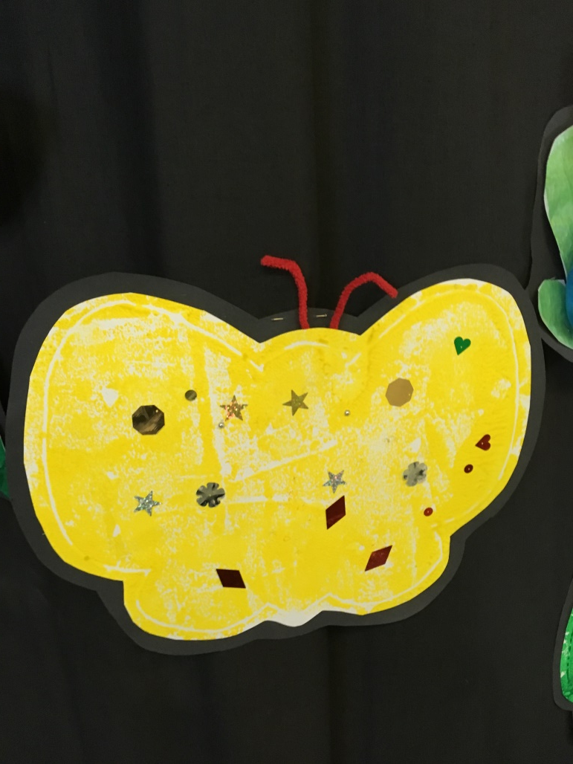
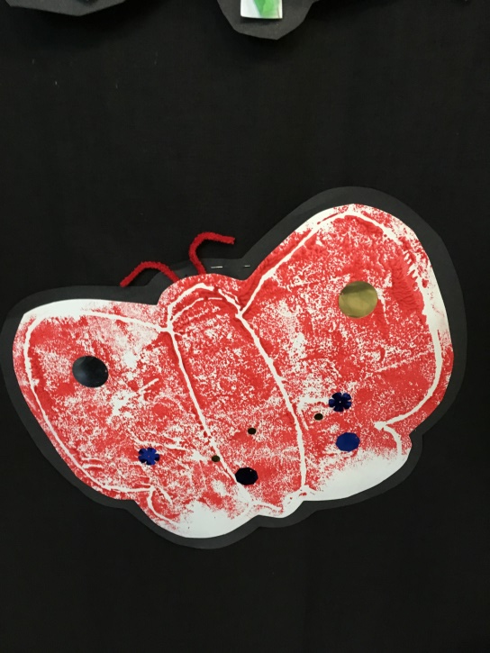

Slide 8
Class 2 Art Week Memories
Notes:
Class 2 recounts of the week

Slide 9
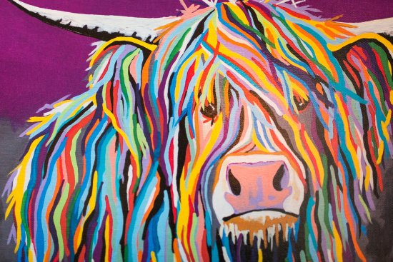
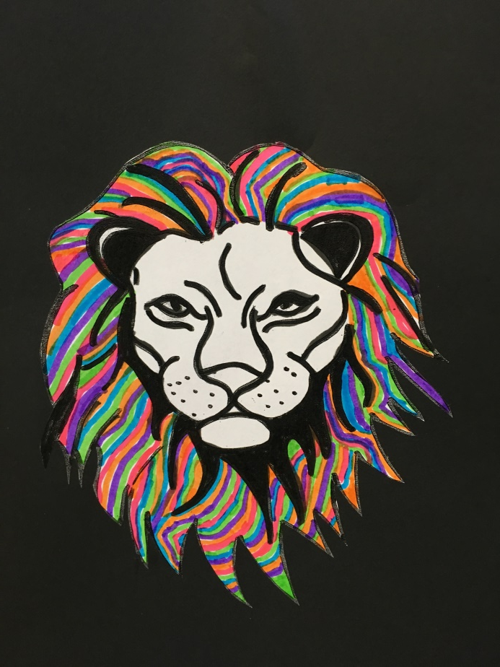
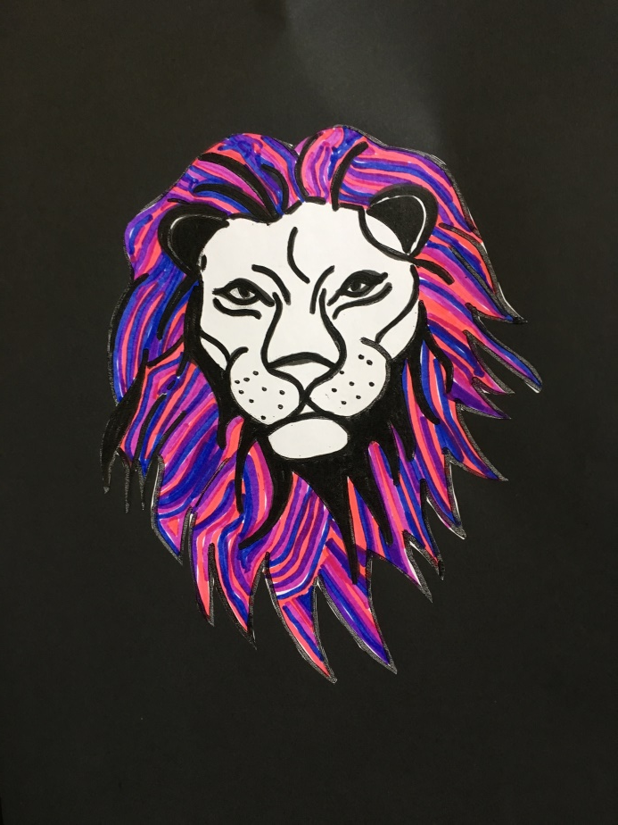
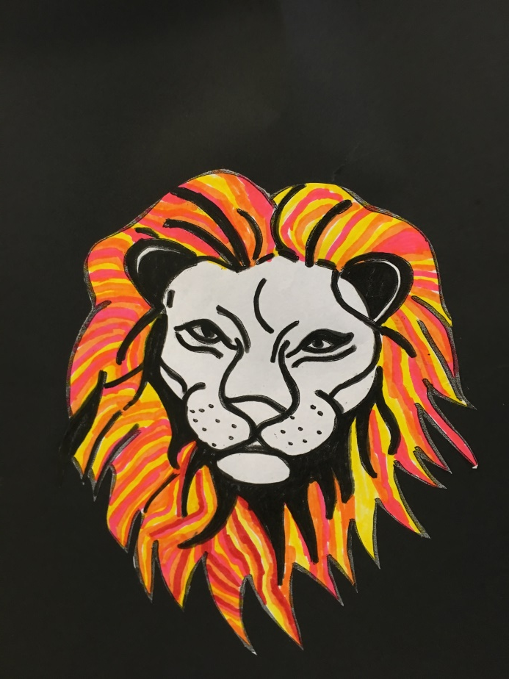

Slide 10
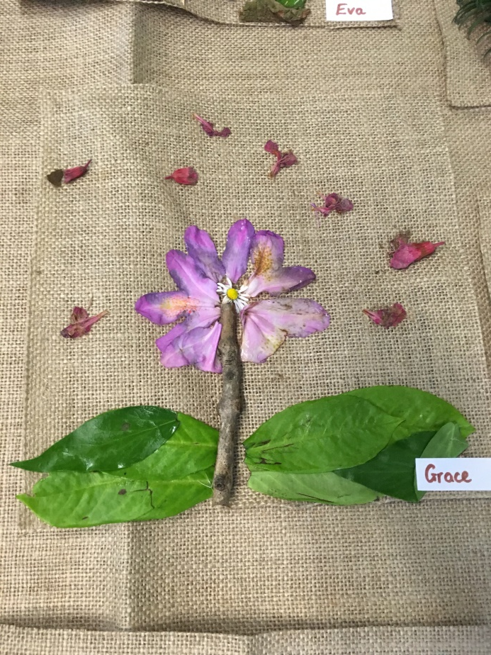
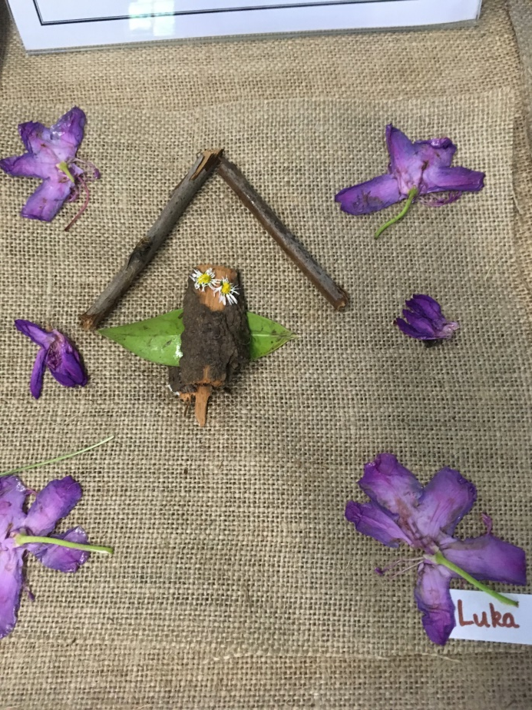
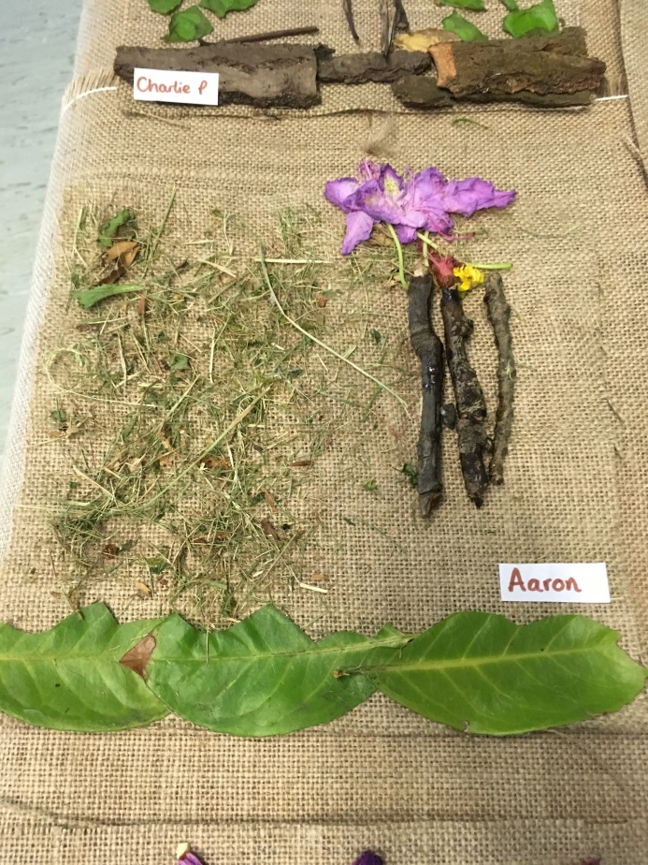
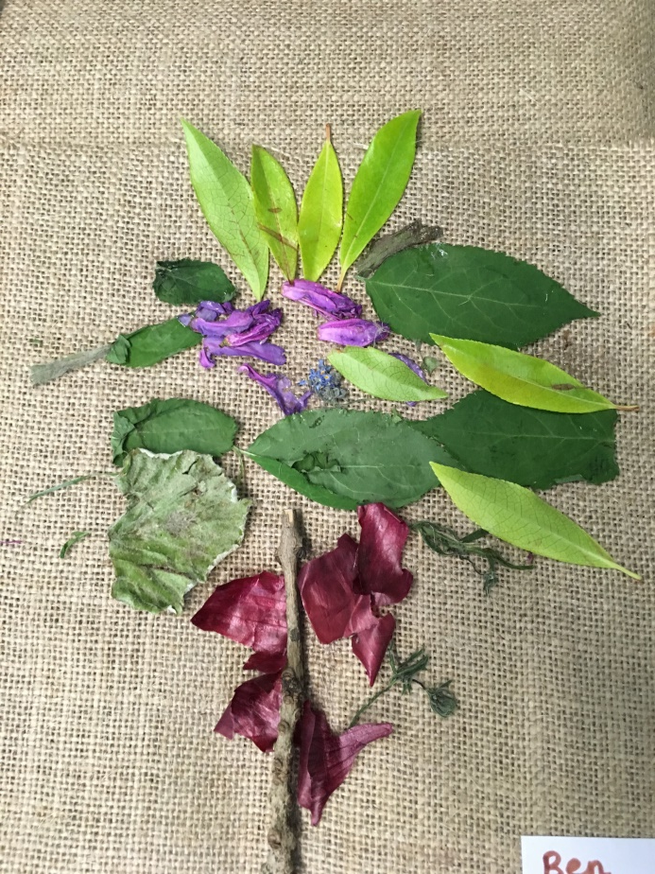

Slide 11
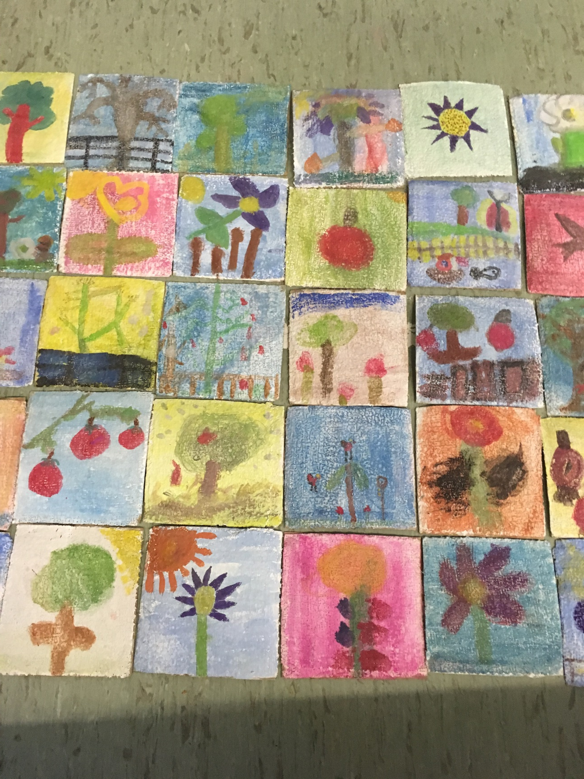

Slide 12

Notes:
Amanda Rodgers dance school spent only 1 hour – expression

Slide 13
Class 3 Art Week Memories
Notes:
Class 3 memories

Slide 14
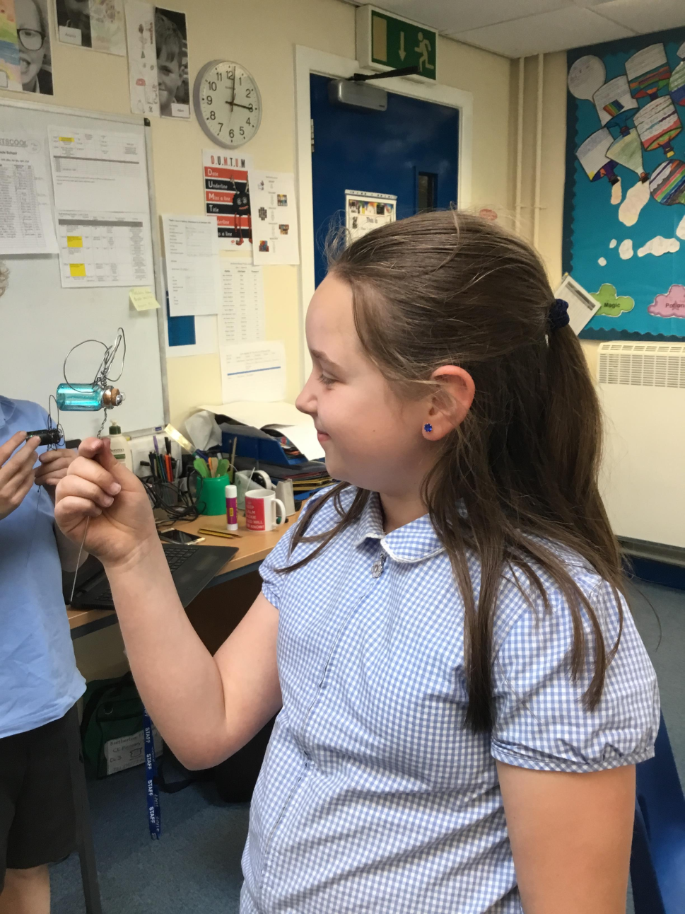
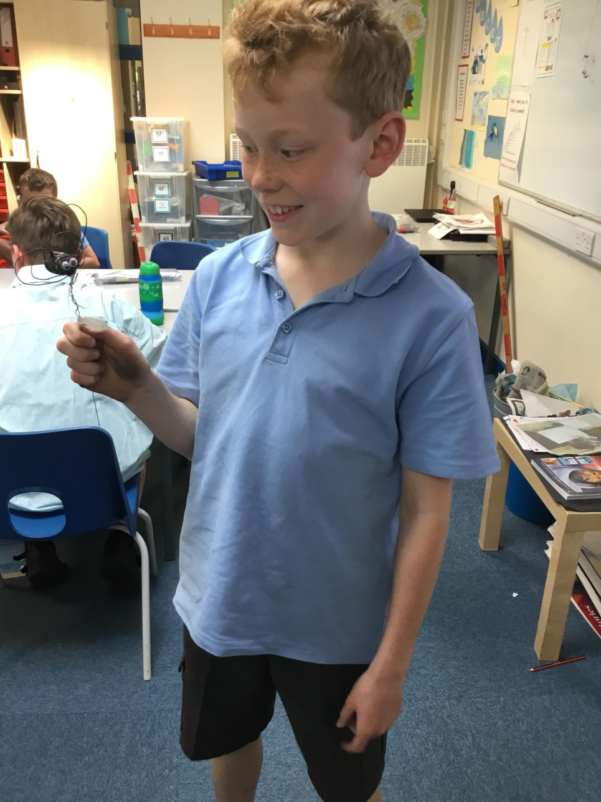

Slide 15
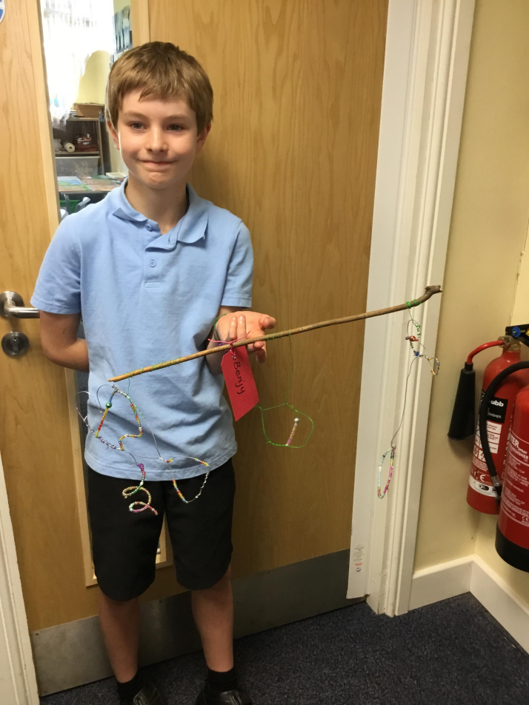
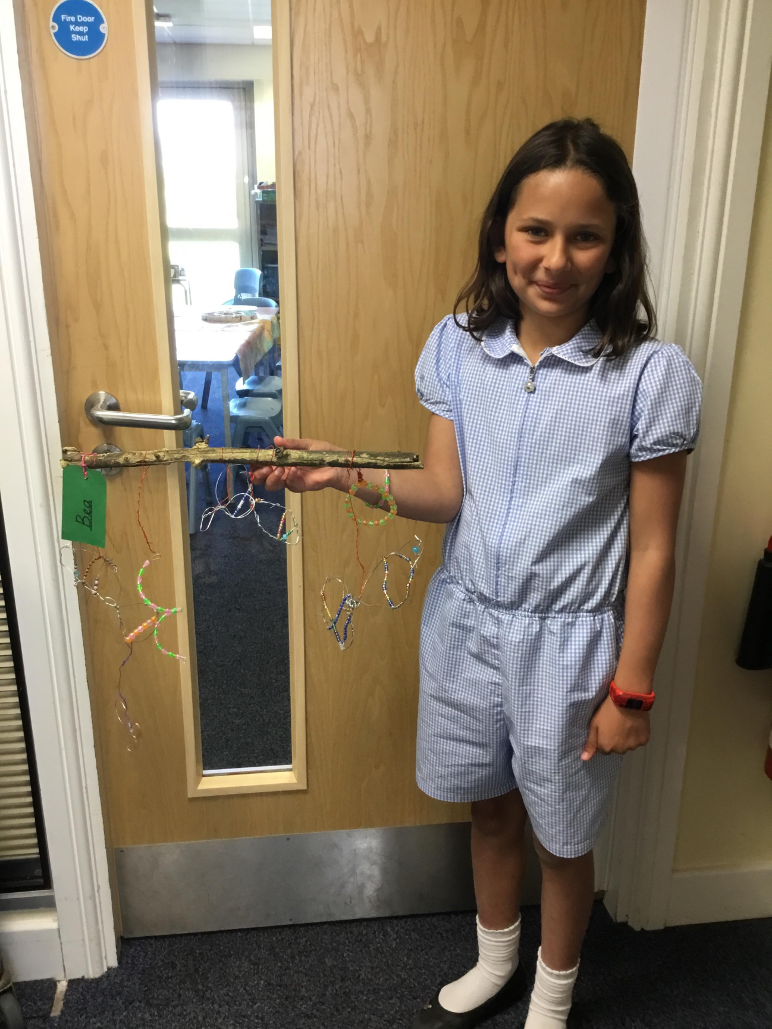
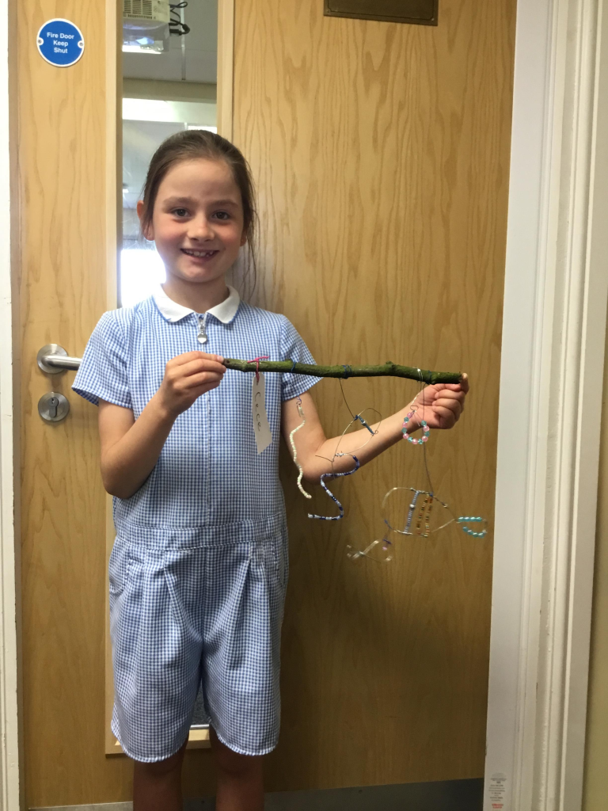


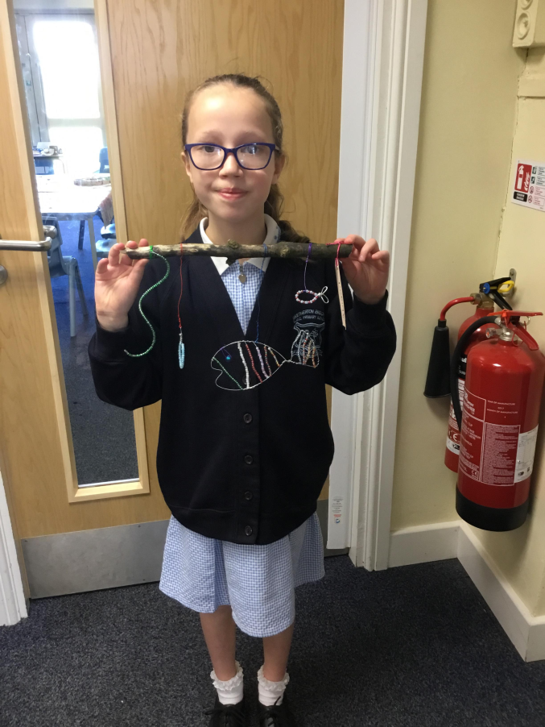

Slide 16
Class 4 Art Week Memories
Notes:
Class 4 recounts

Slide 17
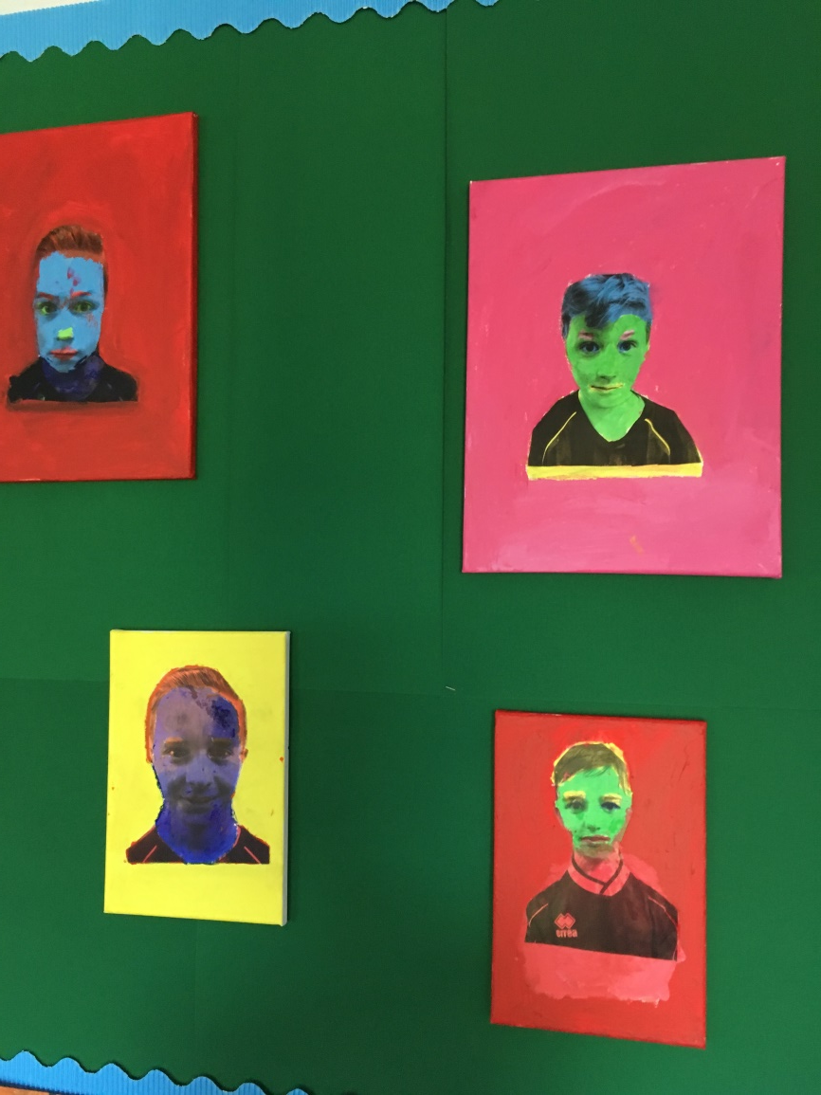
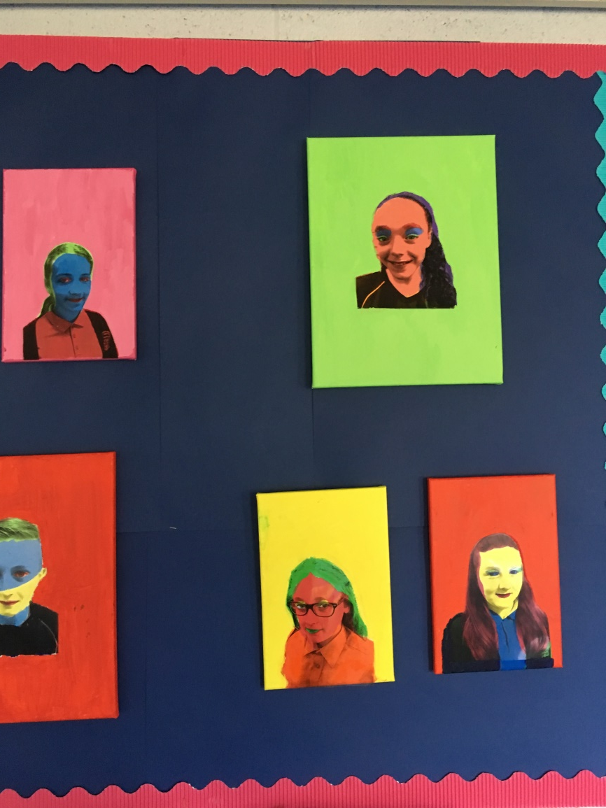
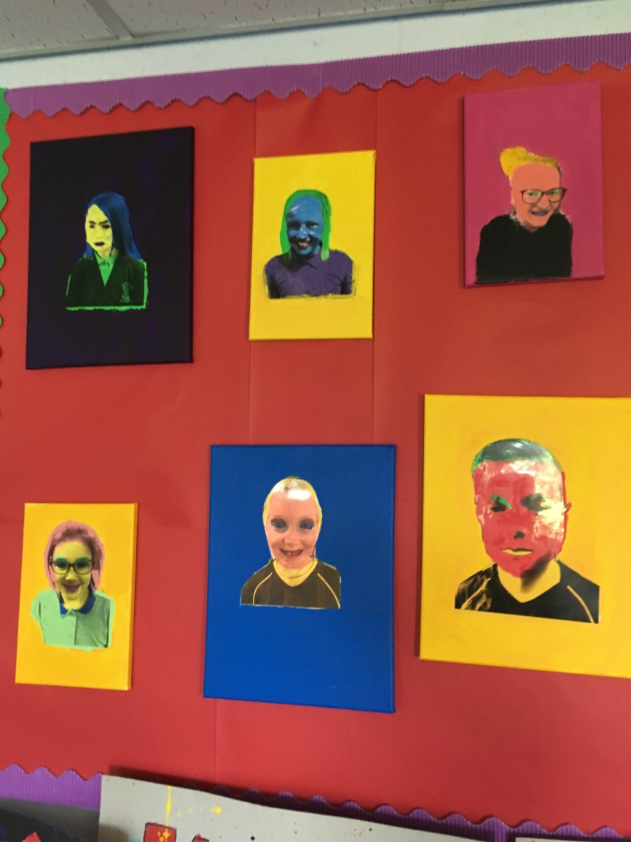

Slide 18
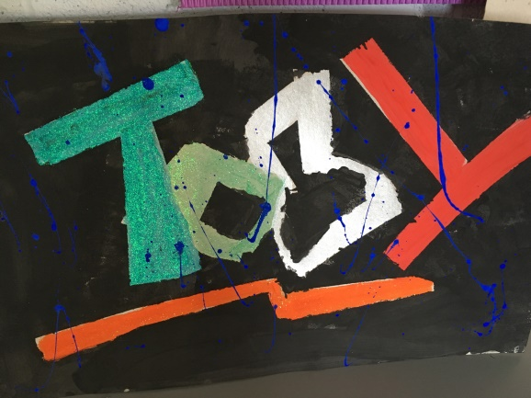
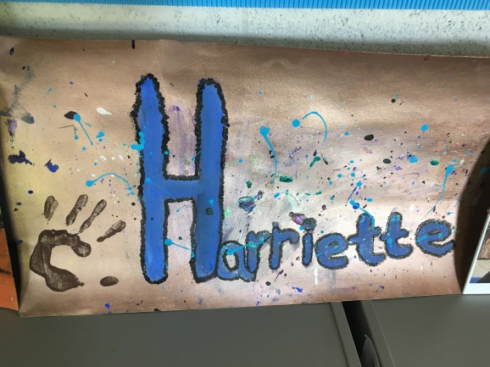
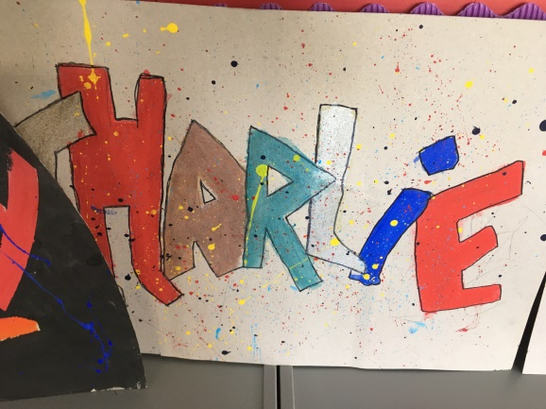
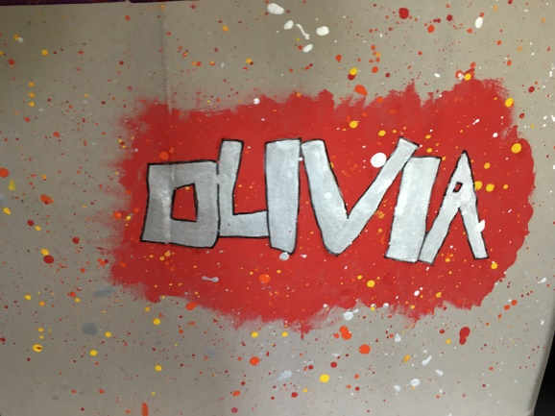
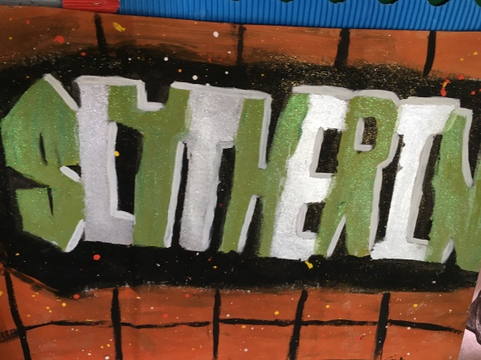

Slide 19
WOW words
Notes:
End with a fun song about the wow in the world

Slide 20
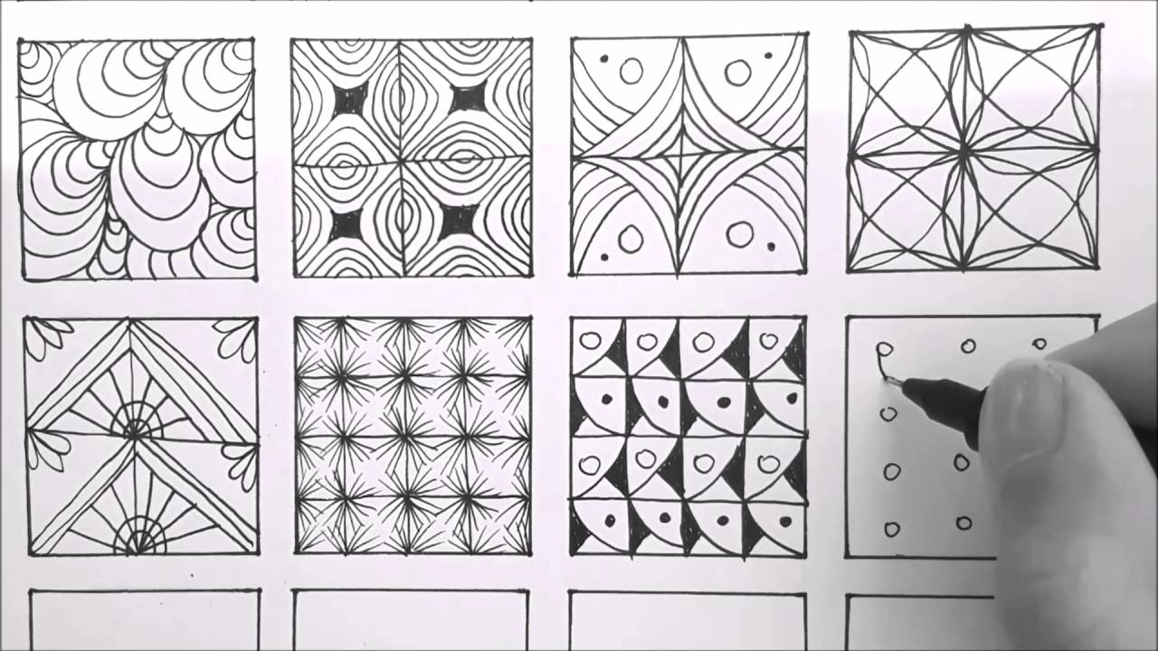
Notes:
Created a zentangle – many children involved in their own time

Slide 21

Thank you for sharing this with us
Have a lovely half term break.

