Slide 1


Our hopes and dreams are in God’s hands

Slide 2

God is greater than we can even imagine

Slide 3


Slide 4


Slide 5
Proverbs 3:5-6
Trust in the Lord with all your heart, and do not lean on your own understanding.
In all your ways acknowledge him, and he will make straight your paths.

Slide 6
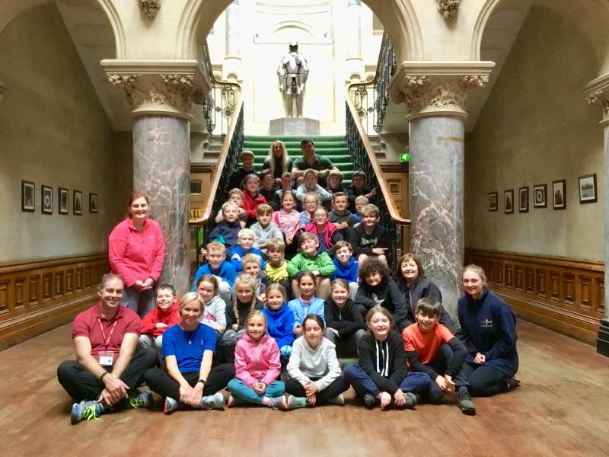

Slide 7


Slide 8
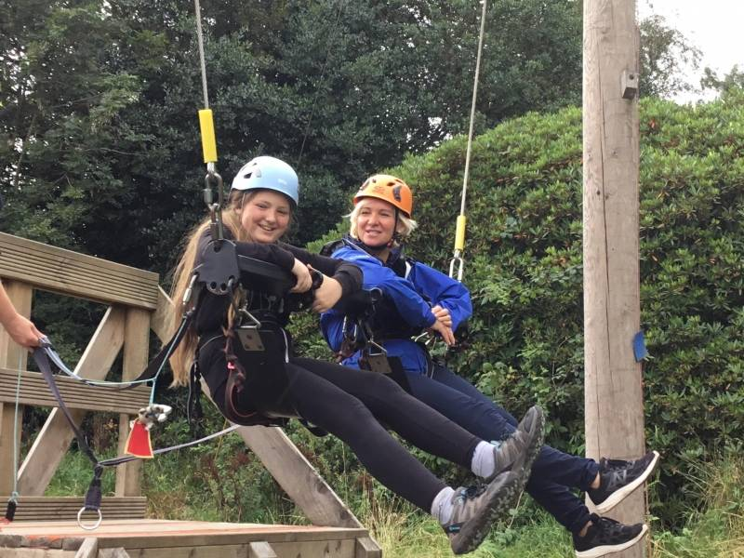

Slide 9


Slide 10
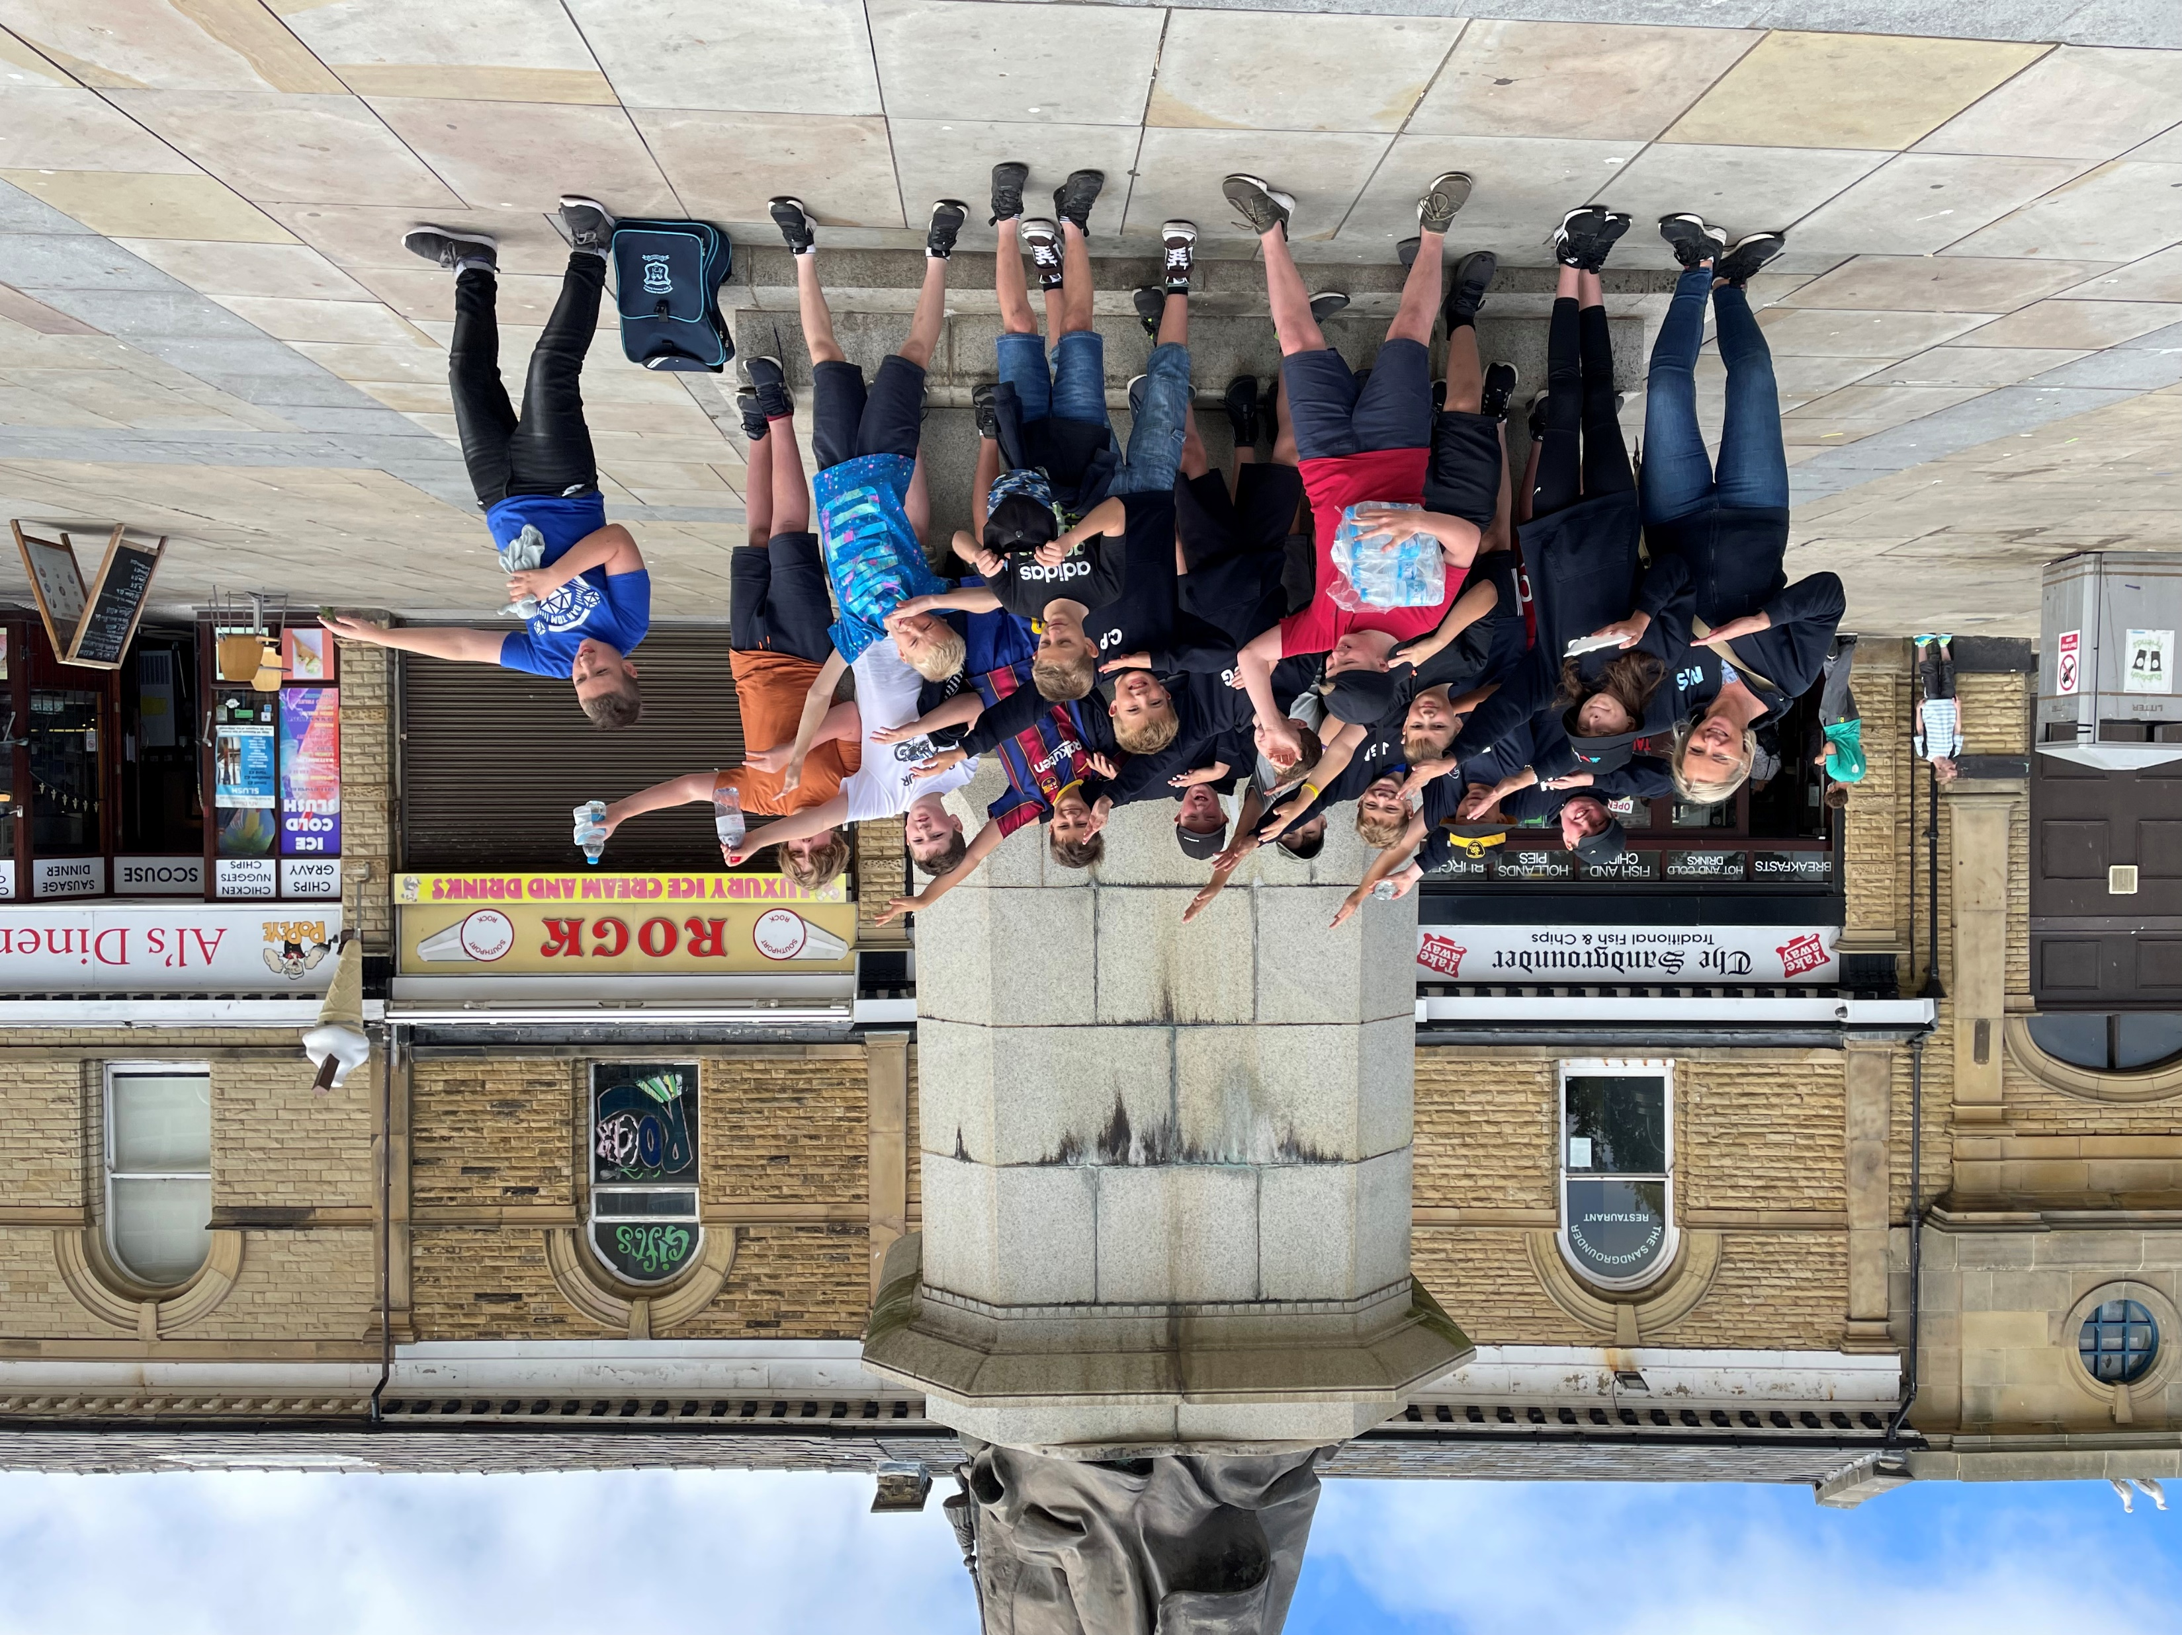

Slide 11
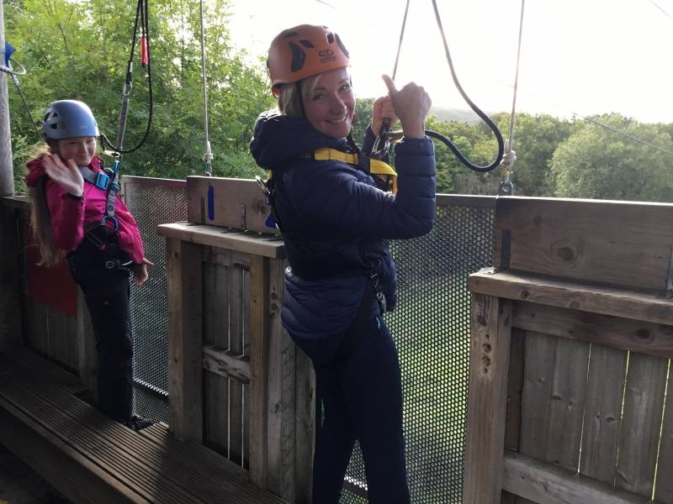

Slide 12


Slide 13
Our end of worship Prayer
May God the Father
…….help us learn
May we grow
……following in the footsteps of Jesus
Help us achieve
……through the Spirit
And may we flourish
…..within God’s Love
Amen

Slide 14
