Slide 1
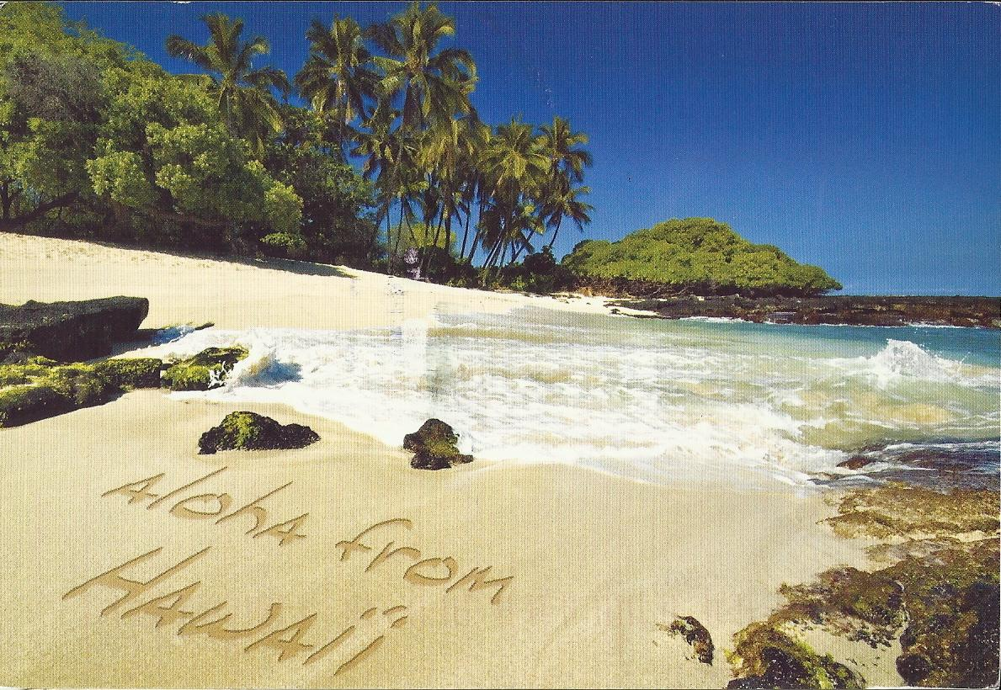
Fruity Tuity Hawaiian Dreams

Slide 2
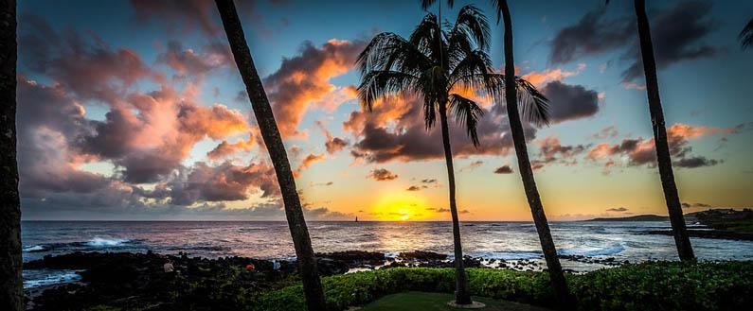
Ratio
12: 5: 3: 2
300ml 125ml 75ml 50ml

Slide 3
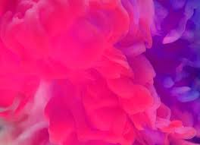
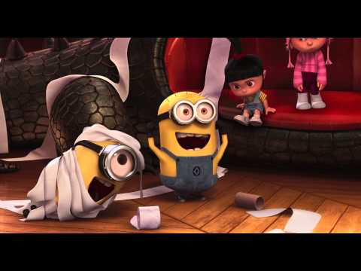
Ingredients
A beautiful Blood orange drink
Soda water that makes you fizz and wizz
Orange that will make you say
Pink lemonade
Slice of lemon and a slice of lime

Slide 4
If you vote for us, then you can try it again at the Easter bingo on Thursday. Also if we win, one lucky year 3 will get to try our limited edition secret, amazing mocktail.

Slide 5

A happy customer quote
“This was amazing once in a lifetime brilliant and wonderful.”

Slide 6
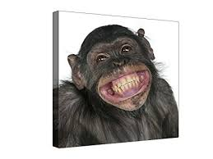
This mocktail
will make
you smile

