Slide 1
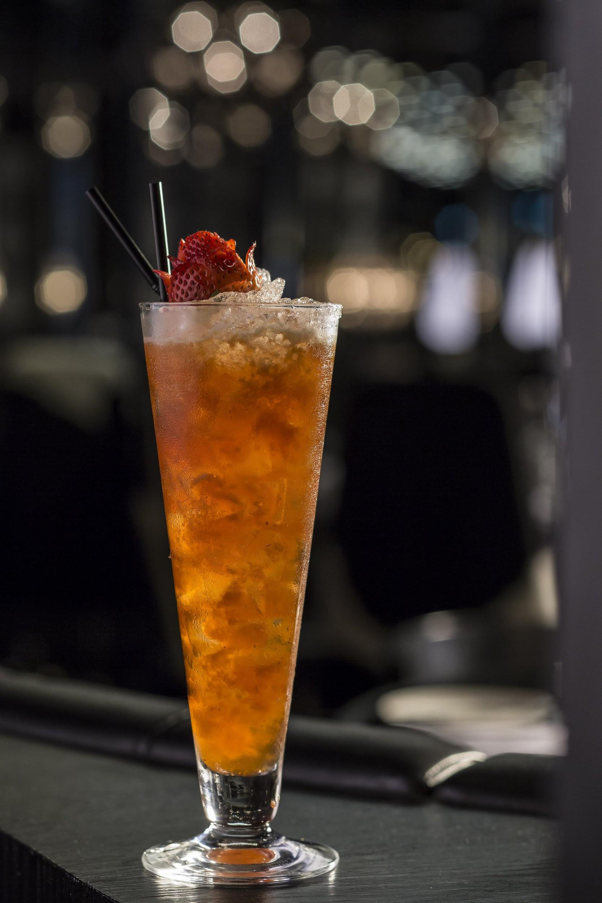
The summer Cacti

Slide 2
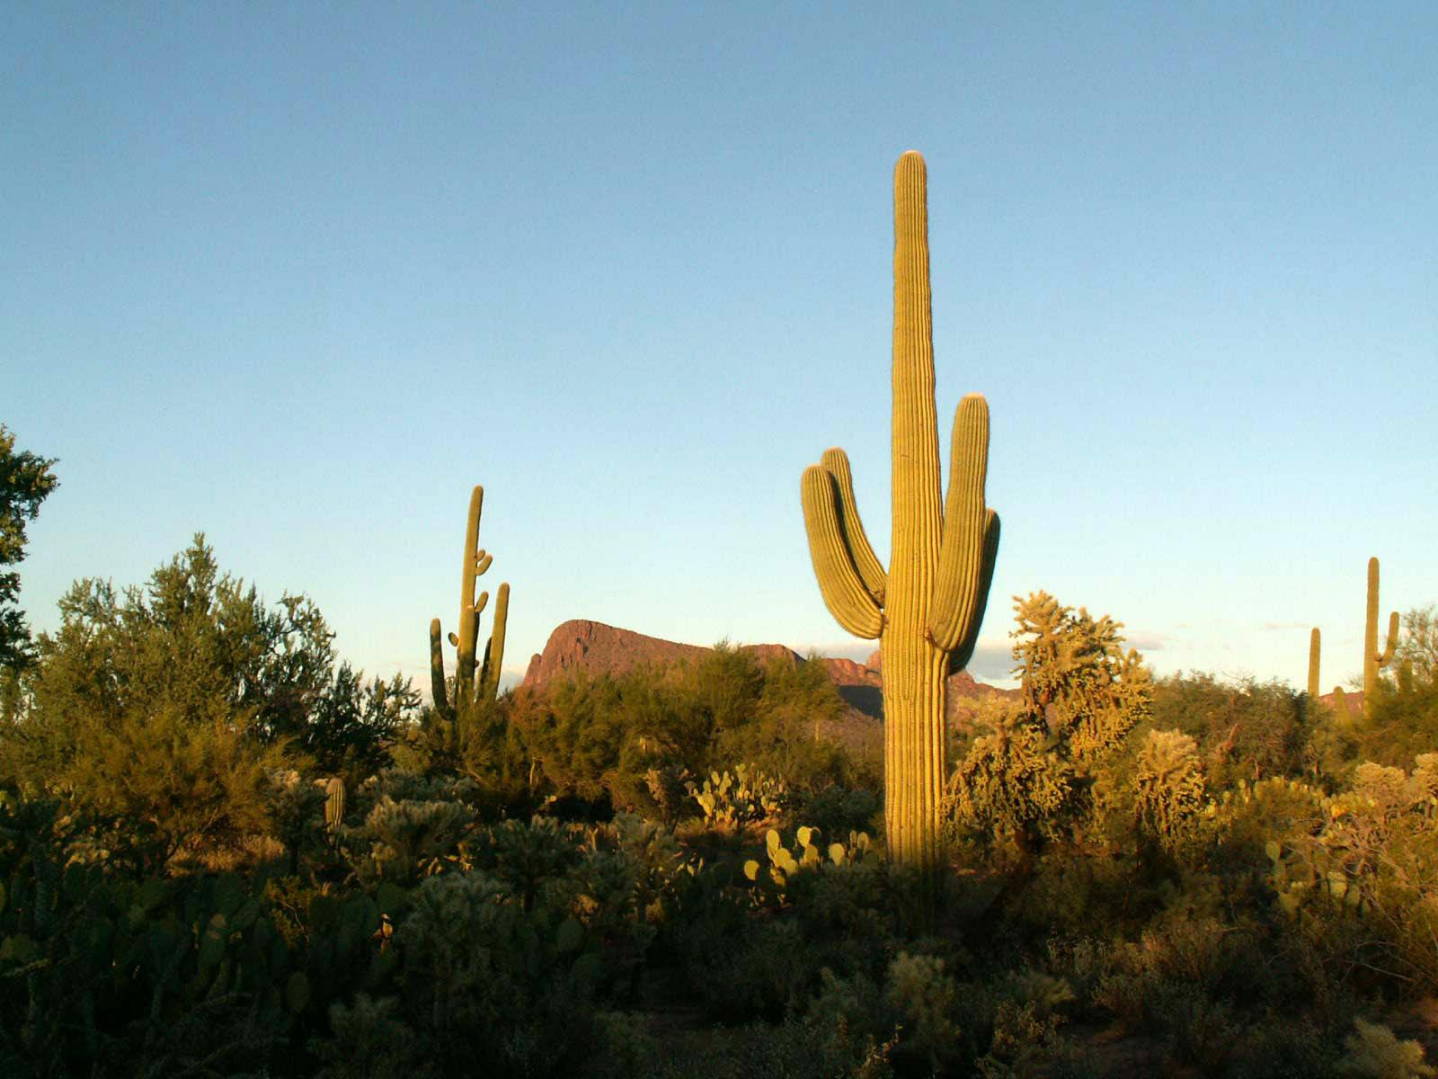
The summer Cacti !
Ingrediants.
6 cups of Coke.
6 cups of Fanta.
2 cups of lemonade.
2 cups of summer fruits.
Ratio 6:6:2:2

Slide 3
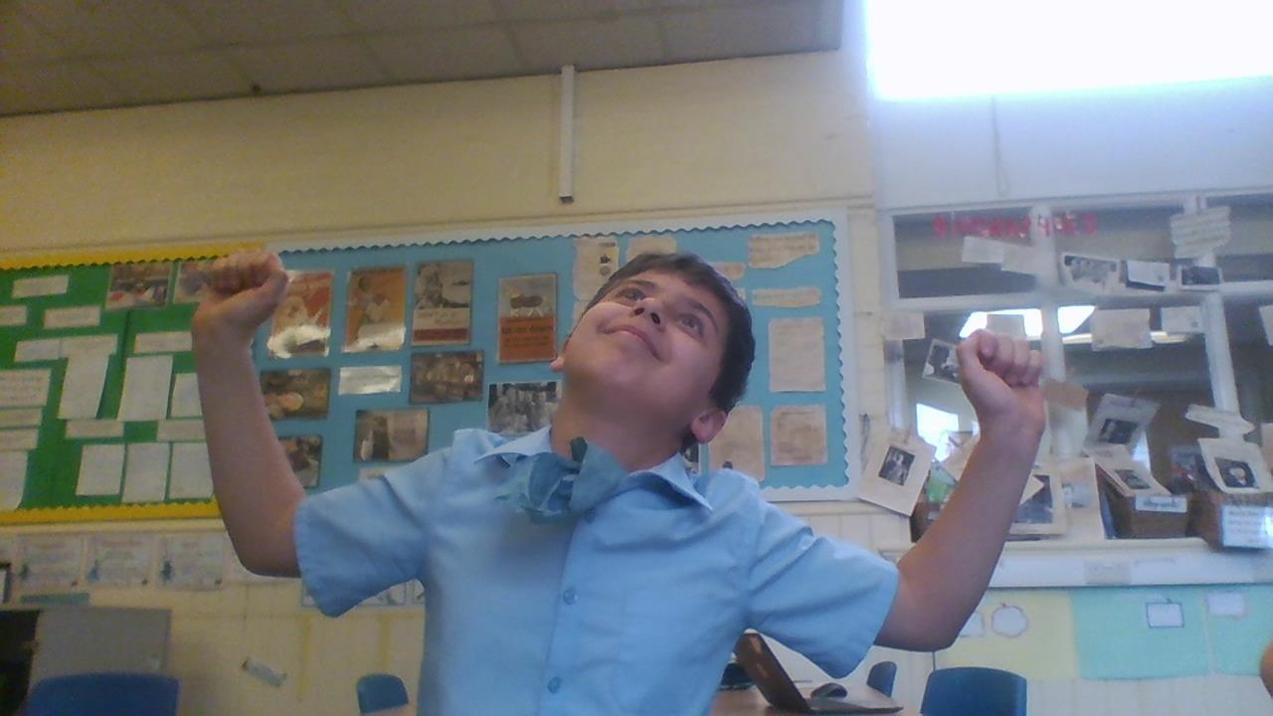
Even the original cactus likes it.

Slide 4
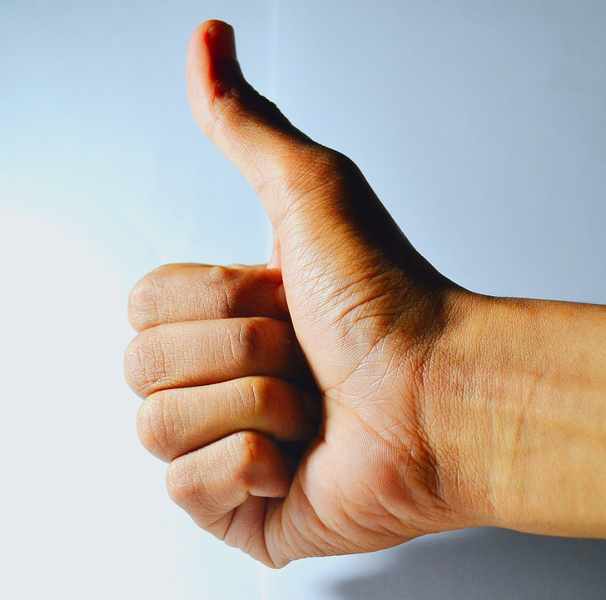
A quote from a happy customer
“It was amazing ,I have never had a drink of something more exquisite.”

Slide 5
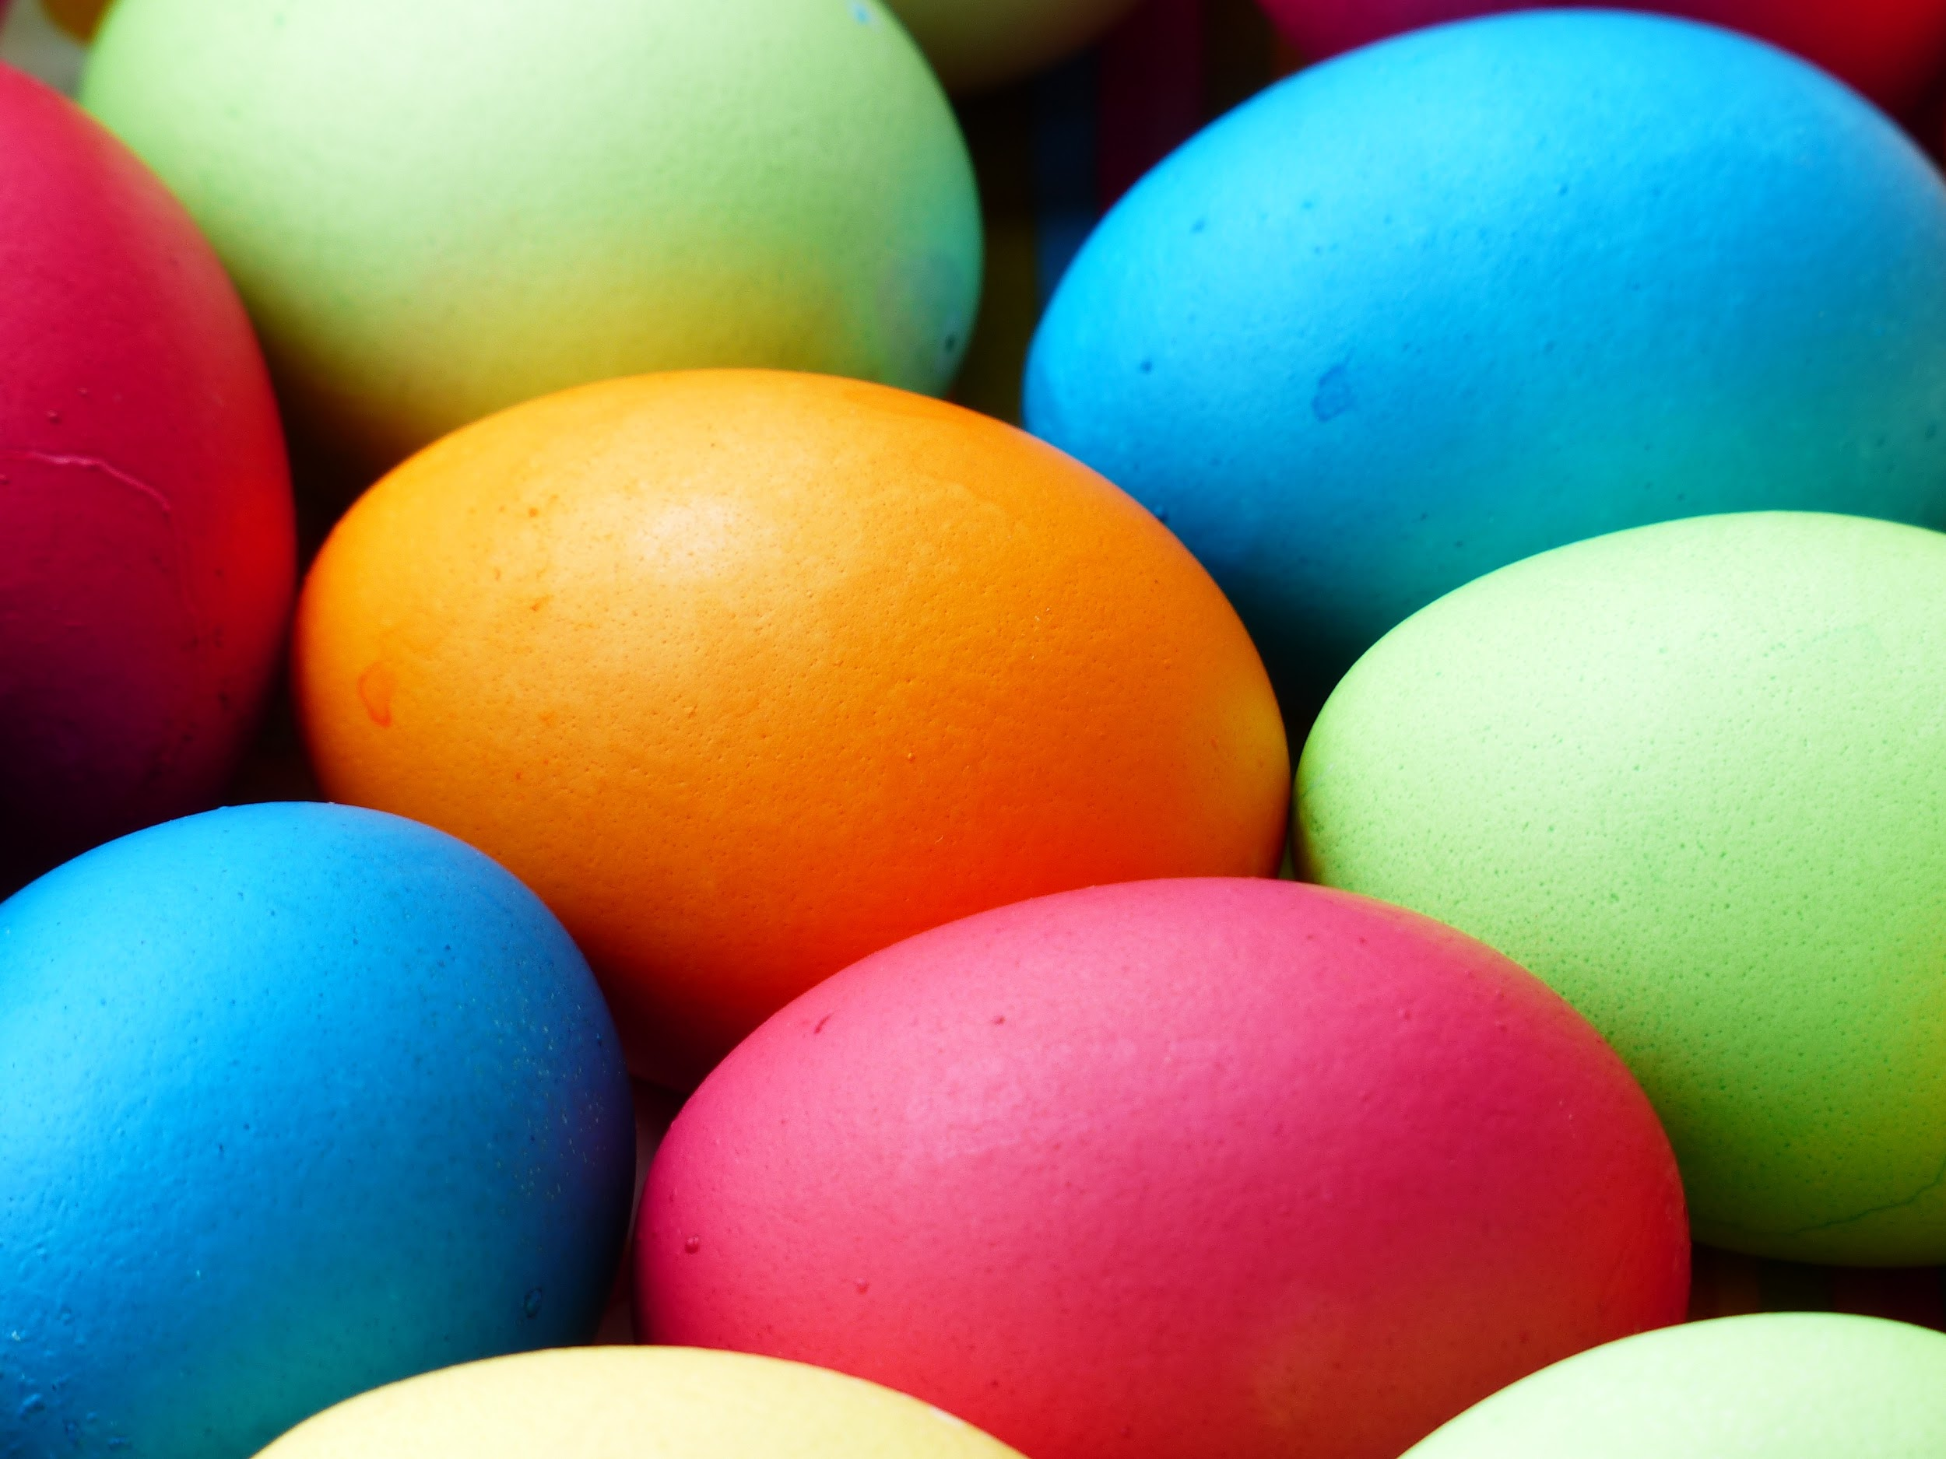
You will find this drink at the Easter Bingo.
If we win.

Slide 6
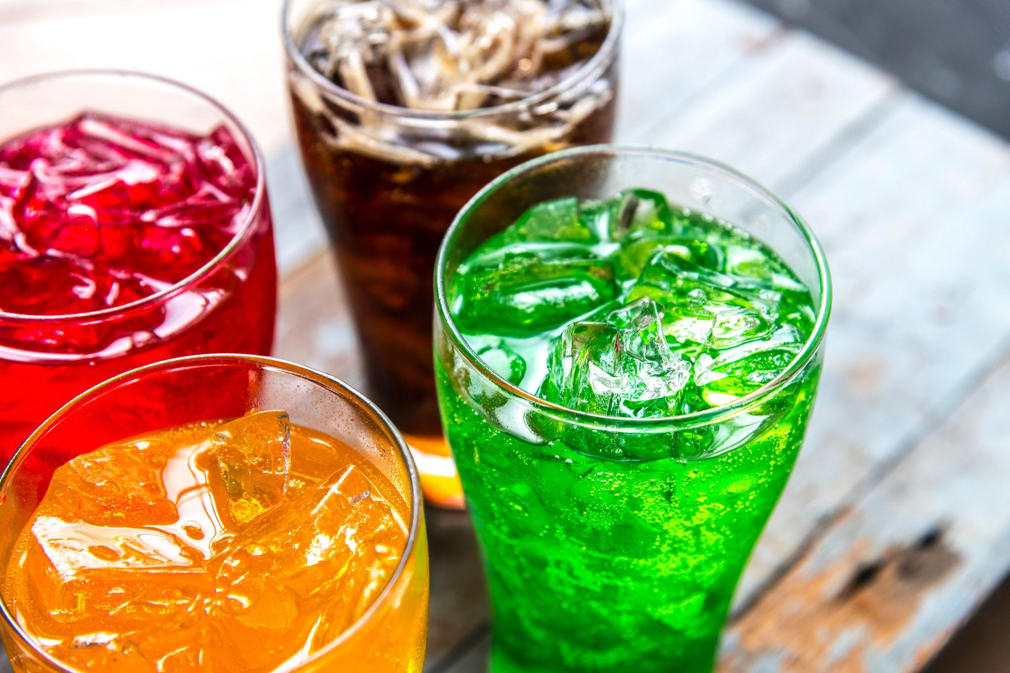
Hope you enjoy our delicious and amazing beverage.

Slide 7
Thank you for listening .
By Benjy, Charlie, Matthew and Jacob

