Slide 1
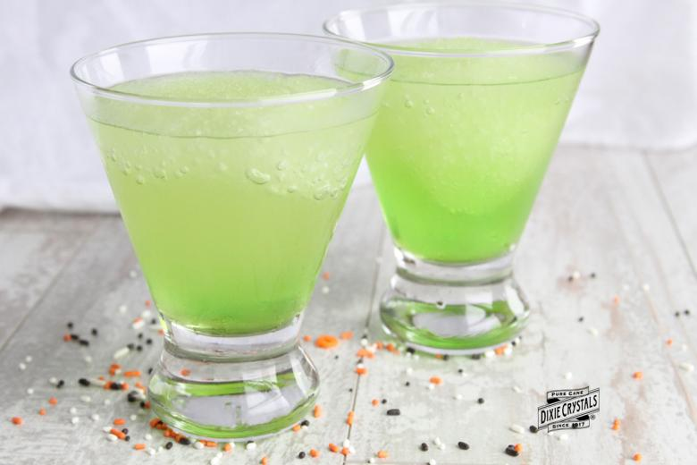
Fizztastic Jolly Juice
Fizztastic Jolly Juice
By Jack, Tobias, Adam and Will
By Jack, Tobias, Adam and Will

Slide 2
How to make our cool concoction!
3 cups of Fantastic Fanta
3 cups of Lovely Lemonade
3 cups of Sassy Summer Fruits Cordial
3 cups of Awesome Orange Cordial
2 cups of Perfect Pineapple Juice
2 cups of Amazing Apple Juice
And a drop of our secret ingredient!
This will produce 15 cups of dazzling drinks for you and your friends.

Slide 3
Are you tired of boring beverages that don’t have that zing? Then try our Fizztastic Jolly Juice! Only once in a lifetime will you taste this glory and magic in a cup!

Slide 4
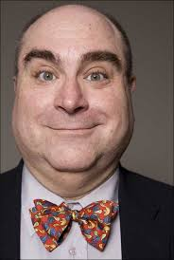
“Try this great drink, you wont regret it!”
Cool Guy
“I will never stop drinking it for next 500 years in which i will live!”
Cool Dude

Slide 5
Thank you for listening
We hope you will enjoy our craved creation. Our hard work and effort went in to making it.
Only available 1-2 times!

