Slide 1



Notes:
Introduce Road Safety Week 2017
Road Safety Week 2017 (20-26 November) will focus on the topic of speed.
Speeding is a big problem in the UK and is a contributory factor in nearly a quarter of fatal road crashes.
Road crashes are the second biggest cause of death among young people aged 5-19. All children and young people use roads and most have experienced road danger, plus children’s health and lifestyles are often heavily influenced by their family’s travel choices and local road safety.
Driving is unpredictable, and if something unexpected happens on the road ahead – such as a child stepping out from between parked cars – it is a driver’s speed that will determine whether they can stop in time and, if they can’t stop, how hard they will hit.
As well as reducing the number of road casualties, there are other benefits to lowering the speed limits in towns and where people live – it encourages more people to walk or cycle, which in turn reduces pollution and improves people’s health.
We all live busy lives and there is often a temptation to speed up in the hope of saving time, where in fact we could be costing lives.
That is why we are encouraging everyone to Speed Down Save Lives for Road Safety Week 2017.

Slide 2
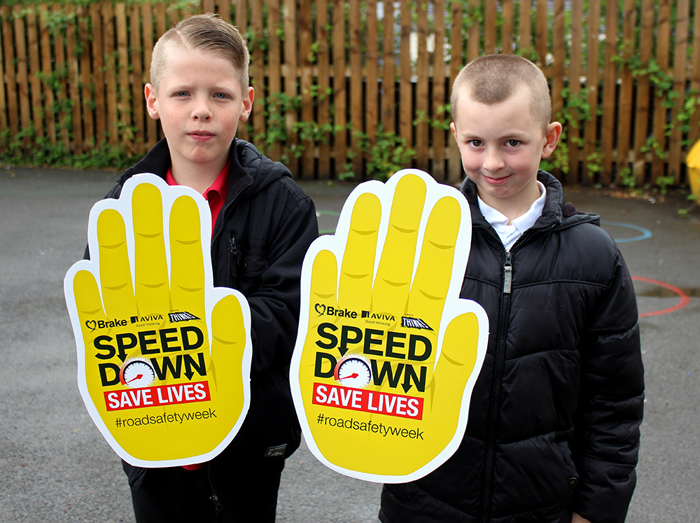
We’re supporting Road Safety Week
Notes:
We’re supporting Road Safety Week
Explain to the pupils that you are going to be talking about speed and stopping distances and why drivers should keep to 20mph in places where people live.
Suggested script:
Pupil 1: We’re supporting Road Safety Week.

Slide 3
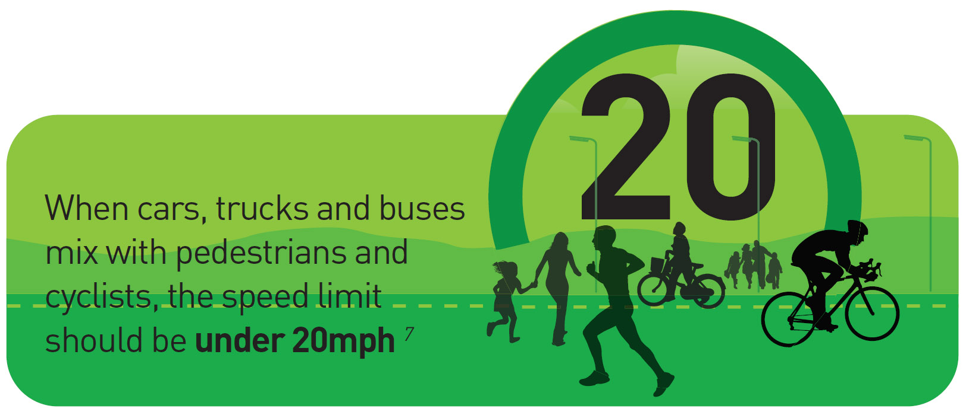
Notes:
Suggested script:
Pupil 2: In places where traffic mixes people walking and on bikes, the speed limit should be 20mph.

Slide 4
Stopping distances increase with speed
Notes:
Stopping distances increase with vehicle speed
Suggested script:
Pupil 3: Do you want to know why? Well, when a car is travelling at 30mph it takes 23 metres to stop. That’s nearly the length of 6 cars.
Pupil 4: When a car is travelling at 20mph it only takes 12 metres to stop. That’s the length of 3 cars.
Use big pictures of cars the children have drawn or mark out the distances across the assembly hall. Show how even if you are what feels like a long way away from a car, the driver may not be able to stop in time

Slide 5
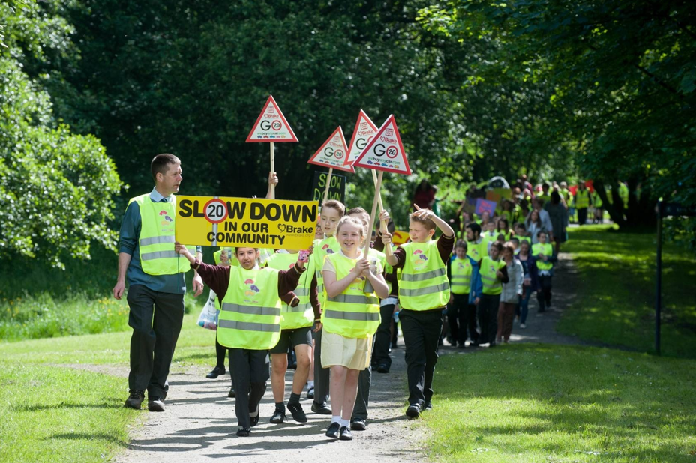

20s plenty in places where people live
Notes:
20s plenty in places where people live
Suggested script:
Pupil 5: We want drivers to drive more slowly and slow down to 20mph in places where people live (not just outside our school).
Pupil 6: That’s why we are launching a school poster competition to ask all drivers to Speed Down and Save Lives in our community.

Slide 6
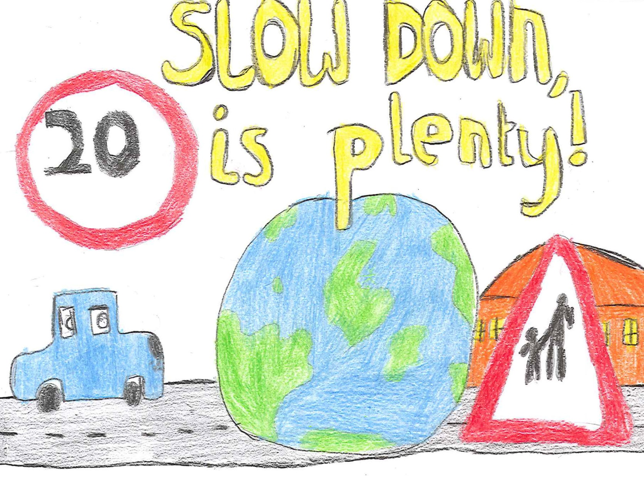
Notes:
School poster competition
Ask the pupils to think about the journeys they make: to school, to visit a friend or relative, or to go to the park.
Tell them they need to design a road safety poster calling for all drivers to ‘Speed Down Save Lives’ in their community.
Posters should explain to adults why driving too fast in places where people live is bad, using bold, bright, imaginative designs, perhaps including some facts about speeding such as the stopping distance for cars travelling 20mph (12 metres) and 30mph (23 metres) or simple statements about slowing down and staying safe on our roads.
There are lots of resources in the action pack to give you further ideas for what to include in a poster.
Next slide has another example of a poster

Slide 7
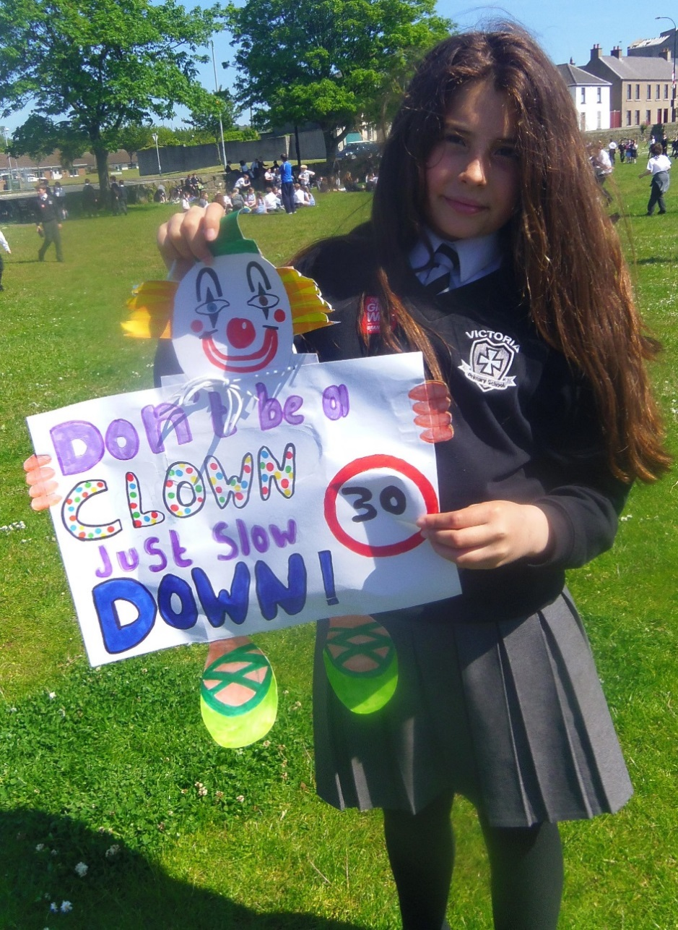
Notes:
Poster competition (continued)
Here’s another example of a road safety poster

Slide 8

Notes:
Quick quiz
Divide the hall into two for a quick quiz. Let’s see what you know about/what you can remember about road safety?
Which two senses should you always use to cross the road safely? (sight and hearing)
Name three places where it is safer to cross the road (three from the following list: subways, footbridges, zebra crossings, puffin crossings, pelican crossings, traffic-light crossings, school crossing patrol/lollipop person)
Name three places you should avoid crossing the road – sharp bends, just before the top of a hill, near parked cars
What do you do if traffic is coming? (let it pass)
True or false? “It’s OK to run across the road if you are in a hurry.” (false – give reasons)
What should the speed limit be in places where people live? (20 mph)
What’s the stopping distance for a vehicle travelling at 20 mph? (12 metres or 3 car lengths)
What’s the stopping distance for a vehicle travelling at 30 mph? (23 metres or nearly 6 car lengths)

Slide 9

Notes:
Time for reflection
Teacher: Let us all close our eyes. Think about the roads that you cross every day on your journey to school, to visit a friend or relative, or to go to the park.
How can you use your eyes and ears to make your journey safer?
How can we help our grown-ups be safe too?

Slide 10
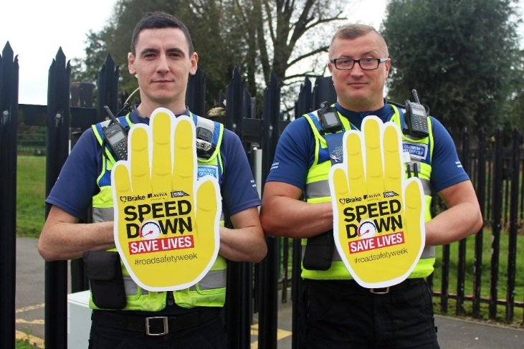

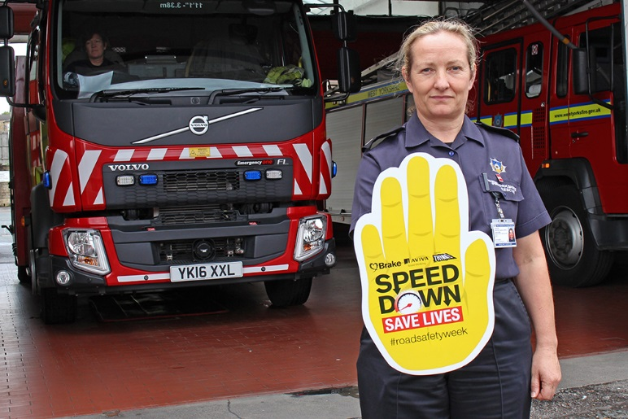
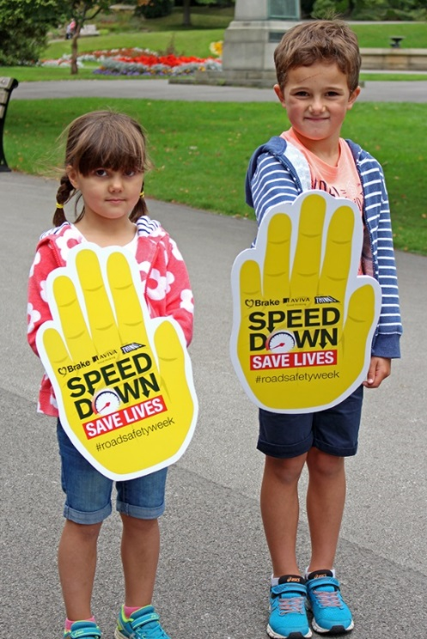
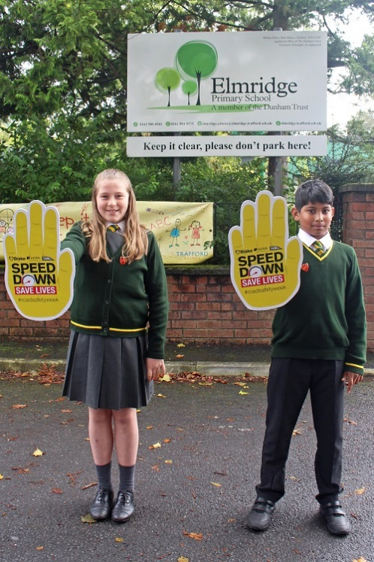
We’re all supporting
Road Safety Week
Notes:
End
End by reminding the pupils about the task set at the start of assembly and ask who can tell you what the extra picture/item is in the hall/room. Tell the pupils they will be learning more about road safety throughout the week.
You could also:
Ask pupils if they know what they should do when they cross a road (introduce or reinforce the Green Cross Code).
Ask pupils which number they should call in an emergency.
Ask pupils if they know which service to ask for if someone has been hurt in a road crash.

Slide 11
Notes:
Remind pupils of main message of Road Safety Week… speed is a factor in many car crashes.
Speed Down Save Lives

