Slide 1


Bretherton Endowed Parent Google Classroom Virtual Meeting
3/12/20

Slide 2

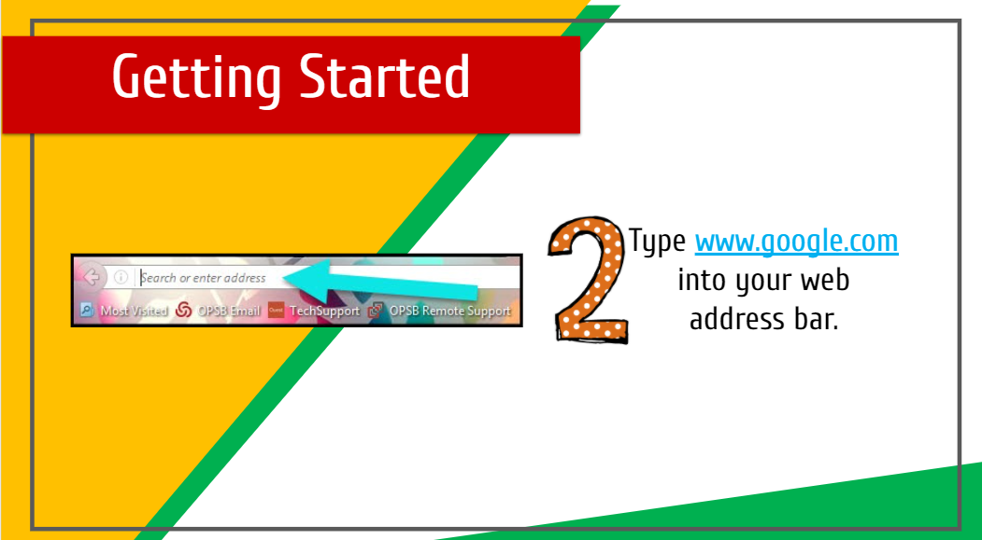
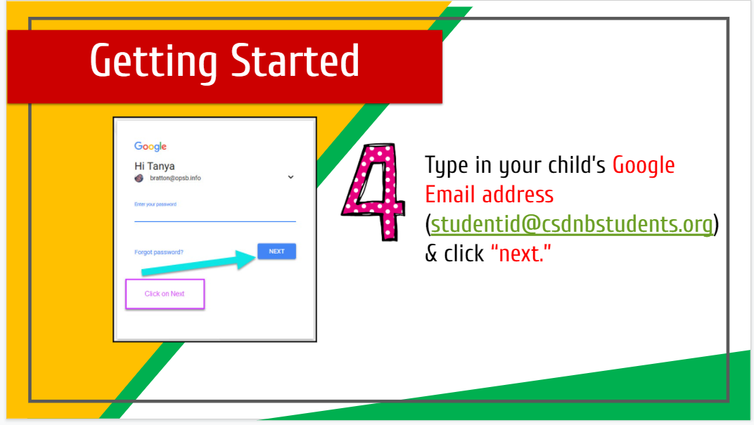
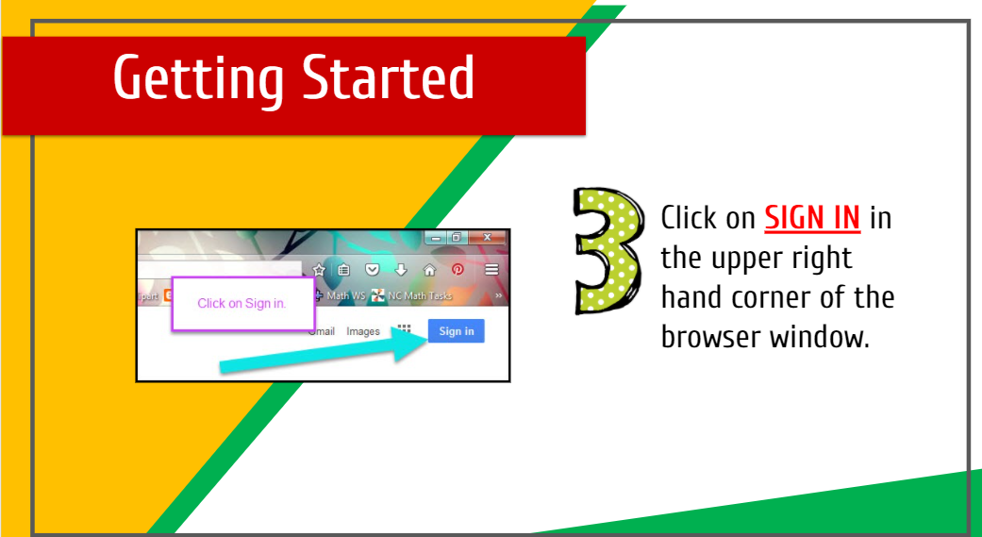

Slide 3
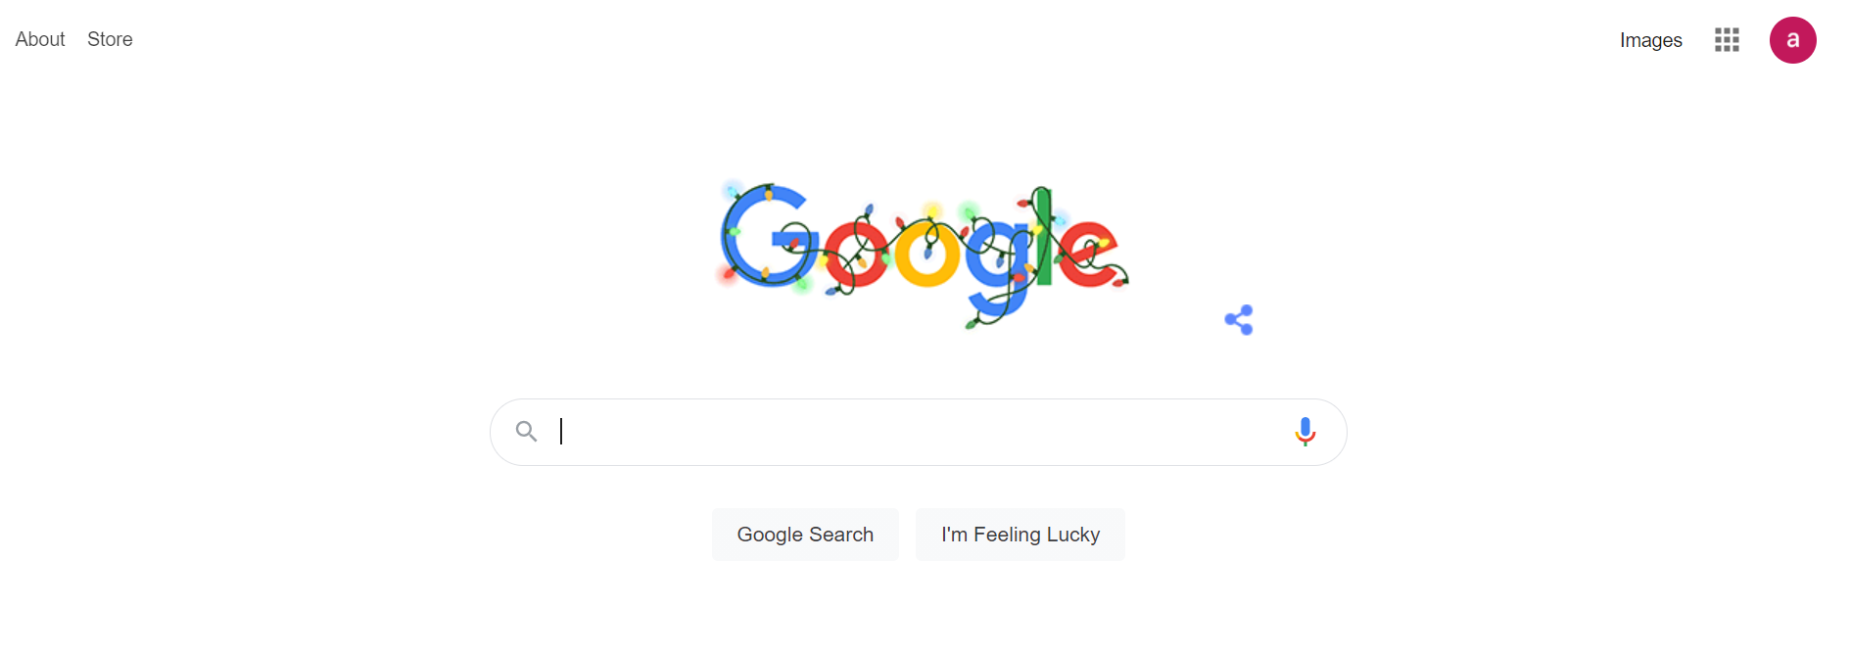
If there is an initial, you are signed in. You should have a ‘Sign in ‘ blue box.

Slide 4
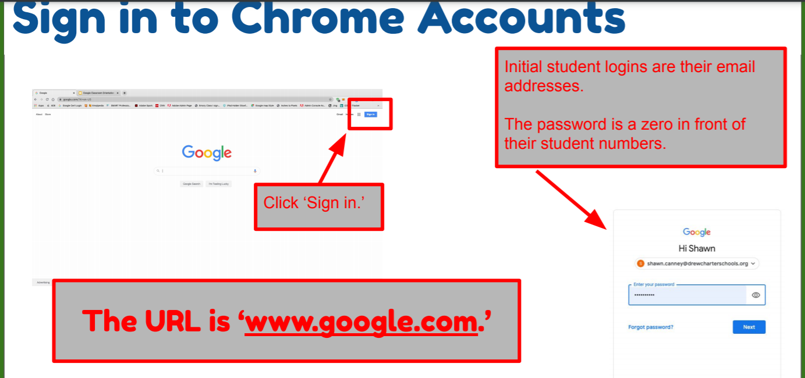
Child’s login is their name@bretherton.lancs.sch.uk and their password is their own.
The school office, Mrs Allchurch or Mrs Moxham can reset if forgotten easily.

Slide 5
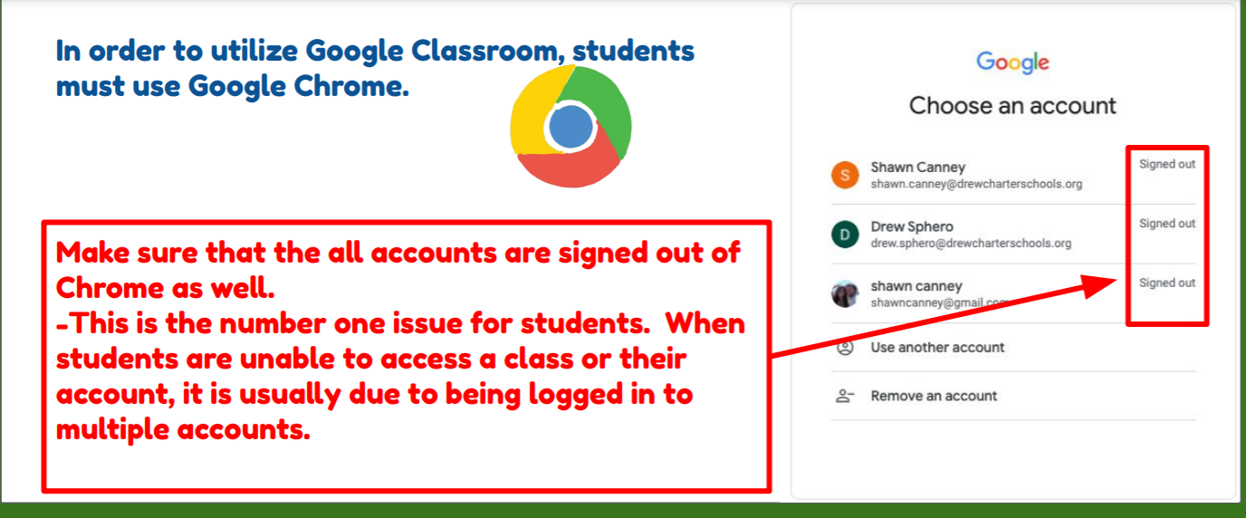

Slide 6
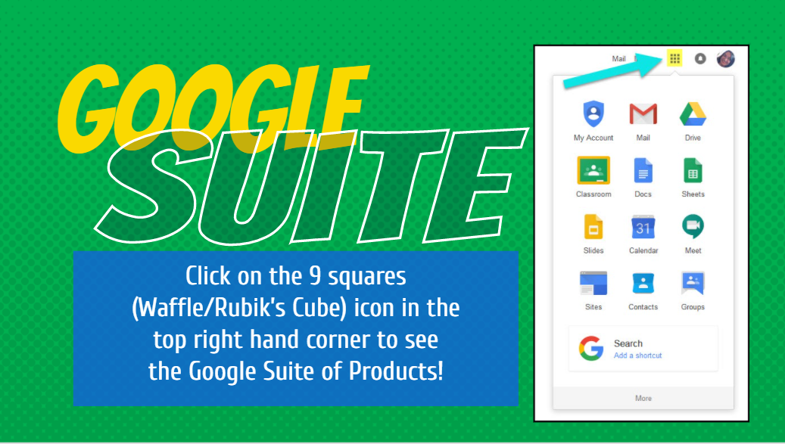

Slide 7
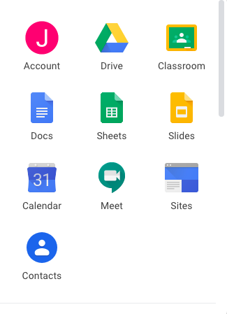
Account – Details of their account
Drive – Where their work is saved. It is a cloud
Classroom – where their work is set and feedback given
Docs – like word and edited and saved in real time
Sheets – like excel
Slides – like powerpoint
Calendar – can be used by the child but not used by school
Meet – Where you can arrange ‘zoom’ calls but disabled for children in school except when arranged by staff
Contacts – not used by school- disabled for children

Slide 8
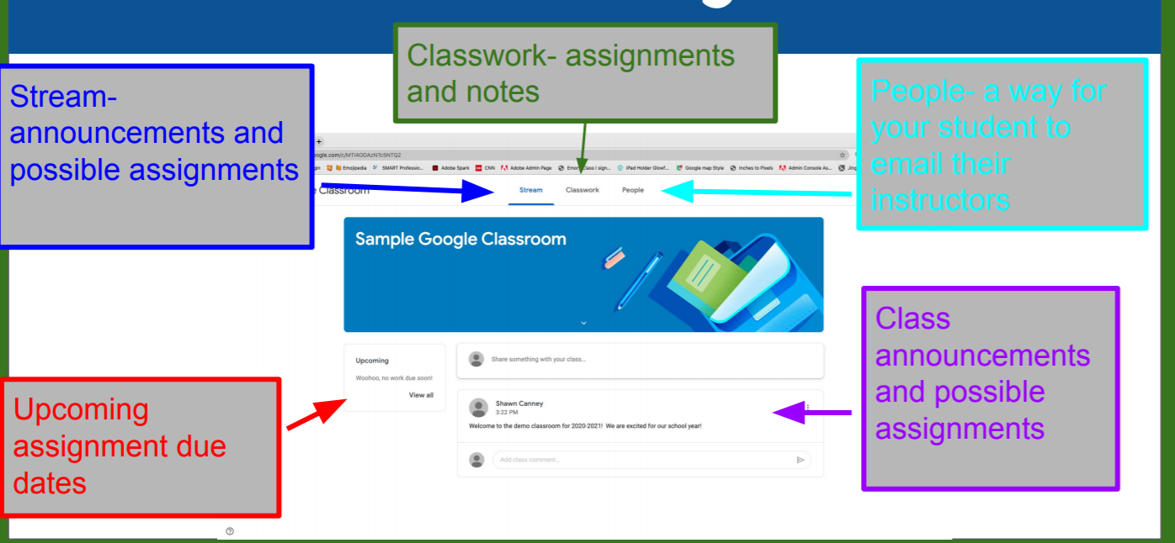
This contains a list of the children within the class. We have disabled direct contact to the children from this area.

Slide 9
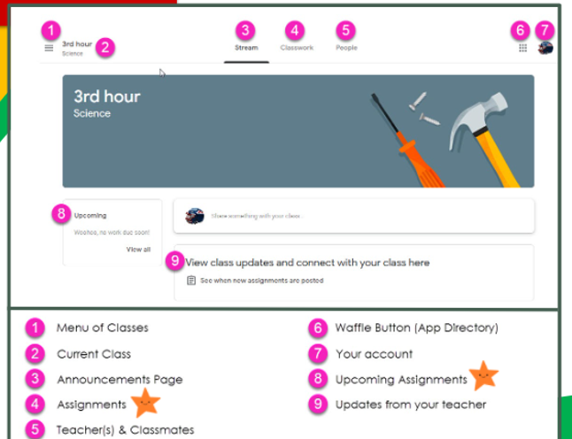

Slide 10
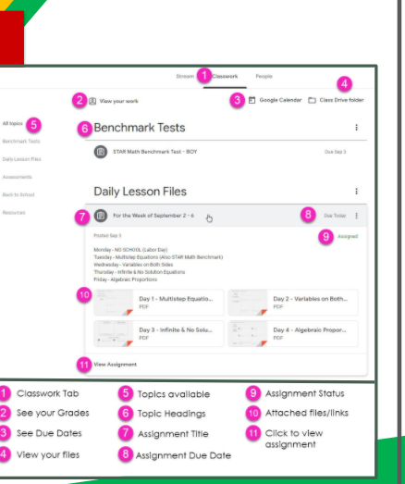

Slide 11
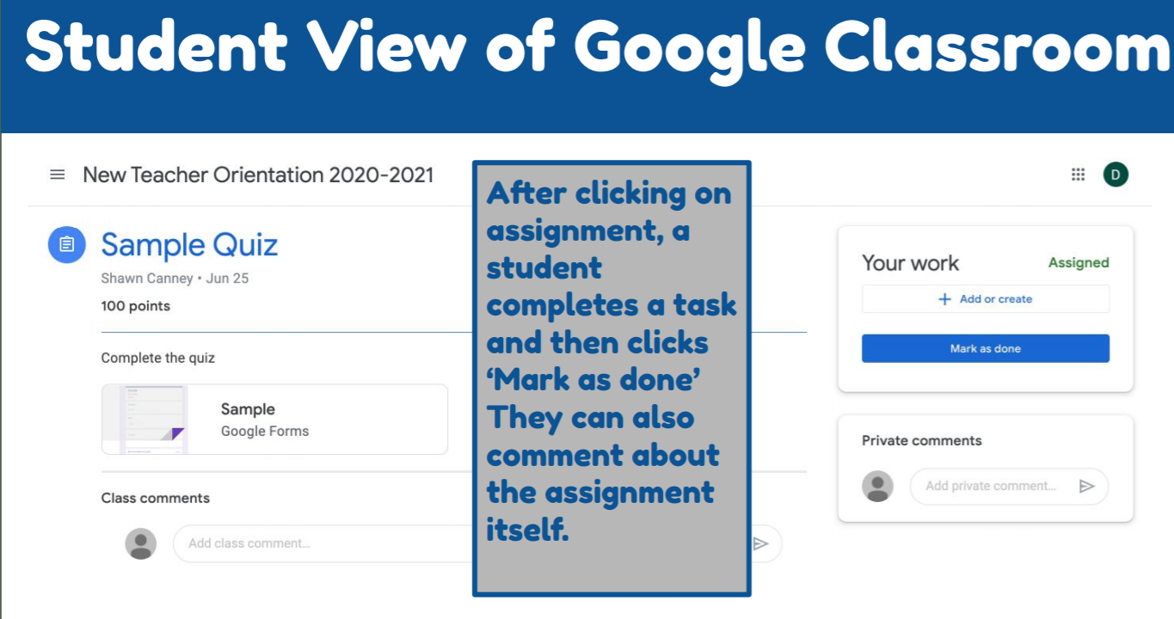

Slide 12
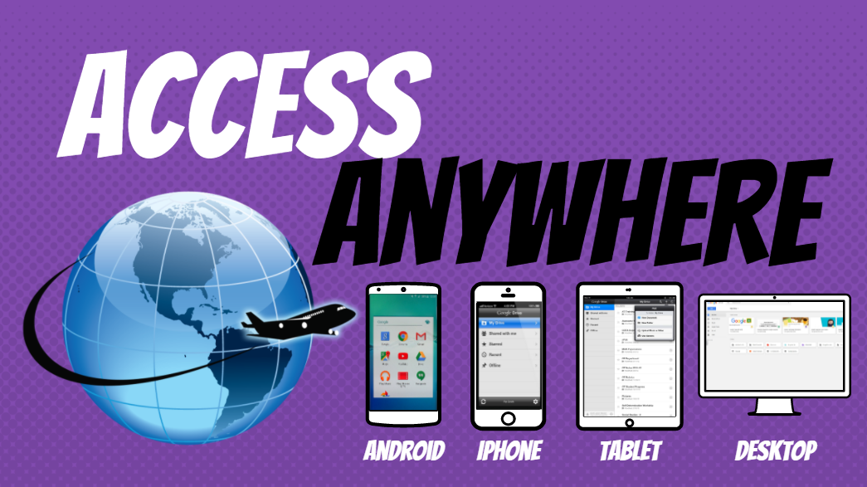

Slide 13
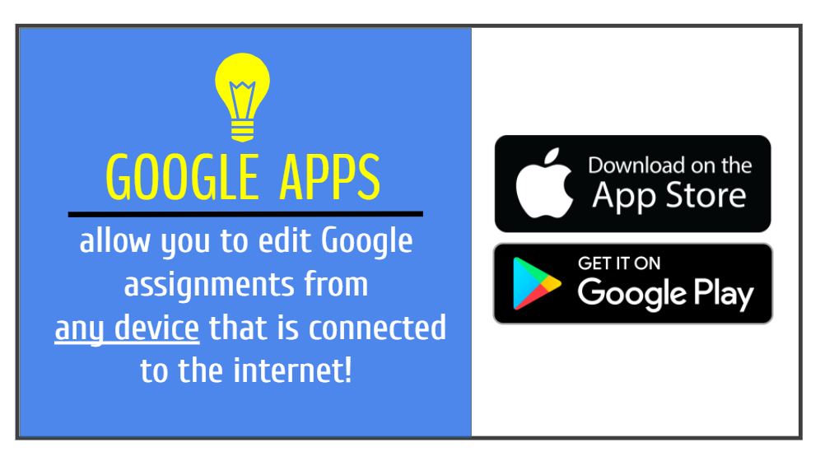

Slide 14
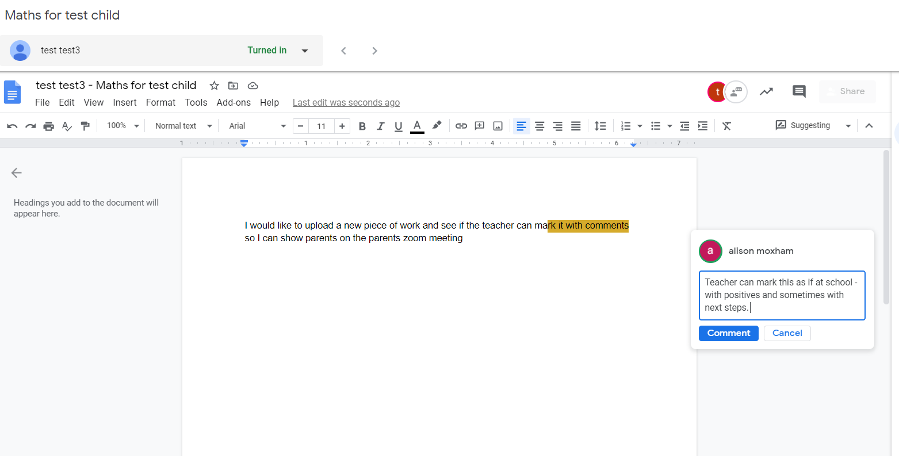
What happens when your child ‘Turns in their homework’?

Slide 15
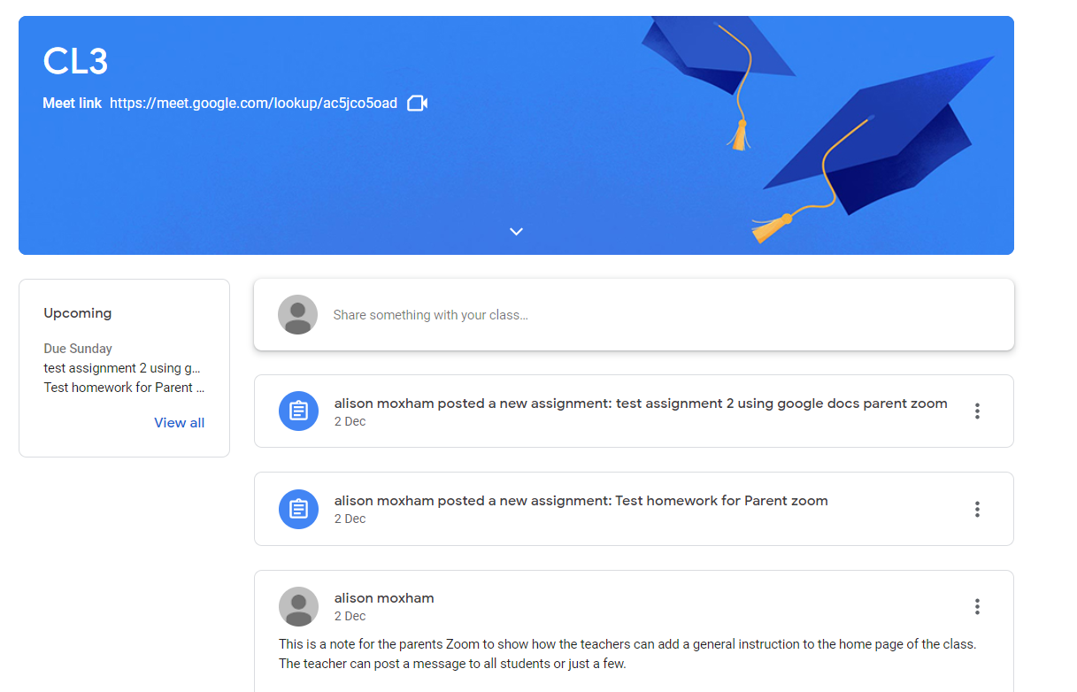

Slide 16
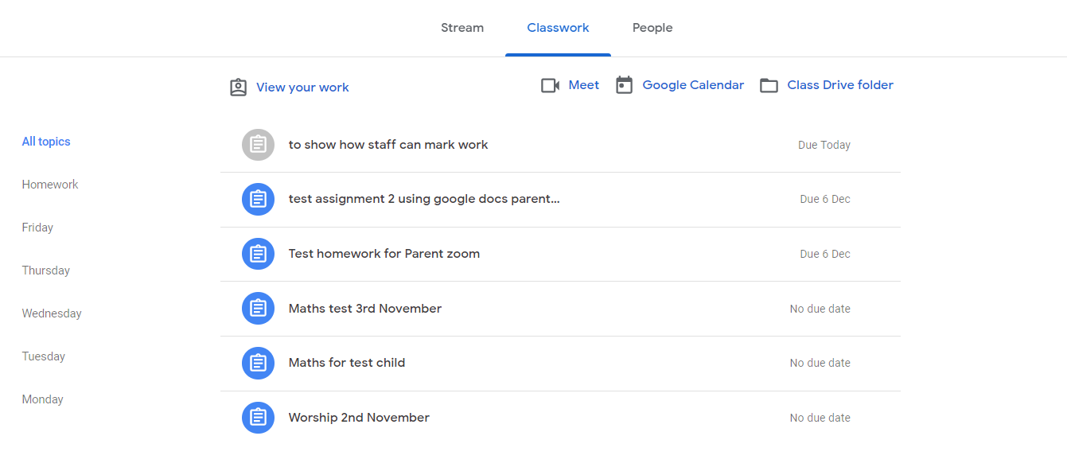

Slide 17
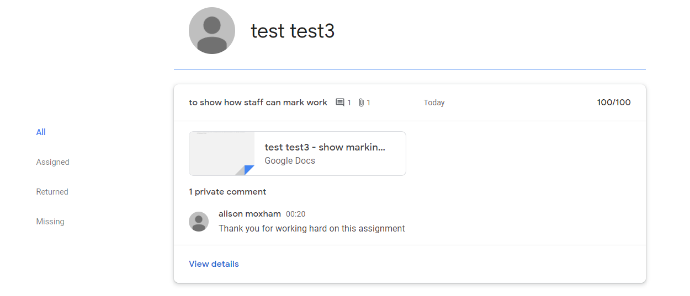

Slide 18
Things we have learned and we need to develop further
We need to return all documents /homework to child otherwise it won’t be included in their ‘DRIVE’ so they won’t be able to access again
Private comments can be read by teacher and responded to
Teachers will not respond to homework that has been turned in but not uploaded

