Slide 1
Sustaining 2022/23
Core Focus
Mastery Principles

Slide 2
Purpose of a Mastery Curriculum
Mastery Principles
Leadership of a mastery curriculum.
Notes:
Throughout the session we would like you to think about your practice, but focus on the whole school. Think about all teachers and support staff involved with teaching maths. Is there knowledge secure? Do they understand why they are teaching certain things? Are your systems consistent?

Slide 3
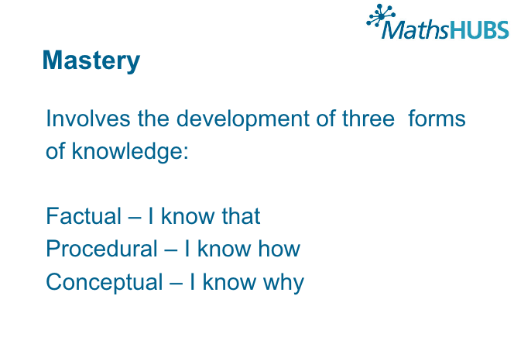

Slide 4
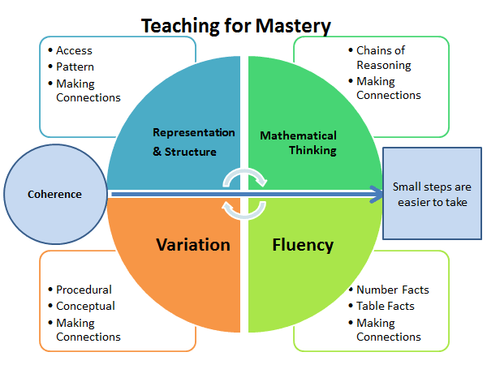
Principles of a Mastery Curriculum
Notes:
Not a tick list
Understanding of principles in own SOW

Slide 5
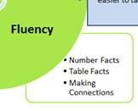
What is fluency?
Quick and efficient recall of facts and procedures and the flexibility to move between different contexts and representations of mathematics
NCETM
Notes:
Theory – cognitive load

Slide 6
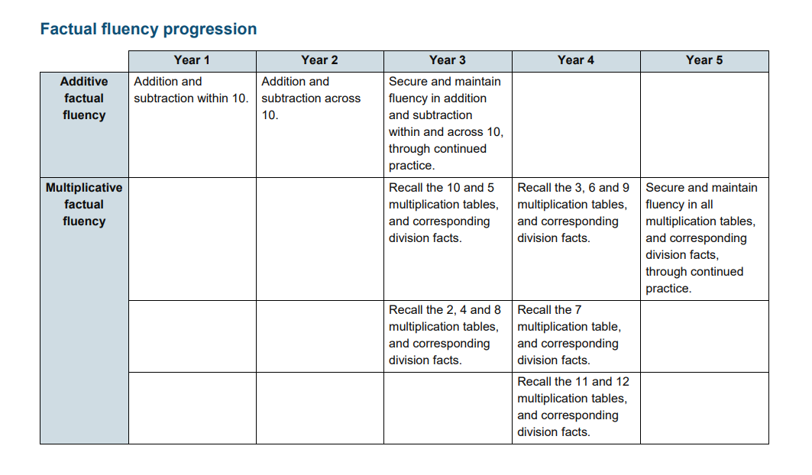
What do children need to be fluent in?

Slide 7
We must teach children the fact/skill and then practice to become fluent.
Counting
Strategy
Just Know

Slide 8
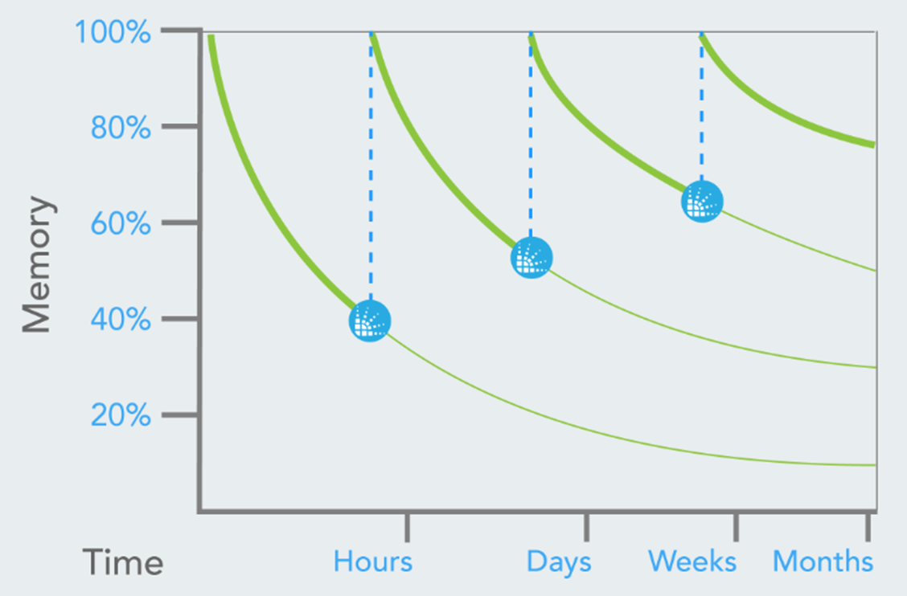
Inter-Leaving

Slide 9
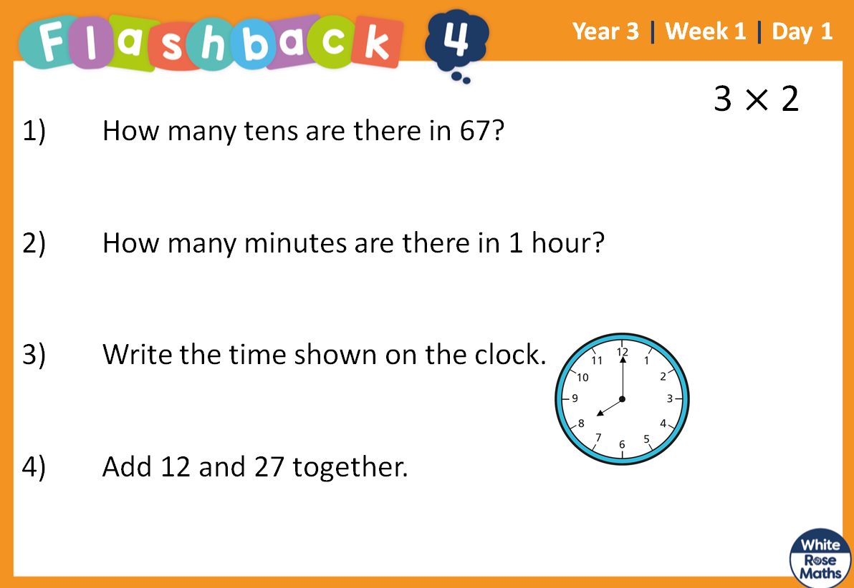
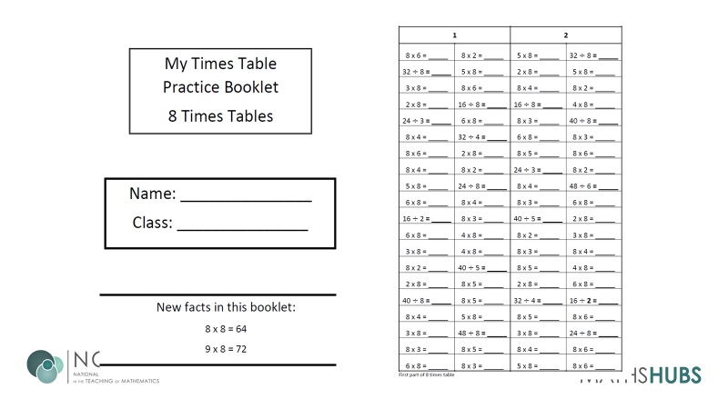
Retrieval Skills
Notes:
Times table booklets

Slide 10
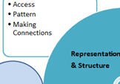

Slide 11
REPRESENTATION AND
STRUCTURE
The abstract nature of learning is a mystery to many children and therefore needs to be scaffolded by the use of effective representation

Slide 12
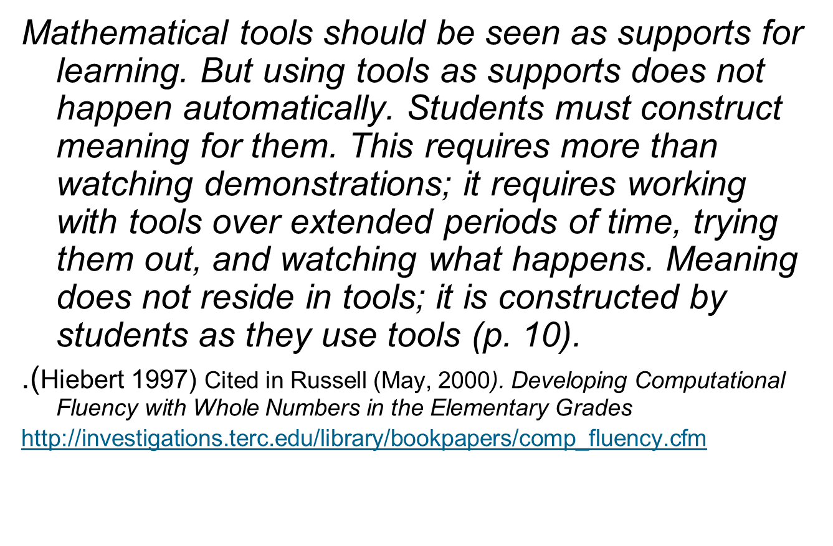
Notes:
What do want, how do we get them, application of skill

Slide 13
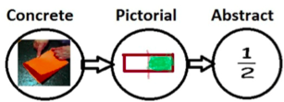
Concrete Pictorial
Abstract
The CPA approach helps children learn and build on existing ideas by introducing abstract concepts in a more familiar and tangible way.

Slide 14
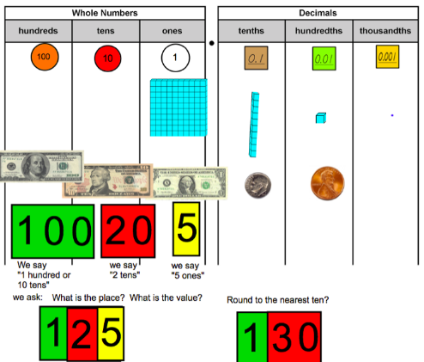
Jean Piaget’s (1951) work suggests that children aged seven to ten years old work in primarily concrete ways and that the abstract notions of mathematics may only be accessible to them through embodiment in practical resources.
Notes:
Emphasis KS2

Slide 15

Notes:
Bring a box as an example
Resources match with SOW

Slide 16
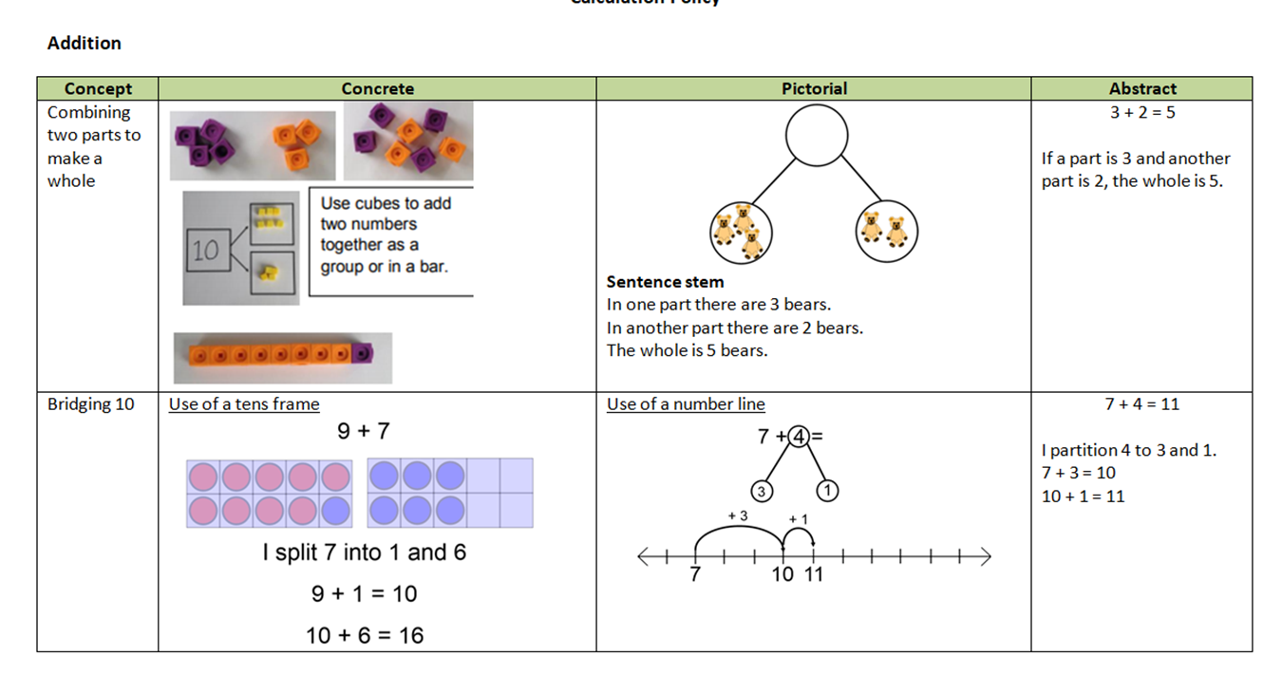

Slide 17
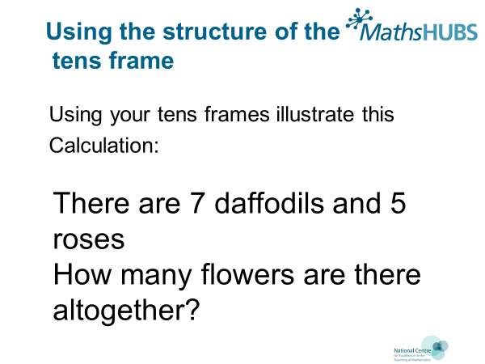

Slide 18
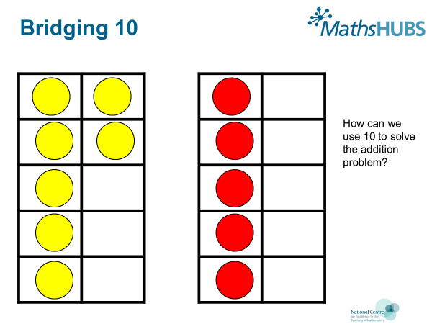
Notes:
Tens frames

Slide 19
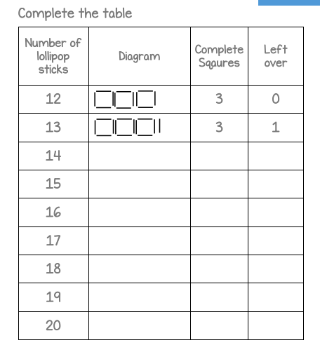
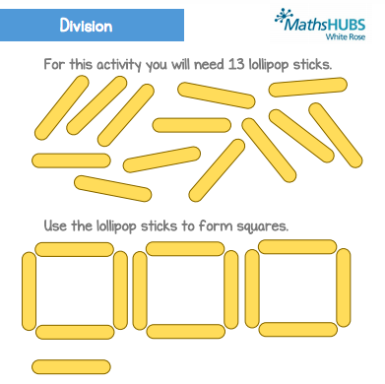
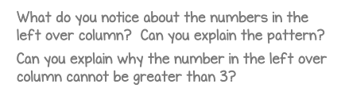

Slide 20
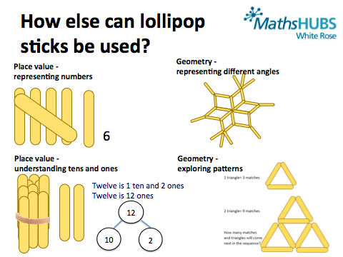

Slide 21





Multiple representations
13 ÷ 4 = 3 remainder 1
Tens | Ones
Notes:
Show your staff the different representations.
(i) Counters shared between 4
Can be done physically with bean bags and hoops or counters and circles. However the grid is ideal for bar modelling (sharing).
(ii) Grouping with place value counters
Start by making the number 13. This could also be done with base 10. Look at the tens: can I make any groups of 4? No, but can I make an exchange? Yes, I exchange one ten for ten ones. I can make 3 groups of 4 with one left over.
(iii) Rods and rulers for repeated subtraction
We want to see how many fours go into 13. Pupils should start at 13 on their rulers and use the Cuisenaire rod that is worth 4. They must always arrive at 0. Three whole fours with 1 left over go into 13.
(iv) Numicon encourage grouping
Start by making the number 13. How many fours go into 13? Place the number four alongside the number 13. Three fours with one left over make 13.

Slide 22
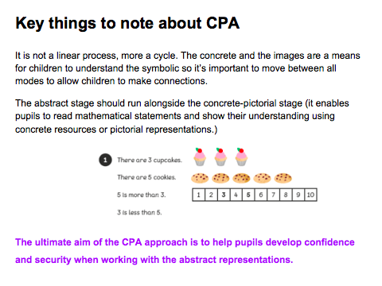

Slide 23
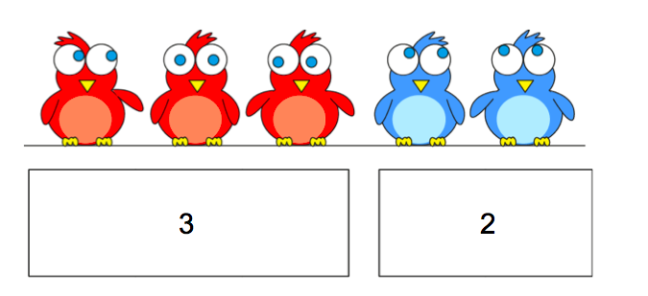
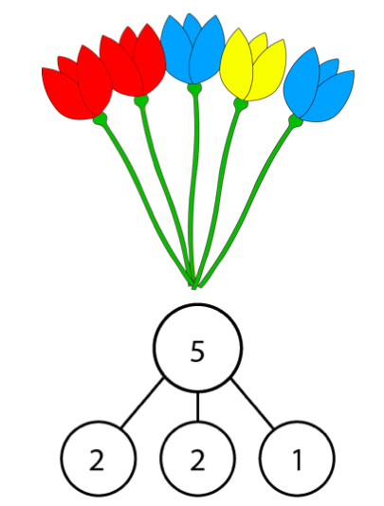
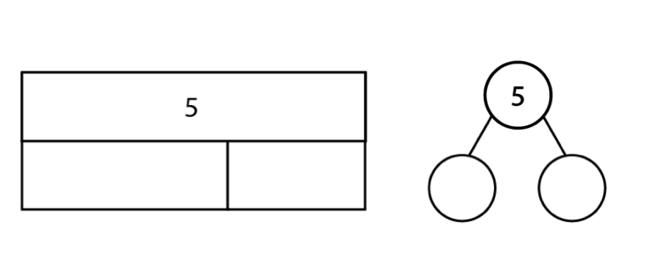
Models
The part-part whole (also known as the cherry diagram) and bar models are excellent tools to help children to represent the mathematics. They can be used in the concrete, pictorial or abstract form.

Slide 24
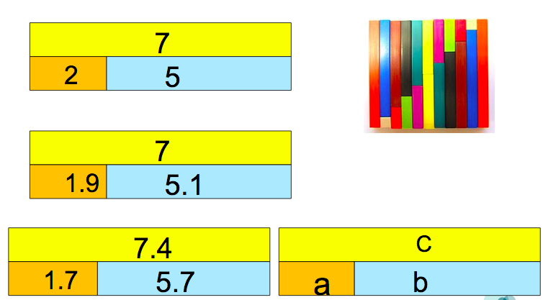
Developing depth/simplicity/clarity.
Notes:
A simple bar model can go into some deep concepts in maths but helps children to understand the structure of what is happening.

Slide 25
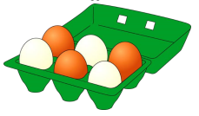
Stem Sentences
An important element of representation and structure which can easily be overlooked.
_______ is the whole; ____ is a part and____
is a part.
Notes:
With stem sentences, the teacher asks children rehearse sentences out loud during the lesson which demonstrate the structure of the maths and help them to verbalise what is happening. It helps the children move to working in the abstract.
Allow participants a bit of time to have a go rehearsing the sentences e.g. the egg box and the eggs are the whole, the white eggs are a part and the brown eggs are a part.

Slide 26

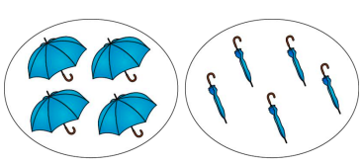

Example from Year 1 Additive Structures. (NCETM Curriculum Prioritisation) link to planning here
'Throughout, encourage children to link the concrete/pictorial and abstract representations by describing the expressions in full sentences, using the following stem sentences:
Notes:
This is an example from a Year 1 lesson. Discuss how it makes reference to children using the full stem sentence to explain their observations. Encourage participants to have a go with the examples given and discuss how the stem sentences will help to improve children's understanding of the additive structure.
How might it help children who typically struggle? How might it help those 'fast finishers?' The benefit for many children who might take longer to understand new concepts is that they hear other children explaining the maths in full sentences which helps them to hear and understand what is happening.

Slide 27
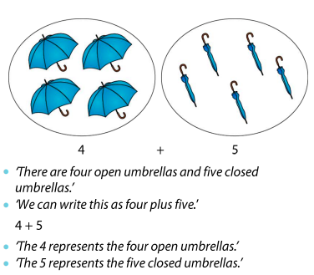

Slide 28
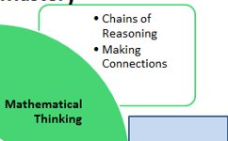
If taught ideas are to be understood deeply, they must not merely be passively received but must be worked on by the student: thought about, reasoned with and discussed with others

Slide 29
Some ideas for Mathematical Thinking.
Problem solving/reasoning questions which require children to apply what they have learnt in a different context.
Always, sometimes, never statements.
Questions that require investigation.
‘Convince me’ or ‘prove it’ statements.
Questions where children have to spot the mistake and correct it and/or offer an explanation.

Slide 30
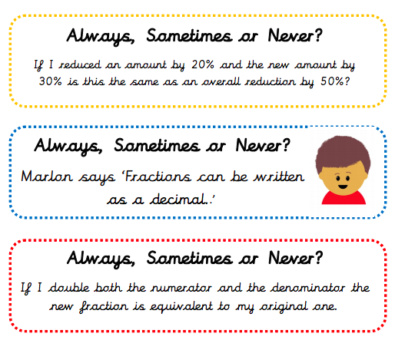
Resources – Deepening Understanding
Year 6
Fractions
Decimals
And
Percentages
Notes:
Deepening Understanding has some great resources for mathematical thinking and adding extra challenge into lessons. They can be very challenging!

Slide 31
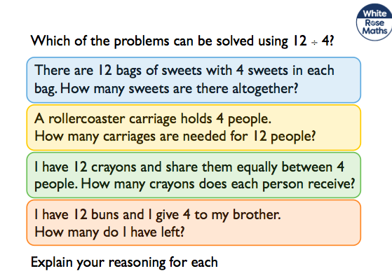
White Rose

Slide 32
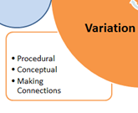

Slide 33
Variation
This is generally perceived as one of the most valuable experiences within Chinese mathematics education community ( Sun, 2011).

Slide 34
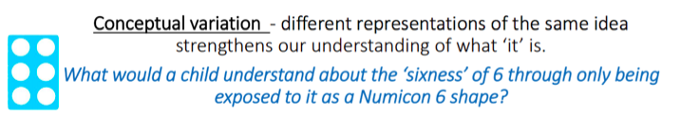
Conceptual Variation
Notes:
Have a discussion around this slide. Would we be limiting children's understanding if we only showed them this representation of 6. What might then happen if they saw 6 introduced in another format?
Can participants think of any areas in maths where we might be limiting understanding through the representations we tend to show?

Slide 35
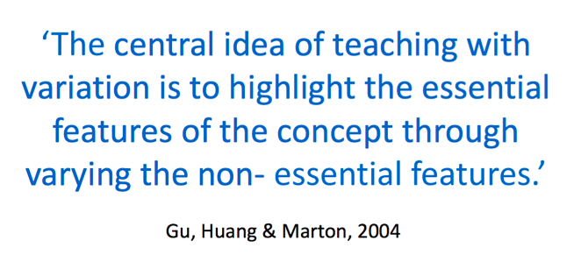
Notes:
Add hyperlink

Slide 36
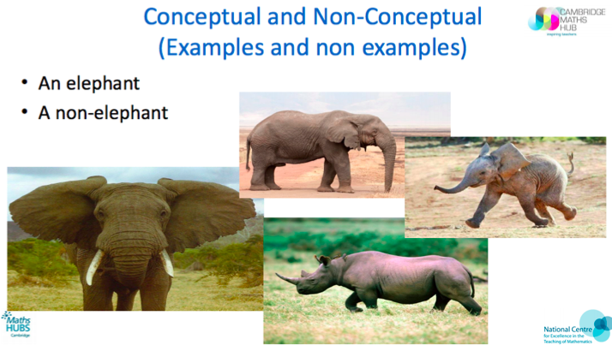
How could this slide be used to generate discussion on conceptual variation with staff back at school?

Slide 37
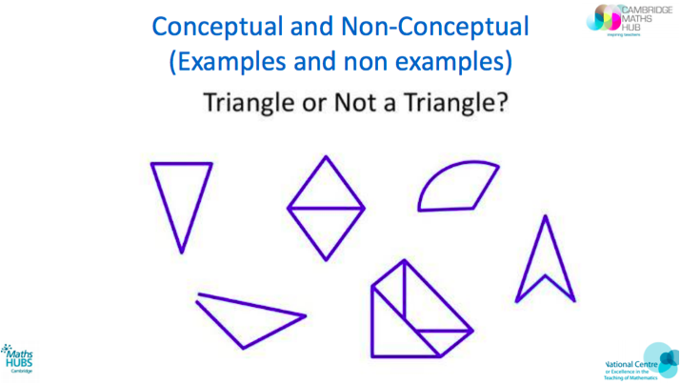
Children gain a deeper understanding about what something ‘is’ by also understanding what it ‘isn’t’
Notes:
How do we present things to children?

Slide 38
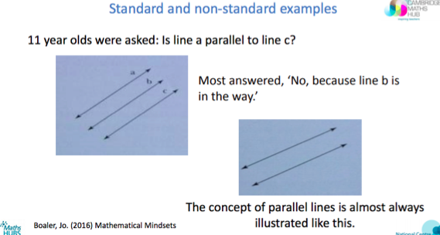
Why is conceptual variation so important?
Notes:
Have a quick discussion about why conceptual variation is so important. If children are only exposed to one example then they may not be able to recognise it in a different context like in this example.

Slide 39
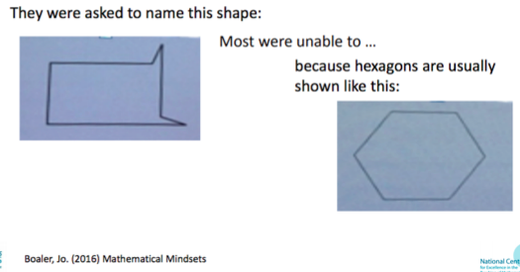
The images they were used to seeing had limited their understanding

Slide 40
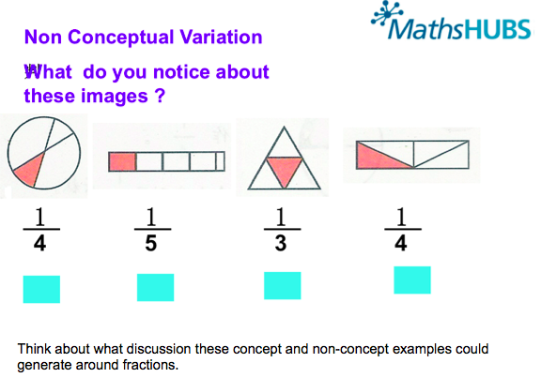
Notes:
Conceptual variation is a good tool for drawing out misconceptions and should be explicitly taught in order to tackle them (and avoid those SATS confusions!)

Slide 41
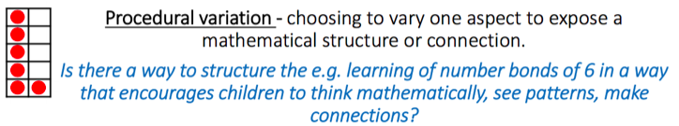
Procedural Variation

Slide 42
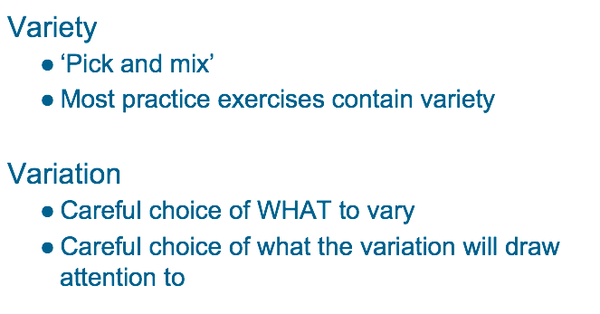
Variation versus Variety
Notes:
To think about variation, it is useful to think of variation in comparison to variety.
An independent task using 'variety' would be randomly chosen numbers which give children practice with a given skill, such as adding.
A task using 'variation' uses carefully chosen examples, perhaps changing one thing each time to draw children's attention to pattern and enable them to make connections with their maths.

Slide 43
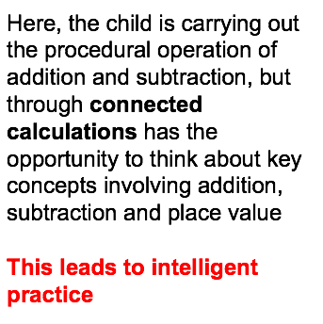
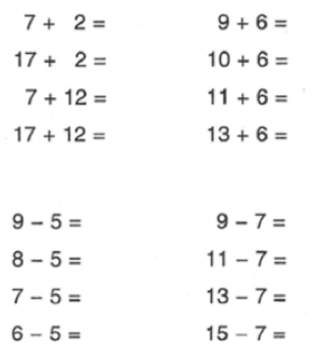
Notes:
“intelligent practice” this involves carefully constructed and sequenced question sets. The idea is to ”minimally vary” non-essential features of the question. Only one aspect varies each time.
Ask participants to add some further calculations to these examples which would continue the intelligent practice e.g. 90 + 60 This might be a good activity for leaders to take back to teachers as a way of thinking about variation and intelligent practice.

Slide 44
Benefits of Intelligent Practice
(Carefully constructed and sequenced question sets)
It reduces cognitive load* since the questions are only changing each time in a small way
Pupils can make connections between questions
Pupils can begin to form expectations and make predictions
Still develops fluency of skills through the practice gained

Slide 45
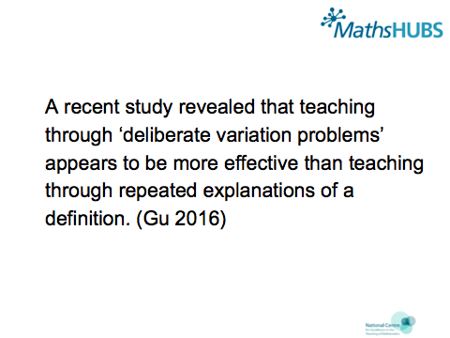

Slide 46

Coherence
Lessons are broken down into small connected steps that gradually unfold the concept, providing access for all children and leading to a generalisation of the concept and the ability to apply the concept to a range of contexts.
                NCETM
Notes:
What might be the problem with a small steps approach?
What might be the problem if we don’t follow a small steps approach? (children don’t retain knowledge, misconceptions are formed, for some children the jump is too big)

Slide 47
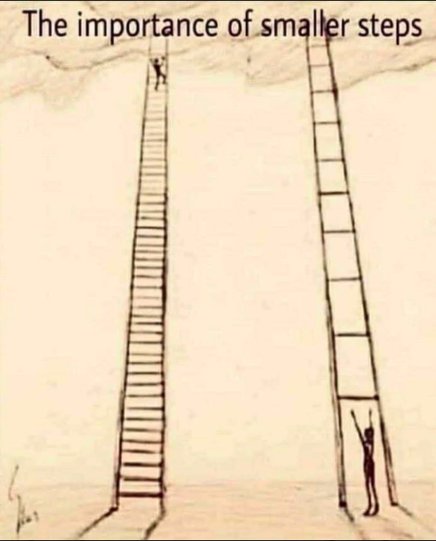
The teacher provides the steps but the child takes and connects the steps, reasoning along the way.
Notes:
There is a quote from Gu about small steps in learning - By putting blocks or stones together as a Pudian, a person can pick fruit from a tree which cannot be reached without
the Pudian (Gu 2014 p340).

Slide 48
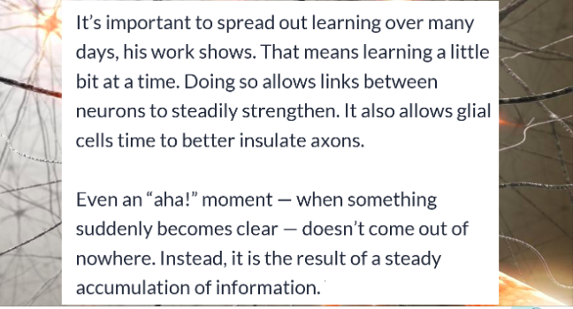
Evidence from neuroscience for small steps and taking time
Bergstrom: https://www.sciencenewsforstudents.org/article/learning-rewires-brain
Notes:
The article that is linked is not a long one but vey useful about how the brain responds and changes to learning over time. Useful as a pre-read to a staff meeting on coherence.

Slide 49
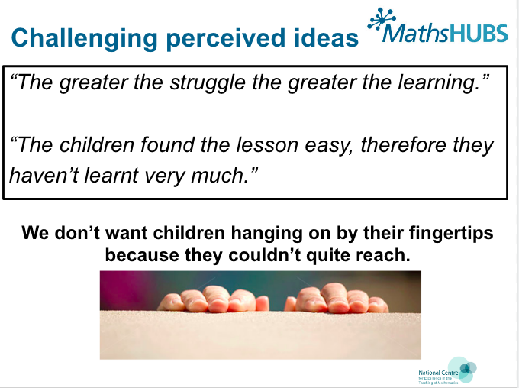
Notes:
We hear this a lot in mastery lessons but the time spent at the beginning can pay dividends when children have the foundations to access much deeper learning.

Slide 50
