Slide 1
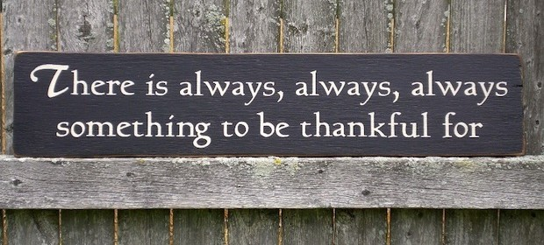
Thankfulness

Slide 2
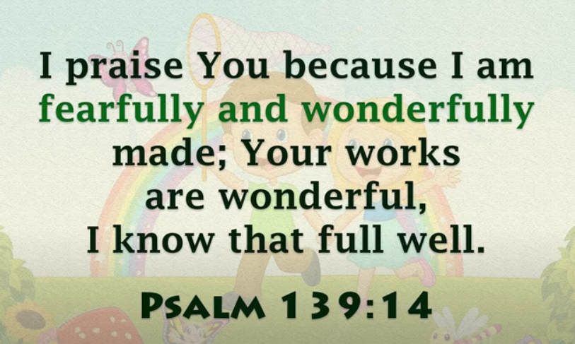

Slide 3
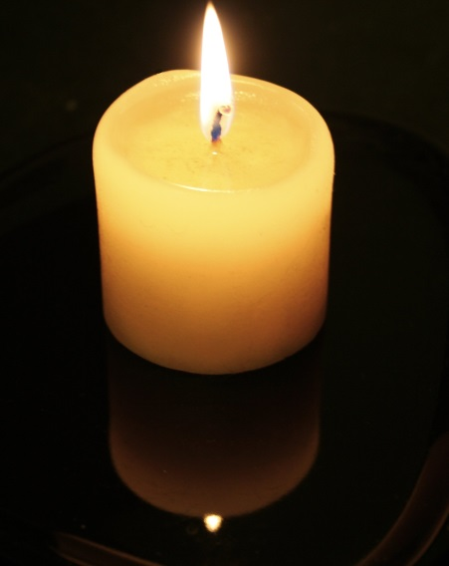
Invitation:
We have gathered here today to think about ‘Thankfulness’
‘This is Jesus the Light of the World’
Watch the flickering flame and feel the presence of Jesus as you listen to God’s Word.

Slide 4
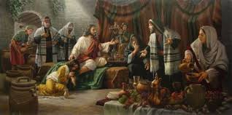
share:
In this story a woman gives a very expensive gift as a way of showing her
gratitude to Jesus. This comes as a shock to the onlookers who do not
understand what is going on.

Slide 5
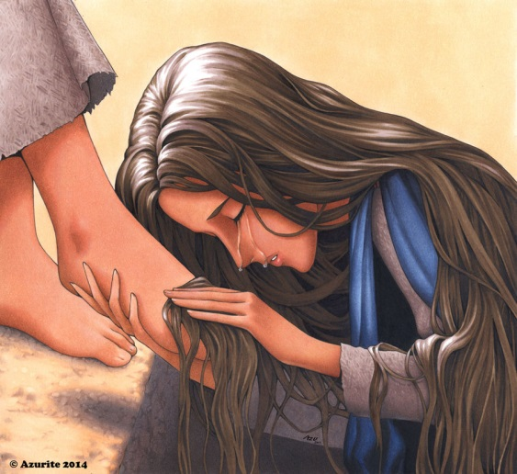
:
The woman in this story was
so grateful that she had been
forgiven, she was prepared to
give away a very expensive jar
of perfume.
Take some time to think of things you are thankful for.
Do you complain and blame others or do you stay positive and thankful for the good things (the blessings) in your life?
Have you ever felt so grateful for something that you would give almost anything in order to thank the person who had been
generous towards you?
As the music plays, write down on the piece of paper something you are thankful for and then hang it on the tree.

Slide 6
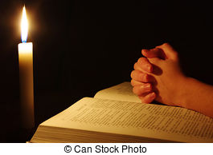
Reflection:
Please listen to the words of this prayer.
After each line you might like to say the words
‘We give you thanks and praise.’
For Jesus, God’s amazing gift to the world,
All: We give you thanks and praise.
For all that Jesus has done for us,
All: We give you thanks and praise.
For giving us all we that we have,
All: We give you thanks and praise.
Amen.

Slide 7



Going forth:
During the day, find a quiet
place and say a prayer of thanks for all that you have.

