Slide 1
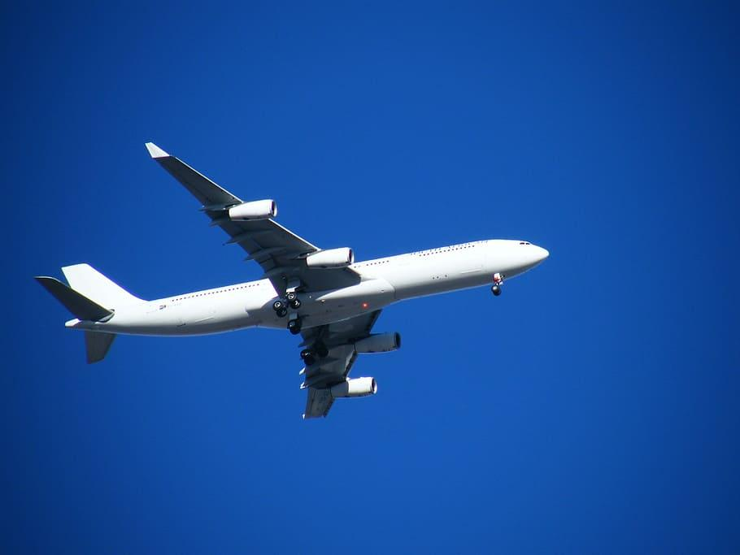
Worlds Best Invention
By Enzo Connell

Slide 2


Slide 3
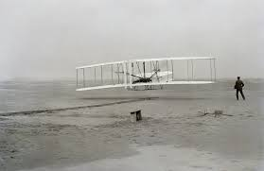
Wright Flyer

Slide 4


Slide 5
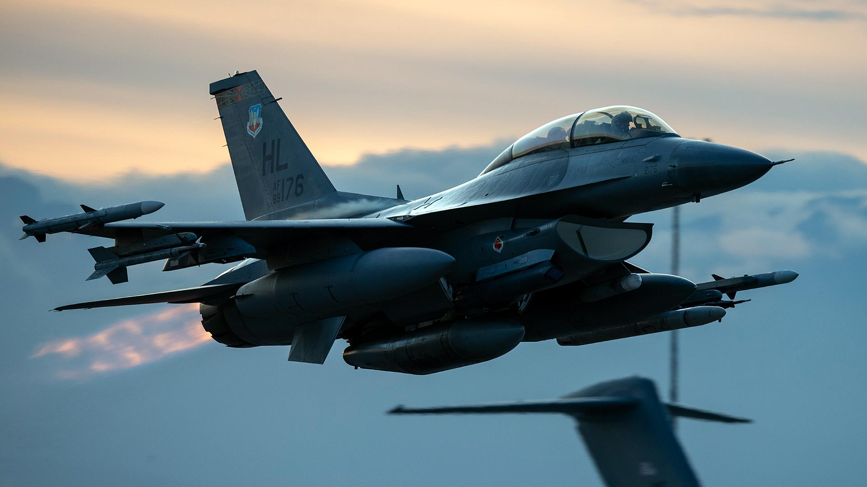
Military

Slide 6
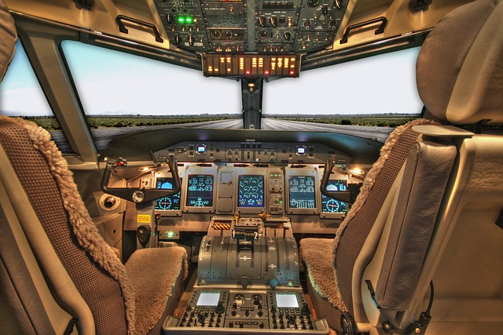

Slide 7




