Slide 1
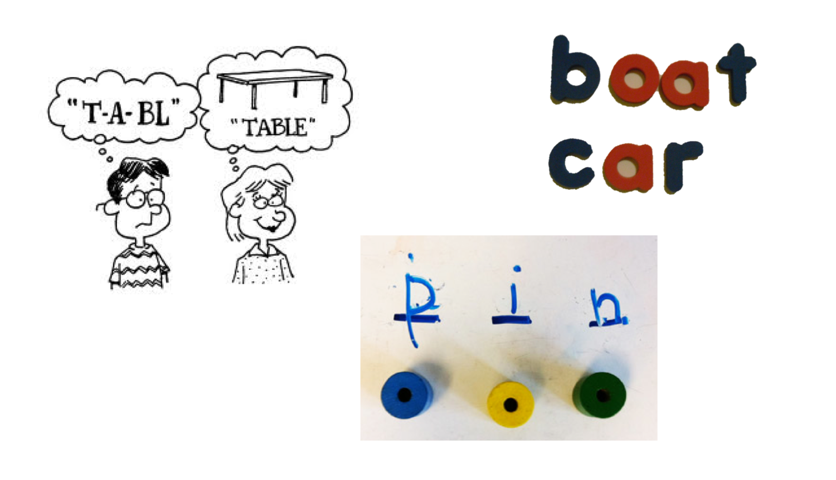
Effective Spelling is taught not ‘caught’
Welcome to the Spelling Workshop

Slide 2
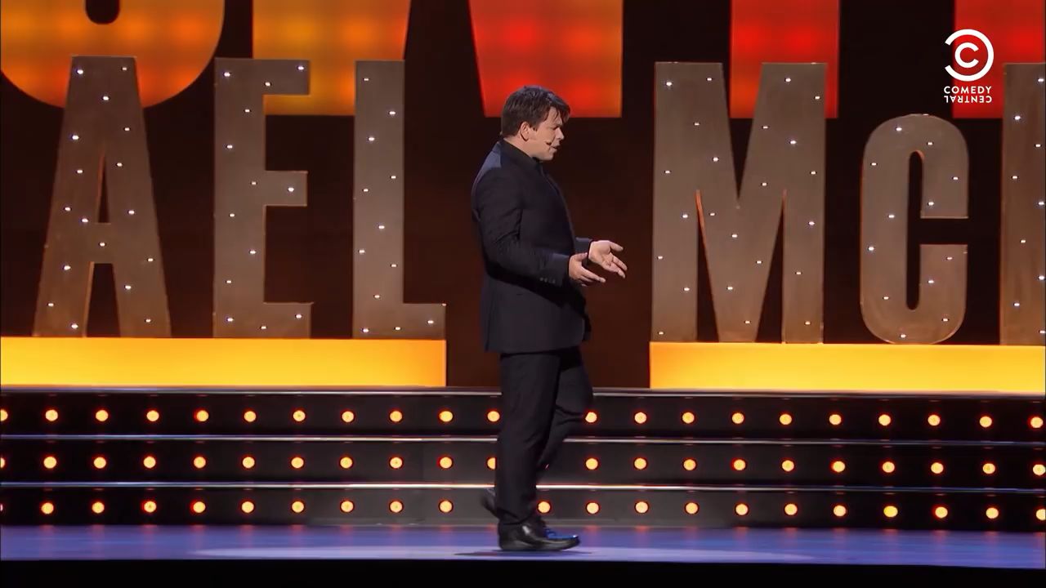

Slide 3
Is this right?
I take it you already know
Of tough and bough and cough and dough?
Others may stumble but not you
On thorough, slough and through.
Well done! And now you wish perhaps,
To learn of less familiar traps?
Beware of heard, a dreadful word
That looks like beard and sounds like bird.
And dead, it's said like bed, not bead
For goodness' sake don't call it 'deed’!
Watch out for meat and great and threat
(they rhyme with suite and straight and debt).

Slide 4
Progression in spelling
Reception and Year 1 - Phonetic spelling alongside some ‘tricky words’
Transitional Spelling Year 2- Writer begins to rely less on phonics and employs visual and meaning based strategies seeing words in their syllables (im-por-tant, pan-da) or constituent parts of complex words (un-success-fully, im-possible). Writer attempts to spell less familiar words.
Independent Spelling - Multiple strategies are used including patterns and rules within the spelling system. The child does not generally rely on phonetics or syllables to spell. They have a clear understanding of complex and compound words and know how elements are spelt by sight. Begins to identify if a word ‘looks right’ and can make adaptations. The child recognises the importance of accuracy and will self correct or get a dictionary. They have learnt a range of exceptions to rules and can apply this understanding.

Slide 5
What do you need to be a great speller?
Word knowledge (prefixes, suffixes, roots, phonetics, vowel, consonant)
Knowledge of word meanings and origins (homophones)
High level of automaticity and visual memory for known words and tricky words
A repertoire of strategies - phonological, visual, morphemic, etymological, knowledge for rules and generalisations
Understanding of rhyme and alliteration and letter strings
Physical ability to enunciate correctly
Auditory ability to hear sounds accurately

Slide 6
Spelling strategies

Slide 7
Phonological
Using sound buttons to break words down into their constituent sounds
Understand that the same grapheme can have different phonemes
Understand that the some phoneme can be represented by different graphemes
To blend and chunk sounds together

Slide 8
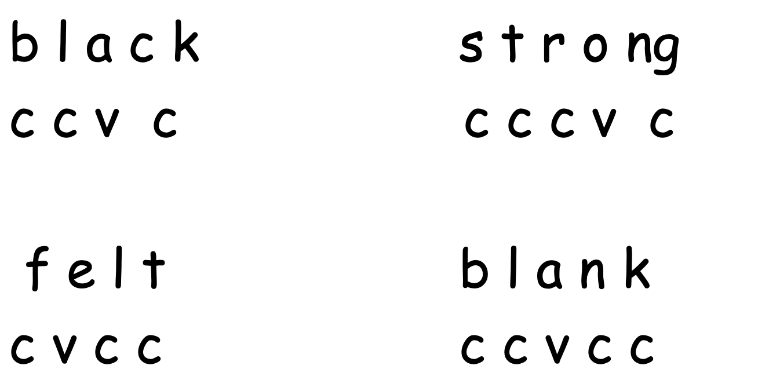
Key knowledge
They should be able to label vowels and consonants by colouring vowels or labelling. This is a key element they will need to understand for application of rules.

Slide 9
Key Knowledge
They should be able to distinguish short vowels from long vowels and vowel phonemes
sunset

Slide 10
Phase 2 sounds
Set 1 | s | a | t | p
 | sat | at | tap | pat
Set 2 | i | n | m | d
 | in | nip | map | dip
Set 3 | g | o | c | k
 | go | on | cat | kid

Slide 11
Set 4 | ck | e | u | r
 | pack | egg | up | rag
Set 5 | h | b | ss
 | hen | bat | miss
 | f / ff |  | l / ll
 | fan | puff | leg | bell

Slide 12
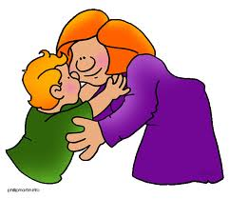



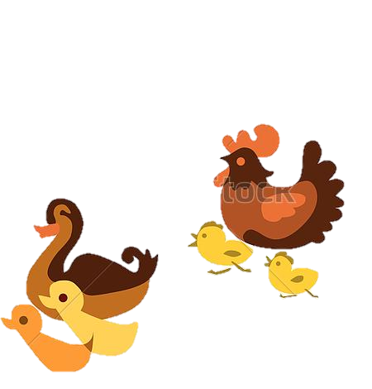
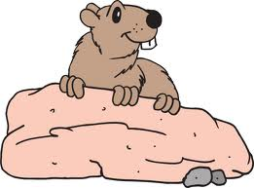
a hug and a kiss get off the bus
huff and puff a bag of nuts
on top of a rock a duck and a hen

Slide 13
Is the sun wet?
Can men jog to get fit?
Has a cat got a web?
Has a fix got six legs?
Has a pot of jam got a lid?

Slide 14
Initial sound
Medial sound
End sound
CAT
How does the placement of the sound relate to writing?

Slide 15
Phase 3
Set 6 | j | v | w | x
 | jet | van | wig | box
Set 7 | y | z / zz |  | qu
 | yes | zip | buzz | quiz
Set 8 | ch | sh | th | ng
 | chip | shop | thin then | ring

Slide 16
Set 9 | ai | ee | oo (long) | oo (short)
 | rain | feet | boot | look
Set 10 | oa | ar | or | igh
 | boat | farm | for | night
Set 11 | ur | ow | oi | ear
 | hurt | cow | coin | dear
Set 12 | ure | air | er
 | sure | fair | corner

Slide 17
Phase 4
Reading and spelling words which are:
CCVC - trip from slam
CVCC - help tank rest
Adjacent consonants can be the trickiest parts of the word to hear so children must sound out their words slowly and carefully.

Slide 18
Ideas to support the learning of phonics
Sound recognition (for reading) – use flash cards or play matching games with sound cards
Letter recall (for writing) - you say the sound, the child identifies the right letter or finds the right flashcard. Use magnetic letters and games such as Bingo, Quickwrite Letters.
Recognising letter shapes – using magnetic letters, tracing letter shapes in sand, flour, finger painting, handwriting in variety of ways (in chalk, pens, sticks in mud)
Sorting sounds – Sorting objects according to the sounds they contain (beginning, middle or end)

Slide 19
Blending for Reading
Children must practise “oral segmentation and blending” (hearing adults talking in “sound-talk”).
This then develops into blending with letters when reading.
Recognising letters ➔ Recognise sound ➔ Blend
Children need to continually practise reading words with new letters learnt, preferably through games.
Pronunciation of sounds

Slide 20
Ideas to support blending and reading
Speak in “sound talk” during the day, e.g. “time for b-e-d”, “get your c-oa-t”.
Use a toy who talks in “toy talk”, e.g. “Floppy likes ch-ee-se, j-a-m, f-i-sh”.
Use “sound buttons” to support your child when learning to read.
Play motivating games, such as Treasure and Rubbish and Alien words, I-spy, sorting sounds, ICT games
Sound searching when reading
IT IS IMPORTANT THAT CHILDREN DO NOT OVER RELY ON THIS STRATEGY AND PERFORM FOR KNOWN WORDS.

Slide 21
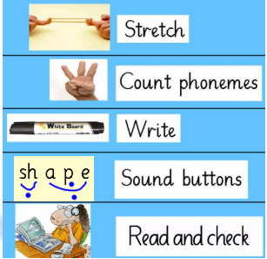
Sound buttons
Sound buttons are used to encourage the sounding out and blending of sounds in reading and segmentation of words when spelling.
Using body percussion to clap sounds.
balloon night black

Slide 22
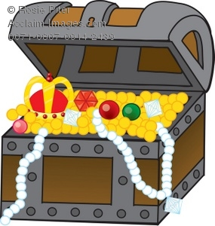
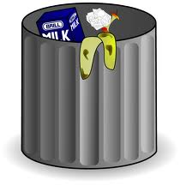
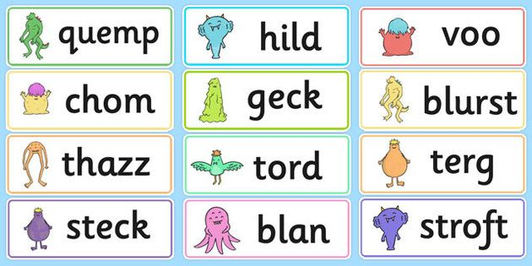
Treasure and rubbish / Real-fake/ Alien words
‘ch’ words
chaip church

Slide 23
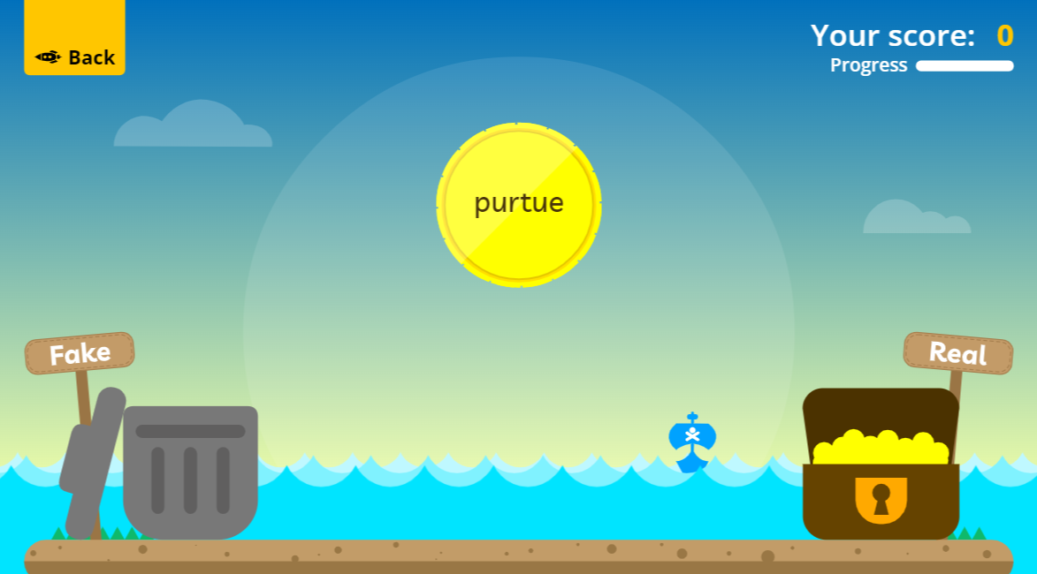
Treasure and rubbish / Real-fake/ Alien words
Buried Treasure on Phonics Play is free to play without a subscription.

Slide 24
Sorting words
‘c’ sound
c k ck

Slide 25
Segmenting for Spelling
Spelling combines the skills of oral segmentation (splitting words into sounds) and letter recall (remembering that the “m” sound = the letter m).
Children need help to hear the sounds in words (“sound-talk”, e.g. b-l-a-ck)
Children will write their own invented spellings - praise correct sounds and point out wrong ones selectively and sensitively.

Slide 26
Phase 5
ay | oy | ou | ir
day | boy | out | girl
ie | ea | ue | aw
tie | eat | blue | saw
wh | ph | ew | oe
when | photo | new | toe
au | a-e | e-e | i-e
cauldren | came | these | time
o-e | u-e
hame | tune

Slide 27
Phase 5 Alternative graphemes
Alternative sounds made by the same grapheme/letters i - fin, find o - hot, no, to c - cat, cent, dance g - got, giant u - but, put, unicorn ow - cow, blow
ie - tie, field
ea - eat, bread, great
er - farmer, her
a - hat, what, path, bacon
y - yes, by, very
ch - chin, school, chef
ou - out, shoulder, could,
you

Slide 28
Alternative sounds and the ‘best bet’
y (y) y (ee) y (igh)
yes
yellow
yarn
yo-yo
year
happy
nearly
many
really
anyway
by
cry
try
lullaby

Slide 29
Alternative graphemes for the same phoneme
Hard c - c (coat), k (kite), ck (sock), ch (school), qu (quickly), x (box) o - o (pot), a (want, was, what) j - j (just), g (magic), dge (fudge), ge (cage) ch - ch (church), tch (switch, patch) ar - ar (card), al (half, balm) oi - oi (noise), oy (enjoy)

Slide 30
Sound buttons
snake spider stary

Slide 31
Long Vowel Sounds and the ‘Best Bet’
ai | ay | a-e | a | eigh | ey | ea
rain train brain main plain aim | day away tray stay May layer crayon | came same Pane name ace age ate ape | acorn angel able apron alien April bacon station stable | weight neigh-bour eight sleigh neigh | they | great steak break

Slide 32
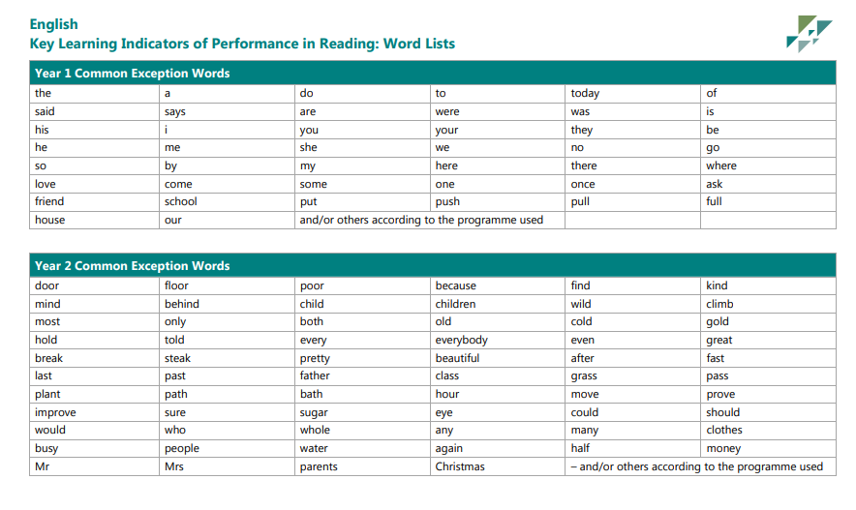

Slide 33
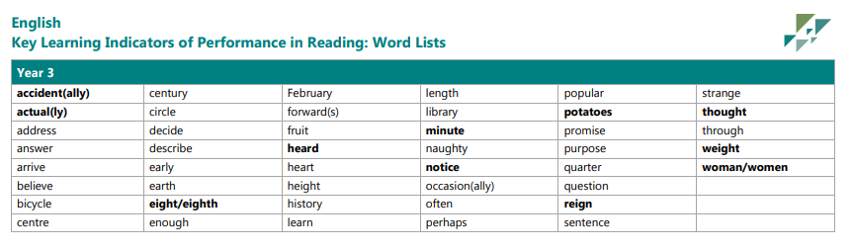

Slide 34
Games and ways to remember spellings
mnemonics rhyming words groups
Kinesthetic activities Applying in sentences
(consistent spelling)
Pictures
Not all strategies will work for all children.

Slide 35
2. Morphemic Strategies
Link between spelling and meaning (helpless, immature, nutrition/nutritious)
That words can be spelt the same but have different meanings (read, watch, bear) - HOMOGRAPHS
That words can sound the same but be spelt differently (no/know, meet/meat, there, their and they’re) - HOMOPHONES
Understand that the some phoneme can be represented by different graphemes
Understand that words can be changed by adding or removing parts to alter meaning (prefixes, suffixes, plurals, word building and tense)
Words can be combines to create new words (compound words)

Slide 36
Past and present tense suffixes
Root Verb - The word that explains what is being done or what is happening in
every sentence. The root Verb is unchanged.
Adding ‘ed’ or ‘ing’
Root Verb ends with an ‘e’ care, use, smile | Drop the ‘e’ and add ‘ed’ or ‘ing’ or for ‘ed’ just add ‘d’ cared, used, smiled caring, using, smiling
Root Verb ends with an ‘y’ cry, try, marry | Exchange the ‘y’ for an ‘i’ to add ‘ed’ and do nothing to add ‘ing’ cried, tried, married crying, trying, marrying
Root Verb ends with a short vowel and a single consonant. hop, hug, slip, | Double the end consonant before adding ‘ed’ or ‘ing’ hopped, hugged, slipped hopping, hugging, slipping
What would happen if you didn’t drop the ‘e’ or double the consonant in these words? Why is is important?

Slide 37






Compound words
snow + man =
sun + glasses =

Slide 38
Compound words
Match simple words to make a compound word.
Sorting complex words from compound words
Oral games – Say the first part of a compound word, can they finish it with another.
Compound word hunts in books/maps
Word chains using HF words
someone, somebody, somewhat, somewhere, somehow, sometimes
anymore, anybody, anywhere, anyhow, anytime

Slide 39
Suffixes – Plurals
y | ch, sh, ss, zz , s, x | ay. oy, iy, ey, uy | f or fe | consonant and an o
Drop the ‘y’ and add ‘ies’ | Add es | Just add s | Drop the f or fe and add ves | Add es
army – armies party – parties lady - ladies Baby - babies | wish – wishes dress – dresses buzz – buzzes lunch – lunches box - boxes | valley – valleys tray – trays boy - boys | knife - knives Leaf - leaves | piano – pianos potato – potatoes tomato - tomatoes
Some words change their form completely child – children man – men cactus - cacti Some remain the same deer tuna sheep fish

Slide 40
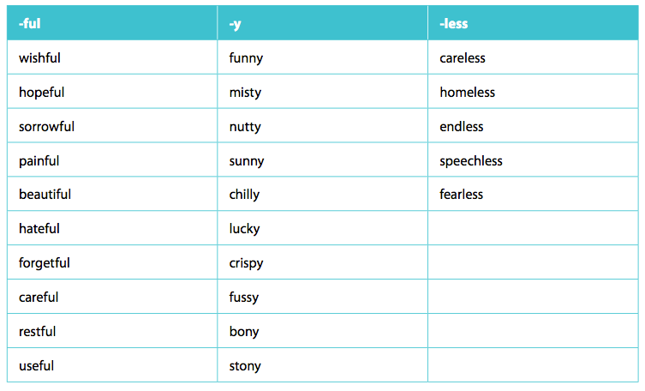
Suffixes – That change nouns/verbs into adjectives

Slide 41
Suffix – adding ly to adjectives to form adverbs
Words that describe how a verb is performed
Tricia crept slowly to the door.
The baker generously sprinkled chocolate chips onto her cake.

Slide 42
Prefixes
un- | dis-
well – unwell tidy – untidy happy - unhappy | please – displease agree – disagree appear – disappear
Changes the meaning of the word by meaning ‘not’ e.g. not happy | Meaning not or the opposite of

Slide 43
Syllables – multisyllabic words
Counting/clapping the beats in words helps children break longer words down into portions for spelling. I also encourage the children to use their fingers to count the sounds, then they know how many to spell.
Quick write activities taking opportunities to recap prior learning of suffixes, prefixes and compound words.
clap - count - draw - write
un – for – tu – nate – ly = unfortunately
in – for – ma – tion = information
ex – pand – ing = expanding
some – bo – dy = somebody
rain - coat = raincoat

Slide 44
Ideas to support segmenting and spelling
“Sound-talk” words to help children hear the individual sounds
e.g ch ee se. What’s the last sound, the sound before __, the
sound after__?
Draw sound boxes/syllable buttons to represent the number of
sounds/syllables in the word.
e.g. peach = 3 sounds (buttons)
= 1 syllable
information = 7 sounds (buttons)
= 4 syllables
How many words can you write with the sound ‘ay’?
Can you invent your own alien words using the different ‘ee’
sounds?
Helping you write a shopping list at home.
Writing a quiz about a topic they enjoy.
Oral word games based upon, complex words (tenses, suffixes
and prefixes) and compound words.

Slide 45
KS2 Curriculum
Specific Spelling pattern
Suffixes
Prefixes
Homophones
Hyphenated words
Statutory Word Lists

Slide 46
Suffixes
Lower KS2 |  |  | Upper KS2
Doubling consonants when adding ing, ed, er, est |  |  | Words ending with fer transferred /. preferred reference / preference
tion | sion/ssion | cian | tial | cial
 |  |  | partial | official
ation |  |  | ant | ance | ancy
ly | ily | ally | ent | ence | ency
slowly | happily | basically
ous | eous | ious | cious | tious
famous | courageous | curious | malicious | nutritious
Possessive apostrophe |  |  | able/ably | Ible/ibly
girl’s bag | girls’ bags | children’s teacher | changeable noticeabale

Slide 47
Prefixes
Lower KS2
dis | mis | sub | super
dishonest | misread | Subdivide submerge | superman supermarket
in | im | ir | il
Incorrect inactive | Impossible immature | irregular | illegible
re | anti | inter | Auto
redo refresh | antibiotic anticlockwise | International interact | autobiography

Slide 48
Spelling patterns
Lower KS2 |  |  | Upper KS2
y |  | ou | ough
myth pyramid | pylon python | cousin touch double country | opught brought bought | rough tough enough | through cough
ture | sure | sc
picture creature nature | treasure leisure measure | science scene discipline | though although dough | thorough borough | plough bough
ch |  |  | I before e except after c
scheme chorus chemist | chalet chandelier chauffer |  | ie | ei | exceptions
gue | que |  | believe achieve | ceiling receipt deceive | sleigh beige foreign reign
league tongue | antique Unique plaque |  | Silent letters

Slide 49
Homophones
aisle/isle | advise/advice
compliment/complement | practise/practice
morning/mourning | devise/ device
Stationary/stationery | License/licence
saw/sore/soar | were/where
new/knew | which/witch
there/their/they’re | our/are
of/off | its/it’s

Slide 50
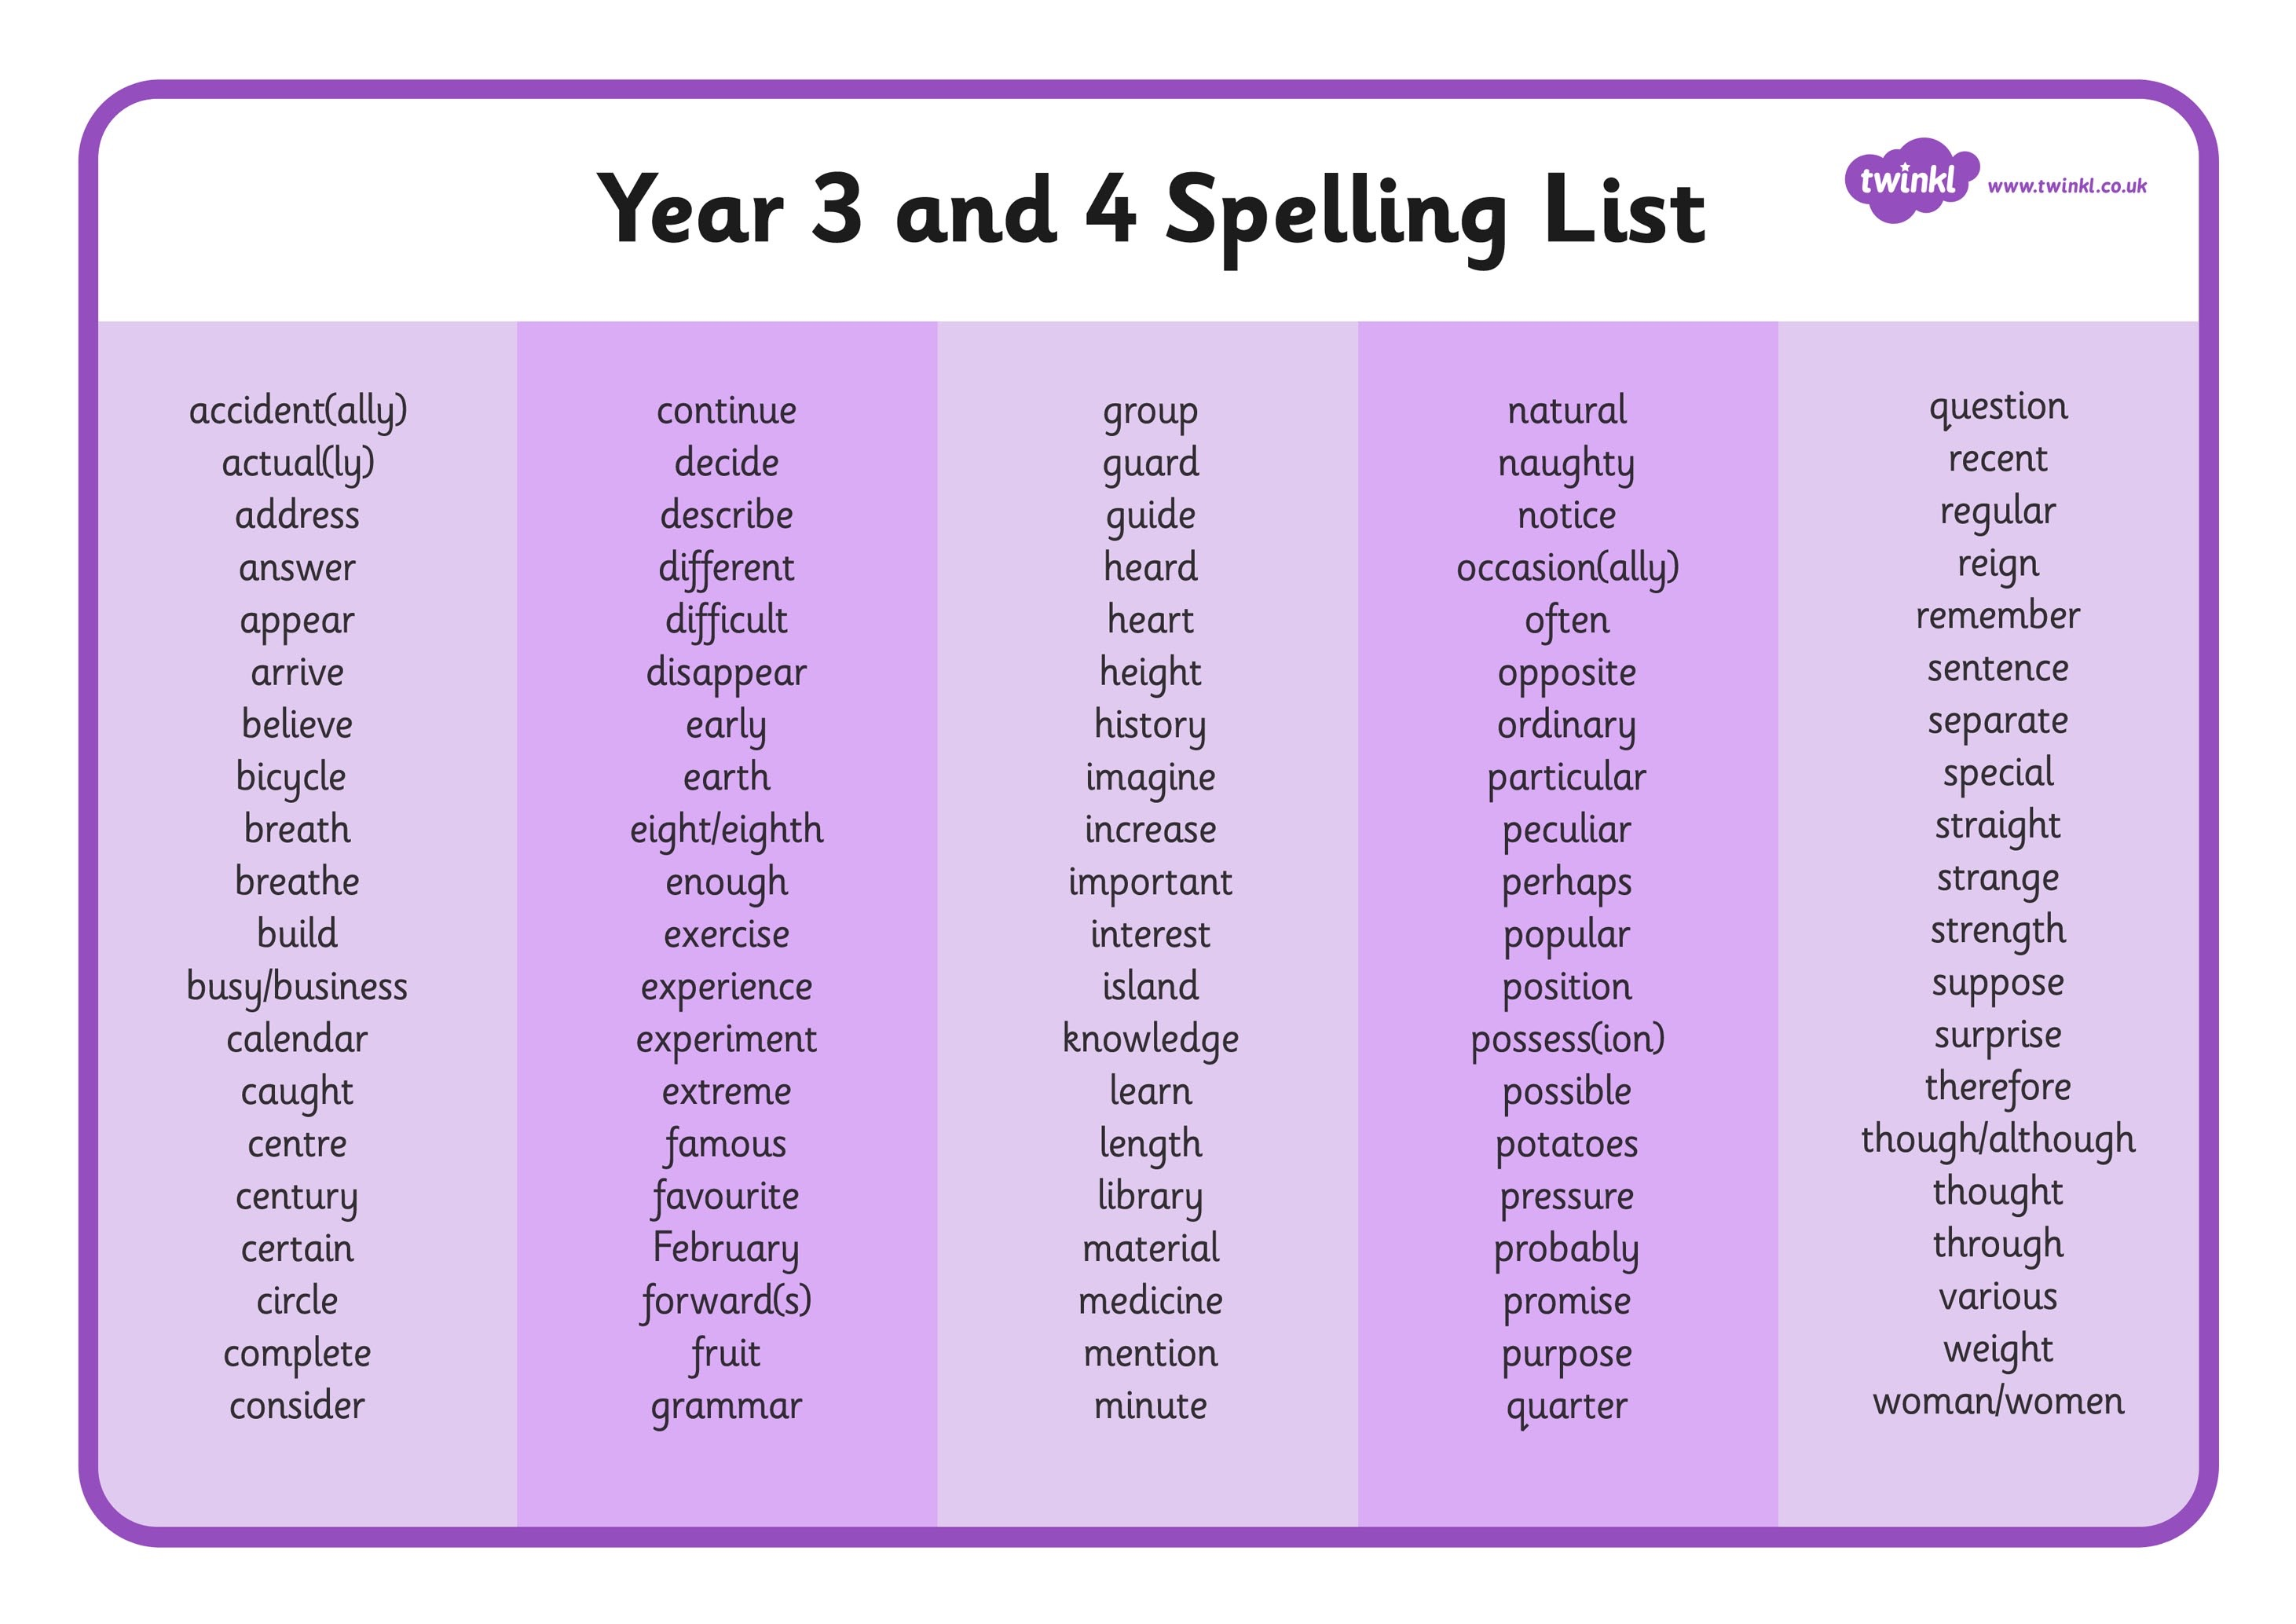

Slide 51
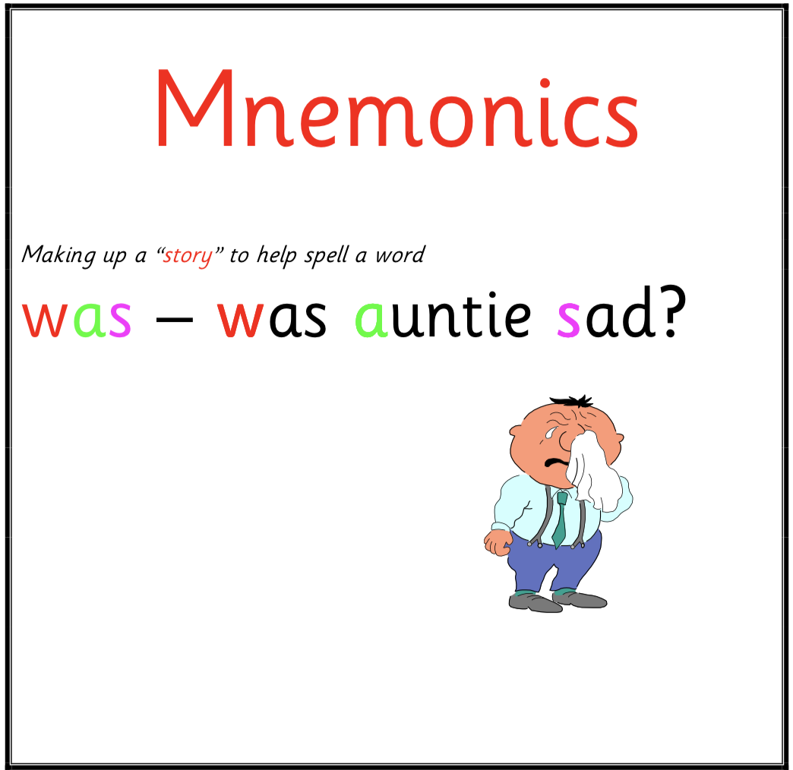

Slide 52
Mnemonics are useful for particularly tricky words, or for key spelling patterns:
• Ould – Oh, you, lucky duck (should, could, would)
• Ound – Oh you naughty duck (ground, found)
• Laugh – Laugh At Ugly Goat Hair. Laughing ants under green hats
• Because – Big Elephants Can Always Understand Small Elephants
• Island – an island is land surrounded by water
• Necessary – 1 collar and 2 sleeves are necessary
• Piece – a piece of pie
• Parliament – Liam went to the Houses of parliament
• Separate – there is a rat in separate
• Secretary – a good secretary can keep a secret
• Terrible – Ribs feel terrible
• Business – going by bus is good business
• Rhythm – rhythm helps your two hips move
• Accommodation – 2 cats, 2 mice, 1 dog - accommodation
• Soldier – soldiers sometimes die in battle
• Quiet – keep quiet about my diet
• Guitar – I only play guitar when I’m drinking fruit juice

Slide 54

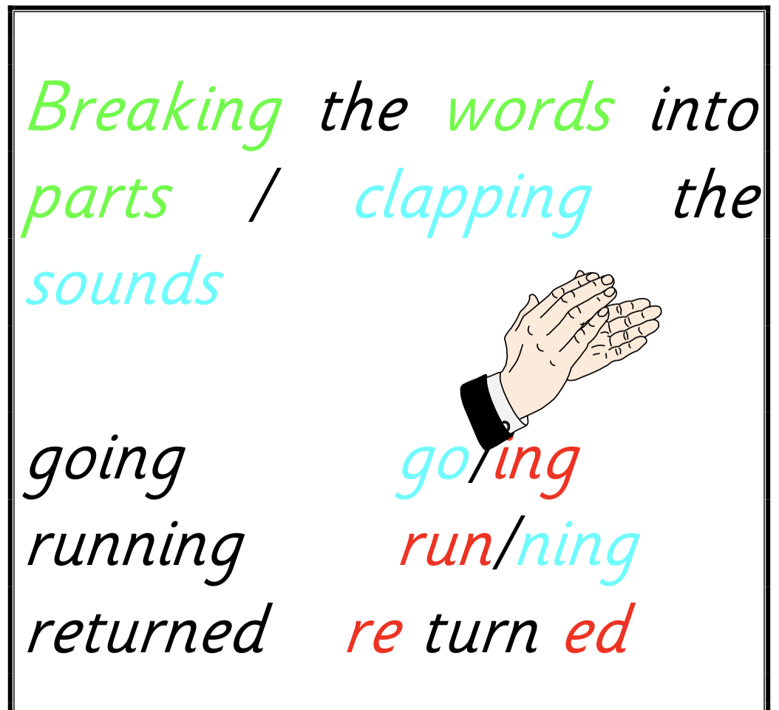

Slide 55
Syllables in Spelling
All good spellers are skillful at breaking words
up into syllables.
care-ful hos-pit-al u-ni-ver-si-ty
Breaking a word into syllables makes it easier
to deal with one small bit at a time.

Slide 56
Knowing the Root word
particularly
past/passed guest/guessed build/billed
magically
nutritious
malicious

Slide 57
Correct pronunciation
peculiar vs perculiar
pronunciation vs pronounciation
disastrous vs disarsterous
every vs evry
really vs rilly
interest vs intrest

Slide 58
Knowing what cannot be heard
explanation vas explaination
England vs Ingland
describe vs discribe
extra vs xtra

Slide 59
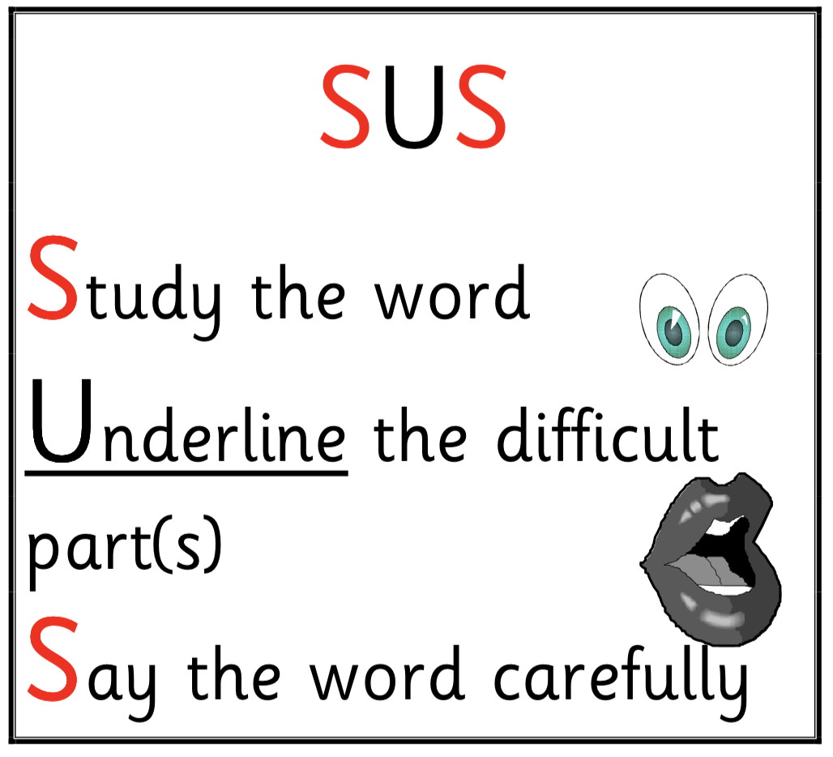

Slide 60
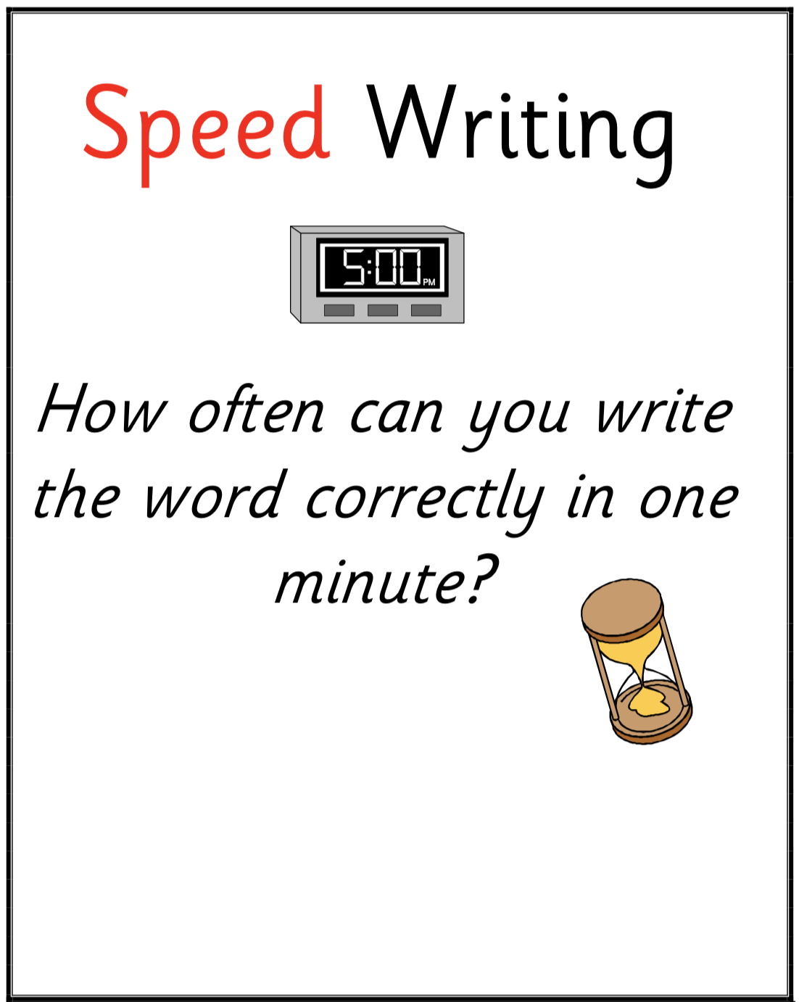

Slide 61

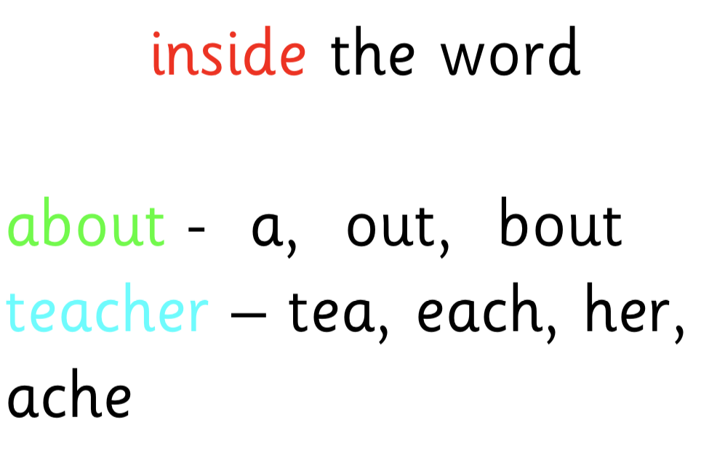

Slide 62
was
saw
CHURCH
CH on the right CH on the left and (you are) U R in the middle.
FRIEND
If you fri your friend he’ll come to an end
Friday is the end of the school week

Slide 63
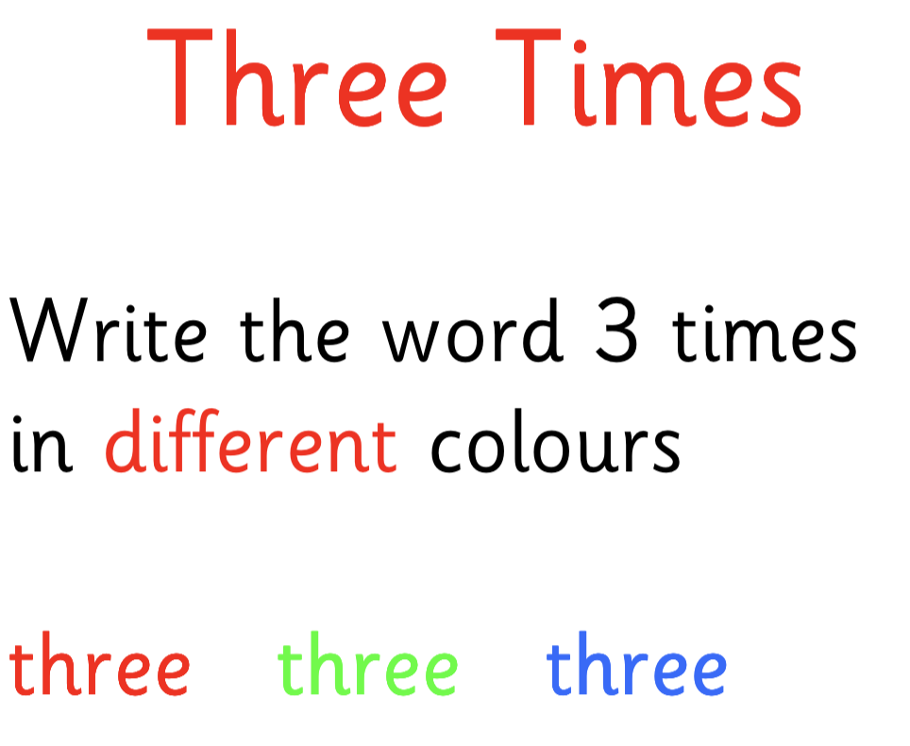

Slide 64
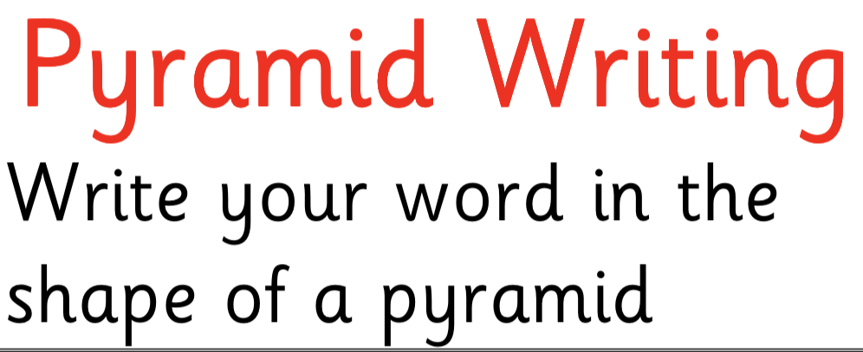


Slide 66








Slide 67
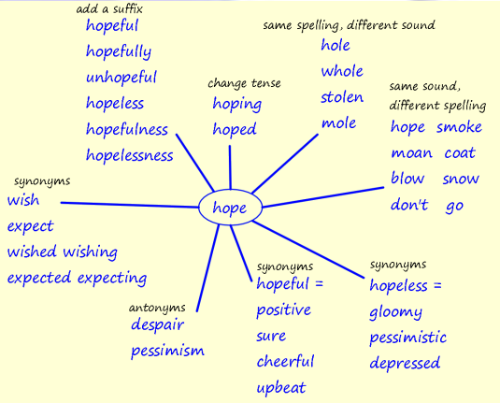

Slide 68
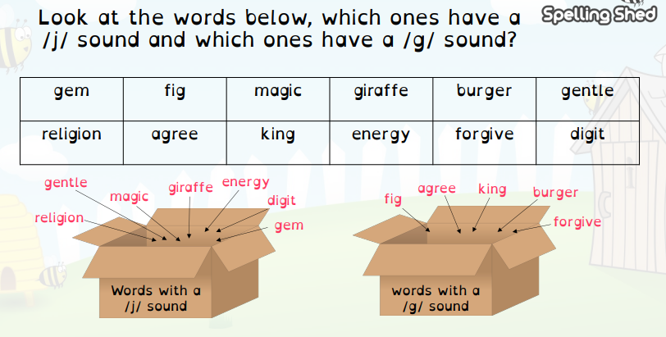
Spelling Shed

