Slide 1
Values

Slide 2
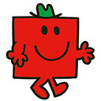
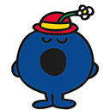

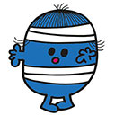
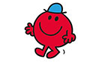
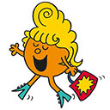
Values
Lets start by imagining a place where everyone is different.
Some are strong
Some are bossy
Some are small
  Some fall over a lot and bump into things
  And some are fabulous

Slide 3
Values
But they all get along. The reason for this is they have a set of values that enable them to live happily along together.
Thoughtfulness, think how your behaviour affects others, and how others actions could affect you.
Tolerance of others behaviour and actions.
Understanding we are all different and accepting that we all have good and bad points and focusing on the good in everyone.
All Mr Men and Little Miss are equal.

Slide 4
Values
At our school we also have values and we discuss one each month. These values help to build and reinforce our community to have the best school possible with the best pupils.
At Bretherton Endowed CE Primary School we:
Respect other people and God’s world (RESPECT)
Never give up, even when things are hard and face our fears (COURAGE)
Are proud of who we are and celebrate differences (HUMILITY)
Think that telling the truth is the right thing to do (TRUTHFULNESS)
Work hard so that we can be the best we can be (HOPE)
Are true friends (FRIENDSHIP)
Show kindness towards others (COMPASSION)
Give thanks for all we receive (THANKFULNESS)

Slide 5
Values
Now you all have your own values as well. These help to you the person you are now and will grow up to be.
These might be influenced by your family, religion, your social group, clubs you belong to or enjoy going to, books that you read, languages or another country.
As a country Britain has its own values. These are commonly referred to as British Values (imaginative titles is not one of these values), we aregoing to look at these next.

Slide 6
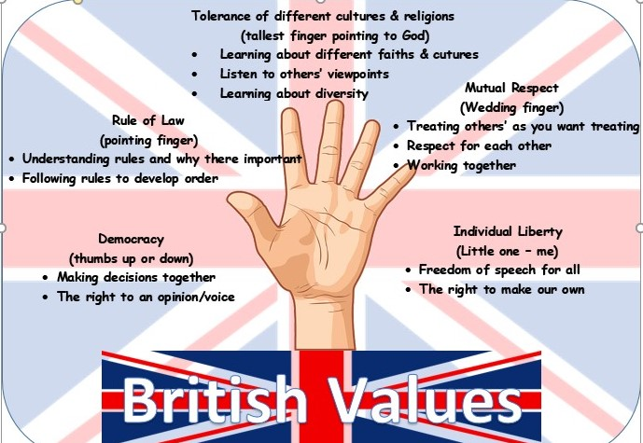

Slide 7

British Values
There are five British Values, these are:
Democracy
The rule of law
Individual liberty
Mutual Respect
&
Tolerance of those of different faiths and beliefs

Slide 8
British Values – Democracy
Britain is a Democracy – this means that the British public vote for the people they want to lead either the country, the county or the town / area as a Mayor. These elected representatives will structure laws and decide how to run the area they are responsible for.
If we did not live in a democracy either one person or a group of self appointed people will make all the decisions and laws, we would have no option but to do as we are told. That would not be very fair.

Slide 9
British Values – the rule of law
Britain has a police force who ensure that everyone in the country do not do something wrong that break the law.
This ensure that we are all safe and that no one is going to o something that could cause us harm or upset us.

Slide 10
British values – Individual liberty
In Britain, we can live how we choose as long as it is within the laws of the land.
We are also able to have our own views and opinions on issues or events and anything else.

Slide 11
British values – mutual respect
As we all have our own opinions on things we might not always agree with other people, but we show respect for other peoples thoughts, opinions and feelings.
By giving others respect, we can expect others to show us respect.

Slide 12
British values – tolerance of those of different faiths and beliefs
Because in Britain we have Individual Liberty and Mutual Respect we accept that people have a different religion, faith or beliefs than our own.
All people have the freedom to worship their religion as they see fit.

Slide 13

British values
Now what do British Values mean to

