Slide 1

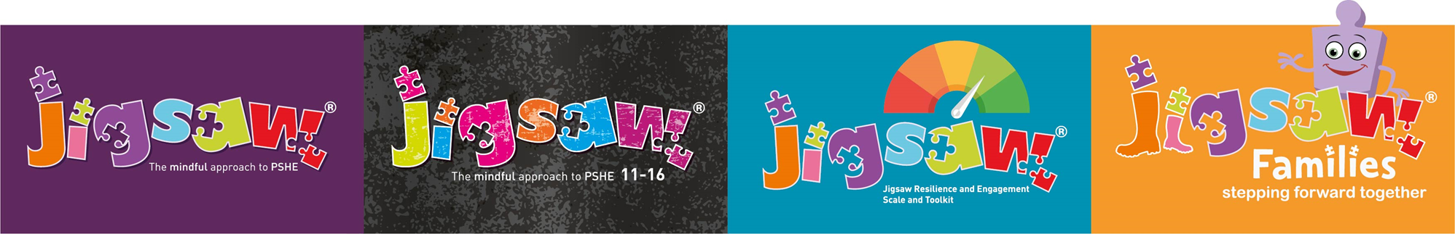
Relationships, Sex & Health Education (RSHE)
Information for parents
Welcome!
“Walking in the footsteps of Jesus with our Christian family, we learn, grow, achieve and flourish together in God’s love”

Slide 2
The aim of the meeting:
To inform you of the school’s legal obligations on Relationships, Sex and Health Education
To explain what we need to teach, when and why we believe it is so important
To answer any questions you may have
Notes:
Emphasise partnership between home and school and importance of parents being on board with this work.
Explain we are going to be transparent.

Slide 3

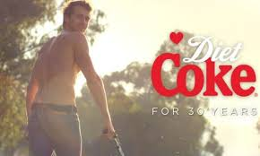
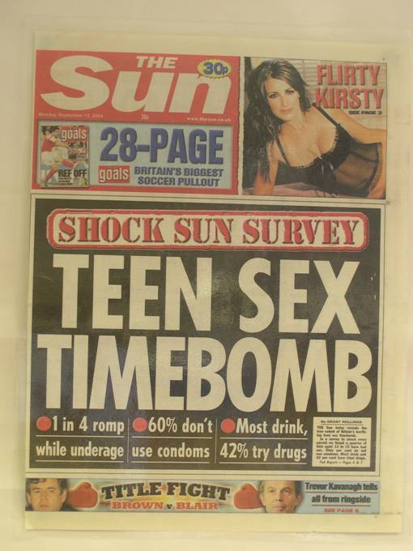
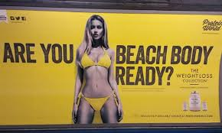

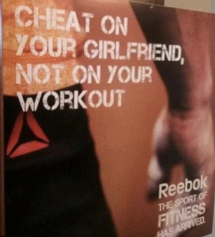

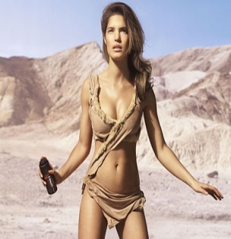



Today’s considerations
The internet
Television
Social media
Other media
Friends
Family
School
Notes:
Where and when did you learn about relationships and sex? Was this the best way?
Was there anything that you didn’t understand?
Was there anything you were frightened about?
Has the world changed since then?
If we are trying to keep children safe…what do we need to consider?
Ask is this just sex education , or is it also about relationships as well …and maybe health education too?
DOES IT MATTER AS LONG AS CHILDREN ARE EQUIPPED TO STAY SAFE, HEALTHY, HAPPY ETC?
What do we have to consider when it comes to the needs and experiences of today’s children and young people?
Are there any others not on this list?
NB: the logos are for Facebook, Twitter, Snapchat, Instagram and Tinder.

Slide 4

Music and lyrics
Heard he in love with some other chick
Yeah yeah, that hurt me, I'll admit
Forget that boy, I'm over it
I hope she gettin’ better sex
Hope she ain't fakin’ it like I did, babe
Took four long years to call it quits
Forget that boy, I'm over it
‘Shout out to my ex’ by Little Mix
Notes:
Invite the parents/carers to guess the lyrics, song and act.
Then reveal the answer. This is particularly interesting as the Little Mix demographic is predominantly girls from age 8 upwards.
These lyrics pale into insignificance compared to artists like Drake, or those in the drill music genre which is popular at present.
Can we protect our children from all the things we don’t want them to see/hear?
Remind parents that children talk to each other in the playground/school/after school so it can be very difficult to protect them from hearing about some of this stuff even if we don’t let them view or hear it first-hand.

Slide 5
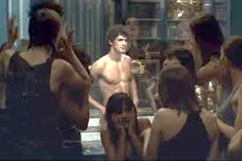
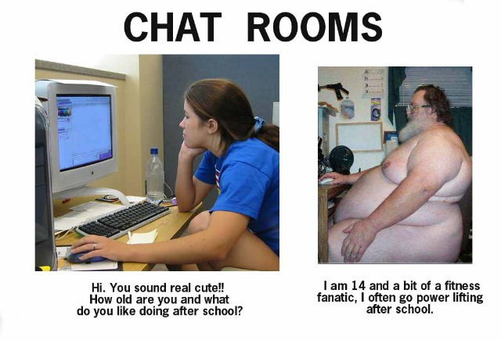
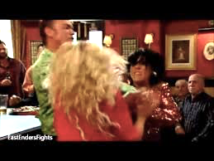

What messages do children receive from adverts, tv and also on social media?
Pure XS for men
Paco Rabanne
Notes:
We are not suggesting parents let their children see this type of adverts but we are suggesting that the world surrounds children with sexually-oriented influences/media, so we need to equip children to understand what healthy and positive relationships are, and how to keep themselves safe.
How much of the media coverage about relationships is positive, showing healthy, positive, caring relationships? How do we equip our children to stay safe when usinng chat rooms- maybe not now but in the future.
Is there a balance in what is shown on TV between healthy happy relationships and those that are less so?
Interestingly, these adverts were both shown on the lead up to Christmas before the watershed.

Slide 6
Be aware…
We are educating children and young people
to live in the real world, with all its contradictions
When it comes to sex, children’s heads are probably not empty – but they may be full of myths and half-truths
We mustn’t let our adult knowledge of relationships and sex prevent us seeing things from a child’s perspective
Our focus should be on building healthy attitudes and positive relationships, not just fighting off perceived threats
Notes:
Really important to emphasise how we as adults can often put our own concerns/prejudices, etc. on to children and that this can distort the information we give.

Slide 7

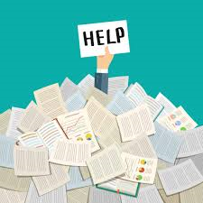
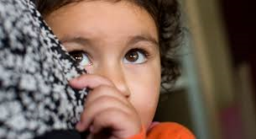
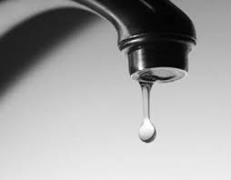
If RSE is so important, which approaches are best?
Notes:
Keeping children in the dark not very sensible given the world we live in and what kids experience and hear about on a daily basis.
Drip feeding appropriate information – hence Jigsaw’s spiral and progressive approach.
Information overload- telling them everything and just causing more confusion.
Scare tactics: Might work for some young people but lots of research that says it can encourage others to take risks
Jigsaw uses the spiral curriculum approach… drip-feeding age and stage appropriately.

Slide 8
Relationships Education
What should children know about relationships and why?
What a positive, healthy, caring, safe relationship looks and feels like
How to speak up and get help when a relationship does NOT feel healthy/positive/safe
How to make and maintain positive relationships
(Online and offline relationships)
Notes:
Emphasise that Relationships Education is not only about intimate relationships, it also includes learning about families and friendships, kindness and acceptance of others who are different from ourselves, how we treat and look after ourselves, the importance of community.
Use this slide as a lead in to the new statutory guidance which is on the next slide.

Slide 9
What does the government
(England) say is the aim of Relationships Education?
‘Today’s children and young people are growing up in an increasingly complex world and living their lives seamlessly on and offline….children and young people need to know how to be safe and healthy, and how to manage their academic, personal and social lives in a positive way’
DfE Guidance on Relationships Education, Sex Education and Health Education 2019

Slide 10
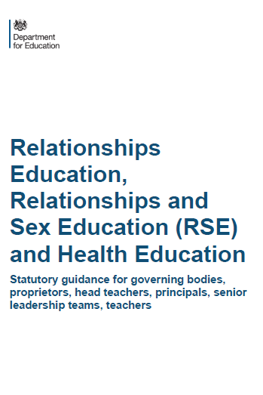

Compulsory status of RSE and Health Education
In 2017 the government passed an amendment to the Children and Social Work Bill to make RSE and Health Education statutory from Sept 2020.
Supported by over 100 organisations, including Public Health England, Teaching Unions, NCB, etc)
Ratified by House of Lords 24 April 2019
Notes:
September 2020, the new guidance comes into force. We already had an RSE policy but it was voluntary whether we taught it but we felt it improtant that we included it. This just akes sure that all schools ensure that it is contained within their curriculum offer. This has implications for right of withdraw which we will be covered later.

Slide 11
“Learning together, growing together, achieving together, caring together
within our Christian family”
As a church school, we also have to consider what the Diocese advises about Relationship education?
“The government’s shift in the guidance on sex and relationship education to strengthen the work on relationships is welcomed by the Diocese Board of Education.”
“The following passage should be the basis of all relationship education within a church school.”
‘You shall love the LORD your God with all your heart, with all your soul, and with all your mind.’ 38 This is the first and great commandment. 39
And the second: ‘You shall love your neighbour as yourself.’ 40 On these two commandments hang all the Law and the Prophets.”
Matthew 22v37-40
“We should model our relationships on obedience to this and understand our
relationships though a deeper understanding of these commands.”

Slide 12
What are the expectations for Primary Health Education?
Mental wellbeing
Internet safety and harms
Physical health and fitness
Healthy eating
Drugs, alcohol and tobacco
Health and prevention
Basic First Aid
Changing adolescent body (Puberty)
Notes:
So school are expected to teach the following:
Note that lessons on puberty are considered statutory at Primary level because they have been included within compulsory Health Education

Slide 13
What are the expectations for Primary Relationships Education?
Families and people who care for me
Caring friendships
Respectful relationships
Online relationships
Being safe
© Jigsaw PSHE

Slide 14
LGBT+
Equality
What the DfE RSHE guidance says
‘Schools are required to comply with relevant requirements of the Equality Act 2010. Further guidance is available for schools in The Equality Act 2010 and schools advice. Schools should pay particular attention to the Public sector equality duty (PSED) (s.149 of the Equality Act).’ - Para 27 page 13
‘Schools should be alive to issues such as everyday sexism, misogyny, homophobia and gender stereotypes and take positive action to build a culture where these are not tolerated, and any occurrences are identified and tackled.’ - Para 31 page 13
Notes:
The DfE legislation is LAW as is the Equality Act.
The quotes on this slide come from the DfE RSHE guidance.

Slide 15
Sex Education is discretionary at Primary… what exactly does the guidance say?
The Department continues to recommend that all primary schools should have a sex education programme tailored to the age and physical and emotional maturity of the pupils… drawing on knowledge of the human life cycle set out in National Curriculum Science - how a baby is conceived and born’

Slide 16
Science Key Stage 1
identify, name, draw and label the basic parts of the human body and say which part of the body is associated with each sense
notice that animals, including humans, have offspring which grow into adults
Science Key Stage 2
describe the differences in the life cycles of a mammal, an amphibian, an insect and a bird
describe the life process of reproduction in some plants and animals
describe the changes as humans develop to old age
learn about the changes experienced in puberty
Notes:
What we are expected to teach in Science.

Slide 17
September 2020 onwards in Primary Schools
(England)
After September 2020,
Legally:
Schools MUST teach the Science curriculum
The DfE guidance 2019 states that Relationships and Health Education (including changing adolescent body) are compulsory
Plus…
a ‘recommendation’ that all schools have a Sex Education Programme
How schools do this is left up to them.
Notes:
To recap.

Slide 18
Our mission as outlined in our SRE policy is:
The greatest commandment Jesus taught was to love God and to love your neighbour. Within this commandment is the foundation of the Christian view of relationships. At Bretherton Endowed Church of England Primary School our relationship education seeks to live out this commandment and explore how we can ‘love our neighbour’ through what we say and do.
Our school focusses on the importance of relationships and the qualities and character needed to sustain positive relationships that honour each other whether within a friendship, family relationship or romantic relationship.
Each child is a unique being, a child of God, loved and accepted. As such, our school seeks to enable children to develop through an inclusive programme of teaching that is based on Christian principles, which both respects the human body and seeks to ensure health and well-being.
Our aim is to provide age-appropriate and accurate information underpinned by our Christian values, ultimately equipping children for life today and keeping them safe.
How will
we approach
this at Bretherton?
Notes:
If we simply taught sex education through the Science curriculum, can we really do that without explaining why our bodies change? We believe it’s like giving half of a story and doing our children a disservice.
We will still cover the requirements of our Science Curriculum but will also teach SRE within our PSHE curriculum both the statutory Health and Relationship aspects but also a sex education programme tailored to the age and physical and emotional maturity of our pupils.

Slide 19
Can you withdraw your children from RSE?
From September 2020…
(Government guidance 2019 page 17)
“Parents have the right to request that their child be withdrawn from some or all of sex education delivered as part of statutory RSE”.
NOT from Relationships or Health Education.
We define Sex Education as:
Human reproduction, conception and birth
Changing adolescent body (Puberty) comes under Health education and is compulsory.

Slide 20
Whole-school approach from 3-16
Being Me in My World
Celebrating Difference
Dreams and Goals
Healthy Me
Relationships
Changing Me
Relationships
Values
Mental health
Self-esteem
Social skills
Safeguarding inc.
Internet safety
(Golden Threads)
Notes:
These are the units of study in Jigsaw PSHE. Relationships is woven throughout the other other puzzles (units) as well as being a unit in it’s own right.
Explain that the DfE statutory requirements sit within this whole-school PSHE Programme:
Relationships…in the Relationships Puzzle but also throughout as we start with building a positive relationship with self and issues such as respect and understanding, rights and responsibilities, kindness, families, anti-bullying, race and hate crime are covered age appropriately in Celebrating Difference and to some extent in Dreams and Goals (there is a focus on local and global communities in some of these lessons).
Health Education…in Healthy Me
Changing Me covers correct body terminology (in KS1) and puberty and human reproduction in KS2.

Slide 21


Relationships, Puberty and Reproduction in Jigsaw 3-11
Relationships
Changing Me
Families
Friendships
Love and Loss
Memories
Grief cycle
Safeguarding and keeping safe
Attraction
Assertiveness
Conflict
Own strengths and self-esteem
Cyber safety and social networking
Roles and responsibilities in families
Stereotypes
Communities
* Life cycles
* How babies are made
* My changing body
* Puberty
Growing from young to old / Becoming a teenager
Assertiveness
Self-respect
Safeguarding
Family stereotypes
Self and body image
Attraction
Change / Accepting change
Looking ahead / Moving class/schools
Notes:
Explain where the statutory requirements for Relationships and Health Education sit and what could be called Sex Ed are included in Jigsaw. The Sex education pat of the curriculum is within the Changing Me puzzle.

Slide 22
Puberty and Human Reproduction in Jigsaw 3-11 Changing Me Puzzle
FS | Growing Up | How we have changed since we were babies
Y1 | My changing body | Understanding that growing and changing is natural and happens to everybody at different rates
 | Boys’ and girls’ bodies | Appreciating the parts of the body that make us different and using the correct names for them
Y2 | The changing me | Where am I on the journey from young to old, and what changes can I be proud of?
 | Boys and girls | Differences between boys and girls – how do we feel about them? Which parts of me are private?
Y3 | Outside body changes | How our bodies need to change so they can make babies when we grow up – outside changes and how we feel about them
 | Inside body changes | How our bodies need to change so they can make babies when we grow up – inside changes and how we feel about them (animations used – shorter version Female and Male Reproductive Systems)
Notes:
ALL THIS FALLS WITHIN THE STATUTORY HEALTH EDUCATION GUIDANCE…changing adolescent body so is compulsory.
More detail about exactly what is covered in each year group.
Emphasise that only 2 or 3 lessons in every year group are specifically about either puberty (statutory) or How babies are made (not statutory).
Also emphasise that correct terminology is introduced early so the school can meet its safeguarding obligations and to get the children used to using the words appropriately (ie we also teach them when it’s appropriate to use these words and when not). A further rationale for this is that in KS2, body part words are not seen as something rude or dirty.
Puberty is introduced very gently in Y3 because some girls may start their periods early and it is necessary to prepare them for this so they aren’t scared or worried.

Slide 23
Puberty and Human Reproduction in Jigsaw 3-11 Changing Me Puzzle
Y4 | Having a baby | The choice to have a baby, the parts of men and women that make babies and I am made from the joining of their egg and sperm.
 | Girls and puberty | How a girl’s body changes so that she can have a baby when she’s an adult – including menstruation
Y5 | Puberty for girls | Physical changes and feelings about them – importance of looking after yourself
 | Puberty for boys | Developing understanding of changes for both sexes – reassurance and exploring feelings
 | Conception | Understanding the place of sexual intercourse in a relationship and how it can lead to conception and the wonder of a new life
Y6 | Puberty | Consolidating understanding of physical and emotional changes and how they affect us
 | Girl talk / boy talk | A chance to ask questions and reflect (single sex)
 | Conception to birth | The story of pregnancy and birth
Notes:
Notes:
Conception is introduced age appropriately in Y4 in the context of why our bodies change during puberty. Note that one lesson in Y4 is called Puberty for girls, this doesn’t exclude the boys, it covers them too, but the main focus is on menstruation.
Conception and puberty is built upon in Year 5 and then puberty, conception and childbirth is covered in more detail (but still age-appropriately) in Y6 with a chance for single gender group lessons (up until this point lesson shave all been mixed gender).
Remind the parents/carers that when moving to secondary school Sex Ed is compulsory so there is an expectation that children will be moving into Y7 with some knowledge.

Slide 24

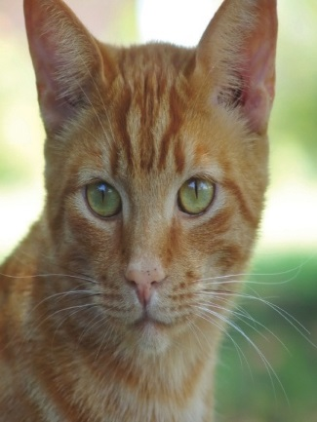


Some example materials from Jigsaw
– younger children
Notes:
Share some of the materials used so everyone can see what it looks like.

Slide 25
KS2 resource
- outside changes for girls

Slide 26
KS2 resource
- outside changes for boys

Slide 27
Example of one of the KS2 resources
- inside body changes for boys

Slide 28
Example of one of the KS2 resources
- inside body changes for girls

Slide 29
Example of a KS2 resource
- conception and childbirth

Slide 30
Example of a KS 2 resource - body image and self esteem/exploring the impact
of social media on mental health
Notes:
Explain that SRE also covers relationship with ourselves such as body image, self esteem etc.

Slide 31
Relationships
Changing Me
Families
Friendships
Love and Loss
Memories
Grief cycle
Safeguarding and keeping safe
Attraction
Assertiveness
Conflict
Own strengths and self-esteem
Cyber safety and social networking
Roles and responsibilities in families
Stereotypes
Communities
Notes:
Explain that Jigsaw emphasizes positive relationship with self as the starting point for positive relationships with others
Share some Relationships Puzzle resources

Slide 32

Example of a relationships resource for KS1
Notes:
SRE also covers different relationships too.

Slide 33
How Jigsaw teaches about different families in Y1
Notes:
The next few slides highlight some of Jigsaw’s materials in regard to some of the ‘trickier’ elements in Sex and Relationships Education
This PP is used to show lots of different families on the planet Zarg including those with adopted or fostered children, single parents, same gender parents etc. This is preceded by a matching game where children identify different animal families. After the PP show the children draw and label their own family. Same gender families are simply explained as those with 2 mums or 2 dads.

Slide 34

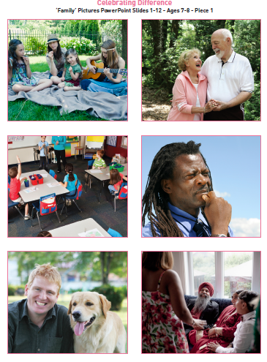
How Jigsaw teaches about different families in Y1
Notes:
The teacher uses these pictures to show a range of families. Children discuss in groups and come up with a definition A Family is…
The lesson notes also help challenge stereotypical families and encourage children to think about other types of family that are not represented e.g. military families, adoptive families. Same gender families are not taught in isolation – just as another family type.

Slide 35
Solve it together
Notes:
Relationships Skills are built throughout Jigsaw e.g. conflict resolution

Slide 36
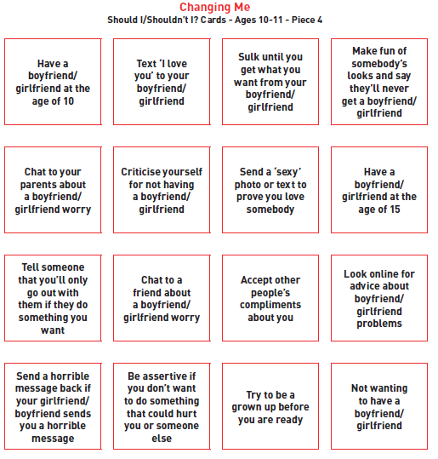
Boyfriends and girlfriends Y6
As part of this lesson on boyfriends and girlfriends children sort these cards into Should/Shouldn’t piles
They also discuss reasons
why people choose to have a romantic relationship when older
Notes:
Year 6

Slide 37
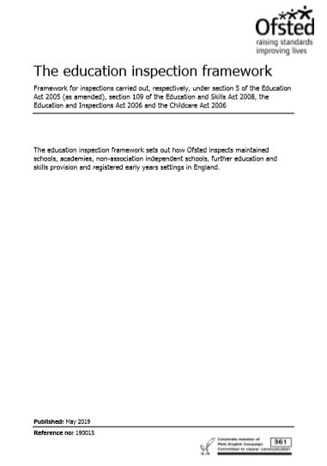
And the new Ofsted framework (May 2019)
Judgements:
Overall effectiveness and
x4 key judgements …
  Quality of education
  Behaviour and attitude
  Personal development
  Leadership and management
Safeguarding
Notes:
Schools will be inspected using these key judgements and the provision of Relationships and Health Education will feed into this process in particular regard to Personal Development, but also in regard to Safeguarding which a judgement that runs across the whole Inspection framework. We obviously don’t just do this for Ofsted but just to point out that it is obviously deemed a vital part of learning as it has been included by Ofsted.

Slide 38

Thank you.
Any questions?
“Walking in the footsteps of Jesus with our Christian family, we learn, grow, achieve and flourish together in God’s love”

