Slide 1

Welcome to
Year 1
We are going to have an incredible year full of new learning and fun!

Slide 2

Where are you on the Roar Rainbow?

Slide 3
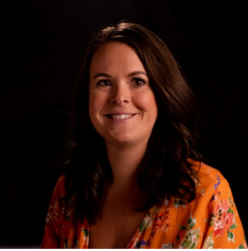
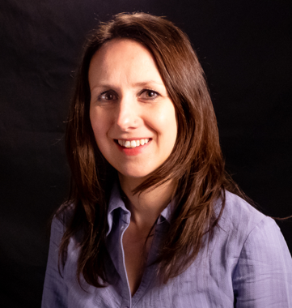
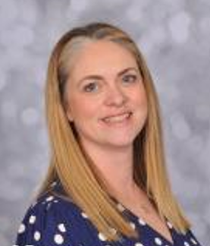
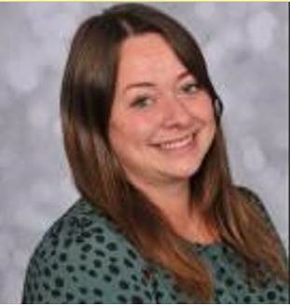
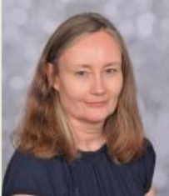
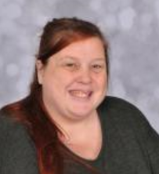
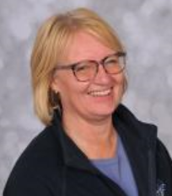
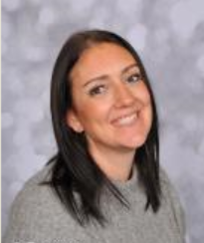
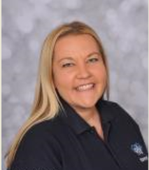
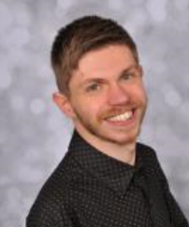
Here is the Year 1 team!
Mrs Plumtree
Miss Mills
Miss Stephenson
Mrs Howard
Mrs Whiteley
Mrs Grove
Mrs Meadow
Ms Gilbert
Mrs Powell
Mr Eccleston

Slide 4

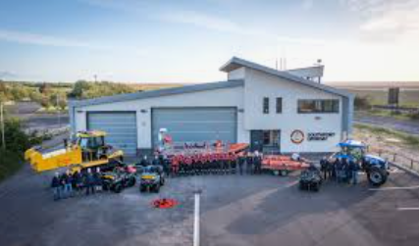


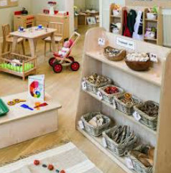
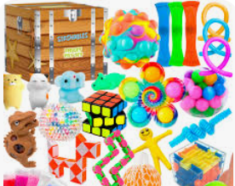
Things to look forward to in Year 1…
The Atkinson
Lifeboat Station
Seaside Day
History of Toys
Fun
activities

Slide 5
Does anyone have any questions so far?

Slide 6
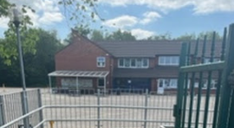

Let’s look at a ‘typical’ day in Year 1.
Our day starts at 8.30am. Register closes at 8.40am.
Enter the playground and walk to the Year 1 classroom doors. 1P and 1M have doors facing the playground and 1S’s door is around the back to the left of the school, past Year 2.
The teachers will greet you at the door. You will come in, put your things away and complete a morning activity.

Slide 7
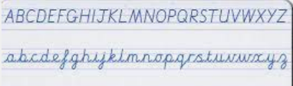

Throughout the day we will complete some Maths, English and Phonics tasks. We will also learn about lots of different subjects like Art, Geography, History, Science, RE, RHE, DT, Music, Computing and PE. We can explore these through out provision areas in the central area and outside.

Slide 8




English
In English we will learn how to form our lower case and capital letters correctly. We will also learn to write sentences with capital letters, full stops and the conjunction ‘and’.
These are some of the books we will study in English.

Slide 9

We will also do lots of reading.
You will read books to us in Guided Reading and we will read stories to you.
Make sure you read at least 3 times a week at home and get your reading diary signed!

Slide 10


Maths
In Maths we learn to count to 100. We also learn to count in 2s, 5s and 10s.
We learn to add and subtract numbers within 20.
We also learn about Shape, Measure,
Fractions and Time.

Slide 11


Slide 12
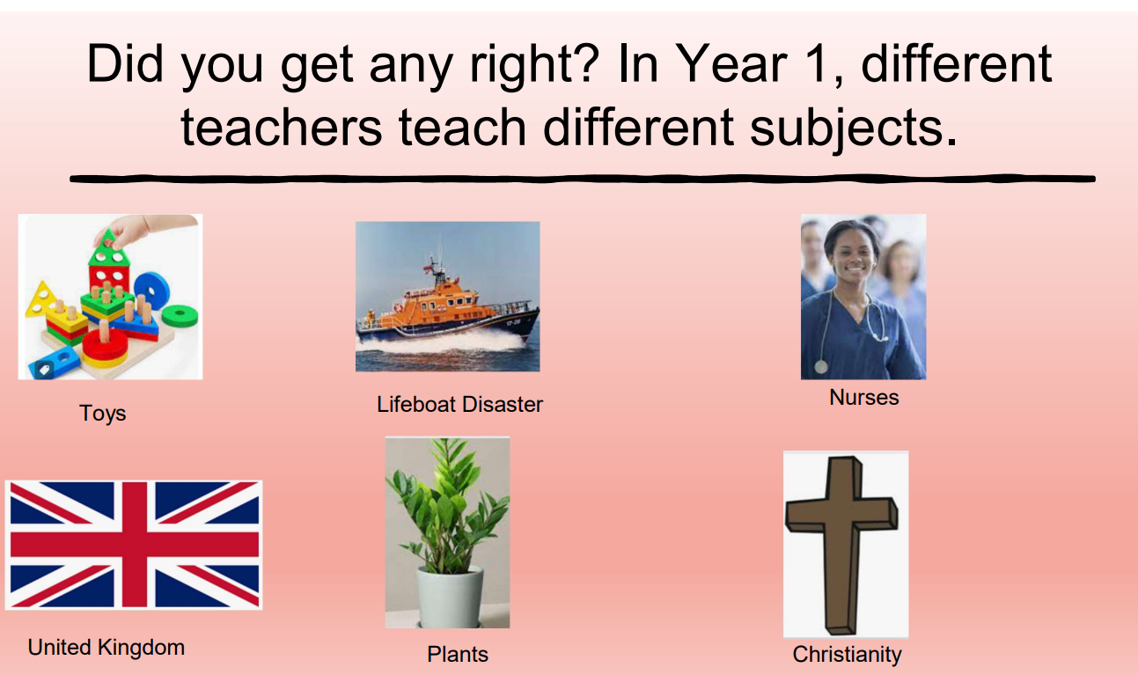

Slide 13


Slide 14
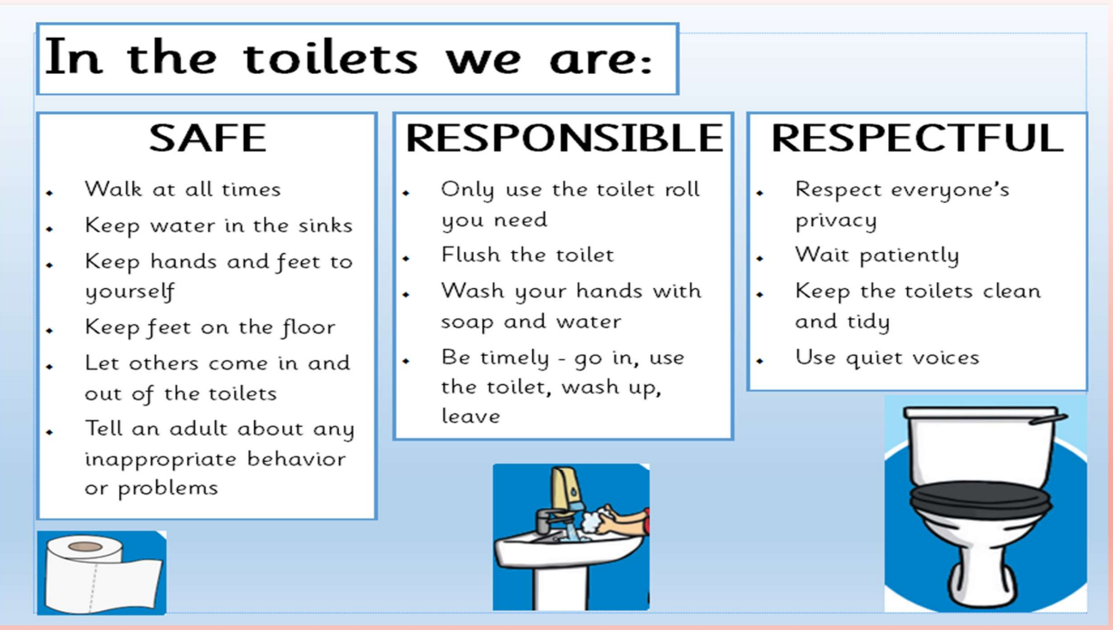
We use the same toilets that you used in Reception. Remember …

Slide 15
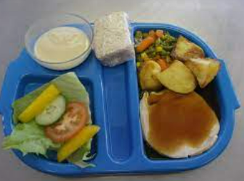
DINNER TIME
Year 1 choose their dinner the day before, just like in Reception. We give out your lunch bands and then
Year 1 go outside to play at 11.00. Then you go to the hall to eat your lunch.
We must remember to follow the dinnertime rules.

Slide 16
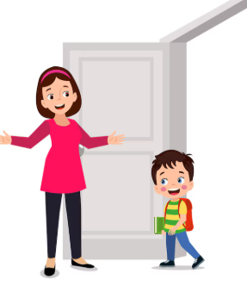
Home time is at 2.45pm
Your grown ups will collect you from the classroom door.
We are here on the door at the end of the day, if they have any questions to ask us.

Slide 17

Your thoughts about Year 1…
Do you know all the adults in the Year group?
What are you looking forward to?
What is worrying you?

Slide 18
Where are you on the Roar Rainbow now?

Slide 19

Any questions…………..

