Slide 1

WELCOME TO RECEPTION
Norwood Primary School 2025

Slide 2
INTRODUCTION TO NORWOOD
Core values are Aspire, Respect and Enjoy
We are a large school, with 3 classes in every year group from Reception to Year 6
We are a modern, well-resourced school with excellent facilities and resources.
Our grounds include a large playground, 2 Multi-Use Goal Areas (MUGAs), 2 trim trails, outdoor play area for our Early Years children, outdoor area for Key Stage 1 children, a large field, woodlands which are used for Forest School sessions, and an After School Club extension

Slide 3
INTRODUCTION TO STAFF
Head Teacher: Mr. Lee Dumbell
Deputy Head Teacher:Mrs Patricia Bennett
Assistant Head Teacher: Mrs Aileen McCarthy
Chair of Governors: Mrs Lesley Lee
Early Years Lead: Mrs Ruth Thorpe
Pastoral Leader: Mrs Kim Taylor
SENDCo: Mrs Rachael Brookfield

Slide 4
TASTER VISITS
We are offering visits for the children to attend on
Tuesday 8th July or Wednesday 9th July
Between 3.00-4.00pm
The date of your child’s visit is included in your information pack that you should have received.
The children will have the opportunity to play in their classroom and meet their teacher and teaching assistant, as well as some of their new friends.
Parents do not stay at these visits, as we would like to start getting to know your children.
If you really cannot attend on the date of your visit but could attend the alternate date, please let us know and we’ll see what we can do.

Slide 5
KEY INFORMATION
Children begin part-time on Monday 8th September.
Morning part-time sessions are 8.30am-11.00am.
Afternoon part-time sessions are 12.15pm-2.45pm.
Children begin full-time on Monday 15th September 8.30am – 2.45pm
During their part-time days they DO NOT have their lunch at school, they will receive a snack.
On Wed 3rd Sept, Thursday 4th Sept and Friday 5th Sept, we will be inviting parents and children into school for an initial parent and child meeting for 30 minutes each.
In your pack your appointment time and date is confirmed, based on the information you returned to us in May.

Slide 6
SCHOOL UNIFORM
The uniform, for our Reception children, is slightly different to the rest of the school, to suit the activities that our Early Years children complete every day.
Boys uniform will be: white polo shirt, navy school sweatshirt, navy jogging bottoms and navy/black trainers. (every item should be named). In the summer, navy shorts may be worn.
Girls uniform will be: white polo shirt, navy school sweatshirt/cardigan, navy jogging bottoms/leggings and navy/black trainers. (every item should be named) In the summer navy shorts or blue and white gingham (the same material as summer dresses) shorts may be worn.
All trainers should be Velcro fastenings, no laces please.
Reception children also require Wellington boots and waterproofs (either trousers and a jacket, or an all- in -one romper style suit). These should all be named and in a bag with your child’s name on too. The waterproofs will stay in school, as we access outdoor play every day. In this bag, please put some spare underwear and socks, in case of any accidents.
The children also require black P.E. pumps, in a named, separate bag.

Slide 7
SCHOOL MEALS
ALL children in Reception have school meals for their lunch, NO packed lunches.
There are two hot choices every day (at least one choice is vegetarian), there are also sandwiches and jacket- potatoes available every day.
All dietary requirements can be catered for, but you will need to discuss this with your class teacher at your parents meeting.
We try to encourage the children to choose one of the hot choices, but if they really don’t like either choice, they can choose a sandwich or jacket- potato.
We have had great success with even the fussiest eaters, encouraging them to try new things and expanding their diets.
It is AMAZING what children will try when they see their friends eating it!

Slide 8
HOW CAN I HELP MY CHILD BE READY FOR SCHOOL?
The most important skills to teach your child to aid their readiness for school, are their self-help skills.
Are they fully toilet trained (including wiping their own bottoms)? Our toilets are not located directly off our classrooms, they are at the end of our corridor. Children access these toilets independently. We do not send a member of staff every time a child goes to the toilet, and we do not check that a child has cleaned themselves properly every time they visit the toilet. Of course, if any child has an accident, we will assist them in cleaning and getting changed. However, unless there is a diagnosed medical condition, we would expect all children to be able to use the toilets independently.
Can they put on their own coats and shoes? In a class of 30 children, it can take a long time to get outside if the staff have to put on everybody’s coat and Wellington Boots. These are skills easily practised at home.

Slide 9
HOW CAN I HELP MY CHILD BE READY FOR SCHOOL? (CONTINUED)
Encourage your child to pack their own reading bag for school, including reading books and any letters. At the end of the school day when we are giving items out, we encourage all children to put their things into their bags.
Does your child recognise their own name? In school they will need to be able to find their own coat pegs, their own books, their own pencil pots and their own clothing with their name on. We do use photographs as well, but being able to recognise their name gives them lots of confidence.
Can they use a knife, fork and spoon? Can they drink from an open cup? At lunchtime we do have staff to assist the children in cutting up their food, but they have 90 children to support. The more independent the children can be, the better. Sitting down together for your meals, as a family, is a lovely way to prepare your child for their school lunches.

Slide 10
HOW CAN I HELP MY CHILD BE READY FOR SCHOOL (CONTINUED)
Do you have a set bedtime routine? Getting the children into good habits at bedtime can be crucial for their success at school. Well rested children make better progress and can cope with the business of the school day much better. Try to stick to the same routine every night. School age children should be sleeping in their own beds for the entire night. If your child still tries to get in your bed with you, this should be discouraged to ensure that everyone is getting a good night’s sleep! This could be something you work on over the summer if this is still happening in your home.
Does your child still use a dummy, bottle or push-chair? The extended use of dummies and bottles can have detrimental effects on a child’s speech development. School age children should NOT be using either. The extended use of a push-chair can also affect a child’s gross motor development. School age children should be encouraged to walk whenever possible, unless there is a diagnosed medical condition.

Slide 11
OUR THREE RECEPTION CLASSES
Class RT – Mrs Thorpe (class teacher) and Mrs Ashton (teaching assistant)
Class RM – Miss McCallum (class teacher) and Mrs Parry (teaching assistant)
Class RW - Mrs West (class teacher) and Mrs Singleton (teaching assistant)
Our classes are put together using information shared from pre-schools and parents. We try to ensure that they have at least one familiar face from their pre-school if we can. We also ensure that there is a fair mix of genders and birthdays across all 3 classes. Even if your child has not been placed with someone that you would have really liked them to be with, we promise that they will make new friends very quickly!
You will all have an opportunity to meet with your class teachers and teaching assistants at your parents meeting in September.

Slide 12
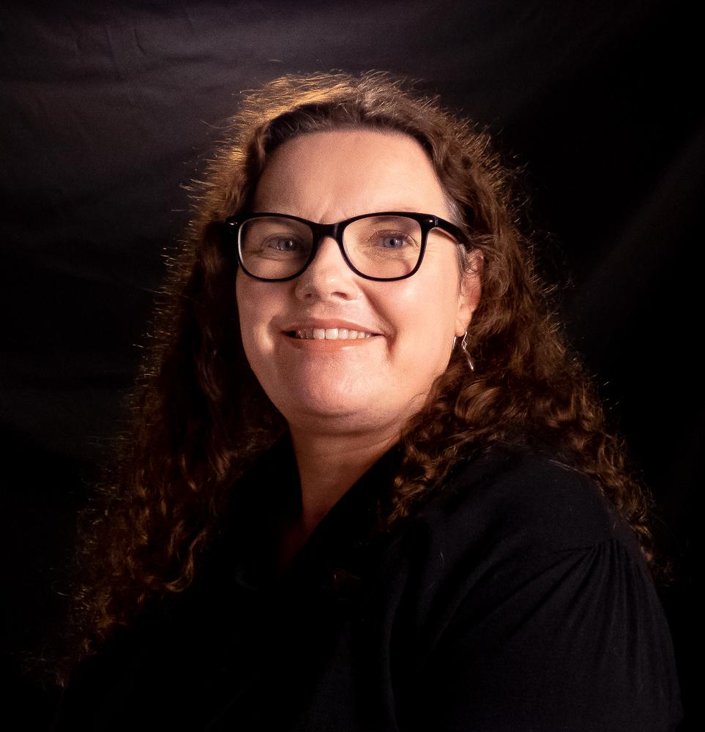
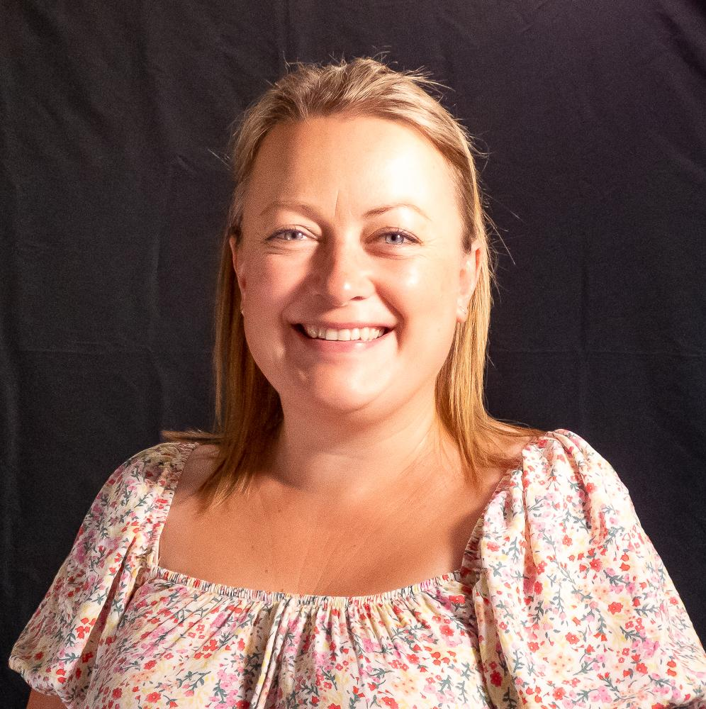
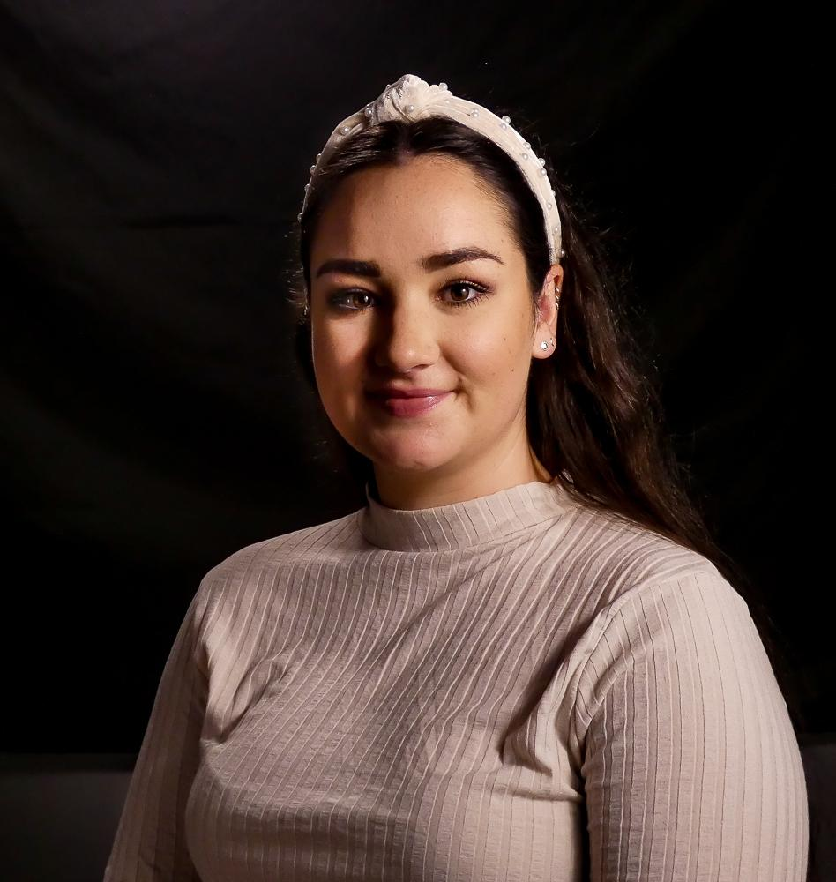
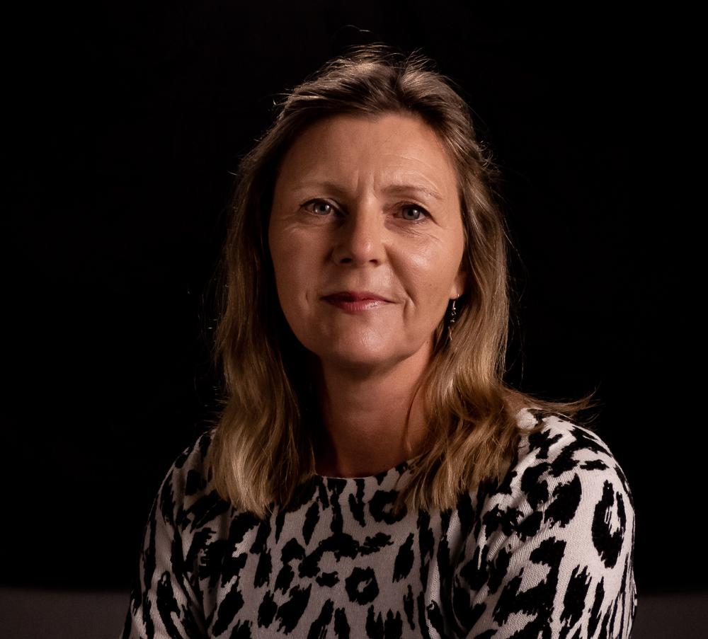
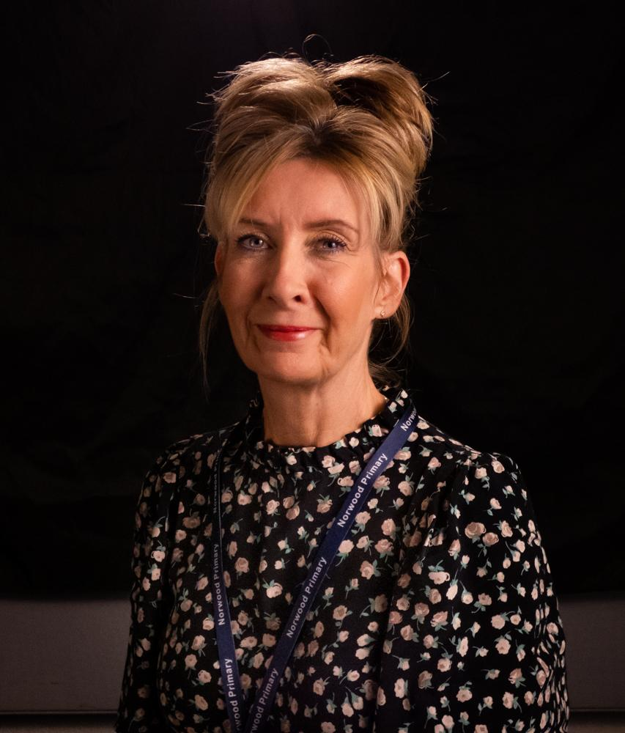
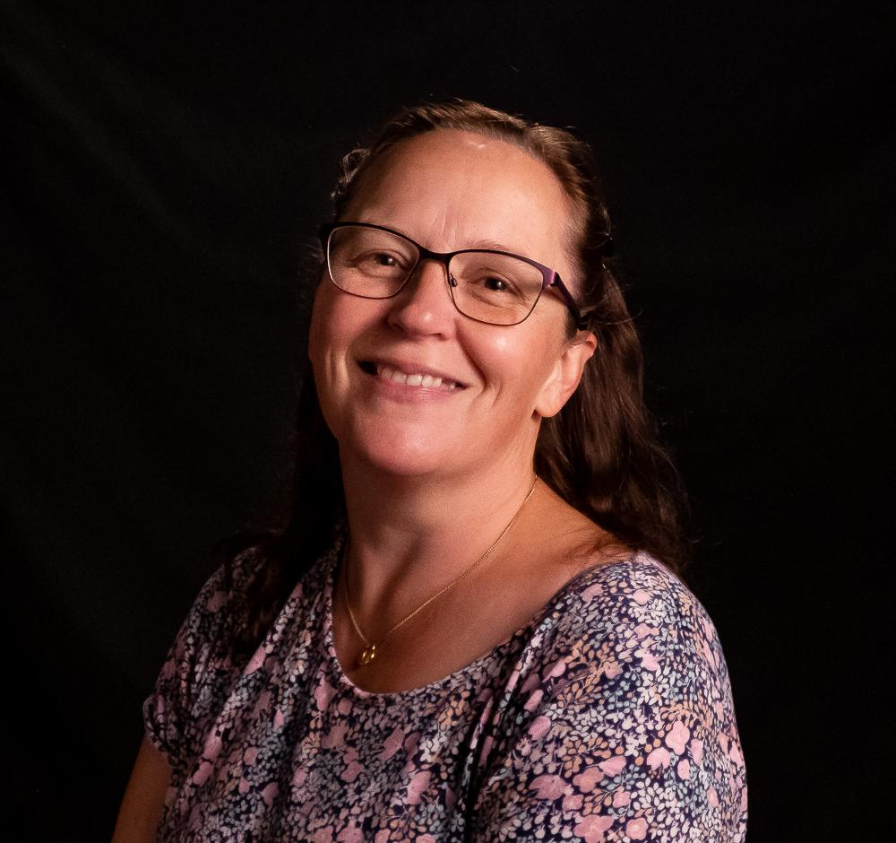
OUR RECEPTION TEAM
Class RT Class RW Class RM

Slide 13



INFORMATION
WE WILL SHARE LOTS OF INFORMATION WITH YOU THROUGHOUT THE YEAR. THIS WILL BE DONE VIA OUR SCHOOL WEBSITE, NEWSLETTERS, PARENT NOTICE BOARDS, SCHOOL SPIDER AND CLASS DOJO.
IT IS IMPORTANT THAT YOU READ ANY INFORMATION SENT TO YOU, AS SOME WILL REQUIRE ACTIONS FROM YOU.
ANY PROBLEMS YOU MAY HAVE, PLEASE SPEAK TO YOUR CLASS TEACHER IN THE FIRST INSTANCE. STAFF ARE AVAILABLE ON THE DOOR EVERY MORNING AND AFTERNOON. IF IT’S SOMETHING THAT NEEDS A LONGER DISCUSSION, APPOINTMENTS CAN BE MADE.

Slide 14
A SEVEN- YEAR RELATIONSHIP
We cannot wait to welcome your child and your family into our school community, whether this is your first child attending our school, or your fourth or fifth!
At Norwood we strive to have excellent home-school partnerships, working together for the benefit of ALL our children.
Please set a good example to your children on the playground, on the Crescent, to other parents and children, to our staff, and to our local community.
Please don’t believe everything your child says about us, and we won’t believe everything they say about you!
Please come and join us at our Summer Fair on
Friday 12th July .
Enjoy your Summer.

