Slide 1

Welcome to Year 5
We are going to have an incredible year full of new learning and fun!

Slide 2

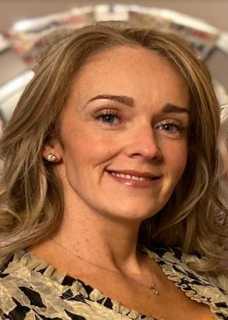

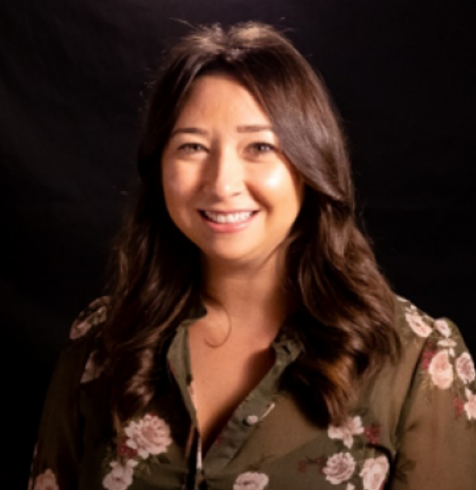
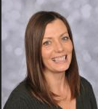


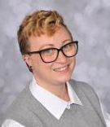
Here is the Year 5 team which may include some familiar faces!
Mr Dempster
(Phase Leader)
Mrs Fessey
Mrs Healy
Mrs Williams
Miss Lloyd
Mrs Dickinson
Mr Duckworth
Miss Rees
Mrs Quinn

Slide 3
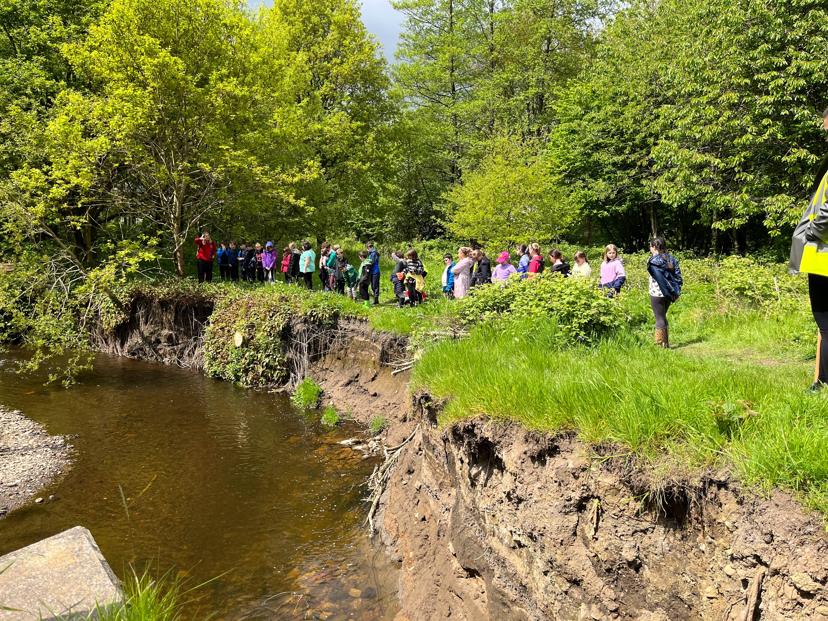
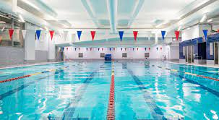
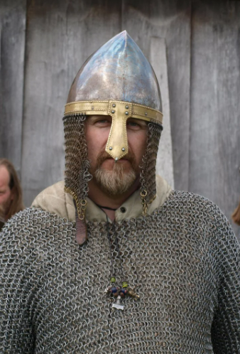

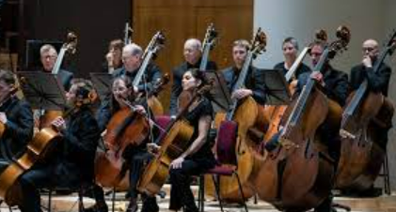

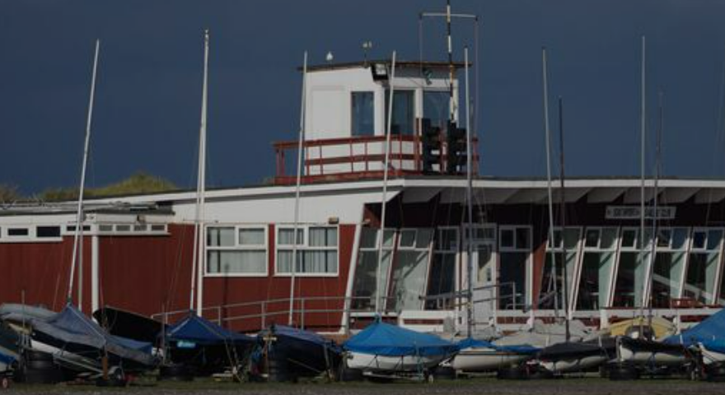
Things to look forward to in Year 5…
Swimming in the Autumn and Spring term
Bradshaw Brook
Visit from a Viking
Band
Southport Yacht Club
Mini Police
Philharmonic Hall

Slide 4
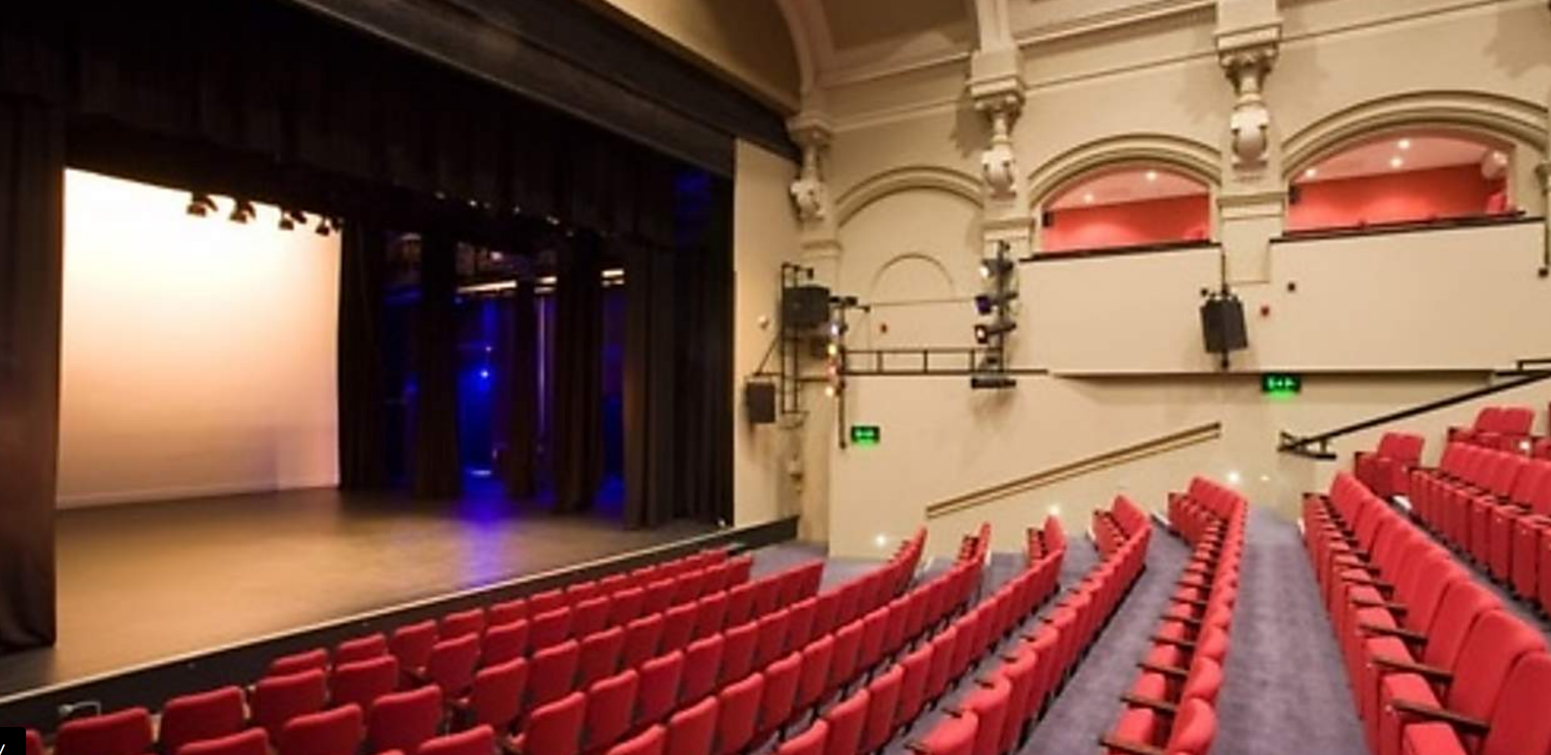
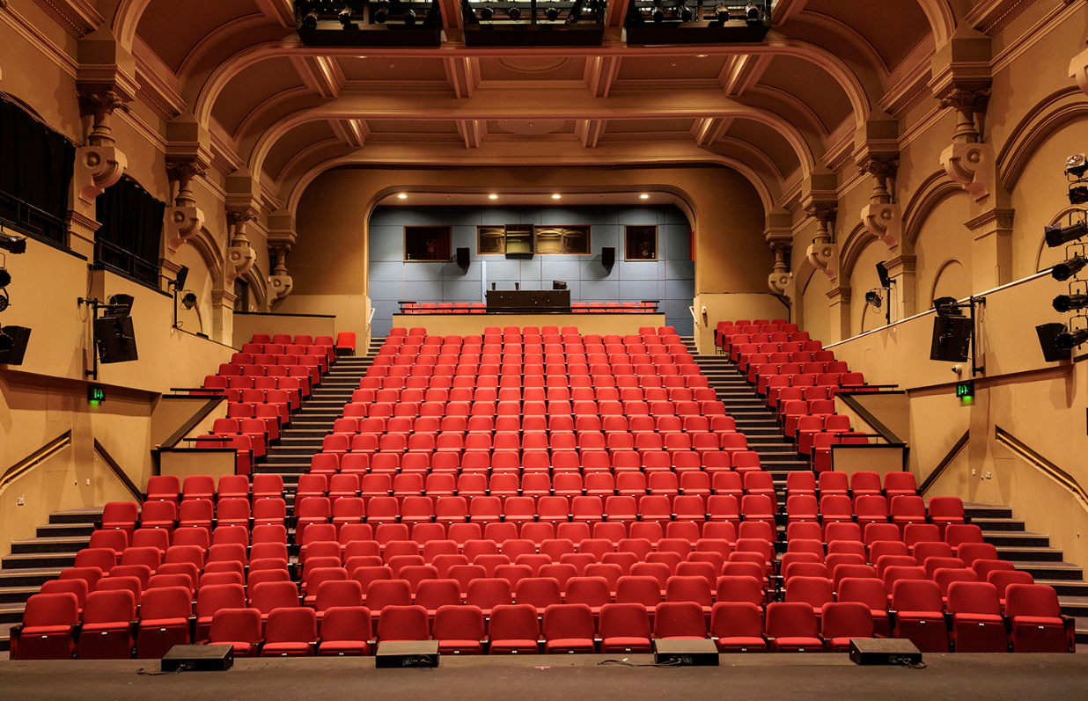
Y5/6 Production
This year, you will get the opportunity to take part in a production at The Atkinson!

Slide 5
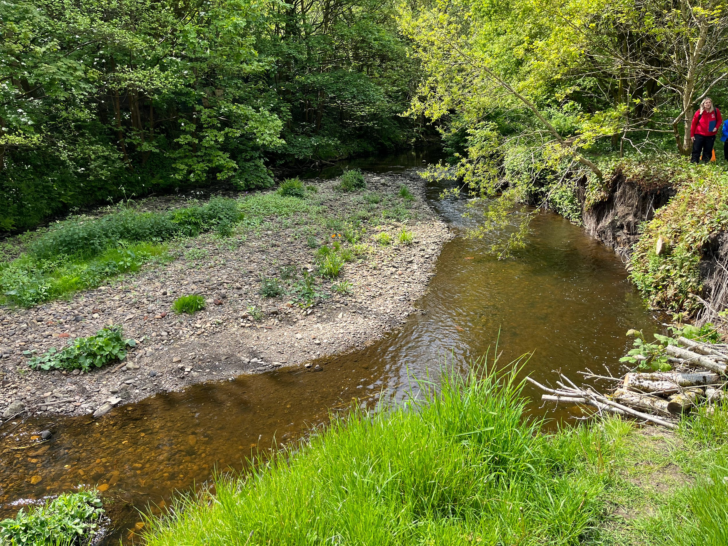
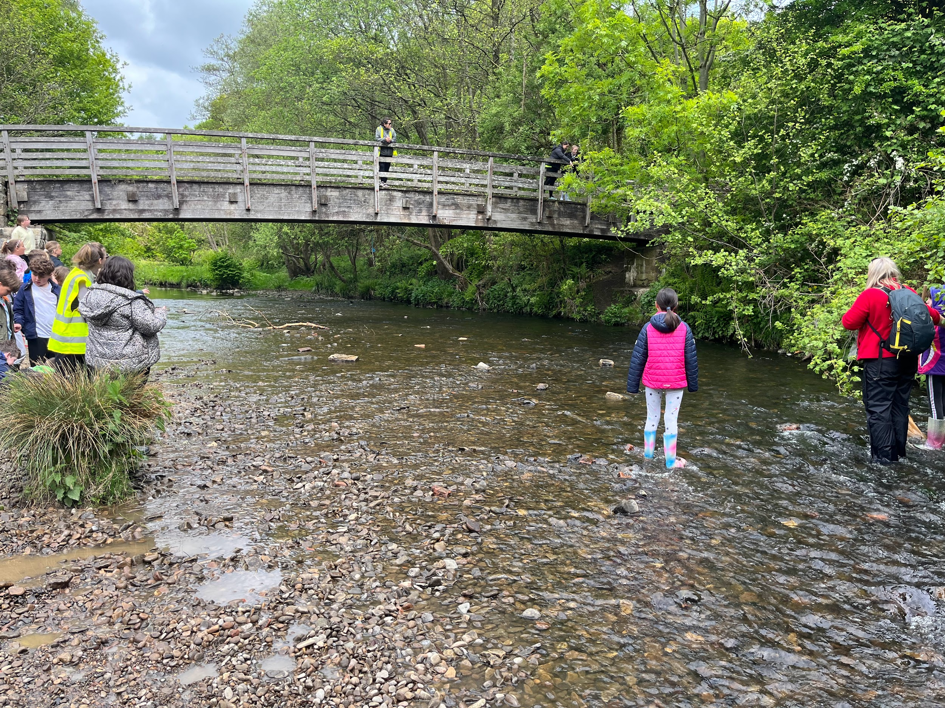
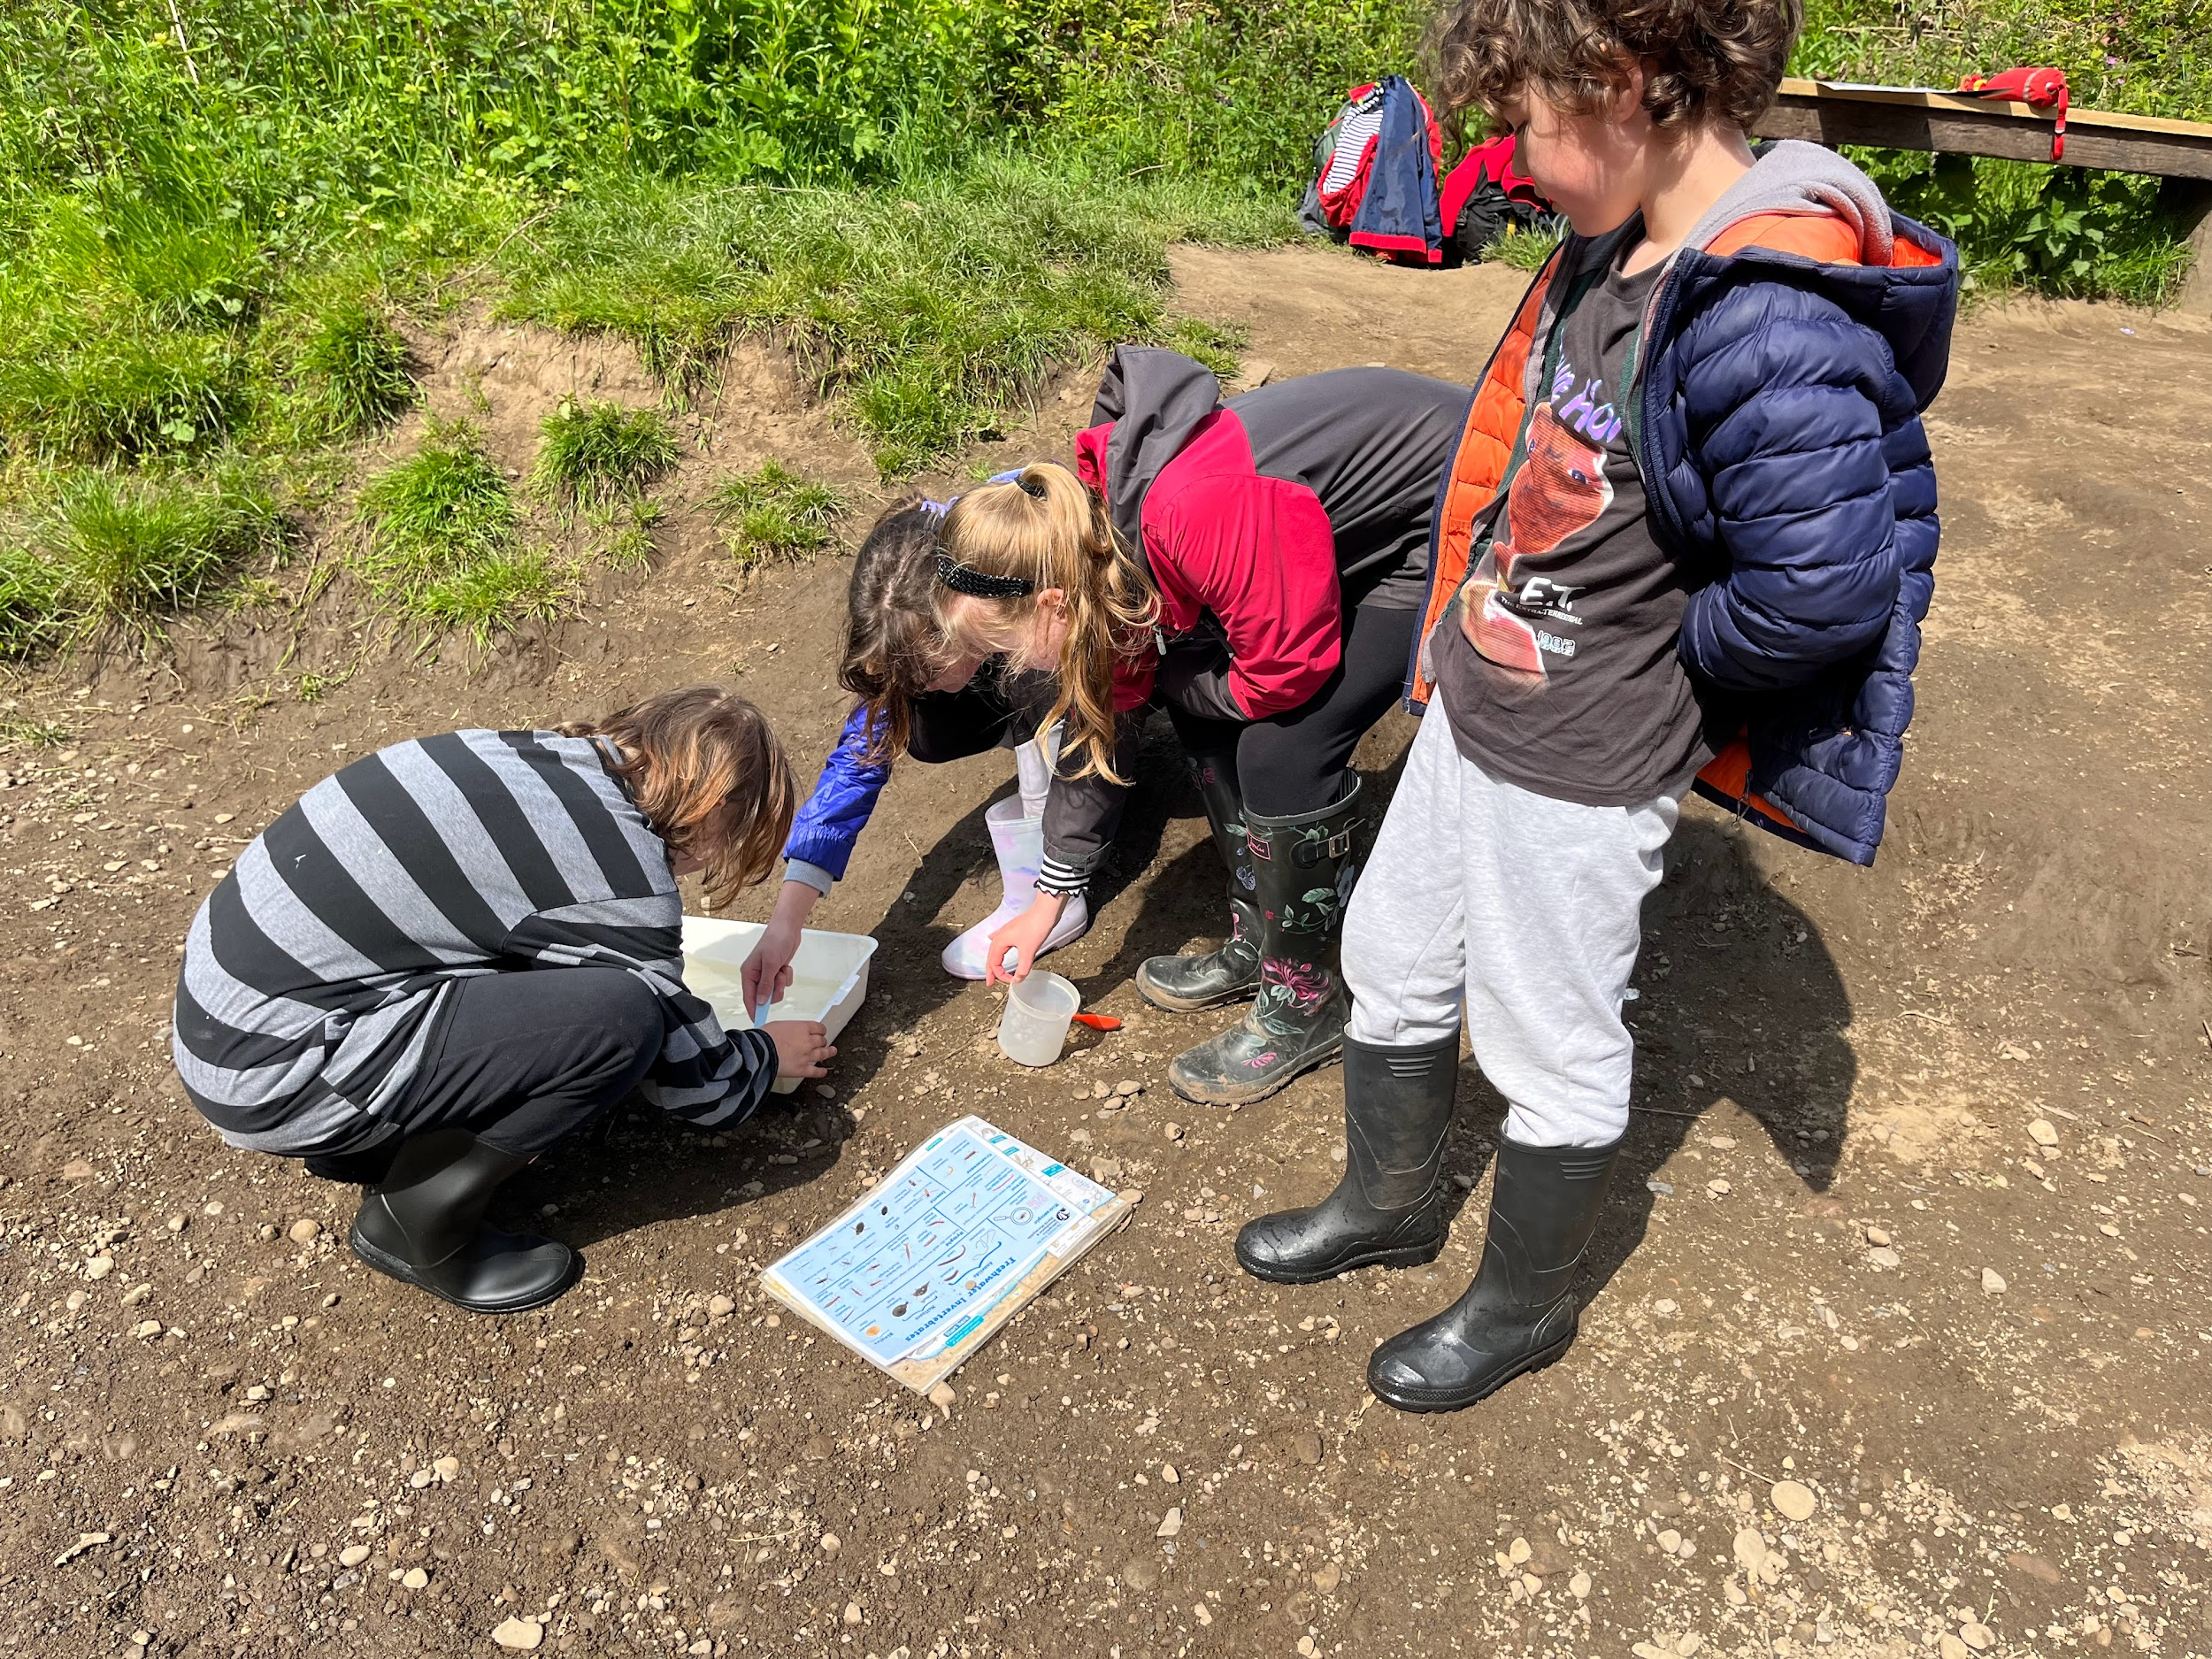
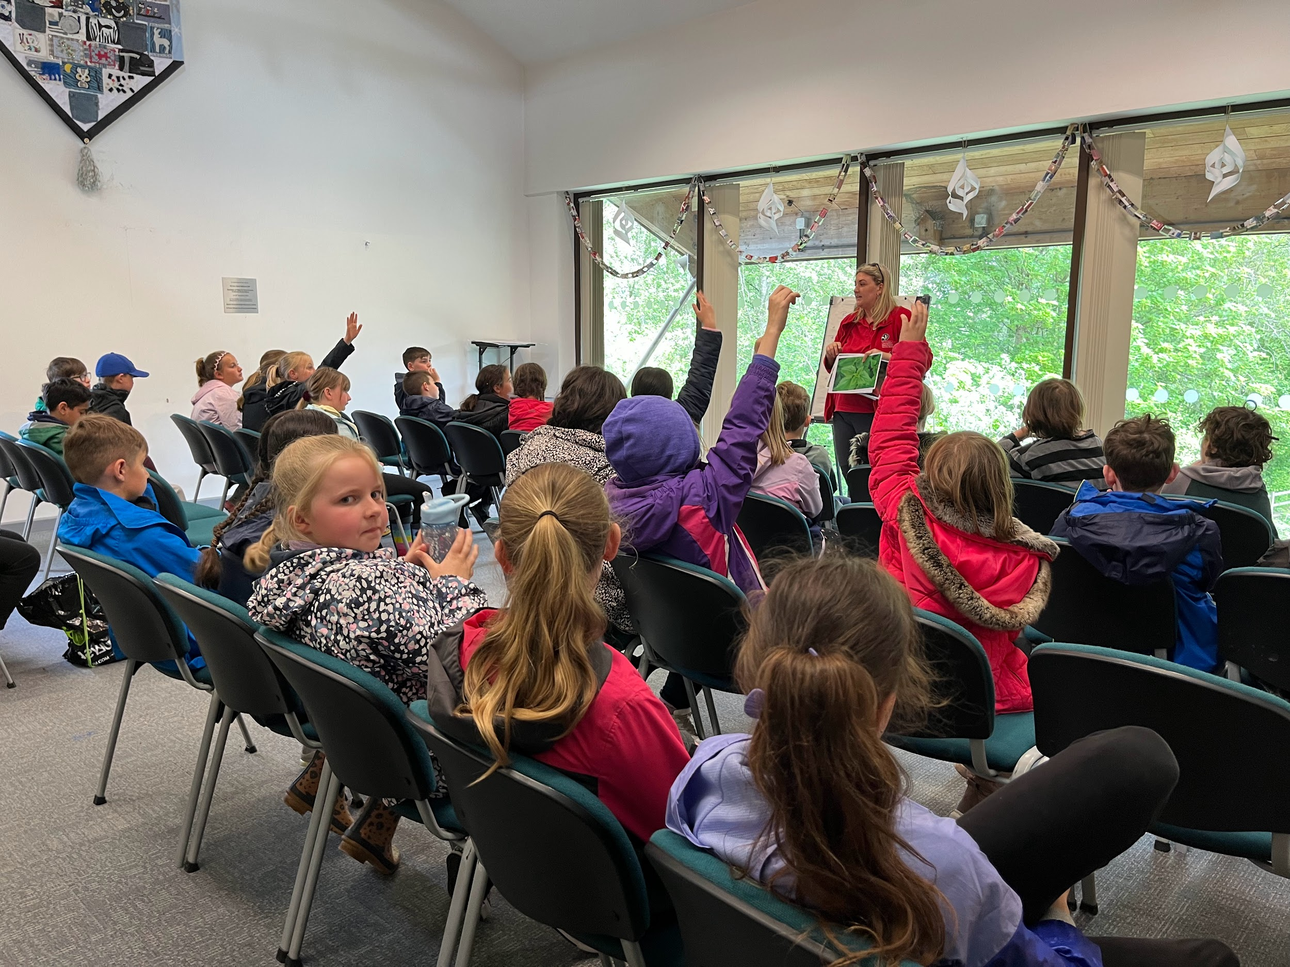
Bradshaw Brook!

Slide 6

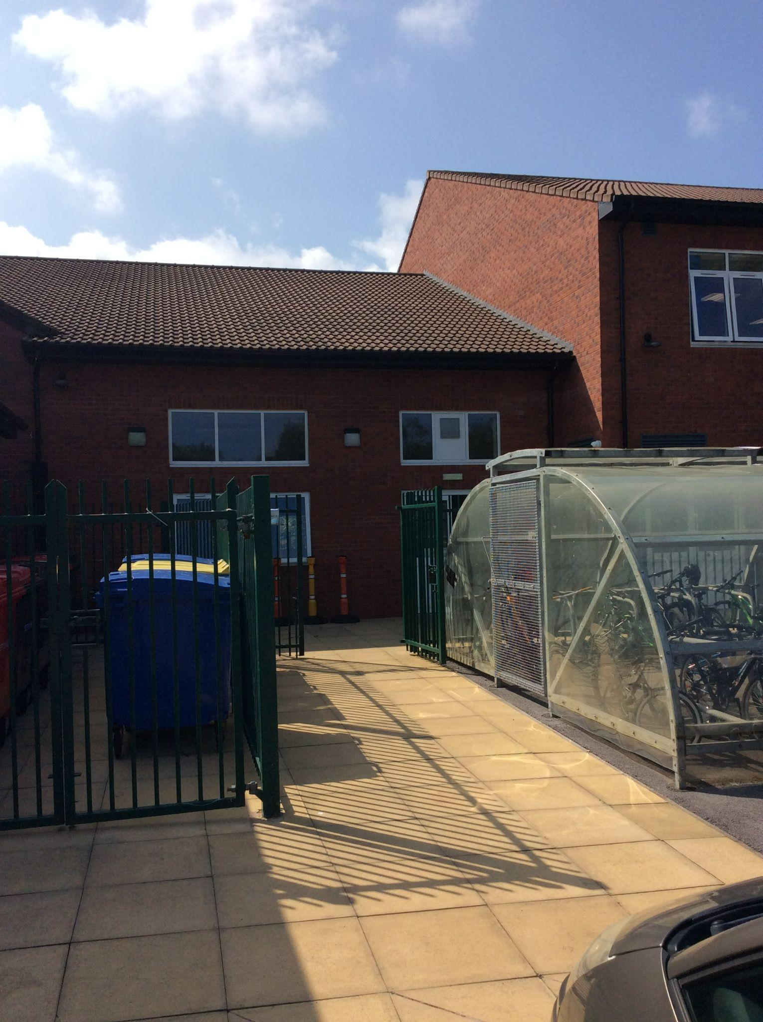
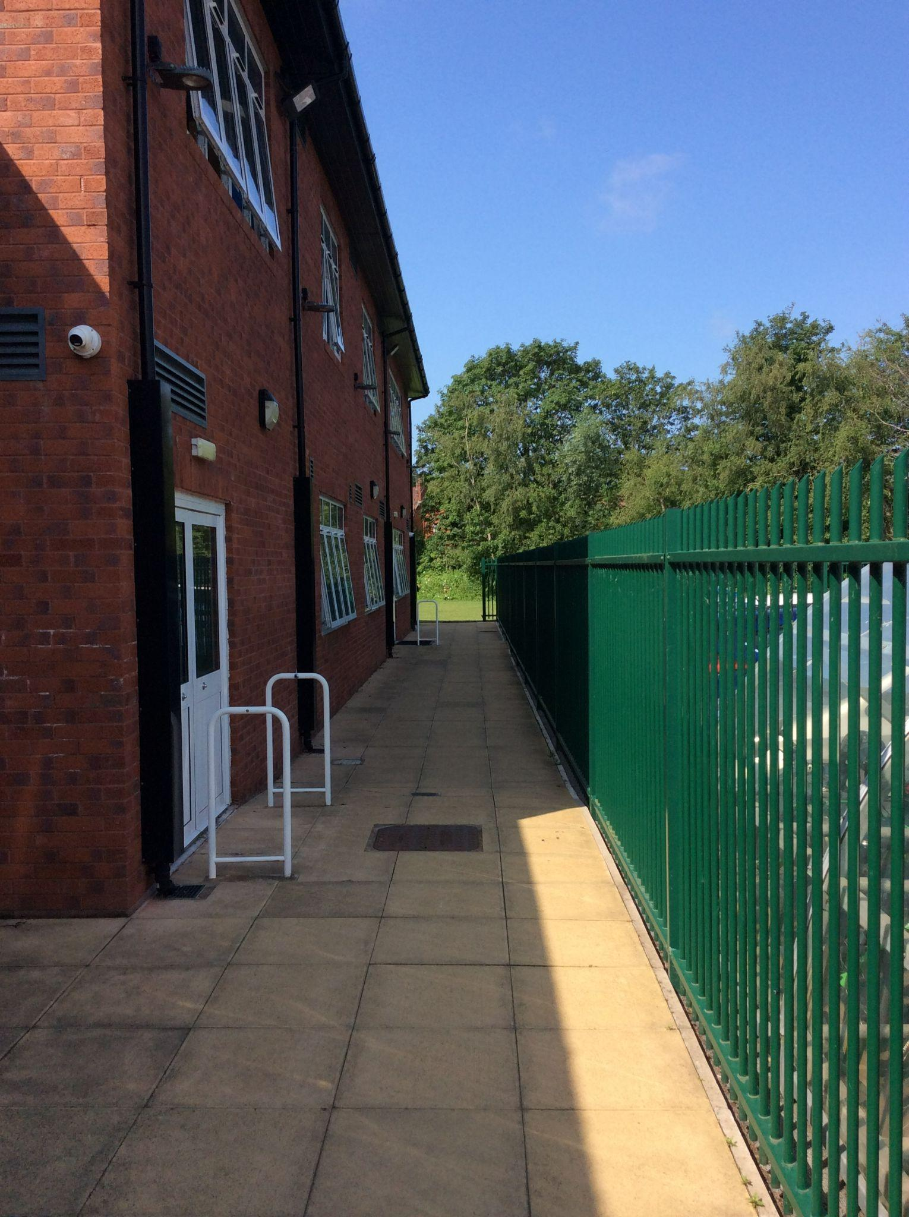
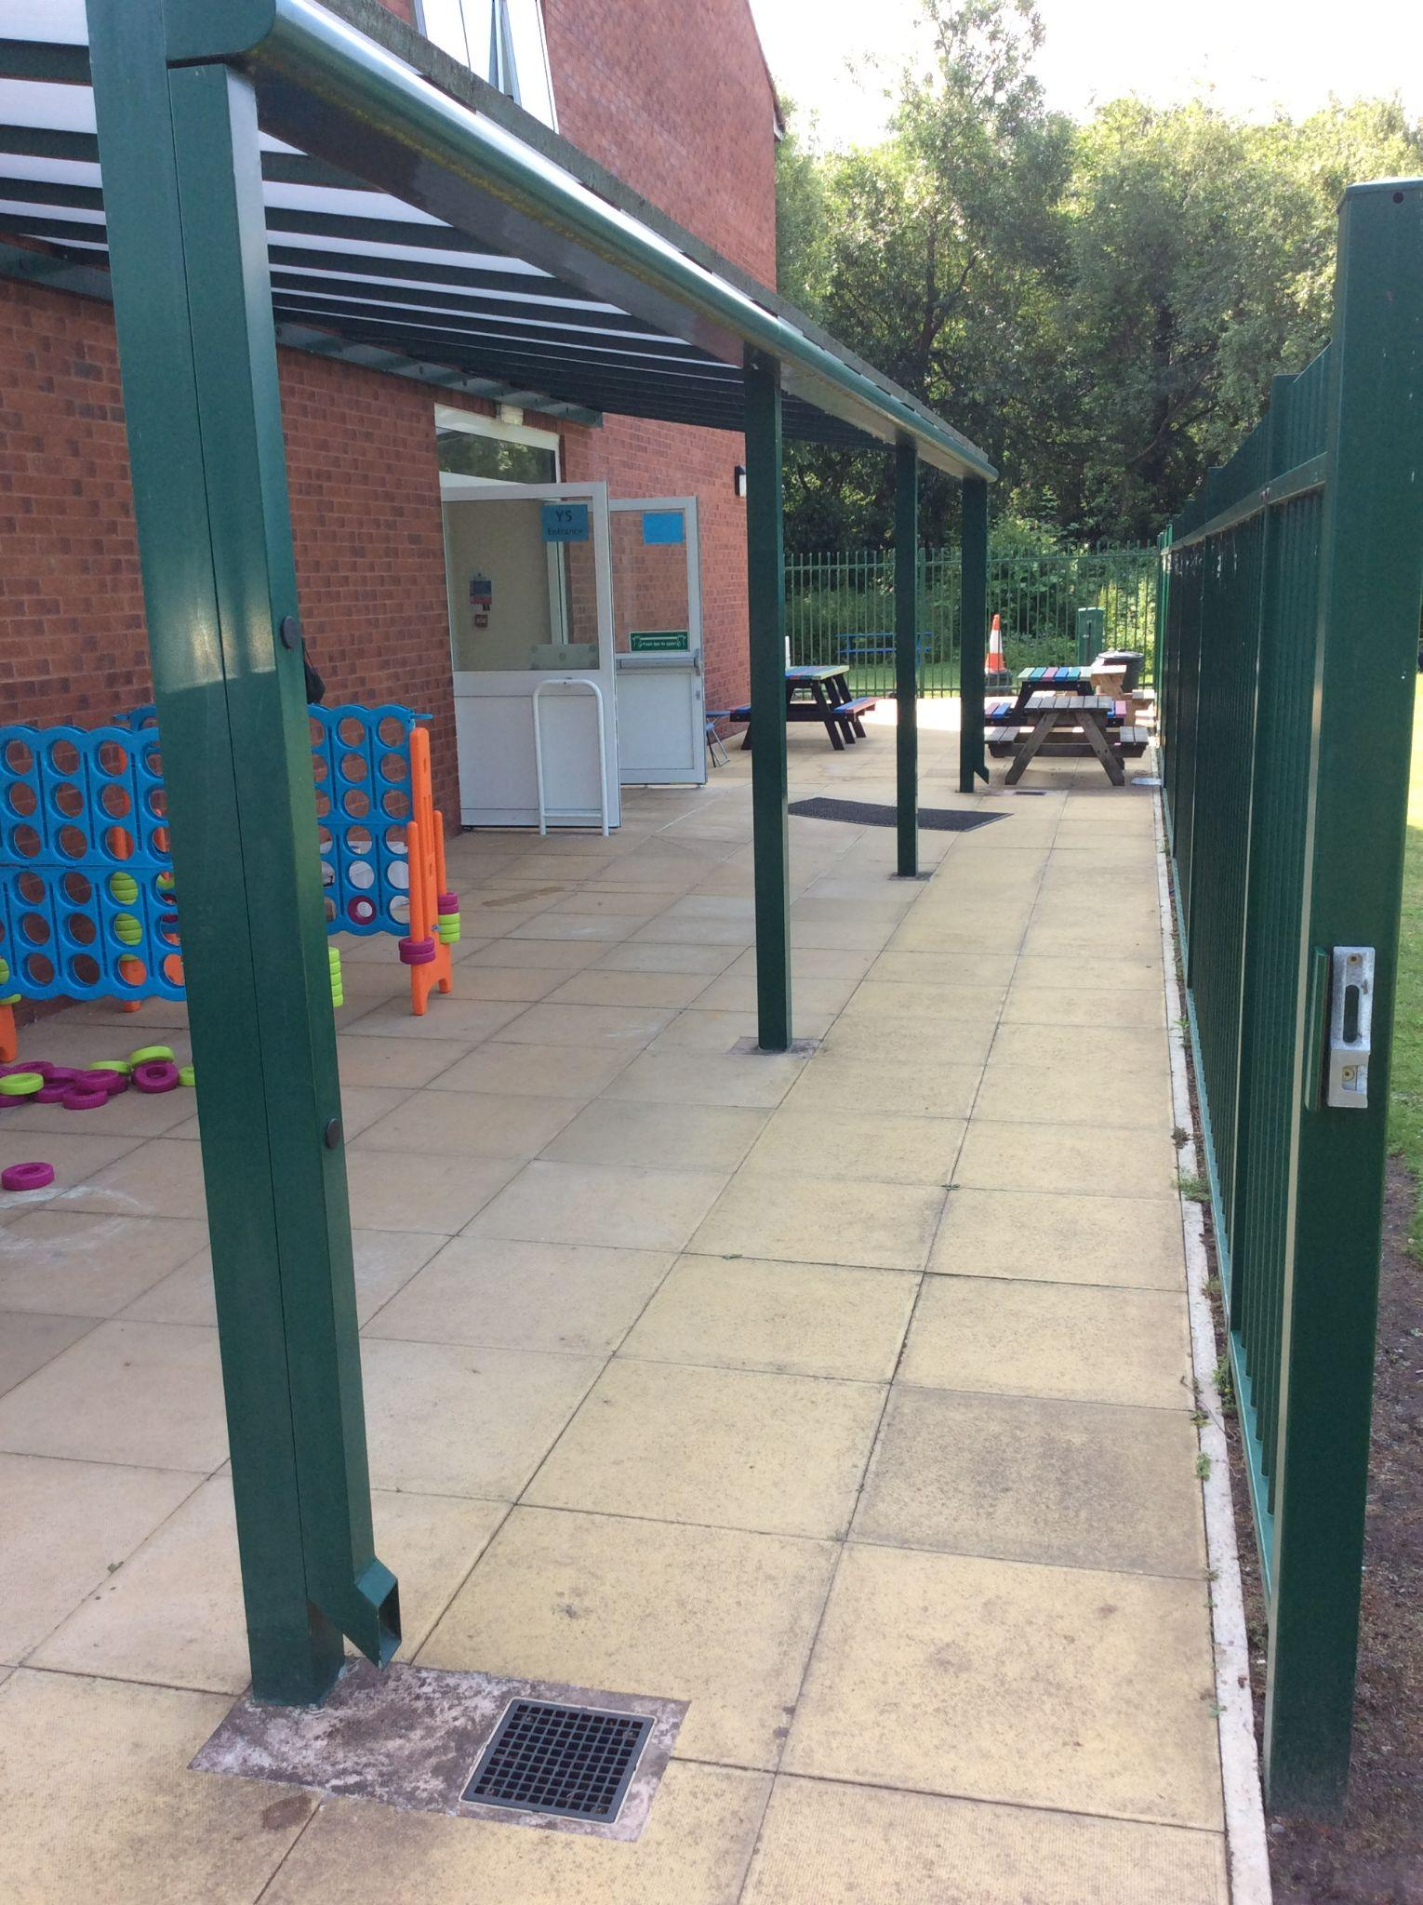
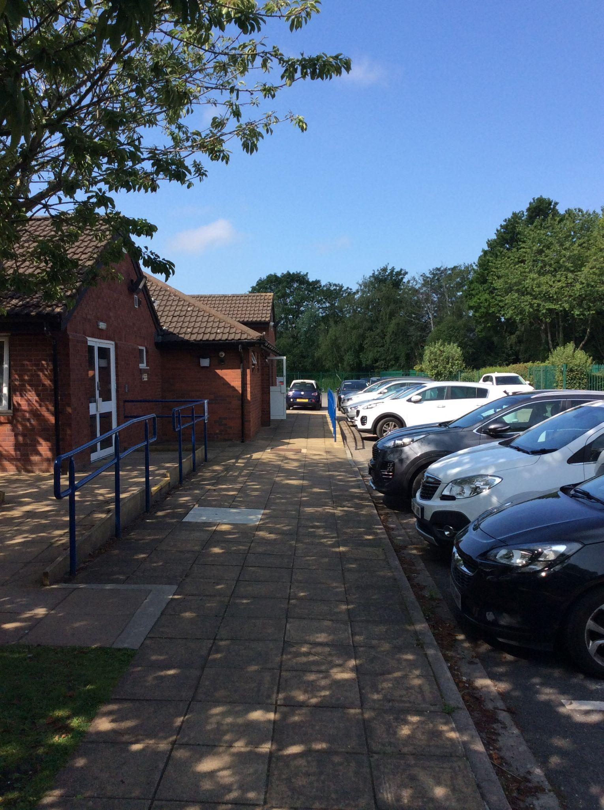
Let us look at a ‘typical’ day in Year 5.
Our day starts from 8:30am. Register closes at 8:45am.
Walk down the side of school, down the side of the staff car park.
You will come through these gates next to the Year 5 and 6 bikesheds.
You will then enter this door near to the field.

Slide 7
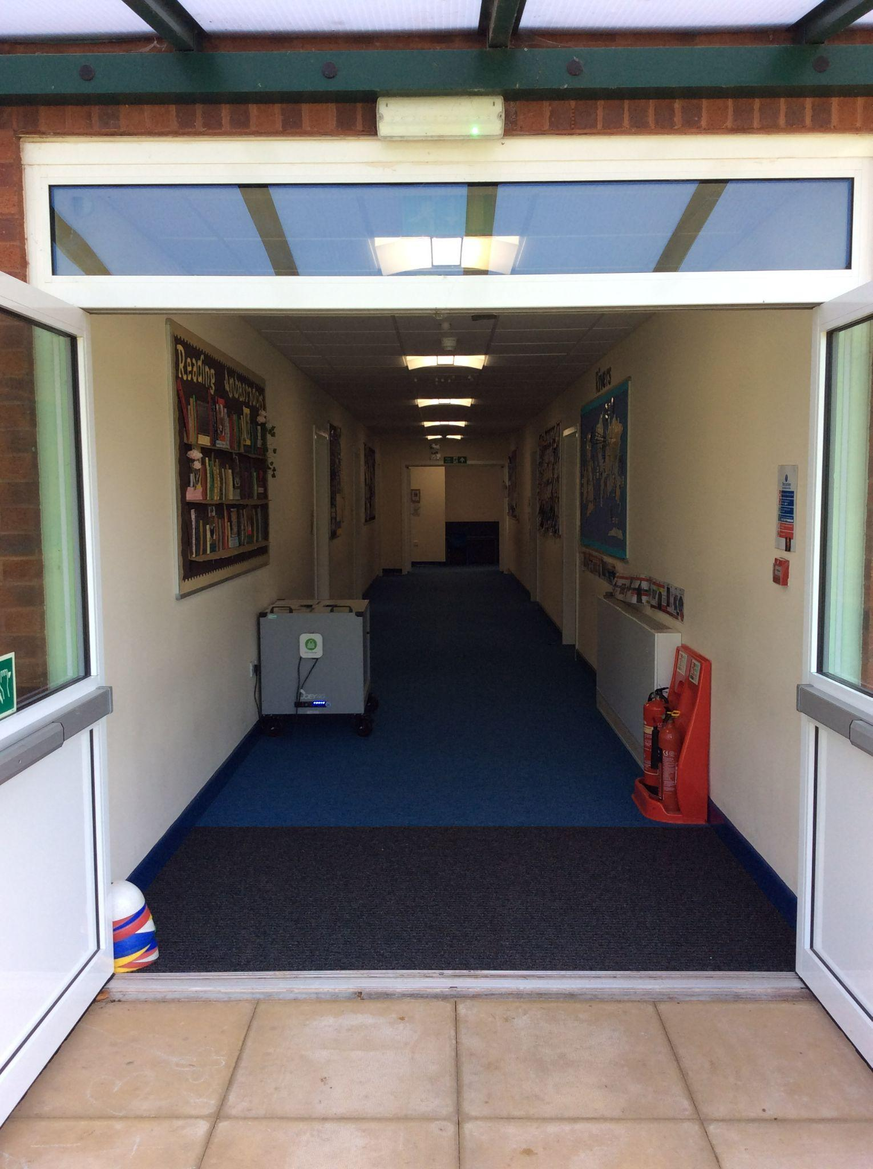
Once you come in, you walk along the corridor and head into your classroom.

Slide 8
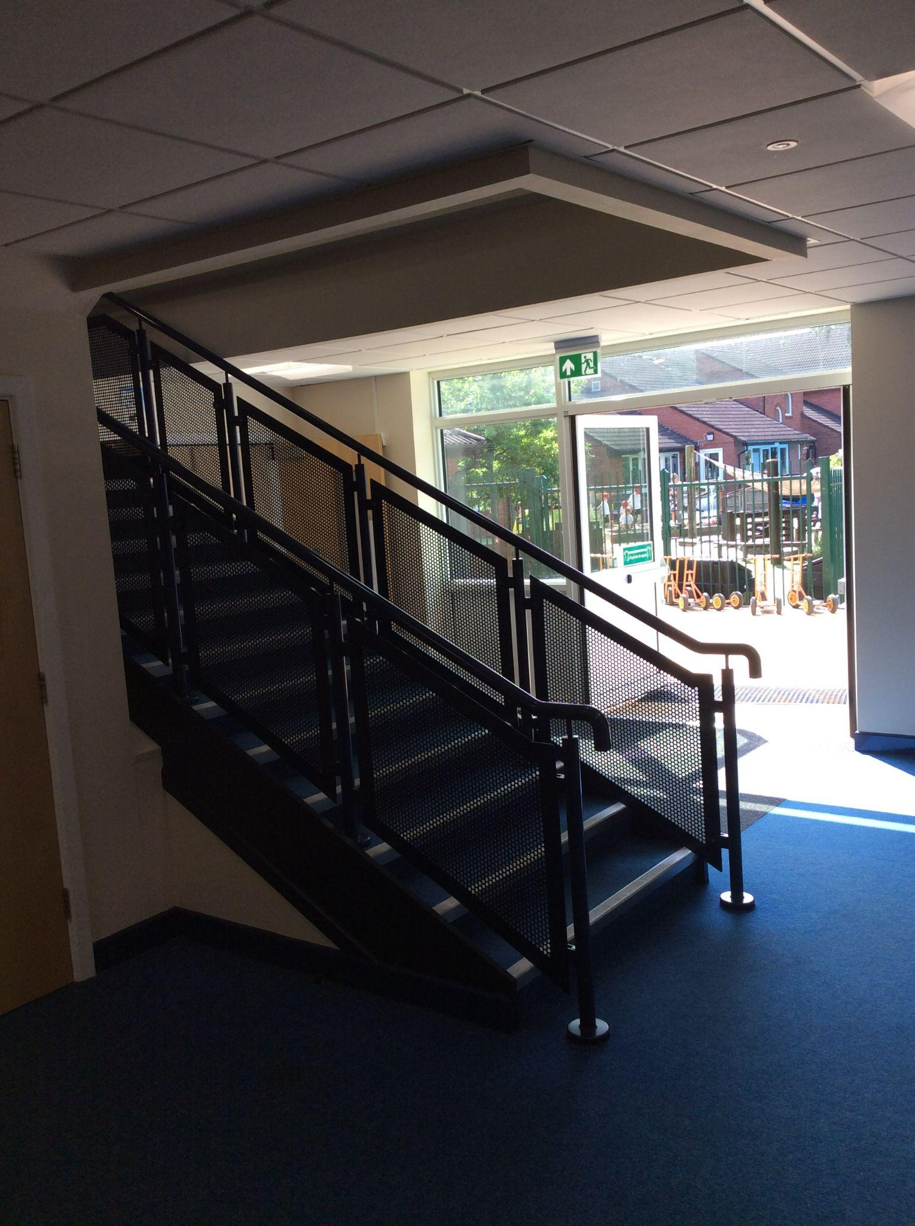
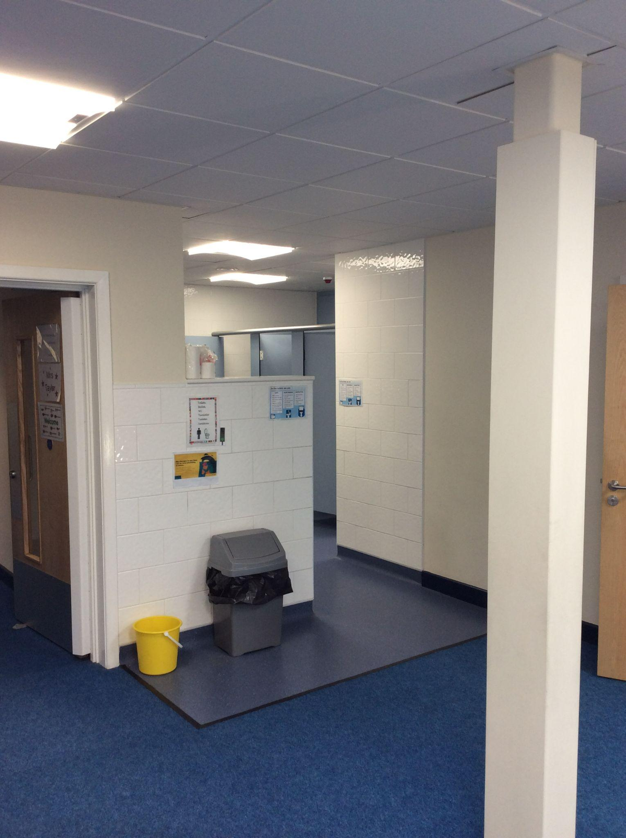
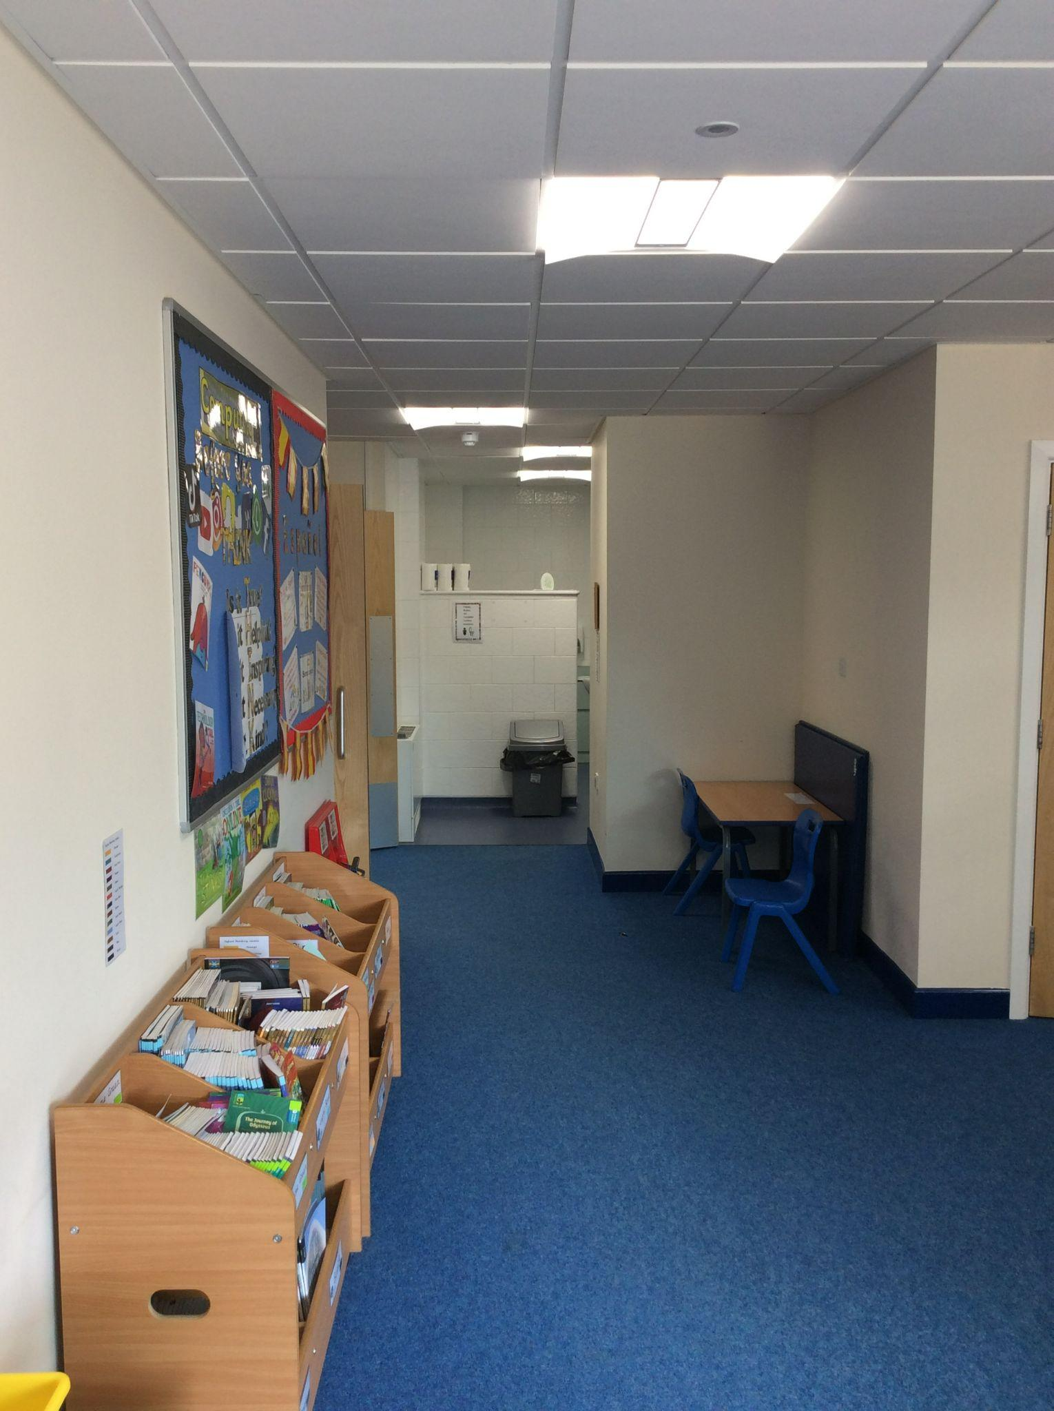
Playtime and Toilets
At playtime, we play on the yard.
We can use the 4 square and if there are any balls left, we can play other ball games in the designated area - no football though!
We use these toilets, girl’s toilets are at the end of our corridor.
Boy’s toilets are upstairs next to Mrs Bennet and Mrs Taylor’s office.
You all know the rules when using the toilets.
In Year 5 we trust you to maintain a high standard of behaviour.
In Year 5 it is your responsibility to report any issues to an adult straight away.
BOYS GIRLS

Slide 9
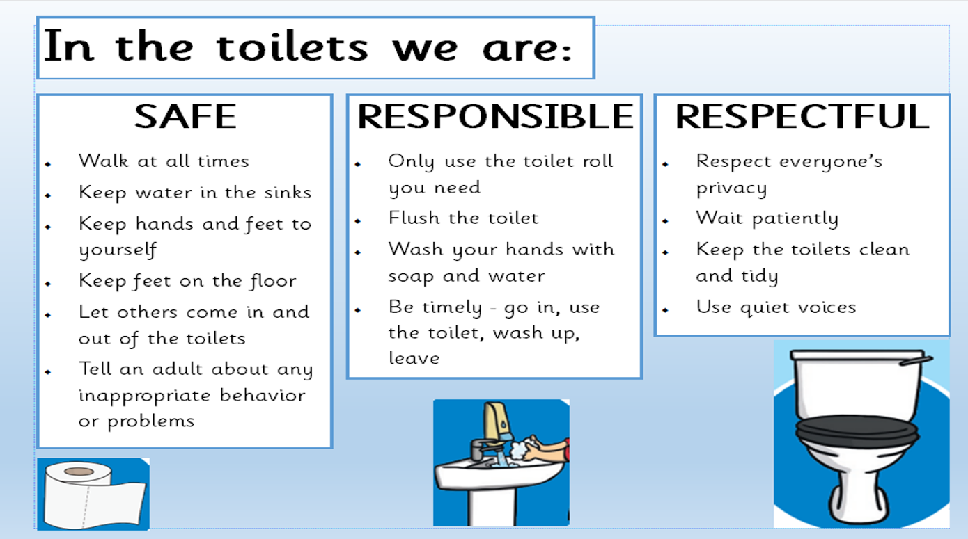

Slide 10


Slide 11



Next we begin our English lessons. Here we will learn different grammar and spelling rules. We will also read and write about different texts.
Here are the books that we will read:
DOES ANYONE KNOW ANYTHING ABOUT THESE BOOKS?

Slide 12
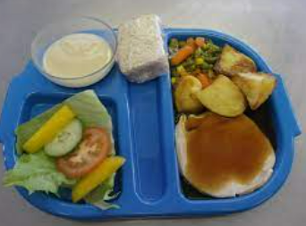
DINNER TIME
Year 5 go out to play first at dinnertime.
We play on the big yard, near the MUGA.
We get called to the hall around 12.30pm.
Line up when the whistle has gone for your year group - please line up sensibly in your table groups
Children who are packed lunches must wait to eat until the children with hot dinners have returned to the table before anyone starts to eat.
If you are a packed lunch and require cutlery - please take it to the trolly to be washed after use
Indoor voices should be used when speaking to others - you are not to shout across to other tables. Some children find noisy environments difficult.
You MUST NOT leave the lunch hall until a member of staff has asked their table to leave - lunch time lasts for 20 minutes in the hall, so don’t think that if you eat your dinner in 5 minutes you will get to go out!MUGA will be timetabled.
You will be allocated a table to sit at with your friends and stay on these tables once allocated.
If it is wet play, we will remain in our classrooms until called to the hall for our dinner.

Slide 13
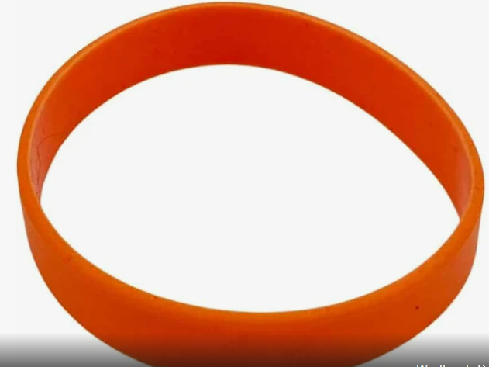
DELI BAR
Y5 and 6 get deli options.
Year 5 options are on a Tuesday and a Thursday.
Your parents will need to register at the start of half term that you require a deli.
On the day, you will take an orange band from the basket at the end of the corridor.
This shows the ladies in the kitchen that you are Deli that day.

Slide 14
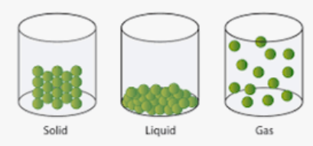

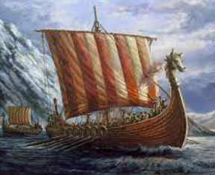

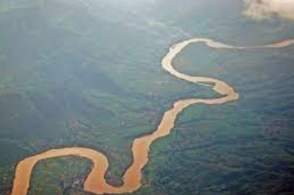

In the afternoons, we cover lots of different subjects and topics. Can you guess what they might be?

Slide 15
Did you get any right? In Year 5, different teachers teach different subjects.
The Vikings / History
States of Matter/ Science
The Mayans / History
Religious celebrations / RE
Rivers / Geography
Earth and Space/Science

Slide 16
Home time is at 3:05pm
We normally go out across the reception play area together at the end of the day.
Adults should be waiting on the quiet yard.
If you have a bike or scooter, you must go with your adult to collect it.
It is always busy on the yard, so please make sure you let the staff know that you have seen your adult. If your adult is not there, you will wait with the member of staff.

Slide 17
Walking Home on your own
As you get older, your parents might allow you to go home on your own, or be met half way home by them, for example, on the bridge.
If this is the case, your parents must complete a letter - available from the office.

Slide 18
Mobile Phones
For those making their own way home, you might need to bring a mobile phone to school.
If so, your parents must to complete a form stating that you will have a mobile phone in school. You can not bring your phone in without the form being completed.
Once you come into school each day, you will need to sign your phone in and out of the class tray.

