Slide 1
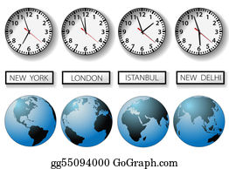

L.O. To be able to solve problems involving time.
www.mrsmorganmaths.weebly.com

Slide 2
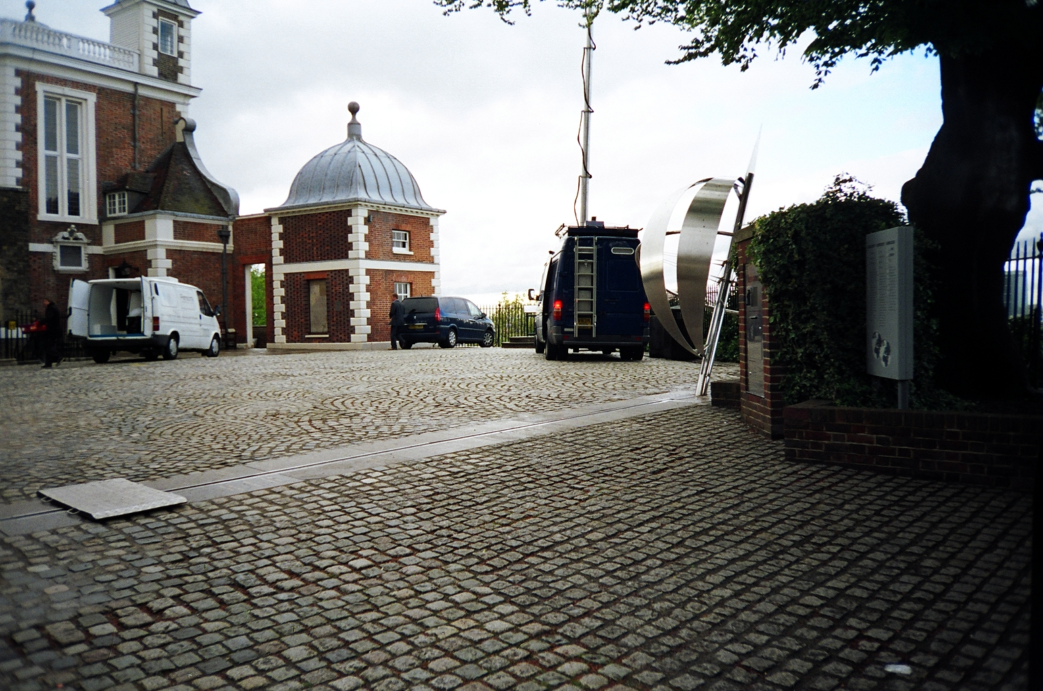
What is this picture of?
www.mrsmorganmaths.weebly.com
Notes:
Greenwhich Meridian line

Slide 3
What is this picture of?
Greenwich Mean Time
www.mrsmorganmaths.weebly.com
Notes:
Greenwhich Meridian line

Slide 4
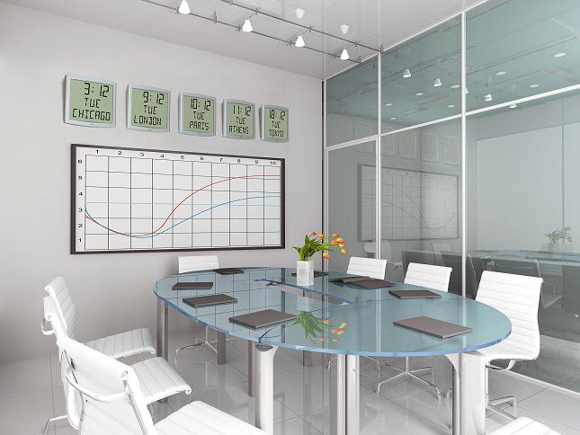
Why are there so many clocks?
www.mrsmorganmaths.weebly.com

Slide 5
Why are there so many clocks?
They are the times in different cities in different countries around the world.
www.mrsmorganmaths.weebly.com

Slide 6
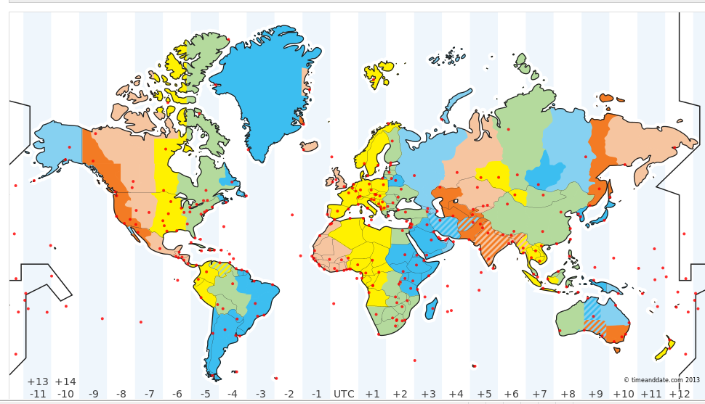
Time Zones
Task: cut out the counties. Arrange them in order of who celebrates new years day first.
www.mrsmorganmaths.weebly.com

Slide 7
Time Zones
http://www.timeanddate.com/time/map/
www.mrsmorganmaths.weebly.com
Notes:
Main task – give out A3 coloured time zone maps and worksheets

Slide 8
Plenary
Use the time zone map to design a question, like the ones that you have answered today. Ask someone else to complete your question.
www.mrsmorganmaths.weebly.com

