Slide 1
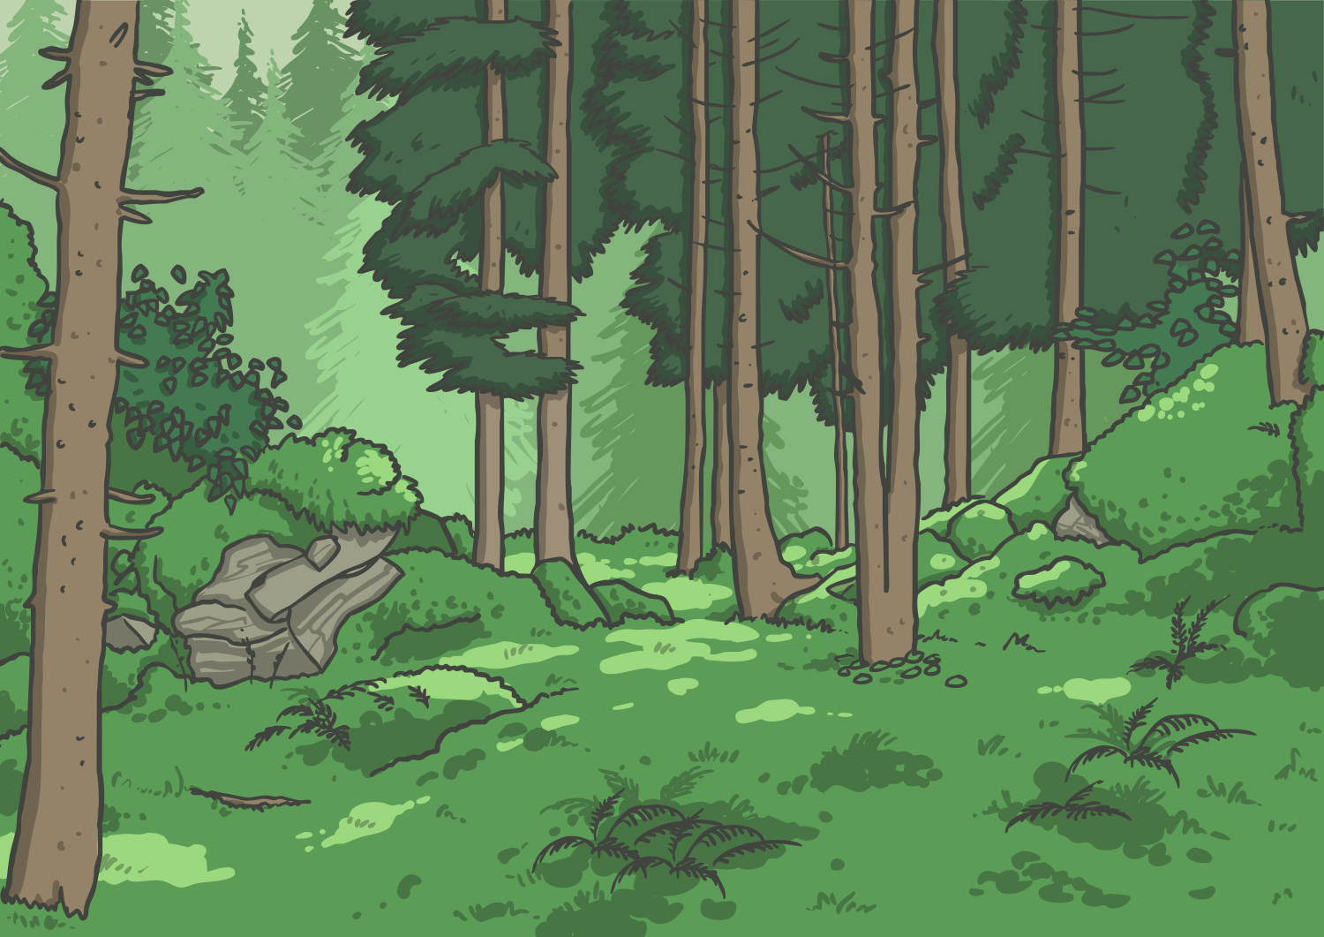

Is it imperative that the
subjunctive be used?
(If I were you, I’d have a look at this . . . )

Slide 2
Strange New Verbs
Huh? The subjunctive verb form? What’s that?
Have a look at these sentences, can you see anything unusual about the verbs?
If John were to get an A on his test, I would be very surprised.
Were I a little bit taller, I would be able to reach the shelf.
I would run if I were younger.
If I were him, I’d try a lot harder at school.

Slide 3
Strange New Verbs
Wouldn’t we usually say them like this?
If John got an A on his test, I would be very surprised.
If I was a little bit taller, I would be able to reach the shelf.
I would run if I was younger.
If I was him, I’d try a lot harder at school.

Slide 4
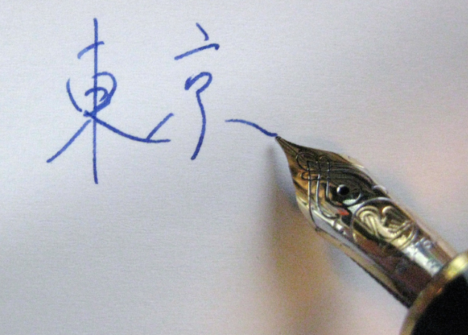
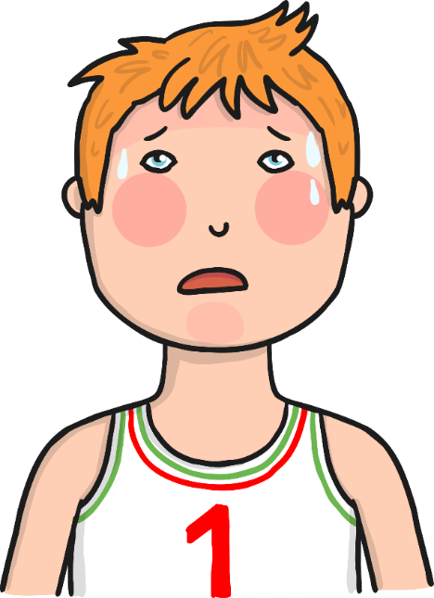
Subjunctive Verbs
The subjunctive verb form can be used to show that we don’t think the situation is really possible.
I’m not going to cool down anytime soon!
Japanese isn’t going to be taught here.

Slide 5
Subjunctive Verbs
The subjunctive verb form structure is really quite simple:
For all verbs except the past of ‘be’, you use the same as the infinitive (basic) form.
be (past)
be (present)
all other verbs (past and present)
I were
you were
he, she, it were
we were
you were
they were
I be
you be
he, she, it be
we be
you be
they be
I work
you work
he, she, it work
we work
you work
they work

Slide 6
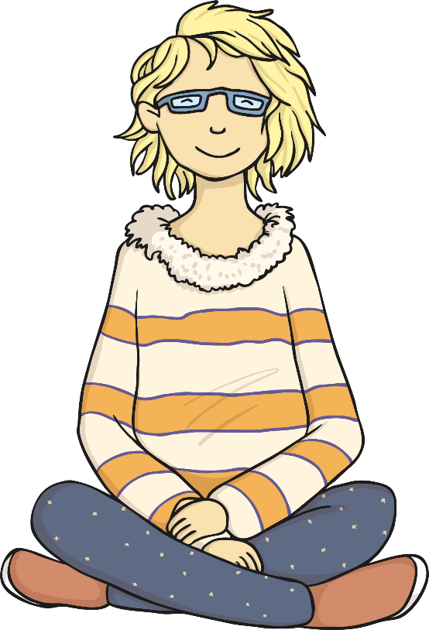
Subjunctive Verbs
Actually, it’s even easier because the subjunctive doesn’t change according to the person (I, you, he/she/it, etc.)
You don’t always notice this, because it sometimes sounds like the normal verb.

Slide 7
Ok, that’s what it is, but what is it for?
The subjunctive verb form isn’t common in everyday British speech.
However, it is often used after formal verbs such as require, demand, suggest, propose.
The governors propose that class 5 learn maths all day.
The Queen demands that all children be taught to curtsey.
Mrs Smith requires that James Brown go to her office now.
Might I suggest that your son wait outside until we have finished our chat?

Slide 8
Other Uses
The subjunctive verb form is also used after formal expressions, such as it is desirable/necessary/vital/essential
It is desirable that the whole class be here early for the trip.
Is it necessary that you eat all your chocolate right now?
It is vital that each child bring their own water bottle to school.
It is essential that Magda take her hay fever medicine daily.

Slide 9
Plenary
What have we learned about the subjunctive form?
The subjunctive form is used in formal language.
It can be used to give advice or a talk about an unreal situation.
The subjunctive form follows certain verbs or expressions.
If I were you though, I wouldn’t worry too much about it!

