Slide 1
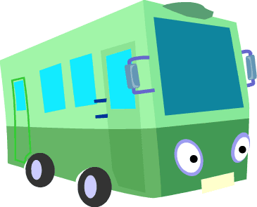
Tony the taxi

Slide 2
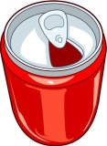
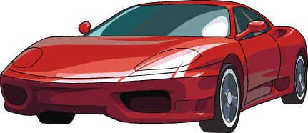

Tony the taxi is going to the shop.
What does he see when he comes to a stop?

Slide 3
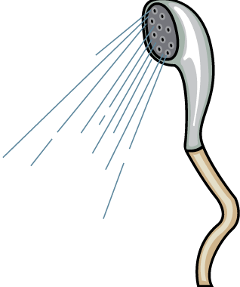
Tony the taxi is going to the shop.
What does he see when he comes to a stop?

Slide 4
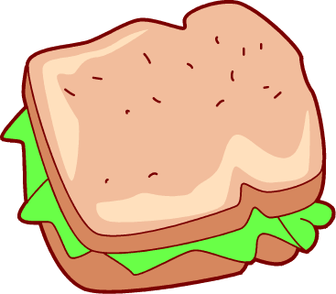
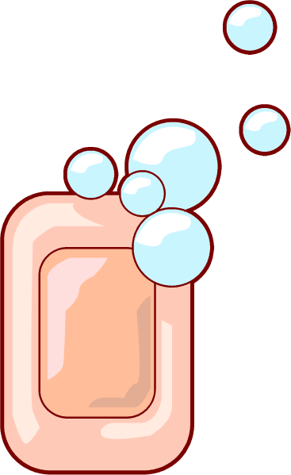
Tony the taxi is going to the shop.
What does he see when he comes to a stop?

Slide 5

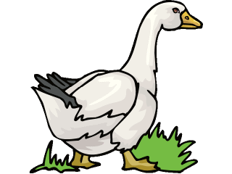
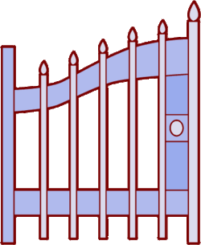
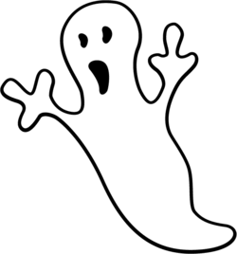
Tony the taxi is going to the shop.
What does he see when he comes to a stop?

Slide 6
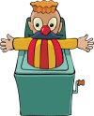
Tony the taxi is going to the shop.
What does he see when he comes to a stop?

Slide 7

Tony the taxi is going to the shop.
What does he see when he comes to a stop?

Slide 8
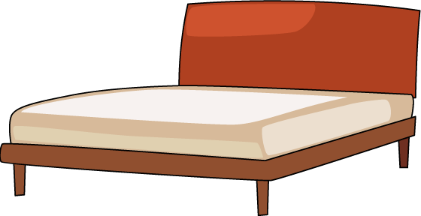
Tony the taxi is going to the shop.
What does he see when he comes to a stop?

Slide 9
Tony the taxi is going to the shop.
What does he see when he comes to a stop?

Slide 10

Tony the taxi is going to the shop.
What does he see when he comes to a stop?

Slide 11



Tony the taxi is going to the shop.
What does he see when he comes to a stop?

Slide 12
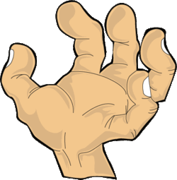


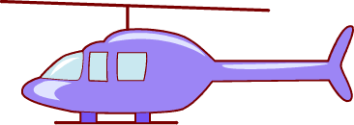
Tony the taxi is going to the shop.
What does he see when he comes to a stop?

Slide 13
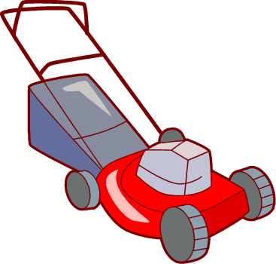


Tony the taxi is going to the shop.
What does he see when he comes to a stop?

Slide 14
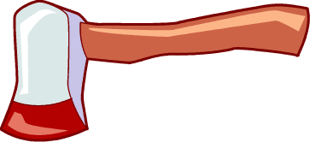



Tony the taxi is going to the shop.
What does he see when he comes to a stop?

Slide 15
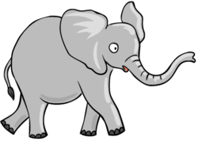
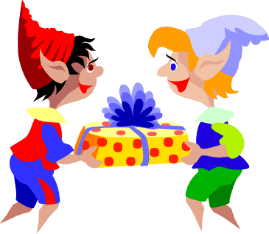

Tony the taxi is going to the shop.
What does he see when he comes to a stop?

Slide 16

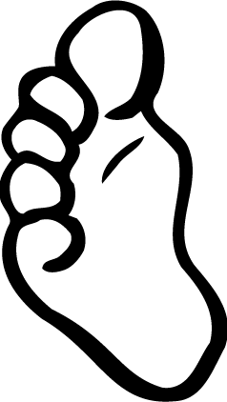
Tony the taxi is going to the shop.
What does he see when he comes to a stop?

Slide 17

Tony the taxi is going to the shop.
What does he see when he comes to a stop?

Slide 18


Tony the taxi is going to the shop.
What does he see when he comes to a stop?

Slide 19
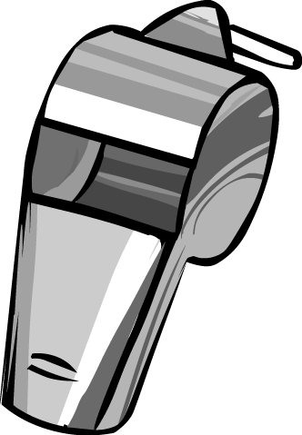
Tony the taxi is going to the shop.
What does he see when he comes to a stop?

Slide 20
The end

