Slide 1
Alliteration
story
‘h’
Hannah goes on a hike
Hannah is walking in the countryside. On the way she spots lots of things. Can you help her remember them?

Slide 2
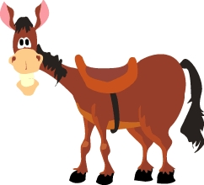
I was taking a hike and I saw….

Slide 3

I was taking a hike and I saw….

Slide 4
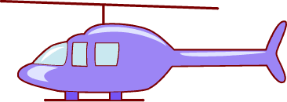
I was taking a hike and I saw….

Slide 5

I was taking a hike and I saw….

Slide 6

I was taking a hike and I saw….

Slide 7
I was taking a hike and I saw….

Slide 8
I was taking a hike and I saw….

Slide 9
I was taking a hike and I saw….

Slide 10
I was taking a hike and I saw….

Slide 11
I was taking a hike and I saw….

Slide 12

I was taking a hike and I saw….

Slide 13
Phew! That was hard work remembering!
Thank you everybody!
Bye bye!

