Slide 1
Phonics satpi

Slide 2

pin

Slide 3

zip

Slide 4
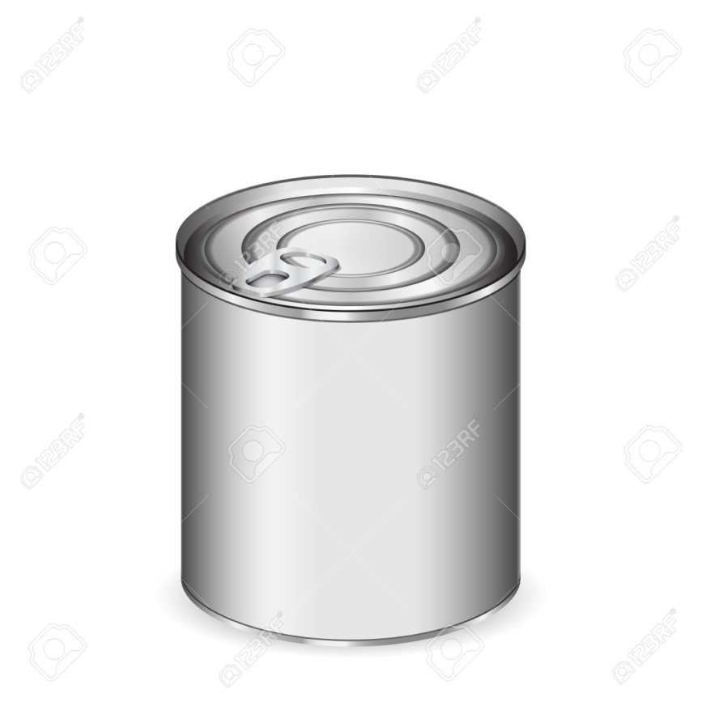
tin

Slide 5
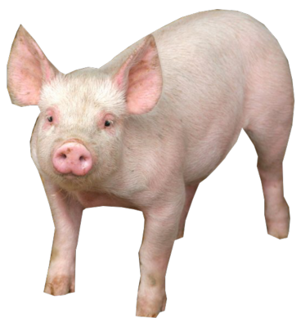
pig

