Slide 1
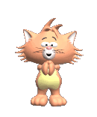
Jolly Phonics
Click on the set you need to access or just click through the presentation
Set 1: s, a, t, p, i, n
Set 2: ck, e, h, r, m, d
Set 3: g, o, u, l, f, b
Set 4: ai, j, oa, ie, ee, or
Set 5: z, w, ng, v, oo, oo
Set 6: y, x, ch, sh, th, th
Set 7: qu, ou, oi, ue, er, ar

Slide 2

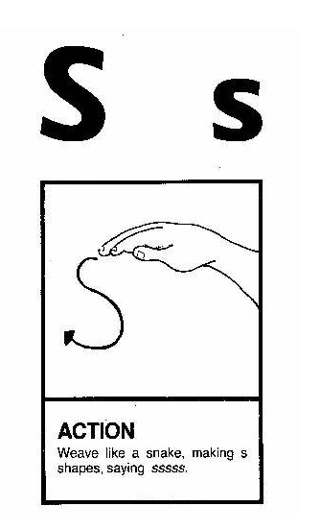
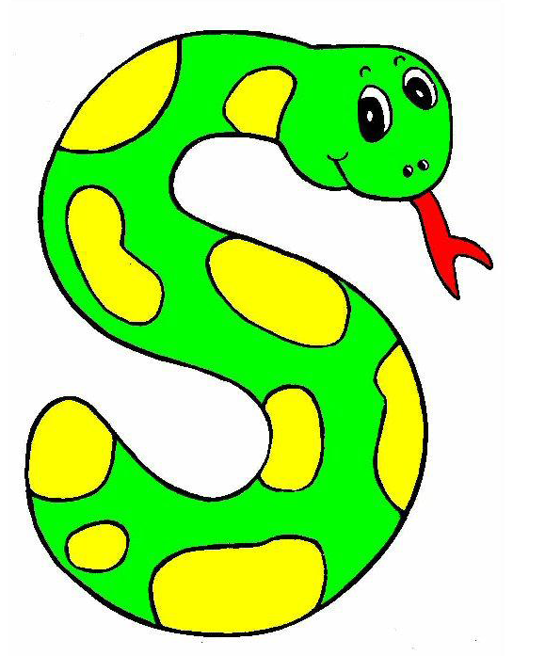
Song: s
Action
Weave like a snake,making s shaps,saying sssss.
The snake is in the grass.
The snake is in the grass.
/sss/! /sss/!
The snake is in the grass.
Notes:
The snake is in the grass.
The snake is in the grass.
/sss/! /sss/!
The snake is in the grass.

Slide 3
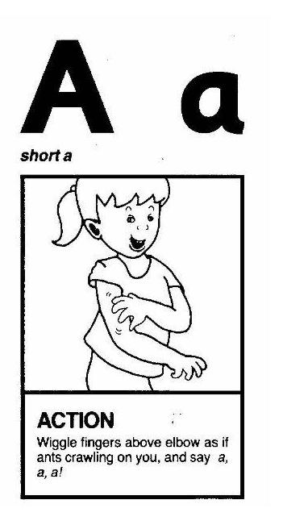
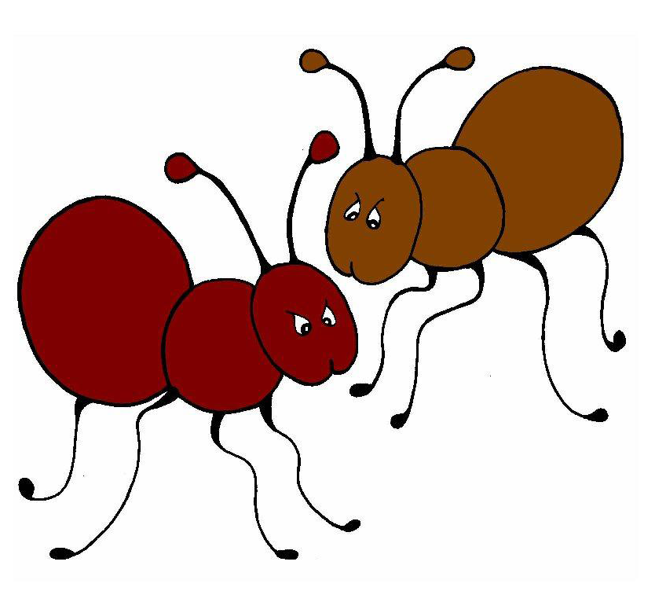
Song: a
Action
Wiggle fingers above elbow as if ants are crawling on you,and say a,a,a.
/a/ - /a/ ! Ants on my arm.
/a/ - /a/ ! Ants on my arm.
/a/ - /a/ ! Ants on my arm.
They’re causing me alarm.
Notes:
/a/ - /a/ ! Ants on my arm.
/a/ - /a/ ! Ants on my arm.
/a/ - /a/ ! Ants on my arm.
They’re causing me alarm.

Slide 4
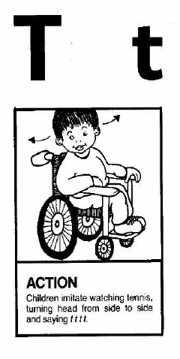
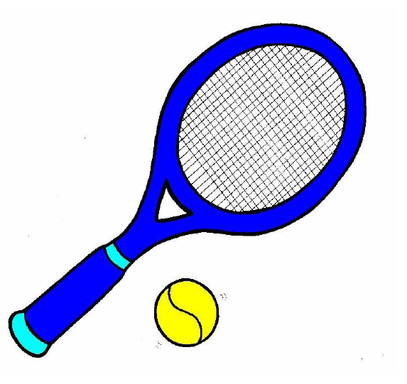
Song: t
Action
Children imitate watching tennis,turning head from side to side,and saying t,t,t,t.
When I watch the tennis game,
/t/ - /t/ - /t/,
/t/ -/t/-/t/…
…when I watch the tennis game
My head goes back and forth.
Notes:
When I watch the tennis game,
/t/ - /t/ - /t/,
/t/ -/t/-/t/…
…when I watch the tennis game
My head goes back and forth.

Slide 5
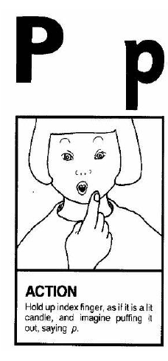
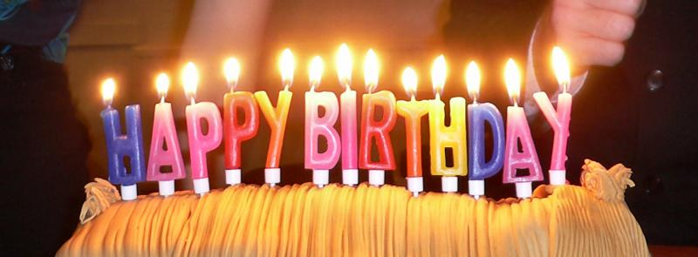
Song: p
Action
Hold up index finger,as if it is a lit candle,and imagine puffing it out,saying p,p,p.
Puff out the candles on the pretty pink cake.
/p/,/p/,/p/,
/p/,/p/,/p/,
Puff out the candles on the pretty pink cake.
Puff! Puff! Puff!
Notes:
Puff out the candles on the pretty pink cake.
/p/,/p/,/p/,
/p/,/p/,/p/,
Puff out the candles on the pretty pink cake.
Puff! Puff! Puff!

Slide 6
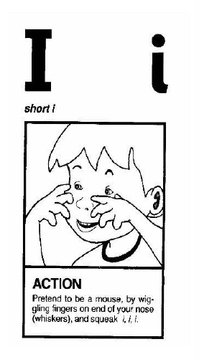
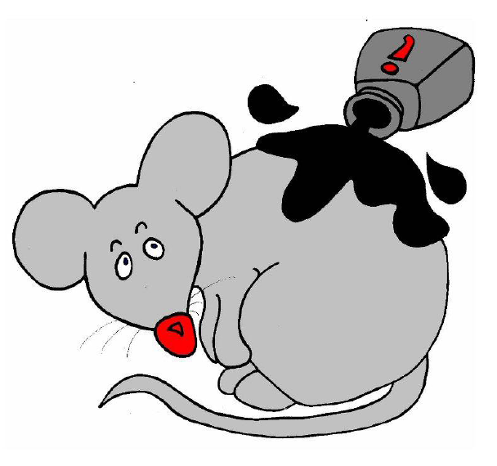
Song: i
Action
Pretend to be a mouse,by wiggling fingers on end of your nose(whiskers) and squeak i, i, i .
Inky the mouse is my pet.
She spilled the ink and got wet.
The ink it spread all over the desk.
/i/, /i/,/i/,/i/ - Inky’s wet!
Notes:
Inky the mouse is my pet.
She spilled the ink and got wet. The ink it spread all over the desk.
/i/, /i/,/i/,/i/i/ - Inky’s wet!

Slide 7
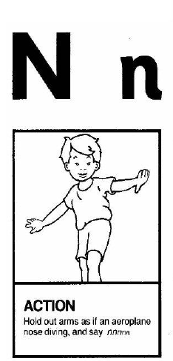
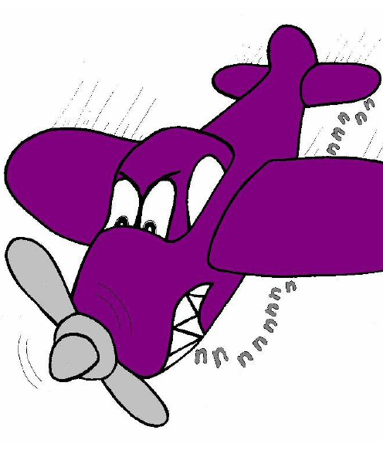
Song: n
Hear the aeroplane,
/nnn/!
Hear the aeroplane,
/nnn/!
Hear the aeroplane,
/nnn/!...
…making lots of noise.
Action
Hold out arms,as if an aeroplane nose diving and say nnnn.
Notes:
Hear the aeroplane,
/nnn/!

Slide 8
Set 2
ck, e, h, r, m, d
ck
ck
e
h
r
m
d
Notes:
ck

Slide 9
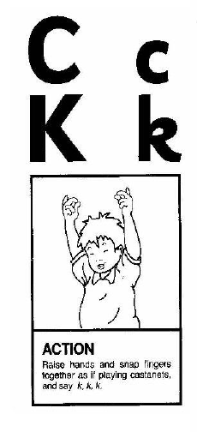
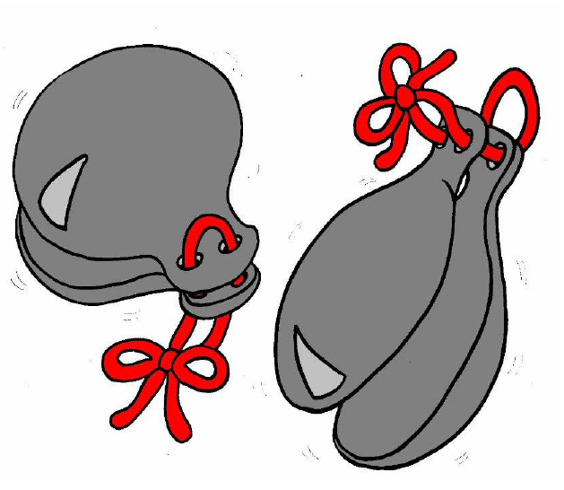
Song: c,k
Action
Raise hands and snap fingers together as if playing castanets and say k,k,k,k.
We are clicking castanets,
/c/-/c/-/c/.
We are clicking castanets,
/c/-/c/-/c/.
We are clicking castanets,
Clicking castanets…
…we are clicking castanets,
/c/-/c/-/c/.
Notes:
We are clicking castanets,
/c/-/c/-/c/.

Slide 10
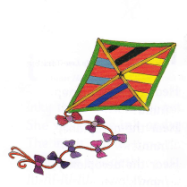
Song: c,k
Action
Raise hands and pretend to fly a kite and say k,k,k,k.
Kites are flying in the sky,
/k/-/k/-/k/,
Kites are flying in the sky,
/k/-/k/-/k/,
Kites are flying in the sky,
/k/-/k/-/k/,
Notes:
Kites are flying in the sky,
/k/-/k/-/k/,

Slide 11
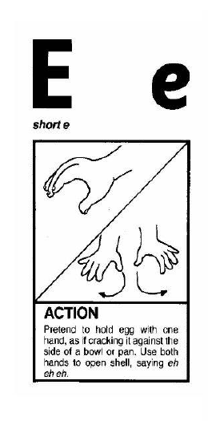
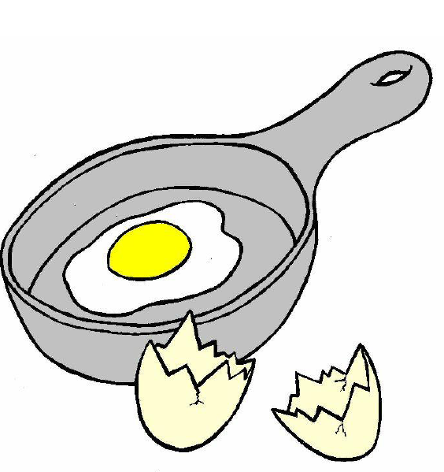
Song: e
Action
Pretend to hold egg with one hand,as if cracking it against the side of a bowl or pan. Use both hands to open shell,saying eh,eh,eh
Eggs in the pan,/e/,/e/,/e/.
Eggs in the pan,/e/,/e/,/e/.
Eggs in the pan,/e/,/e/,/e/.
Crak the egg like this…/e/!
Notes:
Eggs in the pan,/e/,/e/,/e/.
Eggs in the pan,/e/,/e/,/e/. Eggs in the pan,/e/,/e/,/e/.

Slide 12
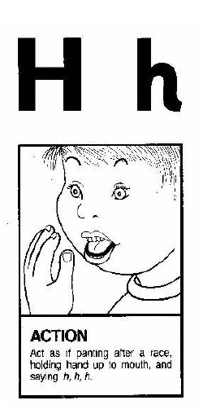
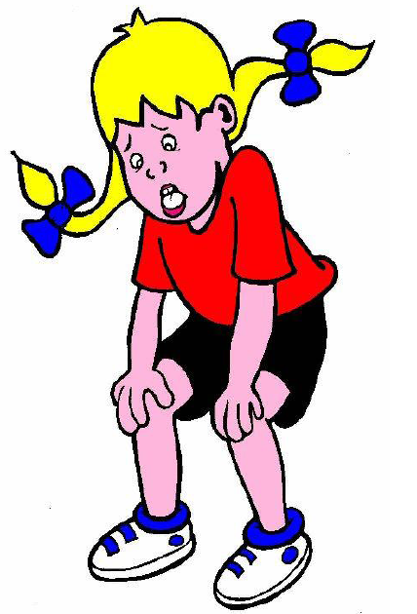
Song: h
Action
Act as if panting after a race,
holding hand up to mouth and saying h,h,h.
I like to hop,hop,hop,
up and down.
I like to hop,hop,hop,
up and down.
I like to hop,hop,hop,
up and down.
/h/,/h/,/h/,/h/,/h/.
Notes:
I like to hop,hop,hop,
Up and down.

Slide 13
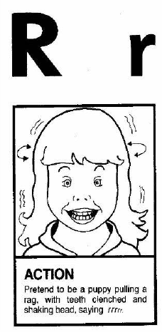
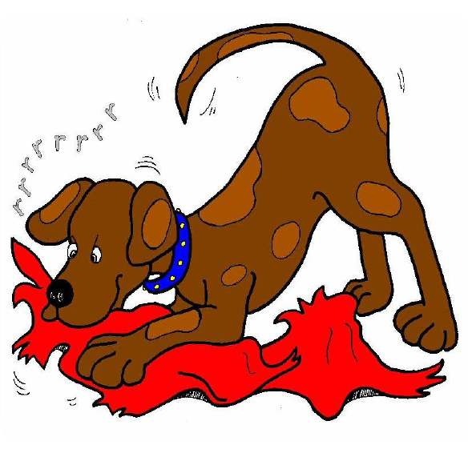
Song: r
Action
Pretend to be a puppy pulling a rag with teeth clenched and shaking head saying rrrr.
See my puppy rip the rag.
/rrr/! /rrr/!
See my puppy rip the rag,
When he pulls so hard.
Notes:
See my puppy rip the rag./rrr/! /rrr/!
See my puppy rip the rag,
When he pulls so hard.

Slide 14
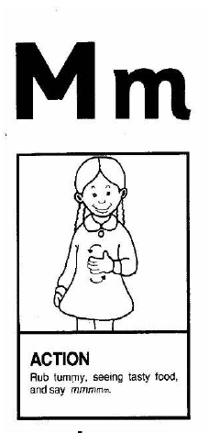

Song: m
Action
Rub tummy seeing tasty food and say mmmmm.
The mum and the dad make many meals.
/mmm/! /mmm/!
The mum and the dad make many meals
for their hungry children.
Notes:
The mum and the dad make many meals.
/mmm/! /mmm/!
The mum and the dad make many meals
For their hungry children.

Slide 15
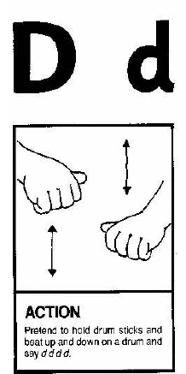
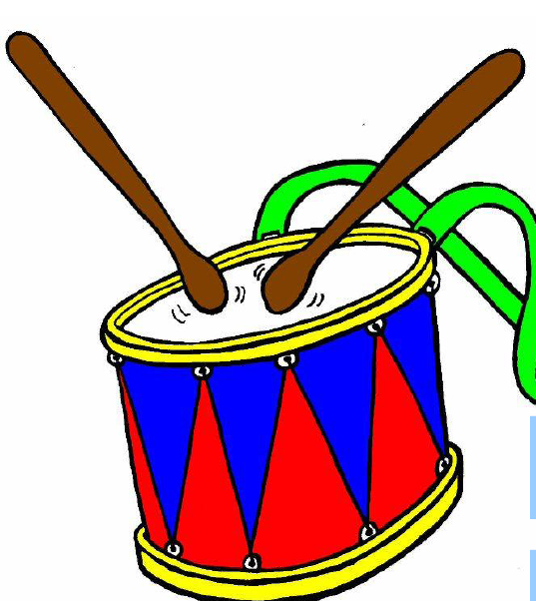
Song: d
Action
Pretend to hold drumsticks and beat up and down on a drum and say d,d,d,d.
See me play on my drum.
Playing drums is lots of fun,
with a /d/-/d/-/d/-/d/
/d/-/d/-/d/-/d/.
See me play upon my drum!
Notes:
See me play on my drum.
Playing drums is lots of fun,
with a /d/-/d/-/d/-/d/
/d/-/d/-/d/-/d/.
See me play upon my drum!

Slide 16
Set 3
g, o, u, l, f, b
g
o
u
l
f
b

Slide 17
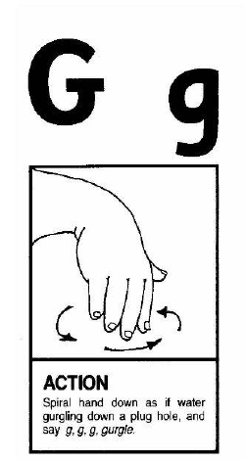
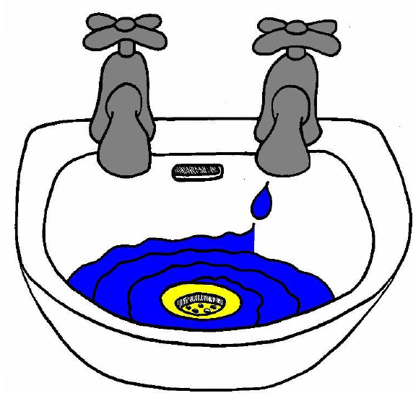
Song: g
Action
Spiral hand down as if water gurgling down a plug hole,and say g,g,g,gurgle.
The water gurgles down the drain.
The water gurgles down the drain.
The water gurgles down the drain.
With a /g/-/g/-/g/-/g/-/g/.
Notes:
The water gurgles down the drain.

Slide 18
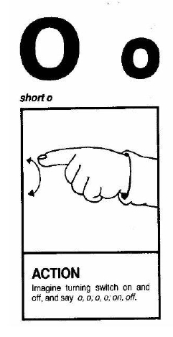
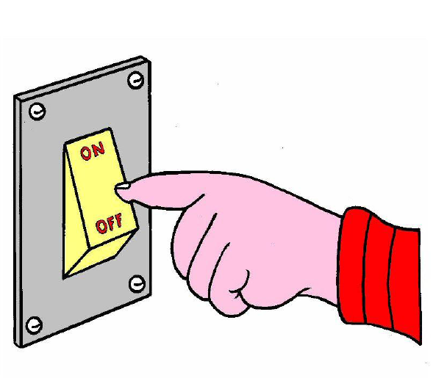
Song: o
Action
Imagine turning a switch on and off,and say o,o,o,on,off.
Now it’s dark,
The lights go on.
/o/-/o/-/o/-/o/-/o/.
Time for bed,
The lights go off!
/o/-/o/-/o/-/o/-/o/.
Notes:
Now it’s dark,
The lights go on.
/o/-/0/-/o/-/o/-/o/.
Time for bed,
The lights go off!

Slide 19
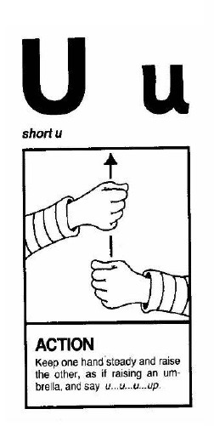

Song: u
Action
Keep one hand steady and raise the other,as if raising an umbrella,and say u,u,u,up.
/u/-/u/ up go umbrellas.
/u/-/u/ up go umbrellas.
/u/-/u/ up go umbrellas…
..when it starts to rain.
Notes:
/u/-/u/ up go umbrellas.

Slide 20
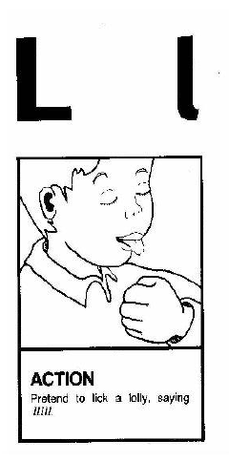
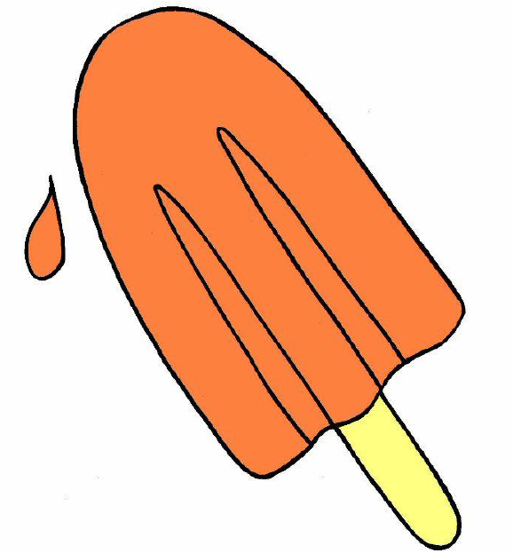
Song: l
Action
Pretend to lick a lolly,saying l,l,l,l.
We lick our lollipops.
We lick our lollipops.
/l/-/l/-/l/!
We lick our lollipops.
Notes:
We lick our lollipops.

Slide 21
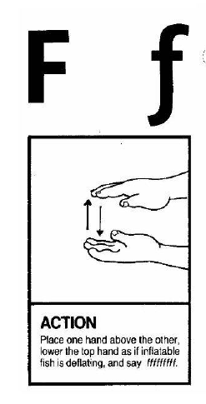
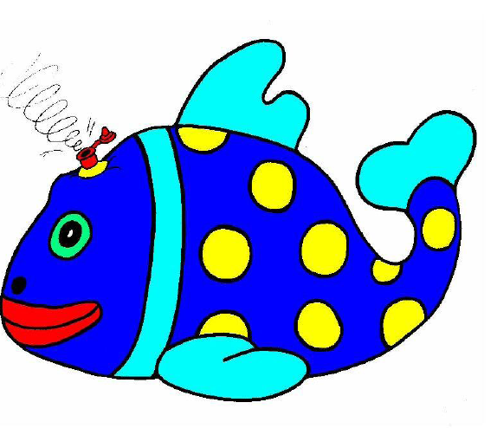
Song: f
Action
Place one hand above the other,lower the top hand as if an inflatable fish is deflating,and say fffffff.
My friends and I
went to the beach
with my floating fish.
It got a hole …
… the air came out. /ffff/!
Notes:
My friends and I
went to the beach
with my floating fish.
It got a hole …
… the air came out. /ffff/!

Slide 22
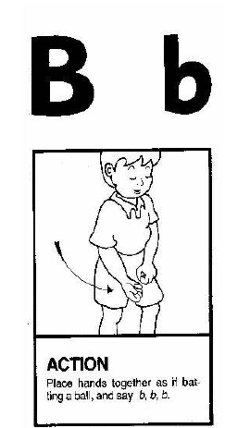
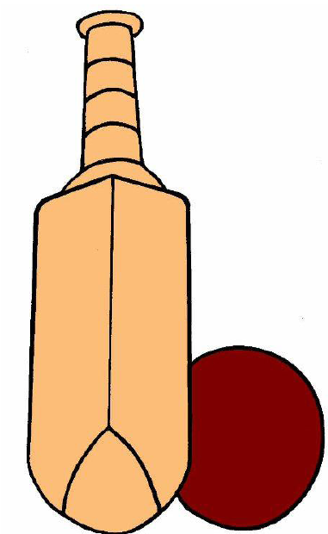
Song: b
Action
Place hands together as if batting a ball,and say b,b,b.
Bring your bat and bring your ball.
/b/-/b/!
Bring your bat and bring your ball…
… to the park to play!
Notes:
Bring your bat and bring your ball./b/-/b/!

Slide 23
Set 4
ai, j, oa, ie, ee, or
ai
j
oa
ie
ee
or

Slide 24
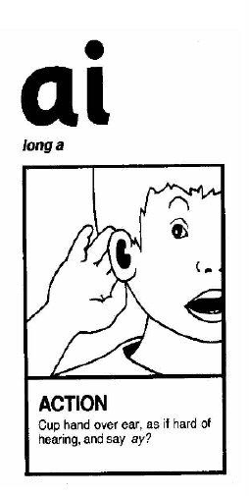
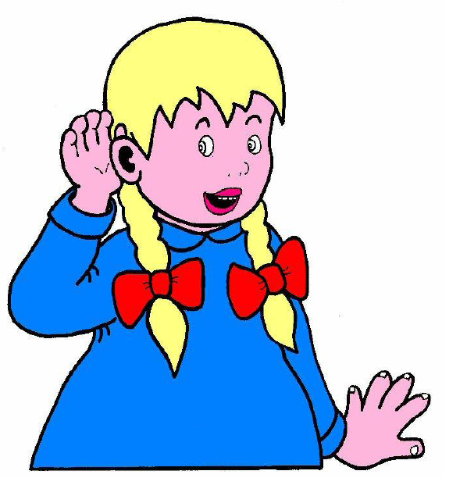
Song: ai
Action
Cup one hand over ear , as if hard of hearing , and say ay?
My ear hurt.
I was in pain.
/ai/? /ai/?
My ear hurt.
I was in pain.
What did you try to say?
Notes:
My ear hurt.
I was in pain.
/ai/? /ai/?

Slide 25
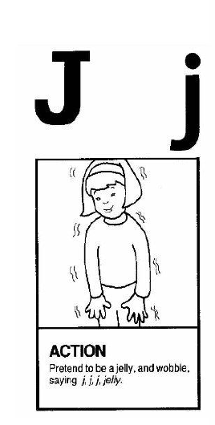
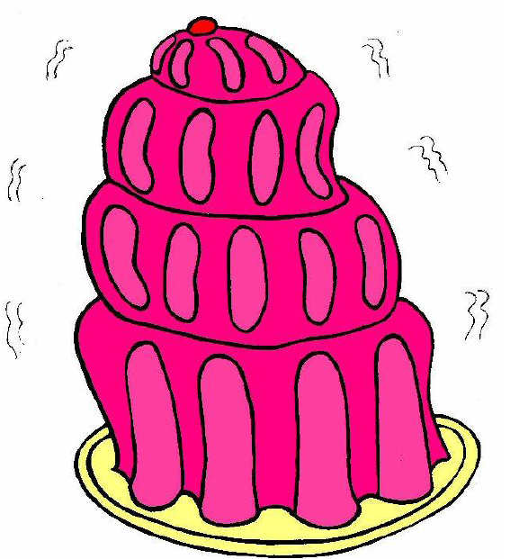
Song: j
Action
Pretend to be a jelly,and wobble,saying j,j,j,jelly.
Jelly and jam,
jelly and jam,
jiggling on a plate.
Oh,what will I eat it with/
/j/-/j/-/j/-/j/-/j/.
Notes:
Jelly and jam,
Jelly and jam,
Jiggling on a plate.
Oh,what will I eat it with/
/j/-/j/-/j/-/j/-/j/.

Slide 26
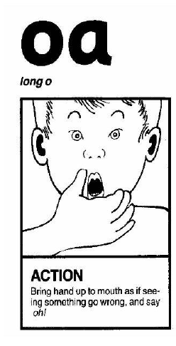
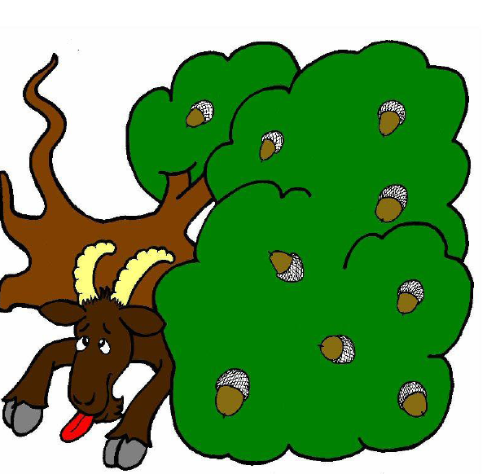
Song: oa
Action
Bring hand up to mouth as if seeing something go wrong , and say oh!.
OH, did you see the billy goat?
/oa/-/oa/-/oa/,
/oa/-/oa/-/oa/.
Oh, did you see the billy goat,
Under the old oak tree?
Notes:
Oh,did you see the billy goat?
/oa/-/oa/-/oa/,
/oa/-/oa/-/oa/.
Oh, did you see the billy goat,
Under the old aok tree?

Slide 27
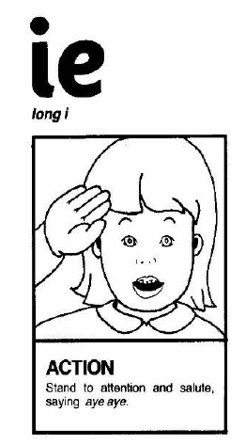
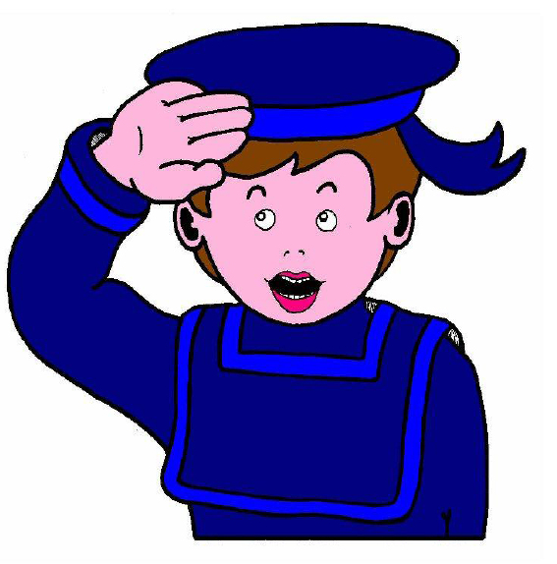
Song: ie
Action
Stand to attention and salute,saying aye,aye.
The captain said,”/ie/-/ie/!”
The captain said,”/ie/-/ie/!”
Stand up straight!
“Don’t be late!”
The captain said,”/ie/-/ie/!”
Notes:
The captain said,”/ie/-/ie/!”

Slide 28
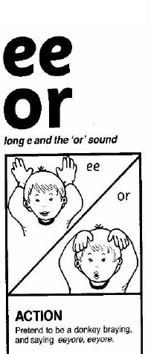
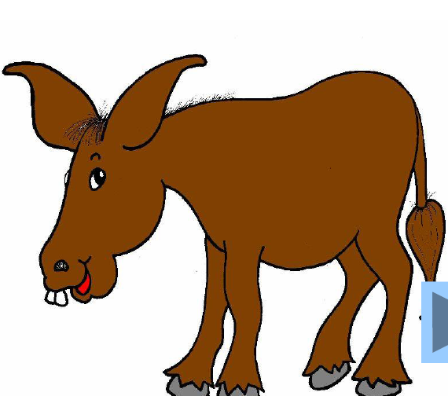
Song: ee or
Action
Pretend to be a donkey braying and saying eeyore,eeyore.
See the donkey
in its stall.
“Eeyore!”
/ee/-/or/!
is its call.
Notes:
See the donkey
In its stall.
“Eeyore!”
/ee/-/or/!
Is its call.

Slide 29
Set 5
z, w, ng, v, oo, oo
z
w
ng
v
oo
oo

Slide 30
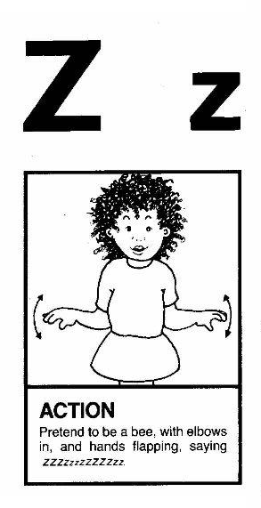

Song: z
Action
Pretend to be a bee,with elbows in,and hands flapping,saying zzzzzzzzzzzzzz.
Did you ever hear
a bee buzz,
a bee buzz,
a bee buzz?
Did you ever hear a bee buzz,
“/zzz/!”, like this?
Notes:
Did you ever hear
A bee buzz,
A bee buzz,
A bee buzz?

Slide 31
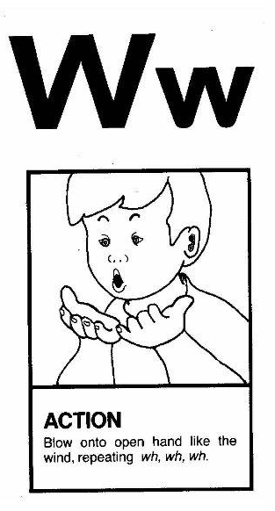
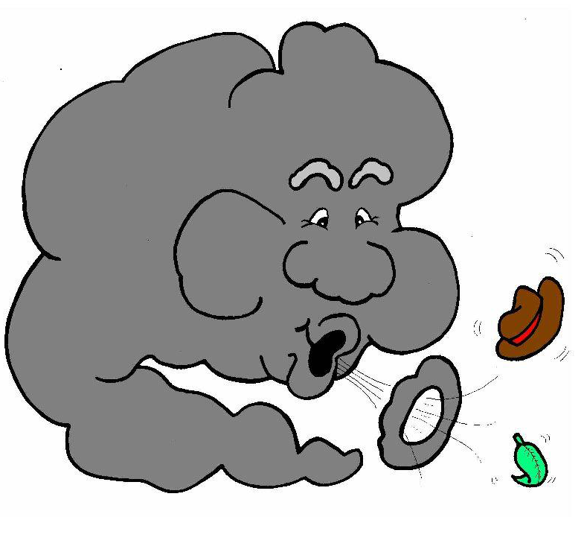
Song: w
Action
Blow onto open hands like the wind,repeating wh,wh,wh
I see the clouds moving,
/w/-/w/-/w/.
I see the kites flying,
/w/-/w/-/w/.
I see the trees bending,
/w/-/w/-/w/.
The wind is blowing strong.
Notes:
I see the clouds moving,
/w/-/w/-/w/.
I see the kites flying,
/w/-/w/-/w/.
I see the trees bending,
/w/-/w/-/w/.
The wind is blowing strong.

Slide 32
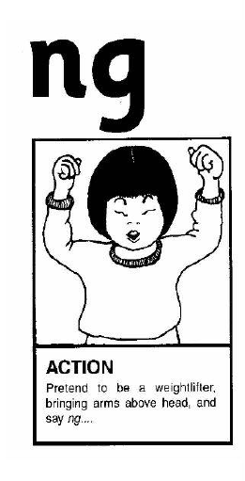

Song: ng
Action
Pretend to be a weightlifter,putting your arms above your head,and say ng,ng,ng.
If you’re strong and you know it,
Say”/ng/!”
If you’re strong and you know it,
Say”/ng/!”
If you’re strong and you know it
And you really want to show it…
…if you’re strong and you know it,
Say”/ng!”
Notes:
If you’re strong and you know it,
Say”/ng/!”

Slide 33


Song: v
Action
Pretend to be driving along in a van,saying vvvvv.
Drive Vic’s van
Round the village.
Drive Vic’s van
Round the village.
Drive Vic’s van
Round the village.
/v/-/v/-/v/-/v/-/v/!
Notes:
Drive Vic’s van
Round the village.
/v/-/v/-/v/-/v/-/v/!

Slide 34


Song: oo
short
long
Action
Imagine being the cuckoo in a cuckoo clock,jutting head forwards and back,repeating the call of the cuckoo, u,oo,u,oo.
Who wants to be a cuckoo?
Who wants to be a cuckoo?
Who wants to be a cuckoo?
/oo/-/OO/, /oo/-/OO/,/oo/-/OO/!
Notes:
who wants to be a cuckoo?

Slide 35
Set 6
y, x, ch, sh, th, th
y
x
ch
th
th
sh

Slide 36


Song: y
Action
Pretend to eat yoghurt from a spoon,saying y,y,yoghurt with each spoonful.
I like to eat,eat,eat,
yoghurt and bananas.
I like to eat,eat,eat,
yoghurt and bananas.
I like to eat,eat,eat,
yoghurt and bananas.
/y/-/y/-/y/-/y-/y-!
Notes:
I like to eat,eat,eat,
Yoghurt and bananas.

Slide 37


Song: x
Action
Pretend to take an x-ray with an x-ray camera,saying ks,ks,ks.
/ks/-/ks/! Take an x-ray.
/ks/-/ks/! Take an x-ray.
/ks/-/ks/! Take an x-ray.
- x-ray of my hand.
Notes:
/ks/-/ks/! Take an x-ray.
- x-ray of my hand.

Slide 38


Song: ch
Action
Pretend to be a steam train moving arms like the piston rods, saying ch,ch,ch.
Trains are chugging up the hill.
/ch/-/ch/-/ch/,
/ch/-/ch/-/ch/.
Trains are chugging up the hill.
/ch/-/ch/-/ch/
Choo.choo.
Notes:
Trains are chugging
Up the hill.
/ch/-/ch/-/ch/,
/ch/-/ch/-/ch/.
Trains are chugging
Up the hill.
/ch/-/ch/-/ch/
Choo.choo.

Slide 39


Song: sh
Action
Place index finder over your lips ,and say sh,sh.
Hush!Hush!Hush!
Don’t make a sound.
Be as quiet as you can be.
The baby’s asleep and I’m tired out.
Sh! /sh/-/sh/-/sh/-/sh/!
Notes:
Hush!Hush!Hush!
Don’t make a sound.
Be as quiet as you can be.
The baby’s asleep and I’m tired out.
Sh! /sh/-/sh/-/sh/-/sh/!

Slide 40


v
unv
Song: th
Action
Child pretends to be a little rude by sticking out tongue a little and saying th(as in them),and very rude by sticking tongue out further and saying th(as in thumb)..
Did you ever hear a rude clown make this sound and that sound?
Did you ever hear a rude clown say
/th/-/th/, /th/-/th/?
Notes:
Did you ever hear a rude clown make this sound and that sound?
Did you ever hear a rude clown say /th/-/th/, /th/-/th/?

Slide 41
Set 7
qu, ou, oi, ue, er, ar
qu
ou
oi
ue
er
ar

Slide 42


Song: qu
Action
Make a duck’s beak with hinged hands ,and say qu , qu ,qu..
The duck in the pond
quacks”/qu/-/qu/-/qu/,”
”/qu/-/qu/-/qu/.”
”/qu/-/qu/-/qu/.”
The duck in the pond
quacks”/qu/-/qu/-/qu/,”
all around the pond.
Notes:
The duck in the pond
Quacks”/qu/-/qu/-/qu/,”

Slide 43


Song: ou
Action
Pretend your finger is a needle and prick the thumb,saying ow!
I pricked my thumb with a needle.
/ou/-/ou/-/ou/!
/ou/-/ou/-/ou/!
I pricked my thumb with a needle.
/ou/-/ou/,ouch!
Notes:
I pricked my thumb with a needle.
/ou/-/ou/-/ou/!

Slide 44


Song: oi
Action
Cup hands around mouth as if hailing a passing boat,saying oi,ship ahoy’.
The sailors met upon the sea,
/oi/-/oi/,/oi/-/oi/,
They found some oil way down deep.
/oi/-/oi/,”Ship ahoy!”
Notes:
The sailors met upon the sea,
/oi/-/oi/,/oi/-/oi/,
They found some oil way down deep.
/oi/-/oi/,”ship ahoy!”

Slide 45


Song: ue
Action
Point to different people around you,and say you,you,you.
I’d like to have a barbecue,
/ue/-/ue/-/ue/,
/ue/-/ue/-/ue/.
I’d like to have a barbecue
with you,and you,and you!
Notes:
I’d like to have a barbecue,
/ue/-/ue/-/ue/,
/ue/-/ue/-/ue/.
I’d like to have a barbecue
With you,and you,and you!

Slide 46


Song: er
Action
Roll hands over and over each other, and say er, er(as in mixer).
The mixer in the bowl goes
/er/-/er/-/er/,
/er/-/er/-/er/.
The mixer in the bowl goes
/er/-/er/-/er/,
/er/-/er/-/er/.
mixing the food together.
Notes:
The mixer in the bowl goes
/er/-/er/-/er/,
/er/-/er/-/er/.

Slide 47


Song: ar
Action
Open your mouth ,and say ah!
“Open wide,” the doctor said.
/ar/!/ar/!
“Let me look at your sore throat.
Please say, /ar/!”
Notes:
“Open wide,” the doctor said.
/ar/!/ar/!
“Let me look at your sore throat.
Please say, /ar/!”

Slide 48
Thank You
Jolly Phonics images ©Jolly Phonics

