Slide 2

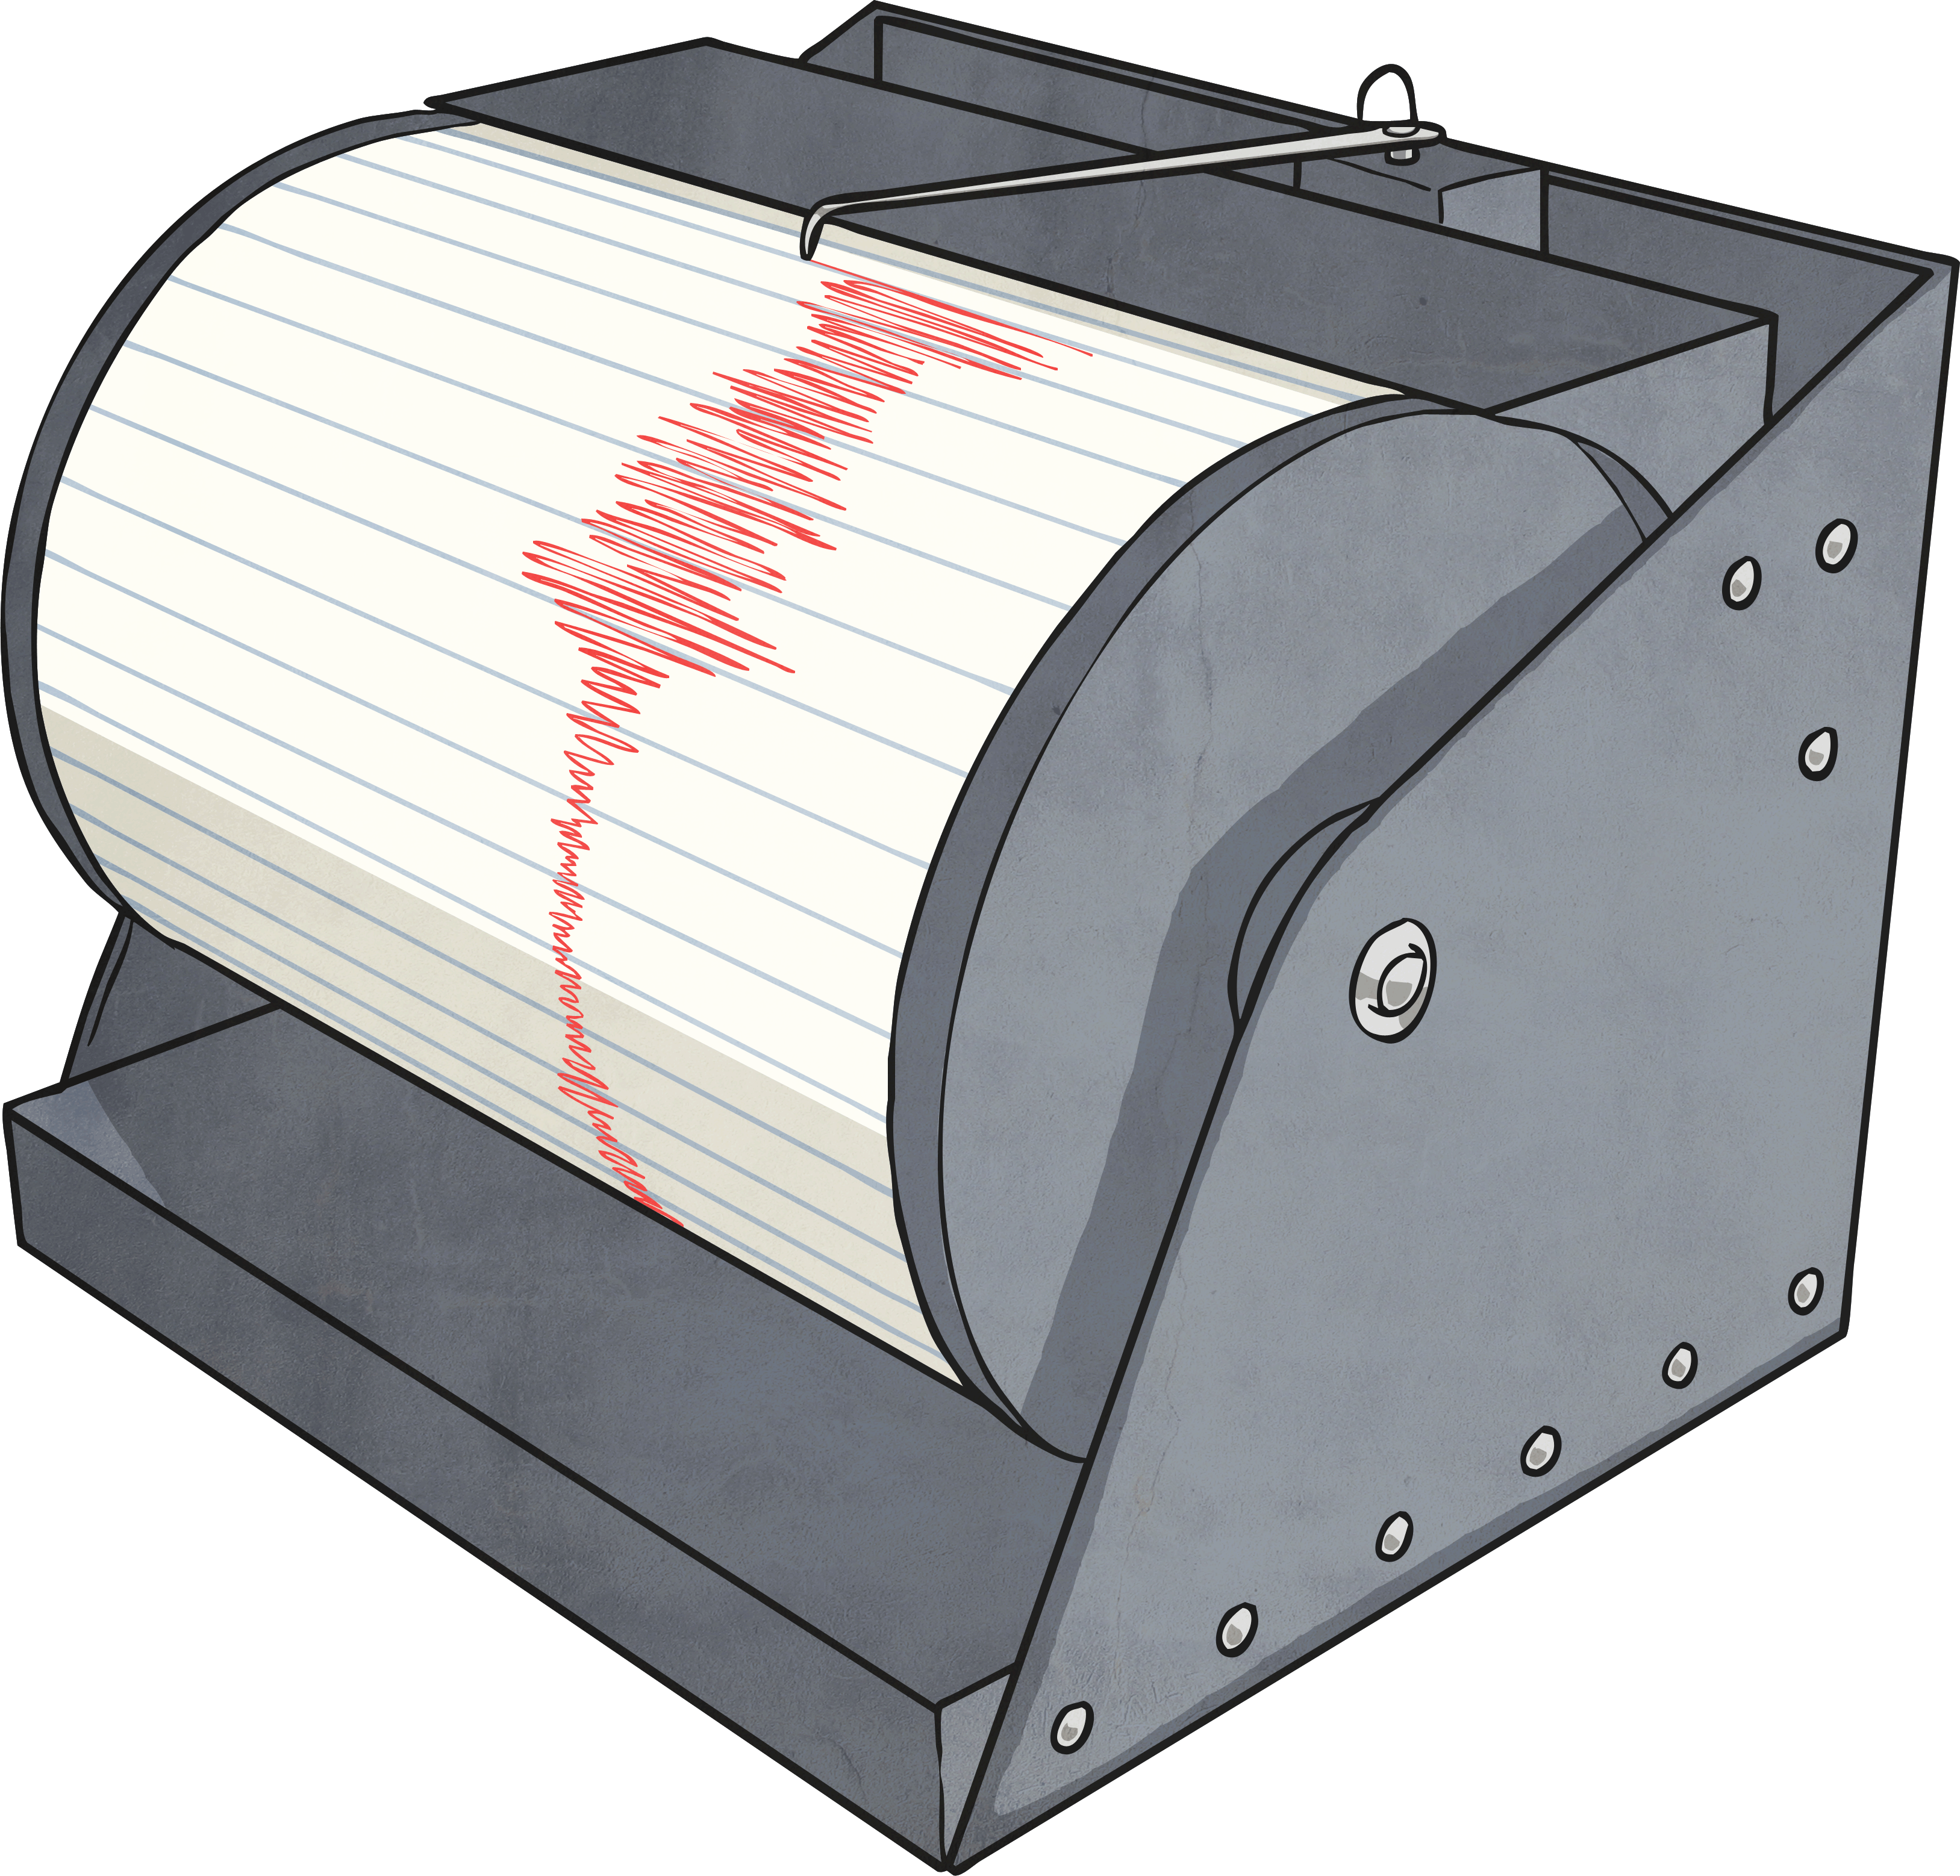
Imagine throwing a rock into a still lake. What happens when your rock hits the still water and beings to sink?
Small waves or ripples spread out from where the stone hit the water.
It’s just the same with earthquakes. When an earthquake happens, it sends out waves (seismic waves) that travel through the ground making it shake. Is there a way ground motion can be measured?
Using an instrument called a seismograph
(say: size-mo-graf) or seismometer, scientists
measure and record seismic waves.
What do you already know about seismographs?
What do you want to know about seismographs?

Slide 3
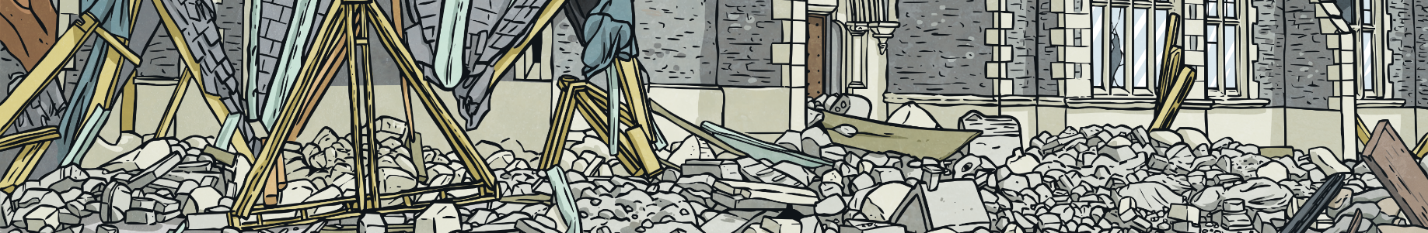
Let’s find out more about seismographs.
Seismograph comes from Greek words. These words means ‘to shake’ and ‘earthquake’ (seien and seismos) and ‘written, writing’ (graphos) or recording.
A seismograph creates the seismogram. A seismogram is a record of the seismic waves.
The sensor part of a seismograph is called the seismometer.
Did you know…?
The first known recordings of a distant earthquake were made in 1889.

Slide 4
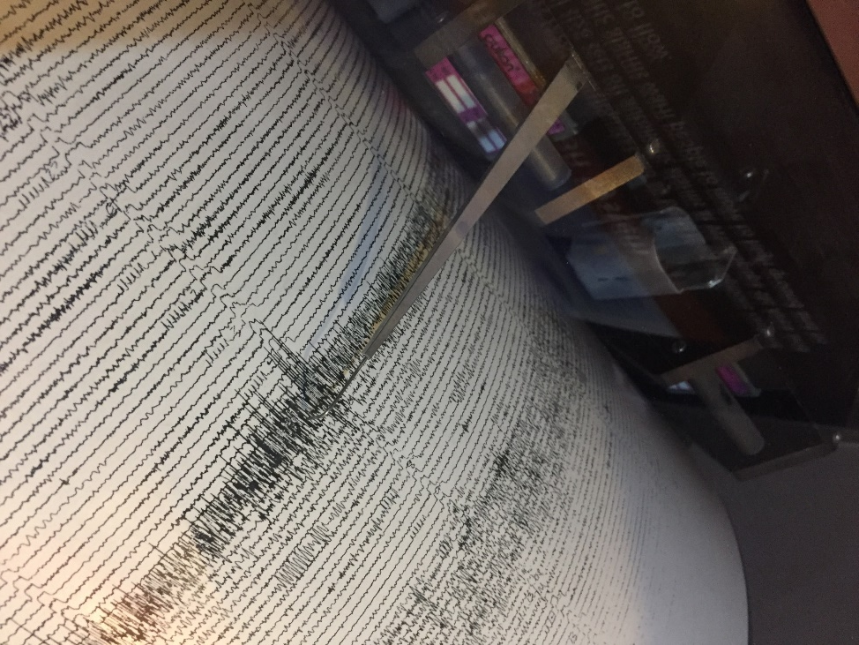
A seismograph is an instrument that measures and records seismic waves that move through the earth when there is an earthquake. Seismographs are securely fastened to the earth. A weight that hangs on a string (pendulums) inside the case doesn’t move. Instead the spring or string that it is hanging from absorbs all the movement. The difference in position between the shaking part of the seismograph and the still part is what is recorded.
There is a problem when trying to measure ground motions - finding a steady point that remains fixed when the ground moves. Most seismographs have used different pendulums (part that has a hanging weight that tends to remain still when the ground moves -inertia) to help solve that problem.

Slide 5

When there is an earthquake, a seismograph will make a record or draw a line to show how much the ground shook.
Scientists use these drawings to find;
the time the earthquake occurred
location of the earthquake
how far below the earth’s surface the earthquake happened
the amount of energy released by the earthquake
to learn more about tectonic plates and the earth’s layers

Slide 6
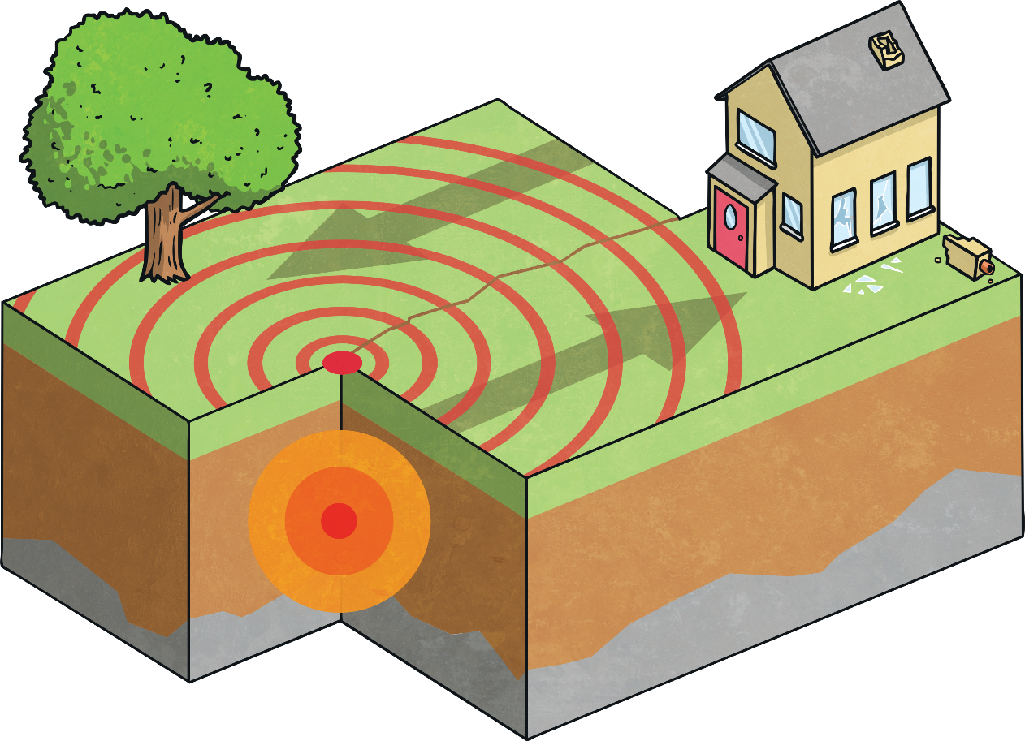
Did you know…?
Six Italian scientists were convicted of manslaughter and sent to prison for failing to predict the 2009 L’Aquila earthquake in which 309 people died. They appealed their cases successfully and were eventually not sent to prison.

Slide 7
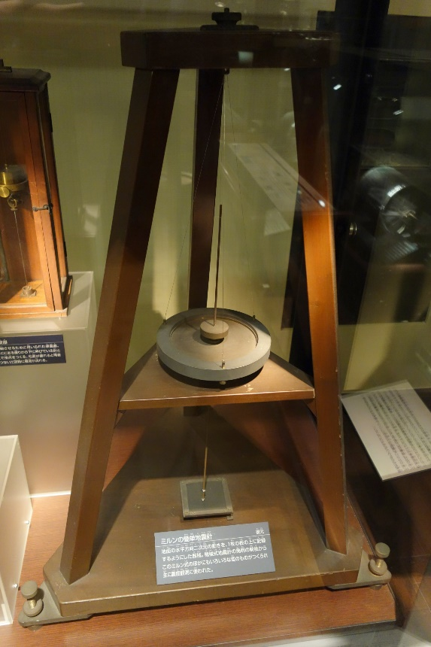
Seismographs are most useful when they are:
accurate
sensitive
show the direction of an earthquake
show the size and strength of an earthquake
show the time an earthquake occurred
record data (seismogram)
“Seismograph” by Daderot is licensed under CC BY 2.0
Over human history, many scientists have found ways to measure earthquakes and to improve the seismograph.

Slide 8
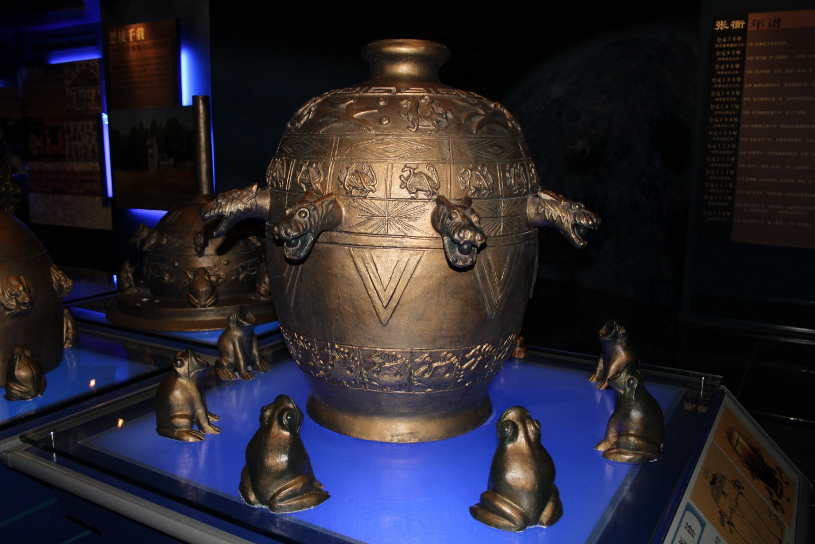
“Han Eathquake-Detecting Machine Model” by Gary Todd is licensed under CC BY 2.0
Did you know…?
One of the first instruments to indicate there was an earthquake was called a seismoscope. It didn’t record the time ground motions happened but only showed that shaking had occurred.

Slide 9
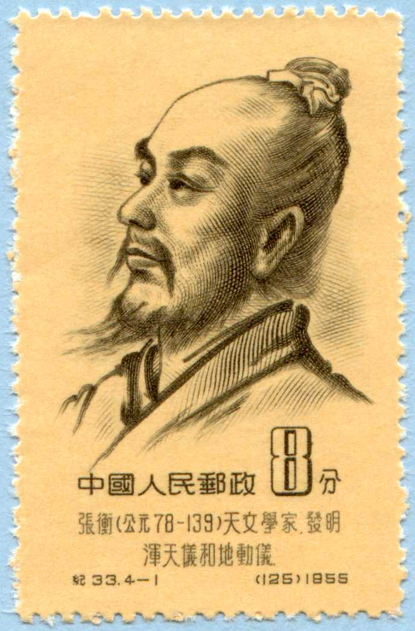
Development Of The Seismograph
Zhang Heng
132 AD
The earliest known seismoscope (an instrument that showed that shaking had happened but didn’t record the time of ground movements) was created in China.
There had been more than a few earthquakes in China. So, an astronomer Zhang Heng created a seismoscope to help warn people that one was coming
or happening.
“Zhang Heng” by State post Bureau of the People’s Republic of China is licensed under CC BY 2.0

Slide 10
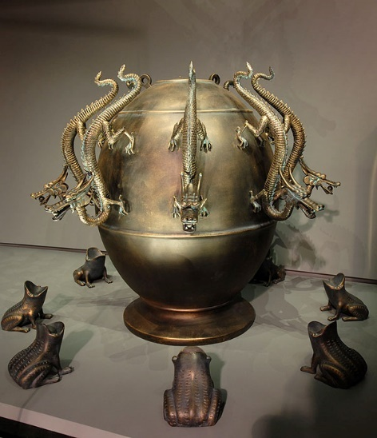
Development Of The Seismograph
Zhang Heng’s seismoscope looked like this:
cylinder-shaped with a pendulum inside
eight dragon heads around the top with a ball in each of their mouths
eight frogs near the base, one under each of the dragon heads
“Muséum de Toulouse” by Sismomètre is licensed under CC BY 2.0
It is thought that when an earthquake happened, the pendulum inside the seismoscope would move. The pendulum pushed a lever that opened a dragon's mouth. A ball rolled out and landed into a frog's mouth below. This made a noise alerting the Emperor. The dragon’s mouth that was left open pointed in the direction of the earthquake.

Slide 11
Development Of The Seismograph
Father Andreas Bina
1751
Bina was a teacher of philosophy in the monasteries of Italy. He is thought to have designed a simple seismoscope. It involved hanging a pendulum from a high floor of a building. At the base of the pendulum was a pointer. There was a tray of sand underneath the pointer. When the pendulum moved due to an earthquake, the pointer would made marks in the sand.

Slide 12
Development Of The Seismograph
British Scientists
1870
Some small earthquakes hit the town of Comrie in Scotland. So, scientists decided to built an earthquake house. The house had small wooden posts inside it. They were balanced on their ends and were supposed to fall over when there was an earthquake. Unfortunately, this didn’t work too well and the system wasn’t sensitive enough to record any earthquakes.

Slide 13
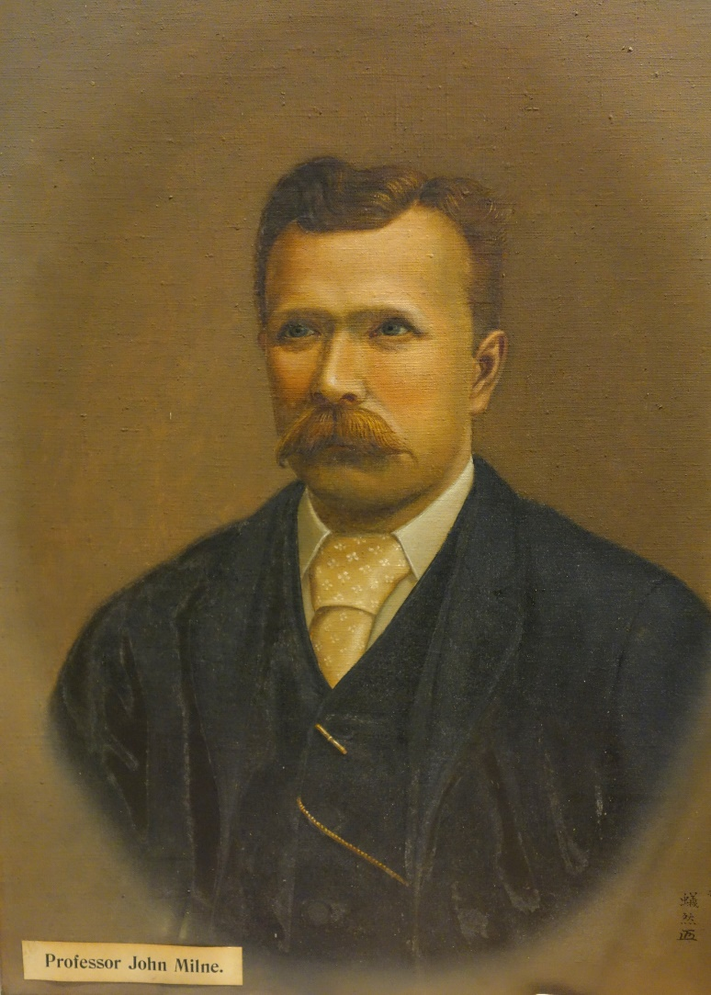
Development Of The Seismograph
John Milne
1880
Milne created a seismograph that was a bit different to others before it. His contained a horizontal pendulum. Milne record earthquakes in Japan using it and then made a small worldwide seismographic network. There was a problem with the design though. Any vibrations in the room created by people where the instrument was would be shown in its recording. The pendulum needed to be dampened and this idea was developed in 1898.
“Professor John Milne” by Daderot is licensed under CC BY 2.0

Slide 14
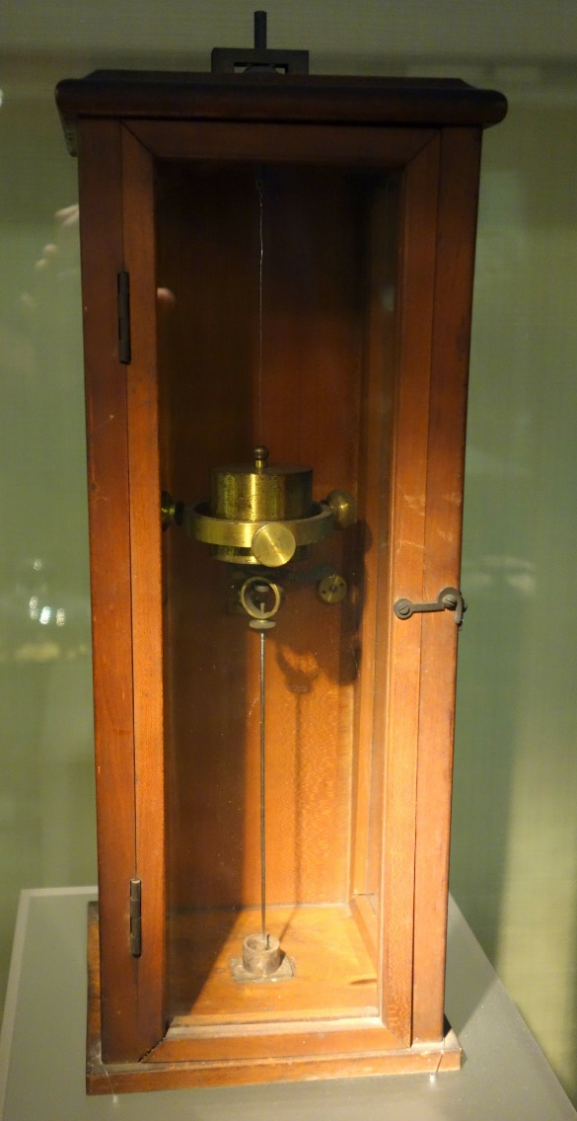
Development Of The Seismograph
Milne, along with James Alfred Ewing and Thomas Gray, created the Seismological Society of Japan which helped the quick development of earthquake measuring instruments in the 1880s. These scientists really helped make the seismograph a useful
research instrument.
Seismometers still used pendulums but they had now progressed to record the time of earthquakes on a clockwork drum. At first, pen and paper was used for recording data but then light beams on photographic paper became popular. Even weak signals caused by large earthquakes anywhere in the world could now be detected.
“Milne’s duplex pendulum seismometer (restored)” by Daderot is licensed under CC BY 2.0

Slide 15
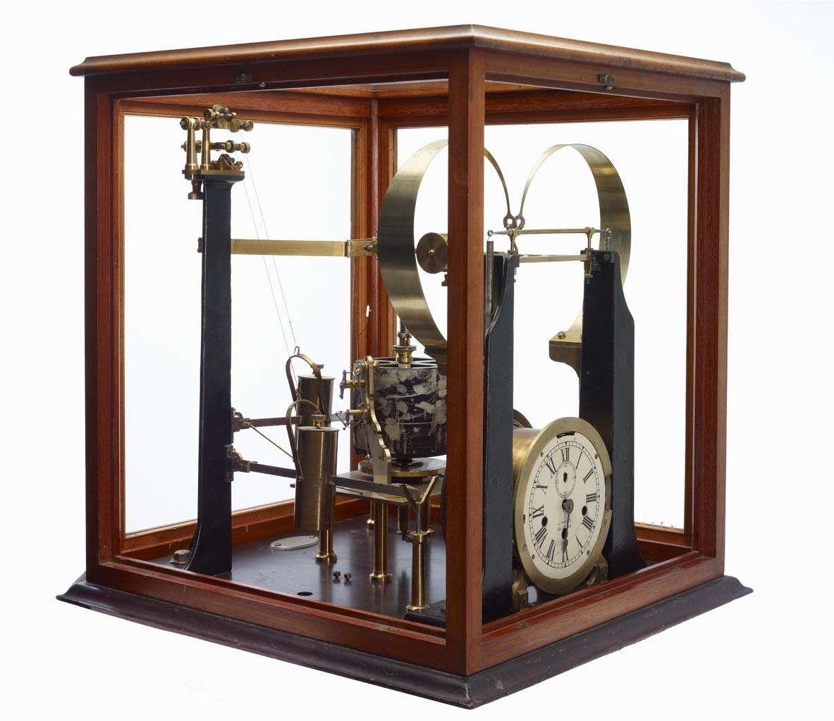
Development Of The Seismograph
“Seismograph - Gray-Milne, Model 5, 1888W ” by Rodney Start is licensed under CC BY 2.0
Did you know…?
The horizontal pendulum seismograph was improved greatly after World War II. The Press-Ewing seismograph uses a Milne pendulum and it is still used throughout the world today.

Slide 16
Development Of The Seismograph
Luigi Palmieri
1856
Palmieri created an instrument with U-shaped tubes filled with mercury (a liquid metal). This device could record the time, strength and length of an earthquake. When there was an earthquake, the mercury would move and stop a clock. Next, a small floating object that was on top of the mercury would move with the motion of the ground - the movement was recorded on a drum.
Did you know…?
Palmieri’s device is thought to be the first to record the times that earthquakes occurred.

Slide 17
Development Of The Seismograph
Filippo Cecchi
1875
Cecchi’s seismograph also used pendulums. The movement created by seismic waves would activate a clock, and it was recorded on a surface at the speed of 1 cm per second. Looking at the recordings, scientists could figure out the time of an earthquake’s beginning as well as how long it lasted.
Did you know…?
Some people feel Cecchi was the inventor of the earliest seismograph.

Slide 18
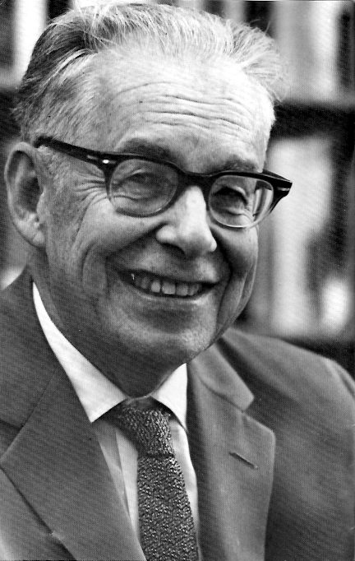
Seismograph and the Richter Scale
Charles Richter
1935
Richter scale is a popular unit for measuring the magnitude of an earthquake.
Richter used the signals from a small Wood-Anderson seismograph to form his magnitude scale for earthquakes.
Did you know…?
Another measure is the Mercalli scale, and this is based on people’s observations during an earthquake.

Slide 19
Development Of The Seismograph
Electromagnetic Seismographs
1900s
Scientists started to develop electromagnetic seismographs. These work when a coil is moved through a magnetic field whenever there is an earthquake. The movement makes an electrical current that is put into a machine. It measures the current and then gives data about the source and direction of the earthquake.
Electromagnetic seismographs helped monitoring of earthquakes worldwide. By the 1960s the World-Wide Standardized Seismography Network was formed to find earthquakes in more than 60 countries.
Seismographs will continue to be an important tool because there is so much more to be discovered about earthquakes and how they change our planet.

Slide 20
Other Important People and the Development of the Seismograph
1811 Jared Brooks’ pendulums
1844 James Forbes’ Seismometer
1852 Robert Mallet’s seismoscope
1858 P. G. M. Cavalleri’s seismometer
1869 Zöllner’s horizontal pendulum
1889 Ernst von Rebeur-Paschwitz’s horizontal pendulums and photographic recording
1898 Emil Wiechert‘s inverted-pendulum seismograph
1903 Galitzin’s ectromagnetic seismograph
1935 Hugo Benioff’s no pendulum strain seismograph

Slide 21
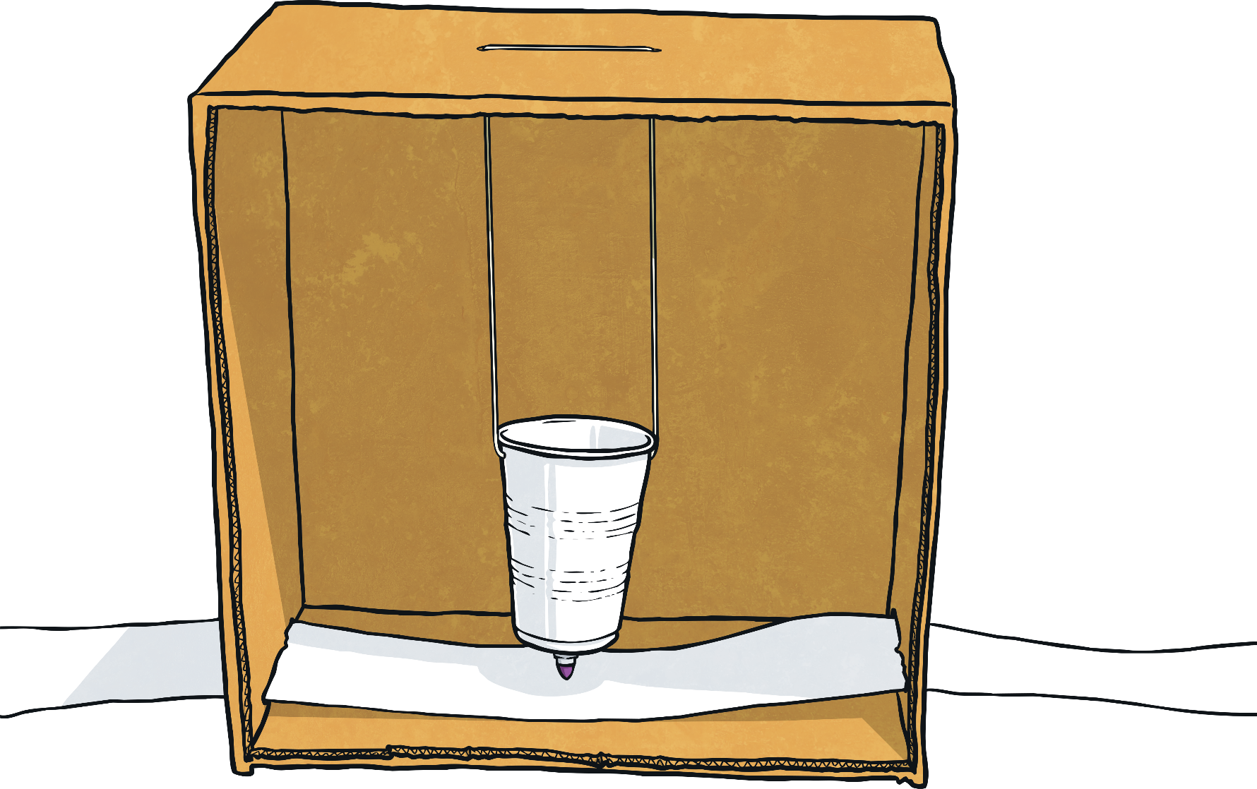
It’s Your Turn!
Can you design and make your very own seismograph?

