Slide 2
Explanation
Purpose
Tells us how something works or gives us information about something.

Slide 3
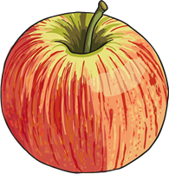
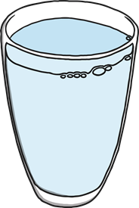
Structure
A general statement is used to introduce the topic of explanation.
There are lots of things we can do to stay healthy and to keep illnesses away.
A series of logical steps explaining how or why something occurs.
The best drinks for staying healthy are water and milk. Fruit juices can be good for us but they can have a lot of sugar in them. Fizzy drinks are not good for us at all.
Steps continue until the final state is produced or the explanation is complete.

Slide 4

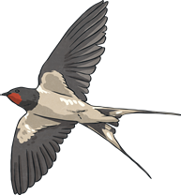
Features
Explanations are written in the present tense.
Many birds fly south
Conjunctions that signal time are used in explanations.
then next several months later
Explanations are written using causal connectives.
because so this causes

Slide 5
Features
Title – explains what the text is for
Opening Statement – about the subject
Clear, simple points about why or how something occurs
Technical words – where appropriate
Conjunctions – e.g. because, resulting in
Present tense
Summary Paragraph

Slide 6
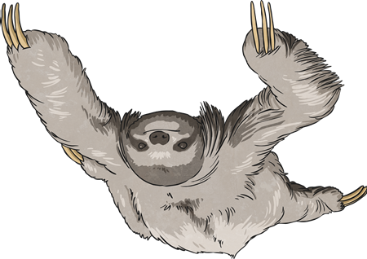
Use a clear title that indicates what you are writing about.
Decide whether to use diagrams, charts, illustrations or flow charts to help explain.
Title and Introduction
Use the first paragraph to introduce the subject to the reader.
Try to make the title intrigue the reader.
Why do sloths hang about?
Using how or why in a title helps.

Slide 7
Organise the writing and illustrations to explain:
What you need.
How it works.
Why it works.
When and where it works.
What it is used for.
Add in extra, interesting information.

Slide 8
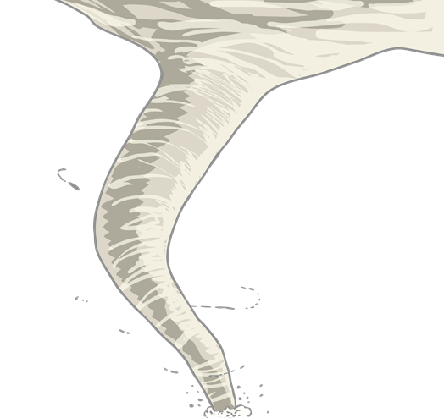
Interest the reader with an exclamation or question.
Beware – whirlwinds can kill!
Did you know...?
Interest the reader.
Strange as it may seem…,
Not many people know that…

Slide 9
Reread the explanation pretending that you know nothing about the subject. Does it make sense?
Finish by drawing all ideas together in a concluding paragraph.
Ending
If specialised terminology is used, a glossary may be needed.
Relate the ending to the reader.

