Slide 1
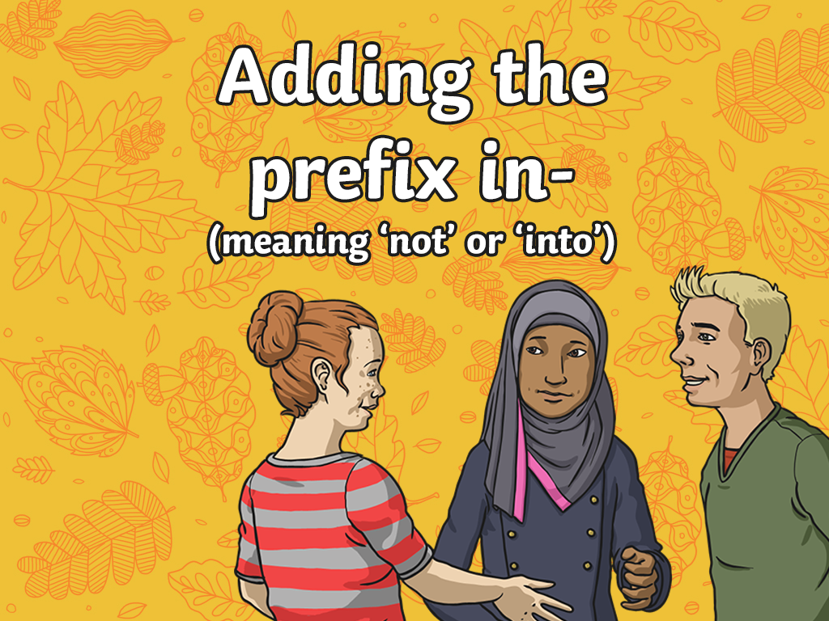


Slide 2

This week, we are going to look at words
that contain a particular prefix?
What is a prefix?
A prefix is a string of letters that are added to the beginning of a root word, which changes its meaning. Each prefix has a meaning.
This week we will look at root words with the prefix ‘in-’ added to them.
Keep thinking about the meaning of the prefix ‘in-’ as we go through
the lesson.

Slide 3

Work with a partner to play this ‘in-’ prefix quick quiz.
Write your answers on your whiteboards.
Who can answer all the questions correctly?
Can you think of the ‘in-’ prefix word missing from this sentence?
I just couldn’t make up my mind what I wanted from the ice cream van as I was feeling very ________.
inaccurate indecisive inactive

Slide 4
Answer
Can you think of the ‘in-’ prefix word missing from this sentence?
I just couldn’t make up my mind what I wanted from the ice cream van as I was feeling very indecisive.

Slide 5

Work with a partner to play this ‘in-’ prefix quick quiz. Write your answers on your whiteboards. Who can all the questions correct?
Can you think of the ‘in-’ prefix word missing from this sentence?
Because of her _________ measurements, Polly’s cake didn’t rise in the oven.
inaccurate infinite inactive

Slide 6

Answer
Can you think of the ‘in-’ prefix word missing from this sentence?
Because of her inaccurate measurements, Polly’s cake didn’t rise in the oven.

Slide 7
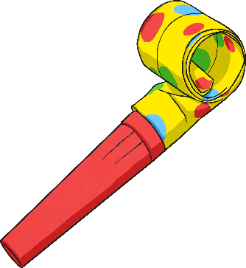
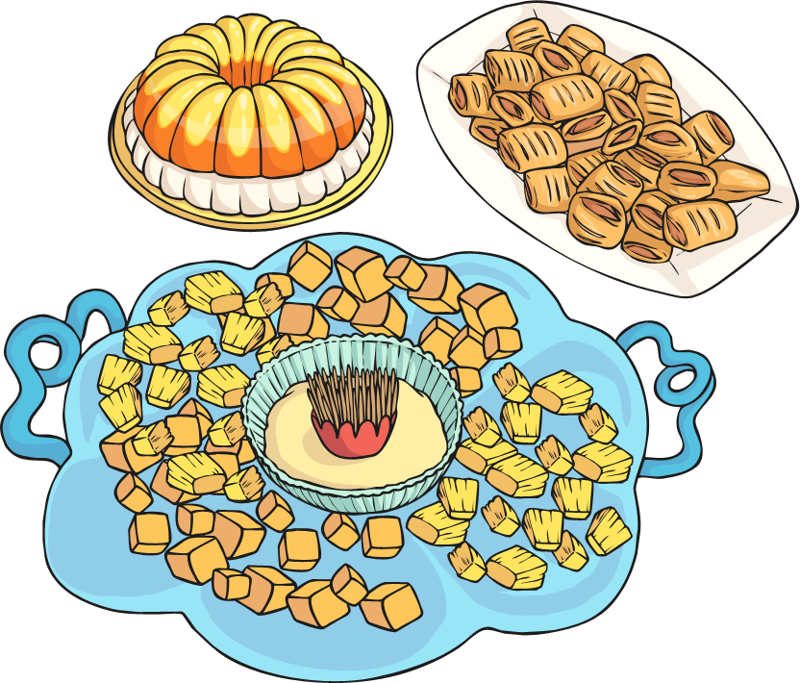
Work with a partner to play this ‘in-’ prefix quick quiz. Write your answers on your whiteboards. Who can all the questions correct?
Can you think of the ‘in-’ prefix word missing from this sentence?
As Jack had an
_______ to keep a secret, everyone knew about the surprise party.
inedible indecisive inability

Slide 8
Answer
Can you think of the ‘in-’ prefix word missing from this sentence?
As Jack had an
inability to keep a
secret, everyone knew about the surprise party.

Slide 9
Can you think of any more words with an in- prefix?
decisive → indecisive
accurate → inaccurate
ability → inability
correct → incorrect
complete → incomplete
active → inactive
secure → insecure
definite → indefinite
edible → inedible
finite → infinite
So, what is the meaning of the prefix ‘in-’?
‘in-’ usually means not and creates an opposite word to the root word (antonym).

