Slide 1
Year 6 | Week 7 | Day 1

Slide 2

Year 6 | Week 7 | Day 1

Slide 3
Year 6 | Week 7 | Day 2

Slide 4
Year 6 | Week 7 | Day 2

Slide 5
Year 6 | Week 7 | Day 3

Slide 6
Year 6 | Week 7 | Day 3

Slide 7
Year 6 | Week 7 | Day 4

Slide 8
Year 6 | Week 7 | Day 4

Slide 9
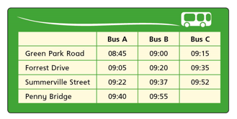
Year 6 | Week 7 | Day 5

Slide 10
Year 6 | Week 7 | Day 5

