Slide 1
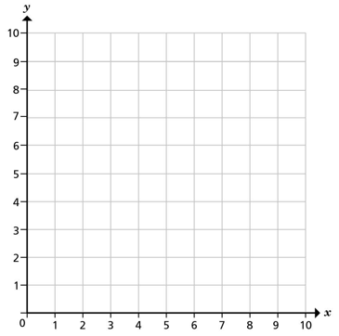
Year 6 | Week 5 | Day 5

Slide 2
Year 6 | Week 5 | Day 5

Slide 3
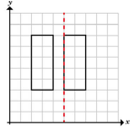
Year 6 | Week 6 | Day 1

Slide 4
Year 6 | Week 6 | Day 1

Slide 5
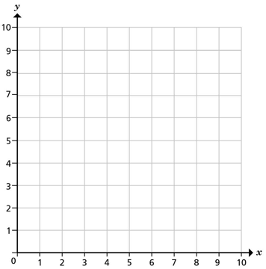
Year 6 | Week 6 | Day 2
A
C
B

Slide 6
Year 6 | Week 6 | Day 2
A
C
B

Slide 7
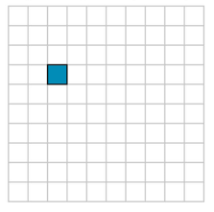
Year 6 | Week 6 | Day 3
A
B
T

Slide 8
Year 6 | Week 6 | Day 3
A
B
T

Slide 9


Year 6 | Week 6 | Day 4

Slide 10
Year 6 | Week 6 | Day 4

