Slide 1
Earthquakes

Slide 2
Aim
I can describe and understand key aspects of physical geography in the context of earthquakes.
Success Criteria
I can tell you where earthquakes happen.
I can explain why earthquakes happen.
I can tell you how to keep safe in an earthquake.
I can compare the strength of earthquakes.

Slide 3
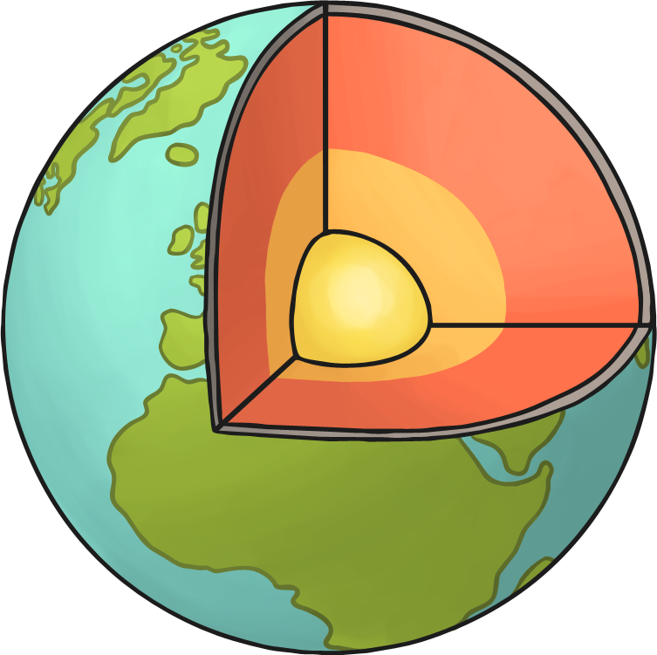
The Earth’s Crust
The Earth has 4 layers:
The crust: This is the outermost layer. The land we stand on is not just one solid piece. It is made of many pieces called plates. These plates fit together like puzzle pieces.
The mantle
The inner core
The outer core

Slide 4
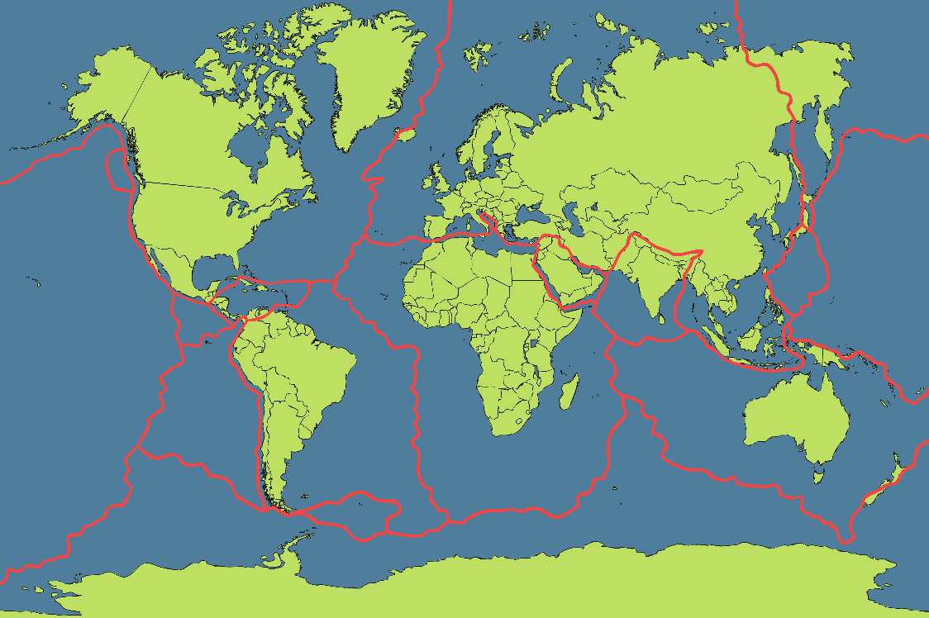
The Earth’s Plates
The Earth’s plates are always moving. They move so slowly that we usually can’t feel it.
The edges of plates are called faults. Faults can rub together, push toward each other, or pull away from each other.
Take a look at the Earth’s plates. How many faults do you notice in the United States?

Slide 5
How Can You Move Your Plates?
Use the two pieces of paper you have been given.
Can you remember the different ways can you move the plates around?
Rubbing together
Towards each other
Away from each other
This kind of movement causes earthquakes.

Slide 6
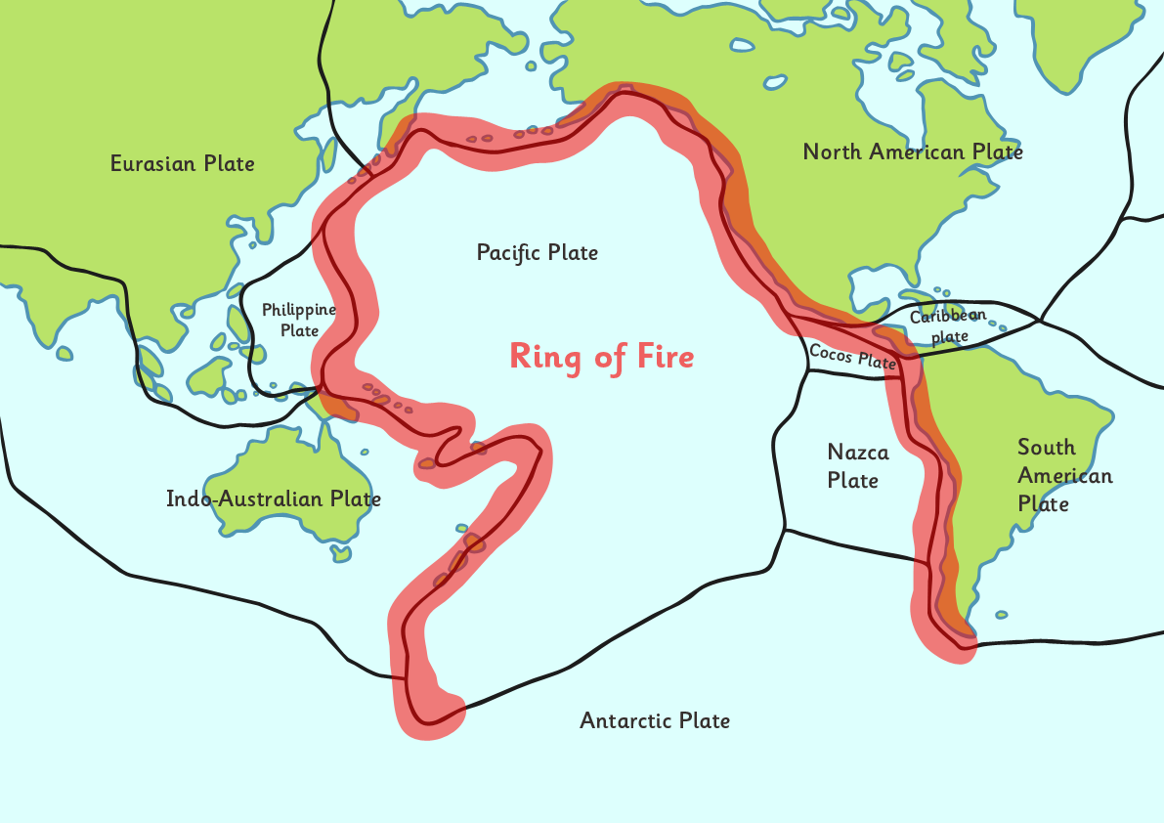
Where do Earthquakes Occur?
Look at the map. Earthquakes happen frequently in these areas. What do you notice about where they happen?

Slide 7
Preparing for an Earthquake
Drop, Cover and Hold
Stay Calm
Stay
Duck under a strong table or desk. Cover your head and neck with your arms. Stay away from windows.
Make safe choices for yourself and those around you.
Shelter in place. Whether you’re in a car, in bed, or in a public place. Do not try to run out of the building during strong shaking, hold tight until the shaking stops.

Slide 8
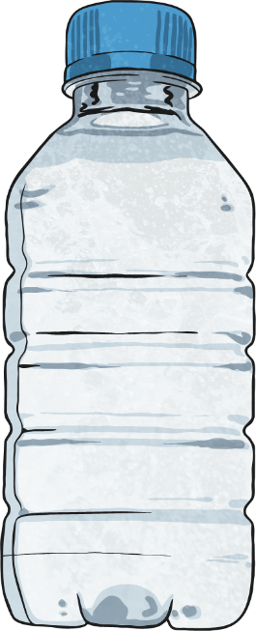
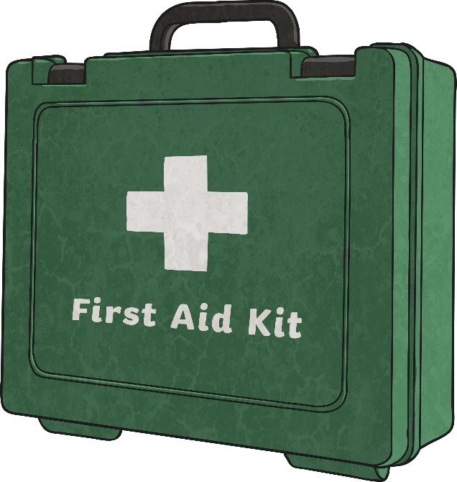
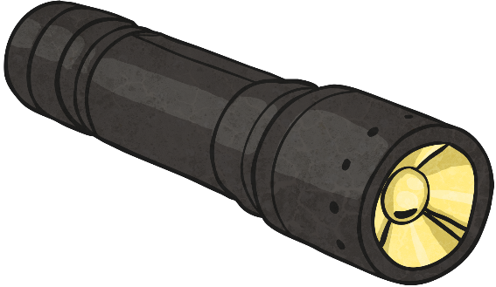
Staying Safe in an Earthquake
No one can predict when an earthquake will occur. Design a safety plan with your family to help you be prepared.
Building a Safety Kit:
Include the following items:
  plenty of water;
  flashlights;
  emergency whistles;
  extra shoes and clothes;
  a first aid kit;
  a battery operated radio.
What else could you include in a safety kit?

Slide 9
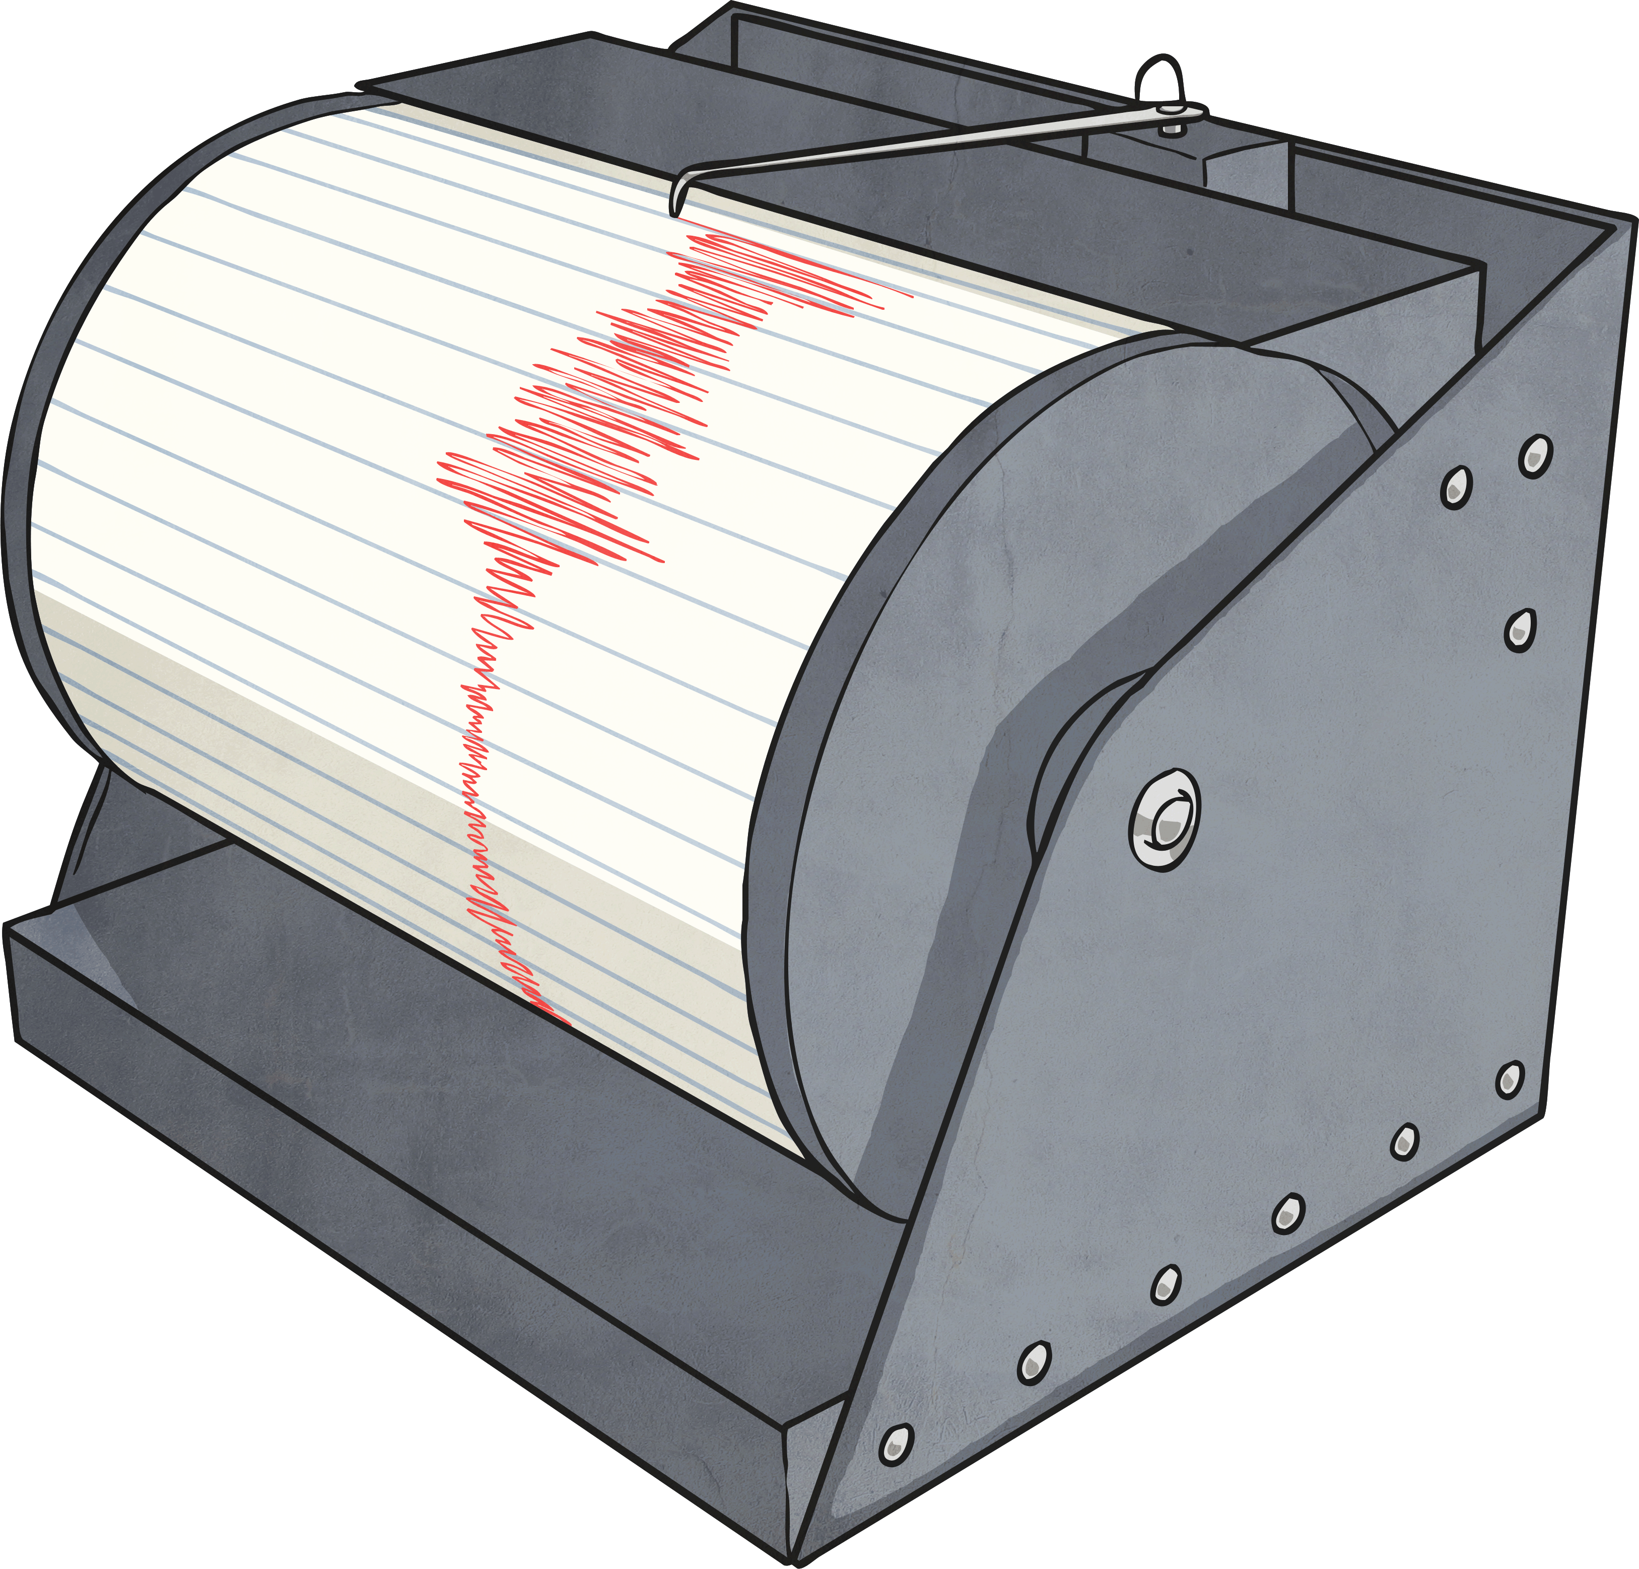
How Strong Is It?
There are two main ways to measure the power of an earthquake.
Machines called seismographs measure the power of an earthquake at its epicentre on a scale called the Richter scale.
Another measure is the Mercalli scale, and this is based on people’s observations during an earthquake.

Slide 10
Comparing Earthquakes
Mercalli Intensity | Effect
I | Felt by no-one.
II | Felt by very few people. Hanging objects may swing.
III | Felt by many but they don’t realise it is an earthquake.
IV | Felt indoors by most people. Vibrations similar to a lorry hitting a building.
V | Felt by nearly everyone. Sleeping people may be woken. Trees and telegraph poles sway.
VI | Felt by all. People run outside. Furniture moves. Slight damage to property.
VII | Felt by all. People run outside. Moderate damage to buildings
VIII | Specially designed buildings damaged, others collapse.
IX | All buildings damaged. Cracks appear in ground.
X | Many buildings destroyed.
XI | Almost all buildings destroyed. Wide cracks in the ground. Water, gas and electric out of action.
XII | Total destruction. The ground moves in waves or ripples.

Slide 11
Aim
I can describe and understand key aspects of physical geography in the context of earthquakes.
Success Criteria
I can tell you where earthquakes happen.
I can explain why earthquakes happen.
I can tell you how to keep safe in an earthquake.
I can compare the strength of earthquakes.

