Slide 1
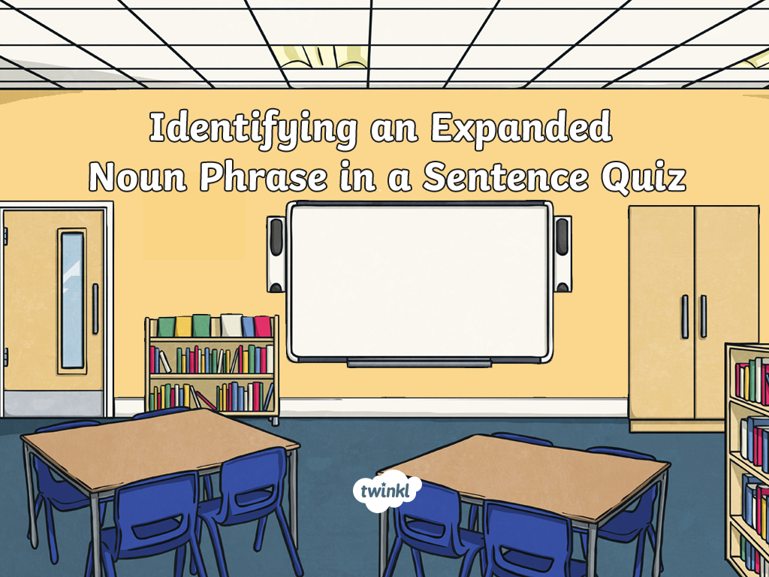
Click to begin

Slide 2
Which is the expanded noun phrase?
The clumsy man tripped up
because he wasn’t looking.
looking
The clumsy man
tripped up

Slide 3
Correct!
Well done!
Next question

Slide 4
Which is the expanded noun phrase?
That new pink bike is mine.
That new pink
is mine
That new pink bike

Slide 5
Correct!
Well done!
Next question

Slide 6
Which is the expanded noun phrase?
The determined athlete ran as fast as possible.
The determined athlete
as fast as possible
ran

Slide 7
Correct!
Well done!
Next question

Slide 8
Which is the expanded noun phrase?
Her beautiful hair is very long.
Her beautiful hair
is
very long

Slide 9
Correct!
Well done!
Next question

Slide 10
Which is the expanded noun phrase?
The old bakery sells pastries.
The old bakery
bakery sells
pastries

Slide 11
Correct!
Well done!
Next question

Slide 12
Which is the expanded noun phrase.
I need a stronger stick for the den.
I need
the den
a stronger stick

Slide 13
Correct!
Well done!
Finish

Slide 14
Oh no!
Have another go!
Try again

