Slide 1

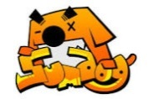

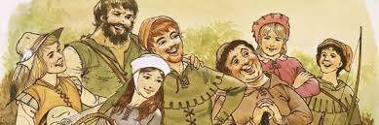
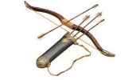
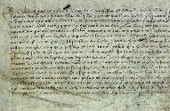

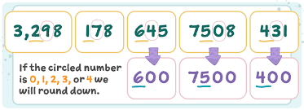

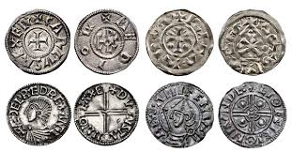

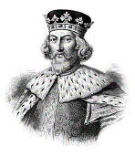
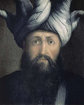
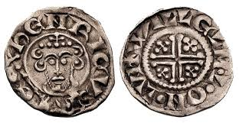
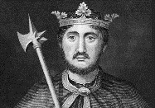
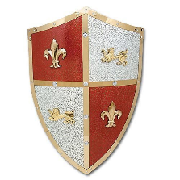
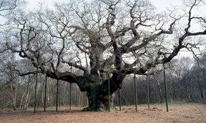
Homework Grid Y6 Autumn 1
Y6 Homework:
Spellings – tested every fortnight.
Daily reading (reading book or https://www.activelearnprimary.co.uk)
SumDog Maths challenges and competitions.
Times Table Rock star activities
Learn new vocabulary.
In addition to this, we would like you to choose some of the homework ideas from this grid to do at home over this eight week half-term. We will have time in school to talk about the homework you have done that week. If you want to bring your homework to school or a photograph of you doing an activity from the grid, that would be great!
Imagine you are the Sheriff of
Nottingham. Write a letter to King John
asking for help
to get rid of
Robin Hood.
Write a short
newspaper report announcing the archery contest Robin Hood won. Decide whether your newspaper is for or against Robin first.
Write your own poem (any style) about Robin Hood.
Writing
Write a character
description of one of
the Merry Men.
Learn all your x-tables and their related division facts.
Remember, practice makes perfect!
Write a guide to money in Robin Hood’s time.
Maths
Write a secret message from Robin Hood to one of his Merry Men in code (don’t forget to include a key!).
Practise rounding integers to the nearest 10, 100 and 1,000
Topic
Create a map of Sherwood Forest now, and as it was in Robin Hood’s day.
Draw a picture / make a 3D model of Major Oak
(Robin’s hideout)
Design and make a shield or banner for Robin Hood and his Merry Men –
think carefully
about the
style and
colours.
Research the life of either King Richard the Lionheart, King John or
Saladin (Arabic leader during the crusades).
Mint your own King John coins, you could make these out of salt dough or
chocolate (these are better!)

