Slide 1

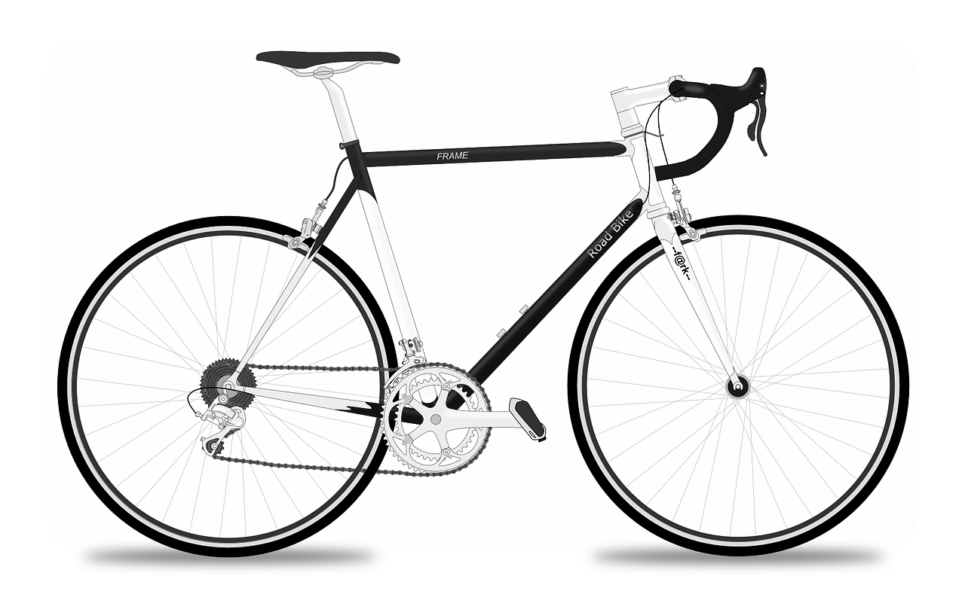
Year 5 – How is information shared? Activity handout
Lesson 1 – Systems
Save a copy
Bicycle system
This resource is available online at ncce.io/csn5-1-a1-w. Resources are updated regularly — please check that you are using the latest version.
This resource is licensed under the Open Government Licence, version 3. For more information on this licence, see ncce.io/ogl.
Notes:
Last updated: 01-07-20
Image source: https://pixabay.com/vectors/racing-bicycle-racer-racing-bike-161449/

