Slide 1



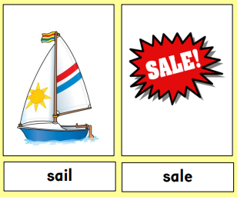
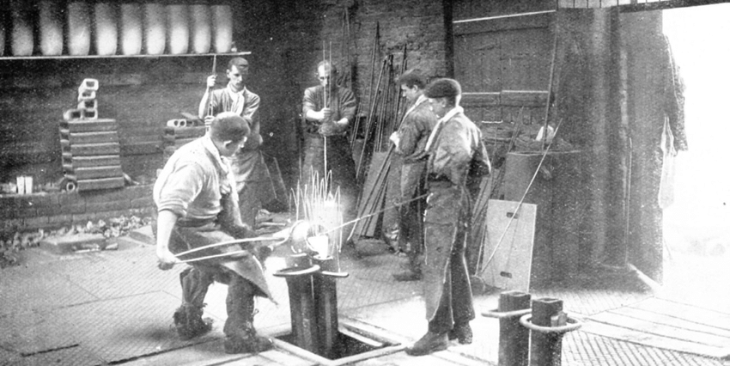


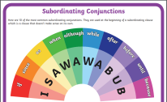

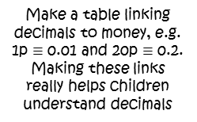


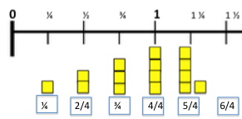
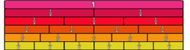
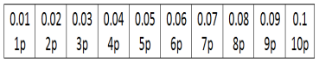
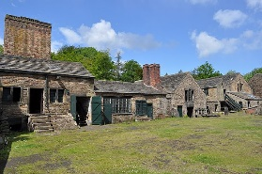
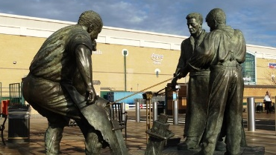
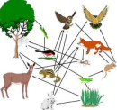
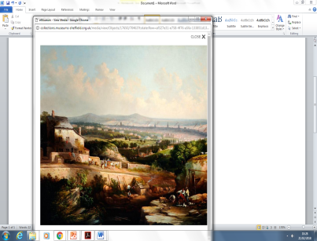
Y4 Homework Grid Spring 2
Y4 Homework:
20 Spellings – tested every fortnight.
Daily reading (reading book or https://www.activelearnprimary.co.uk )
Remember, good readers
make good writers!
Regular Sumdog maths challenges and
competitions and spelling challenges.
In addition to this, I would like you to choose some of the homework ideas from this grid to do at home.
Do your home work in your homework book. Bring your home work book in on Thursday mornings for marking ☺
Research Tricky Homophones. Write a short story using homophones. Underline the homophones you’ve
used.
Imagine what life was like as a steel worker. Write a diary of your day at work. Be imaginative!
Explain to your grown-up how to use a subordinate conjunction in the middle of a sentence, then how to switch it to the start of a sentence with a comma. Google
Subordinating
conjunctions
to give you
ideas.
Writing
Log on to Phonics Play and select Phase 5.
www.phonicsplay.co.uk
Practise your target
times- table facts and their related division facts.
Using bits of paper, make a fraction wall for 1/10s, 1/5s, and 1/2s. Look at the working wall in school for help!
Can you make a fraction wall for some equivalent fractions?
Make fraction number lines that include improper fractions and whole numbers.
Start with a blank number line
Maths
Use Hit the Button:
https://www.topmarks.co.uk/maths-games/hit-the-button
Topic
Investigate food chains and food webs. Use the Internet to find some for specific habitats such as deciduous
Research Sokari Douglas Camp’s metal sculptures. Can you draw two of them, using curved lines to show 3D shapes?
Visit the Steelmen statues at Meadowhall. Take a picture of yourself with them. What is the
real name of the statue?
Take a trip to Western Park Museum and have a look at Joseph McIntyre’s A View of Sheffield from Psalter Lane. Think about: How is the river being used? How is
Sheffield
different now?
What time
of year it is in
the painting?
woodland or deserts.
What do food chains always start with?

