Slide 1
BAKERY

Slide 2






Recipe
Ratio and proportion
Ingredients
(makes 6 cupcakes)
For the cupcake mixture:
120 g butter
120 g caster sugar
120 g self-raising flour
2 eggs
1 tsp vanilla extract
For the icing:
140 g butter
275 g icing sugar
2 tbsp milk
White Rose Bakery
There are 30 children in the class.
How much of each ingredient is needed to make 30 cupcakes?

Slide 3
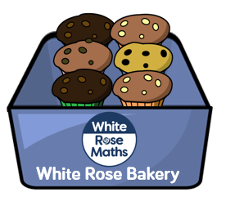


Ingredients
(makes 6 cupcakes)
For the cupcake mixture:
120 g butter
120 g caster sugar
120 g self-raising flour
2 eggs
1 tsp vanilla extract
For the icing:
140 g butter
275 g icing sugar
2 tbsp milk
Ingredients
(makes 30 cupcakes)
For the cupcake mixture:
For the icing:
$×$ 5
Ingredients
(makes 30 cupcakes)
For the cupcake mixture:
600 g butter
600 g caster sugar
600 g self-raising flour
10 eggs
5 tsp vanilla extract
For the icing:
700 g butter
1,375 g icing sugar
10 tbsp milk
$×$ 5

Slide 4



I want to make cupcakes for 3 family members.
Ingredients
(makes 6 cupcakes)
For the cupcake mixture:
120 g butter
120 g caster sugar
120 g self-raising flour
2 eggs
1 tsp vanilla extract
For the icing:
140 g butter
275 g icing sugar
2 tbsp milk
There are 32 children in my class. I want everyone to get a cupcake!
Have a go
How much of each ingredient is needed?

Slide 5
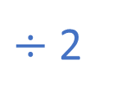



I want to make cupcakes for 3 family members.
Ingredients
(makes 6 cupcakes)
For the cupcake mixture:
120 g butter
120 g caster sugar
120 g self-raising flour
2 eggs
1 tsp vanilla extract
For the icing:
140 g butter
275 g icing sugar
2 tbsp milk
Ingredients
(makes 3 cupcakes)
For the cupcake mixture:
For the icing:
Ingredients
(makes 3 cupcakes)
For the cupcake mixture:
60 g butter
60 g caster sugar
60 g self-raising flour
1 egg
$\frac{\text{1}}{\text{2}}$ tsp vanilla extract
For the icing:
70 g butter
137.5 g icing sugar
1 tbsp milk
$÷$ 2
Ingredients
(makes 3 cupcakes)
For the cupcake mixture:
60 g butter
60 g caster sugar
60 g self-raising flour
1 egg
$\frac{\text{1}}{\text{2}}$ tsp vanilla extract
For the icing:
70 g butter
138 g icing sugar
1 tbsp milk
$÷$ 2

Slide 6

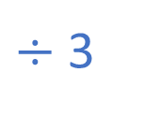

There are 32 children in my class. I want everyone to get a cupcake!
Ingredients
(makes 6 cupcakes)
For the cupcake mixture:
120 g butter
120 g caster sugar
120 g self-raising flour
2 eggs
1 tsp vanilla extract
For the icing:
140 g butter
275 g icing sugar
2 tbsp milk
Ingredients
(makes 2 cupcakes)
For the cupcake mixture:
For the icing:
$÷$ 3
Ingredients
(makes 2 cupcakes)
For the cupcake mixture:
40 g butter
40 g caster sugar
40 g self-raising flour
$\frac{\text{2}}{\text{3}}$ egg
$\frac{\text{1}}{\text{3}}$ tsp vanilla extract
For the icing:
47 g butter
92 g icing sugar
$\frac{\text{2}}{\text{3}}$ tbsp milk
$÷$ 3

Slide 7
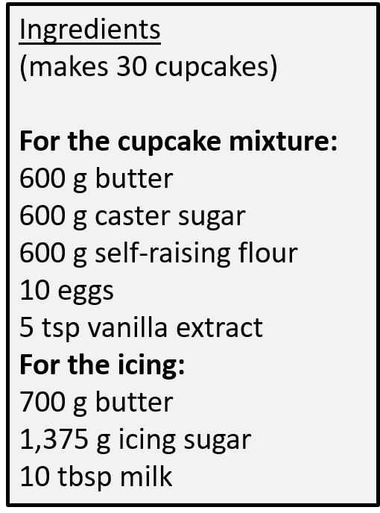
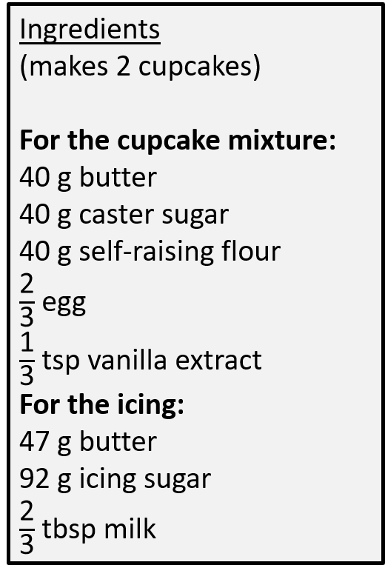
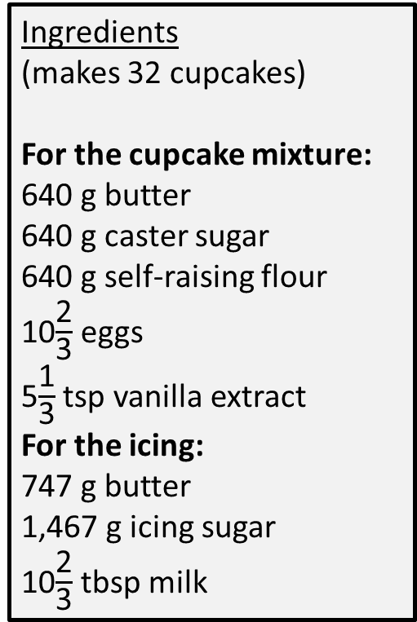
Ingredients
(makes 32 cupcakes)
For the cupcake mixture:
640 g butter
640 g caster sugar
640 g self-raising flour
10$\frac{\text{2}}{\text{3}}$ eggs
5$\frac{\text{1}}{\text{3}}$ tsp vanilla extract
For the icing:
747 g butter
1,467 g icing sugar
10$\frac{\text{2}}{\text{3}}$ tbsp milk

Slide 8
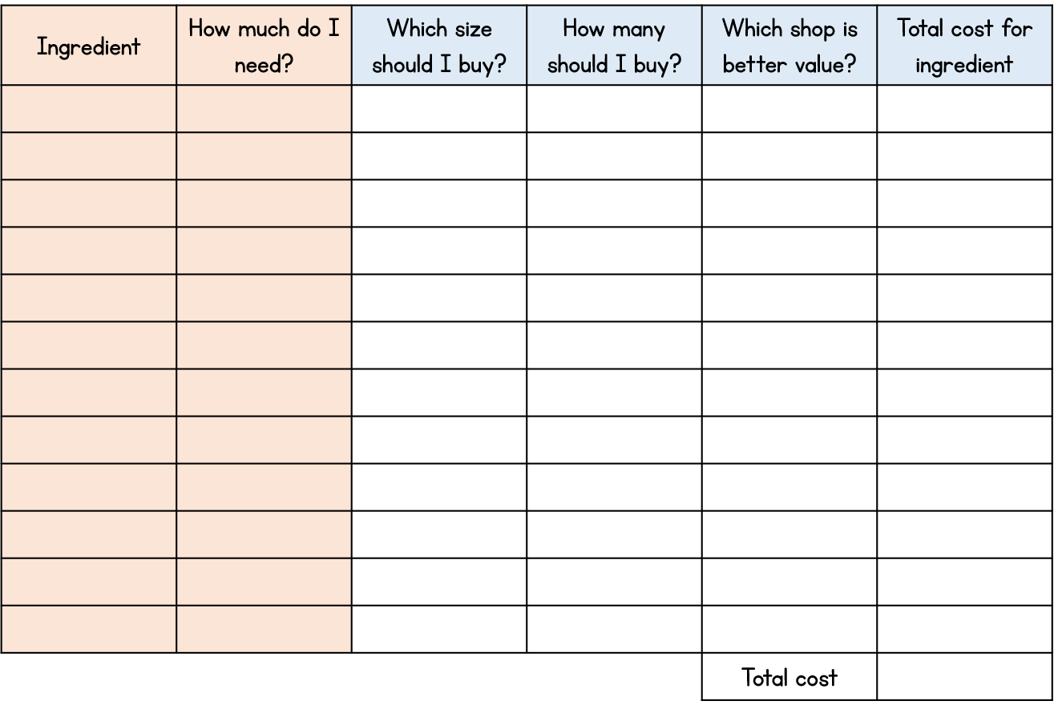
Ingredients
(makes 6 cupcakes)
For the cupcake mixture:
120 g butter
120 g caster sugar
120 g self-raising flour
2 eggs
1 tsp vanilla extract
For the icing:
140 g butter
275 g icing sugar
2 tbsp milk
Activity 1
Decide on the amount of cupcakes you would like to make.
Work out how much of each ingredient is needed.
You may want to add extra ingredients for flavour.
This will be used for the rest of the project.

Slide 9
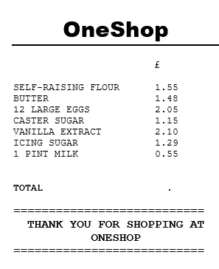
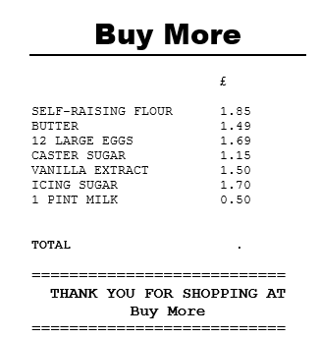
Cost of the ingredients
Four operations
Which is better value for money?

Slide 10









155 $+$ 148
155 $+$ 150
$=$ 305
£3.03
305 $−$ 2
$=$ 303
£5.30
205 $+$ 115 $+$ 210
5 $+$ 5 $=$ 10
10 $+$ 10 $=$ 20
200 $+$ 100 $+$ 200 $=$ 500

Slide 11






129 $+$ 55
130 $+$ 55
$=$ 185
£3.03
185 $−$ 1
$=$ 184
£5.30
117p
$=$ £1.17
£1.84
£9.00
£10.17

Slide 12
Have a go
£10 17
£9 88
Which is better value for money?
Buy More

Slide 13
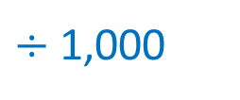
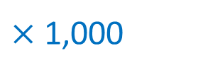



1 Kilogram $=$ 1,000 grams
$÷$ 1,000
Unit conversions
g
kg
$×$ 1,000
Complete the conversions.
2,000
3
2 kg $=$ _____ g
20 kg $=$ _____ g
1.5 kg $=$ ______ g
0.7 kg $=$ ______ g
0.432 kg $=$ _____ g
3,000 g $=$ _____ kg
30,000 g $=$ _____ kg
1,700 g $=$ ______ kg
823 g $=$ ______ kg
20,000
30
1,500
1.7
700
0.823
432
Have a go

Slide 14
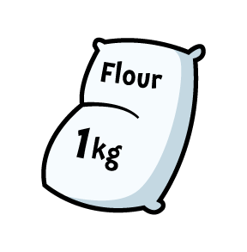
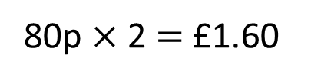
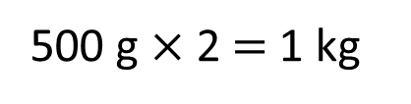
One Shop
B
C
A
1 kg
500 g
750 g
£1.55
80p
90p
500 g $×$ 2 $=$ 1 kg
80p $×$ 2 $=$ £1.60
Which is better value for money?

Slide 15

One Shop
39 pence per 250 g
B
C
A
1 kg
500 g
750 g
£1.55
80p
90p
1,000 g
A
£1.55 $÷$ 4 $=$ 0.3875
250 g
Which is better value for money?

Slide 16

One Shop
39 pence per 250 g
C
A
1 kg
750 g
£1.55
90p
750 g
30 pence per 250 g
C
90p $÷$ 3 $=$ 30p
250 g
Which is better value for money?

Slide 17
Buy More
A
B
C
1 kg
300 g
1.5 kg
£1.85
50p
£2.30
Have a go
Which is better value for money?

Slide 18




Buy More
A
B
C
1 kg
300 g
1.5 kg
A
£1.85
50p
£2.30
1 kg
£1.85 $×$ 3
$=$ £5.55
£2.30 $×$ 2
$=$ £4.60
A
C
£1.85
1 kg
1.5 kg
£1.85
£2.30
Which is better value for money?

Slide 19


Buy More
50p $×$ 5
$=$ £2.50
A
B
B
C
B
1 kg
300 g
300 g
1.5 kg
50p
50p
£2.30
£1.85
300 g
B
B
50p
300 g
300 g
50p
50p
Which is better value for money?

Slide 20
Buy More
A
B
C
1 kg
300 g
1.5 kg
£1.85
50p
£2.30

Slide 21
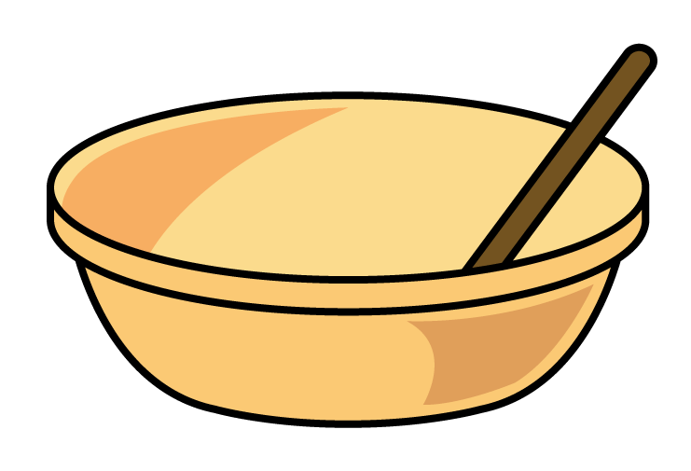
Which is better value for money?
Percentages
One Shop
Buy More
30% off!
Sugar
Sugar
1 kg
1 kg
£1.60
£1.15

Slide 22
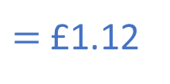
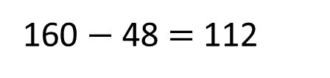
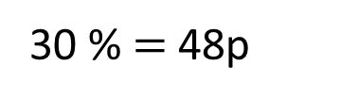
Which is better value for money?
One Shop
Buy More
30% off!
Sugar
30 % $=$ 48p
Sugar
Sugar
160 $−$ 48 $=$ 112
1 kg
$=$ £1.12
1 kg
£1.60
£1.15
160p
16
16
16
?

Slide 23
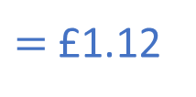
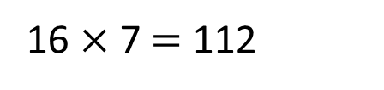
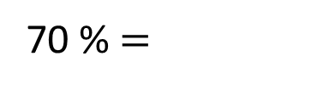
Which is better value for money?
One Shop
Buy More
30% off!
70 % $=$
Sugar
Sugar
Sugar
16 $×$ 7 $=$ 112
1 kg
$=$ £1.12
1 kg
£1.60
£1.15
160p
16
?

Slide 24


One Shop
Buy More
Buy one get one free!
20% off!
Best Butter
Best Butter
250 g
250 g
£1.85
£1.40
Have a go
I need 500 g of butter. Which one is better value for money?
I need 750 g of butter. Which one is better value for money?

Slide 25

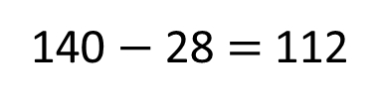
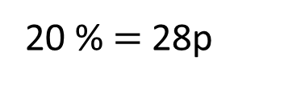
140p
20 % $=$ 28p
140 $−$ 28 $=$ 112
14
14
One Shop
?
Buy More
Buy one get one free!
20% off!
Best Butter
Best Butter
Best Butter
Best Butter
Butter
250 g
250 g
250 g
250 g
£1.85
£1.12
£1.40
£1.12
£2.24
I need 500 g of butter. Which one is better value for money?
For 500 g One Shop is the best value for money.

Slide 26
140p
20 % $=$ 28p
140 $−$ 28 $=$ 112
14
14
One Shop
?
Buy More
Buy one get one free!
20% off!
Best Butter
Best Butter
Best Butter
Best Butter
Butter
250 g
250 g
250 g
250 g
£1.85
£1.12
£1.40
Best Butter
Best Butter
£1.12
250 g
250 g
£1.85
£1.12
£3.70
£3.36
For 750 g Buy More is the best value for money.
I need 750 g of butter. Which one is better value for money?

Slide 27
Best Value worksheet

Slide 28
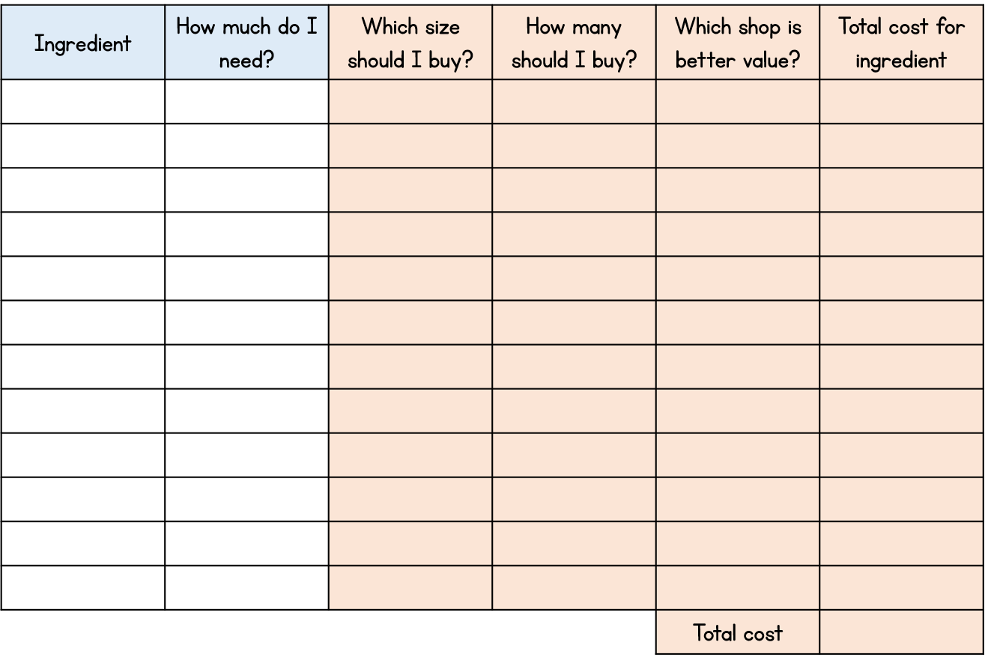
Activity 2
Using the amount of ingredients you chose in Activity 1, price up the cost of all the ingredients you need.
Check the amount of each ingredient – make sure you choose the correct size package for the amount you need.
Don’t forget to check if there are any deals on!
You can use your local supermarket website or the price template we have provided.

Slide 29




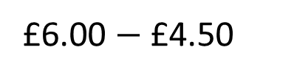
Profit and loss
Money
Ingredients to make 6 cupcakes costs £4.50
You sell each cupcake for £1.00
You will get £6.00
How much profit have you made?
£1.50
£6.00 $−$ £4.50

Slide 30
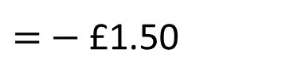
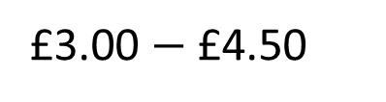
Profit and loss
Ingredients to make 6 cupcakes costs £4.50
You sell each cupcake for 50p
You will get £3.00
How much profit have you made?
£3.00 $−$ £4.50
$=$ $−$ £1.50
None. Made a loss of £1.50

Slide 31
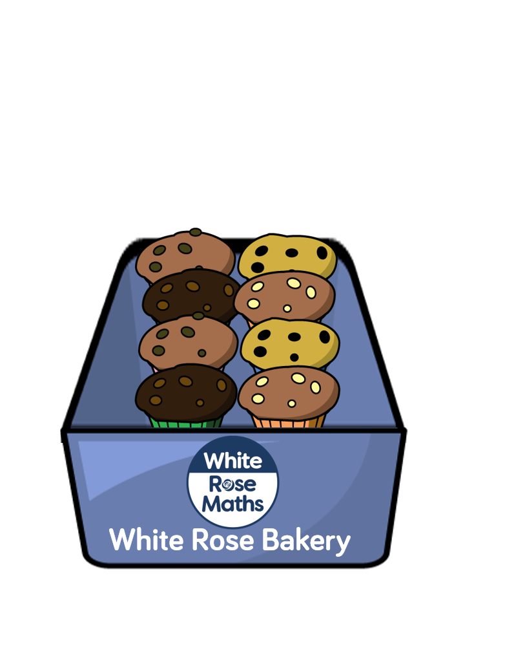

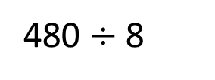
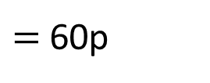
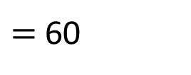
Ingredients to make 8 cupcakes costs £4.80
How much does Whitney need to sell each cupcake for to make a profit?
Any amount greater than 60p
480p
60
60
60
60
60
60
60
60
480 $÷$ 8
$=$ 60
$=$ 60p
Have a go

Slide 32

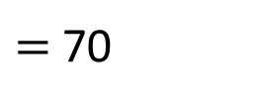
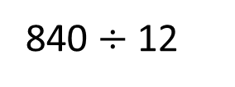
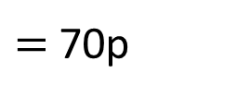
Ingredients to make 12 cupcakes costs £6.00
How much does Dexter need to sell each cupcake for to make a profit of £2.40?
70p
600p
840p
840 $÷$ 12
$=$ 70
$=$ 70p
Have a go

Slide 33


Ingredients to make 12 cupcakes costs £4.50
Ron sells his cupcakes in packs of 4
and charges £1.60 for one pack.
£1.60
Annie sells her cupcakes individually and charges 45p each.
45p
Who makes the most profit?
How much more profit do they make?
Have a go

Slide 34
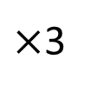
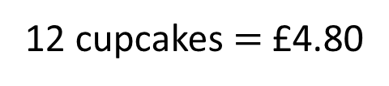
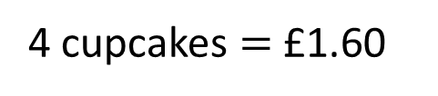
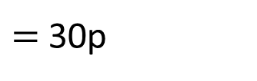
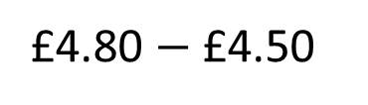
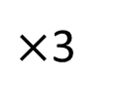
Ingredients to make 12 cupcakes costs £4.50
Ron sells his cupcakes in packs of 4
and charges £1.60 for one pack.
£1.60
£1.60
£1.60
£1.60
4 cupcakes $=$ £1.60
$×$3
$×$3
12 cupcakes $=$ £4.80
£4.80 $−$ £4.50
$=$ 30p
Ron makes 30p profit.

Slide 35
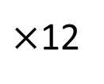
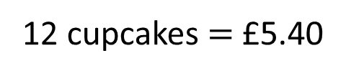
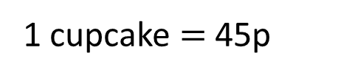
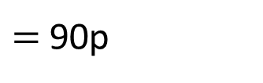
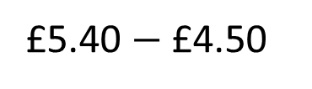

Ingredients to make 12 cupcakes costs £4.50
Annie sells her cupcakes individually and charges 45p each.
45p
45p
45p
45p
45p
45p
45p
45p
45p
45p
45p
45p
1 cupcake $=$ 45p
$×$12
$×$12
12 cupcakes $=$ £5.40
£5.40 $−$ £4.50
$=$ 90p
Annie makes 90p profit.

Slide 36
Ingredients to make 12 cupcakes costs £4.50
Ron sells his cupcakes in packs of 4
and charges £1.60 for one pack.
£1.60
Annie sells her cupcakes individually and charges 45p each.
45p
Who makes the most profit?
How much more profit do they make?
Ron makes 30p profit.
Annie makes 60p more profit than Ron.
Annie makes 90p profit.

Slide 37




Ingredients to make 12 cupcakes costs £4.50
Ron sells his cupcakes in packs of 4
and charges £1.60 for one pack.
£1.60
Annie sells her cupcakes individually and charges 45p each.
45p
Who makes the most profit?
How much more profit do they make?
£1.60
£1.60 $÷$ 4 $=$ 40p
5p
5p $×$ 12 $=$ 60p
40p | 40p | 40p | 40p
40p
45p
Annie makes 60p more profit than Ron.

Slide 38
Profit and Loss worksheet

Slide 39
Activity 3
Use the price template provided or the price list you created from your local supermarket.
Work out how much you need to sell your cupcakes for to make a profit of
£2.00
£3.50
£5.00

Slide 40
Packaging
Nets of 3-D shapes
What 3-D shapes will these nets form?
Which would be best to use for packaging your cupcakes?
Have a think

Slide 41



Nets of 3-D shapes
What 3-D shapes will these nets form?
Which would be best to use for packaging your cupcakes?

Slide 42


The length and width is 6 cm.
Area, perimeter and volume
6 cm
6 cm
We want to put 4 cupcakes in a box.
What is the area of the base of the box?
18 cm
2 cm
6 cm
2 cm
6 cm
2 cm
18 $×$ 18 $=$ 324 cm²
18 cm

Slide 43

The length and width is 6 cm.
6 cm
6 cm
26 $×$ 18 $=$ 468 cm²
We want to put 6 cupcakes in a box.
Remember to leave 2 cm either side of the cupcake.
What is the area of base of the box?
18 cm
2 cm
6 cm
2 cm
6 cm
2 cm
6 cm
2 cm
Have a go
26 cm

Slide 44




The length and width of a cupcake is 6 cm.
Area, perimeter and volume
6 cm
We don’t want squashed cupcakes!
7 cm
The height of a cupcake is 7 cm
9 cm
How tall does the box need to be?
If there are 4 cupcakes in the box,
what is the volume of the box?
18 $×$ 18 $=$ 324 cm²
324 $×$ 9
$=$ 2,916 cm³

Slide 45
The length and width of a cupcake is 6 cm.
6 cm
7 cm
The height of a cupcake is 7 cm
If there are 6 cupcakes in the box, what is the volume of the box?
4,212 cm³
If there are 8 cupcakes in the box, what is the volume of the box?
5,508 cm³
Have a go

Slide 46
3 cm
Nets of 3-D shapes
2 cm
4 cm
3 cm
4 cm
2 cm

Slide 47
40 cm
18 cm
52 cm
Sketch the net of this cuboid.
40 cm
52 cm
18 cm
Not drawn to scale.

Slide 48
98 cm
41 cm
127 cm
Sketch the net of this cuboid.
Have a go

Slide 49
Packaging worksheet

Slide 50
Activity 4
Think about how you are going to package the amount of cupcakes you are making.
Work out the dimensions of your packaging – make sure all the cupcakes can fit in!
Sketch a diagram of the net to help you plan.
Create an eye-catching design for your packaging.
Things to think about:
Are you going to decorate your package?
Do you have a logo?
Have you got a brand name?

Slide 51
Activity 5
Create your packaging using the correct dimensions and decorate.

Slide 52





Baking problems
Mo puts his cupcakes in the oven at 12:48 pm
The cupcakes take 18 minutes in the oven and then you must leave them to cool for 14 minutes before you can decorate them.
18 $+$ 14 $=$ 32 minutes
What time can Mo start decorating his cupcakes?
1:20 pm
$+$ 12 mins
$+$ 20 mins
12:48
1:00
1:20
Have a think

Slide 53
Rosie, Dexter and Amir are all making cupcakes.
Amir makes 3 times as many cupcakes as Dexter.
Dexter makes 16 more cupcakes than Rosie.
Altogether they make 144 cupcakes.
How many cupcakes does Amir make?
Have a think

Slide 54


Amir makes 3 times as many cupcakes as Dexter.
Dexter makes 16 more cupcakes than Rosie.
Altogether they make 144 cupcakes.
?
Amir
32
32
32
144 $+$ 16 $=$ 160
160
Dexter
32
144
160 $÷$ 5
16
16
Rosie
Amir makes 96 cupcakes.
What else can you find out?

Slide 55

Annie decorates $\frac{\text{2}}{\text{5}}$ of her cupcakes with chocolate sprinkles.
Fractions
18 cupcakes are decorated with chocolate sprinkles.
How many cupcakes did Annie decorate altogether?
?
45 cupcakes.
45
Total amount of cupcakes
9
9
9
9
9
Chocolate sprinkles
18
Have a think

Slide 56
Cooking Problems worksheet

Slide 57

Activity 6
Time to go bake
your cupcakes!
Put them in the packages you made.
We’d love to see your
cupcakes and packaging
designs on social media.

Slide 58

Ingredients
(makes 10 bagels)
7 g dried yeast
4 tbsp sugar
2 tsp salt
450 g bread flour
Optional:
Poppy, fennel and/or sesame seeds to sprinkle on top.
White Rose Deli
Bagel choices
Salmon, cream cheese and salad
Mozzarella, pesto and salad
Ham and cheese
Chicken and roasted vegetables

