Slide 1
IALT think about rights in the classroom and to identify behaviour that respects human rights

Slide 2
Everyone at school has the right to learn, be safe and be treated fairly. It is also important to behave in a way that is respectful of the human rights of others.
What can be done in your classroom to make sure that everyone is enjoying their right to:
be safe
be treated fairly
learn
TASK 1: Write one thing that will help these rights, eg:
The right to be SAFE – dangerous things to be put away
The right to be TREATED FAIRLY – all get a turn
The right to LEARN – enough books and paper

Slide 3
Think about the following…
Everyone in school has the right to learn and be safe an be treated fairly. If that is right for us, then it is right for everyone else too. It is important that we behave in away that means everyone can enjoy their rights.
However can you think of some examples of people disrespecting other people’s human right? Why do some people behave that way? What can we do to make up for disrespecting others’ rights?
How can we avoid behaving unfairly an disrespecting the rights of others?
How does it feel to have your rights disrespected by other?

Slide 4
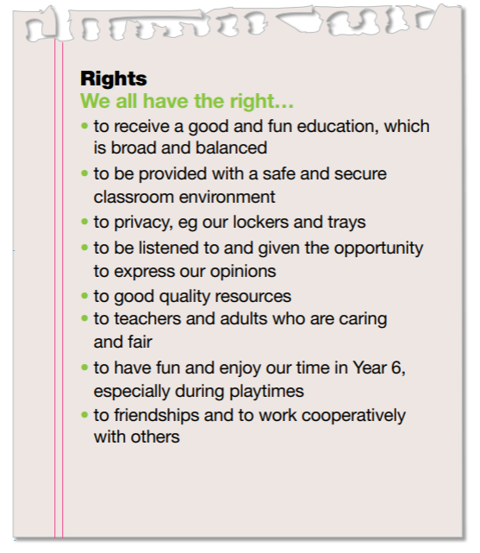
TASK 2: Create your own class list of rights. This charter was drawn up by Year 6 pupils.

