Slide 2
Metaphor
x
Figurative – using or containing a non-literal sense of a word or words.
Metaphor is the device that compares something directly with something else in order to create a .
figurative
resemblance
x
Resemblance – similar in appearance or quality to somebody or something else.

Slide 3
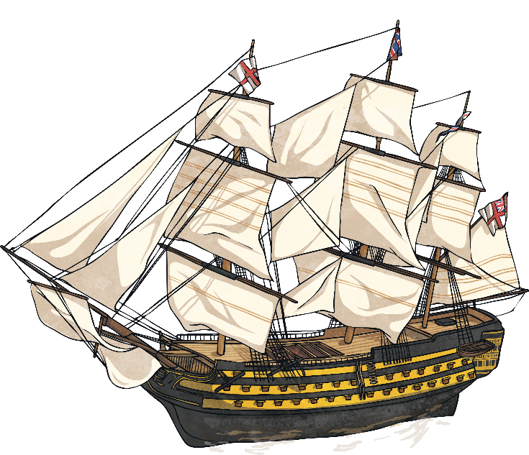
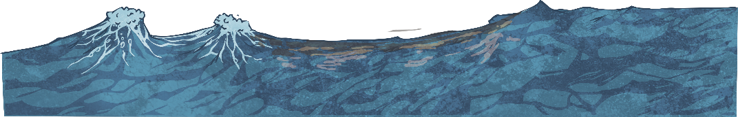
What Is It?
“The moon was a ghostly galleon, tossed upon cloudy seas.”
‘The Highwayman’, Alfred Noyes.
ghostly galleon
x
Image – a picture of something.
We know that a ship can’t be a ghost, but using this metaphor forms the eerie that Alfred Noyes wanted to create for the reader.
image

Slide 4
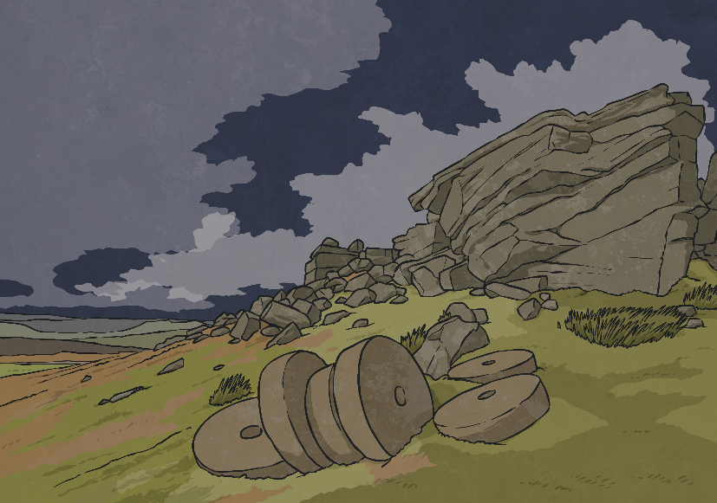
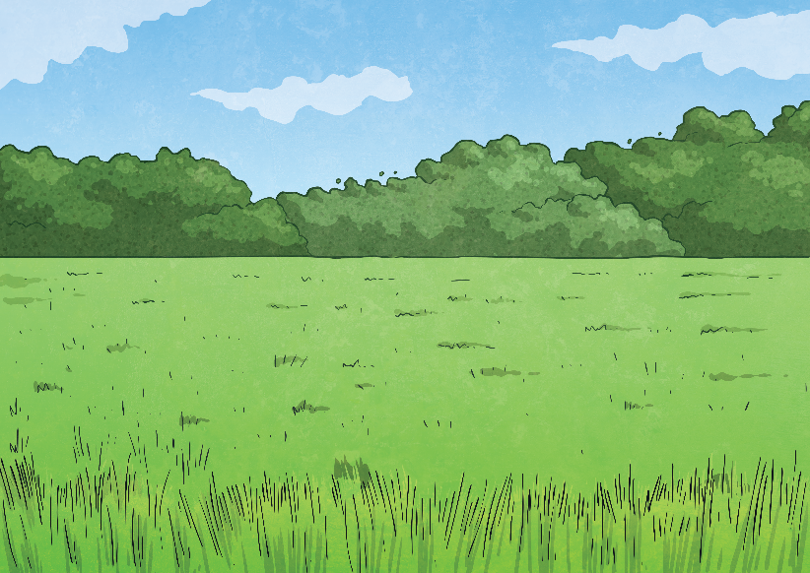
Why Use It?
Using metaphors enables the writer to and add
description to something.
economically
powerfully
specific
x
x
Powerfully – able to produce a strong effect on people’s ideas or emotions.
Economically – efficiently, briefly or carefully.
x
Specific – exact and detailed.
What image does this extract from The Highwayman create for you: A or B? Tell me why.
“The road was a ribbon of moonlight over the purple moor,”
A
B

Slide 5
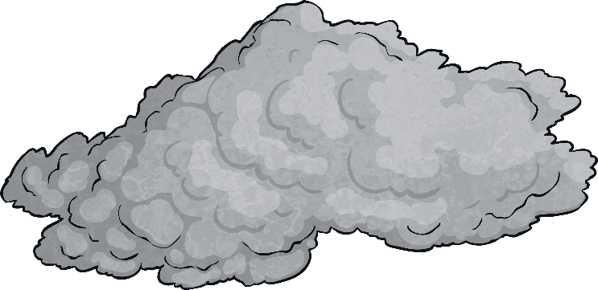
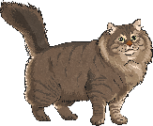
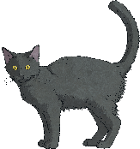
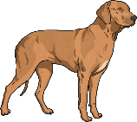
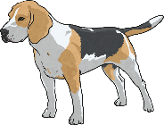
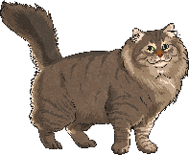
How to Identify a Metaphor
Metaphors are easy to spot because the
between the descriptions of one thing to another do not contain ‘like’ or ‘as’. Figurative sentences containing ‘like’ or ‘as’ are usually similes.
comparisons
x
Comparisons – presenting two or more things to discover similarities and differences between them.
‘It was raining cats and dogs’
and not
‘It was raining like cats and dogs’.

Slide 6
How to Use Metaphors for Description
Metaphors can give sentences more detail about description, interest and power. Here are some metaphorical sentences for describing parts of
the body.
Her spidery hand quickly wrapped round the boy’s wrist.
His leather-soled feet ignored the sharp shingle on the beach.
Dr Roper’s lips slithered into a smile.
How do each of these metaphors add detail to the description of the features?

Slide 7
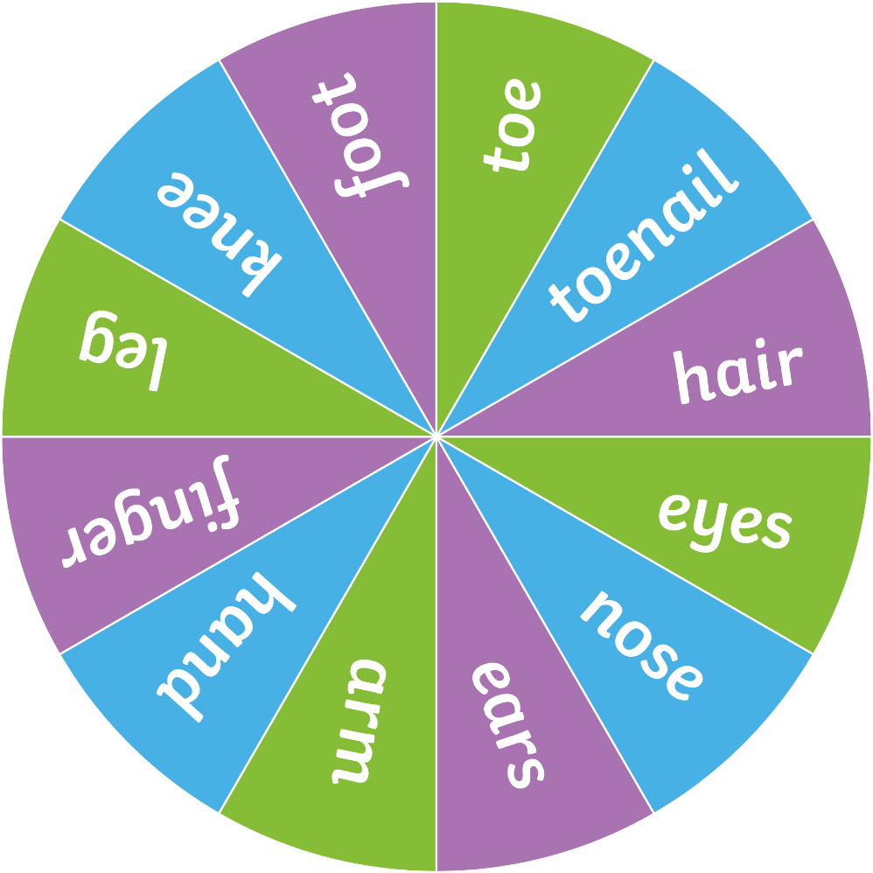
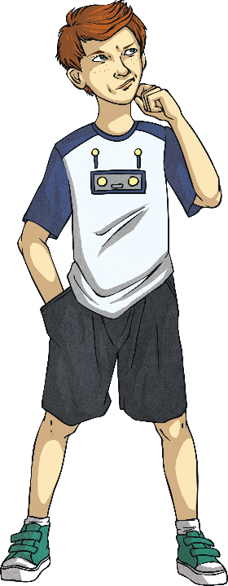
How to Use Metaphors for Description
Now let’s try to create some of our own metaphors to add description to other body parts…
Spin

Slide 8
How to Use Metaphors for Interest
Here are some metaphorical sentences for adding interest to some objects.
The orange peel football slowly dribbled to a halt.
The fully-clothed tree swayed in the breeze.
The racing water babbled with joy.
How do each of these metaphors add interest to the objects?

Slide 9
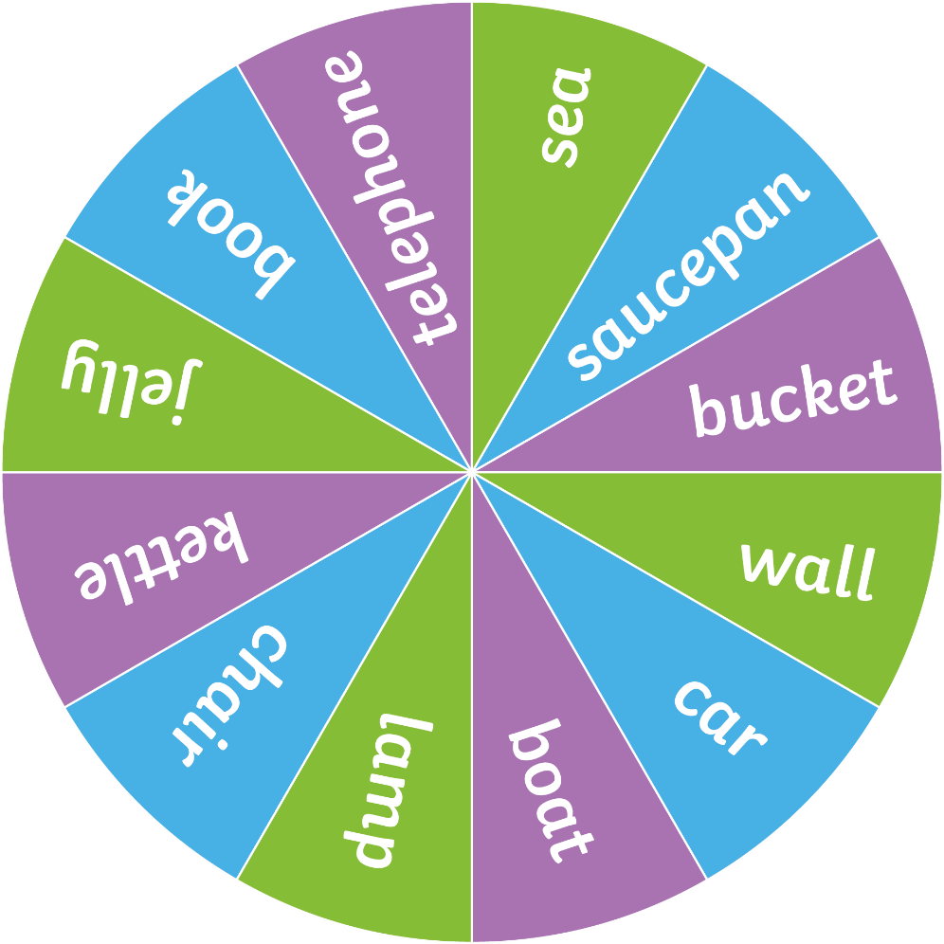
How to Use Metaphors for Interest
Now, try some of your own…
Spin

Slide 10
How to Use Metaphors for Power
Here are some metaphorical sentences for adding power to the descriptions. Often, animal qualities are used to draw comparisons.
His gorilla fists punched the air in victory.
Her crocodile jaws snapped shut round the apple.
Cassi, the racing snake, easily won the 100m sprint.
How do each of these metaphors add power to the descriptions?

Slide 11
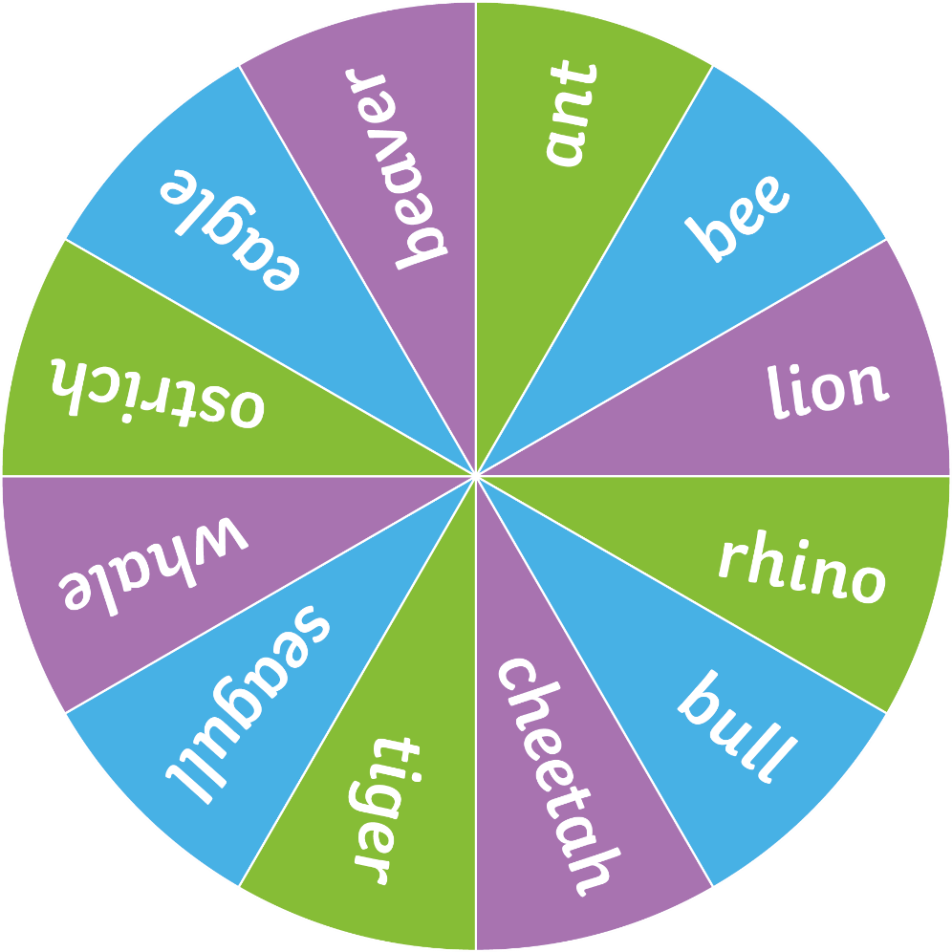
How to Use Metaphors for Power
Now, try some of your own…
Spin

Slide 12
Try It Yourself!
Use the Matching Metaphor Game to match the cards to complete
the metaphorical sentences.
The moon
is a white balloon.
ANSWER
The train lines are
snakes.
ANSWER
Do the metaphors add description, interest, power or something else to the sentences?

Slide 13
Vocabulary for Verse
In poetry, the vocabulary you choose can set the mood. As you have seen from the extracts of Alfred Noyes’ poem ‘The Highwayman’, metaphors can be very effective.
Try using different metaphorical detail to create more description, interest and power in your poetry or prose.
For example:
Time flew by. (description)
Swimming in a sea of people, we braved the sales. (interest)
A tidal wave of donations flooded in after the television appeal. (power)

Slide 14
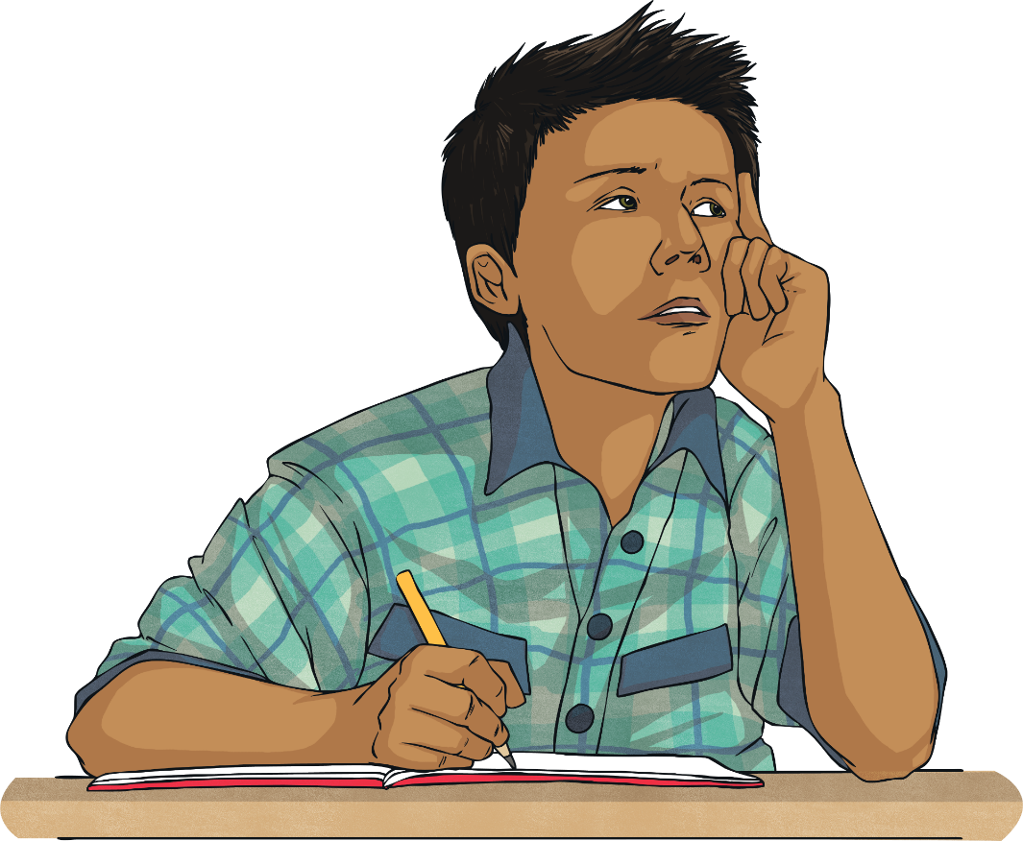
Have a Go!
Find some metaphorical words and phrases in poems or prose that you know. What effect does it have? Does it add to the description, interest or power?
Have a go at adding metaphor to your own work to make it more descriptive, interesting or powerful.

Slide 15
Getting You Started
Here are some examples of metaphors to include in your writing:
This lesson is a recipe for disaster.
He showered her with gifts.
I have butter fingers.
She pulled the wool over my eyes.
You are my sunshine.
A blanket of snow fell.
They hatched a plan.
My name is mud.

