Slide 1
12 x 11 = ?
3 x 5 = ?
Multiplication Tables Check
Information for Parents
by Mr. Melleney, September 2022
6 x 9 = ?
7 x 8 = ?

Slide 2

Multiplication Tables Check
What is the Multiplication Tables Check?
The Multiplication Tables Check (also known as the MTC) is the new national times tables test for Year 4 children across the country.
Under the National Curriculum, children are expected to know all of their times tables up to 12 x 12 by the end of Year 4.

Slide 3
Multiplication Tables Check
Details
Takes place in June 2023
Carried out in school, using a laptop
25 questions
6 seconds to answer each question
Results are given to schools a few days later
No pass or fail mark, but we will be aiming for 25/25.

Slide 4
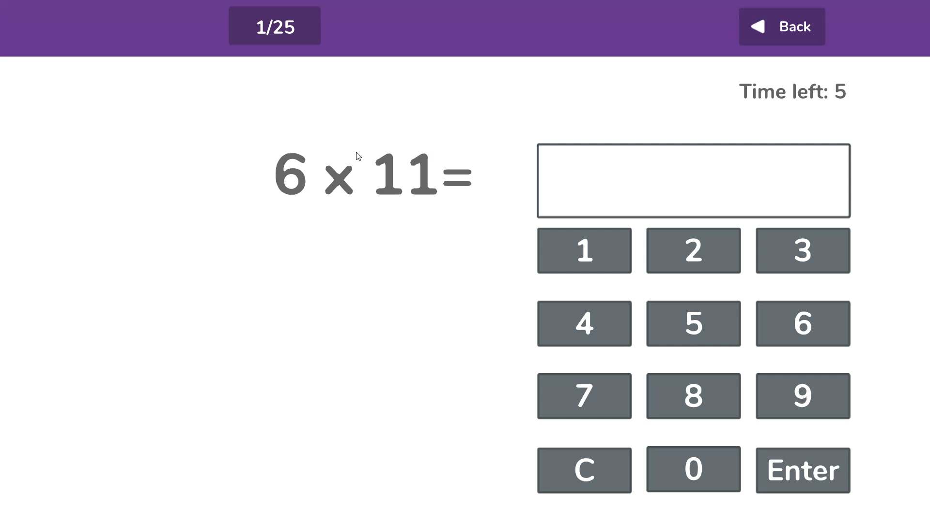
Multiplication Tables Check
What does the MTC look like?
Here is an example of what the test looks like:

Slide 5
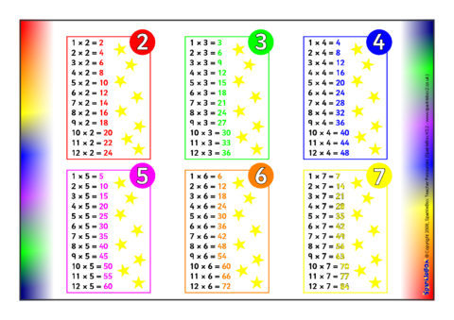
Multiplication Tables Check
How does school help my child prepare?
1. Times tables practised in class, several times a week.

Slide 6
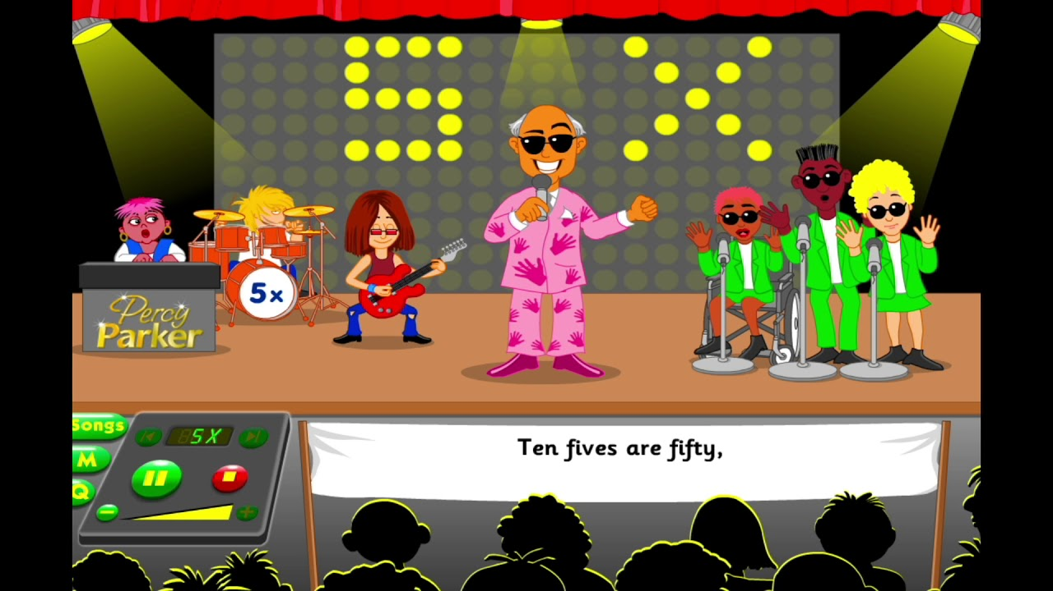
Multiplication Tables Check
How does school help my child prepare?
2. We learn times tables by singing songs.

Slide 7

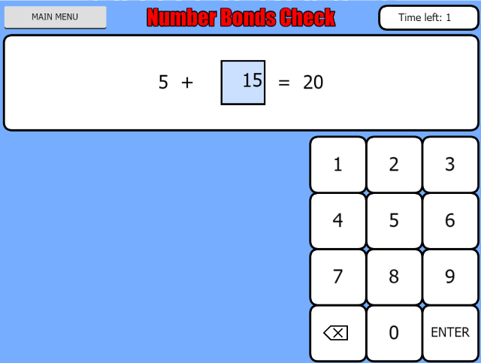
Multiplication Tables Check
How does school help my child prepare?
3. We practise using a website called ‘Maths Frame’ which simulates the real test.

Slide 8
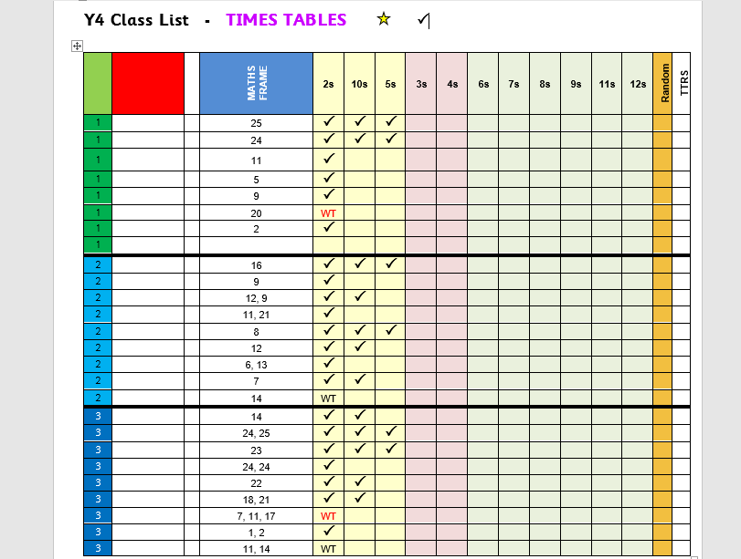
Multiplication Tables Check
How does school help my child prepare?
4. Each child is assessed individually by Mr. Melleney every three weeks – and then given a personalised target.

Slide 9
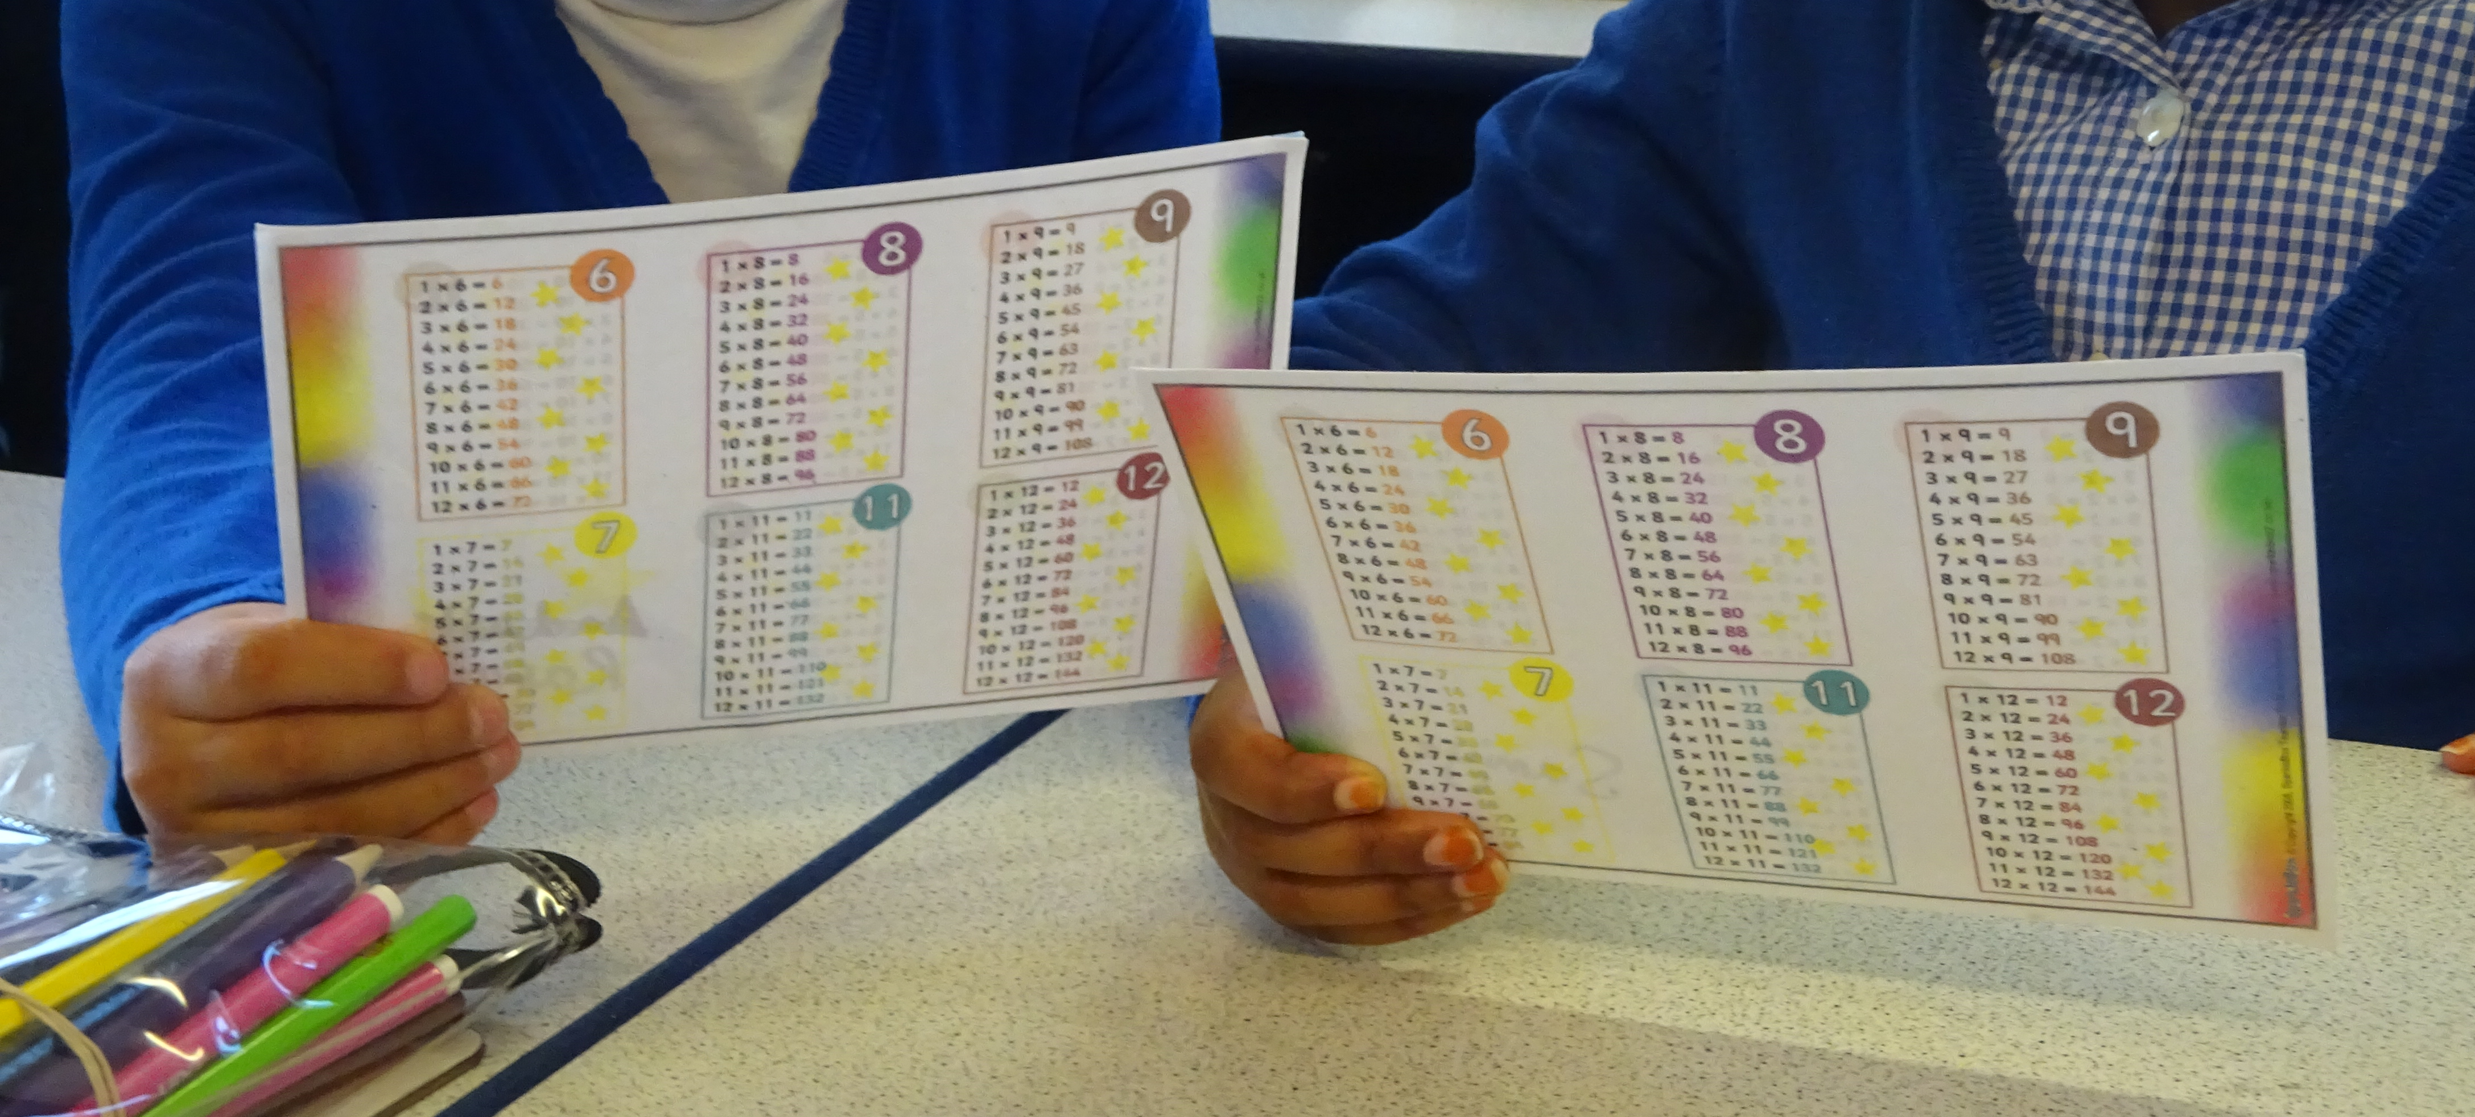
Multiplication Tables Check
How does school help my child prepare?
5. Children are partnered up so that they can help each other learn their times tables.

Slide 10
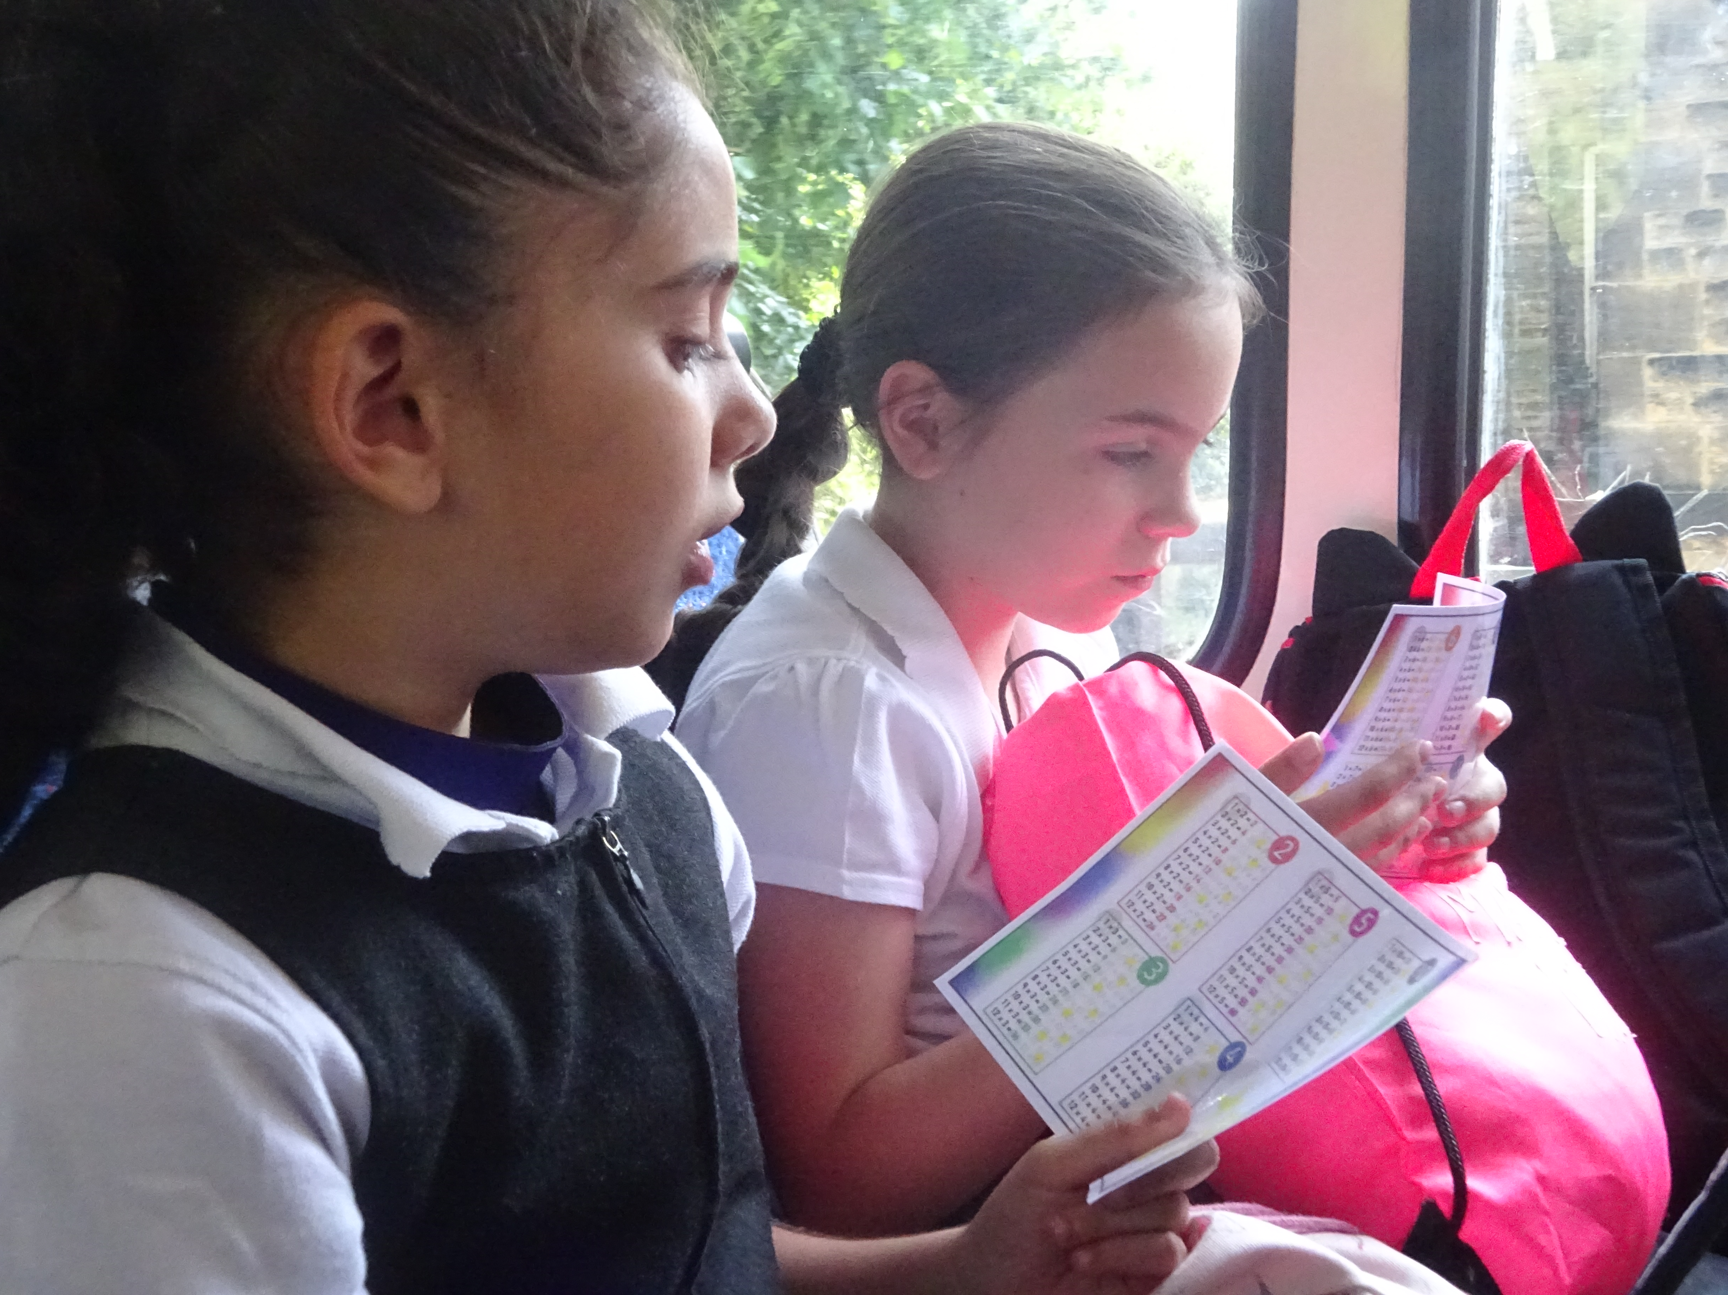
Multiplication Tables Check
How does school help my child prepare?
6. Practise at any opportunity!

Slide 11
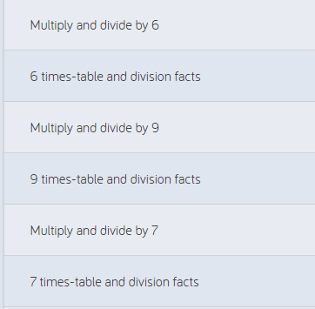
Multiplication Tables Check
How does school help my child prepare?
7. Children are taught times tables as part of set maths lessons.

Slide 12
Multiplication Tables Check
How can I help my child prepare?

Slide 13
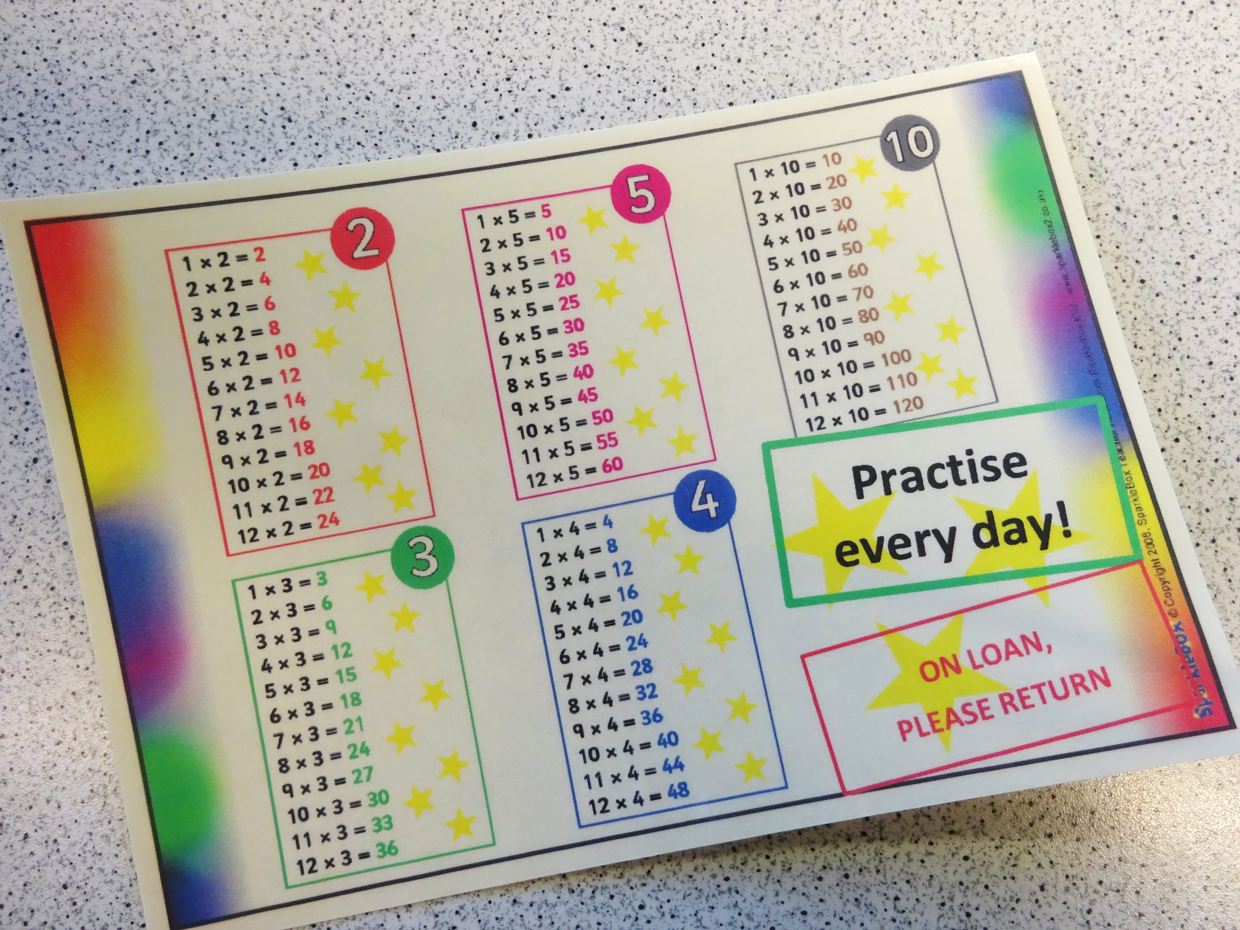
Multiplication Tables Check
How can I help my child prepare?
1. Practise with your child at home! Every child has been provided with a times table mat on loan. Please ask your child which times table they need to practise. Please practise division facts, too!

Slide 14

Multiplication Tables Check
How can I help my child prepare?
2. Practise on mathsframe at home. You can click ‘view results’ and it will tell you which times tables your child needs to practise.

Slide 15


Multiplication Tables Check
How can I help my child prepare?
3. Encourage your child to use these educational apps. Your child has been provided with usernames and passwords.

Slide 16
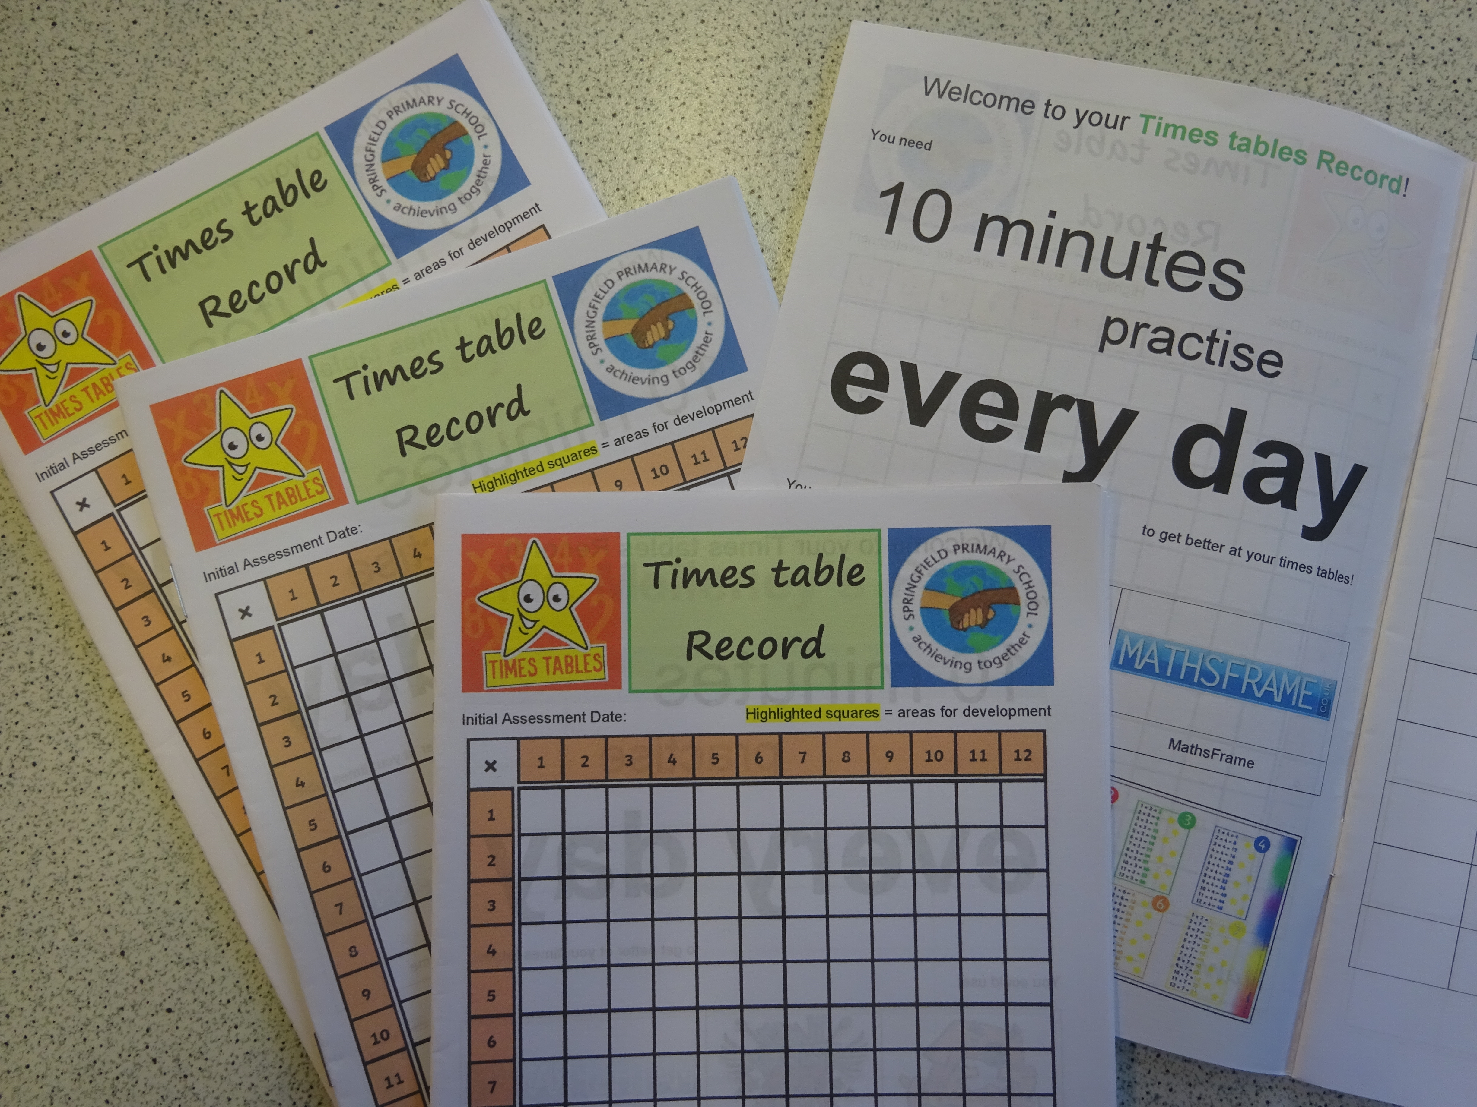
Multiplication Tables Check
How can I help my child prepare?
4. If your child needs to make quick progress, they will also be provided with a Times Table Record. This is just like a Reading Record – please log the practise your child does at home every day.

Slide 17
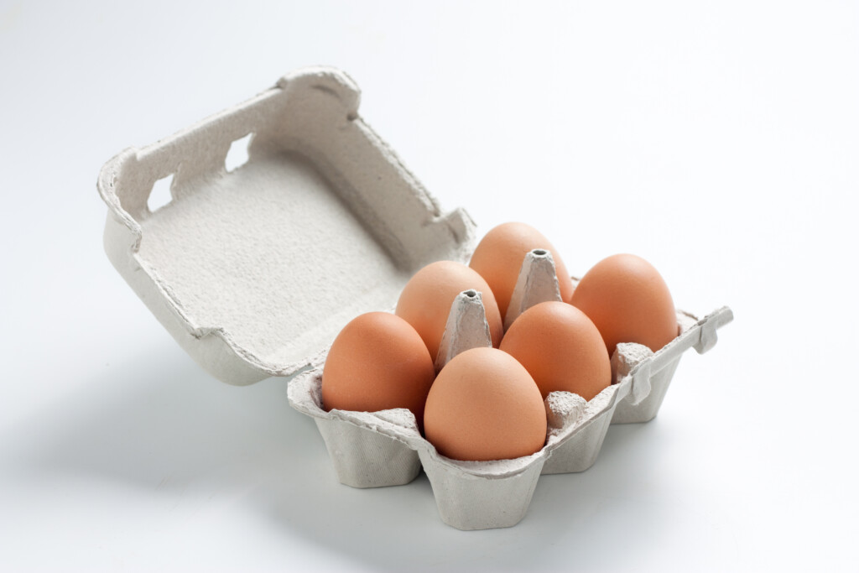
Multiplication Tables Check
“I need 18 eggs this week. How many boxes do I need?”
How can I help my child prepare?
5. Try to bring times tables into real-life situations, like in the supermarket, or walking around the town centre or even just when cooking at home.

Slide 18
Multiplication Tables Check
Any questions?
Please do not hesitate to speak to me if you have any questions about the MTC.
Thank you for your support!
Mr. Melleney

