Slide 1



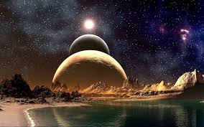
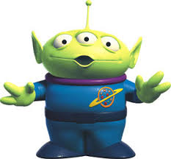
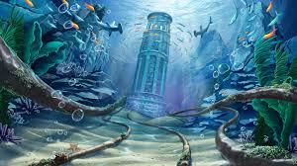

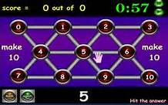

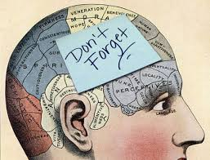

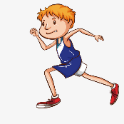
Homework grid Y5/6 Summer 1 2021
In addition to this, I would like you to choose some of the homework ideas from this grid to do at home over this six week half-term. We will have time in school to talk about the homework you have done that week. If you want to bring your homework to school or a photo of you doing an activity from the grid, that would be great!
Weekly homework:
spellings or dictionary work
daily reading (school book or www.activelearnprimary.co.uk/login
maths practice www.sumdog.co.uk
Write a science fiction story.
Literacy and speaking and listening
Write a poem about a strange alien.
Describe an underwater world.
Have you read and signed your reading record?
Practise multiplying and dividing decimals by 10, 100 and 1,000.
3.2 x 10 = 32.0
0.25 ÷ 100 = 0.0025
Why not work out how long you spend doing different activities each day? Like a log of your typical school day.
How quickly can
you recall your
maths facts?
Double / Halve
Divide / Multiply
Add / Subtract
Use your memory aids and techniques to help tricky facts.
Visit: Hit My Button
Maths and problem solving
Convert between different units of measurement.
100g = 0.1kg
0.6m = 60cm
Explain the functions of the human heart.
Devise a warm-up exercise for the class to do in PE.
Memory challenge!
Science and topic
Research the effects of smoking on the human body.
How many random words can you remember from a given list in one minute?

