Slide 1


Slide 2

The Questions!

Slide 3

Round 1 – Book Geography!
If I’m going to these places, what book am I in?
1.

Slide 4

Round 1 – Book Geography!
If I’m going to these places, what book am I in?
2.

Slide 5

Round 1 – Book Geography!
If I’m going to these places, what book am I in?
3.

Slide 6

Round 1 – Book Geography!
If I’m going to these places, what book am I in?
4.

Slide 7
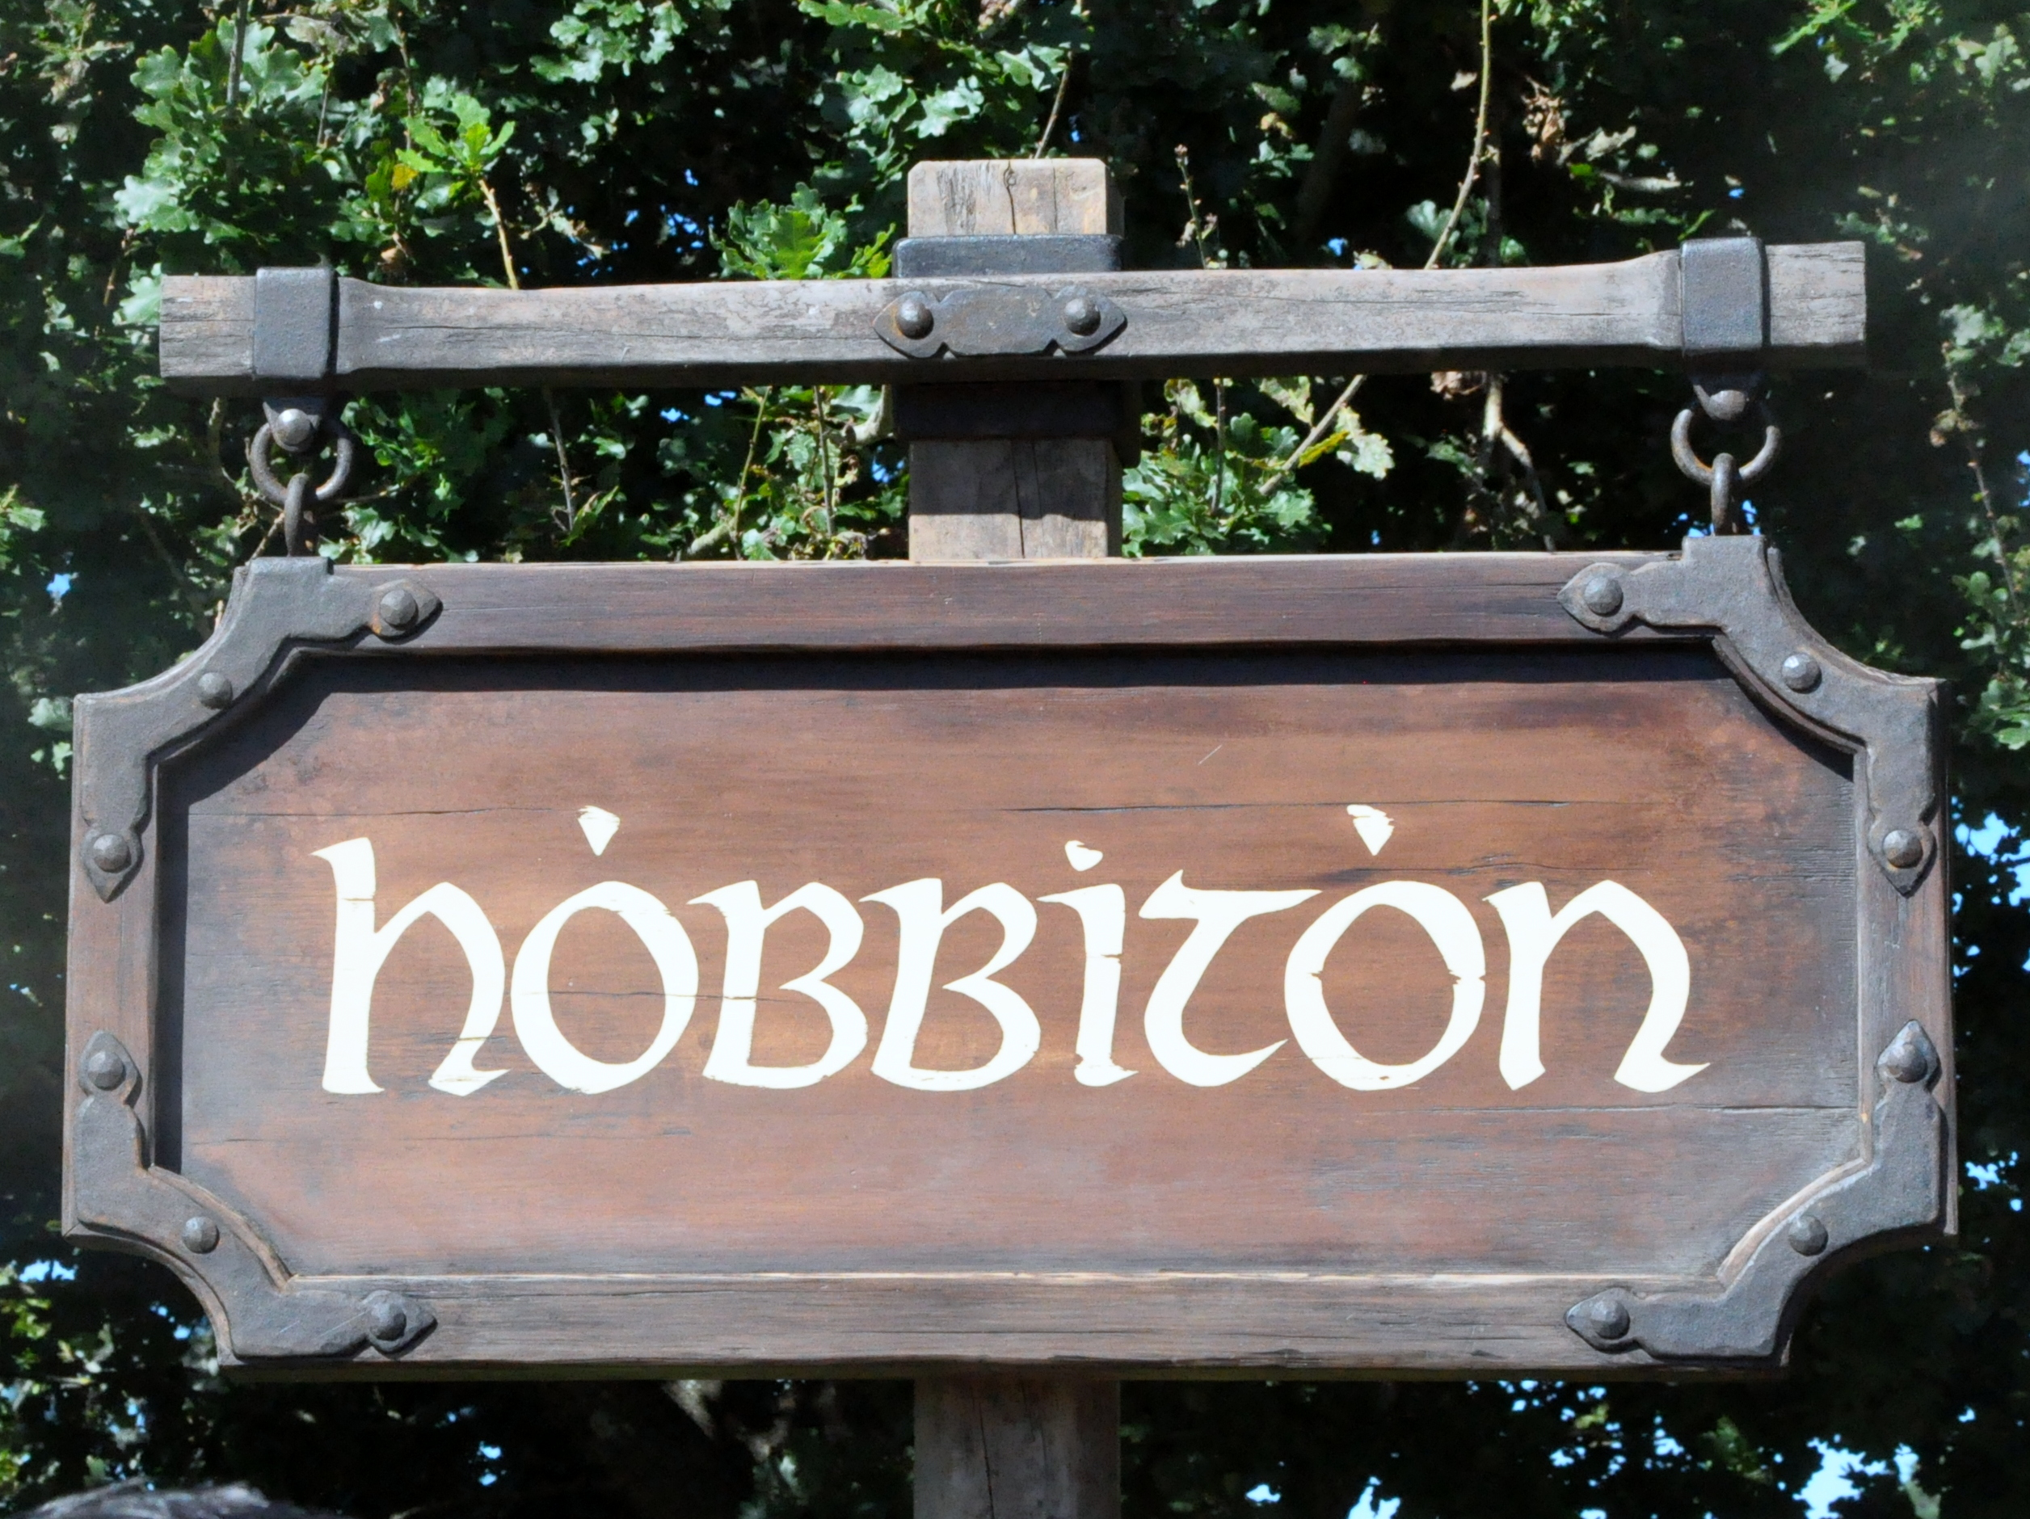
Round 1 – Book Geography!
If I’m going to these places, what book am I in?
5.

Slide 8
The Answers!

Slide 9
Round 1 – Book Geography!
If I’m going to these places, what book am I in?
1.
Peter Pan

Slide 10
Round 1 – Book Geography!
If I’m going to these places, what book am I in?
2.
Winnie the Pooh

Slide 11
Round 1 – Book Geography!
If I’m going to these places, what book am I in?
3.
Harry Potter

Slide 12
Round 1 – Book Geography!
If I’m going to these places, what book am I in?
4.
The Wizard of Oz

Slide 13
Round 1 – Book Geography!
If I’m going to these places, what book am I in?
The Lord of the Rings or The Hobbit
5.

Slide 14

Who wrote this book?
The Questions!

Slide 15

Round 2 – Who Wrote This Book?
1.

Slide 16
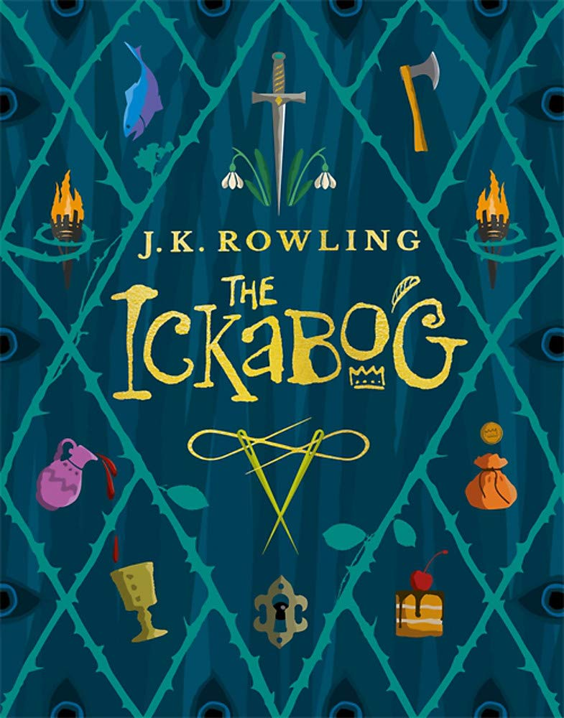
Round 2 – Who Wrote This Book?
2.

Slide 17

Round 2 – Who Wrote This Book?
3.

Slide 18
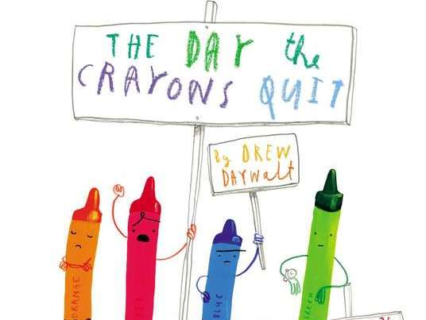
Round 2 – Who Wrote This Book?
4.

Slide 19

Round 2 – Who Wrote This Book?
5.

Slide 20
Who wrote this book?
The Answers!

Slide 21
Round 2 – Who Wrote This Book?
1.

Slide 22
Round 2 – Who Wrote This Book?
2.

Slide 23
Round 2 – Who Wrote This Book?
3.

Slide 24
Round 2 – Who Wrote This Book?
4.

Slide 25
Round 2 – Who Wrote This Book?
5.

Slide 26

Which book are they from?
The Questions!

Slide 27
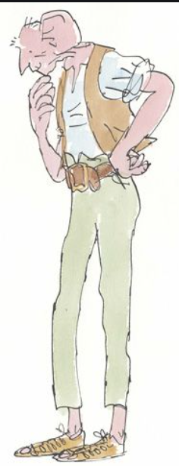
Round 3 – Which book are they from?
1.

Slide 28

Round 3 – Which book are they from?
2.

Slide 29
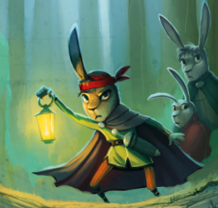
Round 3 – Which book are they from?
3.

Slide 30
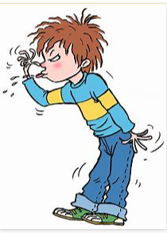
Round 3 – Which book are they from?
4.

Slide 31
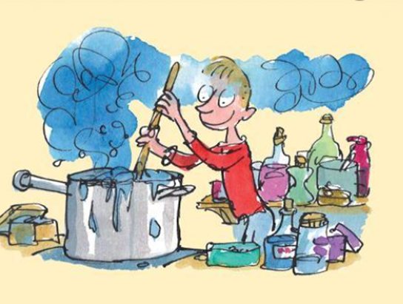
Round 3 – Which book are they from?
5.

Slide 32
Which book are they from?
The Answers!

Slide 33
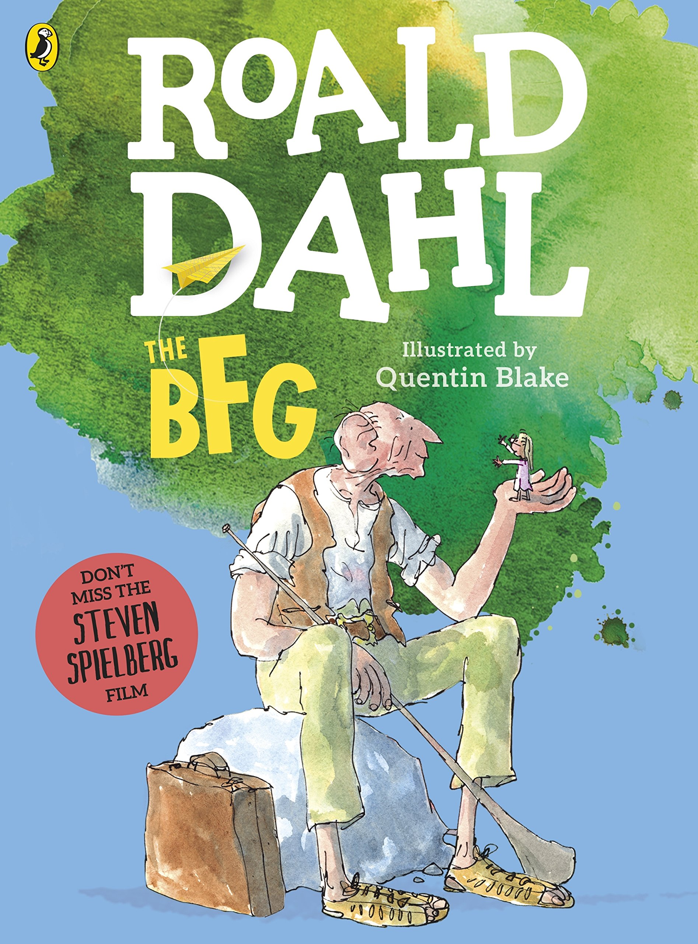
Round 3 – Which book are they from?
1.

Slide 34

Round 3 – Which book are they from?
2.

Slide 35
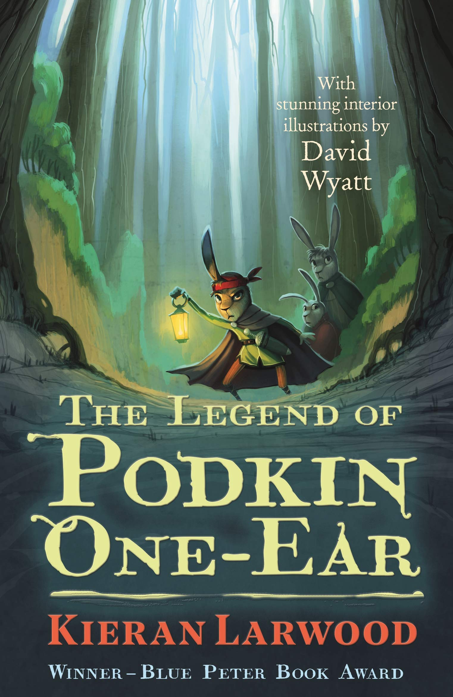
Round 3 – Which book are they from?
3.

Slide 36

Round 3 – Which book are they from?
4.

Slide 37
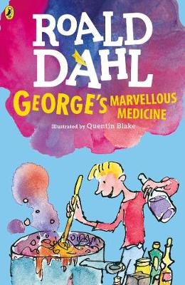
Round 3 – Which book are they from?
5.

Slide 38
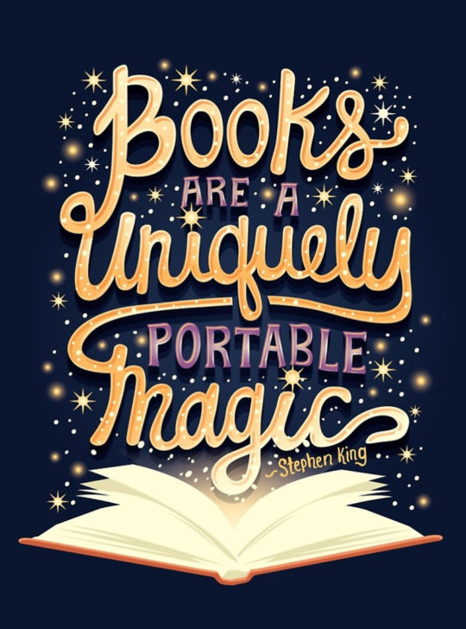
Name that book!
The Questions!

Slide 39

Round 4 – Name that book!
1.

Slide 40

Round 4 – Name that book!
2.

Slide 41

Round 4 – Name that book!
3.

Slide 42

Round 4 – Name that book!
4.

Slide 43

Round 4 – Name that book!
5.

Slide 44
Name that book!
The Answers!

Slide 45
Round 4 – Name that book!
1.

Slide 46
Round 4 – Name that book!
2.

Slide 47
Round 4 – Name that book!
3.

Slide 48
Round 4 – Name that book!
4.

Slide 49
Round 4 – Name that book!
5.

Slide 50

The Final Round
The Questions!

Slide 51
1. What can you get free from libraries?

Slide 52
2. What can you read for 20 minutes every day to make you more intelligent?

Slide 53
3. What can increase your levels of happiness, without needing a plug, electricity or batteries?

Slide 54
4. What can you buy for free with your
World Book Day voucher?

Slide 55
5. What can bring you joy, not just on World Book Day, but every day of the year?

Slide 56
The Final Round
The Answers!

Slide 57
