Slide 2


Who Is the Masked Reader?
Can you work out who the celebrity masked reader is and what book they are reading?
?
Solve three clues to work out who the masked reader is.
?
Solve three more clues to find out what book they’re reading.

Slide 3





Masked Reader 1
Clue 1: He is a judge on the TV show ‘Britain’s Got Talent’.
Clue 2: He is a children’s book author, a comedy writer and actor.
Clue 3: He swam 140 miles of the River Thames in 2011 for Sport Relief.
?
Click to find out who it is.

Slide 4


It’s David Walliams!

Slide 5
Can you guess what David is reading?
Clue 1: The lead character in the book is a boy.
Clue 2: The boy finds he isn’t good at being good.
Clue 3: One of the characters in the story is called Perfect Peter.
?
Click to find out what the book is.

Slide 6

David is reading ‘Horrid Henry’ by Francesca Simon.

Slide 7
Masked Reader 2
Clue 1: He is a British rapper and makes grime music.
Clue 2: He was the first British rapper to headline at Glastonbury (a famous festival). He was also the first Black
British solo artist to headline there.
Clue 3: He has started publishing books under the label #Merky Books.
?
Click to find out who it is.

Slide 8
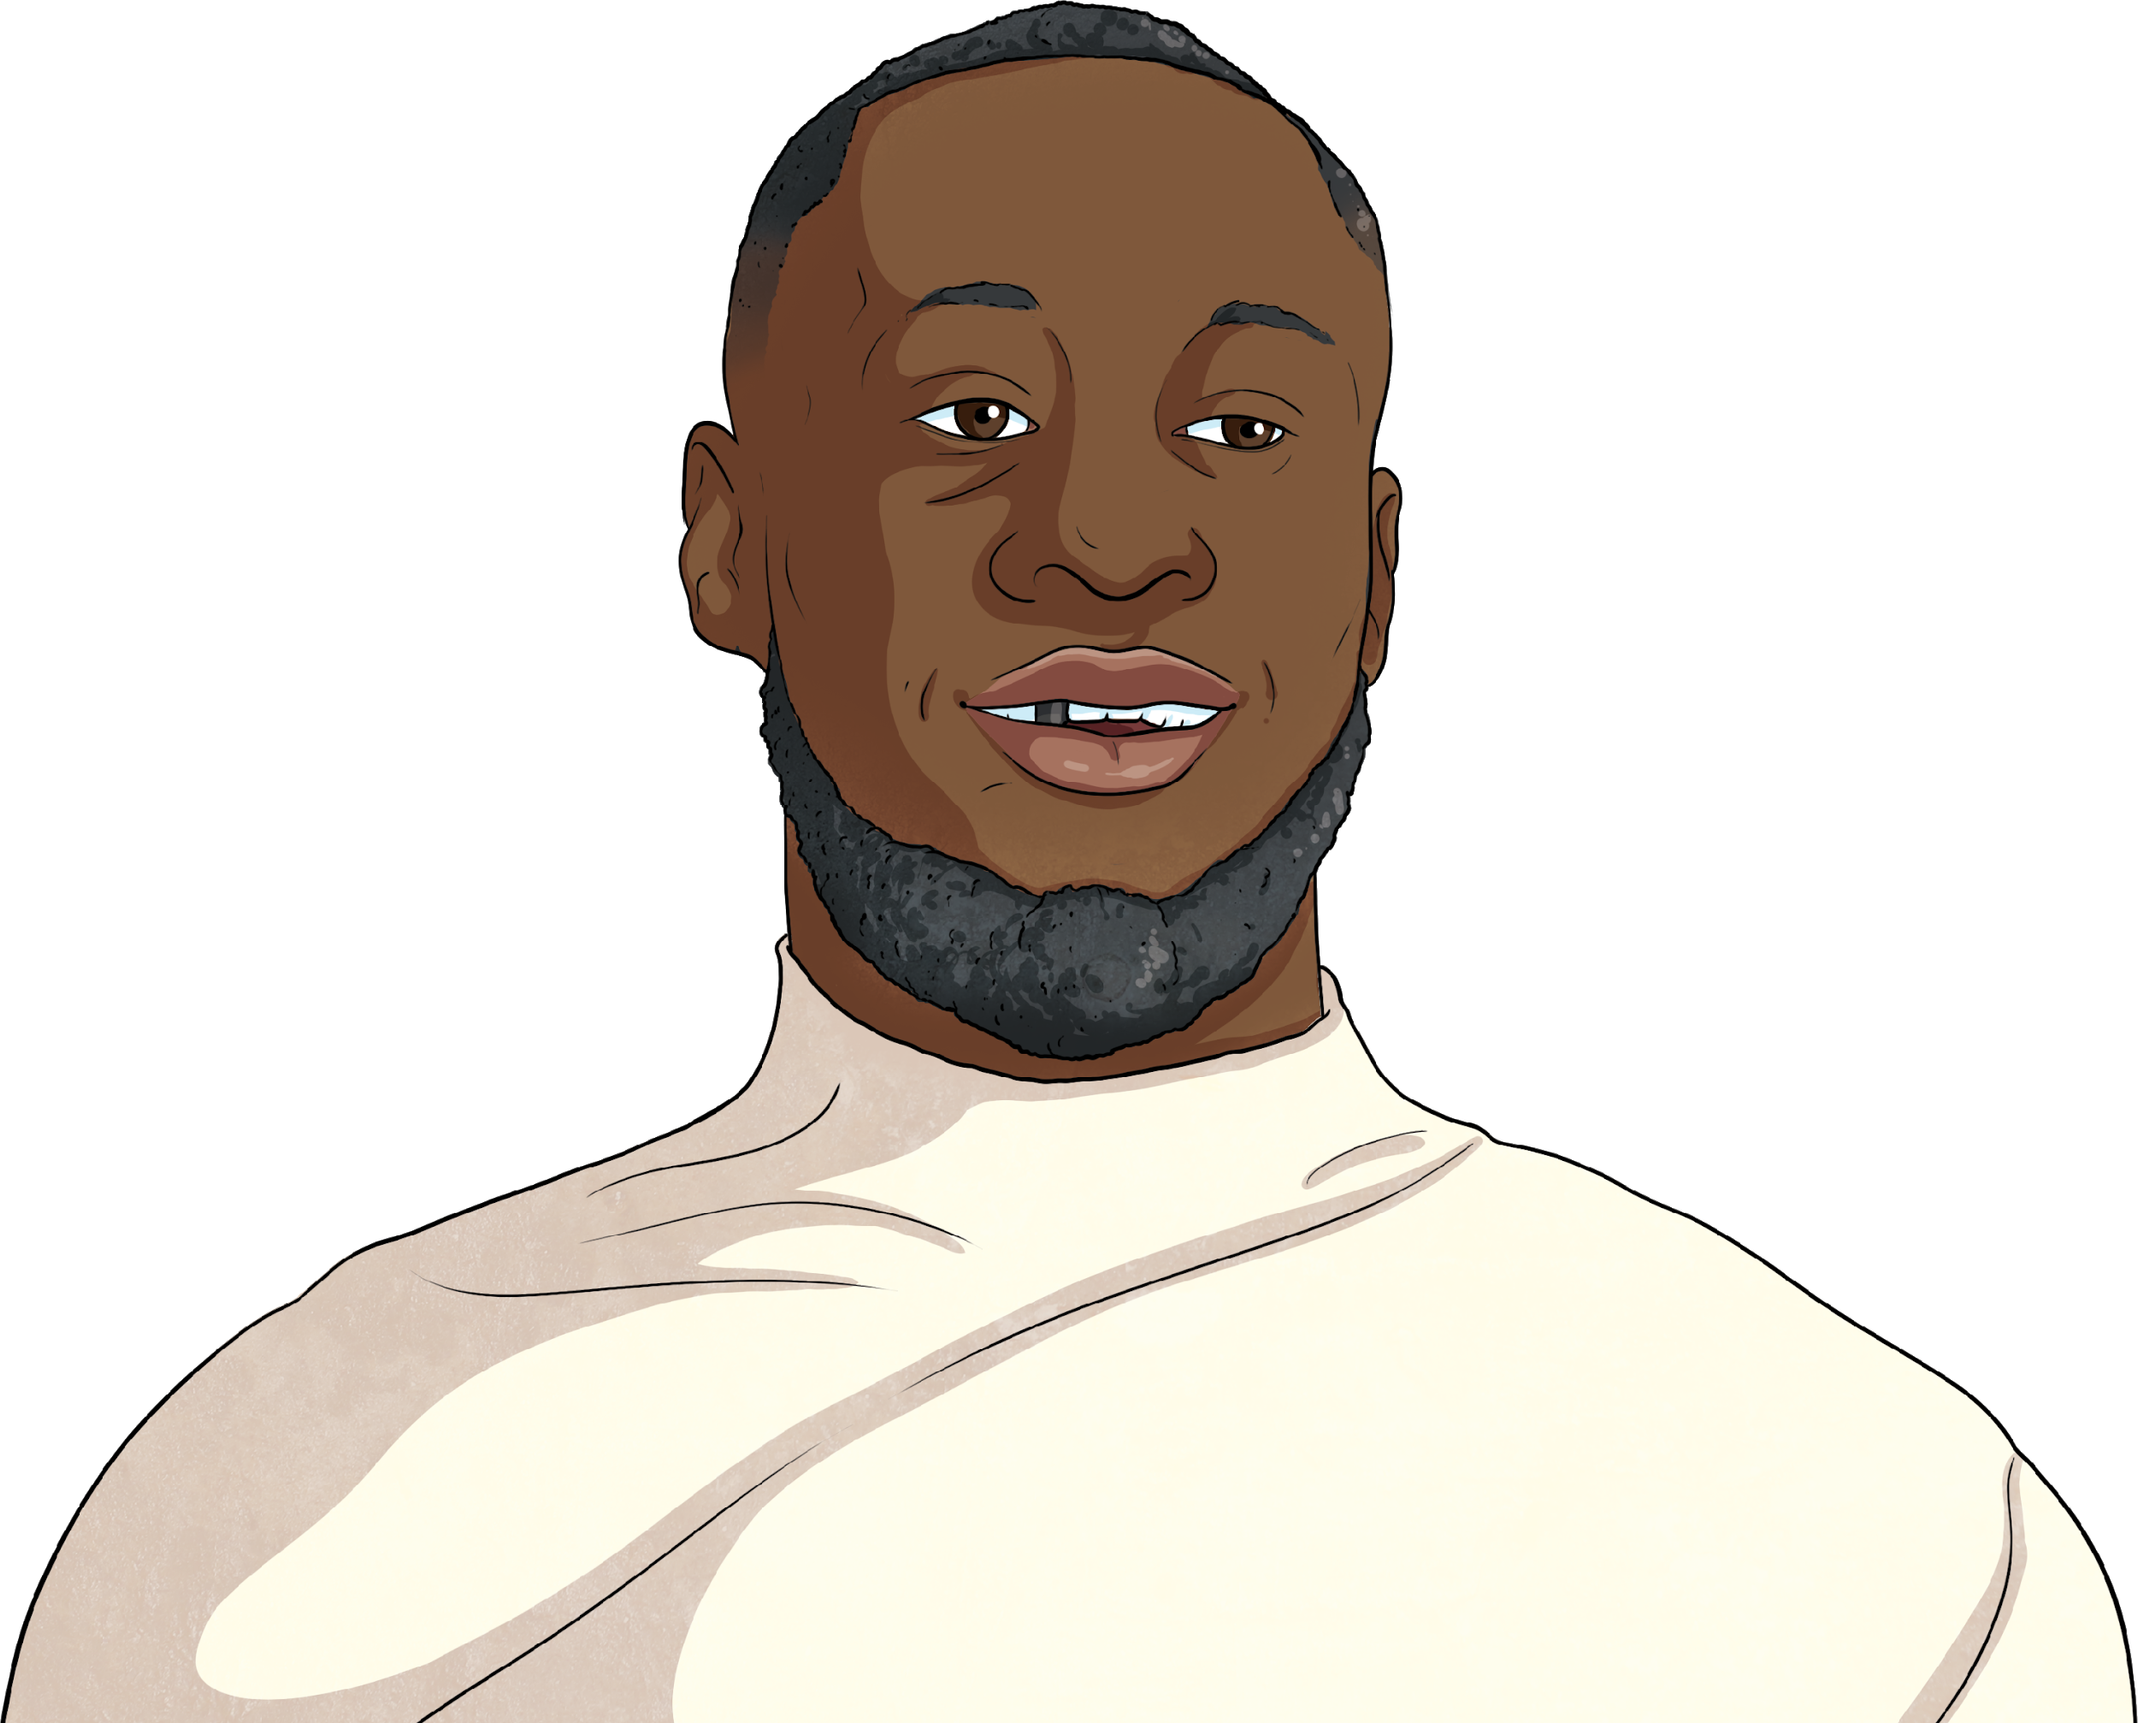
It’s Stormzy!

Slide 9
Can you guess what Stormzy is reading?
Clue 1: The book is written by Stormzy’s favourite author, Malorie Blackman.
Clue 2: The story is about a missing teddy bear.
Clue 3: It has a character called Prince, a detective dog.
?
Click to find out what the book is.

Slide 10

Stormzy is reading ‘Betsey Biggalow the Detective’ by Malorie Blackman.

Slide 11
Masked Reader 3
Clue 1: He’s a British paralympian.
Clue 2: He has been involved with the Superhero Tri – an event which encourages people with disabilities to
participate in triathlon disciplines.
Clue 3: He appeared on Strictly Come Dancing in 2017, dancing with Oti Mabuse.
?
Click to find out who it is.

Slide 12
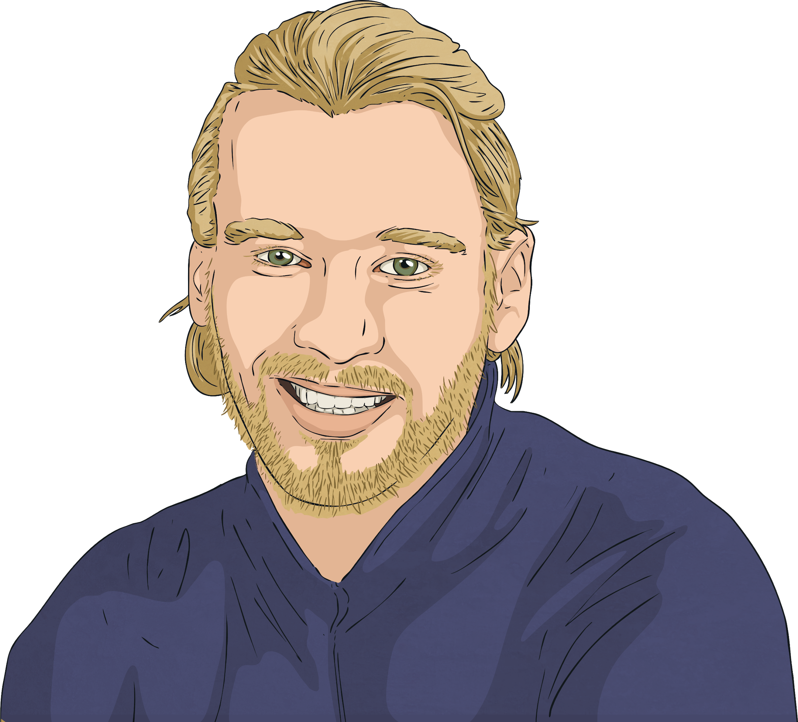
It’s Jonnie Peacock!

Slide 13
Can you guess what Jonnie is reading?
Clue 1: The book features two boys named George and Harold.
Clue 2: The boys hypnotise their headteacher.
Clue 3: The book’s villain is called Dr Diaper.
?
Click to find out what the book is.

Slide 14

Jonnie is reading ‘The Adventures of Captain Underpants’ by Dav Pilkey.

Slide 15
Masked Reader 4
Clue 1: She is a professional singer and one of her albums is called ‘Our Version of Events’.
Clue 2: She had the honour of performing at the opening and closing ceremonies of the London Olympics in 2012.
Clue 3: She received an MBE for her services to music.
?
Click to find out who it is.

Slide 16
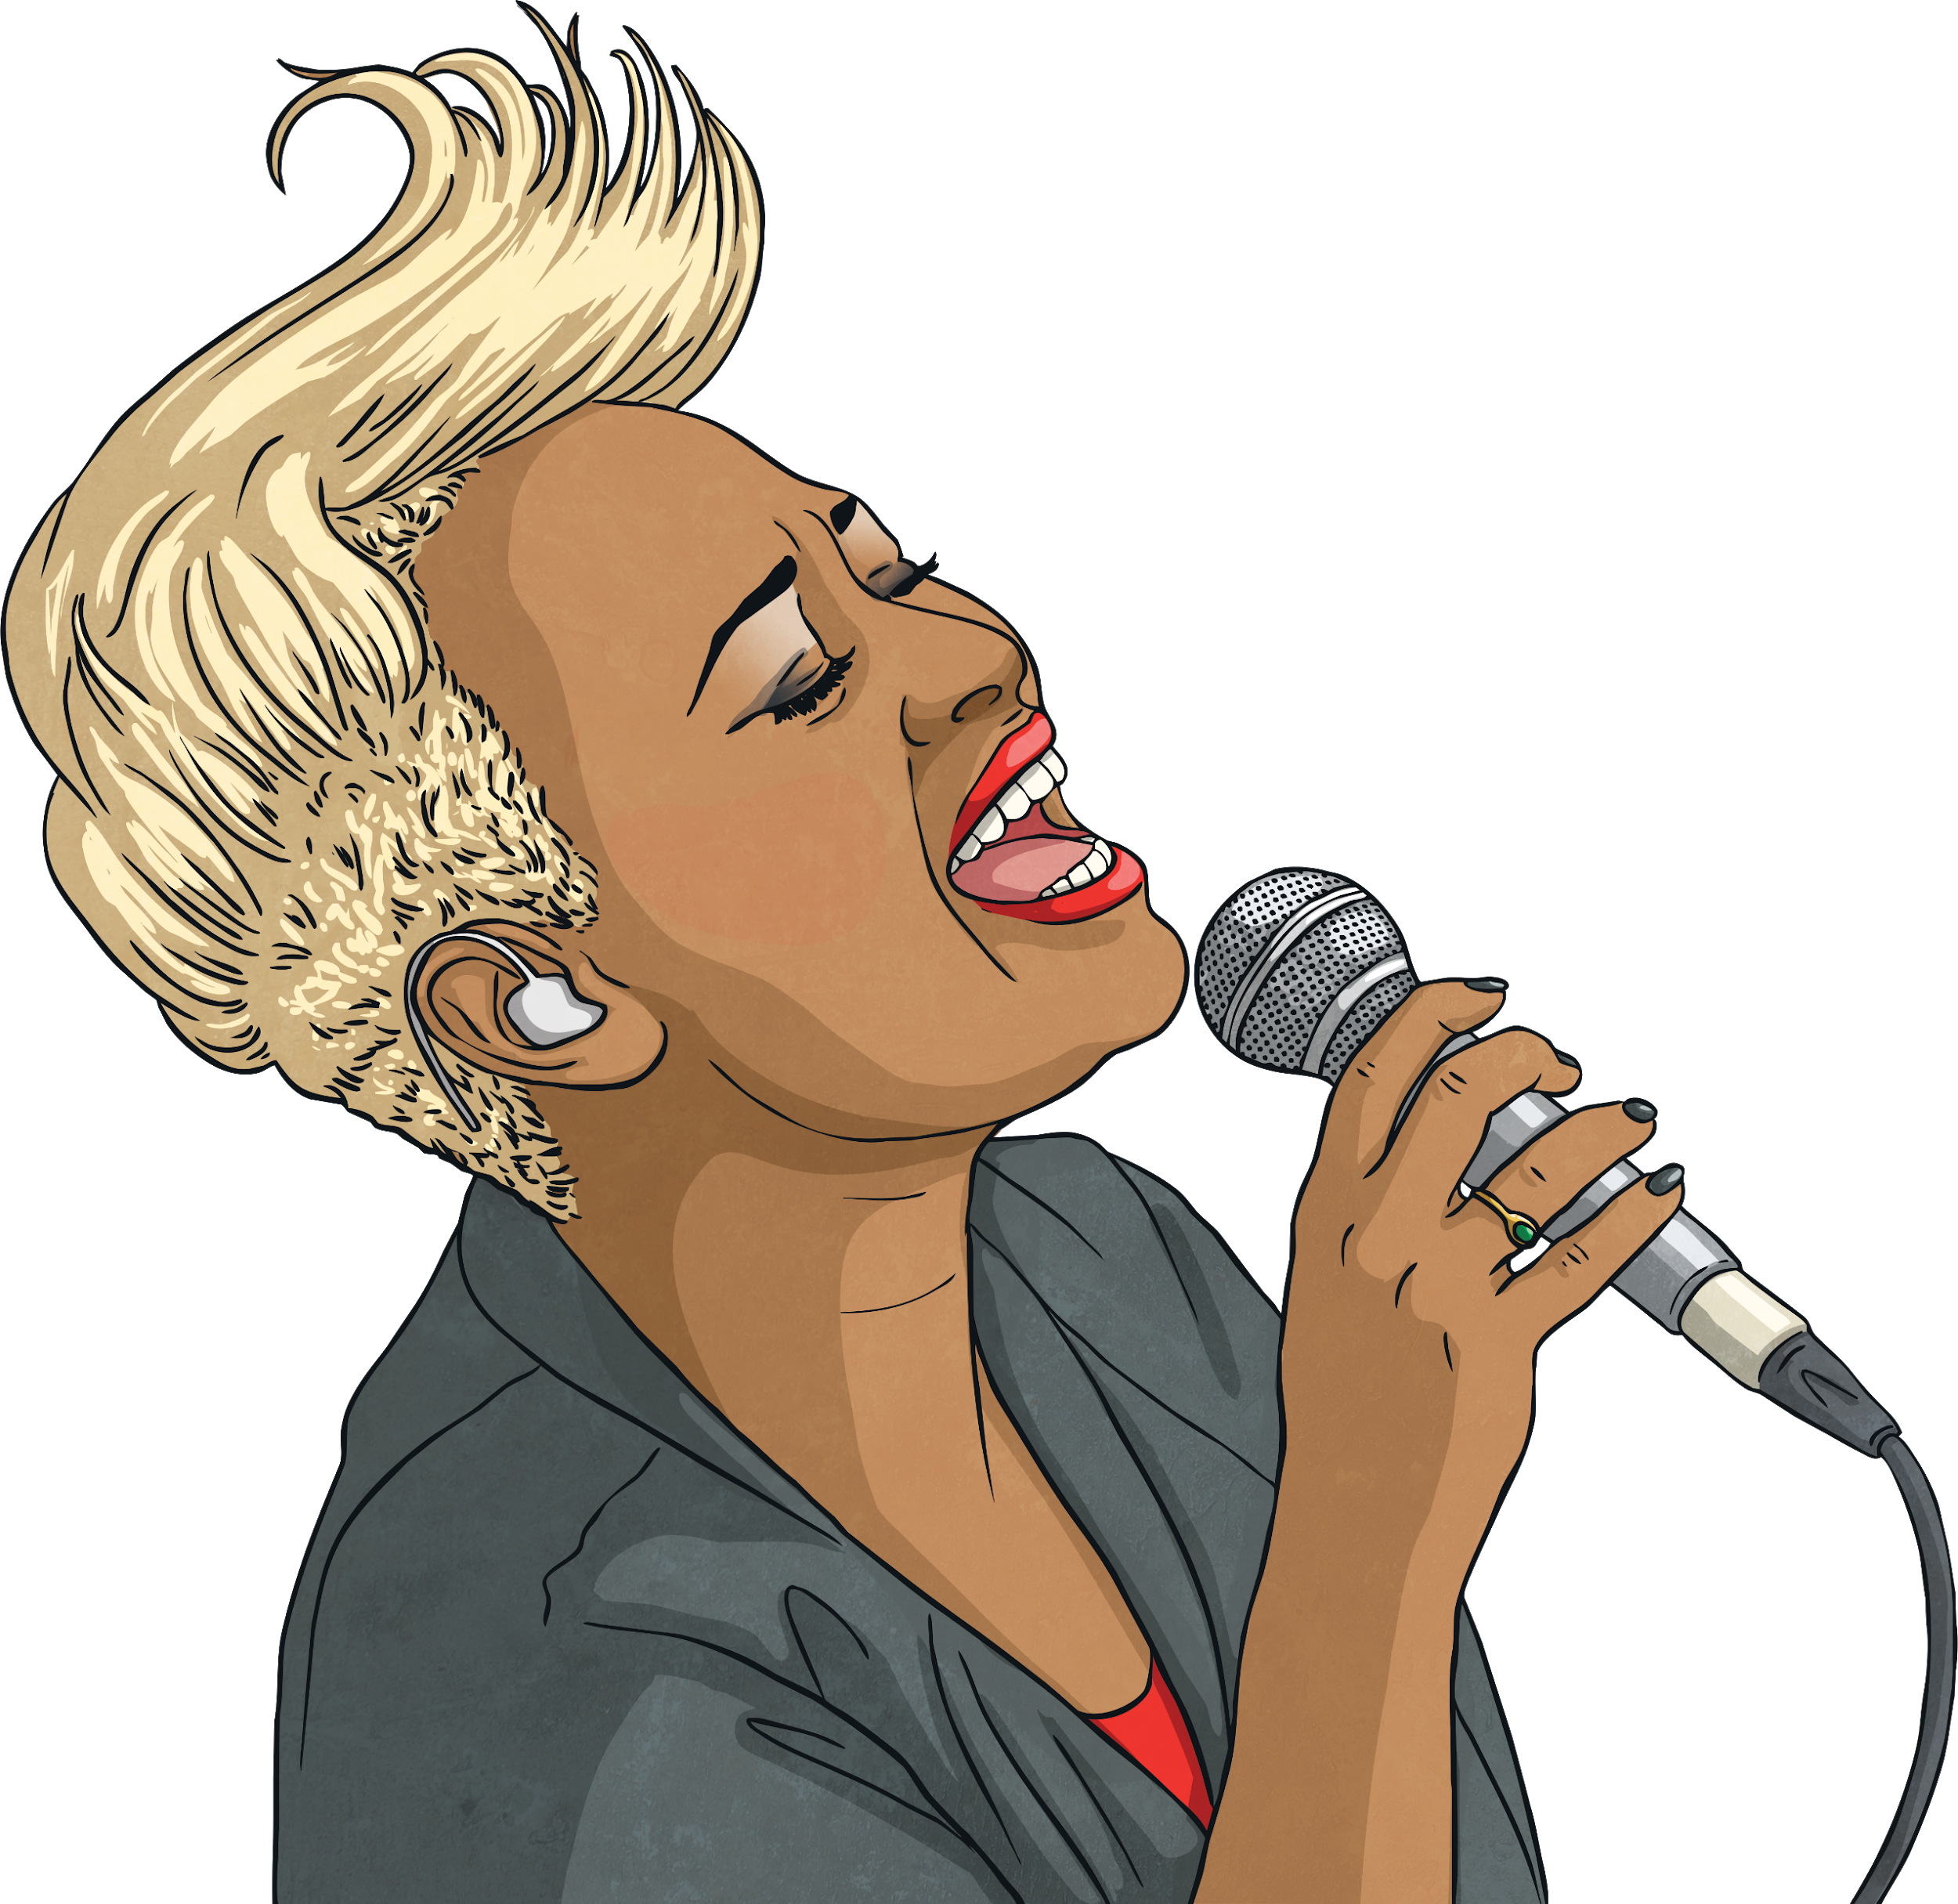
It’s Emeli Sandé!

Slide 17
Can you guess what Emeli is reading?
Clue 1: The book is about siblings, Amanda and Josh, who have just moved to a new house.
Clue 2: The story is set in the town, Dark Falls.
Clue 3: Amanda and Josh have a suspicion that their house is haunted.
?
Click to find out what the book is.

Slide 18
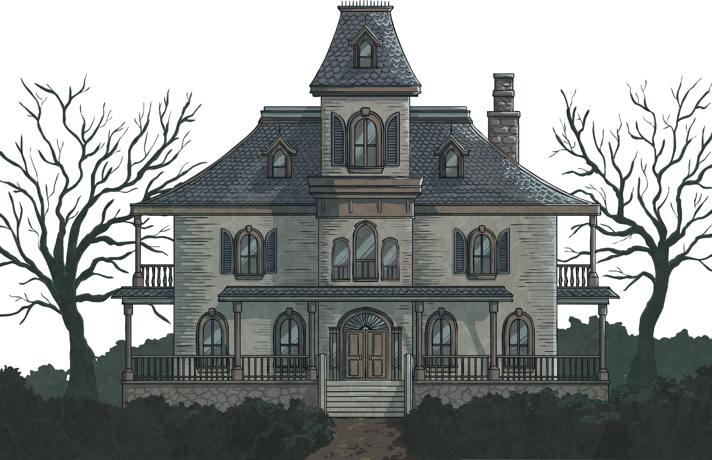
Emeli is reading ‘Welcome to Dead House’ by RL Stine.

Slide 19
Masked Reader 5
Clue 1: She is a twin.
Clue 2: She was born in Los Angeles.
Clue 3: She spoke at Joe Biden’s inauguration and is the youngest-ever inaugural poet.
?
Click to find out who it is.

Slide 20
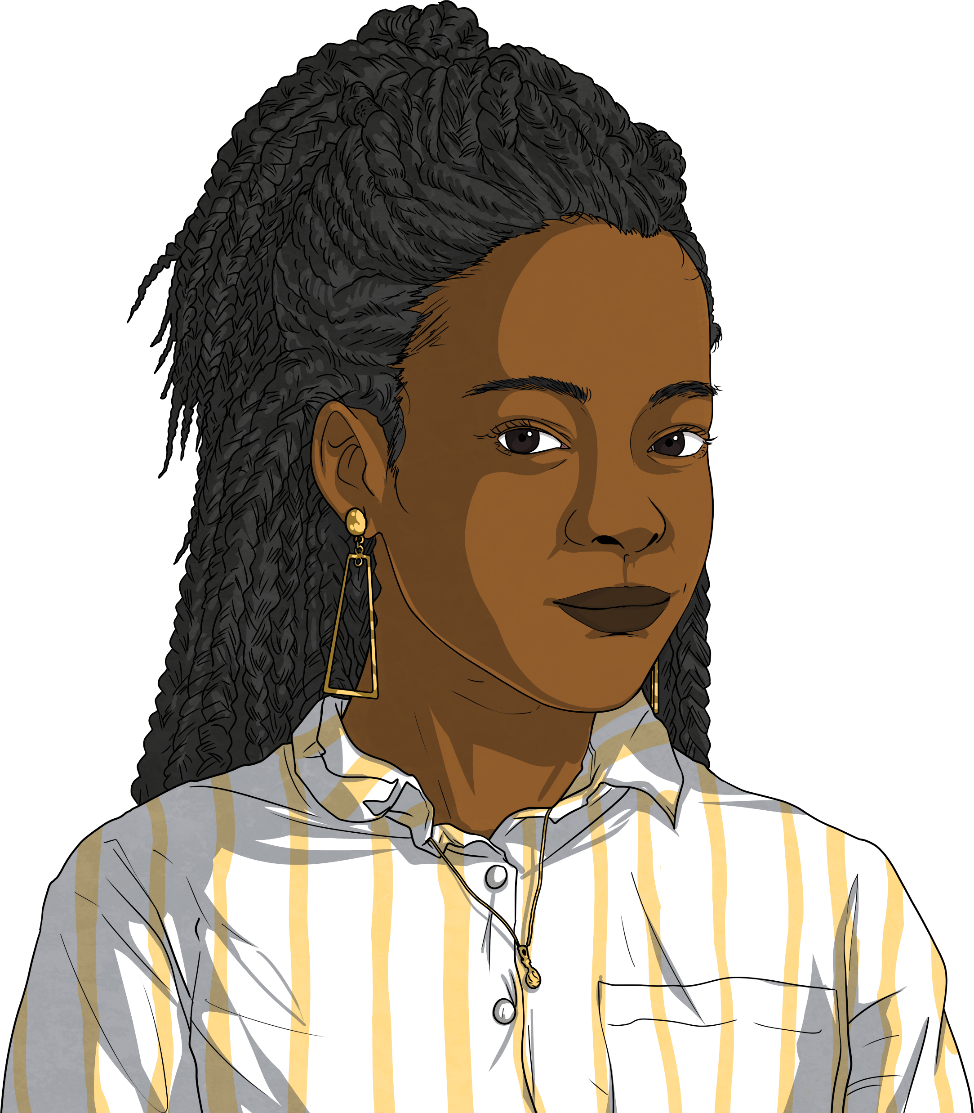
It’s Amanda Gorman!

Slide 21
Can you guess what Amanda is reading?
Clue 1: The main character of the book has a twin, just like Amanda does.
Clue 2: The twin and his two siblings find a book ‘Arthur Spiderwick’s Field Guide to the Fantastic World Around You.’
Clue 3: The book is full of unexpected things, such as faeries.
?
Click to find out what the book is.

Slide 22


Amanda is reading ‘The Spiderwick Chronicles: The Field Guide’ by Tony DiTerlizzi and Holly Black.

Slide 23
Masked Reader 6
Clue 1: She was born in Pakistan in 1997.
Clue 2: She (and other school children) were banned from going to school and she spoke out about her desire for an education.
Clue 3: She started a charity to support the right of all girls to have an education and won a Nobel Peace Prize for this.
?
Click to find out who it is.

Slide 24
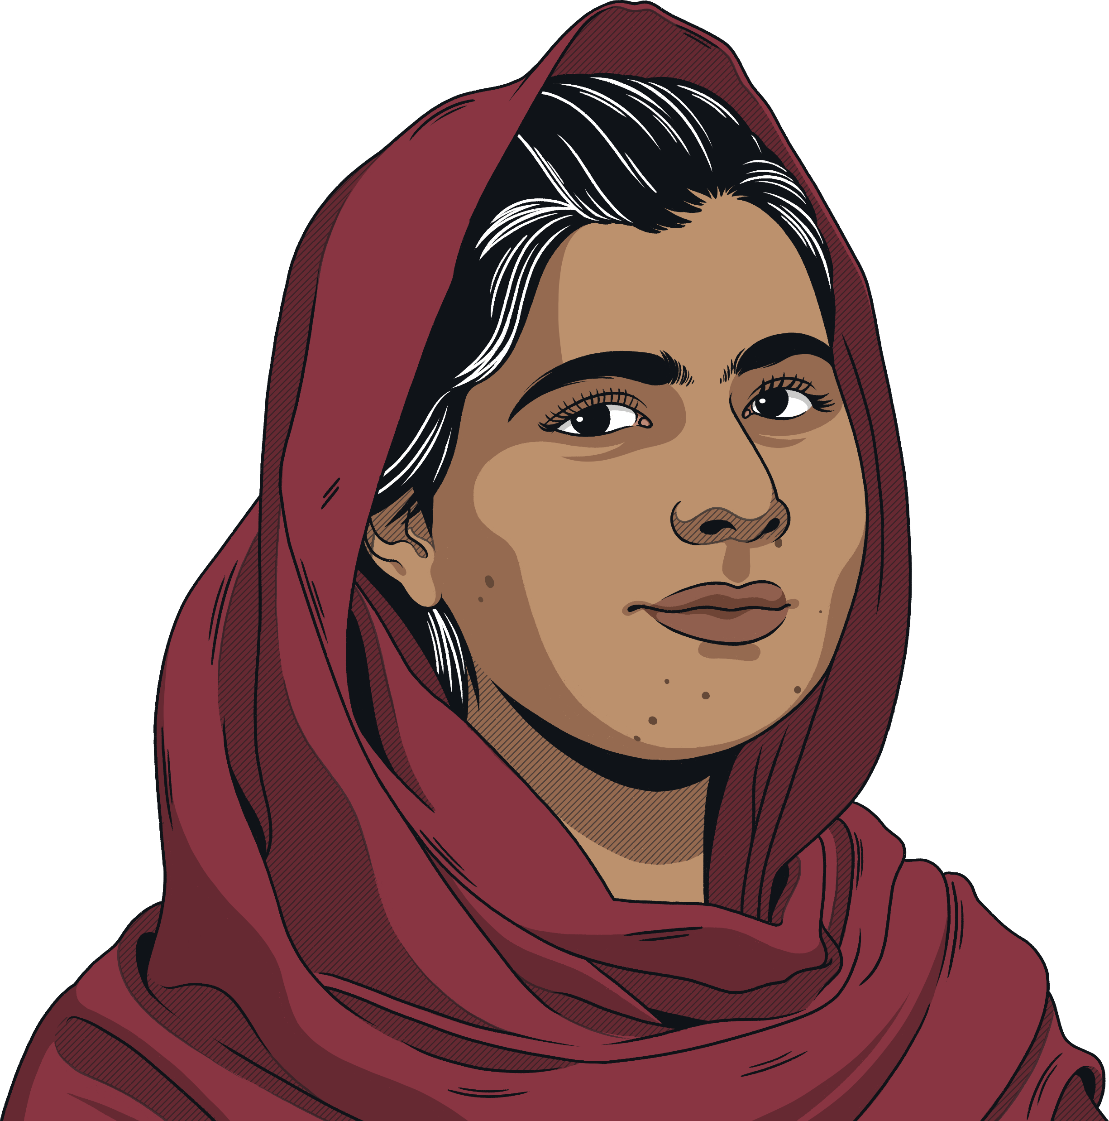
It’s Malala Yousafzai!

Slide 25
Can you guess what Malala is reading?
Clue 1: The book is about a plan to spread a computer virus.
Clue 2: Like Malala, the main character’s actions have an important impact on other children.
Clue 3: The book’s protagonist is called Alex Rider.
?
Click to find out what the book is.

Slide 26

Malala is reading ‘Stormbreaker’ by Anthony Horowitz.

Slide 27
Now It’s Your Turn!
Think of your own masked reader (this could be a celebrity, or someone in your school).
Think of the book the masked reader is reading.
Think of three clues about the reader and three about the book.
?
Let your classmates try to guess who your masked reader is and what they are reading.

